Slide 1
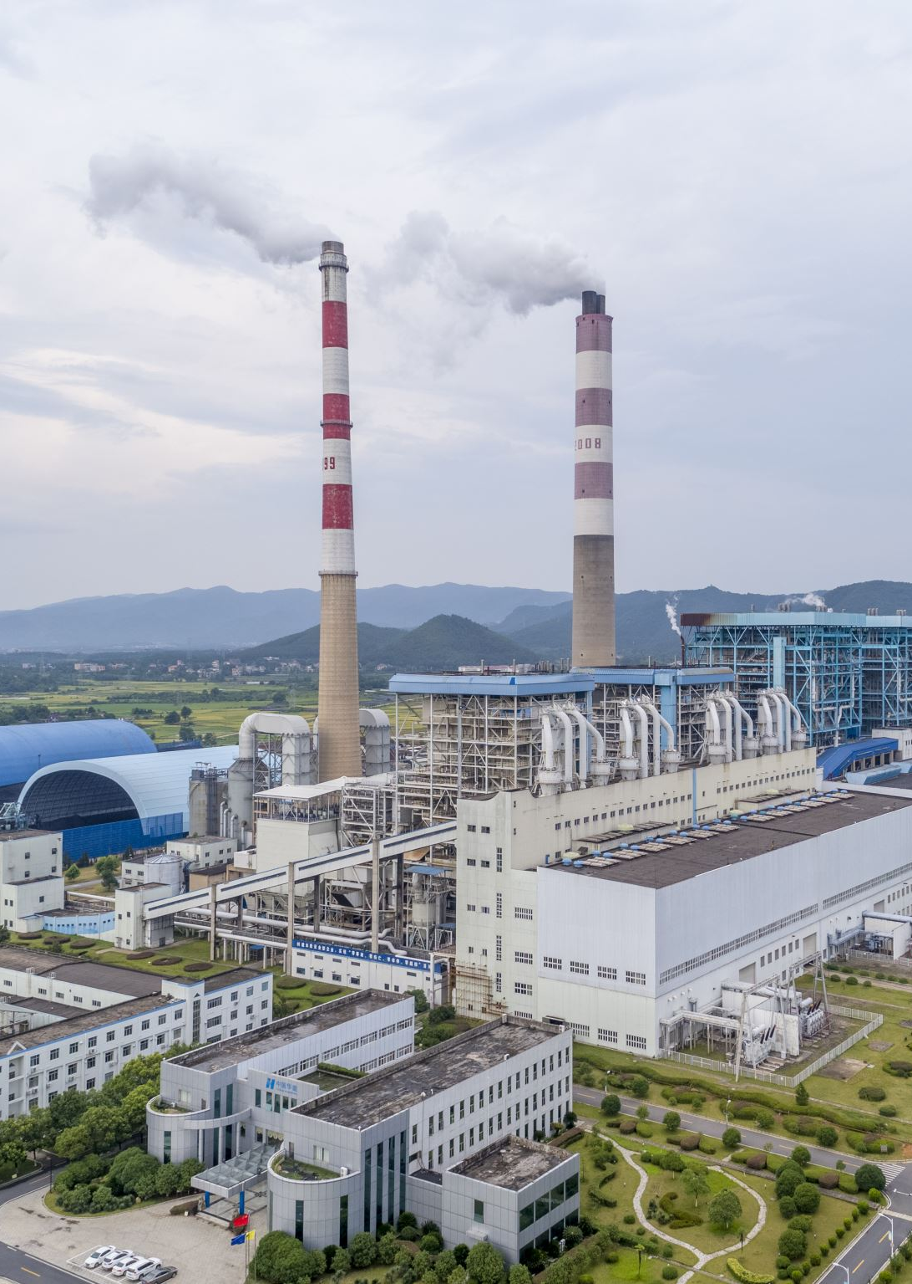
Natural Experiments Everywhere: Legal Epidemiology Methods for Policy and Health
Health Law Professors Conference 2025
Kelly DeBie, PhD, JD, MS

Slide 2

Intro & Disclosures
Just completed my PhD in environmental health specializing in epidemiology at Colorado State University
Background in public policy, law, ethics, and public health
Bring together all my prior experience to study how politics and policy impact population health
I have no funding or conflicts of interest to disclose

Slide 3

How do we determine whether policy changes are impacting health outcomes? Especially now??? (Also applies to court decisions or mass firings or reductions in funding…)

Slide 4
the “gold standard” of study design in epidemiology
Randomized control trials

Slide 5
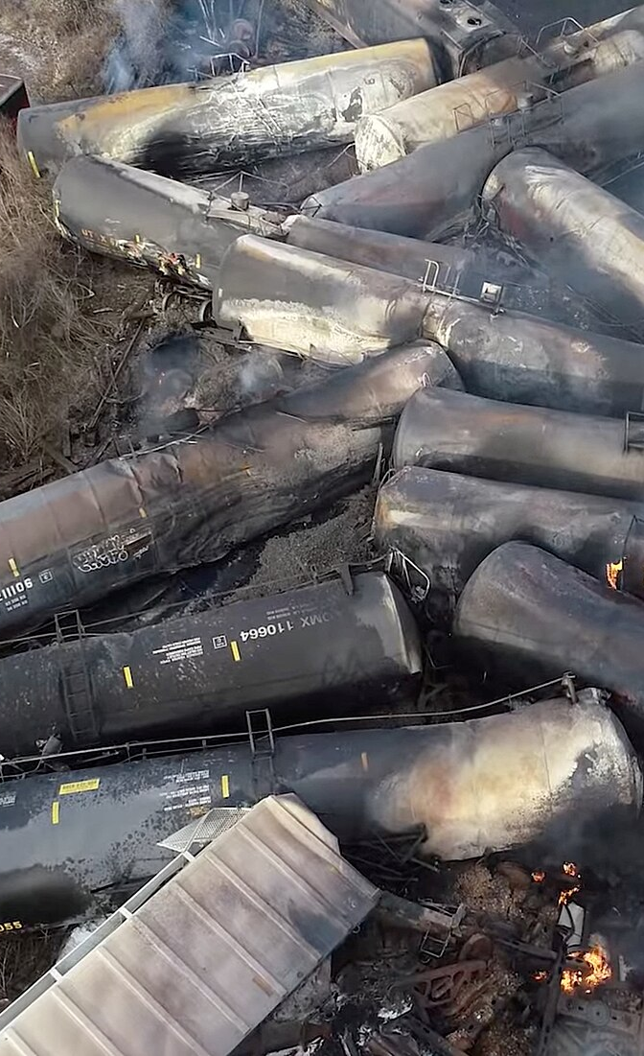
Can we ethically experiment on populations?
For the most part, no
It would be unethical to subject one group to a harmful exposure on purpose just to see what happens
For example – we aren’t going to burn a bunch of vinyl chloride intentionally to see if it makes people sick
But…we can collect data to study these exposures if/when something happens
2023 Train derailment in Palestine, Ohio
https://cloudfront-us-east-2.images.arcpublishing.com/reuters/7RR732VBRBN2TBUTYHSTC7DUXU.jpg

Slide 6
Natural experiments methods designed to study how policy/law or other sudden changes influence health outcomes
Something influential changes, and not at the selection of the researcher
Provides an opportunity to study something we couldn’t ethically research

Slide 7
Methods We will talk about here today
Difference in Differences
Time Series
ARIMA
Interrupted Time Series
Synthetic/negative controls
Generalized Estimating Equations

Slide 8
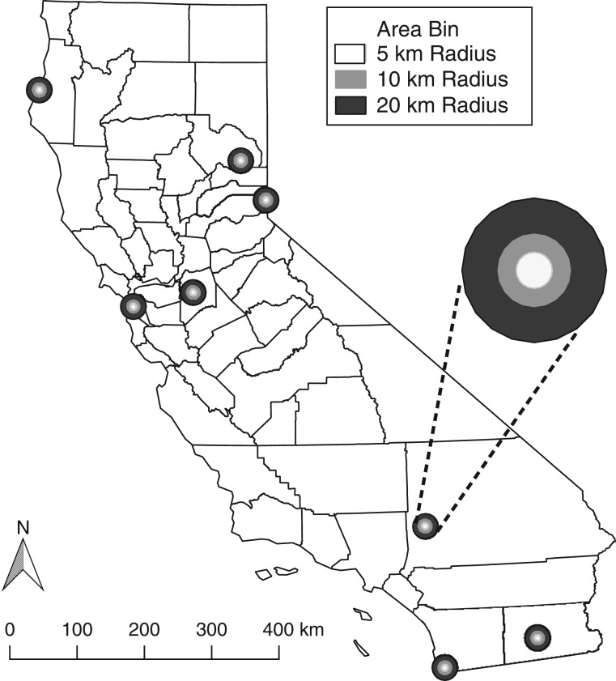
Difference in Differences
Retirements of Coal and Oil Power Plants in California: Association With Reduced Preterm Birth Among Populations Nearby
Casey JA, Karasek D, Ogburn EL, Goin DE, Dang K, Braveman PA, Morello-Frosch R. Retirements of Coal and Oil Power Plants in California: Association With Reduced Preterm Birth Among Populations Nearby. Am J Epidemiol. 2018 Aug 1;187(8):1586-1594. doi: 10.1093/aje/kwy110. PMID: 29796613; PMCID: PMC6070091.

Slide 9
Prior research had shown:
Increased air pollution associated with power plants
Air pollution associated with birth outcomes
But could we say that power plants cause differences in birth outcomes?

Slide 10
What we Ideally want to be able to measure:
Power Plants
Air Pollution
Birth Outcomes

Slide 11
Epidemiology is more complicated when we have steps between what we think the exposure is and the outcomes we can measure
Did power plant closures result in fewer preterm births?
Notes:
The air pollution came FROM the power plants – extra step in the causation pathway

Slide 12
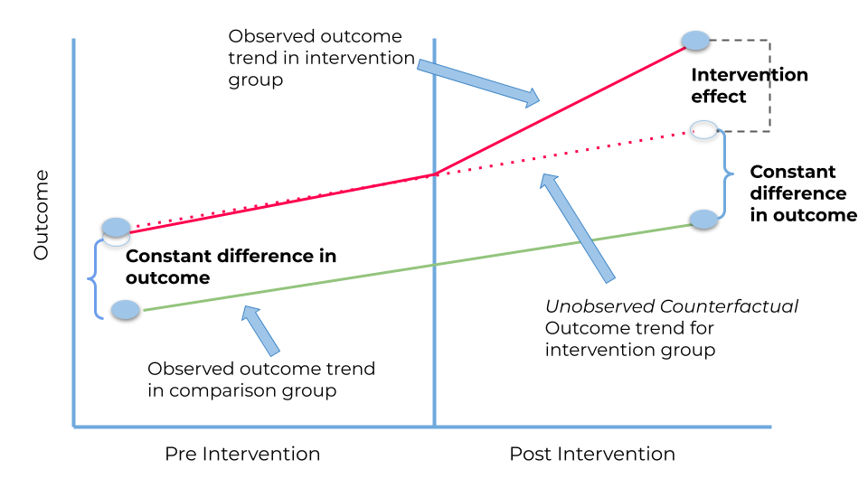
Difference in differences Parallel trends assumption: we assume that all groups would follow the same trends in their outcomes if nothing else changed
https://medium.com/bukalapak-data/difference-in-differences-8c925e691fff

Slide 13
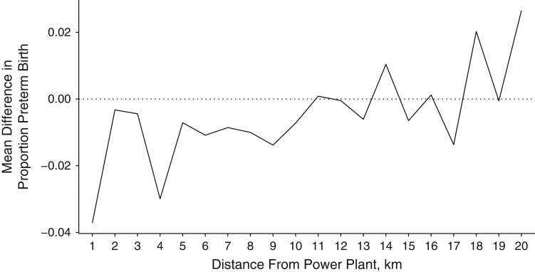
Casey paper Findings
Two findings shown here:
Increased distance from power plants was found associated with a reduction in pre-term birth risk
Closures of plants decreased the risk of preterm births nearby

Slide 14
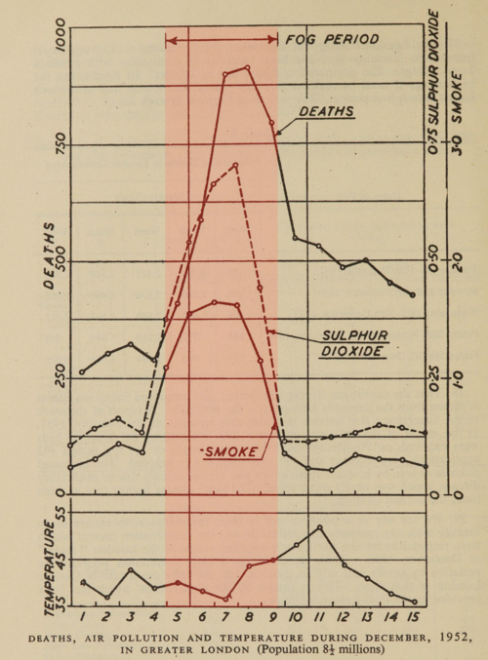
Time series
London Smog event, December 1952
Looking at the daily data showing the smoke, pollution levels, fog and deaths – it’s fairly obvious these things are all related to one another
Statistical models have developed over time to be able to leverage this kind of data
https://commons.wikimedia.org/wiki/File:1952_Great_London_Smog_mortality.png

Slide 15
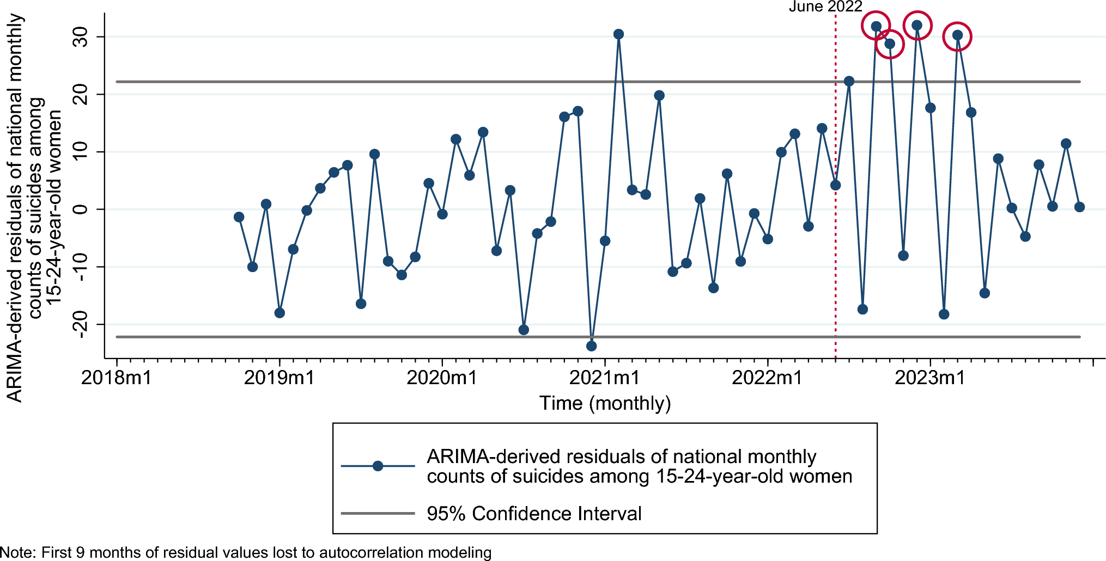
ARIMA – Time series method that models projected counts, then compares with what actually happened
These researchers wanted to know if there was any evidence of increased suicide in women 15-24 after Dobbs
Singh, P., Crawford, A., Crow, S. et al. Suicide deaths among reproductive-aged women in the US post-Dobbs: a national time-series analysis. Soc Psychiatry Psychiatr Epidemiol (2025). https://doi.org/10.1007/s00127-025-02902-7

Slide 16

Interrupted time series
ITS methods are my personal favorite for evaluation of policy effects
Quasi-experimental regression discontinuity designs
Use repeated observations over specified time intervals
First establishes the baseline time trend, then estimates changes in trend attributable to policy changes or other interventions at specific points in time
Comparing each group to itself at different points in time

Slide 17
Changes in Out-of-state abortions in Colorado after Texas SB8
After SB8, over 7 times the number of Texas residents traveled to CO for abortions, after adjusting for time trends. RR: 7.86 (3.30-20.09)
If we drop March/April 2020, rises to 13.12 (6.73, 27.14)
DeBie, Kelly A., et al. “Association of Reproductive Access Restrictions and Out-of-State Abortion Care in Colorado, an Interrupted Time Series Analysis for 2018-2024.” American Journal of Obstetrics & Gynecology, vol. 0, no. 0, May 2025, https://doi.org/10.1016/j.ajog.2025.04.071.
Notes:
Visual here fit with a spline using 5 degrees of freedom

Slide 18
Synthetic Controls
Create a comparison where there isn’t a good reason for there to be one
Used to identify uncontrolled confounding
Ex: Wyoming residents associations with Texas SB8
Confirmatory negative control
I have also done this using different combinations of unexposed states for infant mortality studies

Slide 19
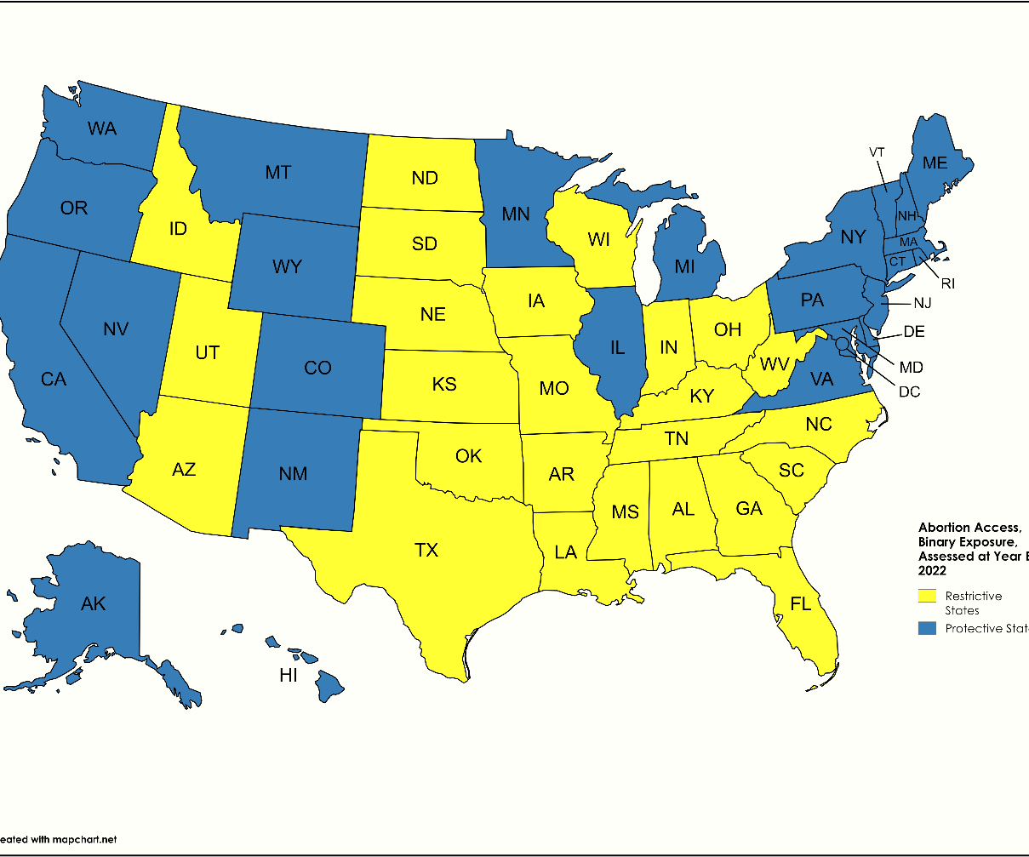
Generalized estimating equations
Method to take clustered data that has correlation inherent and compare it over time based on a forcing variable
Exposure: State level abortion laws
Outcome: State level infant mortality before and after Dobbs
We would expect correlation within the data – they aren’t independent observations

Slide 20
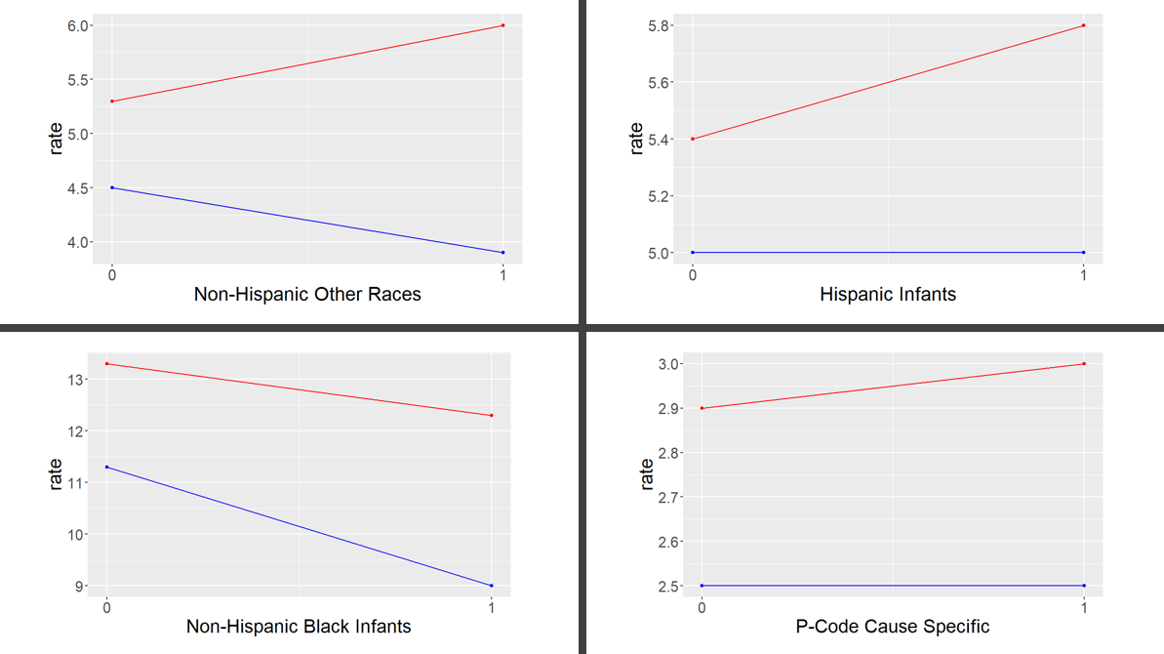
Crude rates over time
Notes:
Crude rates over time. We ideally want to see declining rates over time for all groups and the gap between the states shrinking. We don’t. First point 2018/2019, second 2023. Infant mortality in 3 groups is no longer declining in restrictive states. P-code increase is not statistically significant. (Change in trend for Hispanic infants not found to be statistically significant yet though).Black infants still declining, but there is evidence the gap is widening.

Slide 21
Results for interaction term between time and the exposure Protective states are the reference category Signals here that the gap may be widening in these groups over time when we compare restrictive states to protective ones
 | Adjusted Rate Ratio (95% Confidence Interval)
All-Cause | 1.02 (0.95, 1.10)
Non-Hispanic Black | 1.16 (1.06, 1.28)
Non-Hispanic White | 0.97 (0.90, 1.05)
Non-Hispanic Other Races | 1.31 (1.09, 1.56)
Hispanic | 1.58 (0.87, 2.87)*
P-Code | 1.05 (0.95, 1.17)
Q-Code | 0.99 (0.89, 1.10)

Slide 22
There are robust ways to study how sudden changes to law & policy impact populations
We may have to get creative in the coming years
New methods are being developed to study the combination of laws/policies
Data availability is a real concern (the Wayback machine and other sites…)
Data integrity and security will likely become issues as well
You can and you will find a way to study the things you care about
Collaborate!
Call on experts in other fields, lean on scientists and data analysts
Notes:
Constructed metric to study how changes in abortion access and anti-LGBTQ laws are associated with the supply of physicians; these methods can be used to study many other outcomes as well

Slide 23
Thank you! I’d be happy to take questions at the end of the session
Kelly DeBie, PhD, JS, MS
kelly.debie@colostate.edu

