Slide 1
A better way to research?: Empirically testing co-creation of research methods
Leslie E. Wolf, JD, MPH (lwolf@gsu.edu)
ASLME Health Law Professor’s Conference
June 4, 2025
|

Slide 2
The project
Co-creating Novel, Feasible, and Inclusive Research Methods (CONFIRM)
PCORI award, PIs: Christy Ledford and Samantha Jones from MCG at Augusta University

Slide 3
Background
Some populations remain underrepresented in research
Community engaged research may increase research participation among those populations
But impact of community engagement on participation has not been tested

Slide 4
CONFIRM underlying hypothesis
Engaging study participants as co-researchers (not just advisors) will result in methods that are more participant-centered, timely, relevant to participant/community concerns, culturally sensitive, and trustworthy and, thus, will increase willingness to enroll and continue participating

Slide 5
CONFIRM approach
Evaluate impact of co-creation on retention and perceptions of community impact and research credibility and
Evaluate the implementation of the co-creation approach

Slide 6
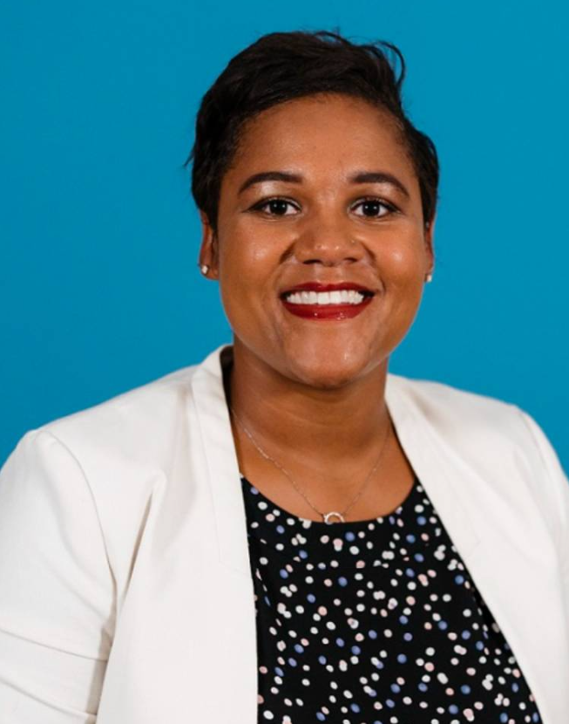
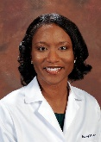
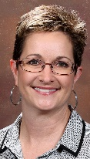
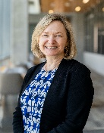

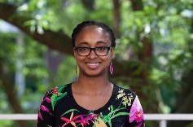
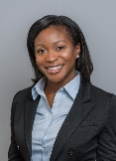

CONFIRM team
Christy JW Ledford, PhD, Dual-PI
Samantha Jones, PhD, Dual PI
Jessica Britt-Thomas, PhD, co-investigator
Ebony Whisenant, MD, co-investigator
Jennifer Waller, PhD, co-investigator
Leslie Wolf, JD, MPH, co-investigator
External Scientific Advisory Council
External Scientific Advisory Council
Study coordinator
Lillie Williamson, PhD, co-investigator
Britney Pooser, consultant
Community Expert Council
Traci Greene, community outreach coordinator
Augusta University
Georgia State University
LEGEND
HUB Augusta Collaborative
University of Wisconsin -Madison

Slide 7
Stay tuned and thank you!
|

