Slide 1
Polarization is Making Us Sick – Social Science Could Offer an Antidote
Timothy Callaghan
Associate Professor
Department of Health Law, Policy, and Management
Matt Motta
Assistant Professor
Department of Health Law, Policy, and Management

Slide 2
Background
Polarization
Mass level – people who self-identify as Democrats or Republicans increasingly hold different attitudes and express different behaviors
Elite level – policymakers who affiliate with a given party tend to formulate and enforce policies differently based on their partisanship
Consistent evidence of growing polarization at the mass and elite levels
Growing evidence that this polarization has extended into public health; with health attitudes and behaviors increasingly polarized on the basis of partisan identities

Slide 3
JHPPL’s 50th Anniversary
On the 50th Anniversary of the Journal of Health Politics, Policy, and Law, Matt and I were asked to write a paper on two vital questions:
How did this polarization of public health happen?
What can we do about it?

Slide 4
The Origins of Polarization
40 years ago, the attitudes of Republican and Democrat members of congress overlapped quite a bit making compromise easier; it is far more difficult today.
Chicken or the Egg?
Who was the first mover in polarization – politicians or the public?
Evidence tends to suggest that politicians were the first mover
Politicians get more extreme, and the public reacts to trusted politicians by becoming more extreme themselves
As the public becomes more extreme, politicians react to this to get re-elected in a cycle of polarization
As the public moves further and further apart from each other, more extreme politicians on each side of the aisle get elected

Slide 5
Callaghan and Motta’s Cycle of Polarization

Slide 6
Politicization of Public Health
Critical point – public health has ALWAYS been political
Politics determines the allocation of resources and which policy topics get prioritized
It has always been true that politics influences health access, quality, and cost
So, what has actually changed?
While policy choices that impact health have always been political, for the first time individuals are pursuing different health behaviors BECAUSE of partisanship
Driven by actions of politicians and social media echo chambers

Slide 7
Pandemic as a Catalyst for Polarization
Politics put above public health during pandemic
White House interference constant…example: demanding CDC guidance allowing religious services despite evidence of potential danger
Politics within CDC also matter – determined to produce own COVID test instead of relying on those in other countries at start of pandemic
Politicians questioned the safety of COVID-19 vaccines and the guidance of scientists to win a base increasingly interested in ‘healthcare freedom’
Messaging
The choice to let politicians lead daily press conferences nationally (Trump) or at the state level (Cuomo) necessarily politicized things more
Made politicians focused on re-election the center of all discussion

Slide 8
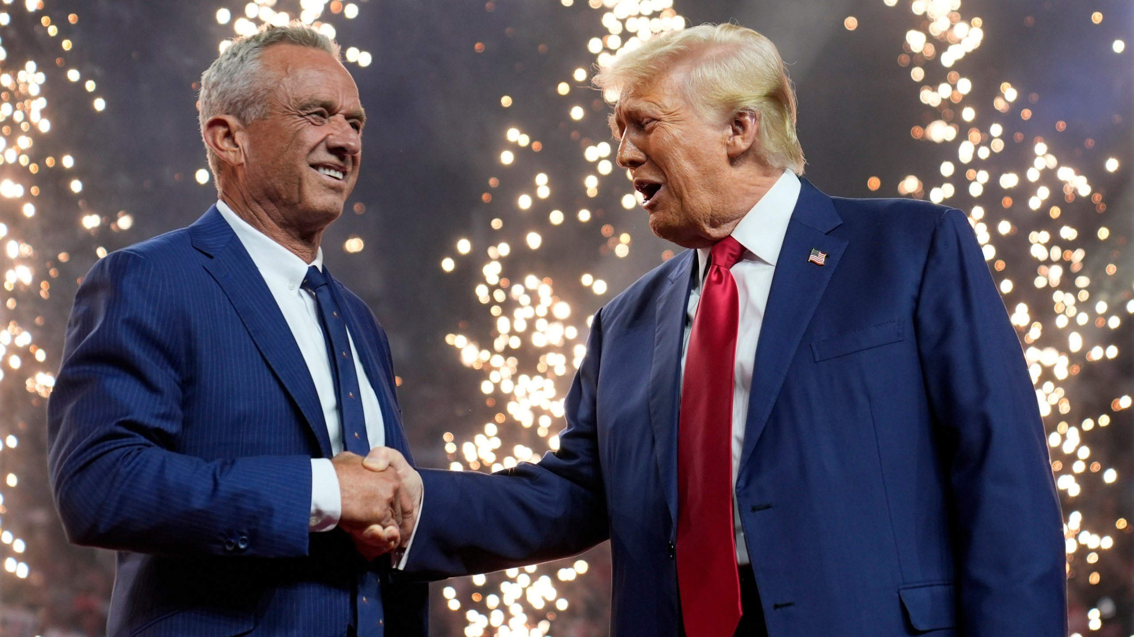
The Second Trump Administration as a Tipping Point

Slide 9
Actions During the Second Trump Administration
Political interference into the vaccine approval process
Political interference in LGBTQ health research
Political interference into health equity work
Political interference into climate and health work
Political interference into immigration; with massive public health consequences
Cuts to grants in the majority of these spaces

Slide 10
Top Down or Bottom Up?
To stop the cycle of polarization and its negative impacts on health, we need to decide if we should take a top down or bottom-up approach
We propose a bottom-up approach
Focus on interrupting the polarized signals people transmit to their lawmakers
Should disincentivize policymakers from taking further action to cater to increasingly polarized health opinion
Reasoning – its really hard to change elite behavior unless the electoral incentives change

Slide 11
How to Stop Runaway Polarization in Its Tracks
We propose a 3-pronged approach to stopping runaway polarization
Investments in Research
Politically-oriented Clinical Interventions
Advances in Communications Interventions

Slide 12
How Do We Best Confront Growing Politicization?
To confront polarization, we must first get research funded that can study this topic
Incredibly difficult to get research in this space funded
NSF vs. NIH – neither is a perfect fit
Private foundations are overwhelmed
Many private foundations concerned about appearing political
Funding is essential because publicly available health data does not include measures of partisanship

Slide 13
What Kinds of Research are Needed?
Research examining the impact of polarization on health outcomes
0 of 69 CDC surveys includes a measure of partisanship
Longitudinal health politics data; field too often emphasizes cross-sectional survey research
Research focused on elites' actions, rhetoric, and its implications

Slide 14
How Do We Best Confront Growing Politicization?
2. To confront polarization, we must involve clinicians
If polarization is impacting health attitudes and behaviors, it is going to manifest in clinical practice
Clinicians are currently not trained to address this
Clinicians are trusted by patients, potentially making them incredibly effective messengers once trained
Bioethical dilemma – how to we address the political determinants of health without scaring away patients?
Building a toolkit for clinicians to manage these situations is going to be essential
Evaluation of ongoing initiatives - VotER

Slide 15
How Do We Best Confront Growing Politicization?
3. Advances in Health Communication Research
We need considerably more research which works to understand which messages and messengers are most likely to depoliticize health
We must systematically compare and contrast effects of many different messaging strategies…move towards megastudies
Interventions must work beyond vignettes – social media advertising campaigns, tv ads, etc.
Focusing on the laboratory isn’t enough – field testing is critical
Partnerships with community stakeholders who can administer at scale is vital

Slide 16
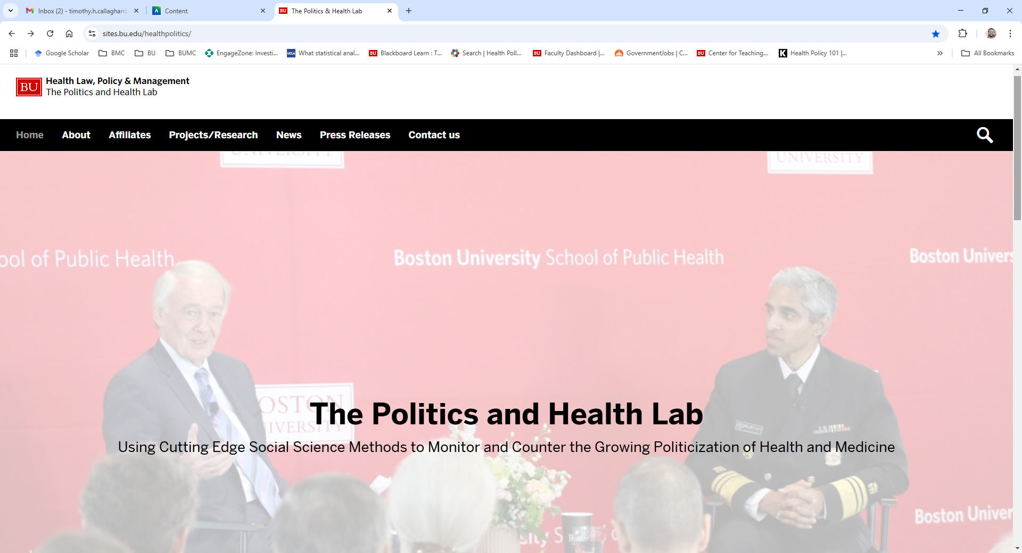
Exciting News: The Politics and Health Lab at Boston University Has Been Launched!!!!!!

Slide 17
Questions & Comments
Tim Callaghan, PhD
timcal@bu.edu

