Slide 1
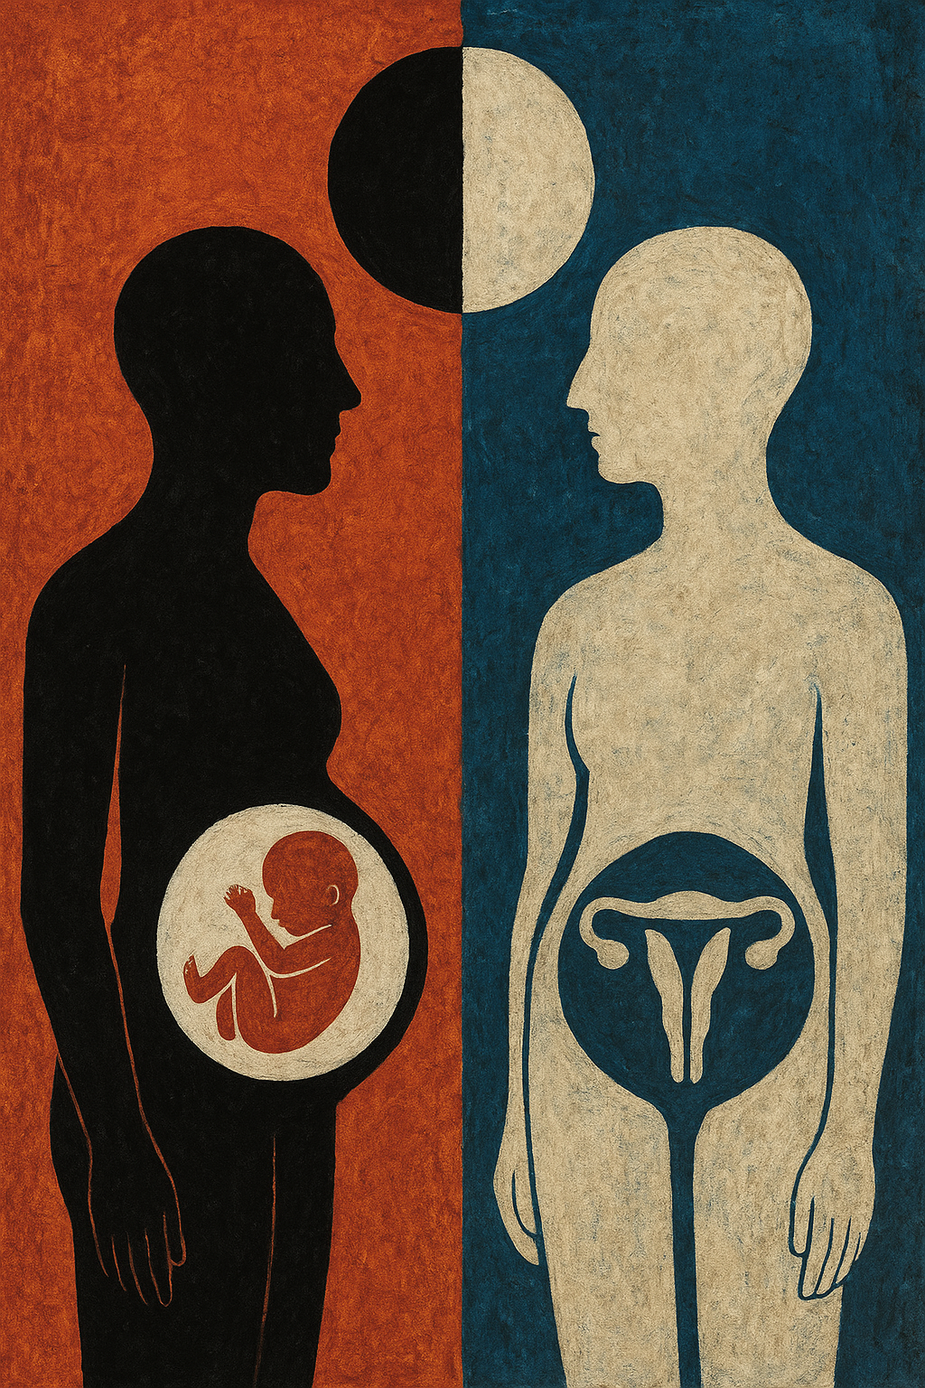
Consciously Extreme: Personhood & Fetal Containers
Chris Nero Coughlin, JD, Professor
Wake Forest University School of Law
Nancy M. P. King, JD, Emeritus Professor
Wake Forest University School of Medicine
Pdrawing generated by PerplexityAI
Notes:
Add cite here.

Slide 2
Overview
Which personhood counts -- and why?
A current example – and how did we get here?
Dobbs was NOT the beginning – many threads have been woven together
Forced cesareans
ADs: whose autonomy counts more?
Organ & tissue donation: no duty to rescue
Sophie’s choices
Pregnancy and ADs
Pregnancy and neurological death
Treating dangerous pregnancies after Dobbs
Personhood and embryos
Brain organoids and potential consciousness
Increased focus on individuals, definitions, and categories: who counts?
Decreased access to supports for pregnant women and fetuses – undoing solidarity

Slide 3
Neurological Death and the Fetus: Was the Adriana Smith Case Inevitable? See Prof. Kimberly Mutcherson, A Brain-Dead Woman is Kept Alive on Machines to Gestate a Fetus. It was Inevitable, NY Times (May 24, 2025).
Georgia statute (Living Infants Fairness and Equality Act (LIFE)) bans abortion after 6 weeks with limited exceptions for medical emergency, futility and rape. Enforcement focuses on health care providers and includes medical licensure revocation, disciplinary actions, civil legal liability, fines, and possible criminal prosecution.
Adriana Smith, 30-year-old Black nurse and mother, went to hospital complaining of severe headaches. Next morning rushed to hospital with multiple blood clots and declared brain dead in February (after probable malpractice). She was 9 weeks pregnant at the time.
Emory University Hospital, Ms. Smith’s employer, has maintained support for her body to bring the fetus to viability for more than 90 days, informing Ms. Smith’s mother that “because of the fetus her daughter was carrying, it could not legally withdraw the artificial means of keeping her body functioning.”
Ms. Smith’s family is being billed for this “treatment.”
Photo from GoFundMe page

Slide 4
Adriana Smith Case: Who is Saying What?
LIFE bill’s sponsor, state Sen. Ed Setzler (R-Acworth) stated: "I’m thankful for the hospital recognizing the full value of this small human life that’s living inside of this tragically dying young mother; mindful of the agony of this young mother’s family."
Mack Parnell of the Faith and Freedom Coalition, a lobbyist for the bill stated: Trying to paint the 'heartbeat' bill as doing something that it doesn’t is a disservice to our state. It was not the intention. We will leave those decisions to the family. …”
Georgia attorney general’s office stated: “There is nothing” in the LIFE abortion legislation “that requires medical professionals to keep a woman on life support after brain death. Removing life support is not an action with the purpose to terminate a pregnancy.. . . [O]ur prayers go out to [her family]”.
BUT April Newkirk, Ms. Smith’s mother: “I’m not saying we would have chosen to terminate her pregnancy. But I’m saying we should have had a choice. We should have had a choice."
"Emory Healthcare uses consensus from clinical experts, medical literature, and legal guidance to support our providers as they make individualized treatment recommendations in compliance with Georgia’s abortion laws and all other applicable laws. Our top priorities continue to be the safety and wellbeing of the patients we serve. Because of federal privacy rules, we are unable comment on individual patient cases."
https://www.11alive.com/article/news/politics/ag-heartbeat-law-misapplied-case-pregnant-georgia-mom-kept-alive/85-0eabfb9f-24cd-4222-8c50-2f6806aa4822; https://www.fox5atlanta.com/news/brain-dead-georgia-woman-kept-life-support-due-states-abortion-law

Slide 5
“Emory University Hospital, once Ms. Smith’s place of employment, would not be legally allowed to remove organs from a brain-dead person without family consent if this person hadn’t previously registered her wish to be a donor, even if doing so could save or improve dozens of lives. . . .
See Prof. Kimberly Mutcherson, A Brain-Dead Woman is Kept Alive on Machines to Gestate a Fetus. It was Inevitable, NY Times (May 24, 2025).
But see McFall v. Shimp (Alleghany County PA, Ct. of Common Pleas 1978), an individual is not under compulsion to aid another person at their mental or physical expense. In the opinion, Judge Flaherty stated:
For our law to compel defendant to submit to an intrusion of his body would change every concept and principle upon which our society is founded. To do so would defeat the sanctity of the individual and would impose a rule which would know no limits, and one could not imagine where the line would be drawn…For a society which respects the rights of one individual, to sink its teeth into the jugular vein or neck of one of its members and suck from it sustenance for another member, is revolting to our hard-wrought concepts of jurisprudence.
Alexia Ingram, McFall v. Shimp and the Case for Bodily Autonomy, https://hulr.org/spring-2021/mcfall-v-shimp-and-the-case-for-bodily-autonomy

Slide 6
How did we get here?
Is this the right question?
Well, it’s a long story and Dobbs is not the beginning
A lot of threads, woven together, make strong rope:
Individual autonomy/no duty to rescue/weak solidarity
Men count more than women
Pregnant women as fetal containers
Abortion controversies
Consciousness and personhood
Hostility to poor and people of color
Failures of prevention
Key:
None of these threads is truly new
But the rope keeps getting stronger
Drawing generated by perplexityai

Slide 7
Countermanding Pregnant Women’s Choices: A Long History
Forcing cesareans based on fetal monitoring
Often affecting poor women of color
Often later shown unnecessary
Forcing cesarean when treating pregnant woman harms fetus
Angela Carder case
Later shown futile
Criminalizing miscarriage or “harm” to a fetus
So, do “fetal containers” have duties that others do not?
See Theresa Morris and Joan H. Robinson, Forced and Coerced Cesarean Sections in the United States, https://journals.sagepub.com/doi/full/10.1177/1536504217714259; George Annas, At Law: Women as Fetal Containers, https://www.jstor.org/stable/3562083

Slide 8
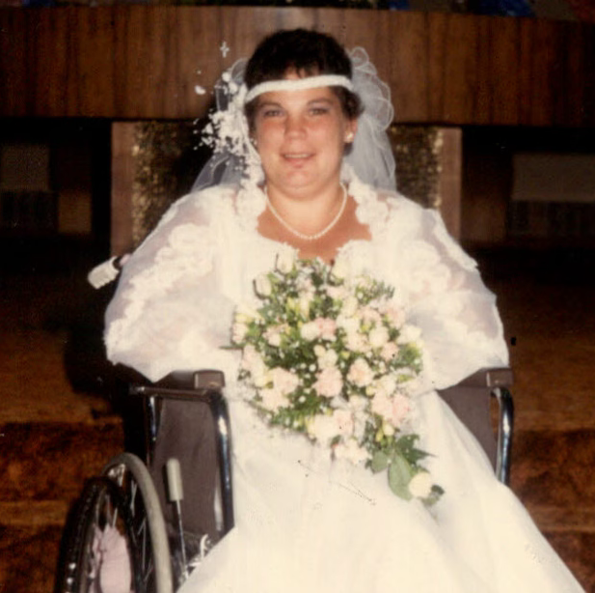
Angela Carder case
In re A.C., 573 A.2d 1235 (D.C. Cir. 1990), court ordered C-section although AC withdrew consent, in an unsuccessful attempt to save the life of her fetus. Fetus survived 3 hours. Carder survived 2 days but would have lived longer but for the C-section.
D.C. Cir. held that a pregnant woman has a right to refuse medical treatment, even if it means the fetus's life is at risk and the trial court's decision to override her wishes was error.

Slide 9
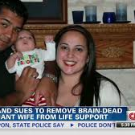
Marlise Muñoz & others
Marlise Nicole Muñoz – 14 weeks pregnant when she suffered a pulmonary embolism. Bc she was pregnant, TX hospital kept her body on a ventilator despite a determination of brain death. Muñoz's husband sued.
TX has restricted advance directives in pregnancy, but the law was not applicable because his wife was legally dead.
A judge ordered the hospital to remove organ support & her cardiac functions stopped on January 26, 2014

Slide 10
These are Sophie’s Choices
Prioritization of fetus over pregnant woman
Religious dictates
Hospital policies
OB policies
ADs invalidated by pregnancy in many states
Approximately 37 states have some type of restrictions (automatic or viability based)
Regardless of stage of pregnancy
Often unknown to women whose ADs refuse treatment
All regardless of honoring, or even determining, pregnant women’s prior or current choices or preferences

Slide 11
The post-Dobbs spotlight
After Dobbs, prioritizing the fetus became clear and obvious
Reluctance of hospitals, practices, and providers to treat in ways that threaten fetus until pregnant woman’s death without intervention appears certain
Taken together, and with the long view, it’s plain: personhood of fetuses outweighs that of pregnant women

Slide 12
Fetal Personhood Laws
STATE:
Child Support
Tax Credit
Wrongful Death, Battery
Fetal Homicide
FEDERAL:
Personhood language in maternal health bills, birth control bills, tax codes, child support laws, college savings plans, COVID-19 relief packages, and essential safety-net programs like Temporary Assistance for Needy Families (TANF).
Life at Conception Act, a federal personhood bill
Planned Parenthood, The Growing Threat of Fetal Personhood Measures Across the Country, https://www.plannedparenthoodaction.org/pressroom/the-growing-threat-of-fetal-personhood-measures-across-the-country

Slide 13
Post-Dobbs: Embryo Personhood and IVF- Alabama
Added a fetal personhood to its Constitution in 2018
In Feb. 2024, in LePage v. Ctr for Rep. Med., the Alabama Supreme Court ruled the amendment assigned rights to an embryo outside of the womb.
On March 6, lawmakers enacted a bill shielding IVF service providers from prosecution related to the damage or destruction of an embryo plus limited protection to IVF-related manufacturers.
(Photo Source: Source: WSFA 12 News); Ali Martin, What Alabama’s IVF ruling is having ripple effects. What it does – and doesn’t – do, Christian Science Monitor, https://www.csmonitor.com/USA/2024/0318/Alabama-s-IVF-ruling-is-having-ripple-effects.-What-it-does-and-doesn-t-do (March 18, 2024).

Slide 14
Broad embryonic personhood laws or constitutional amendments establish that
embryos are “people” under state laws and regulations, and can take the following
forms depending on the state:
(1) State constitutional amendments granting an inalienable right to life from the moment of fertilization or conception.
(2) Anti-abortion laws that statutorily expand legal and constitutional rights to fertilized eggs and embryos.
(3) Legal definitions of “person” in general definitions statutes that include fertilized eggs and embryos, applying across all state laws.
Pregnancy Justice, Giving Legal Rights to Fertilized Eggs, Embryos, and Fetuses Threaten Access to Fertility Care, chrome extension://efaidnbmnnnibpcajpcglclefindmkaj/https://drive.usercontent.google.com/download?id=1HgWo5NY_TVWzhVGoHOO4xBb3EG1olh_1&authuser=0&acrobatPromotionSource=GoogleDriveNativeView

Slide 15
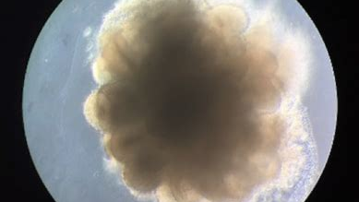
Brain organoidS
Source: Yang S, Hu H, Kung H, Zou R, Dai Y, Hu Y, Wang T, Lv T, Yu J, Li F. Organoids: The current status and biomedical applications. MedComm (2020) 2023 May 17;4(3):e274.

Slide 16
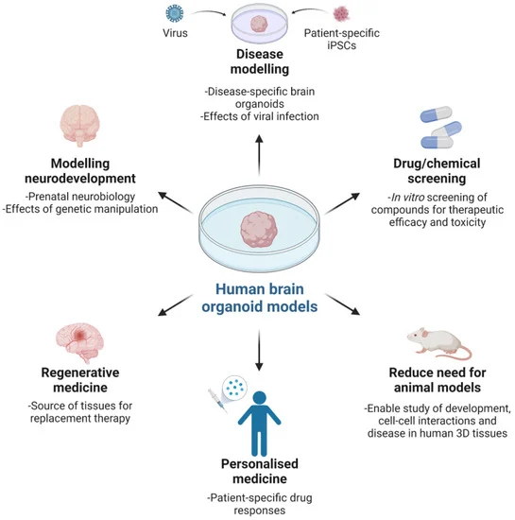
See Sawai T, Sakaguchi H, Thomas E, Takahashi J, Fujita M. The ethics of cerebral organoid research: being conscious of consciousness. Stem Cell Rep. 2019;13(3):440

Slide 17
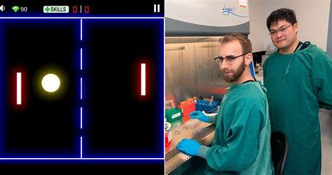
Scientists teach brain organoids “Pong”
https://www.youtube.com/watch?v=9ksLuRoEq6A

Slide 18
Consciousness
https://creativecommons.org/publicdomain/zero/1.0/

Slide 19
Best ways to support healthy fetal development
Medical Care
Nutrition and Essential Nutrients
Immunizations
Prenatal Vitamins
Healthy Lifestyle Choices
Avoiding Harmful Substances
Bonding and Intellectual Stimulation

Slide 20
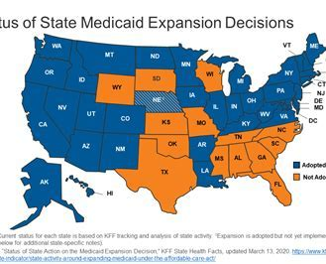
Decreased Access to Supports for Pregnant Women and Fetuses – Undoing Solidarity

Slide 21
Conclusion
Focus on definitions and categorizations has increased significantly
This has helped obscure attention to consequences
And it has also obscured the increasingly radical truncation of every resource that supports fetuses and facilitates their development into conscious persons
Something is wrong here; the way to correct it seems clear

Slide 22
Selected References
https://www.pregnancyjusticeus.org/
https://www.kff.org/
https://www.plannedparenthood.org/
Joan H. Krause, Pregnancy Advance Directives, 44 Cardozo Law Review 805 (2023)
King NMP, Coughlin C, Levine B. “Strategy, Morality, Courage: Health Law and Bioethics after Dobbs,” J Law Med. Ethics 2024;52:290-308. DOI: 10.1017/jme.2024.104
Coughlin C, King NMP. “Dobbs, the Intrusive State, and the Future of Solidarity,” Cambridge Q Healthcare Ethics 2023; Mar. 16. doi: 10.1017/S0963180122000792.
Coughlin CN, King NMP, McEwan E. “Brain Organoid Research in a Post-Dobbs World,” Ethics Hum Res 2025;47(2):41-47. DOI: 10.1002/eahr.60017

