Slide 1
Choice Following Prenatal Diagnosis is More Urgent than Ever
Ellen Wright Clayton, MD, JD
Professor of Law
Craig-Weaver Professor of Pediatrics
Center for Biomedical Ethics and Society
Vanderbilt Medical Center and University

Slide 2
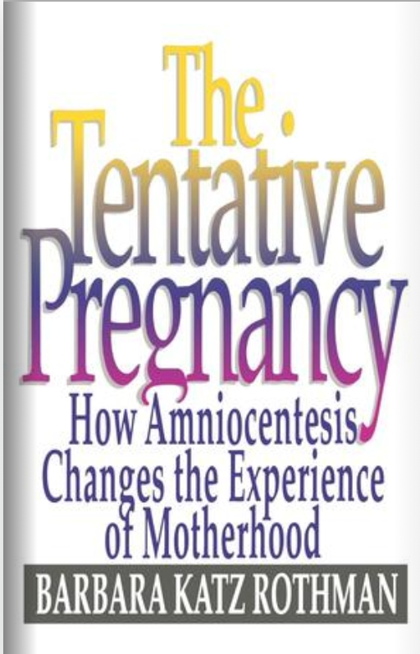
This issue has always been contested
At that time, prenatal diagnosis was offered to limited number of people

Slide 3
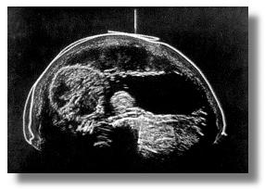
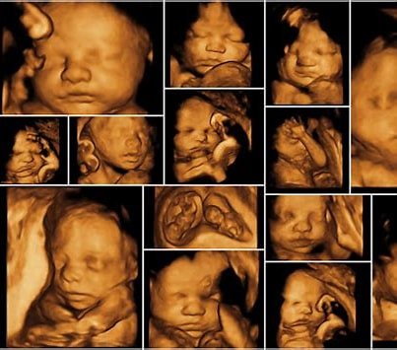
What has changed?
Noninvasive prenatal tests are recommended by obstetrical organizations for all pregnant women
Administered at ~ 10 weeks
Currently test for Trisomies 13, 18, and 21 as well as sex chromosome variants
Disagree with Allyse, et al., HCR 2025 March-April Issue 29-38
Ultrasound has become more powerful and more routine
History of Ultrasound in Obstetrics and Gynecology, Part 2 1970s
yashojyotfetalmedicine.com

Slide 4
Examples of current abortion exemptions/bans
10 states have no exceptions for fetal anomalies
States with limits for fetal anomalies
AK, IN, NE, SD Lethal fetal anomaly” means a fetal condition diagnosed before birth that will result in the death of the unborn child with reasonable certainty within three (3) months of the birth
WY “Lethal fetal anomaly” means a fetal condition diagnosed before birth and if the pregnancy results in a live birth there is a substantial likelihood of death of the child within hours of the child's birth
IN Must be informed “that Indiana does not allow a fetus to be aborted solely because of the fetus's race, color, national origin, ancestry, sex, or diagnosis or potential diagnosis of the fetus having Down syndrome or any other disability.” see also KY
OK Fetal anomaly incompatible with life” means a profound and irremediable congenital or chromosomal anomaly that is incompatible with sustaining life after birth. Fetal anomaly incompatible with life does not include conditions which can be treated;
SC “Fatal fetal anomaly” means that, in reasonable medical judgment, the unborn child has a profound and irremediable congenital or chromosomal anomaly that, with or without the provision of life-preserving treatment, would be incompatible with sustaining life after birth
UT (9)(a) “Severe brain abnormality” means a malformation or defect that causes an individual to live in a mentally vegetative state. (b) “Severe brain abnormality” does not include (i) Down syndrome; (ii) spina bifida; (iii) cerebral palsy; or iv) any other malformation, defect, or condition that does not cause an individual to live in a mentally vegetative state.
NC Life‑limiting anomaly. – The diagnosis by a qualified physician of a physical or genetic condition that (i) is defined as a life‑limiting disorder by current medical evidence and (ii) is uniformly diagnosable.
WV “Nonmedically viable fetus” means a fetus that contains sufficient lethal fetal anomalies so as to render the fetus medically futile or incompatible with life outside the womb in the reasonable medical judgment of a reasonably prudent physician. See also GA, IA, MS
Limits on post-viability abortion for fetal anomalies
DL post viability permitted “in the event of a fetal anomaly for which there is not a reasonable likelihood of the fetus's sustained survival outside the uterus without extraordinary medical measures”; see also MA

Slide 5
What about the argument from disability rights?
Crucially, the discourse surrounding disabilities has changed dramatically in the last 50 years but support is still incomplete
Many of the arguments about the adverse impact of abortion following prenatal diagnosis turn on misrepresentations of the impact of disability
Women should receive accurate information about
What tests may reveal, and
If a problem is identified, condition, prognosis, and course of care – here, Allyse, et al., are correct

Slide 6
What do the limits on abortion after prenatal diagnosis mean for women and their families?
In more than one third of states, women must continue their pregnancies unless they can travel to a more permissive state
What may lie in store?
Possible prenatal intervention
Surgery for spina bifida and other anomalies
Intrauterine gene therapy trials
Choosing to deliver at site where high-tech care is available
NICU and cardiac surgery
Long term specialty care in- and outpatient
Increasing trend to “hospital at home”
Many, but not all, women and families choose these interventions, which can dramatically affect children and families

Slide 7
But the ultimate question is whether women should be allowed to choose abortion after prenatal diagnosis
The very technology that enables diagnosis and affects families is the reason why the answer is yes

