Slide 1
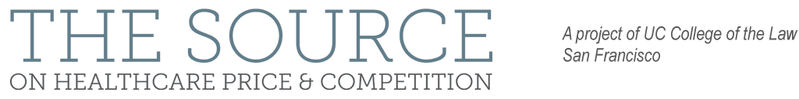
LESSONS LEARNED FROM HCA’S PURCHASE OF MISSION HOSPITAL IN ASHEVILLE NC
Mark A. Hall
Wake Forest Univ.
Funded by the Arnold Foundation

Slide 2


Slide 3
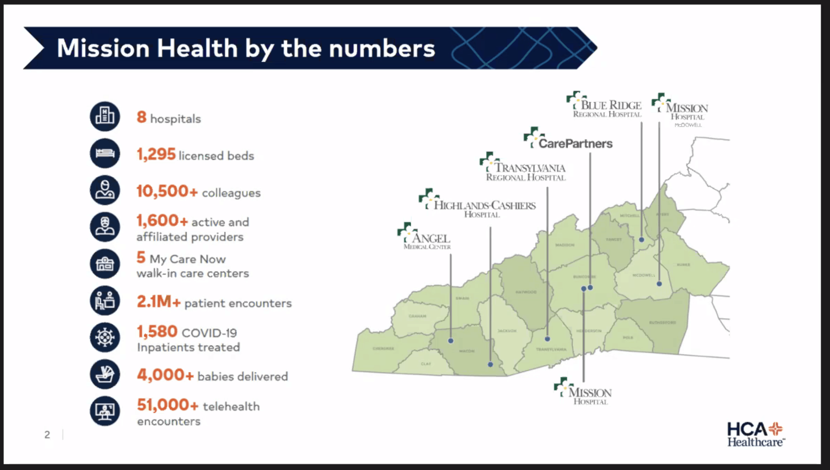

Slide 5


Slide 6
Beloved Mission Crumbled Rapidly
Sept. 2016 Repeal of COPA
July 2017 Failed Blue Cross Negotiation
March 2018 Sale to HCA authorized

Slide 12
HCA’s Roof Caving In
Suit by Attorney General
“Immediate Jeopardy” under Medicare
Suits by several municipalities
Several large private lawsuits

Slide 13
Lessons Learned
Need for Due Diligence by the Board
State Legislature Easily Led Astray
Limits on Attorney General review authority
Inherent Difficulty Disciplining Cost-Cutting
Can CON become more pro-competitive?

