Slide 1
Bottom-up Federalism: What Tobacco 21 Taught Tobacco Regulatory Science
Page D. Dobbs, PhD
Associate Professor of Public Health
1L, University of Arkansas School of Law

Slide 2
Conflicts of Interest
Completing legal externship with Truth Initiative, Schroeder Institute and Campaign for Tobacco Free Kids during Summer 2025

Slide 3
Tobacco 21
Laws that raise the legal minimum sales age (MLSA) to 21 year
Strong Public Support (Lee et al., 2016; King et al., 2015; Volinsky et al., 2018; Winickoff et al., 2016; Zhang et al., 2018)
Decreases tobacco initiation among 15-17-year-olds by 25% (Bonnie et al., 2015)
Reduces smoking rates among:
Adults by 12% (Bonnie et al., 2015)
18-20-year old young adults (Friedman & Wu, 2019)
18-20-year-olds who have used cigarettes by 39% (Friedman et al., 2019)

Slide 4
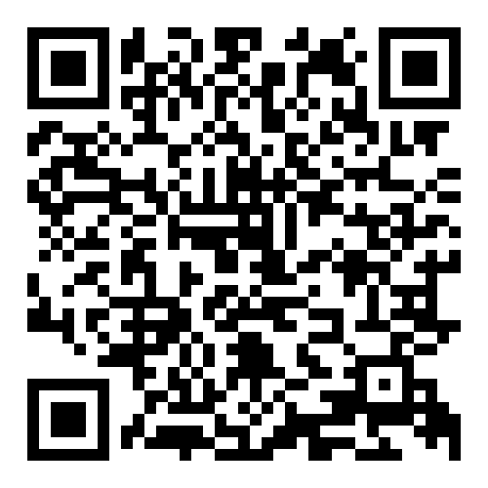
Scan Me

Slide 5
Tobacco 21 Assessment Tool Development
Tobacco 21 Summit
October 2017
Dobbs, P. D. , Chadwick, G., Ungar, K. W., Dunlap, C. M., White, K. A., Kelly, M. C. T., Cheney, M. K. (In press). Development of a tobacco 21
policy assessment tool and state-level analysis in the USA, 2015-2019. Tobacco Control, 1-9.

Slide 6
Tobacco 21 Assessment Tool Development
Preliminary Tobacco 21 policy assessment tool developed
Literature Review
Tobacco 21 Summit
Review of current passed policies
October 2017
June 2018
Dobbs, P. D. , Chadwick, G., Ungar, K. W., Dunlap, C. M., White, K. A., Kelly, M. C. T., Cheney, M. K. (In press). Development of a tobacco 21
policy assessment tool and state-level analysis in the USA, 2015-2019. Tobacco Control, 1-9.

Slide 7
Tobacco 21 Assessment Tool Development
Tool revision based on feedback
Minor Revision for item order and wording
Minor revisions for question wording and response categories
Preliminary Tobacco 21 policy assessment tool developed
Minor wording revisions and clarifications
Literature Review
Feedback from subject matter experts
Legal review by attorney
Review by Tobacco 21 Research Team
Tobacco 21 Summit
Test tool with a sample of policies
Review of current passed policies
Final review and approval
October 2017
June 2018
October 2018
Dobbs, P. D. , Chadwick, G., Ungar, K. W., Dunlap, C. M., White, K. A., Kelly, M. C. T., Cheney, M. K. (In press). Development of a tobacco 21
policy assessment tool and state-level analysis in the USA, 2015-2019. Tobacco Control, 1-9.

Slide 8
Tobacco 21 Assessment Tool Development
Tool revision based on feedback
Minor Revision for item order and wording
Minor revisions for question wording and response categories
Minor wording revisions and clarifications
Finalized tool used to code state & local policies
Preliminary Tobacco 21 policy assessment tool developed
Literature Review
Feedback from subject matter experts
Legal review by attorney
Review by Tobacco 21 Research Team
Tobacco 21 Summit
Test tool with a sample of policies
Review of current passed policies
Final review and approval
October 2017
June 2018
October 2018
November 2018
Dobbs, P. D. , Chadwick, G., Ungar, K. W., Dunlap, C. M., White, K. A., Kelly, M. C. T., Cheney, M. K. (In press). Development of a tobacco 21
policy assessment tool and state-level analysis in the USA, 2015-2019. Tobacco Control, 1-9.

Slide 9
Tobacco 21 Assessment Tool Development
Tool revision based on feedback
Minor Revision for item order and wording
Minor revisions for question wording and response categories
Minor wording revisions and clarifications
Finalized tool used to code state & local policies
Preliminary Tobacco 21 policy assessment tool developed
Literature Review
Overall, 18 states and 477 local policies coded
Feedback from subject matter experts
Legal review by attorney
Review by Tobacco 21 Research Team
Tobacco 21 Summit
Test tool with a sample of policies
Review of current passed policies
Final review and approval
October 2017
June 2018
October 2018
November 2018
April 2020
Dobbs, P. D. , Chadwick, G., Ungar, K. W., Dunlap, C. M., White, K. A., Kelly, M. C. T., Cheney, M. K. (In press). Development of a tobacco 21
policy assessment tool and state-level analysis in the USA, 2015-2019. Tobacco Control, 1-9.

Slide 10
Policy Components
Policy Indicator | Operational definition

Slide 11
Policy Components
Policy Indicator | Operational definition
Policy Prohibition | Includes the terms sale/sell, give, distribute, and/or barter

Slide 12
Policy Components
Policy Indicator | Operational definition
Policy Prohibition | Includes the terms sale/sell, give, distribute, and/or barter
Comprehensive Tobacco Product Definition | Products that ‘contain’, ‘made’, ‘derived’ from ‘tobacco’ and/or ‘nicotine’
 | Includes ENDS. "Electronic nicotine delivery system"
 | Includes tobacco product "components", "parts", or "accessories"
 | Exempts products authorized for sale as a cessation product, as defined in the Federal Food, Drug, and Cosmetic Act

Slide 13
Policy Components
Policy Indicator | Operational definition
Policy Prohibition | Includes the terms sale/sell, give, distribute, and/or barter
Comprehensive Tobacco Product Definition | Products that ‘contain’, ‘made’, ‘derived’ from ‘tobacco’ and/or ‘nicotine’
 | Includes ENDS. "Electronic nicotine delivery system"
 | Includes tobacco product "components", "parts", or "accessories"
 | Exempts products authorized for sale as a cessation product, as defined in the Federal Food, Drug, and Cosmetic Act
Age Verification | Requires seller to obtain age verification
 | ID request based on appearance age
 | Appearance age to request for photo identification

Slide 14
Policy Components
Policy Indicator | Operational definition
Policy Prohibition | Includes the terms sale/sell, give, distribute, and/or barter
Comprehensive Tobacco Product Definition | Products that ‘contain’, ‘made’, ‘derived’ from ‘tobacco’ and/or ‘nicotine’
 | Includes ENDS. "Electronic nicotine delivery system"
 | Includes tobacco product "components", "parts", or "accessories"
 | Exempts products authorized for sale as a cessation product, as defined in the Federal Food, Drug, and Cosmetic Act
Age Verification | Requires seller to obtain age verification
 | ID request based on appearance age
 | Appearance age to request for photo identification
Signage | Sign stating legal age of sale for tobacco products is 21 years

Slide 15
Policy Components
Policy Indicator | Operational definition
Enforcement | Policy states that enforcement (compliance/inspection) checks will be done
 |  | Enforcement agency identified in the law
 |  | Minimum number of inspections per retailer
 |  | Minimum number of under-age compliance checks/stings per retailer
 |  | Age of under-age compliance check decoy
 |  | Provides justification for retail inspections/compliance (e.g., smoking rates, access rates, location, density, demographics)
 |  | Requires reinspection upon violation
 |  | Compliance reporting required
 | Includes a Tobacco Retail License (TRL) for vendors
 |  | Identifies fee for license
 |  | Requires annual renewal of the license by retailer
 |  | Enforcement agency/licensing authority sets the license fee

Slide 16
Policy Components
Policy Indicator | Operational definition
Violations & Penalties | Monetary non-compliance fine for retailers
 | Enforces Civil or Criminal penalty for retailer
 | Retail penalty/fine structure identified
 |  | Minimum fine amount for retailer noncompliance | Sets a minimum fine amount for retailer noncompliance
 |  | Penalty fine amount for first, second, third, and subsequent violations | States penalty fine amount for first, second, third, and subsequent violations
 |  | States time period for penalty accrual | States time period for penalty accrual
 | TRL suspension or revocation
 |  |  | States license may be suspended due to repeated violations
 |  |  | States license may be revoked due to repeated violations
 | Enforces a monetary non-compliance penalty for the clerk

Slide 17
Policy Components
Policy Indicator | Operational definition
Education | Education/Training mentioned in the policy for retailer/clerk/employees
 | Education/Training/communication mentioned in the policy for the general public

Slide 18
Policy Components
Policy Indicator | Operational definition
Education | Education/Training mentioned in the policy for retailer/clerk/employees
 | Education/Training/communication mentioned in the policy for the general public
Additional Restriction Measures | State statute includes additional measures, such as: Flavor restrictions Distance restrictions (e.g., from schools) Density restrictions (number of retailers per person) Vending machine restrictions to age 21 Restriction of tobacco sales from pharmacies

Slide 19
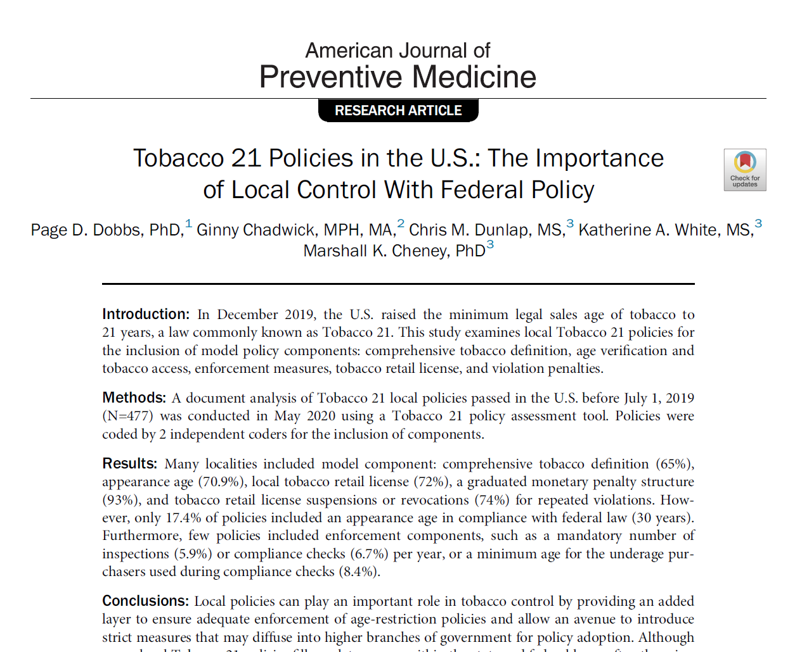
Scan Me

Slide 20
Enforcement Policy Language in Tobacco 21 passed before July 1, 2019

Slide 21
Federal Tobacco 21 Law
December 20, 2019, the Appropriations Act established a new Federal minimum legal sale age (MLSA) making it “unlawful for any retailer to sell a tobacco product to any person younger than 21 years of age.”

Slide 22
FDA’s Final Rules
reflect the increased minimum age of sale for cigarettes, smokeless tobacco, and covered tobacco products from 18 to 21 years of age;
increase the minimum age for verification by means of photographic identification for cigarettes, smokeless tobacco, and covered tobacco products from under the age of 27 to under the age of 30;
increase the minimum age of persons who may be present or permitted to enter at any time for facilities that maintain vending machines to sell cigarettes, smokeless tobacco, or covered tobacco products from 18 to 21 years of age; and
increase the minimum age of persons who may be present or permitted to enter at any time for facilities that maintain self-service displays to sell cigarettes or smokeless tobacco from 18 to 21 years of age.

Slide 23
FDA’s Final Rules
reflect the increased minimum age of sale for cigarettes, smokeless tobacco, and covered tobacco products from 18 to 21 years of age;
increase the minimum age for verification by means of photographic identification for cigarettes, smokeless tobacco, and covered tobacco products from under the age of 27 to under the age of 30;
increase the minimum age of persons who may be present or permitted to enter at any time for facilities that maintain vending machines to sell cigarettes, smokeless tobacco, or covered tobacco products from 18 to 21 years of age; and
increase the minimum age of persons who may be present or permitted to enter at any time for facilities that maintain self-service displays to sell cigarettes or smokeless tobacco from 18 to 21 years of age.

Slide 25
FDA’s Final Rule

Slide 26
FDA’s Final Rule
But what about state Tobacco 21 laws?

Slide 27
Synar Amendment
July 1992, Congress passed the Alcohol, Drug Abuse and Mental Health Administration Reorganization Act – included an amendment that required states to enact and enforce MLSA laws.
With the increase of the federal MLSA to twenty-one, SAMHSA outlined a three-year transition period for implementation and compliance

Slide 28
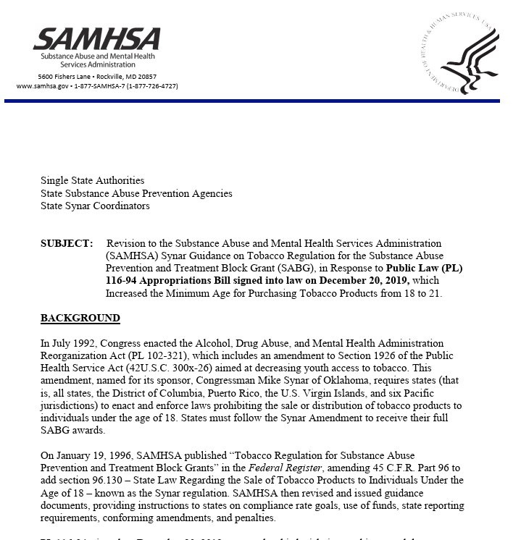
Synar Amendment
Compliance Rate Goals
Use of Funds
State Reporting Requirements
Confirming Amendments
Penalty

Slide 29
Synar Amendment
Compliance Rate Goals
The Compliance Rate Goals outlined in Implementing the Synar Regulation (revised 2011), requires that “…each state reduce its [Retail Violation Rate] RVR to 20 percent or less…” A violation is defined as “the fraction (or percentage) of tobacco-selling outlets in a state that are accessible to minors and sell tobacco to them.
PL 116-94 does not change the compliance rate goal of 20 percent or less. However, the definition of a violation is expanded to include tobacco-selling outlets in a state that are accessible to anyone under the age of 21.

Slide 30
Synar Amendment
Use of Funds
The Synar regulation states that “states may not use the Block Grant to fund the enforcement of their statute, except that they may expend funds from the primary prevention set-aside of their Block Grant allotment under 45 CFR 96.124(b)(1) for carrying out the administrative aspects of the requirements, such as the development of the sample design and the conducting of the inspections” [45 CFR 96.130(j)].
This Revision to Guidance notice clarifies that the prevention set-aside may be used to fund revisions to states’ Synar programs to comply with PL 116-94.

Slide 31
Synar Amendment
State Reporting Requirements
The State Reporting Requirements in Implementing the Synar Regulation (revised 2011) outlines that “states are required to report their sampling methodology and results of the annual Synar survey as a part of the Annual Synar Report no later than December 31.” This includes the state’s sampling methodology, Synar survey results, Synar inspection report, and the Synar inspection protocol. This Revision to Guidance notice does not change the requirement to submit an Annual Synar Report, but does require that states revise their methodology, inspection reports, and inspection protocols to include the revised age requirements (under 21). In addition, the Synar survey results must now include results for sales to youth and young adults under the age of 21.

Slide 32
Synar Amendment
Conforming Amendments
SAMHSA’s previously issued 2011 guidance on Implementing the Synar Regulation explains that, for states to be in compliance with the Synar regulations, states must “enact a law prohibiting any manufacturer, retailer, or distributor of tobacco products from selling or distributing such products to any individual under age 18.”
PL 116-94 removes the requirements for enacting state laws. Therefore, states do not need to demonstrate a change in state law to maintain compliance with Synar. However, SAMHSA’s 2011 guidance further requires that states “enforce underage access laws to a degree that reasonably can be expected to reduce the illegal sale of tobacco products to individuals under age 18.” PL 116-94 increases the minimum age to 21. Therefore, states are expected to enforce underage access to reduce the illegal sale of tobacco products to individuals under the age of 21.

Slide 33
Synar Amendment
Penalty
SAMHSA’s 2011 guidance on Implementing the Synar Regulation explains that “failure to comply with the requirements of the Synar Regulation can result in a State losing up to 40 percent of its Federal Block Grant funds for substance abuse prevention and treatment.”
PL 116-94 revises the penalty to up to 10 percent of the SABG and codifies a negotiated alternate penalty. Instead of taking the 10 percent penalty, states that are found out of compliance (report a Retail Violation Rate above 20 percent) may elect to submit a corrective action plan to the Assistant Secretary for Mental Health and Substance Use within 90 days of receipt of notice that they are not in compliance with the Synar regulations, which outlines strategies they will take to reduce the Retail Violation Rate to 20 percent or less. States may not use SABG funds to pay for these activities and must find alternate sources of funds to cover these costs.

Slide 35
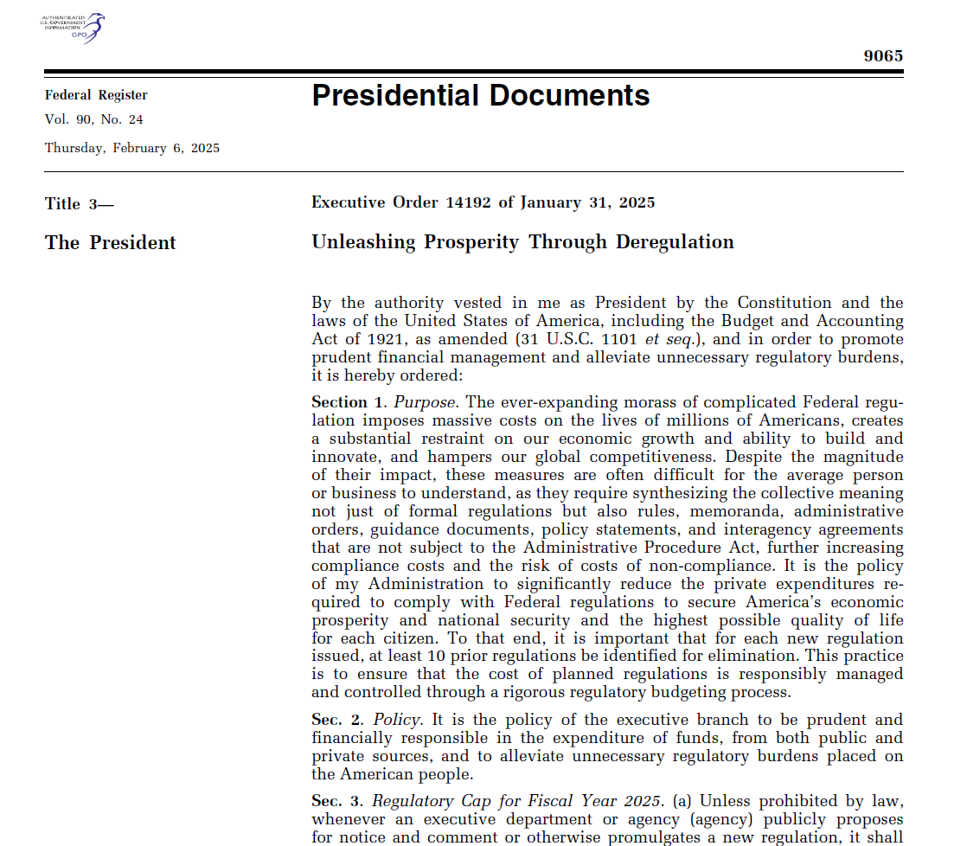
Current Agency Limitations
Executive Order: Unleashing Prosperity Through Deregulation

Slide 36
Current Agency Limitations
Executive Order: Unleashing Prosperity Through Deregulation

Slide 38
Page Dobbs, PhD
Associate Professor of Public Health
University of Arkansas
pdobbs@uark.edu

