Slide 1
Medicaid as a Crucible of Public Goods ASLME 48th Annual Health Law Professors Conference June 2025
Robert I. Field, JD, MPH, PhD
Professor of Law
Professor of Health Management and Policy
Drexel University
3320 Market Street
Philadelphia, PA 19104
rif24@drexel.edu
215-571-4810

Slide 2
Take-Away
Framing Medicaid as a pillar of health, social, and economic wellbeing on which everyone relies
Recognizing Medicaid’s intangible benefits as public goods that the private sector could not provide
Everyone is a Medicaid beneficiary
Re-framing policy debates as a matter of self-interest

Slide 3
Outline
Key Medicaid attributes
Public goods and related concepts
The public goods that Medicaid produces
Implications for policy

Slide 4
Key Medicaid Attributes
Federal-state partnership – companion to CHIP
“Poor stepchild” of Medicare
70-80 million covered, including CHIP
Second largest health insurance program in the U.S. by number of beneficiaries
35% of those under age 19
Expansion over time – key safety valve during pandemic
Covers more than 40% of all births, almost half of all children

Slide 5
Key Medicaid Attributes
Essential financial support for most hospitals and nursing homes
19% of total hospital spending - $283 billion
30% of total nursing home revenue, 62% of all nursing home residents
Flexibility through waivers
Disproportionate share hospital payments (DSH)
Currently under dire threat

Slide 6
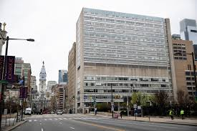
Medicaid Support Example
Hahnemann University Hospital closure - 2019
Insufficient Medicaid reimbursement for for-profit owner
Closure left hospital desert in north Philadelphia
Stress on nearby ERs

Slide 7
Public Goods and Related Concepts
Public goods
Intrinsically nonexclusive and nonrival
No profit potential, so private market could not produce
Common goods
Made nonexclusive or nonrival by external (usually government) action
Quasi-public goods
Some attributes of public goods – nonexclusive or nonrival within limits
Externalities
Costs or benefits to parties that are external to a transaction

Slide 8
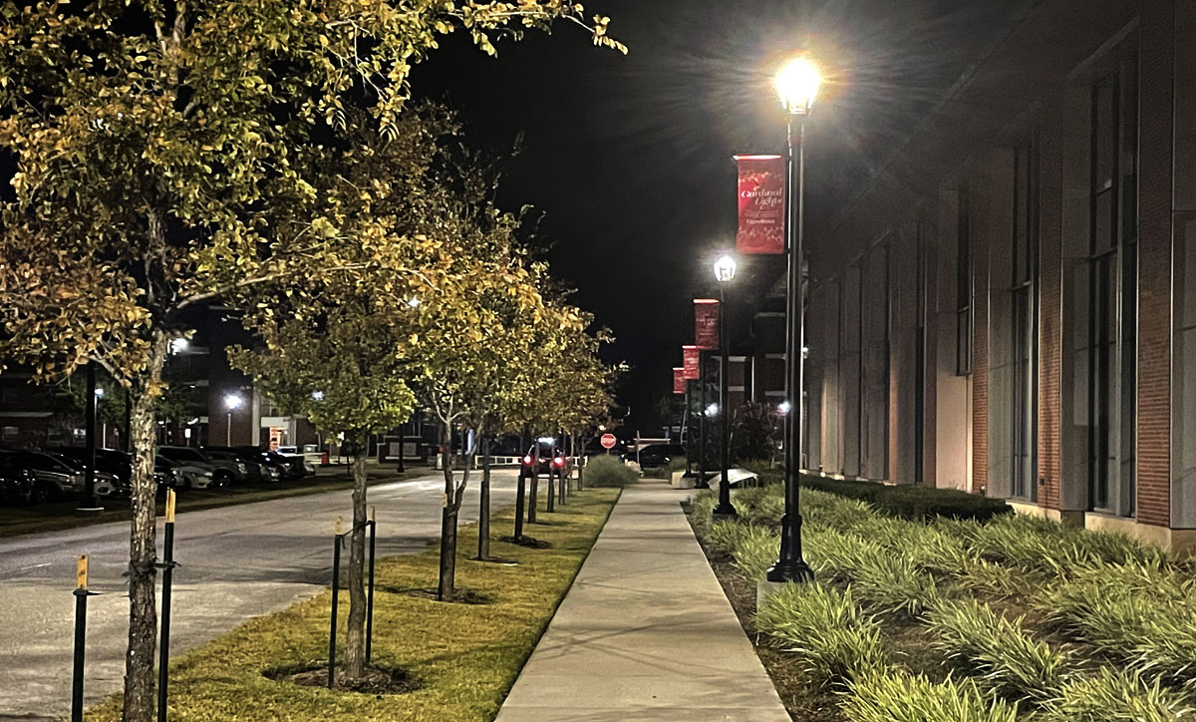
Classic Public Goods Nonexclusive and nonrival

Slide 9
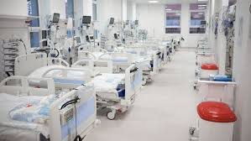
Common Goods Made Nonexclusive or Nonrival
Public Schools
Universal Health Care Coverage

Slide 10
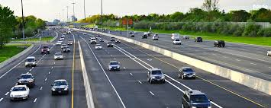
Quasi-Public Goods Nonexclusive or Nonrival Within Limits
Public highways

Slide 11
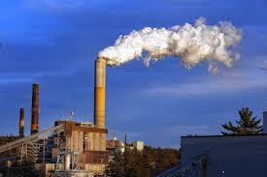
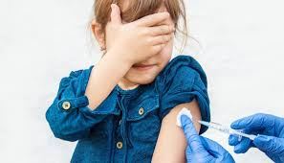
Externalities
Negative – industrial pollution
Positive - vaccination

Slide 12
Medicaid’s Public Goods, Common Goods and Positive Externalities: Health
Health security – community peace-of-mind
Hospital viability – evidence from ACA expansion
Emergency room access - EMTALA
Long-term care - relieves burdens on family caregivers
Pipeline of medical professionals
GME funded in 43 states - $5.58 billion in 2018
Flexibility for experimentation in shaping health care workforce
Long-term sustainability of the health care system
Healthier children
EPSDT – preventive care, early diagnosis
Healthier adults – research on educational and occupational attainment
Reduction in deaths in all age groups

Slide 13
Medicaid’s Public Goods, Common Goods and Positive Externalities: Health
Public health protection
Vaccination, community immunity
Managing chronic diseases
Preventive care
Pandemic response – global effects
Increase in life expectancy – 47.3 years in 1900 to 76.5 years in 1997
Promoting health care innovation
Sec. 1115 and 1915 waivers – prospective payment, HCBS, developmental disabilities
Market for new drugs and treatments

Slide 14
Medicaid’s Public Goods, Common Goods and Positive Externalities: Social and Economic
Mitigating health care and social inequities – increasing social cohesion
Improved health care access in poorer communities
Ameliorating racial and urban-rural disparities
Evidence from utilization before and after enactment and ACA expansion
Waivers to address SDH - housing
Reducing overall poverty
Greater social cohesion
Crime deterrent
More stable families
Enhanced quality of life

Slide 15
Medicaid’s Public Goods, Common Goods and Positive Externalities: Social and Economic
Economic productivity and growth
Healthier workforce – more productive
Hospitals as job creators
$1.1 trillion/year in spending, 5% of GDP
Largest employers in 17 states, especially important in rural areas
Spillover of hospital employment to other sectors
Social burden of illness
Reduction in uninsurance
Saving health care resources that would go a sicker population
Less demand for public health services
Lower premiums for private insurance
National cost of poorer health estimated at $65 billion - $130 billion/year

Slide 16
Medicaid’s Limits
Reimbursement shortfalls
Geographical access limits
Provider fraud and abuse

Slide 17
Conclusion
Medicaid is much more than generosity for the “deserving poor”; it is a pillar of societal and economic wellbeing.
We are all Medicaid beneficiaries, and we will all lose crucial benefits, if it is diminished.

Slide 18
Thank You
Robert I. Field. The Gift That Keeps on Giving: Medicaid as a Crucible of Public Goods. 51 American Journal Of Law & Medicine __ (Winter 2025), https://papers.ssrn.com/sol3/papers.cfm?abstract_id=5198376

