Slide 1
The Harms of Expanding
Physician Assisted Suicide
Katherine Drabiak, JD
Professor
College of Public Health
USF HEALTH
kdrabiak@usf.edu

Slide 2
Objectives
Framing and rebranding
Ethics and the role of physicians
Recent legal expansion
Erasing boundaries and re-making PAS/E
Katherine Drabiak, The Harms of Expanding Physician Assisted Suicide, 35(1) health matrix: journal of law-medicine 1-61 (2025).

Slide 3
Framing
Legal status in the U.S.
U.S. Supreme Court: twice held no Constitutional right to PAS
9 states + D.C. passed laws to permit and regulate the practice
Terminology
Described as Ethical
Control to achieve a peaceful death
State supreme courts: no state constitutional right to PAS
Promotes patient autonomy
Reduces suffering
Upholds dignity
A well controlled practice
Profound differences between patients who seek PAS and those who commit suicide (APHA 2008)
Calling it a suicide is “inappropriate” and “inaccurate” (APHA 2008)
A “planned death” to avoid protracted suffering
Soft, euphemistic terms: medical aid in dying, physician assisted death, death with dignity, end of life choices
“Self-preservation” to avoid being overtaken by illness and unpleasant death – Dr. Timothy Quill
Baxter v. State: physician may use patient’s consent as defense against criminal homicide

Slide 4
PAS Has Been Rebranded
Dictionary definition
Plain meaning
Context
A reminder that assisting a suicide by advising, encouraging, aiding, or abetting a person to end their own life is a crime in most states
Suicide = intentional and voluntary taking of one’s own life
No exceptions for life circumstances, suffering, or proximity to death
Criminal convictions even where the victim was: ill, close to death, pled for assistance
An exception to suicide laws → Not a suicide → Medicalization → A choice, an option, a right
PAS becomes rational and acceptable
Advocacy organizations: compassion, choice, dignity, progress
Overcome public resistance and suicide prevention
This population – the old, the dependent, the disabled, and ill – are different, so the normal law does not apply – Prof. Lucia Silecchia

Slide 5
Applying Ethical Principles
Autonomy for a good death
Safe, effective, meaningful
False binary: already autonomy to choose or reject multiple end of life options
Alleviate suffering
Illness induces physical, psychological, and existential suffering
Burden of illness
People fear imposing economic and emotional burden on others
Caring for a person with serious illness may become burdensome, but the person is not a burden
Dignity
Safeguarding vulnerable populations
Relief from “bad dying”
Peaceful end of life exit
Release valve for desperate patients
People do become a burden when they cannot reciprocate, reasonable to choose PAS – Dr. Brent Kious
Dignity is eroded by pain, deterioration, and reliance on others
Dignity stems from people’s characteristics and abilities
No evidence that PAS has been forced on poor, uneducated, or uninsured – APHA
Negative right (free from interference) → a new positive right (requesting medical assistance to end one’s life) – Prof. Courtney Campbell
Attend to suffering when patients are sick, wounded by illness, alone
Offer compassion and sympathy alongside the patient who suffers
Proper avenue to address suffering is not helping extinguish the person who suffers
People need to be reminded of their value when they are sick, old, impaired by illness – Dr. Daniel Sulmasy
“Undignified” when people can no longer care for themselves or contribute to society
Intrinsic human dignity: all people have worth and due respect – Prof. Jeffrey Brauch
Not lost or conditional based on sickness, debility, and dependence
Human dignity is innate
Categories of vulnerability are narrow and misleading
Vulnerability of illness: relying on others for caregiving, trust in medical profession

Slide 6
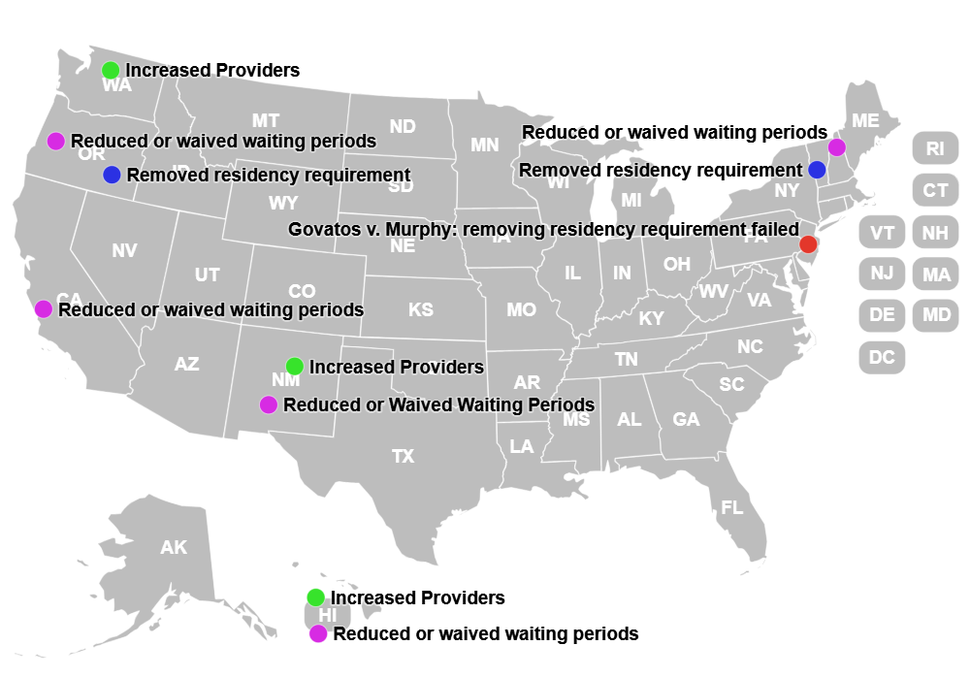
Recent Expansion
Notes:
Increased type of provider: WA, NM, HI
Decreased or waived wait OR, CA, NM, HI
Removed residency requirement: OR, Vermont
Commerce clause: cannot purchase the
privileges and immunities: prevents out of state residents from accessing medical services in state
Residency requirements
Removed residency requirements
Oregon: Gideonse v. Brown → settlement → legislature amended the law
Vermont: Bluestein v. Scott → settlement → legislature amended the law
But…challenge to residency requirement on the merits failed
Govatos v. Murphy in NJ: district court dismissed Plaintiff’s complaint
No state supreme court has concluded that physician-assisted suicide constitutes a fundamental right
“indistinguishable from the criminal act of assisting suicide”

Slide 7
Erasing Boundaries
1
Assistance with administration
2
Reduce capacity requirements
3
Remove or redefine terminal illness
4
Allow for mental illness
Notes:
Parity, equality, and fairness: portray PAS as a benefit
If we allow PAS for terminal patients experiencing, we should extend this to other patients to alleviate their suffering too
Limiting safeguards became barriers to access - Ethicist Daryl Pullman
True fairness and nondiscrimination supports the care for all, but prohibits the intentional termination of life for anyone – Dr. Scott Kim

Slide 8
(1) Assistance with Administration
Neurodegenerative conditions: difficulty swallowing or handling pills
  “Underclass” of terminal patients with neurological illness
  Clinical discussions
    Requiring self-administration is a “barrier to health services” – Shavelson et al. 2023
Shavelson v. Bonta
  Plaintiffs: disability of ALS, requires a “reasonable accommodation” of human assistance with administering lethal drug
  Holding
    No, this would compromise and fundamentally alter the law
    Euthanasia is prohibited
    This would transform [PAS] into “something else entirely” and “[legalize] the killing of others”
Proposals
  Accommodation or assistance with administering lethal drug
  Prior bills (failed) in Maine and Oregon

Slide 9
(2) Reducing Decision-making Capacity Requirements
Current law
Patient must have decision-making capacity
Multiple conditions may undermine decision-making capacity
Dementia, ALS, Parkinson’s, Huntington’s disease
Reduce or change capacity requirements?
Capacity requirements hinder patient autonomy, reflect unfairness, reduce “end-of-life options” for people with decisional impairments
Voluntary, written consent
Progressive, partial, or full loss of decision-making capacity
People with cognitive impairments or intellectual disabilities
Use models of supported decision-making – Prof. Megan Wright
Risks of Modifying the Standard
Not like other treatments, but the purpose is to cause the patient’s death
Well meaning family members may believe the patient is suffering or has a poor quality of life, even if the patient would not make the same evaluation
Burdensome caregiving
Patient’s behavior can be distressing
Psychiatric symptoms
People with dementia just a “husk” of their former self
Patients do not become less of a person or less deserving of care
Proposals
Activate a future advance directive
Bills in HI, CA (failed)
Patients are suggestible to influence
What if patients change their mind?

Slide 10
(3) Remove or Redefine Terminal Illness
Patient “Jessica” –Guadiani et al. 2022
Dr. Guadiani provided lethal prescription, Jessica died from ingestion
Anorexia, OCD, depression
Consuming 100 laxatives per day
On indefinite leave from work
Took action toward suicide: purchased a gun, drove to a bridge to jump
Says she does not want to die, but does not know how live with this pain
Dr. Guadiani assured Jessica and her family further treatment would be futile → nothing more to do
Jessica said PAS was a “blessing” because she could avoid a violent suicide
Why terminal illness
6 months initially meant as a safeguard, but many progressive diseases
Redefining terminal illness
Sidestep terminal illness requirement
Use VSED as a “bridge” to create terminal illness in states that have reduced/waive waiting periods
Creating a new “Terminal Illness” for Anorexia
Anorexia Nervosa is a mental disorder of eating and feeding – American Psychiatric Association
Dr. Jennifer Guadiani counseled patients with anorexia about the option for PAS and provided lethal prescriptions for two patients – Guadiani et al. 2022
Instead, eligibility could be based on suffering →any serious and irreversible disease
CA proposed bill in 2024 to remove terminal illness requirement (failed)
Counsel patients to voluntarily stop eating and drinking for patients with serious, uncurable illness – Pope & Brodoff 2024
But…”incurable” and “irreversible” are not ambiguous terms that can be redefined but related to disease that cannot be reversed – Briscoe & Widera 2024
Multiple problems
Patients with severe and enduring anorexia can and do recover
Patients with anorexia often suffer from co-occurring psychiatric disorders affecting their ability to engage in treatment, retain hope for recovery
Iatrogenic harm of affirming hopelessness
Notes:
Many conditions where patients experience cognitive, psychiatric, or physical decline over many months or years
Jessica’s story

Slide 11
(4) Mental Illness or Unbearable “Suffering”
Calls to expand
Mental illness produces unbearable and intolerable suffering
Problems with expansion
Recognizing patient suffering from mental illness does not equate to an imperative to allow PAS
Suffering from mental illness is just as real as suffering from physical illness
Would provide a “rational, informed method” to “end their life humanely,” because without PAS patients are “coerced into the path of suicide” – Bahji & Delva 2022
Patients can take suffering seriously and treat patients with skill and empathy
Critical differences between physical and mental illness (cause of disease, trajectory, prognosis)
Cultivating and bearing hope for the patient carries a special therapeutic significance for patients with mental illness – Blikshavn et al. 2017
Physicians’ role of trusted fiduciary
Resistance to allowing PAS for mental illness based on “misunderstanding” mental illness and believing it will improve – Prof. Candice Player
Mental illness does not itself undermine a patient’s decision-making capacity
Should not reinforce patient’s distorted thinking
Duty to reject hopelessness and reframe options for patients
Notes:
Netherlands, Luxembourg, Belgium – irremediable or unbearable suffering
Canada – modified law, not yet in effect on the basis of mental suffering
A divide among proponents of PAS and not all believe it should be extended to

Slide 12
Takeaway Points
Proponents used litigation, legislation, and clinical practices to modify or erase principled boundaries
  Changed the purpose of scope of PAS
At an inflection point: expansion is not inevitable
  Parameters of medicine
  Dying well without assisting the patient’s intentional death
Significance of physician involvement
  What’s wrong with it?
    Violates patient trust and vulnerability of illness
    Imprimatur that death is the advisable solution when people suffer, are ill, become disabled by disease
  Another model
    Provide reassurance, comfort, security, assistance

