Slide 1


Too Much Community Benefit? Balancing the Tax Imperative for Community Benefit and Rules Against Inducement
Ellen Farwell ASLME Health Law Professors Conference June 5, 2025
©2024 Roger Williams University. All Rights Reserved.

Slide 2

Agenda
Focus on Social Determinants of Health
Tax-Exempt Hospital Requirements
HHS Programs
Fraud & Abuse Rules
Balancing the Tax Imperative and Inducement Rules

Slide 3
Social Determinants of Health
Conditions in which people are born, grow, live, work and age; access to power, money and resources
Affect a wide range of health, functioning and quality of life outcome and risks
Upstream, structural conditions drive health disparities
Addressing SDH found to be more effective in improving population health and constraining health care spending than improving access to or delivery of health care

Slide 4
Tax-Exempt Hospitals & Community Benefit
Core IRC §501(c)(3) Exemption Standards
Organized and operated for charitable purposes
No inurement for private individuals
No political activity; limited lobbying
Nonprofit Hospitals
History of caring for poor → charitable
Development of private insurance, fee-for-service model, for-profit hospitals → questions about charitable purposes

Slide 5
Tax-Exempt Hospitals & Community Benefit
Revenue Ruling 69-545
“Community Benefit” standard
Possibility of little or no charity care
Promotion of health through benefit to “community as a whole”
Use of excess funds to improve quality of care within facility
Improving clinical care of individual patients
Enhancing and enlarging facilities
Bolstering medical education and research

Slide 6
Tax-Exempt Hospitals & Community Benefit
IRS Form 990, Schedule H
Intended to “combat lack of transparency”
Reporting of community benefit activities including “community health improvement services”
And, reporting of “community building activities”
Housing
Economic development
Environmental improvements
Leadership training & coalition building
Workforce development

Slide 7
Tax-Exempt Hospitals & Community Benefit
IRC Section 501(r)
Financial assistance and limits on collection activities
Community health needs assessment
Indication that hospitals should be working outside facilities to address underlying, structural causes of poor health
Needs may include “the need to address financial and other barriers to accessing care, to prevent illness, to ensure adequate nutrition, or to address social, behavioral, and environmental factors that influence health in the community”

Slide 8
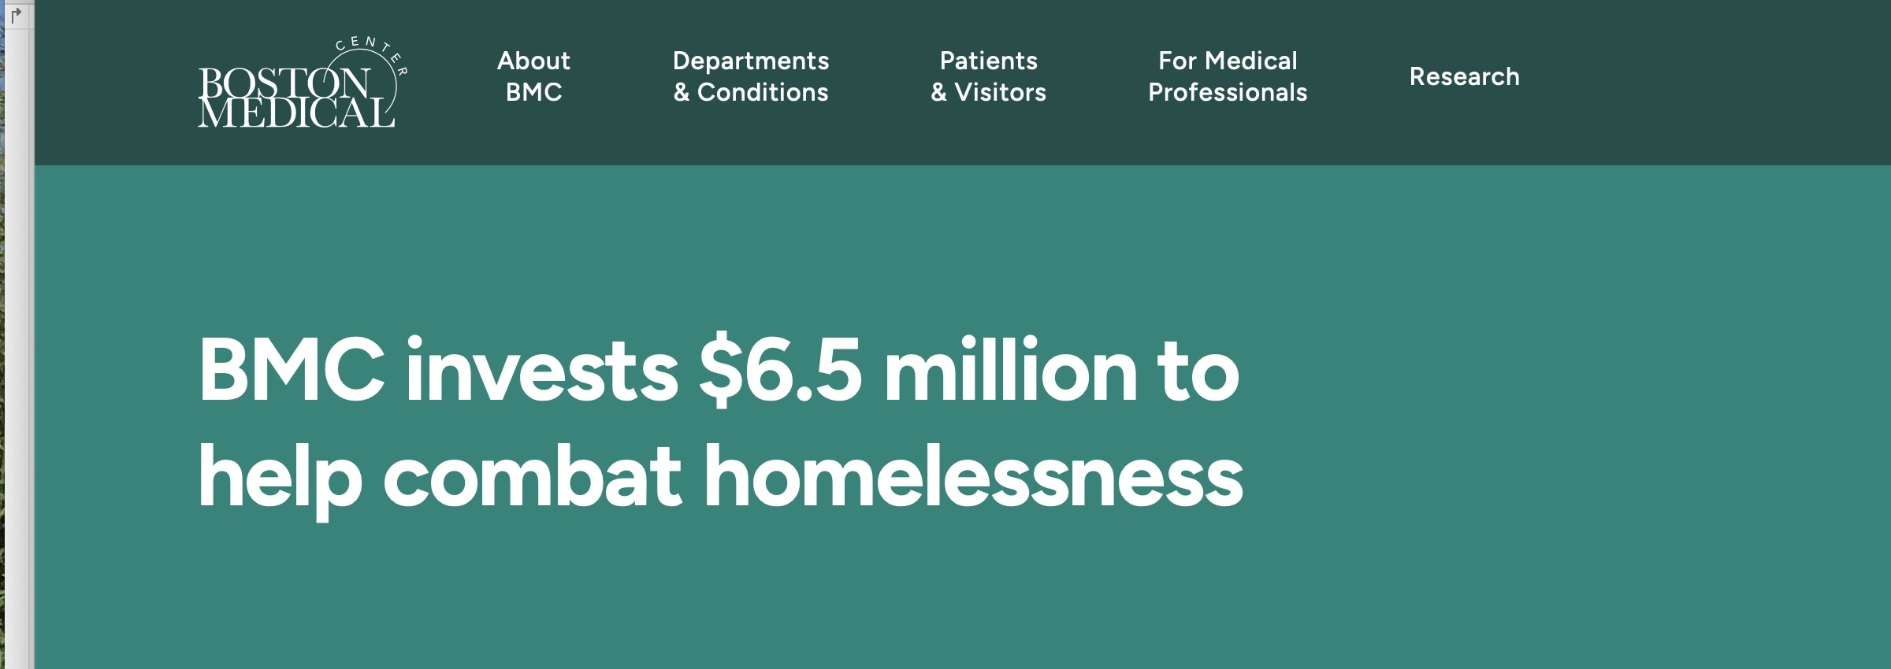



Tax-Exempt Hospitals & Community Benefit

Slide 9
SDH Outside the IRS
Medicare Shared Savings Program
Hospital Readmission Reduction Program
Medicare Advantage Supplemental Benefits
SDH Screening Code & Patient Navigation in PFS
Medicaid Managed Care & Section 1115 Waivers

Slide 10
Civil Monetary Penalties Law & SDH
Beneficiary Inducement Prohibition
Penalty for offering remuneration to federal health program beneficiaries when offeror knows offer is likely to influence beneficiary’s selection of provider
Exceptions for:
Beneficiaries with proven financial need
Promoting delivery of preventative care
Promoting access to care
De minimus goods (but not cash or equivalents)

Slide 11
Anti-Kickback Statute & SDH
Anti-Kickback Statute
Prohibits knowingly offering, paying, or receiving remuneration to induce referrals for goods or services payable by federal health programs
No de minimus, preventative care, access to care exceptions
Examples of Recent Safe Harbors & Exceptions
Safe Harbor for Patient Engagement and Support to Improve Quality, Health Outcomes & Efficiency
FQHC Ability to Distribute Gift Cards during COVID-19 emergency

Slide 12
Next Steps
How does IRS suggestion that hospitals devote resources to underlying structural conditions relate to HHS/OIG focus on individual inducements and SDH exceptions?
Did pandemic era exceptions allow greater flexibility?
What are implications for exemption debate?
How does today’s legal and regulatory uncertainty factor in?

Slide 13
Thank you! efarwell@rwu.edu

