Slide 1
PROTECTING PHYSICIAN’S ABILITY TO PROVIDE MEDICALLY NECESSARY CARE FOR THEIR PATIENTS
Maxwell J. Mehlman
June 6, 2025

Slide 2
Physician Employment Threats
Sham Management Services Organization.

Slide 3
Physician Employment Threats
Sham Management Services Organization.
Stock transfer restriction agreement.

Slide 4
Physician Employment Threats
Sham Management Services Organization.
Stock transfer restriction agreement.
Termination without cause.

Slide 5
Physician Employment Threats
Sham Management Services Organization.
Stock transfer restriction agreement.
Termination without cause.
Non-compete clauses.

Slide 6
State Anti-Retaliation and Anti-Incentive Laws

Slide 7
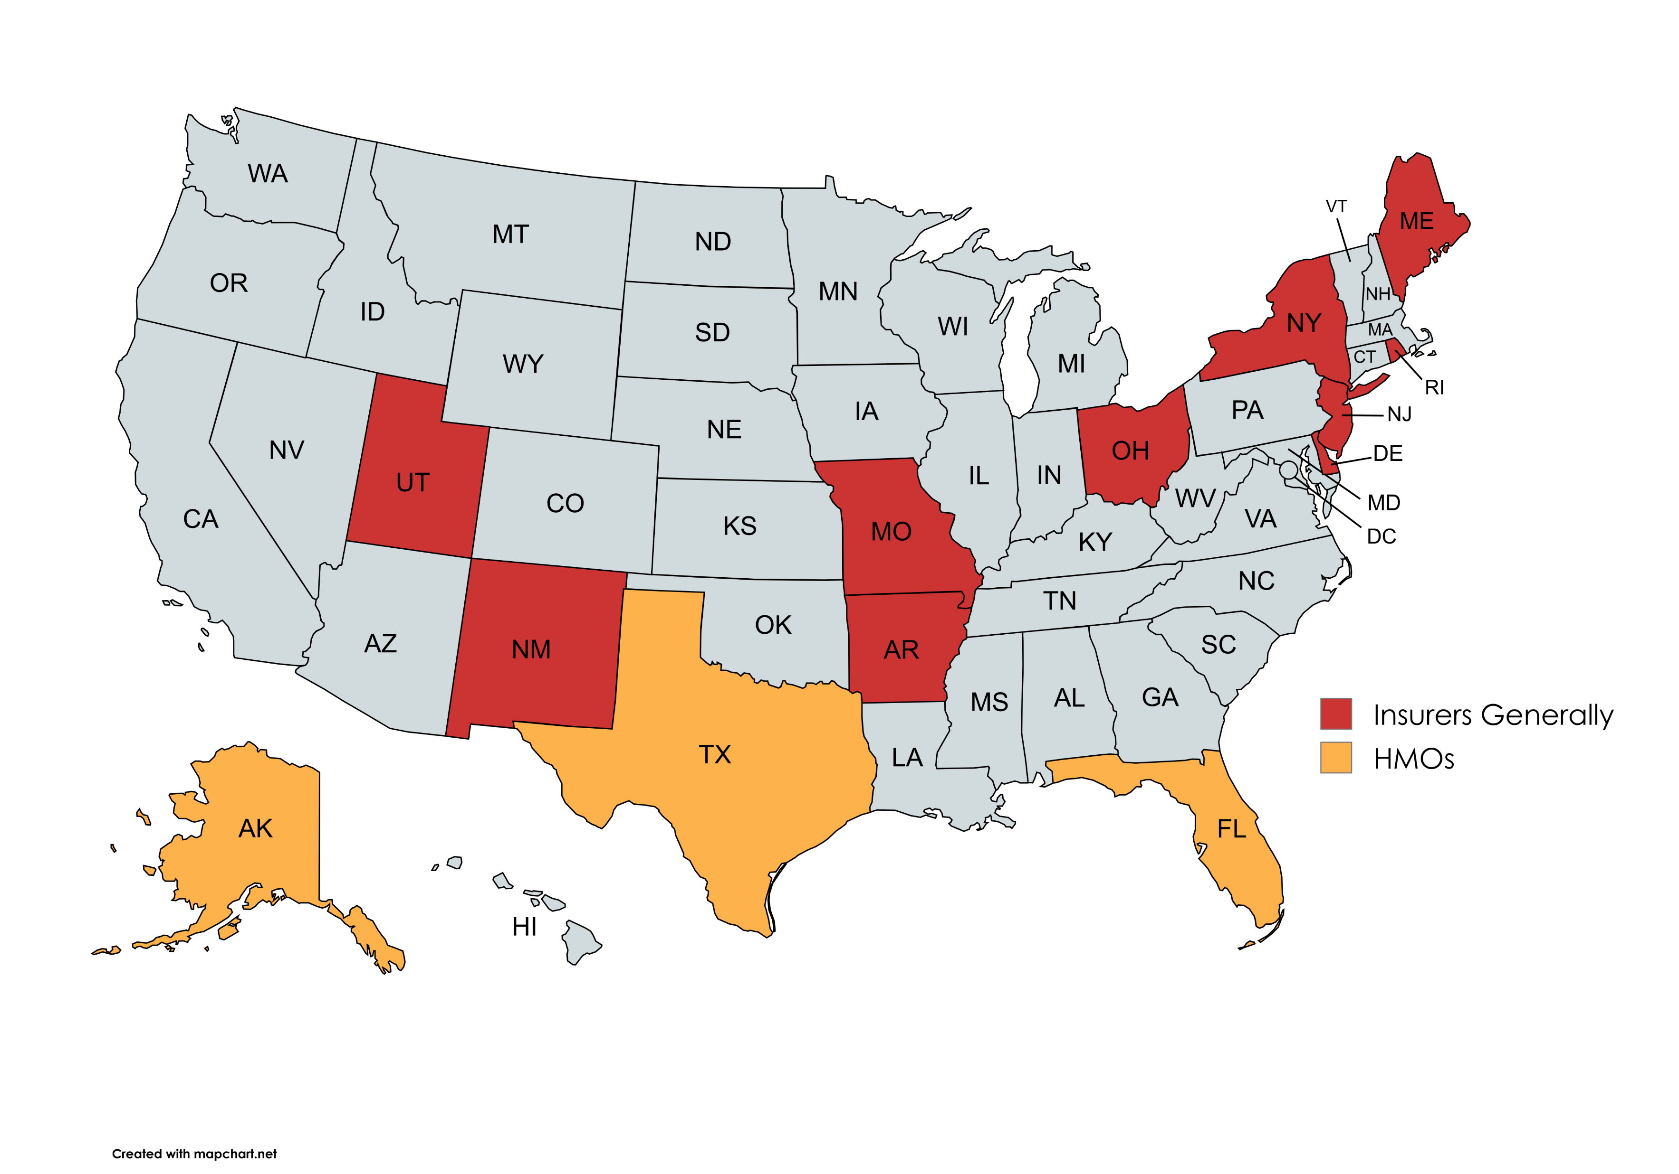
State Prohibitions on Termination of Physicians without Cause by Health Insurers

Slide 8
Maine Rev. Stat. Ann. Tit. 24-A, 4303 (1964)
“A carrier offering or renewing a managed care plan may not terminate or nonrenew a contract with a participating provider unless the carrier provides the provider with a written explanation prior to the termination or nonrenewal of the reasons for the proposed contract termination or nonrenewal and provides an opportunity for a review or hearing in accordance with this subsection.”

Slide 9
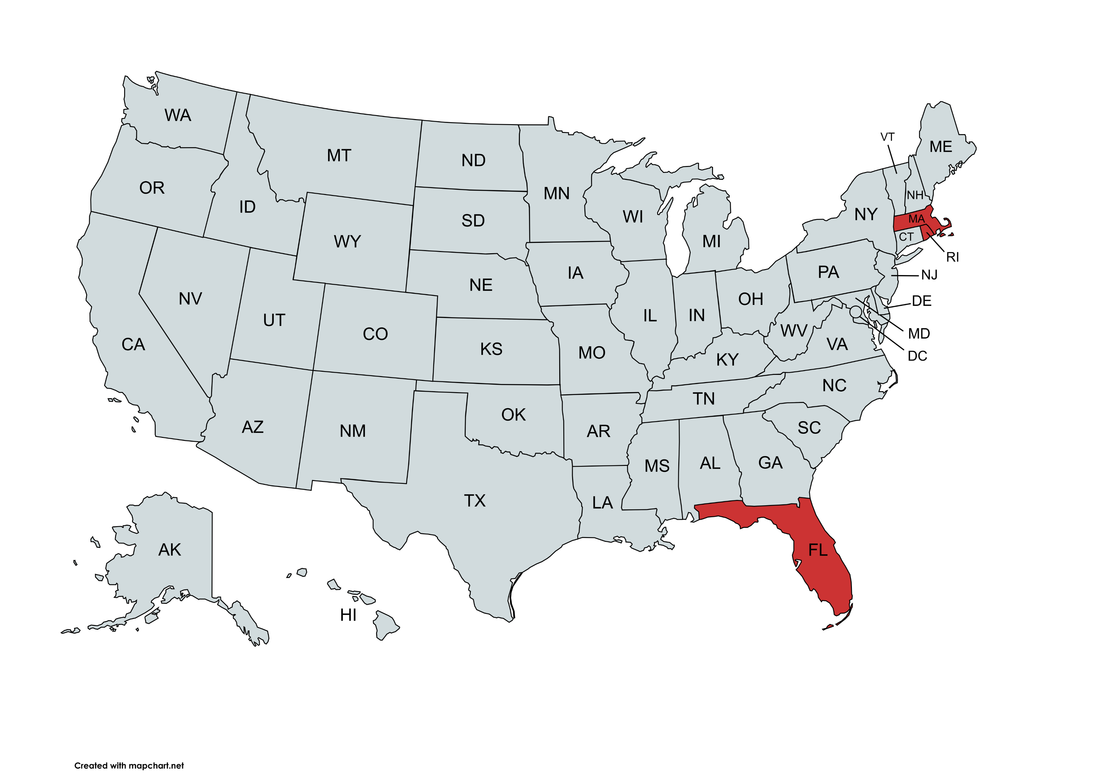
State Prohibitions on Termination of Physicians without Cause by Employers

Slide 10
Mass. Gen. Laws Ann. Ch. 176B, 7 (West 1998)
“No such agreement may be terminated by a medical service corporation unless such corporation shall first have given the participating physician or other provider of health services a written statement of the charges against him or her, an opportunity for hearing, reasonable notice of the time and place of hearing, and a written decision accompanied by a statement of the reasons for the decision.”

Slide 11
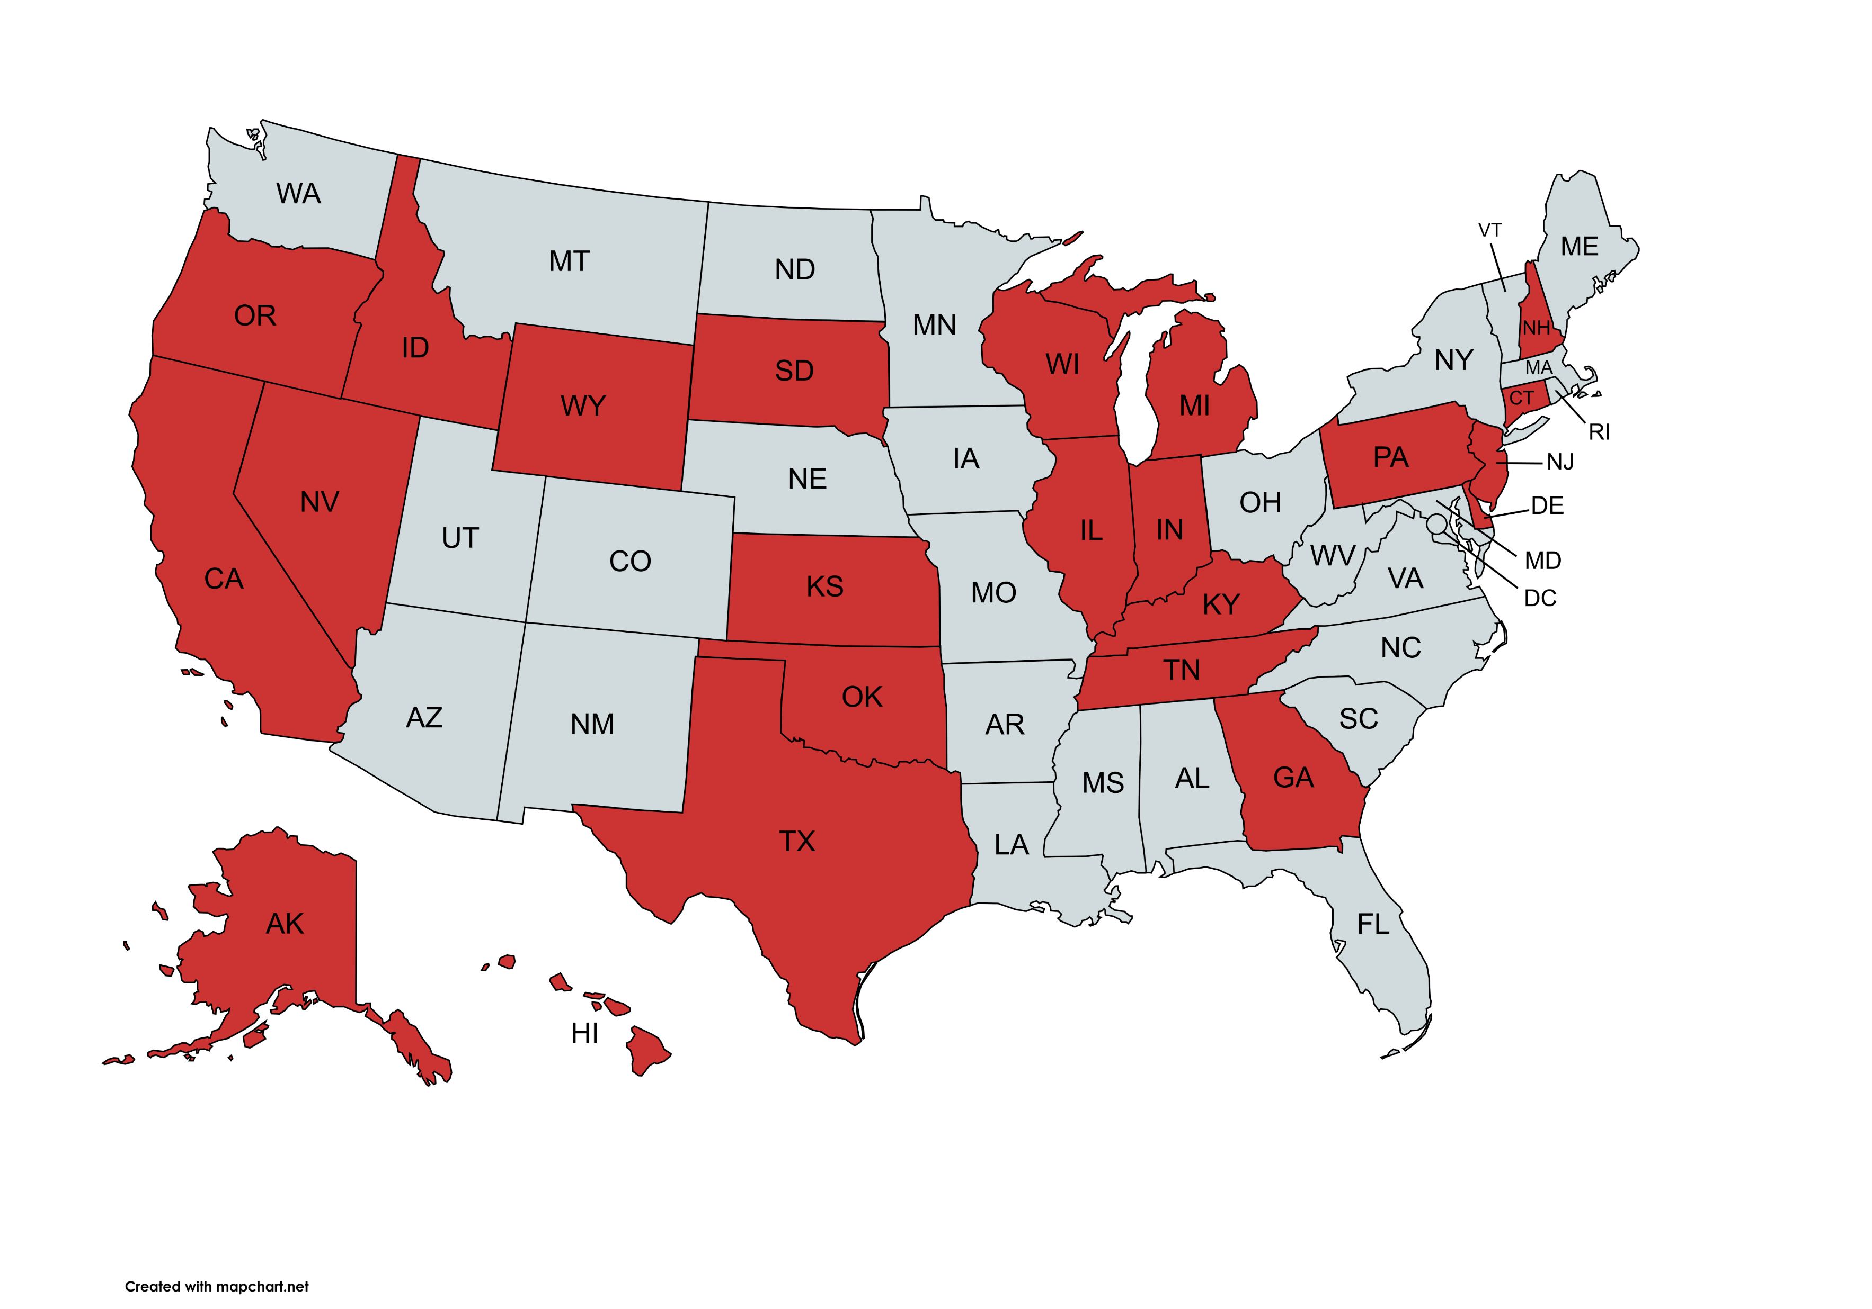
State Prohibitions on Penalizing Physicians for Patient Advocacy

Slide 12
Alaska Statutes Title 21. Insurance § 21.07.010. Patient and health care provider protection
“(a) A contract between a participating health care provider and a health care insurer must contain a provision that …
  (5) states that a health care provider may not be penalized or the health care provider's contract terminated by the health care insurer because the health care provider acts as an advocate for a covered person in seeking appropriate, medically necessary medical care services;
  (6) protects the ability of a health care provider to communicate openly with a covered person about all appropriate diagnostic testing and treatment options ….”

Slide 13
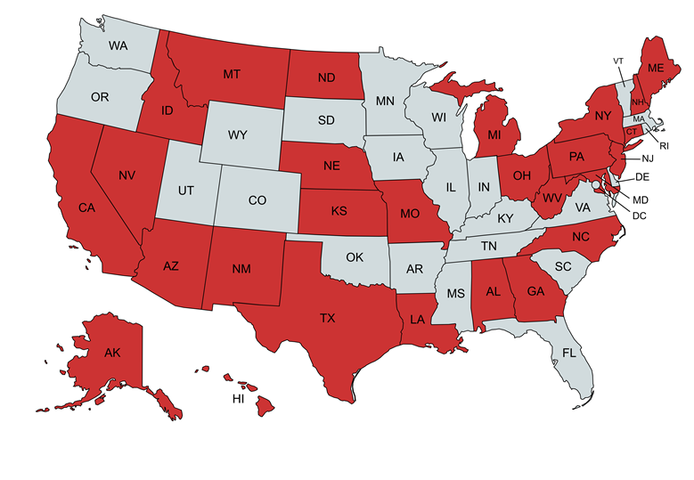

Slide 14
Ohio Rev. Code Ann. §1751.13
        “No health insuring corporation contract with a provider or health care facility shall contain any of the following:
          (a) A provision that directly or indirectly offers an inducement to the provider or health care facility to reduce or limit medically necessary health care services to a covered enrollee ….”

Slide 15
Get all states to enact anti-retaliation, anti-termination-without-cause, anti-gag clause, and anti-binding-arbitration laws.
Apply these laws to employers as well as insurers.
Enhance state enforcement of these laws.
Get all states to require anti-retaliation settlements to be made public.
Get all states to enact anti-inducement laws.
Enhance state enforcement of these laws.
Get all states to enact anti-disincentive (as well as anti-inducement) laws with adequate enforcement.
Simplify prior authorization.
Get all states to enact Minnesota law requiring external reviewers to determine if authorization request is medically necessary.

Slide 16
Hold insurers legally responsible for erroneous denials.
Gold cards?
Make CPT Code 99080 reimbursable.
Enforce corporate-practice-of-medicine rules.
Restrict private equity owners from eviscerating hospitals they own.
Prohibit “friendly physician” –model of practice ownership.
Restore medical staff control over the quality of hospital care.
Unions.

Slide 17
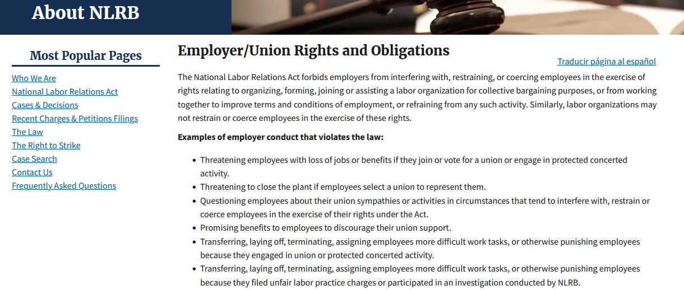

Slide 18
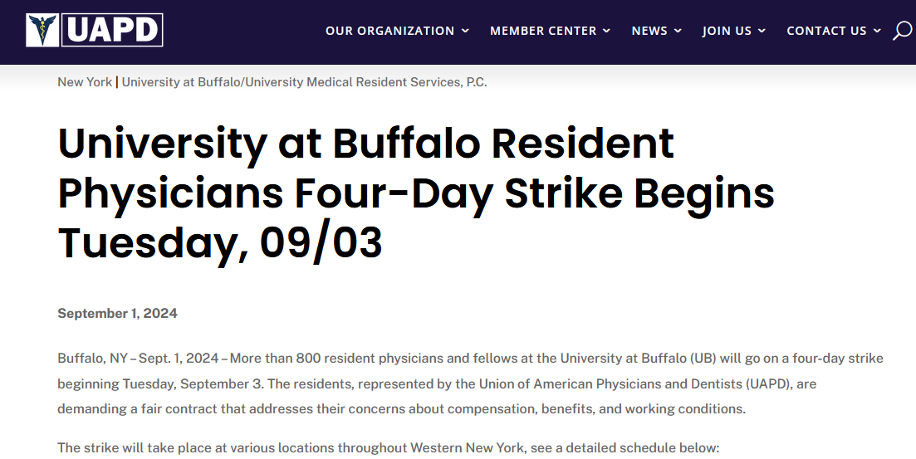

Slide 19
“The parties agree that Unit 16 employees shall not practice, nor shall they be required to practice, in any manner which places their professional license(s) in jeopardy.”
-- UAPG Agreement 12.6

Slide 20
