Slide 1
Same Service, Same Price:
A New Angle for
Hospital Rate Regulation in the
Commercial Market
Christine H. Monahan, J.D.
Assistant Research Professor

Slide 2
The Problem
Same Service, Same Price: A Fresh Opportunity for Hospital Rate Regulation in the Commercial Market

Slide 3
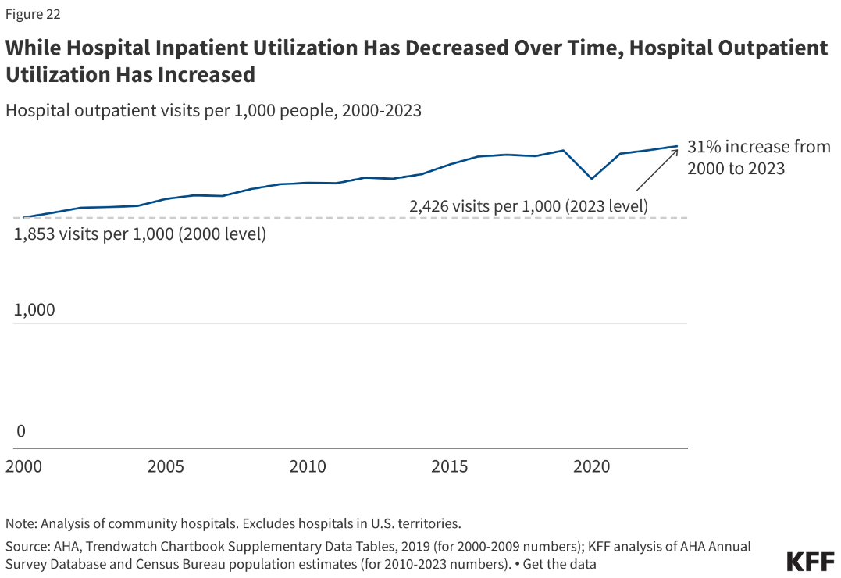
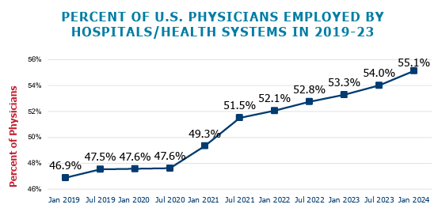
The Rise of Hospital Outpatient Care
Two shifts in care are bringing more people to hospital outpatient departments (HOPDs):
  Inpatient ⇒ outpatient settings
  Independent doctor offices/clinics ⇒ hospital-owned practices

Slide 4
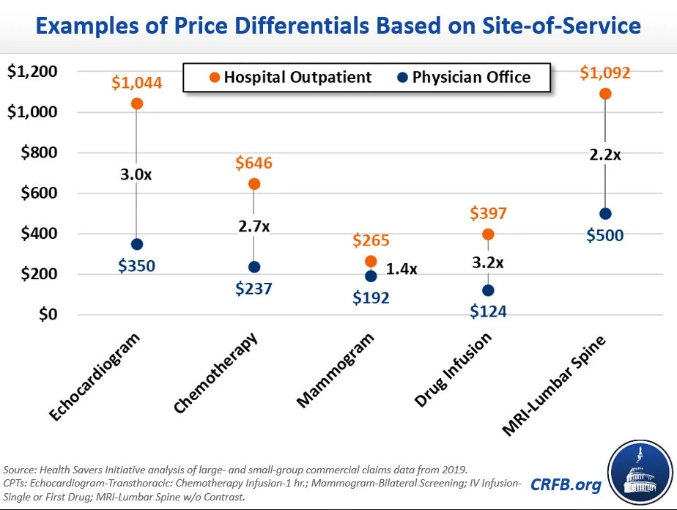
Site-of-Service Differentials
HOPDs/hospital-affiliated providers are more expensive than independent physician offices for the same service

Slide 5
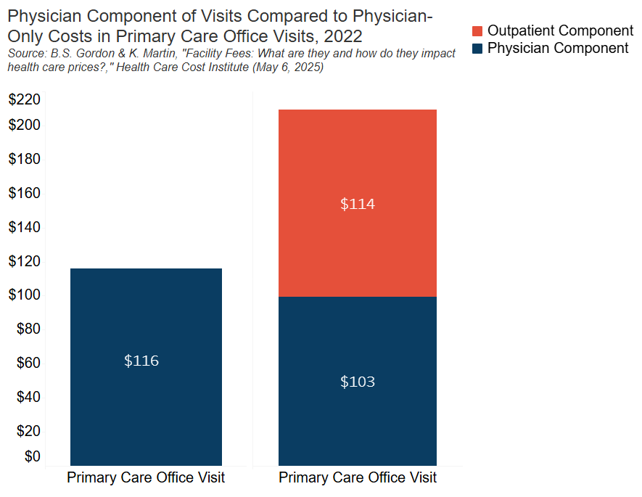
Factors Behind Site-of-Service
Differentials
Split billing:
  Professional bill
    Doctor’s time/labor
  Facility bill
    Hospital overhead
Hospital market power

Slide 6

Direct Consequences
More vertical integration
Greater total spending
Heightened consumer out-of-pocket exposure
Consumer surprise
Potential access problems

Slide 7

Additional Context
Providers have many reasons to vertically integrate
Private payers lack negotiating power, incentives, and relevant information
Hospitals have an information monopoly
Hospital circumstances vary

Slide 8
Current Solutions
Same Service, Same Price: A Fresh Opportunity for Hospital Rate Regulation in the Commercial Market

Slide 9
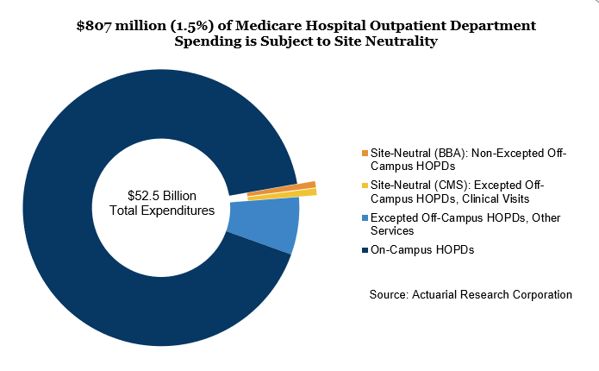
Medicare Site-Neutral Payment Reform
Through congressional and agency action, Medicare has eliminated the site-of-service differential for small portion of HOPD spending
MedPAC recommendation:
  Site-neutral payments for all outpatient services that can be safely and effectively provided in an independent setting

Slide 10
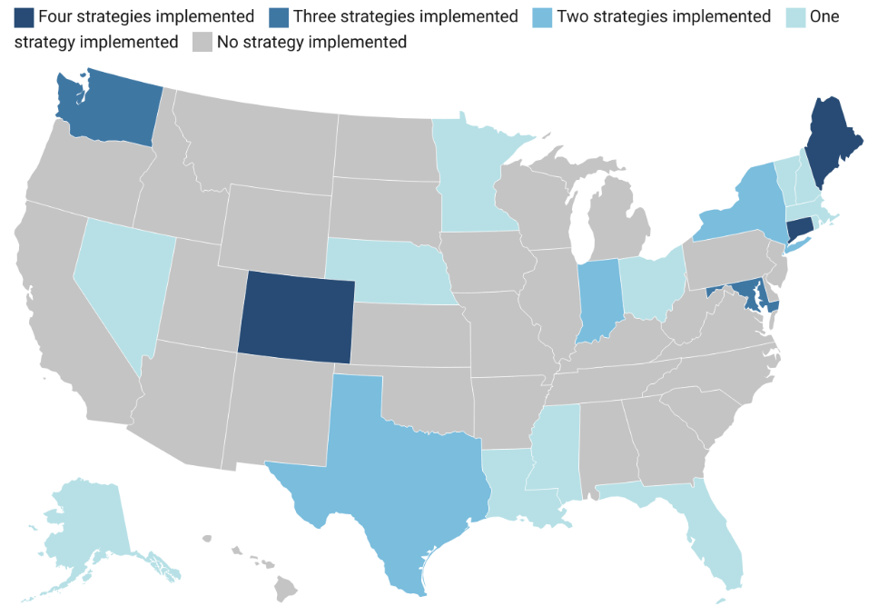
Commercial Facility Fee Reforms
States have enacted a variety of reforms
  Consumer notification requirements
  Cost-sharing protections
  Public reporting requirements/studies
  Billing transparency
  Facility fee billing bans
Federal proposals draw on state action but none have been enacted yet

Slide 11
Next HORIZON
Same Service, Same Price: A Fresh Opportunity for Hospital Rate Regulation in the Commercial Market

Slide 12
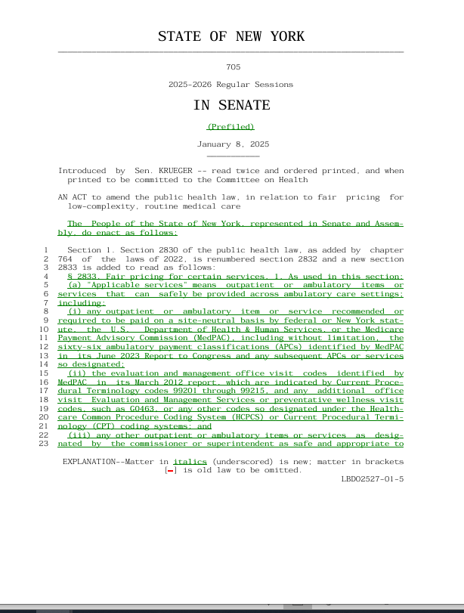
Recent Commercial Site Neutral Proposals
Direct Provider Regulation
New York Fair Pricing Act (A2140/S705)
Vermont Health Care Payment and Delivery System Reform (S126)
Indirect Insurer-Led Approaches
Arkansas Fair and Transparent Reimbursement Rates Act (SB626)
Connecticut Site-Neutral Reimbursements (SB819)
Massachusetts Specialty Medications and Patient Safety (S777)
U.S. Transparent Telehealth Bills Act (HR9457)

Slide 13
Issue Area 1: Providers, Payers, or Both?
Providers
Payers
Hospitals/facilities
  On-/off-campus vs. off-campus only
  Possible exclusions
Physicians/clinicians
State employee health plans
Qualified health plans
Fully insured market
TPAs/self-funded plans (?)

Slide 14
Issue Area 2: Scope of Services
Evaluation & management services
Preventive services
Telehealth
Services safely provided outside hospitals
Scope
Broad or narrow range of services?
Process
Who defines the list?
How is it updated?

Slide 15
Issue Area 3: Payment Limits
Form
Cap, payment level, or corridor?
Level
Benchmark or fee schedule?
  Medicare or commercial rates?
Payment amount
Base rate
Growth rate
Hospital-level adjustments (?)
Base rate
Growth rate
Floor or adjustments

Slide 16
Issue Area 4: Administration
Decision-making body
Agency or independent commission
Funding
Staffing
Decision-making procedures
Flexibility to make modifications
Oversight and enforcement
Reporting requirements/metrics
Penalties
  Noncompliance
  Overseer accountability

Slide 17

Issue Area 5: Other Considerations
Interaction with other payment reforms
Broader rate regulation initiatives
Alternative payment models
Unintended consequences
Volume/utilization effects?
Cross-state effects?
Cross-subsidized services?
Legal challenges

Slide 18
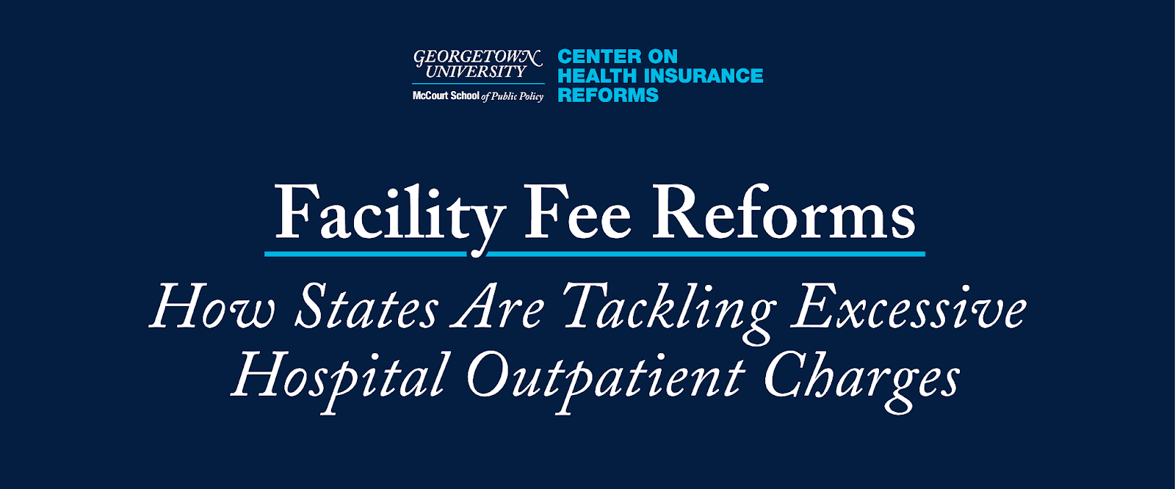


Connect for More…
Ju Christine H. Monahan Assistant Research Professor chm49@georgetown.edu 202.492.9798 Connect with me on LinkedIn! | June 17, 2025, 8:30-10:00 am Georgetown University Capitol Campus Learn more and register here

