Slide 1
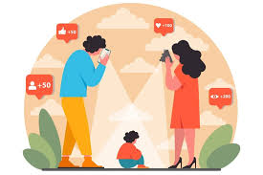
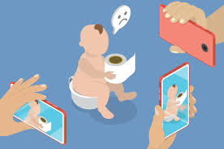
Sharenting: Influencer Parents and a Child’s Right to Privacy
Allison M. Whelan
Assistant Professor
Center for Law, Health & Society
Georgia State University College of Law
*The views expressed in this presentation are those of the author and do not represent the views of any past, current, or future employer.

Slide 2
https://youtube.com/shorts/Sci3KBVfid0?si=fGWrTuA5cSxj2xOg

Slide 3
https://youtube.com/shorts/no_vzk3_O1w?si=U_LAUsCvah1EVzrP

Slide 4
The Internet, Social Media, and Sharenting
As of February 2025:
An estimated 5.56 billion people between the ages of 16 and 64 use the internet (67.9% of the global population)
An estimated 5.24 billion use social media (63.9 % of the global population
By the end of 2024, internet users spent an average of six hours and thirty-eight minutes online every day.
This translates to about 46 hours per week and 101 days per year.
“By this estimation, a person who lives to be 80 will have spent more than 17 years of their adult life using the internet.”

Slide 5
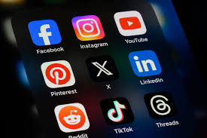
The Internet, Social Media, and Sharenting
Social media = subset of the internet including various platforms where users can create and share user-generated content (photos, videos, text, etc.) as well as engage in conversations and network with others.
First emerged in mid-to-late 1990s with Classmates (1995) and Six Degrees (1997)
Rapid growth in popularity beginning in early 2000s with Friendster (2002), MySpace (2003), Facebook (2004), YouTube (2005), and Twitter (2006).
Today, at least 7 social media platforms have one billion or more monthly active users and at least 16 have at least half a billion or more monthly active users

Slide 6
Sharenting
Sharenting = the practice of parents sharing information about their children online, generally through various social media platforms (TikTok, YouTube, Instagram, Facebook, etc.)
“The habitual use of social media to share news, images, etc., of one’s children” – Collins Dictionary
“What parents do when they talk about their children outside the family circle” – Stacy Steinberg
Talking about one’s children is not new, but sharenting increases its breadth, scope, and audience
Nearly 8 in 10 parents have friends or followers on social media that they have never met

Slide 7
Sharenting: The Scope
According to a 2010 study, 92% of children under two have a “digital footprint,” with images posted of them online.
Average age of “digital birth” occurs around 6 months of age
1/3 of children have information and photos posted about them within weeks of being born
Over 75% of parents have shared stories, videos, or images of children or step-children on social media, with 80% of these including children’s real names (2021 survey)
~30% of parents never seek their child’s consent to post
Less than 25% always seek child’s consent
32% of teens surveyed reported that their parent or step-parent had shared a story, image, or video on social media after the teen asked them not to

Slide 8
Commercial Sharenting
Nanoinfluencers: Less than 15,000 followers
Microinfluencers: 15,000 to 75,000 followers
Midtier influencers: 75,000 to 250,000 followers
Macroinfluencers: 250,000 to 1 million followers
Megainfluencers and celebrities: Over 1 million followers
Average Influencer Compensation Per Sponsored Post
 | Instagram | TikTok | YouTube | Facebook | Snapchat
Nano | $500– $2,000 | $500– $2,000 | $1,000– $2,500 | $500–$1,500 | $200–$1,000
Micro | $2,000– $8,000 | $2,000– $8,000 | $2,500– $9,000 | $1,500– $6,000 | $1,000–$5,000
Mid-tier | $8,000– $20,000 | $8,000– $20,000 | $9,000– $25,000 | $6,000– $15,000 | $5,000– $20,000
Macro | $20,000– $45,000 | $20,000– $45,000 | $25,000– $49,000 | $15,000– $40,000 | $20,000– $35,000
Mega/Celebrity | $45,000+ | $45,000+ | $49,000+ | $40,000+ | $35,000+

Slide 9
Why Sharent?
Stay in touch with loved ones/keep loved ones informed
Social validation
Social connection
Preserve memories
Share/celebrate milestones and accomplishments
Educate/raise awareness about raising children with physical or mental health conditions
Discipline child (through “public” shaming, embarrassment)
Generate income

Slide 10
Sharenting Health Information
Parents of children with physical or mental health conditions use social media for many reasons:
Advice/resources/information
Informal support group
Commiserate/vent about frustrations and hardships
Raise awareness
Raise money
Motivate/encourage the child
“Sharenting serves as an outlet for parents to express their true feelings on the realities of raising children, particularly the hardships brought on by raising children with chronic mental health or developmental needs. By sharing these stories, parents build supportive communities of similarly situated parents and advocate for greater awareness and education around the raising of children with mental and developmental needs”

Slide 11
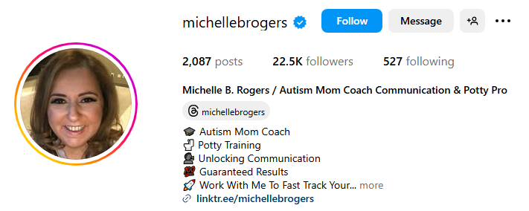
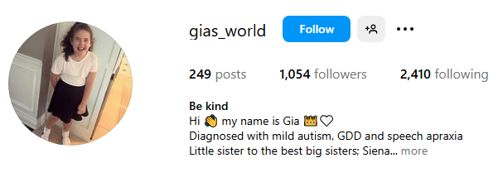
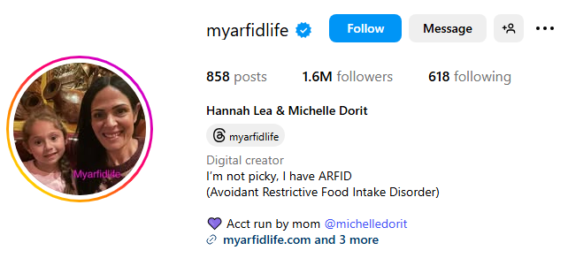
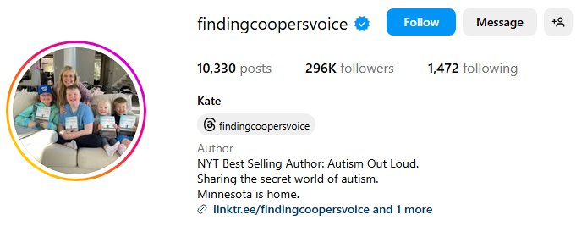
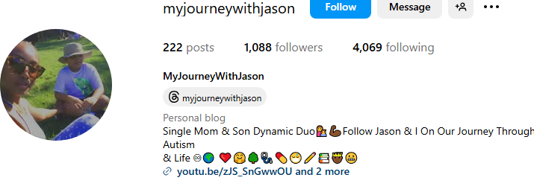
Sharenting Health Information

Slide 12
Risks of Sharenting Health Information
Stigma
Bullying/Harassment
Discrimination
Exploitation & Resentment
Privacy invasion
Autonomy (Self-determination, Open Future)
Additional or new mental health problems

Slide 13
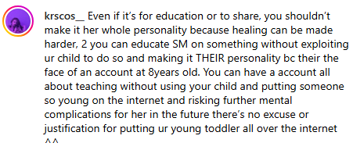

Slide 14
“She gives [her followers] so much more attention then me. She goes off on my dad about how much closer I am with him than her, but I asked to watch a movie with her and she declines. Her reasoning is always that she has a livestream later shes [sic] hosting, or a video to film, or her followers are live. Shes [sic] turned me down so many times I stopped even trying to hangout with her, since if i do get her around shes [sic] on her phone. One time I asked for her opinion and she snapped that she was tired from her job, and that she needed time to post. She livestreams so much that I sometimes have to skip meals because she cant have the background noise and she livestreams in the middle of the kitchen.”
“I didn’t have a single private moment. My mom woke me up with the camera on, and she often filmed right until we went to sleep.”
“I didn’t consent to my entire life being online forever.”
“The most attention she's given me recently was recorded, I was in a dance class and the only time she looked at me was when she was recording what I was doing. The instructor praised me to them for my work multiple times and she didn't even notice, I checked and she was watching a livestream.”
“Any money you get will be greatly overshadowed by years of suffering. . . your child will never be normal. . . I never consented to being online.”
“I had no privacy growing up, absolutely no privacy”
“They didn’t let my older sister go to college right away when she wanted to because her own channel was starting to pick up.”
“They blew through the money on drinking, drugs and vacations they went on without us. I barely have a relationship with my parents because I can't forgive them for taking my privacy away from me.”
“That’s not fair that I have to support everyone . . . . I try not to be resentful but I kind of [am].”
“[N]othing [my parents] do now is going to take back the years of work I had to put in.”

Slide 15
Protecting Children Online: The Legal Landscape
Federal
Children’s Online Privacy Protection Act (COPPA)
Kids Online Safety Act (KOSA)
Kids Off Social Media Act (KOSM)
State
“Mini-COPPA”, “Mini-KOSA”, and “Mini KOSM” (enacted and proposed)
Laws that address $$ earned by minors in entertainment industry
Coogan Laws (enacted and proposed)
“Coogan+” Laws (enacted and proposed)
Deletion/Erasure laws (“right to be forgotten) (enacted and proposed)
Foreign
EU: General Data Protection Regulation (GDPR)
France: Children’s Image Rights Law
Italy – Declaration & Earnings Law
International
UN Convention on the Rights of the Child (CRC)
US has signed but not ratified

Slide 16
Additional Existing Legal Frameworks (?)
Child Welfare
Child Labor
Child Trafficking
Tort law

Slide 17
New Framework: Relationship of Trust + Presumption of Privacy
HIPAA as model
HIPAA applies to “covered entities” and “business associates” that perform services involving protected health information (PHI)
PHI = individually identifiable health information transmitted or maintained in any form
Individually identifiable health information is a subset of health information, including demographic information collected from an individual, and:
(1) Is created or received by a health care provider, health plan, employer, or health care clearinghouse; and
(2) Relates to the past, present, or future physical or mental health or condition of an individual; the provision of health care to an individual; or the past, present, or future payment for the provision of health care to an individual; and
(i) That identifies the individual; or
(ii) With respect to which there is a reasonable basis to believe the information can be used to identify the individual.

Slide 18
New Framework: Relationship of Trust + Presumption of Privacy
HIPAA is based on the importance of fostering a “relationship of trust” between patients and providers
Parent/child relationship = relationship of trust
Prior to minor achieving capacity to consent:
Presumption of privacy for individually identifiable health information (w/ definition amended to include IIHI known by a parent, legal guardian, or family member)
Would apply to “vlogs,” defined as “content shared on an online platform,” regardless of whether it is or is not done in exchange for compensation
Any exception or disclosure of IIHI in “vlogs” would require overcoming presumption of privacy -- balancing the value of disclosure against the benefit and critical importance of encouraging a trusting relationship between child and parent vital for child’s healthy development

Slide 19
New Framework: Issues/Remaining Questions
Enforcement?
Free speech?
Parental rights?
Age of consent?
Exceptions?
Scope?
Online sharing only?
Private accounts?
Anonymous accounts?

Slide 20
Thank You! Additional Questions/Comments/Feedback: awhelan@gsu.edu

