Slide 1
The Ties That Bind
Exploring the Legal Complexities of Public Health and Religious Places of Worship
Lynette Martins, LL.B., PGDip., MBE., LL.M.
Jaharis Faculty Fellow
DePaul University College of Law
ASLME Health Law Professors Conference
June 2025

Slide 2
01
Introduction
02
What is the Problem
Agenda Overview
03
How does the law address this
04
Framework
05
Possible solutions
06
Concluding thoughts
07
Questions

Slide 3
Introduction
Therapeutic effect of religious worship attendance
Rise of Christian Nationalism
Majoritarian Religion > Public Health
Why is this the case?
How does the law currently address it?
Is the law adequate? ⟶ No
Liberal democracy is threatened
Why we must reimagine a different public health

Slide 4
“This book explores the courts’ role in [the U.S. COVID] disaster. More specifically, it examines how judicial decisions — especially constitutional law decisions — that privileged a particularly thin and one-sided conception of liberty helped to undermine our response to the pandemic and amplify the forces that tear at our social fabric”
“[I]f a new surge or pandemic arises, officials at all levels of government will have few tools with which to respond. Personal responsibility will be all that we have”
Notes:
The pandemic precipitated a judicial shift favoring religious liberty claims.

Slide 5
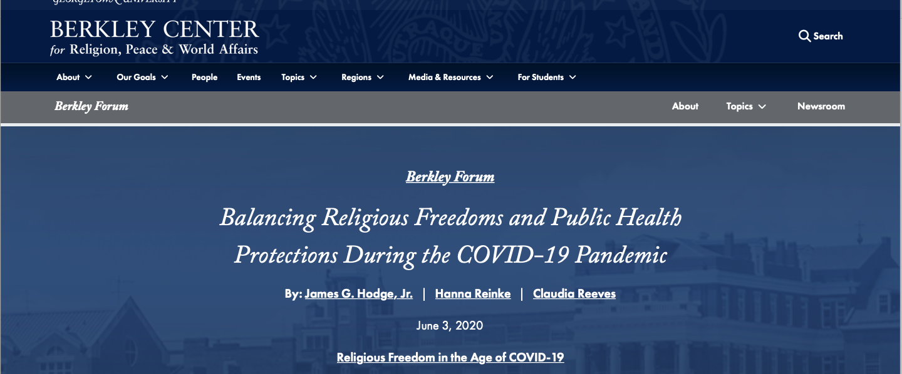

Slide 7
Research Questions
Many places of worship complied others did not
What explains this dichotomy in response?
Legitimate issue
Religious Supremacy and Christian Nationalism
Are we missing an opportunity to engage?

Slide 8
Religious Supremacy
112 lawsuits were successful, predominantly by using religious liberty claims under the First Amendment or the Religious Freedom Restoration Act, or with allegations that an agency or official overstepped the legal authority that a legislature gave them

Slide 9
“Religious supremacy, not religious liberty, is the Roberts Court’s current Trump card.”

Slide 10
However, most faith communities adapted proactively: 94 countries saw religious leaders promote masking, distancing, and virtual services

Slide 11
The CDC’s 2020 guidelines for faith communities emphasized hygiene, ventilation, and outdoor services, which many institutions implemented voluntarily

Slide 12
Tension Between Governor’s Executive Orders and Churches
“To have all of the steps we’ve taken be ignored, and to face the prospect of indefinite unreasonable restrictions placed upon our churches is just not fair!”
“Why are churches being singled out? Why especially are those houses of worship that have been exemplary, strict and successful in heeding all warnings, being shut down again?”
Cardinal Timothy M. Dolan
“The virus feeds on crowds, as we’ve seen in these micro-clusters,” he wrote in an email. “And what the science has demonstrated over and over again these last eight months is that a ‘safe’ large gathering today could turn out to be a super spreader event tomorrow.”
Richard Azzopardi, a senior adviser to the governor, defended the new restrictions.

Slide 13
How Did the Law Respond?

Slide 14
Roman Catholic Diocese v Cuomo
strict scrutiny to New York’s gathering limits, requiring the state to prove that restrictions were narrowly tailored to advance a compelling interest
Courts increasingly rejected the “neutrality” of public health orders, instead comparing religious gatherings to secular activities (e.g., retail stores) to identify unequal treatment
Calvary Chapel v. Sisolak
Nevada limited churches to 50 attendees while allowing casinos 50% capacity, prompting Justice Gorsuch to condemn "obvious discrimination" against religious exercise
South Bay Utd Pentecostal Church v Newsom
whether California Governor Gavin Newsom’s lockdown orders and reopening restrictions under the “Blueprint” framework, placing strict limitations, including closures, on all places of worship in California, violates South Bay’s First Amendment right to free exercise of religion
whether strict scrutiny is the proper standard of review for challenges to state and county restrictions upon free-exercise-of-religion rights during a pandemic, or whether Jacobson v. Massachusetts imposes extra limitations to the Supreme Court’s established line of free-exercise jurisprudence during a pandemic.
Notes:
Roman Catholic Diocese of Brooklyn v. Cuomo, the Supreme Court applied
Calvary Chapel v. Sisolak (2020)
South Bay Utd Pentecostal Church v Newsom

Slide 15
What about State legislatures?
Outside of legal challenges to COVID-19 public health restrictions on religious facilities, at least 25 state legislatures introduced bills limiting or prohibiting emergency restrictions on places of worship in 2020 or 2021.

Slide 16
Post-Pandemic State Legislation
Ohio enacted HB 272 in 2020 prohibiting any public official from closing a place of worship within the state.
Utah enacted SB 195, which requires a health department official to demonstrate that any action to limit the free exercise of religion be the least restrictive means to serve a compelling government interest.
Indiana passed SB 263, which establishes a strict scrutiny standard on health, safety, or occupational codes that substantially burden religious services. It also requires that health, safety, or occupational codes apply equally to religious and non-religious organizations acting in similar capacities.
North Dakota enacted HB 1410, which prohibits emergency orders from the governor to substantially burden a person’s free exercise of religion without showing that it is the least restrictive means necessary to serve a compelling government interest.
North Dakota also enacted SB 2181, which prohibits health officer orders from treating religious conduct more restrictively than “secular conduct of reasonably comparable risk” or “alleged economic need or benefit.”

Slide 17
Conversely, South Korea’s Supreme Court upheld gathering limits after the Shincheonji outbreak, prioritizing containment

Slide 18
Under current precedent, a state law that affects religious activity but was enacted as a neutral measure (i.e., was not enacted with the intention of limiting religious expression) is constitutional. This standard stems from two 1990s era SCOTUS decisions: Employment Div. v. Smith and Church of the Lukumi Babalu Aye, Inc. V. Hialeah.

Slide 19
Should we have a different approach than “mandates”?

Slide 20
Framework
Theories of Responsibilities
Liberal democracy
Communitarian approach
Balancing Competing Interests: Recommendations for Policy
Partnerships between health agencies and congregations can enhance vaccine uptake and disseminate accurate information, as seen in rural communities where churches served as vaccination sites

Slide 21
If yes, what might that new approach look like?

Slide 22
A Different “Power”
Ecclesiastical committees
Engaging with community leaders
Having conversations with each other
Partner with established entities e.g. Baptist Joint Committee for Religious Liberty (BJC)
Notes:
Additionally, courts should defer to epidemiological evidence when assessing the “least restrictive means” under RFRA, ensuring that exemptions do not undermine herd immunity

Slide 23
Religion and Public Health Collaborative Initiatives
At the state level,
California is now exploring how Medicaid funds can help faith communities and ministerial associations address health-related social needs within congregational settings.
And at the local level,
the New York City Department of Health includes faith as a pillar of public health,
while health systems in Memphis, Tennessee and Winston-Salem, North Carolina have pioneered ways to engage faith networks in expanding social support for hospitalized members of local congregations. All of these efforts can increase access to care and reduce health disparities.

Slide 24
Thank You
Lynette Martins
LM1447@Georgetown.edu

