Slide 1
Confronting the Taboo Social Determinant: An Abolitionist Approach to Addressing Health Equity for People Impacted by the Criminal Legal System
Notes:
Good afternoon, it is such a pleasure to be here with all of you. My name is Whitney Cabey, as of July 1, I am an Associate Professor of Emergency Medicine and faculty member within the Center for Health Justice and Bioethics at the Lewis Katz School of Medicine at Temple University. My colleagues and I are here to discuss the health realities of the criminal legal system, which are dire, from a variety of lenses. And we’re also here to propose the use of abolition frameworks and abolition creative imagining in our thinking about how to tackle this incredibly complex systemic injustice. I’m going to essentialize our complex identities for sake of clarity and brevity - we are a doctor, a criminologist, a public health practitioner in anti-violence work with lived experience and a bioethicist. We actually share many of those identities with one another but to make this presentation legible we’ll kind of be speaking from and for those disciplines.

Slide 2
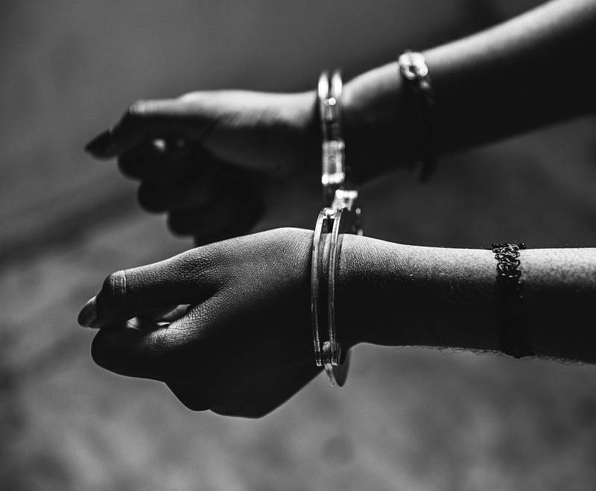
From Health Injustice to Health Liberation: A Call to Action
Whitney V. Cabey, MD, MSHP, MA
Associate Professor
Center for Health Justice and Bioethics
Lewis Katz School of Medicine at Temple University
Notes:
So I’m going to lead off by providing some of the background on why this matters and why we think this matters to the kind of people who would attend a health law conference. Then you’ll hear from my colleagues and we plan to take all questions at the end.

Slide 3
Roadmap
Making the case for mass incarceration as a health crisis
Frameworks for structural change
A case study
Notes:
With my few minutes here’s what I’d like to accomplish

Slide 4
Notes:
Currently ,there are nearly 2 million people confined in a vast array of US institutions including state prisons, local jails, federal prisons, youth facilities, immigration detention, and involuntary psychiatric commitments. Another 3.7 million people are under surveillance in the community.- probation or parole.

Slide 5
Notes:
For anyone who doesn’t know, these are ridiculously high numbers of people being held in captivity. The United States incarcerates more people than any other similarly high income country or independent democracy.

Slide 6
Widra, Prison Policy Initiative, 2024
Notes:
In fact, the per capita rate of incarceration in many states mirrors or outpaces that of countries that are notorious for human rights violations.
I just want to make note of El Salvador at the top of this chart from Prison Policy Initiative. El Salvador has the dubious honor of 1st place status in world incarcerations rates. It is neither accident nor coincidence that the Trump administration is collaborating with the El Salvadorian government to advance its xenophobic aims and it’s also something that we have US states with per capita incarceration rates that are nearly identical to El Salvador. It is a literal takes one to know one situation we have here.

Slide 7
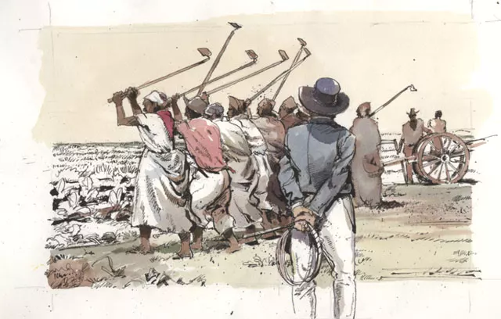
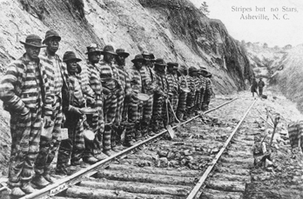
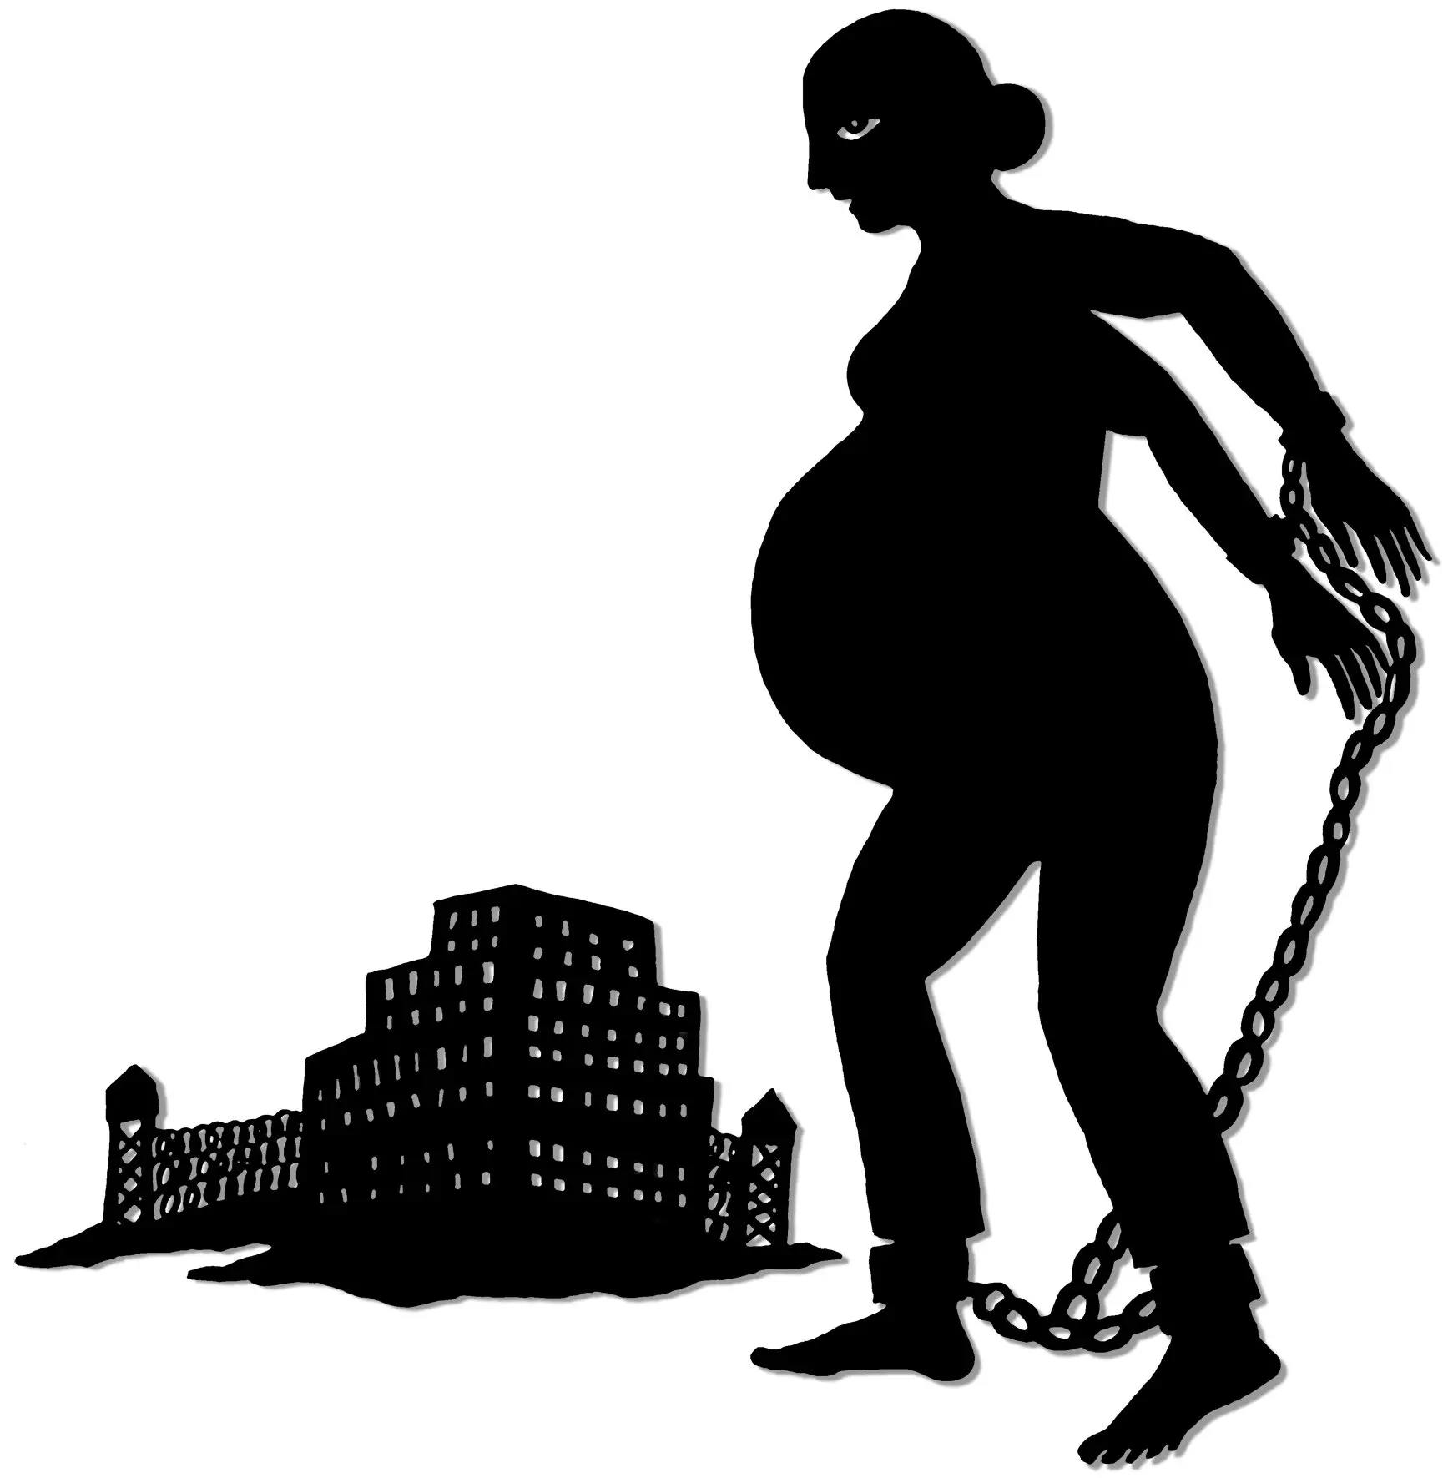
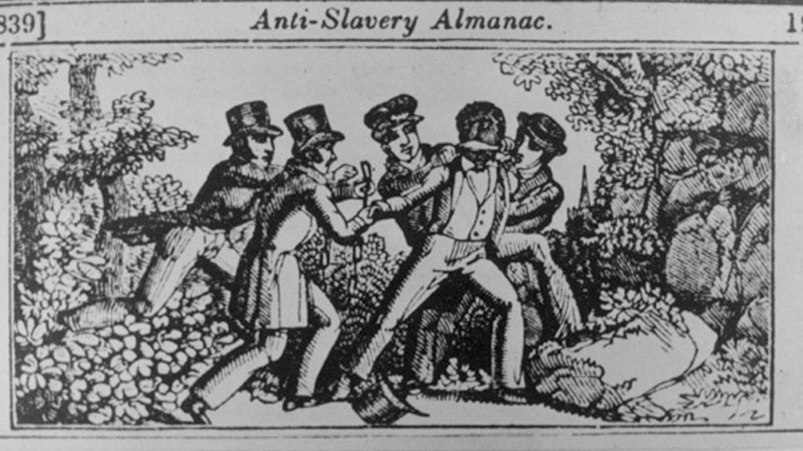
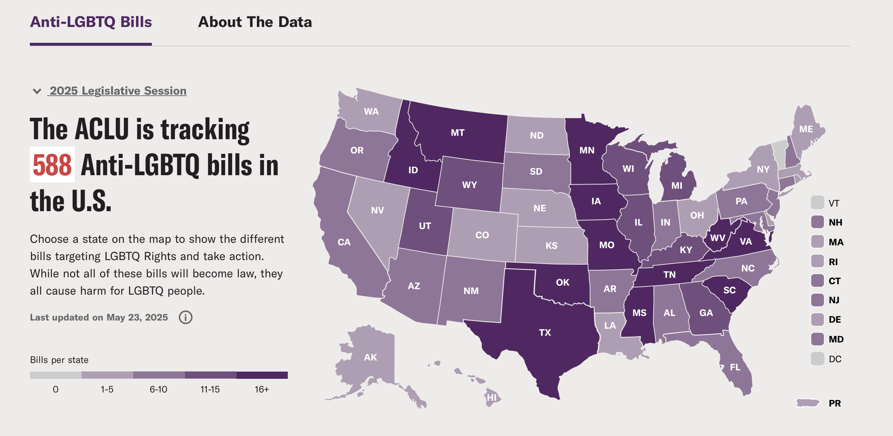
Credits from top left: National Park Service, Ncpedia, Fair.org, Andrea Dezo, ibw21.org, ACLU
Notes:
Note also that the ”top ten” incarcerators in the US are all in the Deep South, they are all former slave states with the exception of South Dakota which is, instead, the site of historic levels of state violence against indigenous people.
From the overseer to the paddyroller, from Jim Crow to the use of militarized police forces during the high of the crack cocaine epidemic,, to super-predators, to family policing and reproductive injustice, to the false conflation of trans-identity with sexual predation, the United States has sustained and successful campaigns of surveillance and state sanctioned control against bodies labeled as deviant. Black, brown, indigenous, sexual minorities, specifically gender non-conforming individuals, people living in poverty, people with behavioral health needs, people who are struggling with substance use disorder – these are the minoritized bodies most at risk of criminal legal system involvement.
Policing has been, and continues to be, a means of social control of these bodies and capitalist extraction from these bodies.

Slide 8
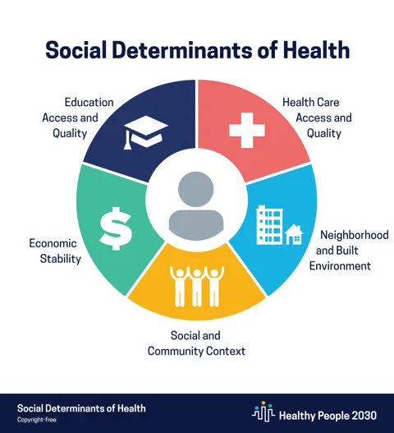
Risk of Incarceration is Related to SDOH
Notes:
Risks of incarceration are tied to social and political determinants of health.
Why is the health of people with criminal legal system involvement so poor? It is multifactorial but one answer is that the criminal legal system targets vulnerable people with high levels of social need.

Slide 9
Risk of Incarceration is Related to SDOH
B. Pettit, B. Sykes, and B. Western, “Technical Report on Revised Population Estimates and NLSY79 Analysis Tables for the Pew Public Safety and Mobility Project” (Harvard University, 2009).
Notes:
Risks of incarceration are tied to social and political determinants of health.
Why is the health of people with criminal legal system involvement so poor? It is multifactorial but one answer is that the criminal legal system targets vulnerable people with high levels of social need.

Slide 10
A history of confinement predicts poor health status and health outcomes
The rate of HIV among prisoners is 5 to 7 times higher than that of the general population.
Notes:
Regardless of location, a history of confinement can be tied to poor health outcomes

Slide 11
A history of confinement predicts poor health status and health outcomes
As the prison population ages, cancer and cardiovascular (CV) disease are leading causes of death for those with CLS involvement.
Incidence and mortality rates are higher than the general population while screening, detection and standard of care treatment adherence are lower.
Notes:
Regardless of location, a history of confinement can be tied to poor health outcomes

Slide 12
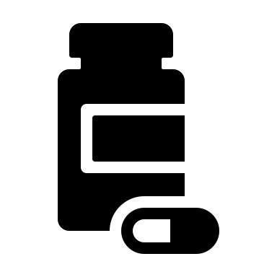
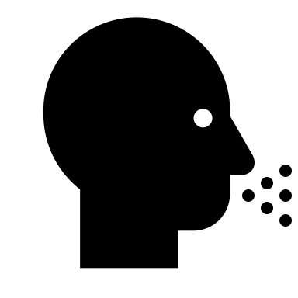
Incarceration is an independent contributor to poor health outcomes
Notes:
Importantly, while it is the case that people enter the carceral system with undiagnosed, undertreated and untreated diseases and higher likelihood of health risk behaviors that contribute to chronic and infectious diseases, this is not the only story or the whole story.
They also develop new diseases, are undertreated for existing disease while incarcerated and have poorer health outcomes after being exposed to the carceral system through a combination of poor carceral healthcare, toxic stress and accelerated aging
Incarceration itself has an independent contribution to poor health outcomes. This is through a combination of barriers to access of any, let alone state of the art care in the underfunded and disjointed carceral healthcare systems, the toxic stress of incarceration and the long term biopsychosocial impacts of incarceration. Dr. Simonsson will discuss some of those psychosocial impacts in more detail, as our next speaker.

Slide 13
Mortality remains high after release
Notes:
The health risks of incarceration continue after release. This 2007 NEJM study painted a disturbing picture of the health effects of incarceration, which do not magically disappear upon release. In fact, when compared to matched controls across Washington State, people with an incarceration history had almost a 13x higher risk of death in the 2 weeks after release. This was driven largely by drug overdose. While this data is older, the landscape of substance use disorder treatment in the criminal legal system remains disjointed and the high risks of relapse, overdose due to decreased tolerance and death are still very present.

Slide 14
Incarceration Increases Barriers to SDOH
Incarceration
Notes:
Incarceration has such a strong, pervasive and outsized negative impact on health, I think one could consider it a macro-determinant. It is certainly one of the most effective mechanisms of gendered and racialized state violence
The impact of this violence is felt not only by individuals but by communities. Almost 50% of people in the US have a loved one who has been touched by the criminal legal system. This is an adverse childhood experience for children, a financial drain on families to the tune of $5billion dollars annually on commissary, phone calls, legal defense. We are draining specific communities of an economic base, social cohesion and overall health status through our collective failure to really draw attention to the impacts of incarceration.

Slide 15
Mass incarceration has shortened the US life expectancy by 5 years.
Notes:
It is a matter of individual justice and liberty but also a public health imperative that we more seriously confront incarceration as a matter of health policy, health law, public health and bioethics. Stated differently, we will not achieve health equity if we fail to place primacy on what it means for people who are currently and previously incarcerated to be healthy and flourish.

Slide 16
Prisoners are among the few groups in the United States with a guaranteed right to healthcare.
Notes:
It doesn’t have to be this way. Prisoners are among the few groups in the United States with a guaranteed right to healthcare.

Slide 17
What does cruel and unusual punishment mean as it pertains to healthcare? The Supreme Court’s 8-1 Ruling in Estelle v. Gamble (1976)
“In order to state a cognizable claim, a prisoner must allege acts or omissions sufficiently harmful to evidence deliberate indifference to serious medical needs.”
“Deliberate indifference” amounts to the "unnecessary and wanton infliction of pain'” proscribed by the Eighth Amendment
States must provide adequate care to people who are incarcerated
Notes:
The Court examined whether the prison medical personnel’s conduct constituted cruel and unusual punishment, constitutionally prohibited under the Eighth Amendment. The Court held that the alleged actions of the prison doctors did not constitute “deliberate indifference” to Gamble’s medical needs. The Court based its decision on claims which revealed that medical personnel saw Gamble on 17 occasions during a 3-month span. In those visits doctors diagnosed his injury as a lower back strain and treated it with bed rest, muscle relaxants, and pain relievers.
The Court held that “in order to state a cognizable claim, a prisoner must allege acts or omissions sufficiently harmful to evidence deliberate indifference to serious medical needs.” It concluded that “deliberate indifference” amounts to the "unnecessary and wanton infliction of pain'” proscribed by the Eighth Amendment.
In response to Gamble’s claim that “more could have been done,” the Court held that the failure to perform an X-ray or to use additional diagnostic techniques did not constitute cruel and unusual punishment, but was, at most, medical malpractice for which state court was the proper forum. It added that “a complaint that a physician [was] . . . negligent in diagnosing or treating a medical condition [did] not become a constitutional violation merely because the victim was a prisoner.” However the Court noted that prisoners "must rely on prison authorities to treat [their] medical needs [and that] if the authorities fail to do so, those needs will not be met."

Slide 18
Healthcare in the criminal legal system is largely inadequate
There is little to no regulation on what constitutes “adequate” care
In many facilities people must pay a co-pay for their care – up to $5
Many inmates ”earn” less than a dollar per hour for their work
A $5 co-pay can be the equivalent of $500 in the free world
Institutional formularies are often out of date, relegating inmates to second or third tier medical management
Coercion, fear of reprisal and fear of appearing “weak”/malingering reduce opportunities for care, especially care outside of the prison system

Slide 19
Notes:
The US carceral system is linked to slavery, our most immoral institution, and our incarceration rates, if not practices, mirror those of oppressive regimes, and incarceration is damaging and extracting from the social fabric of communities most desperately in need of investment, and we have a constitutional basis to advocate for policy change.
Yet, from my vantage point in bioethics we are not giving incarceration the attention it deserves.
Do any of you know this image?
So I think this represents two things- first, that we don’t really have a shared understanding of the deep history of physical, mental and emotional violation that results from incarceration and second, that the framework that we’ve been drawing from for prisoners is mostly about very basic protections against egregious abuse in clinical research. Given what I’ve laid out, I hope it is clear that we need much more than research ethics to guide ethical analysis, policy and research to address health equity for this vulnerable group.

Slide 20
Notes:
Part of what stands in our way of a more robust advocacy for the incarcerated are value judgements, preconceptions and social constructions of criminality. I notice a false narrative circulating at the edges of the discussion around mass incarceration – that the problem would end if we released the non-violent offenders. This is somewhat true at the federal level, which is overrepresented by people serving time under harsh war on drug sentencing guidelines. But the majority of people in state prison are there what are considered violent offenses. Some of this is semantics – you can be sentenced for a violent offense without having actually been the person to pull a trigger, push punch whatever. But a fair number of people are in jail because they did something we collectively pass moral judgement over. Something that caused harm to another person. To embrace the health equity imperative of the criminal legal system means these folks must have access to care and to caring. And I think that is a tough moral and philosophical space that we have not been given tools to navigate. But I’m here to suggest that this is work that bioethics, biomedicine, health law, health policy and public health can and must do.

Slide 21
Notes:
We are socialized to think in a binary way about harm – there is a victim and a perpetrator. The victim should be helped and the perpetrator punished. We are afraid to let go of this model because we’ve been told to do so will make us less safe. But we’ve been operating under the criminal legal system for years and we are not more safe. There are always more prisoners. So if the current system is not protecting us and its extremely damaging to the people it’s supposed to protect us from….aren’t we obligated to change it?
Now is the time to raise the alarm as rates of incarceration are beginning to rise again as we start another cycle of ”law and order” social messaging to justify the transition of what is left the social safety net to the carceral web.

Slide 23
Framework 1: Reform – Improve Healthcare for the Incarcerated
Notes:
Maybe I can’t convince you that there is no place for incarceration but I hope at least I have made a case for healthcare reform in the criminal legal system.
We could make carceral healthcare exemplary
Solidarity – Changing the trajectory of individuals and communities through comprehensive clinical and public health
Agency – Mass incarceration has hamstrung the poorest communities in our country. A healthy start to reintegration is critical for empowerment
Social/Health Justice – rather than collaboration with the prison industrial complex (i.e. the medical industrial complex) we can address some of our complicity with the system through advocacy for the best outcomes for the maximally marginalized.

Slide 24
What could CLS healthcare reform look like?
Federally regulated nationally benchmarked clinical standards of care
Up to date formularies
End privatization of services
Zero barrier access to medication assisted treatment options for opioid use disorder
Highly coordinated carceral to community care transition
Addressing necessary SSDOH - universal basic income, housing, and economic opportunities
Additional research into risks and longitudinal impacts of incarceration
Shunt funding from community supervision to behavioral and medical care
A trauma informed approach that recognizes many “offenders” have also been victims of interpersonal and/or structural violence.

Slide 25
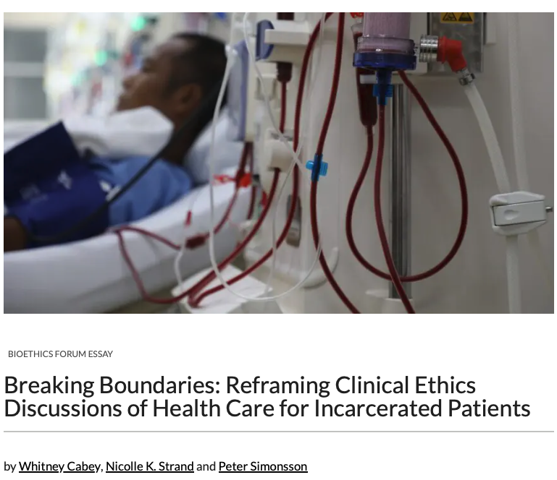
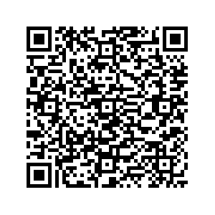
Framework 2: Abolition Bioethics: A Radical, Liberatory Approach
The abolition lens is effective for the theoretical and practical work of dismantling large structures and for addressing the impacts of oppressive policies for those in the grasp of those unjust structures. Bioethics might be uniquely positioned to apply such a lens to address injustices within health care, structural and clinical. Because our field is interdisciplinary, we have the potential to see more of the prism because we are situated across multiple disciplines and knowledge domains. We have suggestions for how we might apply the abolition bioethics lens to the case at issue.
The most ethically sound and justice-serving solution to the barriers arising from W’s incarceration is to mitigate them with compassionate release. Most of the ethical questions at play in his case are related to, if not caused by, the fact that he is incarcerated.

Slide 26
From compassionate release…
“Regardless of the severity of his crime, what we know for certain from the clinical ethics essay is that W will not receive the care he needs due entirely to his circumstance of incarceration. Unlike other more challenging clinical ethics cases, where there seem to be no good solutions, here the fix is simple. Removing W from prison will make it possible for him to receive the best possible treatment—one which has manifested at an extraordinarily young age (a fact we cannot ignore because it is likely that his incarceration caused or hastened his disease). The most ethical solution is to clear the way for him to receive appropriate care, which requires removing him from prison.”

Slide 27
…to Abolition

Slide 28
THANK YOU
Whitney V. Cabey, MD, MSHP, MA
whitney.cabey@temple.edu

Slide 29
Community Violence Intervention: The Role of Returning Citizens as Credible Messengers
Peter Simonsson, PhD, MSW, LCSW
Assistant Professor of Trauma and Violence
Director of Violence Prevention
Center for Health Justice and Bioethics
Department of Criminal Justice
Department of Psychiatry
Lewis Katz School of Medicine at Temple University

Slide 30
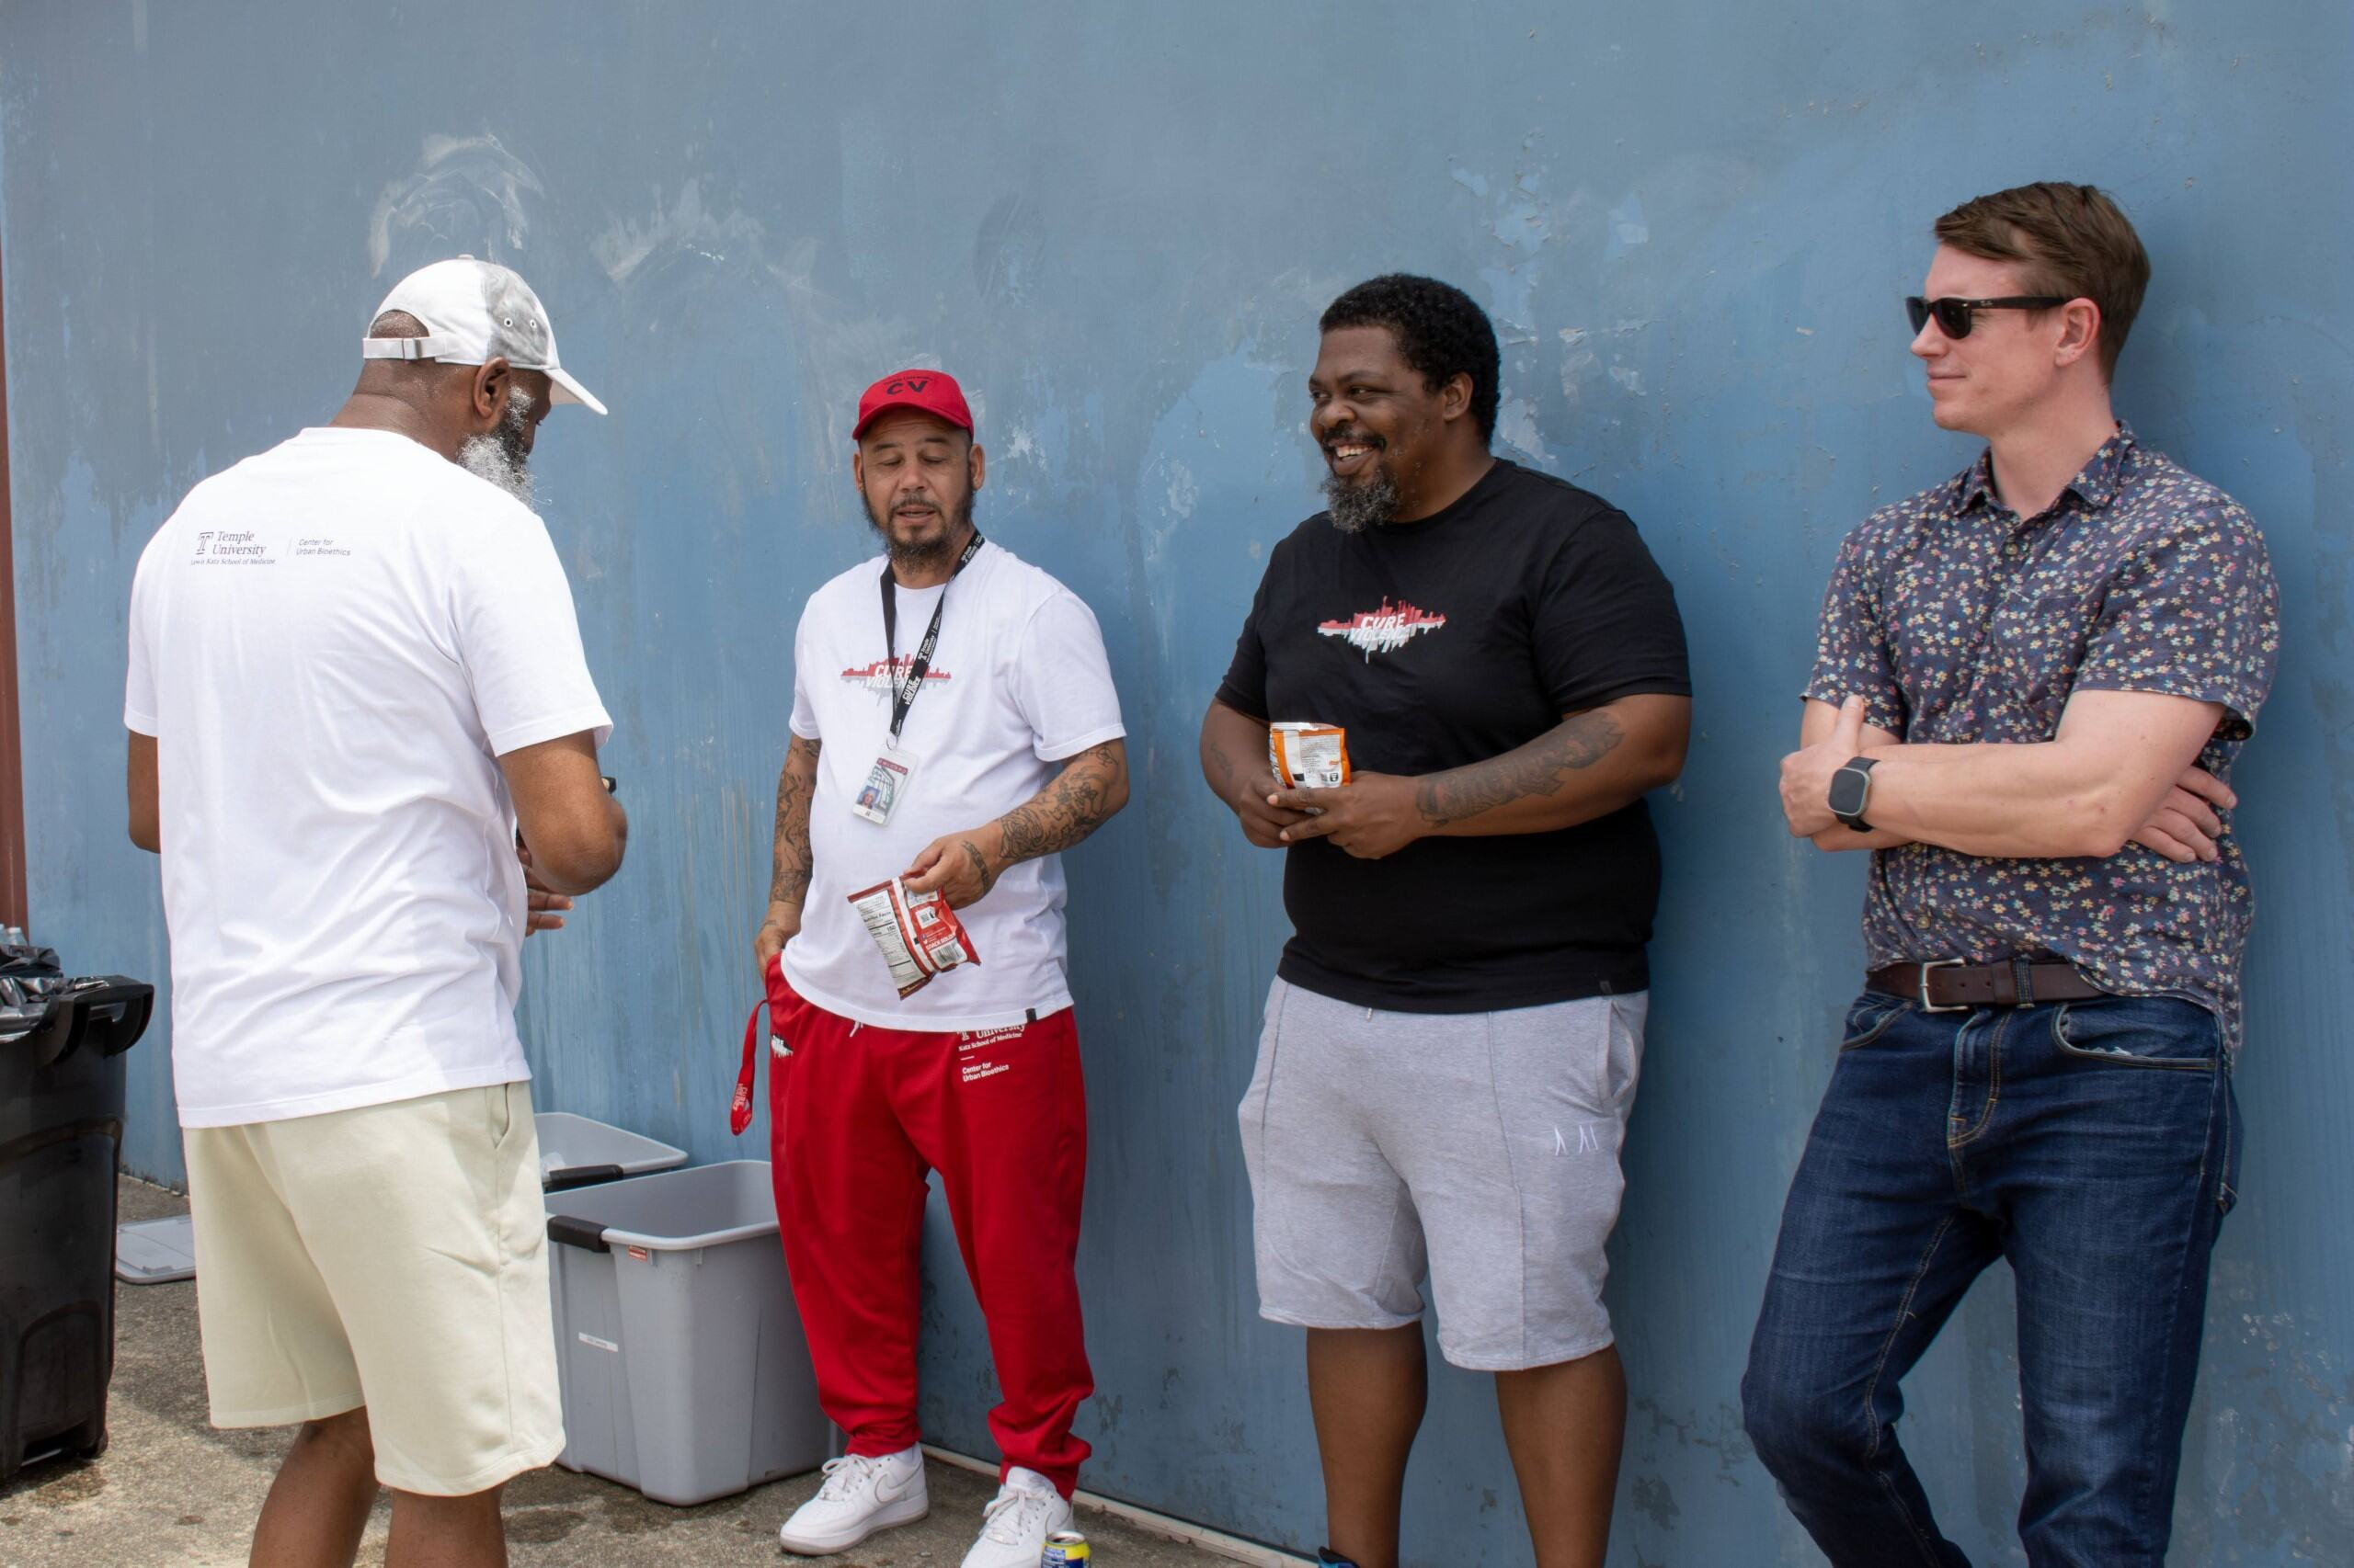
Roadmap
Theoretical framing
Stigma
Desistance
Cure Violence Philly

Slide 31
Who are “Returning Citizens?”
Definition: individuals re-entering society after incarceration
Humanizing the term – more than just “ex-offenders”
Mischaracterization as inherently “bad” and “incapable” of change

Slide 32
Context: Philly and Re-entry
Philadelphia 1.7 million people
Highest incarceration rate in the US with 436 inmates per 100,000 residents (Prison Policy Initiative, 2024)
Top 5 highest community correctional rate in the US with roughly 30,000 residents on probation or parole (Columbia Justice Lab, 2023; ACLU Pennsylvania, 2022)
Largest “poor” city with 22.8% of citizens living below the poverty level (Statista, 2022)
Returning citizens face
Stigma, stereotyping, labeling
Haunted by ghosts from the past – can’t easily shake old life

Slide 33
The Weight of Stigma: Goffman (1963)
“An attribute that is deeply discrediting,” reducing someone “from a whole and usual person to a tainted, discounted one.” (Goffman, 1963)
Social Stigma: A societal reaction that labels and marginalizes individuals based on a perceived difference or deviance from norms (e.g., criminal record).
Personal Stigma: The individual’s internal experience of shame, guilt, or diminished self-worth due to society’s negative judgments.
Notes:
Stigma is a lasting burden. Michelle Alexander and the “new Jim Crow” – time served doesn’t mean anything. Today people talk about a social STAIN. Reinforced by criminal records, things like “sex offender” registry, stereotyping about ”offenders” and institutional bias – like in health care settings.

Slide 34
Stigma: Interactions with Institutions
Internalization of “bad object”
Internalized stigma – self stigmatization “I am not the TYPE of person who can X, Y, and Z…”
Shame – “People will never see me as any different…”
Mistrust of institutions
Design of institutions
Intake forms
ID requirements
Metal detectors

Slide 35
Desistance: Change in returning citizens
Desistance is the process by which individuals cease engaging in criminal behavior, often gradually, over time.
It’s not just a moment, but a long-term shift in identity, behavior, and opportunity.
Key Insight:
Most people “age out” of crime.
Criminal behavior tends to peak in late adolescence to early adulthood, then declines steadily with age — regardless of intervention.

Slide 36
What promotes desistance and healing for returning citizens?
Employment
Meaningful labor
Room for growth, feelings of contributing
Redemption from past life
Healthy bodies and healthy relationships
Sense of connection, community and belonging

Slide 37
Solutions that works: The role of returning citizens in violence prevention
Public health models
Data, evidence-based
Grass-root strategies
Offers returning citizens meaningful labor that’s often deeply personal
Credible messengers
Participatory frameworks
Peer mentoring

Slide 38
Our work: Cure Violence Philadelphia
Firearm violence prevention in North Philadelphia
Cure Violence Philadelphia
Public health model
Community Violence Intervention (CVI)
Returning citizens as credible messengers and mentors
“Walking a cross a minefield, I’d rather follow in the footsteps of someone who crossed it before…” (in Maruna, “Making good”, 2001)

Slide 40
Community Violence Interventions
What are the main ideas behind a public health/CVI response to firearm violence?
Violence spreads like pathogen
Understand individual contagion factors
Messaging about firearm violence
Using data to understand patterns
READI Chicago
Cure Violence
“I do this to help my community. I used to be out on the streets and live that life. I know the mindset of those who are still running the streets and I know how to reach them.”
-Cure Violence Outreach Worker

Slide 41
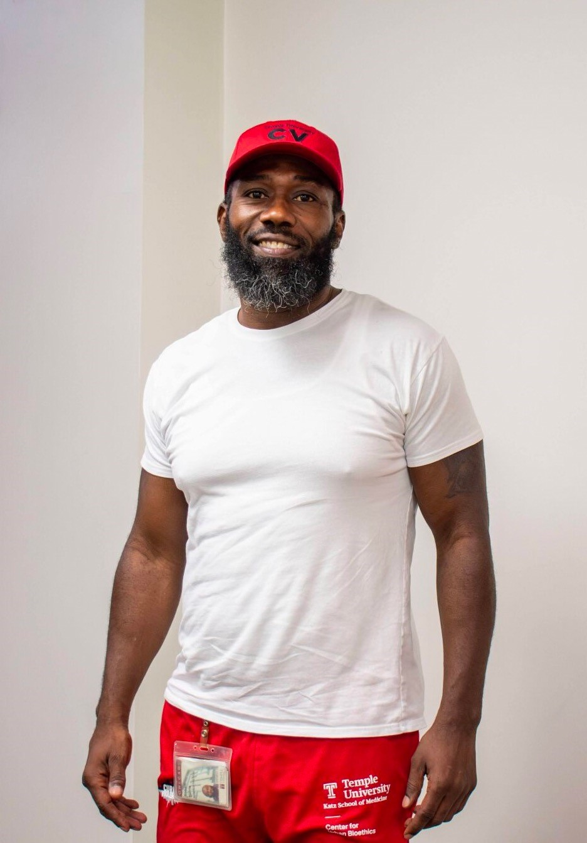
Community Violence Interventions
How do CVI’s address gun violence?
Use returning citizens as credible messengers to identify at-risk individuals
Provide mentoring support
Mediate conflicts
Change community norms

Slide 42
Community Violence Interventions
Who are the credible messengers?
Trusted in their communities
Lived experience
Sustained desistance
New “identity”
“I changed because an OG helped me see things differently, and now I am giving back to the kids out here in my community before they end up like me in prison and whatnot or before they get gunned and hurt.”
-Cure Violence Outreach Worker

Slide 43
Community Violence Interventions
How to build the credible messengers' skills and capacities?
Mentoring training
Social Work
Conflict resolution
Outreach
Motivational Interviewing
Case management
“I mean, it’s not enough to just be black and from the hood, ima need skills and trainings and be a certain kinda person to change the mindset of the kids who be out there shooting.”
-Cure Violence Outreach Worker

Slide 44
Case study: Experiences of formerly incarcerated people as credible messengers
Hospital-based work
Credible messengers’ interactions in health-care institutions
Stigma
Defined by past
Part of a larger study (Funds for a Safer Future)
Sample
Field work
Participatory-Action framework

Slide 45
Case study: Experiences of Stigma
“I know that people don’t see me as a real professional or anything like that even though that this work [CVI outreach] demands a lot from us doing it because the people we work with need a lot from us.” (RC 18)
“Even though they need felons to do this work, they are still guarded you know as if they can’t really trust me. Just knowing that people doesn’t feel safe around you fucks with your head you know. Like I get angry too, like what do I need to do for you to relax around me?” (RC 1)
“I have never felt as ashamed of my past as when I was onboarded [in this role].” (RC 12)

Slide 46
Case study: Experiences of Stigma
“I go to conferences with them but they just bring me because I do this work and it’s a good look on them to bring a black dude from the hood.” (RC 3)
“I am told to attend all these meetings with folks from the city and government and all they have me do is kinda sit there. I am not asked any questions other than about my past. Like, instead of asking me about the here and now and what I see kids going through in the ’hood and my best thoughts about how to help them. But it stops at me talking about my past and they get fascinated by that for a minute before they move on to making the big decisions.” (RC 5)

Slide 47
Case study: Experiences of Redemption and Generativity
“Helping all these people who are struggling on the streets of North Philly, helps me. I used to be out here, hustling, but now when I got this [Cure Violence job] I feel that I have direction, purpose. I am meant to help people in my community, from not being eaten by the streets. They need so many things, and I know that the struggle is real because Ive been there. I know how hard it is to find a job, to feed your family, to stay away from negativity. This job though – it helps me in so many ways as I am helping them. Yes I need the money, but I also need need to help my community especially those who are lost on the streets.” (RC 14)

Slide 48
Case study: Experiences of Rejuvenation and Generativity
“I never knew that telling my story could be so rewarding. Just by connecting with these vulnerable kids and telling them about me, my life, and how I got out and left the streets I can help them change, so they don’t become the next me, or they type of person who I was when I was running the streets.” (RC 8)
“Your story holds so much power. You can tell when you talk to kids out here who are lost on the streets, that they listen because they sense that I know what I am talking about. Ive been them, Ive been out here, and they can tell by the way I speak and handle myself in these neighborhoods. I also know many of these kids' families, you know. I might not know these exact kids on the corner, but I know their uncles, their dads – that also helps. At the end of the day though, this job really helps me going straight instead of going back to my old self and how I used to be.” (RC 13)

Slide 49
Case study: Experiences of formerly incarcerated people as credible messengers
Implications
What we need?
Participatory work
Nothing about us, without us
Need to hear directly from people with lived carceral experiences
Unique roles in injury prevention
Policy – remove barriers to employment
Practice – educational campaign to health-care institutions

Slide 50
THANK YOU
Peter Simonsson, PhD, MSW, LCSW
Peter.simonsson@temple.edu

Slide 51
My Life in Community Violence Intervention
Quinzel Tomoney
Cure Violence Senior Program Manager
Center for Health Justice and Bioethics
Lewis Katz School of Medicine
Temple University

Slide 52
Roadmap
My story
Where I come from
How I changed
Community-focused work
Justice-involved voices
Future work

Slide 53
My Story
Born and raised in Philly
Incarcerated
Deciding to envision a different future drove the change

Slide 54
My Story – Changing Focus
Began working in violence prevention
Early years of program were hard
Tight or nonexistent funding
Difficult to ‘prove’ effectiveness, even when benefits are clear to the people I see and work with every day
Sticking with the work, even through challenges
10+ years later, program is large and successful, but still needs to adapt to community needs

Slide 55
Community-involved Work: My Role in Gun Violence Prevention
Philadelphia Cure Violence, 2012
Developed a team
Returning citizens
Lived criminal-legal experience
Built a team in an area of Philly with high rates of violence
Built trust and connection with the community

Slide 56
Community-involved Work: Need Community’s Trust
Efforts must centered in the community
The community will share their concerns about violence with our team
We will get contacted by the community to address violence
We know the needs and and challenges of the community

Slide 57
Coming Home: Challenges and Needs
When I came home my main challenges were
Employment
Housing
Relationships
Re-connecting
Stigma
Managing my past
Changing the community’s views of me
Notes:
Stigma is a lasting burden. Michelle Alexander and the “new Jim Crow” – time served doesn’t mean anything. Today people talk about a social STAIN. Reinforced by criminal records, things like “sex offender” registry, stereotyping about ”offenders” and institutional bias – like in health care settings.

Slide 58
Future Work
Continuing community-focused work in North Philly
Supporting returning citizens through gun violence prevention
Educating institutions and the public about the challenges of coming home but the necessity of lived experience to combat gun violence and other problems impacting vulnerable communities

Slide 59
THANK YOU
Quinzel Tomoney
Quinzel.tomoney@temple.edu

Slide 60
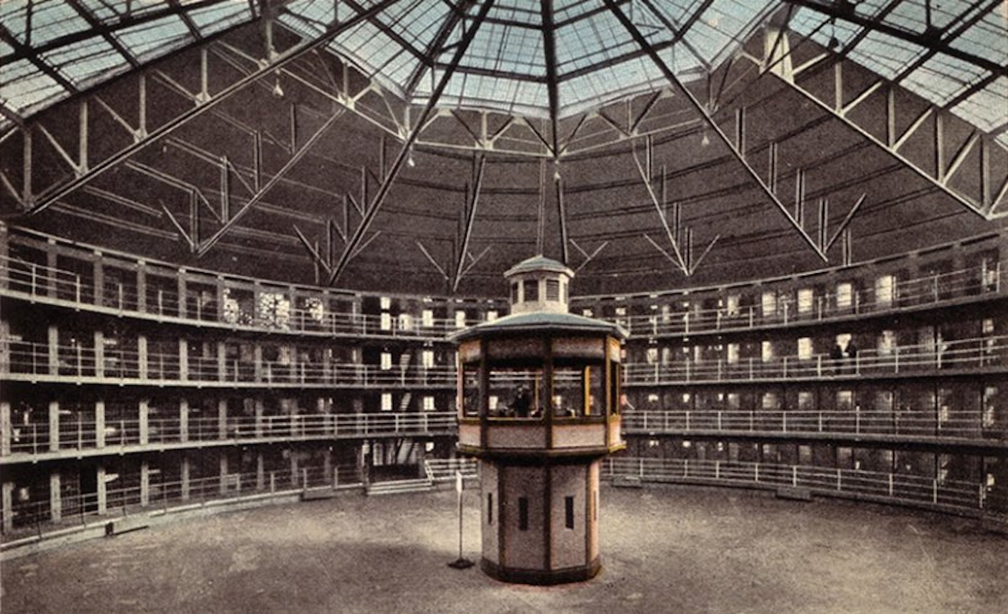
Abolition: A Way Forward?
Nicolle Strand, JD, MBE, MPH
Director and Associate Professor
Center for Health Justice and Bioethics
Lewis Katz School of Medicine at Temple University

Slide 61
Roadmap
Medicine
Racism
Carcerality
Carcerality and Medicine
Abolition Bioethics
Notes:
Whitney talked about some of the health disparities that we see for incarcerated and formerly incarcerated people – I want to talk about the cycle that carcerality, medicine, and racism are all in together, and how medicine isn’t just an unwilling bystander in that cycle but a prime participant in it.
And then we’ll talk about what it might look like to use abolition – or, if that feels like a scary word – to use FREEDOM as a concept in bioethics especially when we think about racialized or incarcerated or otherwise vulnerable patients in our system. Freedom being stronger and more pervasive than autonomy.
So we will start with carcerality in medicine

Slide 64
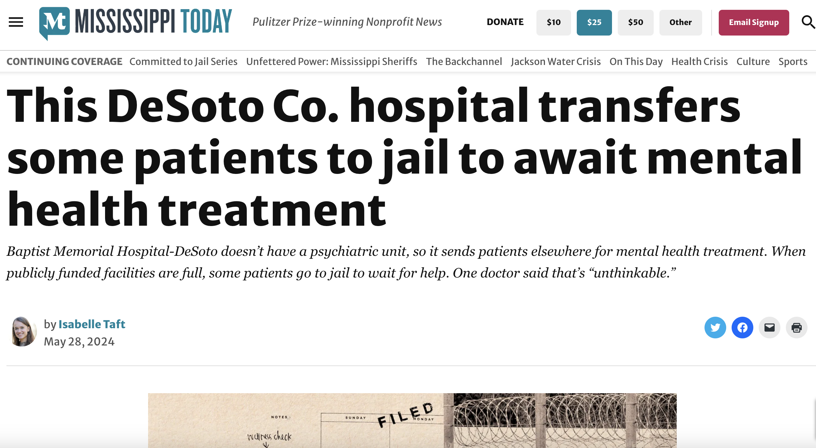

Slide 65
These examples are familiar
There is a spectrum from pure incarceration to coercion of activities that take place commonly in hospital settings
Shackling of incarcerated people in hospitals
physical restraints for people who are not complying/deemed dangerous
chemical restraints for psychiatric patients
monitoring in hospital when it is not strictly necessary
visitor restrictions
searches and removal or certain items
mandatory gown use
coercing patients to stay in hospital (perceived or implied threat)
noncompliant or nonadherent labels
drug testing—presumption of pill seeking—disbelief
involuntary commitment/psych holds
security or police presence in hospital
Notes:
All of these have carceral elements. What do I mean by carceral – they have an element of force, control, coercion. They have an element of restricted movement or freedom. They have an element of surveillance with known or implied threats. They share common features with a prison environment.

Slide 66
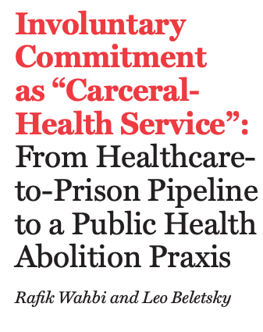
“After being violently restrained individuals are committed to so-called treatment centers for “rehabilitation,” but these sites are far from treatment or rehabilitation, but rather another form of prison or jail. And yet since its inception, the law has consistently been shown to be ineffective, unethical, and racist.”
Notes:
In this great article in JLME, Rafik wrote about involuntary commitment as a “carceral health service” and a “health care to prison pipeline.” This quote is great, where he says:
And here, he notes the racism embedded in the system. So that brings us to…

Slide 67
Who do these happen to and where?
They do not happen only to Black communities, but they happen predominantly in Black and poor communities, and more often to racialized or marginalized people
Every study will show a disparity in these carceral elements of health care
Police presence at hospitals:
Public:
76%
35%
Private:
51%
18%
Security with ability to arrest
Police
Notes:
Who do these carceral elements of the healthc are system happen to, and where do they happen? …
You can see that public insurance has a lot to do with whether or not security and police are heavily present. Which of course is correlated with poverty, economic disinvestment, and racism.

Slide 68
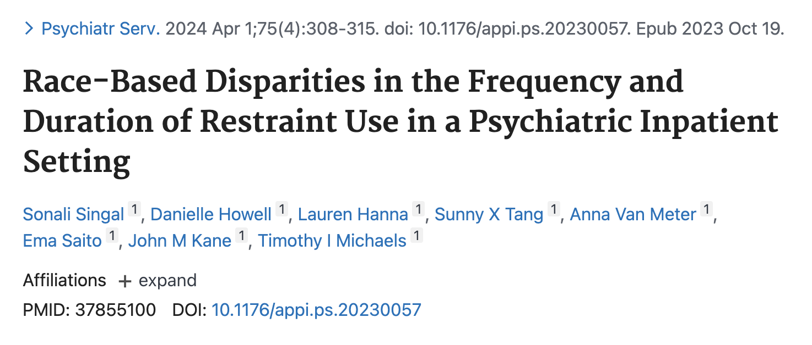
Black patients were 3 times more likely to be physically restrained, controlling for variables including self harm, involuntary vs voluntary status, and even weekends vs weekdays.
Notes:
We can see dozens of studies just like this. People who are most likely to be restrained, arrested in a hospital, or have any number of those carceral techniqus applied against them – they are racialized people. This study is striking and shows that Black patients are 3 times more likely to be physically restrained…

Slide 69
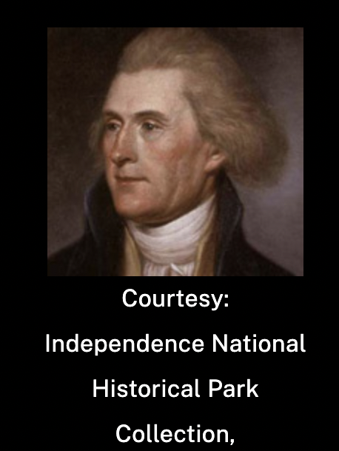
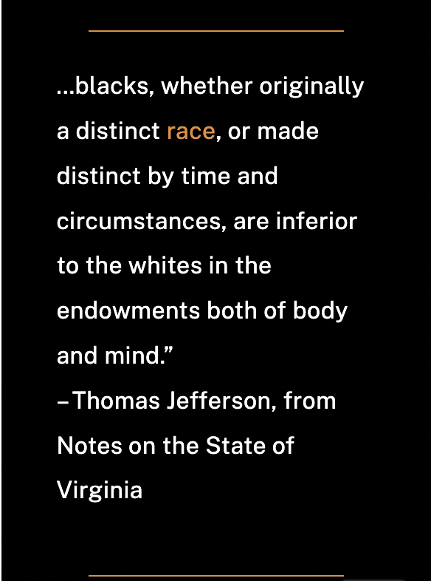
Why do these carceral elements impact Black people more frequently?
History of science and medicine collaborating with racism—perpetuation racism—pathologizing Black bodies—even inventing new justifications to behave in racist ways, by justifying differential treatment
Notes:
Why is this the case? Of course racism is the obvious answer. But I think going back in our history is helpful – because it helps us see that it’s not just racism that arose de novo out of the universe. It’s racism that was corroborated by, invented by, pathologized by, objectified by – science and medicine as fields.
Here we have Thomas Jefferson who wrote in a founding document that we revere and keep in the Smithsonian – that Black people, a distinct race, are inferior to white people in the endowments of both body and mind. Working with Dr. Samuel Cartwright, Jefferson and other founding fathers used scientific justifications to insist that Black people were morally inferior and therefore slavery was justified, or unproblematic, or even, Jefferson sometimes argued, GOOD for Black people because working in the fields helped vitalize their inferior lungs. Science, psychiatry, medicine invented diseases, like drapetomania, to pathologize the very normal reaction of enslaved people to run away from their captors. And medicine, as in J Marion Sims and others, invented and perfected surgical techniques and invented medical devices like the speculum by cruelly and torturously testing and practicing on enslaved women, before finally perfecting and moving on to white women.
So we know this history. And the history is more present than we would hope to believe. And medicine plays a bigger role int eh history than we wish to admit.

Slide 70
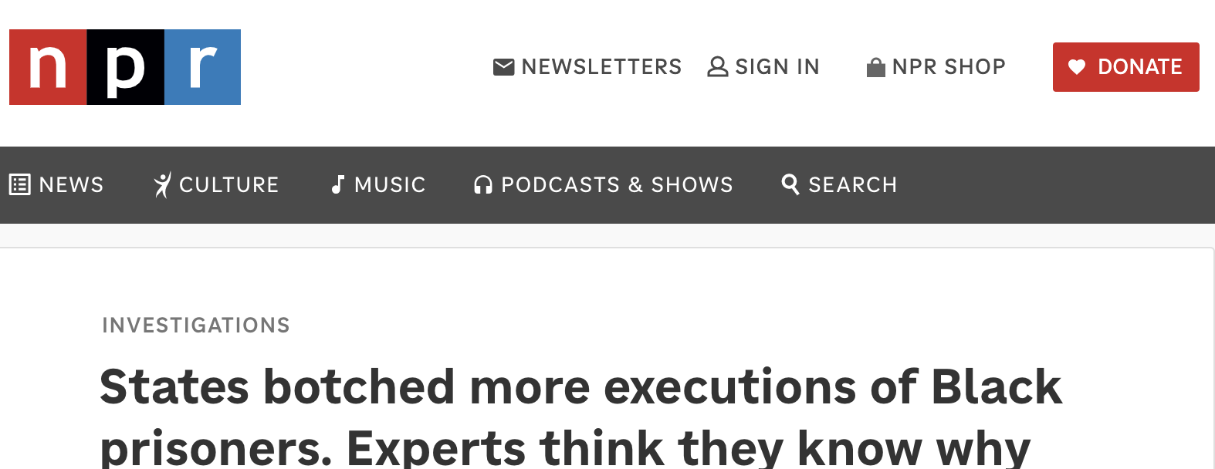
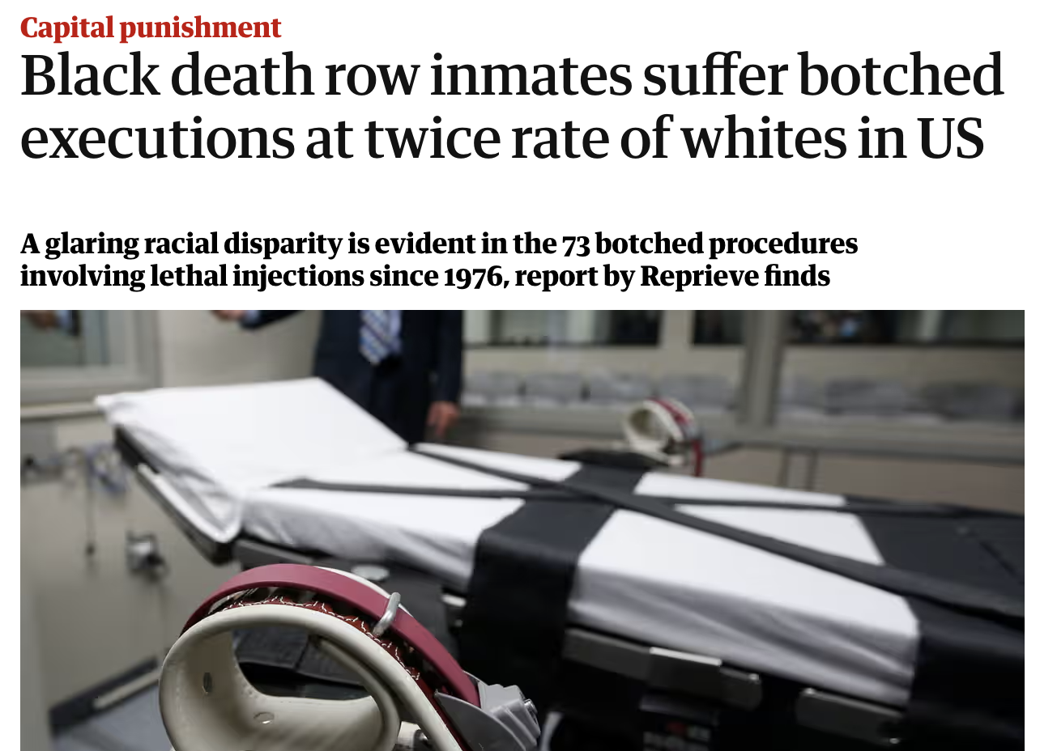
"I heard some guys say, 'Oh these guys are really muscular, it's going to be harder," she said. An execution worker in Nevada suggested that "maybe the nervous system of the Black inmate works different."
Notes:
Those myths pervade today…

Slide 71
Abolition – what does it mean?
Institutions that are so incompatible with our values or ideals. And yet—they do not receive the level of critique we would expect.
Abolition starts with making the contrast visible and stark.
The notion: maybe the only viable path forward is to completely abolish these institutions in their current state.
Where we often end up, instead, is a middle ground called: reform.
Is slavery an institution that could be reformed?
Notes:
So, why abolition, as a way forward?
What does abolition mean? We apply it to institutions that are incompatible, wholly, with our ideals and values, and yet, they exist in society and they don’t receive the level of criticality or critique that we would expect. Slavery was that institution here in the US for 400 years.
So abolition starts with making the contrast – between the institutions and our values – visible and stark. The notion is that maybe the only viable path forward is to completely abolish these institutions in their current form.
Where we often end up, though, as ethicists and as lawyers, is in reforming those institutions around the edges. A middle ground. A compromise. We work to make them better, from within and from outside, and we critique them for the ways they are incompatible with values like humanity and justice. But we rarely argue that they should be dismantled altogether. But I’d ask – if we as ethicists and lawyers were to look back and pretend we existed in the time of slavery, would we feel confident advocating for reforms? Or would we, like many did at the time, say that the institution was so morally abhorrent that the only solution was abolition? Where would we hahve stood then? Where do we stand today?

Slide 72
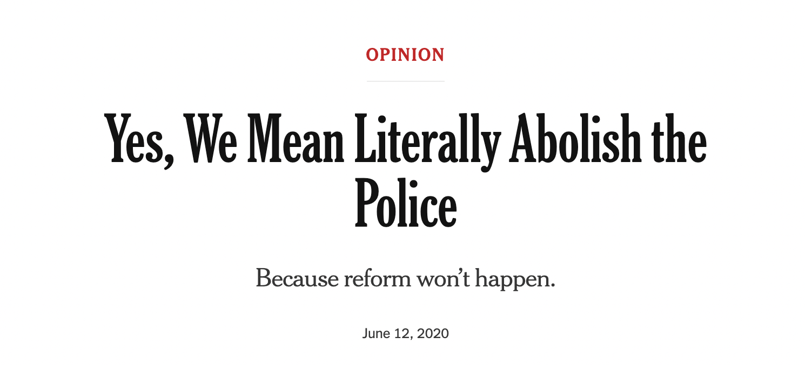
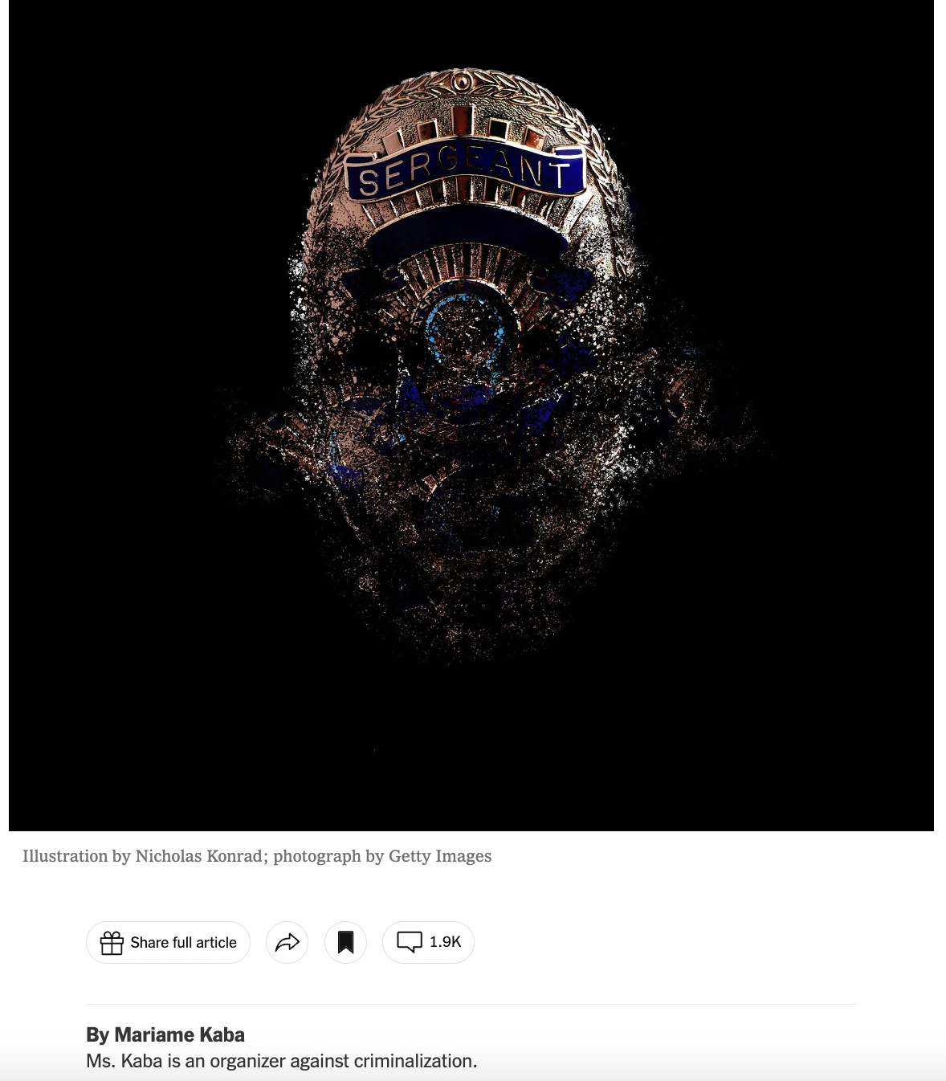
Notes:
Critique of the carceral state has sometimes reached broader calls for abolition. During the 2020 movement for Black lives, some called to “defund” the police, which was essentially a call for abolition. It did not gain mainstream traction.
What we are left with are reforms. One of the tenets of abolition that is worth noting is--just as with slavery, calls to abolish things that seem like mainstays of American life are always met with bewilderment and fierce objection. Even MSNBC commentators essentially scoff at calls to “defund the police” now. No matter how liberal, institutions will tend to protect other institutions. Institutions and bureaucracies prop one another up.

Slide 73
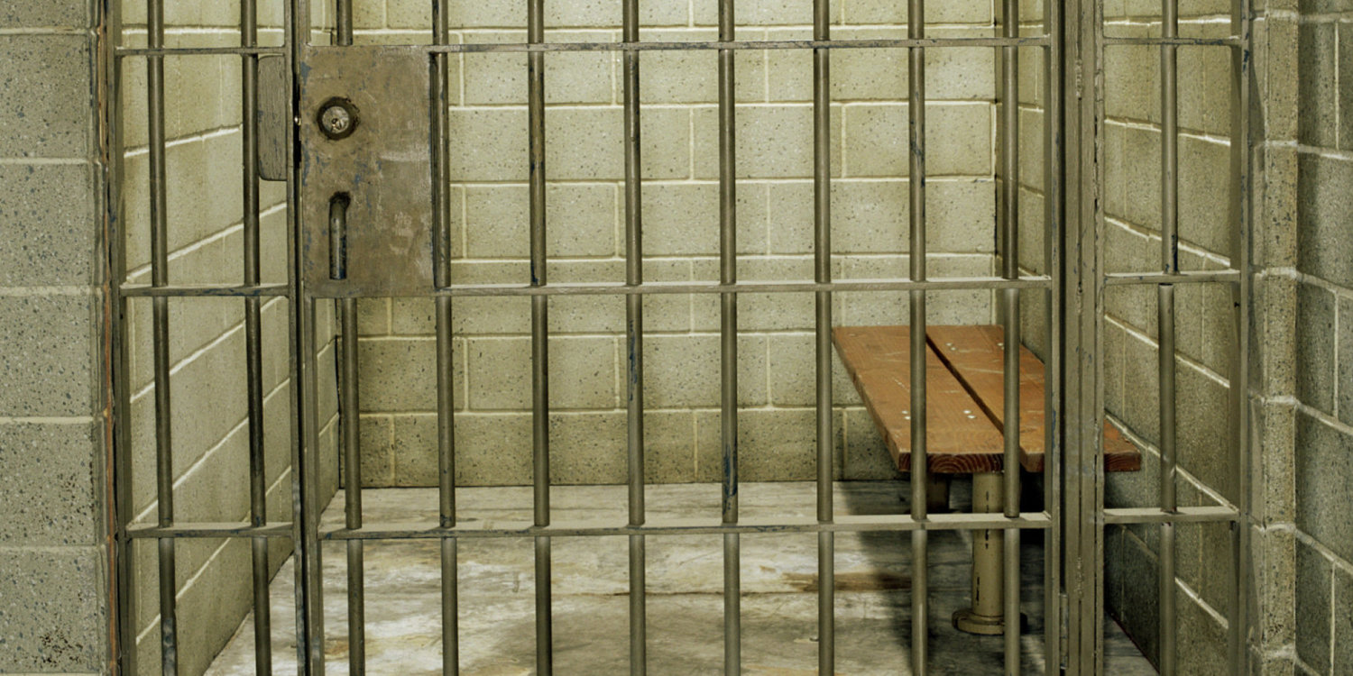
Abolition is radical – that’s the point
Notes:
Abolition encourages us to see the most far reaching possibilities, and to imagine what a world could look like without the institutions we take for granted. It asks us not to compromise, not to just “take the good with the bad.”
For example, rather than accepting that the prison industrial complex sometimes locks people up who are innocent, often kills people who did not deserve to die, always subjects people to horrendous conditions that are beneath a respect for humanity--but assuming that we need such a system because we need to lock up bad people or prevent future harm (which, by the way, the prison system does not achieve) it forces us to ask - can’t we do better? Do we actually need this system? If we were imaging, as though we were writing a utopian sci fi, what would be some other ways that we could protect people from harm without subjecting them to such a harmful inhuman system?

Slide 74
Bioethicists could be abolitionists
Notes:
And bioethics should be among those who apply it.
Bioethics is interdisciplinary. We are able to see more of the prism because we are standing in different spots. We have historians, who can teach us about how every reform effort essentially failed to achieve its goals. Methodologists who can show us that racial disparities are not narrowing, they are widening. Political scientists who can explain to us the nature of capitalism and the American political economy in maintaining the power that insurance and pharmaceutical industries have. And, most importantly, we are all ethicists, and we can see with our eyes that the system as it currently stands does not uphold the basic values of, for example, justice.

Slide 75
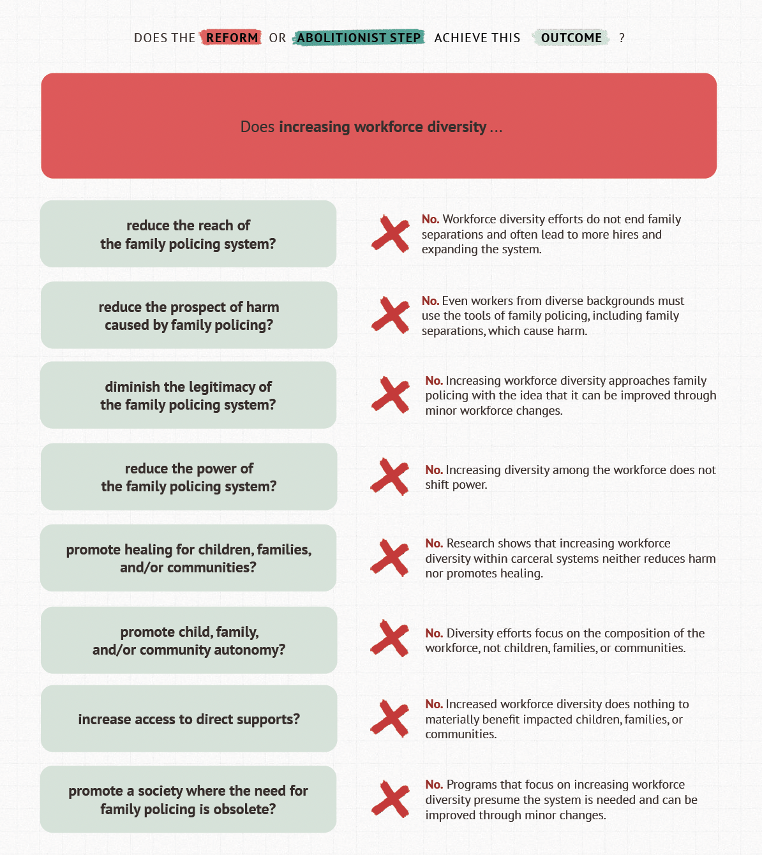
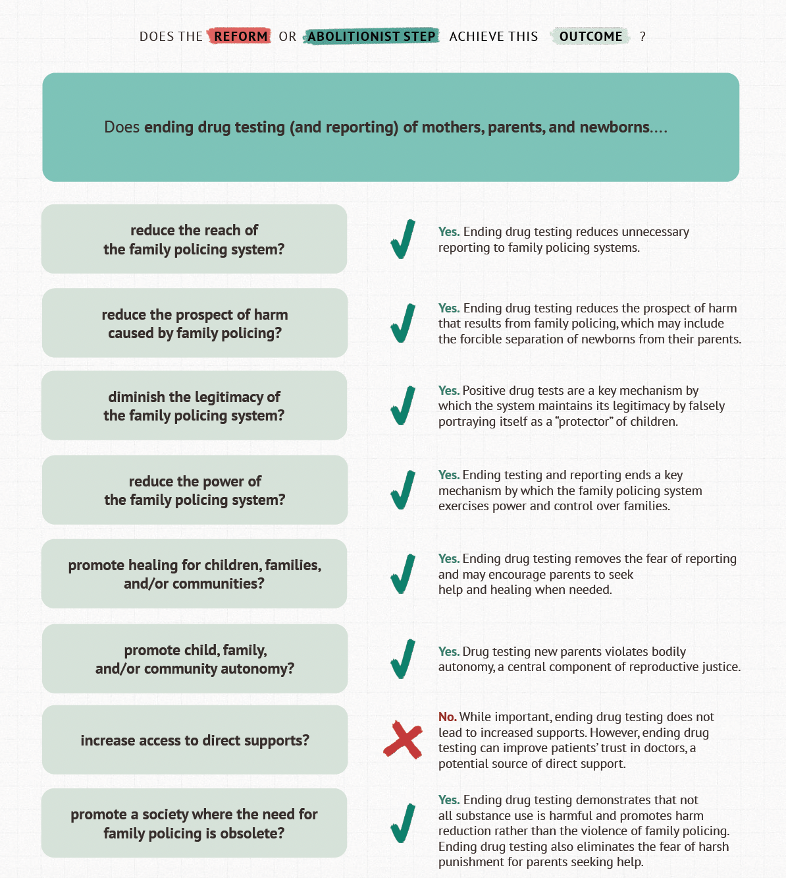
Notes:
UPEND has created set of outcomes that go to the core of the harms that the family policing system causes, putting a stake through the heart of those harms by abolitioning aspects of the system, rather than trying to reform around the edges.
on the left side are those outcomes – we are hoping to, for example, reduce the rteach of the family policing system, the orospect of harm caused by it, we are looking to delegitimize it, reduce its power. But also, importantly, we aren’t just interested in taking things away, we also want to prpomote child, family, and community healing, autonomy, and increase direct supports. Ultimately the goal is to produce a society where the need for such a system is obsolete.
We can compare two actions – an action based in reform, and an action based in abolition, and we can test to see whether it will help achieve our outcomes of interest.
What we find is that the reform does not achieve any of our outcomes. The anologies to health care pop right off the page. DEI efforts inside of a system ruled by racial capitalism – they fall flat. Diversity in the family policing workforce does nothing to materially benefit impacted children – I’ll add the caveat, unless those new employees or leaders of local systems are working inside of those systems to dismantle their power—an outcome that is rare because people with radical abolitionist mindsets rarely get hired for these kinds of roles.
Whereas, an abolitionist step, in this case, ending drug testing and reporting for mothers, parents, and newborns DOES meet many of our goals. Drug tests are a key way that the system maintains legitimacy by portraying itself as a protector of children—assuming that a mother testing positive for a substance means that the child will be better off separated from their mother, and int eh hands of a violent traumatizing system. Ending drug testing and reporting can remove the fear that moms have in seeking help from their doctors, health care providers, rehabilitation systems, and more. Wheras, the practice of testing and reporting discourages moms from seeking help.

Slide 76
For our purposes
Abolition is:
Dismantling racial capitalism and all of its forms and tentacles in the health care system, including:
Abolishing race based algorithms
Abolishing for-profit health care/incentive structures where anyone profits off of sickness
Abolishing any form of restraint or surveillance (carceral elements) in health care
Abolition is not:
DEI
Health equity initiatives that exist in the current structure
Notes:
How do we avoid the cooptation of the term/concept (a la decolonizing, etc)

Slide 77
The Ethics is in the How
Bioethics and dilemmas have a love affair.
A right vs right. A decision with multiple angles and competing values.
That health care is producing, recreating, propagating racial and economic health disparities—through its own and society’s embeddedness in racial capitalism–is not an ethical dilemma we can sink our teeth into. It is a right vs. wrong.
But – how we dismantle it, what we replace it with, how we choose between reforms while we operate in the system we have, how we create a new system and set of incentives for true health – that is extremely ethically complex.
We need a new set of tools to do this work.

Slide 78
Autonomy

Slide 79
Agency
Autonomy

Slide 80
Agency
Autonomy
Freedom

Slide 81
Agency
Autonomy
Freedom
Abolition

Slide 82
If we used the abolition framework on the case from the Hastings Center
Free him
…
And then what?
Notes:
In the case that we critiqued in the Hastings Center essay, we suggested that we think more expansively about how to approach the case in the most ethical way possible. Thnking expansively, the authors of the clinical case chose for this patient a slightly less good form of treatment because of the patient’s circumstance, because of a manmade institution. They suggested working within it, reforming around the edges, instead of thinking radically. So we suggest– freedom. The patient lacks autonomy and agency because of his circumstance. If he truly understood the risks and benefits of each treatment decision, what choice would he make? If he was free to make the choice that was best for him, what would that look like? What if we… freed him? What if we released him from the manmade constraints he is under and make it possible for him to be free.
Aboltion, though, is bigger and bolder even than freeing individual people in cases like these. Yes we do literally mean – free them al. But, ablition is not just about tearing down, it’s also about building. So, as lawyers, as ethicists, as scientists, as people who sit in the panopticon and see the whole picture of society and what these institutions do to humanity, we can see that they do more harm than good, but we also know they exist for a reason. So the most ethical path forward is to build a society where we are all free, but also where harm doesn’t go uncounted for. Where trauma is addressed and root causes of violence are explored and mitigated. Where resources are distributed justly so that crime is a less appealing way of life. This is bold and it’s hard. And we’re not going to accomplish it in one paper or one talk or one decade or one century. But what would it look like if we devoted our resources to this project, rather than that of putting out the fires of moral injury and burnout that happen because the systems we designed don’t work?

Slide 83
THANK YOU
Nicolle Strand
nicolle.strand@temple.edu

Slide 84
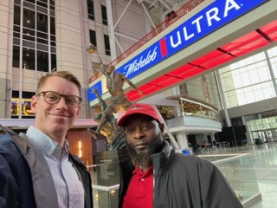
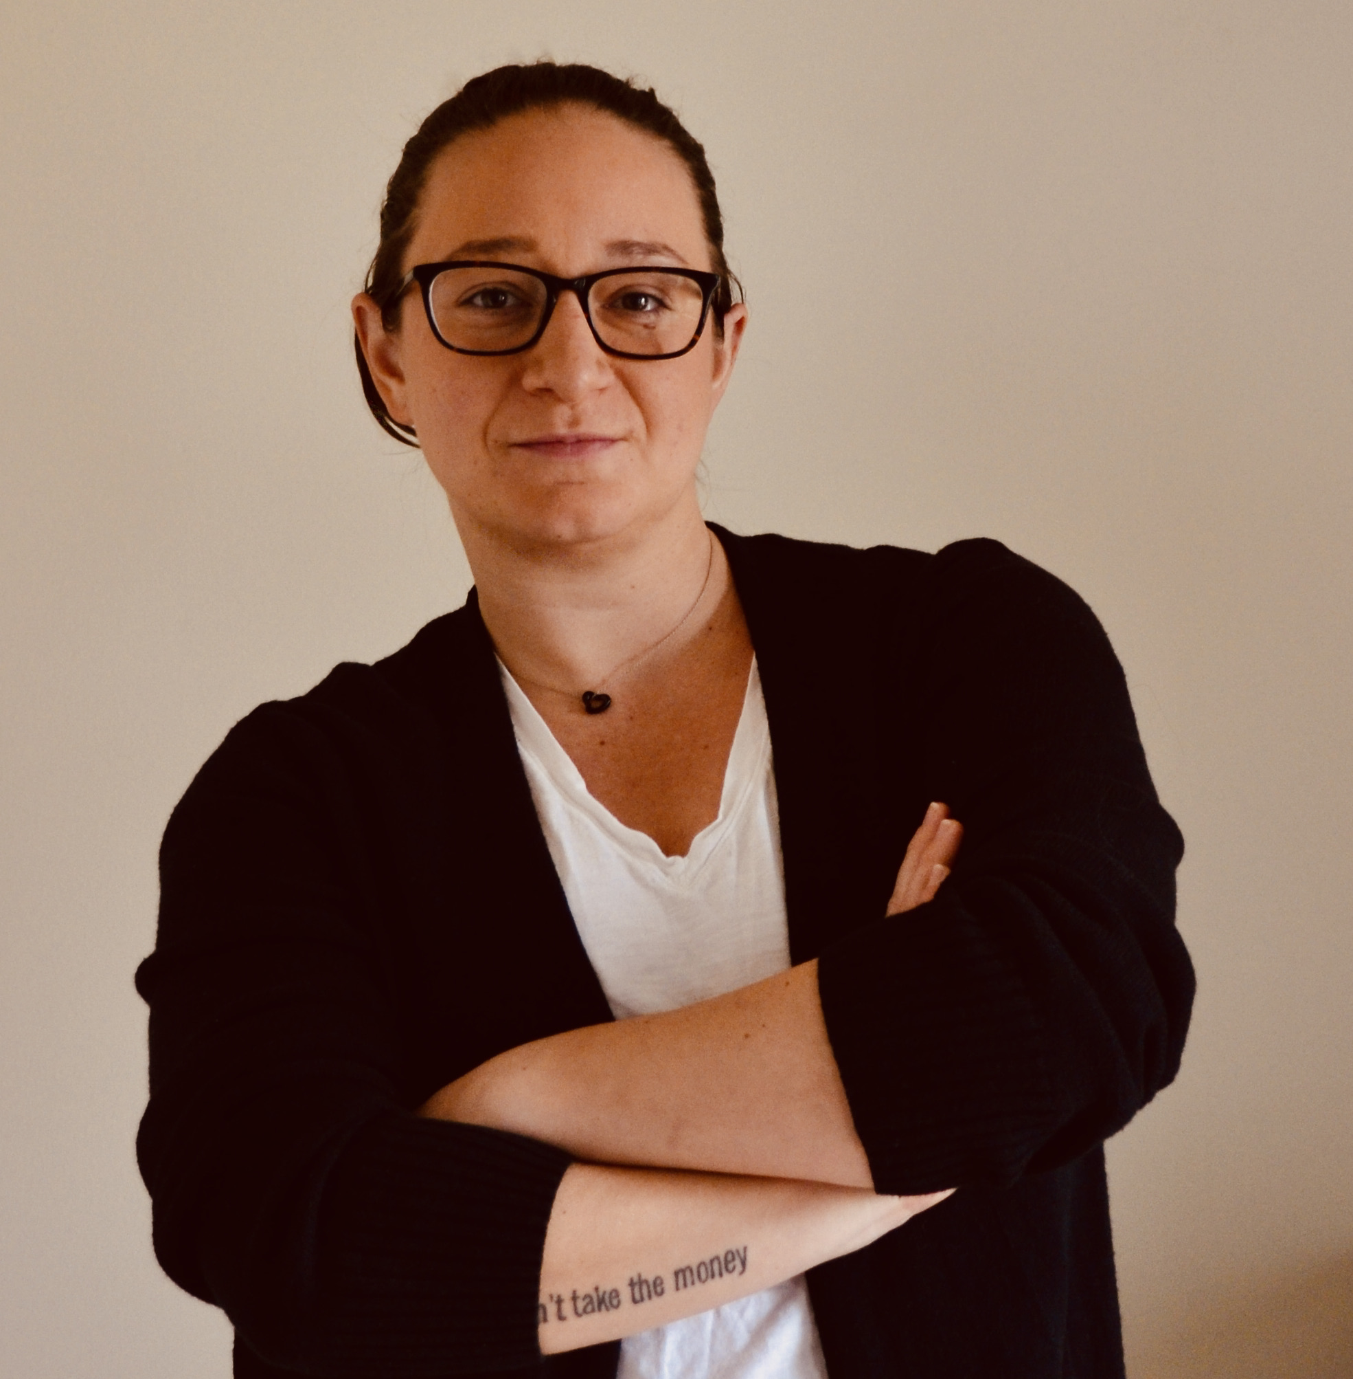
Thank You!
Whitney V. Cabey
whitney.cabey@temple.edu
Peter Simonsson
peter.simonsson@temple.edu
Quinzel Tomoney
quinzel.tomoney@temple.edu
Nicolle Strand
nicolle.strand@temple.edu

Slide 85
Questions & Discussion
Thank you for your attention!

