Slide 1
THE ADA AND MEDICATIONS FOR OPIOID USE DISORDER AMONG INCARERATED POPULATIONS: A STUDY
Shavonnie R. Carthens, JD
University of Kentucky
J. David Rosenberg College of Law

Slide 2
Agenda
Study Overview
Preliminary Results
Next Steps

Slide 3
Study Overview

Slide 4
Study Background
Kentucky is one of the states most affected by the opioid epidemic.
Opioid use disorder is a chronic medical condition and a disability protected under the Americans with Disabilities Act (ADA).
People with OUD, who become incarcerated, are often prohibited from continuation of MOUD, a clear ADA violations..
Medical and legal professionals may interact with incarcerated patients suffering from OUD.
Stigma and bias are barriers to this population receiving medication for OUD.

Slide 5
Study Overview
Assessing baseline knowledge and stigma and changes in knowledge and stigma in future lawyers and nurses on medications for opioid use disorder and patients’ rights to anti-discrimination under the Americans with Disabilities Act – A prospective survey study*
* This study is supported by the University of Kentucky Center for Clinical and Translational Science.
*Amanda Fallin-Bennett, PhD, RN is a co-founder of Voices of Hope, the recovery community organization that partnered with us on this project.
Shavonnie R. Carthens, JD,
College of Law
Amanda Fallin-Bennet
PhD, RN, College of Nursing*
Anna-Maria South
MD, FACP, FASAM, College of Medicine

Slide 6
Study Objectives
Aim 1: To assess among law students and nursing students the baseline knowledge about the ADA as it applies to patients with OUD on MOUD and to assess changes in knowledge after attending an educational intervention.
Aim 2: To assess among law students and nursing students the baseline stigma and biases about patients with OUD on MOUD and to assess intention to address stigma and biases and increase knowledge base after attending an educational intervention.

Slide 7
Study Design
Pre-Survey
Goal Enrollment: 100
Assessment of Knowledge and Bias
Educational Intervention
Medicine Lecture
Legal Lecture
Post-Survey
Assess intention to address knowledge
Assess intention to address bias
Peer Panel: Lived Experience
Statistical Analysis

Slide 8
Study Design: Educational Intervention
Medicine
Law
Lived experience

Slide 9
Medicine Lecture
Basics of opioid use disorder (OUD)
Medication for opioid use disorder (MOUD)
Criminal justice data and implementation considerations

Slide 10
Medicine Lecture
OUD/MOUD Overview:
Chronic Medical Disease
High morbidity and high mortality
High involvement in the criminal legal system
Effective evidence-based treatments available
Severely underutilized

Slide 11
Medications for Opioid Use Disorder (MOUD)
 | Methadone | Buprenorphine | Naltrexone
Mechanism of Action | Full mu receptor agonist | Partial mu agonist | Mu receptor antagonist
Treats Withdrawal | Treats cravings and withdrawal |  | Does not treat withdrawal, minimal treatment of cravings
Reduces Mortality | Reduce all cause mortality Reduce opioid-overdose mortality |  | Has not been proven to reduce all cause mortality
FDA Approval for OUD | Treatment of OUD |  | Relapse Prevention
Source: Substance Abuse and Mental Health Services Administration. Medications for Opioid Use Disorder. Treatment Improvement Protocol (TIP) Series 63 Publication No. PEP21-02-01-002. Rockville, MD: Substance Abuse and Mental Health Services Administration, 2021.

Slide 12
Correction Settings With MOUD
RI DOC: After MOUD implemented, post-incarceration opioid overdoses reduced by 61% in 1st year.
England: After prison-based buprenorphine and methadone program started, 75% and 85% reductions in all-cause mortality and opioid overdose deaths, respectively, within 1st month post-release.
Australia: Prison-based methadone and buprenorphine reduced suicides while in prison.
Mace, S., Siegler, A. Wu, K., Latimore, A., & Flynn, H. The National Council for Behavioral Health and Vital Strategies. (2020). Medication-Assisted Treatment for Opioid Use Disorder in Jails and Prisons: A Planning and Implementation Toolkit Slide: M. Lofwall

Slide 13
Medicine Lecture Takeaways
MOUD with buprenorphine and methadone reduces all cause mortality
MOUD during incarceration increases retention in care
Most jails and prisons do not offer all three forms of MOUD
Not allowing MOUD as a blanket policy is a violation of the ADA (in prisons, jails, nursing homes etc.)
Often: If MOUD offered, it is XR-Naltrexone (no evidence of mortality reduction)

Slide 14
Law Lecture: Incarcerated Individuals and Substance Abuse
According to the DOJ approximately half of the people incarcerated in state and federal prisons suffer from substance use disorder.
OUD disorder goes largely untreated during periods of incarceration, and often resumes after release.
Studies show that medications to treat OUD reduce drug overdose deaths, reduce recidivism, and infectious disease among people involved in the criminal justice system.
Avery, J. J., Starck, J., Xu, Y., Avery, J. D., & Cooper, J. (2018). Attitudes toward defendants with substance‐related charges: An analysis of a national sample of criminal defense attorneys. The American Journal on Addictions, 27(8), 639-645.

Slide 15
A Major Issue for Incarcerated Populations With OUD
Prisons and jails may deny individuals these medications:
Why?
Lack of knowledge regarding an OUD diagnosis and treatment
Inconsistent understanding/application of the law
Stigma
Bias
Criminal defense attorneys may represent individuals who suffer from OUD.
Sallie Friedman & Melissa Trent, Defense Lawyers and the Opioid Epidemic: Advocating for Addiction Medication, National Association of Criminal Defense Attorneys (August, 2018),

Slide 16
Legal Implications of Denying MOUD Treatment
Prohibition of medications can violate the substantive due process protections under the Fourteenth Amendment to the Constitution.
State laws may provide a legal basis for challenging denial of MOUD.
OUD is a disability under Title II of the Americans with Disabilities Act (ADA).

Slide 17
The ADA and Opioid Use Disorder
OUD is a disability under Title II of the Americans with Disabilities Act (ADA).
The ADA protects individuals in recovery from Opioid Use Disorder (OUD) who are not engaging in illegal drug use.
Public-facing businesses or government programs cannot discriminate against this population.

Slide 18
How to Advocate for Clients with OUD?
Review
Review recent caselaw in your jurisdiction regarding MOUD treatment in prisons and jails.
Object
Object on the record if your client is denied access to MOUD.
Seek
Seek the advice of competent treatment professionals.

Slide 19
Panel Discussion
Prof. D’lorah Hughes
VOH - Peer Panelist
VOH - Peer Panelist

Slide 20
Preliminary Results

Slide 21
Participant Characteristics | N = 106
Sex
Female | 95 (89.623%)
Male | 11 (10.377%)
Gender
Female | 94 (88.679%)
Male | 11 (10.377%)
Transgender | 1 (0.943%)
Hispanic
No | 96 (90.566%)
Yes | 10 (9.434%)
Race
Asian | 8 (7.547%)
Black or African American | 3 (2.830%)
White | 93 (87.736%)
Prefer not to answer | 2 (1.887%)
Do you have a loved one/friend/family member with a substance use disorder?
No | 54 (50.943%)
Yes | 52 (49.057%)

Slide 22
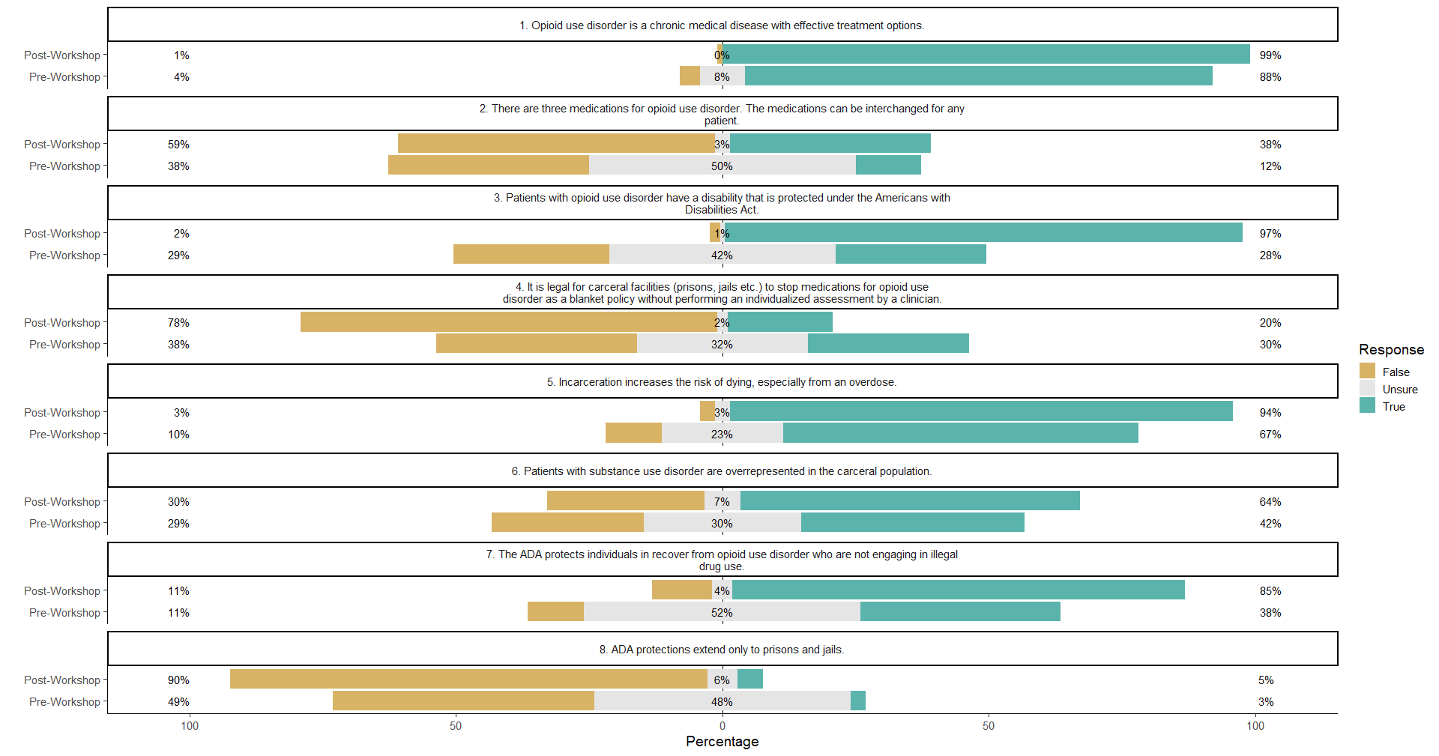

Slide 23
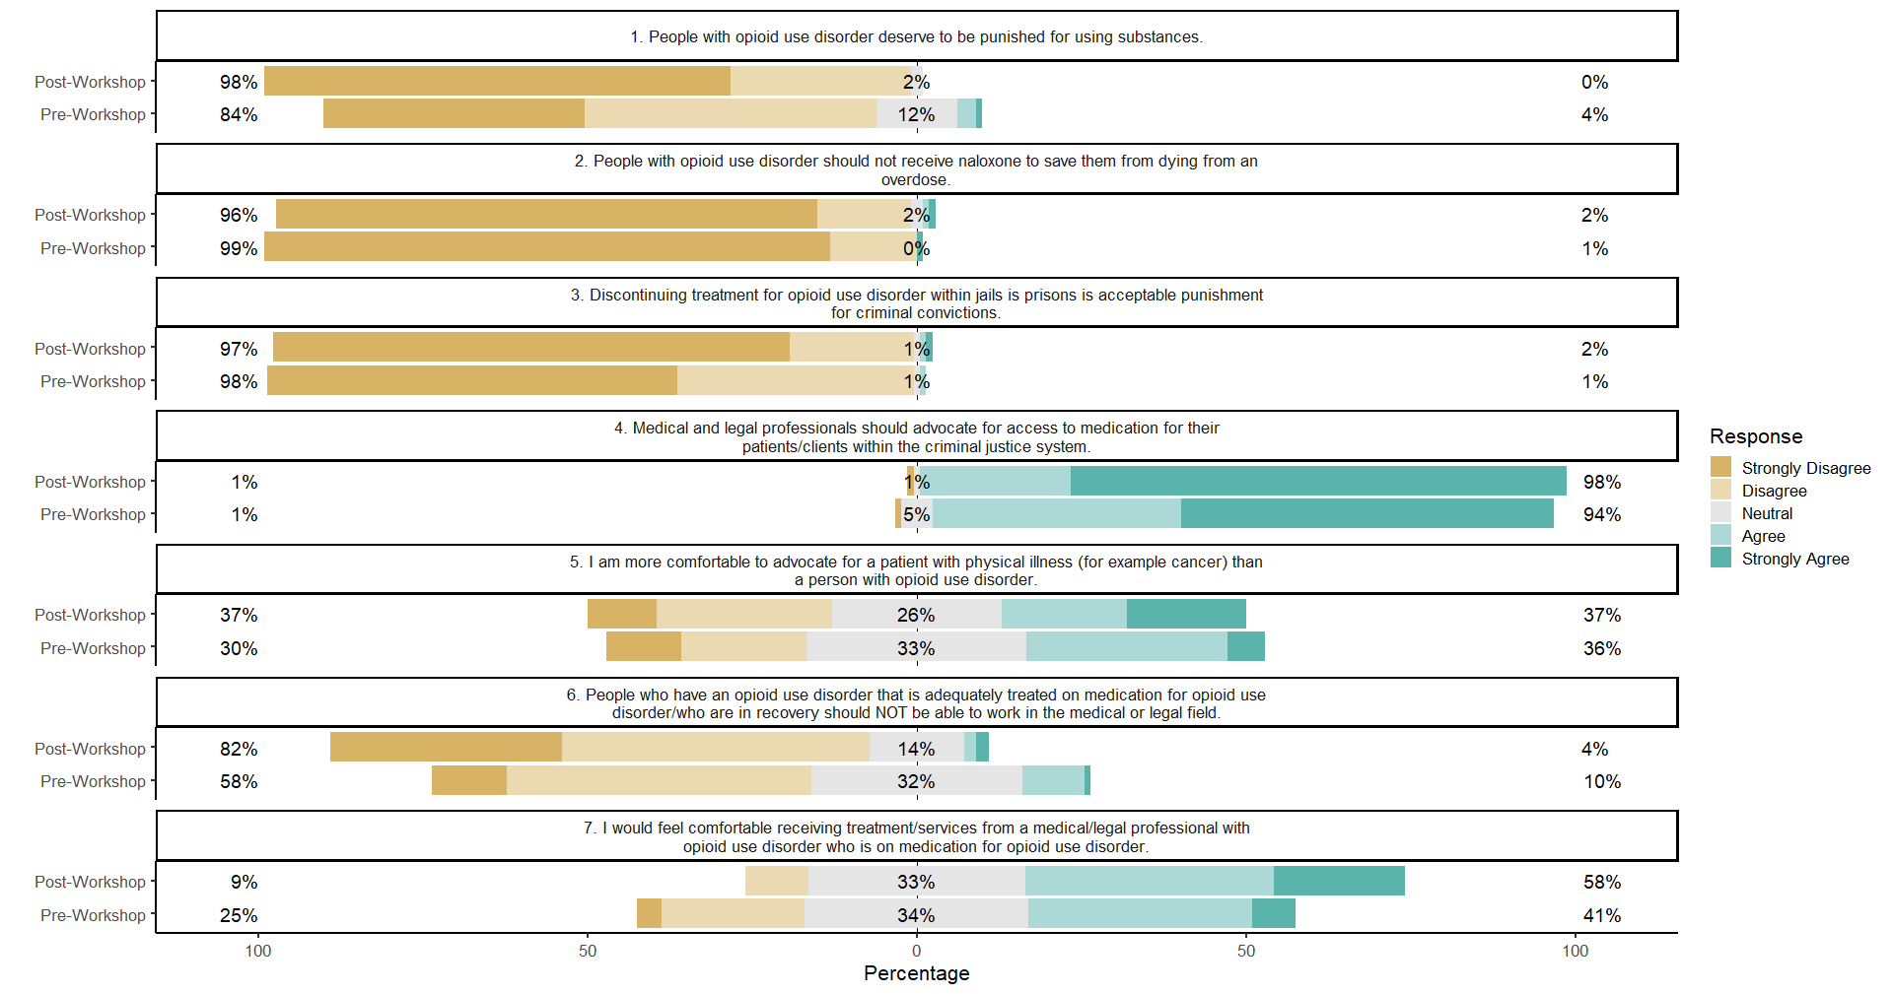

Slide 24
Next Steps
Increased surveying in the College of Law
Continued surveying in the College of Nursing
Analysis & Publication

Slide 25
Thank you!
Shavonnie R. Carthens, JD
shavonnie.carthens@uky.edu

