Slide 1
Law Enforcement,
Reproductive Health Information,
and the HIPAA Privacy Rule
Stacey A. Tovino, JD, PhD
John B. Turner Chair in Law
The University of Oklahoma College of Law
June 4, 2025

Slide 2
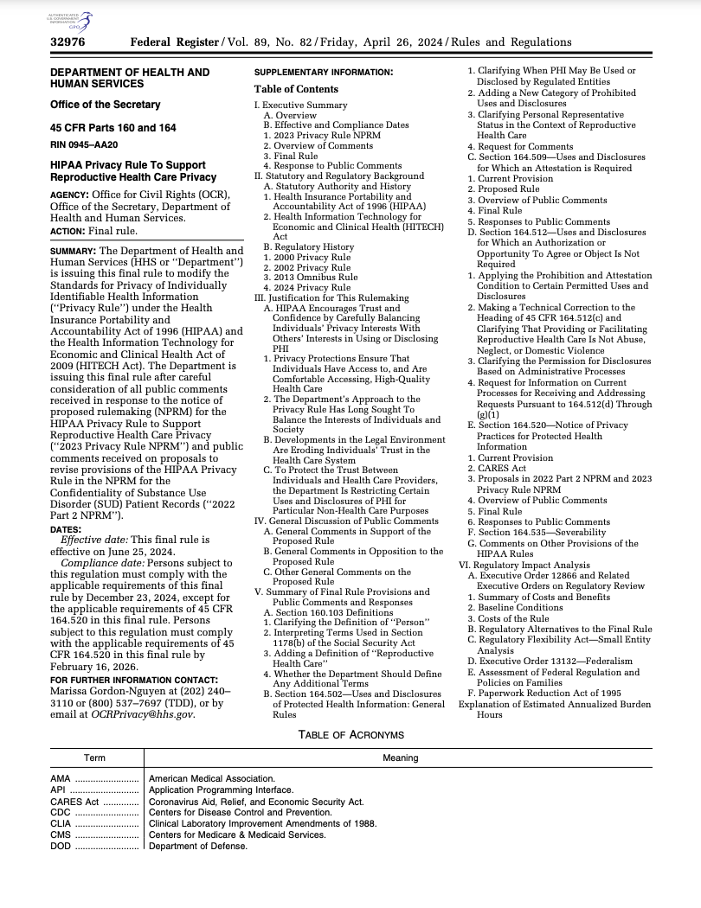
Title: “HIPAA Privacy Rule to Support Reproductive Health Care Privacy”
Pub. Date: April 26, 2024
Length: 91 pages (in total)
>86 pages (preamble)
<5 pages (actual regs)
Comments
Received: >25,900
Eff. Date: June 25, 2024
Comp. Dates: December 23, 2024*
February 16, 2026

Slide 3
Legal Challenges to – and the Current Status of – the April 26, 2024, Final Rule

Slide 4
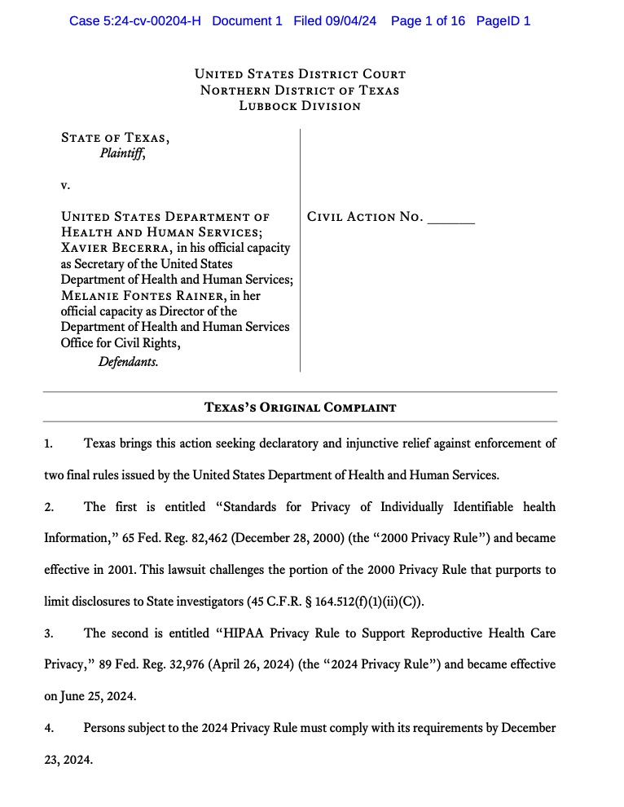
#1

Slide 5
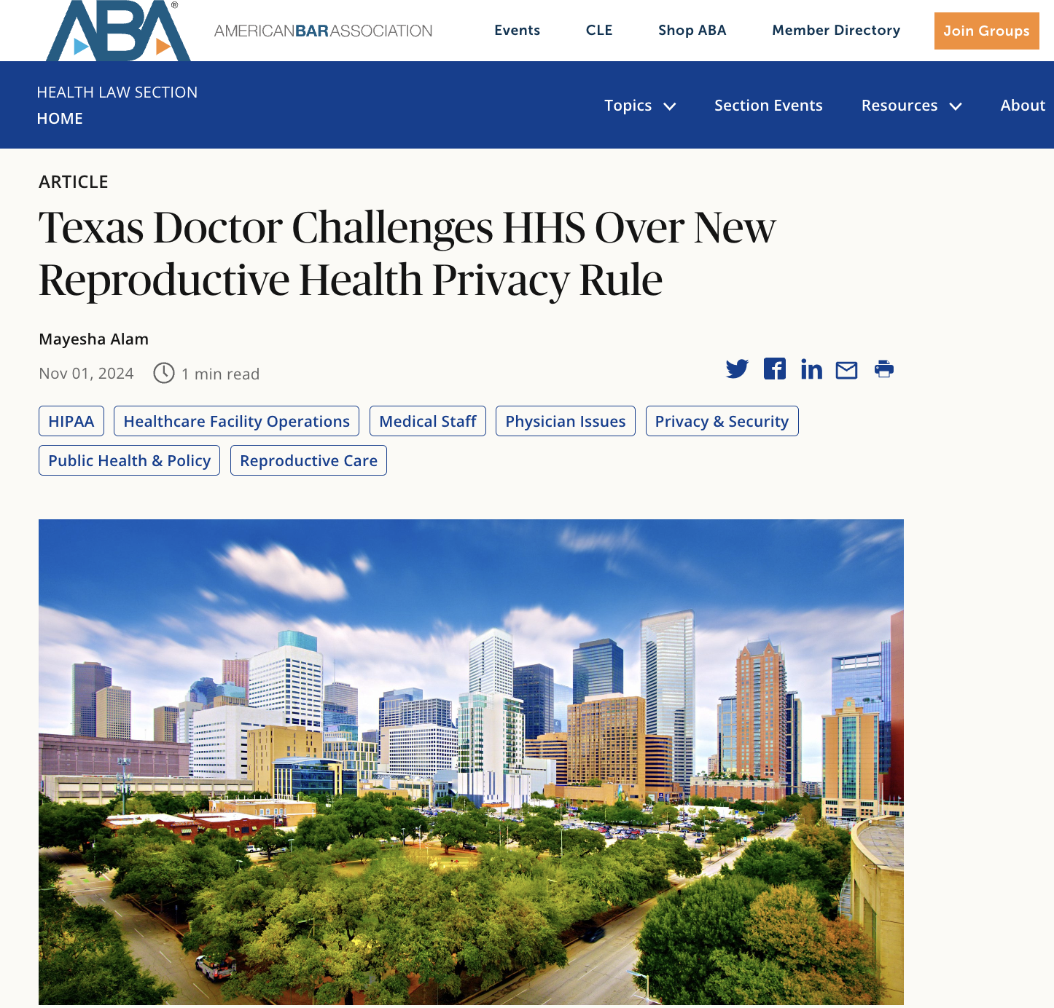
#2

Slide 6
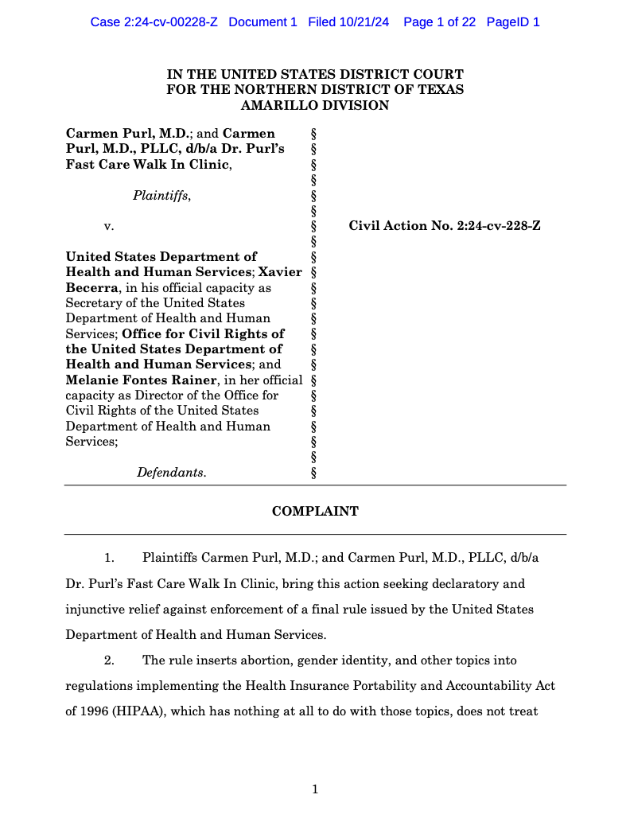

Slide 7
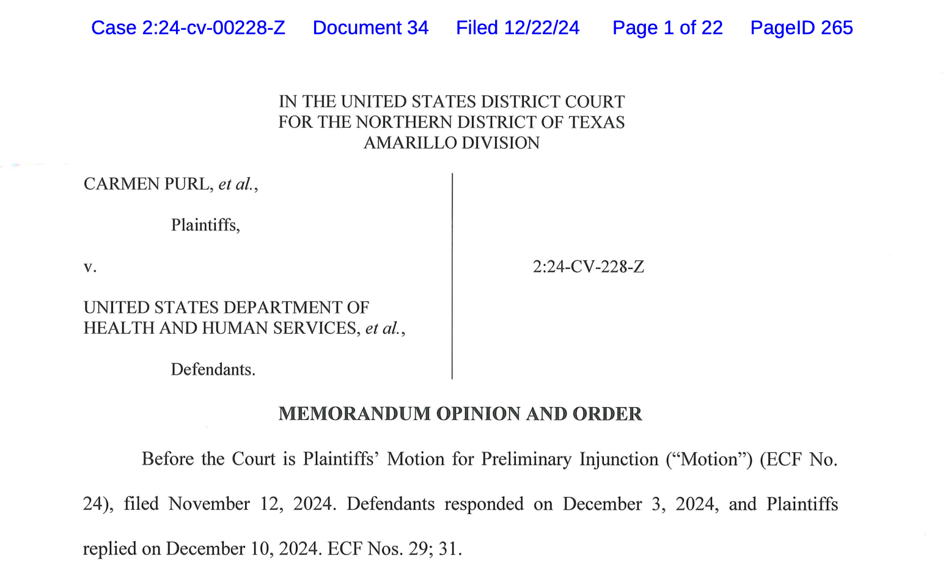

Slide 9
#3

Slide 10
HHS’s most recent filing in the Tennessee litigation (Apr. 21, 2025) focuses on Article III standing issues.

Slide 11
#4

Slide 12
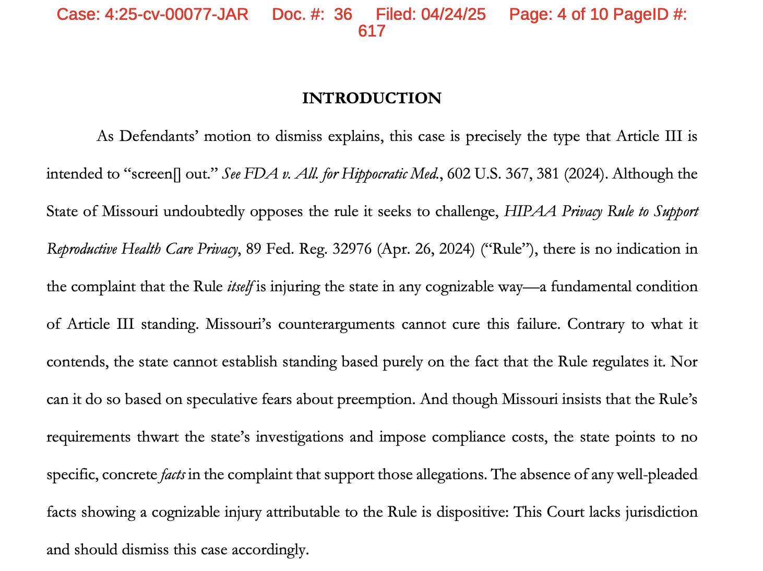
HHS’s most recent filing in the Missouri litigation (Apr. 24, 2025) focuses on Article III standing issues.

Slide 13
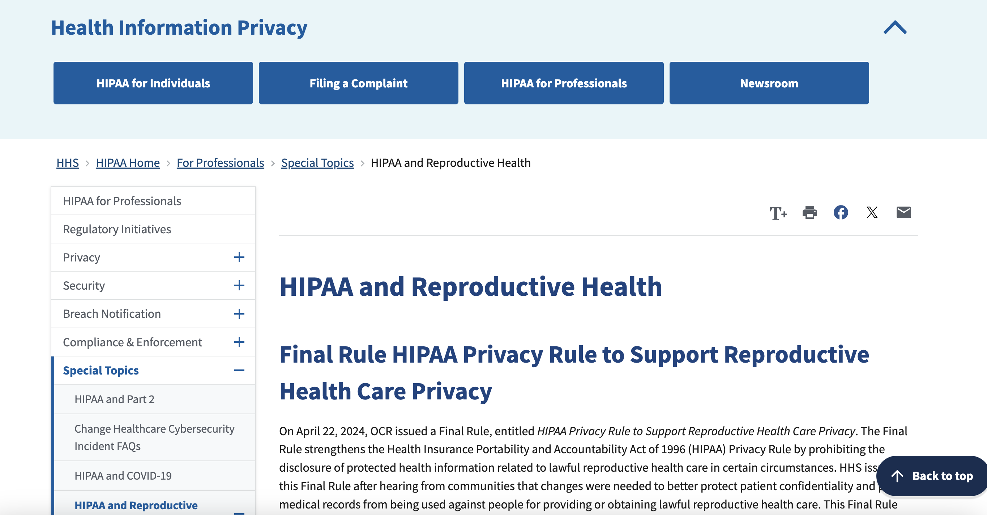

Slide 14
Most of the HIPAA Privacy Rule
has not changed.

Slide 15
First, the HIPAA Privacy Rule still only applies to covered entities (CEs) and their business associates (BAs)
Covered entities (CEs)
Health plans
Health care clearinghouses
Health care providers who transmit health information in electronic form in connection with a standard transaction (e.g., the health care claim transaction)
Business associates (BAs)
45 C.F.R. §§ 164.500(a), (c)

Slide 17
Other Examples of Non-HIPAA Covered Entities and Non-HIPAA-Regulated Business Associates
Any other cash-only health care practice
Web browsers (e.g., Chrome, Firefox, Safari)
Web search engines (e.g., Google, Yahoo)
Most mobile health apps (e.g., period tracker apps)
A friend who drove a person to get reproductive health care
A taxi or an Uber that dropped a person off at a health care clinic
Etc.

Slide 19
See, e.g., Virginia S.B. 754 Signed into law March 24, 2025; effective July 1, 2025

Slide 20
Second, the HIPAA Privacy Rule still only protects protected health information (PHI)
Individually identifiable health information (IIHI) is information that is . . .
Is created or received by a health care provider, health plan, employer, or health care clearinghouse; and
Relates to the past, present, or future physical or mental health or condition of an individual; the provision of health care to an individual; or the past, present, or future payment for the provision of health care to an individual; and
That identifies the individual; or
With respect to which there is a reasonable basis to believe the information can be used to identify the individual.
45 C.F.R. § 160.103

Slide 21
The HIPAA Privacy Rule still excepts the following four categories of information from the definition of PHI
Education records protected by FERPA
Student treatment records
Employment records held by a covered entity in its role as an employer
Information regarding someone who has been dead for more than 50 years
45 C.F.R. § 160.103

Slide 22
Third, the HIPAA Privacy Rule still allows CEs and BAs to de-identify PHI and use that de-identified information however they please
Safe Harbor Method
Expert Determination Method
45 C.F.R. § 164.514

Slide 23
Fourth, the HIPAA Privacy Rule still does not require a CE or BA to disclose a patient’s PHI to law enforcement
There are only two situations in which the Privacy Rule requires a covered entity to disclose PHI, both of which are unrelated to general* law enforcement activities:
To the patient, when requested under and required by 45 C.F.R. §§ 164.524 (right of access) or 164.528 (right to an accounting of disclosures); and
*To the Secretary of HHS, when needed by the Secretary to investigate or determine a covered entity’s compliance with the Privacy Rule.
45 C.F.R. § 164.502(a)(2)(i), (ii).

Slide 24
Although most of the HIPAA Privacy Rule has not changed, covered entities and business associates (other than Dr. Purl in Texas) are now required to comply with a new, purpose-based use and disclosure prohibition (and have been since the final rule’s general compliance date of December 23, 2024).

Slide 25
The final rule establishes a new, purpose-based use and disclosure prohibition that is layered on top of the PBA permissions
This prohibition restricts CEs and BAs from using or disclosing PHI for:
certain investigation purposes
certain imposition of liability purposes and
certain person identification purposes.
45 C.F.R. § 164.502(a)(5)(iii)(A)(1)-(3)
Contrast this purpose-based use and disclosure prohibition to the special confidentiality protections available to psychotherapy notes

Slide 26
Purpose-Based Use and Disclosure Prohibitions
This prohibition restricts CEs and BAs from using or disclosing PHI for any of the following purposes:
“To conduct a criminal, civil, or administrative investigation into any person for the mere act of seeking, obtaining, providing, or facilitating reproductive health care”;
“To impose criminal, civil, or administrative liability on any person for the mere act of seeking, obtaining, providing, or facilitating reproductive health care”; or
“To identify any person for any purpose described in [the preceding two bullets].”
45 C.F.R. § 164.502(a)(5)(iii)(A)(1)-(3)

Slide 27
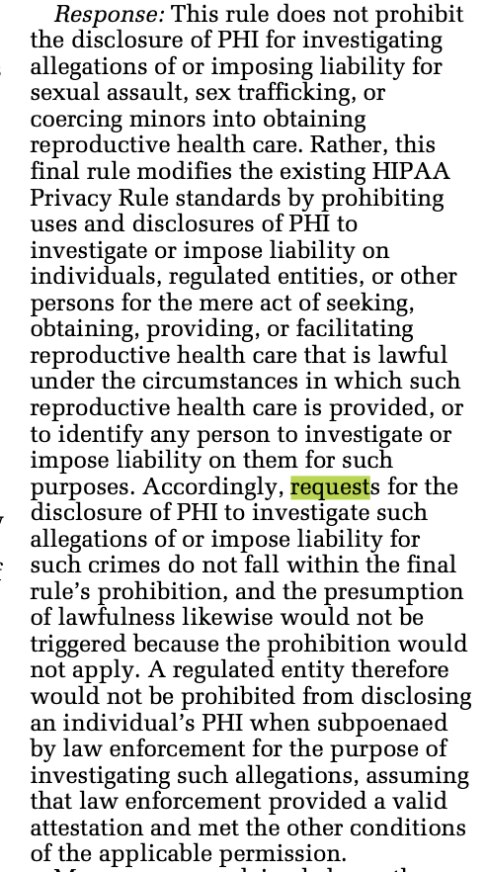
The following activities are considered unrelated to the “mere act of seeking, obtaining, providing, or facilitating reproductive health care”
89 Fed. Reg. 32976, 32994, 32995 (Apr. 26, 2024)

Slide 28
The purpose-based disclosure prohibition only applies when:
The rule of applicability has been satisfied.
45 C.F.R. §§ 164.502(a)(5)(iii)(B)

Slide 29
Rule of Applicability
The law enforcement activity is in connection with any person seeking, obtaining, providing, or facilitating reproductive health care, and the CE or BA that received the request for PHI has reasonably determined that one or more of the following conditions exists:
The reproductive health care is lawful under the law of the state in which such health care is provided under the circumstances in which it is provided;
The reproductive health care is protected, required, or authorized by Federal law, including the United States Constitution, under the circumstances in which such health care is provided, regardless of the state in which it is provided; or
The reproductive health care is provided by another person and presumed lawful. This presumption applies unless the CE or BA has any of the following: (1) actual knowledge that the reproductive health care was not lawful under the circumstances in which it was provided; or (2) factual information supplied by the person requesting the use or disclosure of PHI that demonstrates a substantial factual basis that the reproductive health care was not lawful under the specific circumstances in which it was provided.
45 C.F.R. § 164.502(a)(5)(iii)(B)(1)-(3), (C)

Slide 31
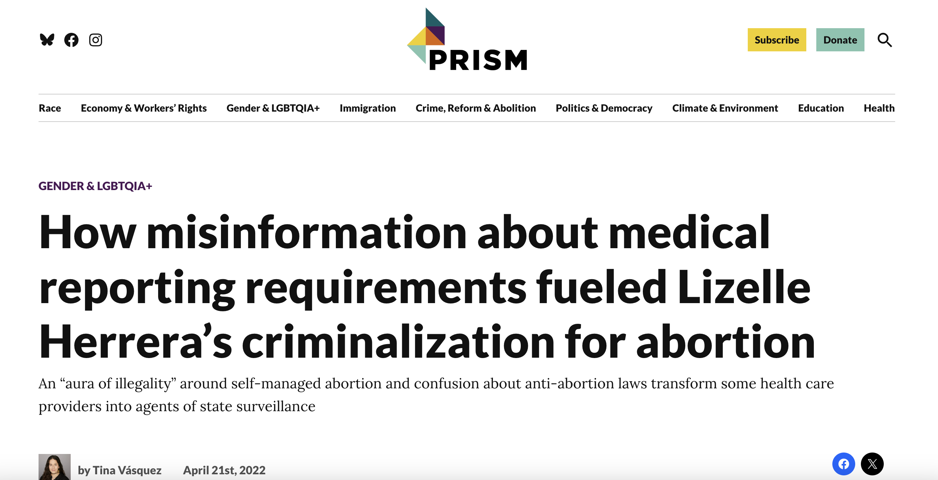

Slide 32
Sources of Examples of Provider- Volunteered Reproductive Health Information
Qualitative research studies investigating provider decision making relating to police reporting in the context of self-managed abortion and other pregnancy loss
Quantitative research studies investigating the prevalence of the criminalization of reproductive health care seeking behavior
Newspaper, radio, television, and other media reports of provider-volunteered reproductive health information

Slide 33
Seven* Permissive Law Enforcement Disclosures Provisions
Mandatory wound and other injury reporting provision
Court order, grand jury subpoena, or other administrative request provision
Identification or location provision
Victim of a crime provision
Decedent provision
Crime on premises provision
Responding to off-site emergency provision
45 C.F.R. 164.512(f)(1)-(6)

Slide 34
My recent scholarship on this topic includes:
Stacey A. Tovino, Confidentiality Over Privacy, 44 Cardozo L. Rev. 101 (2023).
Stacey A. Tovino, Aborted Confidentiality, 65 Boston College L. Rev. 1921 (2024).
Stacey A. Tovino, Law Enforcement, Reproductive Health Information, and the HIPAA Privacy Rule, Iowa J. Gender, Race & Justice (forthcoming 2025).

Slide 35
Thank you!
Stacey.Tovino@ou.edu
832/289-6313

Slide 36
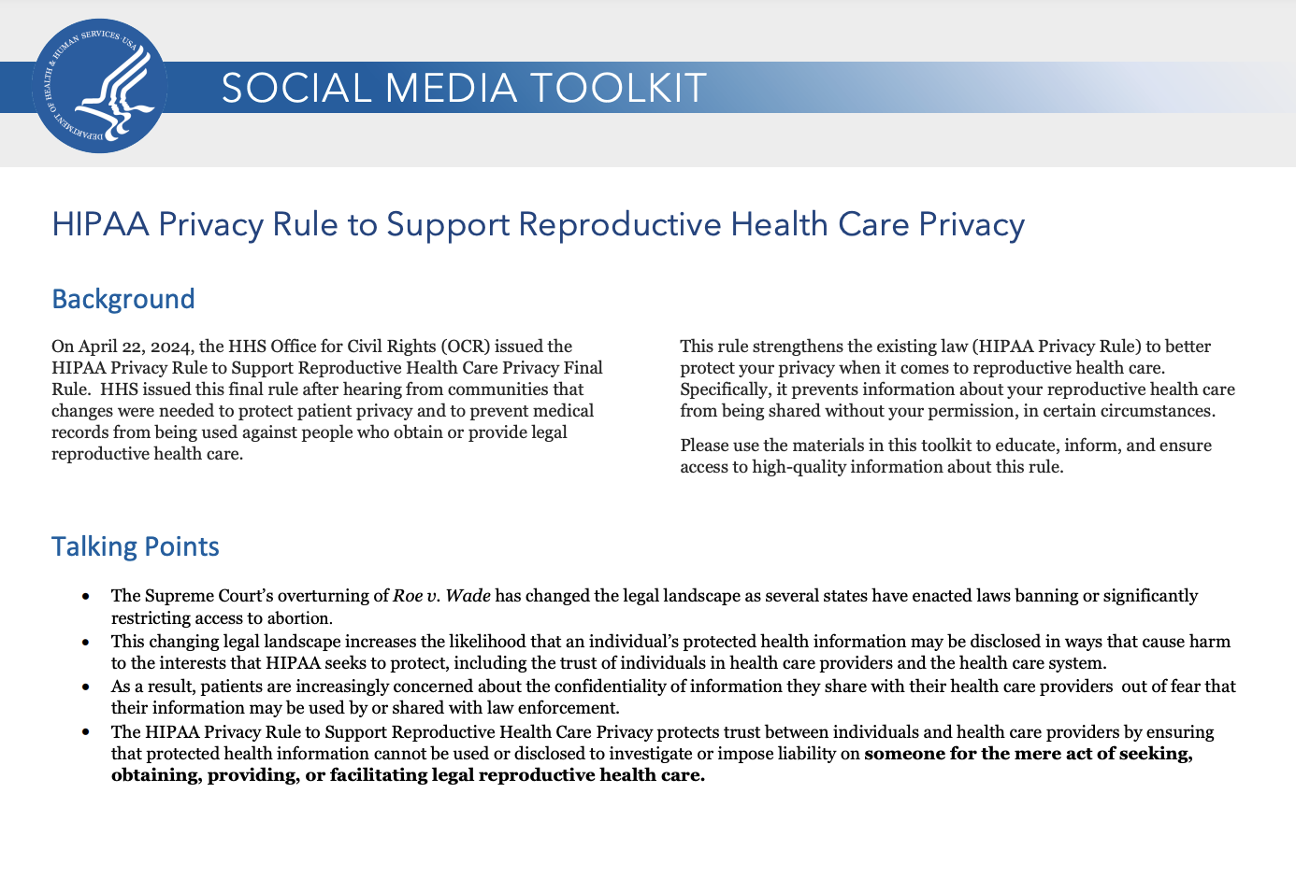
HHS Guidance, Fact Sheet, Social Media Tool Kit, and PowerPoint Presentation https://www.hhs.gov/hipaa/for-professionals/special-topics/reproductive-health/index.html

Slide 37
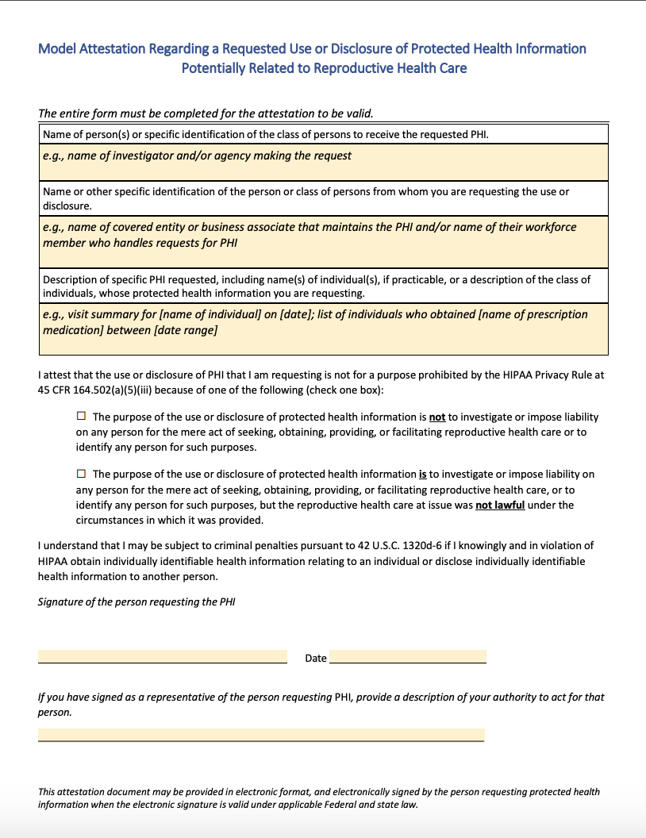
HHS Model Attestation

Slide 38
Let’s practice:
Patient from an abortion-restricting state (e.g., OK) gets a legal abortion in an abortion-permitting state (e.g., NH) and the NH provider receives a request for relevant PHI from OK law enforcement.
Patient from an abortion-restricting state (e.g., OK) gets a legal abortion in an abortion-permitting state (e.g., NH) and an OK provider to whom the patient subsequently presents for an ultrasound or follow-up care receives a request for relevant PHI from law enforcement.
A non-pregnant patient goes to an ob-gyn (in any state) to get birth control and that provider then receives a request for PHI relating to the birth control prescription from law enforcement.

Slide 39
Let’s practice:
Patient in an abortion-restricting state (e.g., OK) gets an abortion in OK to save the life of the patient. Then, an OK law enforcement officer requests PHI about the abortion from the OK provider for purposes of investigating the OK provider for providing an illegal abortion.
Patient in an abortion-restricting state (e.g., OK) gets an illegal abortion in that state. Then, an OK law enforcement officer requests PHI about the abortion from the abortion provider.
Patient in an abortion-restricting state (e.g., OK) gets a legal abortion in an abortion-permitting state (e.g., NH). Then, law enforcement requests PHI from the patient’s covered health insurer, which paid for the NH abortion.

Slide 40
89 Fed. Reg. at 33014
Example of a
substantial factual basis
Example of a lack of a substantial factual basis

Slide 41
Remember, the purpose-based disclosure prohibition only applies when:
The rule of applicability has been satisfied.
45 C.F.R. §§ 164.502(a)(5)(iii)(B)

Slide 42
Rule of Applicability
The law enforcement activity is in connection with any person seeking, obtaining, providing, or facilitating reproductive health care, and the CE or BA that received the request for PHI has reasonably determined that one or more of the following conditions exists:
The reproductive health care is lawful under the law of the state in which such health care is provided under the circumstances in which it is provided;
The reproductive health care is protected, required, or authorized by Federal law, including the United States Constitution, under the circumstances in which such health care is provided, regardless of the state in which it is provided; or
The reproductive health care is provided by another person and presumed lawful. This presumption applies unless the CE or BA has any of the following: (1) actual knowledge that the reproductive health care was not lawful under the circumstances in which it was provided; or (2) factual information supplied by the person requesting the use or disclosure of PHI that demonstrates a substantial factual basis that the reproductive health care was not lawful under the specific circumstances in which it was provided.
45 C.F.R. § 164.502(a)(5)(iii)(B)(1)-(3), (C)

Slide 43
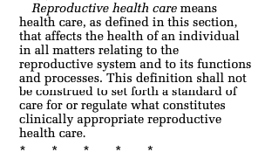
Valid attestation required for uses and disclosures of PHI that are not prohibited by the purpose-based disclosure prohibition
A CE or BA may not use or disclose PHI potentially related to reproductive health care . . . [for one of the 4 PBAs] without obtaining a [valid] attestation . . . from the person requesting the use or disclosure . . .
45 C.F.R. § 164.509(a)(1)

Slide 44
Definition of “person”
“natural person (meaning a human being who is born alive), trust or estate, partnership, corporation, professional association or corporation, or other entity, public or private.”
“Therefore, an ‘individual,’ ‘child,’ or ‘victim’ (e.g., victim of a crime) under the HIPAA Rules must be a natural person.’” 89 Fed. Reg. at 32997.

Slide 45
Public Health v. Law Enforcement Investigations
Population level activities include “identifying, monitoring, preventing, or mitigating ongoing or prospective threats to the health or safety of a population, which may involve the collection of protected health information.”
“The final rule does not affect the reporting of vital statistics.” 89 Fed. Reg. at 32998.

Slide 46
89 Fed. Reg. 33003

Slide 47
Does the HIPAA Privacy Rule ever allow a covered entity to make a disclosure of PHI?
Yes
if the disclosure is for treatment, payment, or health care operations (TPO) under 45 C.F.R. § 164.506;
Yes
if the individual has orally agreed or not objected to the disclosure under 45 C.F.R. § 164.510;
Yes
if the disclosure is for a public benefit activity (PBA) under 45 C.F.R. § 164.512; and
Yes
if the disclosure is in accordance with the patient’s prior written authorization under 45 C.F.R. § 164.508.

Slide 48
Public Benefit Activity (PBA) Disclosures 45 C.F.R. §§ 164.512(a)-(l)
Disclosures required by law
Disclosures for public health activities
Disclosures about victims of abuse, neglect, or domestic violence
Disclosures for health oversight activities
Disclosures for judicial and administrative proceedings
Disclosures for law enforcement purposes
Disclosures about decedents
Disclosures for cadaveric organ, eye, or tissue donation
Disclosures for research purposes
Disclosures to avert a serious threat to health or safety
Disclosures for specialized government functions
Disclosures for workers’ compensation

Slide 49
42 U.S.C. 1320d-7(b)

Slide 50
HHS Fact Sheet: Examples

Slide 51
89 Fed. Reg. 32976, 32993 (Apr. 26, 2024)

Slide 52
89 Fed. Reg. 32976, 32994 (Apr. 26, 2024)

Slide 53
Required Content of an Attestation
A description of the information requested that identifies the information in a specific fashion, including one of the following: (A) The name of any individual(s) whose PHI is sought, if practicable; or (B) If including (A) is not practicable, a description of the class of individuals whose PHI is sought.
The name or other specific identification of the person(s), or class of persons, who are requested to make the use or disclosure.
The name or other specific identification of the person(s), or class of persons, to whom the covered entity is to make the requested use or disclosure.
A clear statement that the use or disclosure is not for a purpose prohibited by the purpose-based disclosure prohibition.
A statement that a person may be subject to criminal penalties pursuant to 42 U.S.C. 1320d-6 if that person knowingly and in violation of HIPAA obtains IIHI relating to an individual or discloses IIHI to another person.
Signature of the person requesting the PHI, which may be an electronic signature, and date.
45 C.F.R. § 164.509(c)(1)

Slide 54
Valid and Defective Attestations
A valid attestation:
Contains the required content (last slide);
Verifies that the use or disclosure is not otherwise prohibited by the purpose-based disclosure prohibition; and
May be electronic, provided that it contains the required content (last slide).
A defective attestation:
lacks required content (see last slide);
contains elements or statements other than the required content;
is combined with any other document except . . .*
The CE or BA has actual knowledge that material information in the attestation is false; or
A reasonable CE or BA in the same position would not believe that the statement that the use or disclosure is not for a prohibited purpose is true.
45 C.F.R. § 164.509(b)(1), (2), and (c)

Slide 56
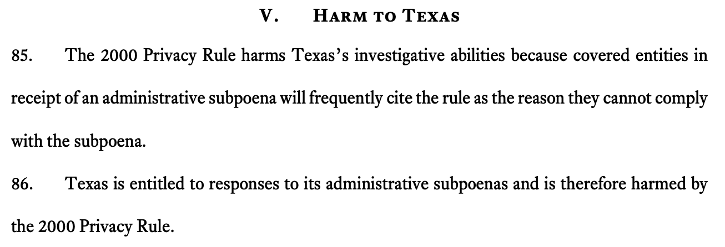
Arguments made by the State of Texas in its September 2024 challenge

Slide 57
The final rule defines “seeking, obtaining, providing, or facilitating reproductive health care” to include, but not be limited to:
“expressing interest in, using, performing, furnishing, paying for, disseminating information about, arranging, insuring, administering, authorizing, providing coverage for, approving, counseling about, assisting, or otherwise taking action to engage in reproductive health care; or attempting any of the same.”
45 C.F.R. § 164.502(a)(5)(iii)(D)

Slide 58
An investigation into whether reproductive health care is necessary to save a pregnant person’s life constitutes an investigation into the “mere act” of S/O/P/F RHC.

Slide 59
1. Mandatory wound and other injury reporting provision
A covered entity may disclose PHI . . . as required by law including laws that require the reporting of certain types of wounds or other physical injuries . . .
Compare Tex. Health & Safety Code § 161.041 (“A physician who attends or treats . . . a bullet or gunshot wound . . . shall report the case at once to the law enforcement authority of the municipality or county in which the physician practices or in which the institution is located.”)
With N.H. Rev. Stat. § 631:6(I) (“. . . a person is guilty of a misdemeanor if, having knowingly treated or assisted another for a gunshot wound or for any other injury he believes to have been caused by a criminal act, he fails immediately to notify a law enforcement official of all the information he possesses concerning the injury . . .”).

Slide 60
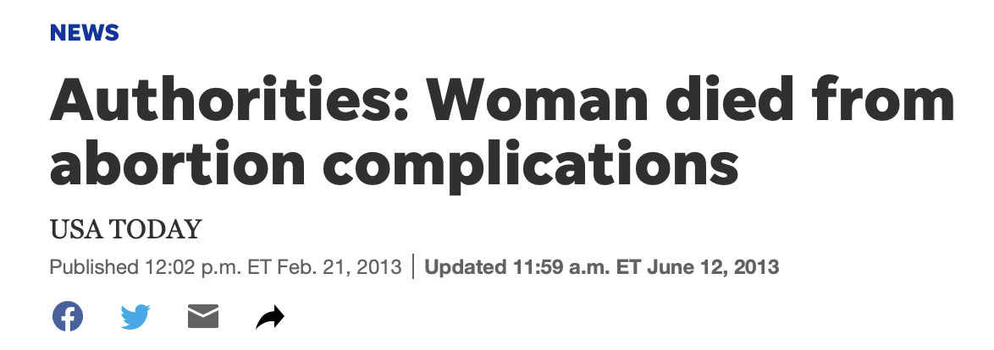
5. Decedent provision
A covered entity may disclose PHI about an individual who has died to a law enforcement official for the purpose of alerting law enforcement of the death of the individual if the covered entity has a suspicion that such death may have resulted from criminal conduct.
45 C.F.R. § 164.512(f)(4).

Slide 61
6. Crime on premises provision
A covered entity may disclose to a law enforcement official PHI that the covered entity believes in good faith constitutes evidence of criminal conduct that occurred on the premises of the covered entity.
An example that might fit under this provision: A patient at a hospital located in an abortion-restrictive state receives a surgical abortion at the hospital because the patient’s attending physician believes the abortion is necessary to save the patient’s life and the patient consents to the abortion. Another physician at the same hospital disagrees that the abortion was necessary to save the patient’s life. If the second physician’s belief that the abortion was unnecessary to save the patient’s life is a good faith belief, the second physician may report the abortion to law enforcement because the abortion occurred on the hospital’s premises.
An example that would not fit under this provision: A person presents to a hospital’s ED bleeding heavily in an abortion-restrictive state and a health care worker believes that the person had an illegal abortion. This provision does not allow the health care worker to disclose the situation to (alert) law enforcement because the perceived crime (the abortion) did not occur on the premises of the hospital (the covered entity).
45 C.F.R. § 164.512(f)(5).

Slide 62
7. Responding to off-site emergency provision
A covered health care provider providing emergency health care in response to a medical emergency, other than such emergency on the premises of the covered health care provider, may disclose PHI to a law enforcement official if such disclosure appears necessary to alert law enforcement to:
(A) The commission and nature of a crime;
(B) The location of such crime or of the victim(s) of such crime; and
(C) The identity, description, and location of the perpetrator of such crime.

Slide 63
Seven* Permissive Law Enforcement Disclosures Provisions
Mandatory wound and other injury reporting provision
Court order, grand jury subpoena, or other administrative request provision
Identification or location provision
Victim of a crime provision
Decedent provision
Crime on premises provision
Responding to off-site emergency provision
*45 C.F.R. 164.512(f)(1)-(6)*

Slide 64
2. Court order, grand jury subpoena, or administrative request provision
A covered entity may disclose PHI …. in compliance with and as limited by the relevant requirements of:
(A) A court order or court-ordered warrant, or a subpoena or summons issued by a judicial officer;
(B) A grand jury subpoena; or
(C) An administrative request for which response is required by law, including an administrative subpoena or summons, a civil or an authorized investigative demand, or similar process authorized under law, provided that:
(1) The information sought is relevant and material to a legitimate law enforcement inquiry;
(2) The request is specific and limited in scope to the extent reasonably practicable in light of the purpose for which the information is sought; and
(3) De-identified information could not reasonably be used.
45 C.F.R. § 164.512(f)(1)(ii).

Slide 65
3. Identification or location provision
A covered entity may disclose PHI in response to a law enforcement official’s request for such information for the purpose of identifying or locating a suspect, fugitive, material witness, or missing person, provided that . . . [t]he covered entity disclose[s] only the following information:
Name and address;
Date and place of birth;
Social security number;
ABO blood type and rh factor;
Type of injury;
Date and time of treatment;
Date and time of death, if applicable; and
A description of distinguishing physical characteristics, including height, weight, gender, race, hair and eye color, presence or absence of facial hair (beard or moustache), scars, and tattoos.
45 C.F.R. § 164.512(f)(2).

Slide 66
4. Victim of a crime provision
A covered entity may disclose PHI in response to a law enforcement official’s request for such information about an individual who is or is suspected to be a victim of a crime . . . if:
The individual agrees to the disclosure; or
The covered entity is unable to obtain the individual’s agreement because of incapacity or other emergency circumstance, provided that:
The law enforcement official represents that such information is needed to determine whether a violation of law by a person other than the victim has occurred, and such information is not intended to be used against the victim;
The law enforcement official represents that immediate law enforcement activity that depends upon the disclosure would be materially and adversely affected by waiting until the individual is able to agree to the disclosure; and
The disclosure is in the best interests of the individual as determined by the covered entity, in the exercise of professional judgment.
45 C.F.R. § 164.512(f)(3).

