Slide 1
Coercive compassion
Theorizing Assisted Outpatient Treatment
Lea Johnston
University of Florida College of Law

Slide 2
Preventive Outpatient commitment [Poc]
Court-ordered outpatient mental health treatment
Serious mental health condition
History of treatment noncompliance
Prevent psychiatric deterioration
Before endangering self or others
Poses no immediate danger
Typically can make rational treatment decisions
May reside in the community

Slide 3
Forms of Outpatient civil commitment
Release from involuntary hospitalization
Alternative to involuntary hospitalization
Preventive treatment

Slide 4
Preventive outpatient commitment statutes
23 states have enacted POC statutes
15 were passed or have been expanded since 2019

Slide 5
Justifications for poc
Thank-you theory
Consequentialism
Patients lack autonomy
POC restores autonomy
Afterwards, patients are grateful
Patients have impaired insight
POC’s anticipated benefits
Outweigh costs to autonomy

Slide 6
Treatment decision-making incapacity

Slide 7
TREATMENT incapacity
Only 2 statutes require decision-making incapacity
Another 3 statutes require impaired decision-making capacity
Most POC statutes merely require unwillingness or unlikelihood of participating in voluntary treatment

Slide 8
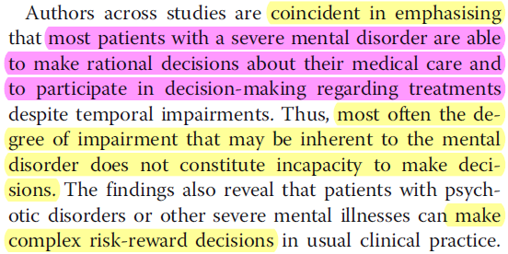

Slide 9
Retrospective patient gratitude

Slide 11
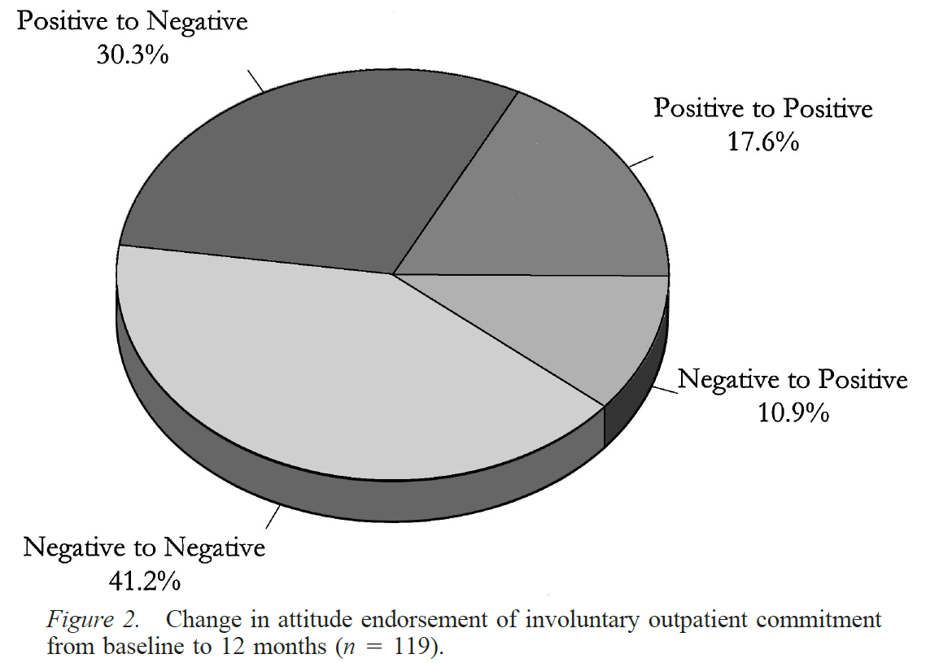

Slide 13
Patients’ views of Poc
negative
positive
Coercion
Lack of self-determination & control over treatment
Impeded therapeutic relationship
Restrictions on freedom & autonomy
Feelings of helplessness
Stigma & judgment by others
Isolation
More independence than hospitalization
Safety net against degeneration
Improved decision-making abilities
Increased feelings of self-control & self-governance
Welcome structure & routine

Slide 14
POC’s Efficacy

Slide 15
No robust evidence suggests that preventive outpatient commitment results in a single, positive health-services or patient-level outcome.

Slide 16
Strength of Clinical Trial Designs
Randomized controlled trials
Controlled trials
Uncontrolled trials

Slide 17
Randomized controlled trials
No statistically significant difference between POC and control group in:
Hospital readmission
Length of hospital stay
Contact with mental health or medical services
Service intensity
Compliance with medication

Slide 18
Randomized controlled trials
No statistically significant difference between POC and control group in:
General mental state
Psychopathology
Social functioning
Quality of life
Offenses resulting in arrest
Homelessness

Slide 19
Strength of Clinical Trial Designs
Randomized controlled trials
Controlled trials
Uncontrolled trials

Slide 20
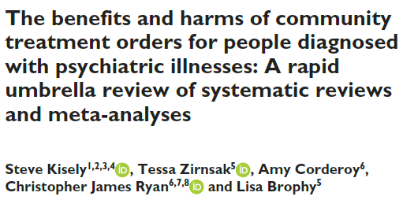
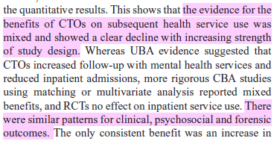

Slide 21
Where to go from here?

Slide 22
Reform POC
Require consent (under supported decision-making model)
Narrow to “revolving-door” patients
History of hospitalization
Patient is likely to be nonadherent to treatment
Leading to likely continued deterioration
To the point of satisfying inpatient commitment criteria
Least restrictive option of care
Individual’s best interest

Slide 23
Reasons for not receiving mental health services:
Cannot afford cost of care (52%)
Not knowing where to go for services (37%)
Concern about being committed to psychiatric hospital or having to take medicine (23%)
13.1M adults with SMI
48% unmet need
31% no services at all in last year

Slide 26
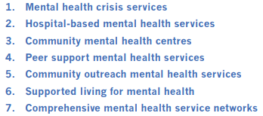
Supporting technical packages:

Slide 27
THANK YOU
Lea Johnston
johnstonl@law.ufl.edu

