Slide 1
Born to Last: Genetic Continuity Beyond Procreation and Parenthood
Dr. Shelly Simana
Boston College Law School
Health Law Professors Conference
June 4, 2025

Slide 2
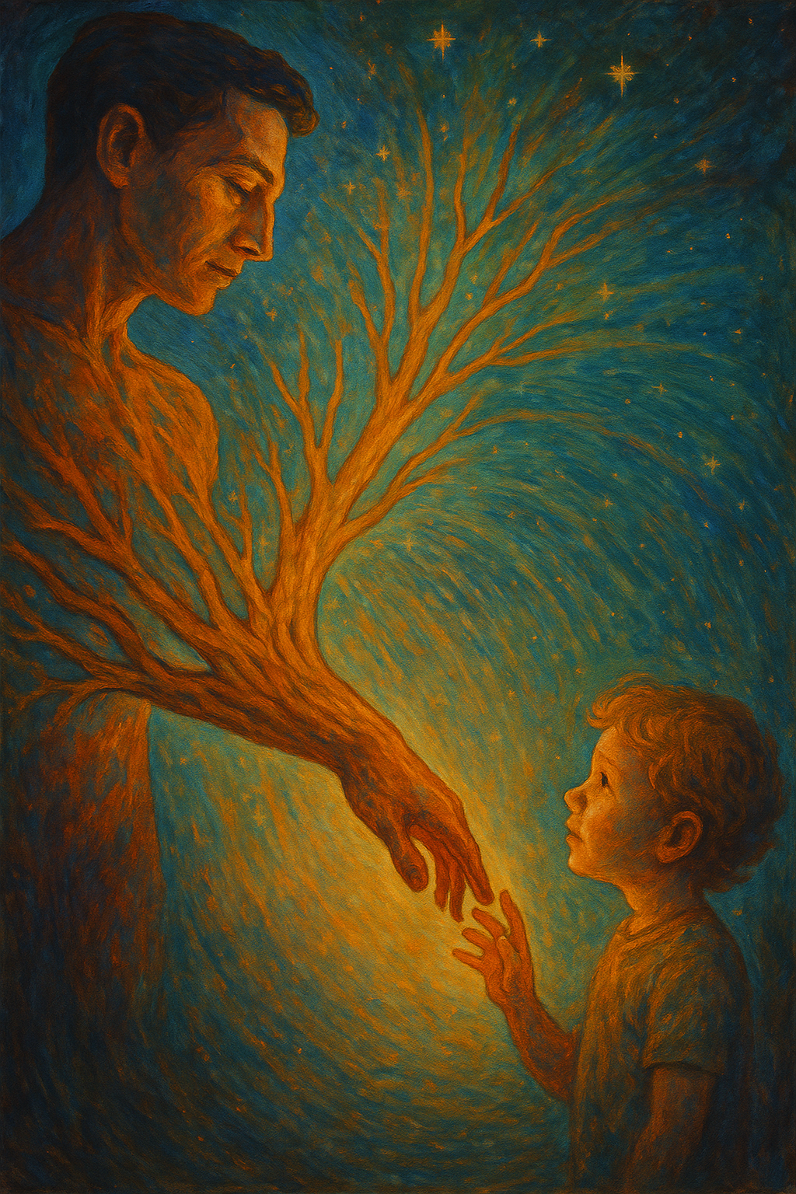

Slide 3
“Genetic Affinity” $$≠$$ $“\text{G}\text{enetic} \text{C}\text{ontinuity}$”

Slide 4
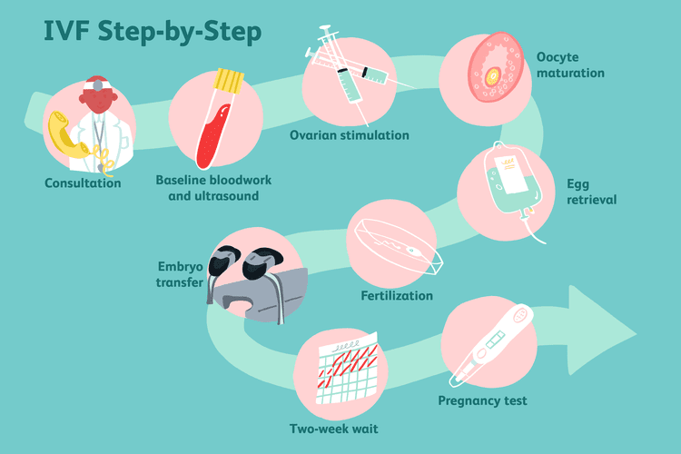

Slide 5
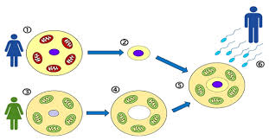

Slide 6
“Do not say that it is going to be ok, because it is not. I have made a great effort and suffered to leave eggs. Please use them. The most important thing for me is that my life will be continued.”

Slide 7
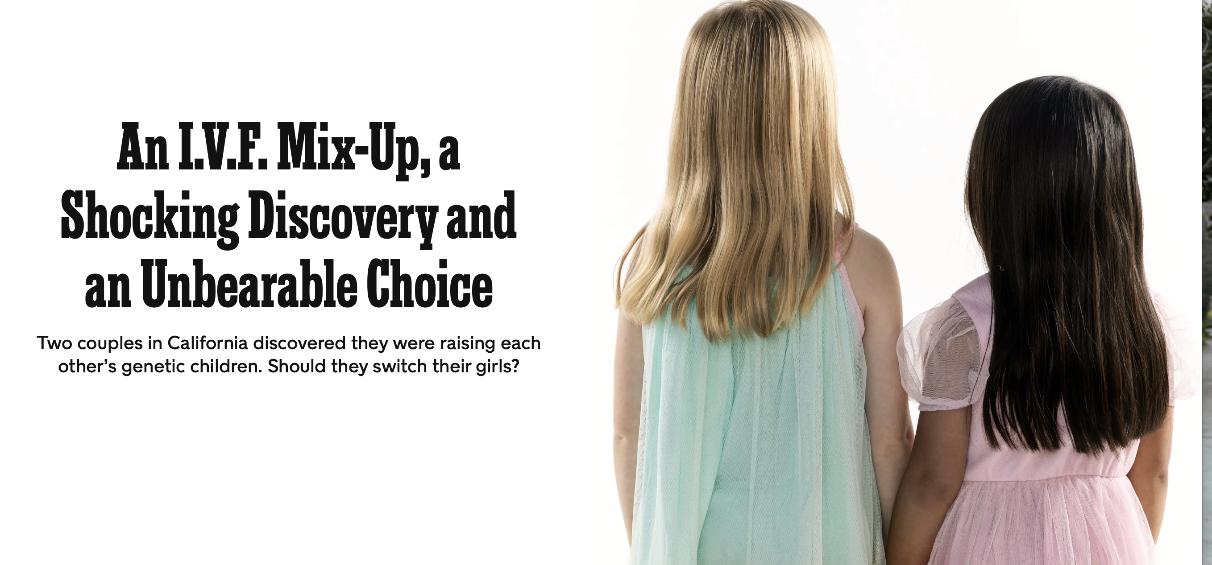

Slide 8
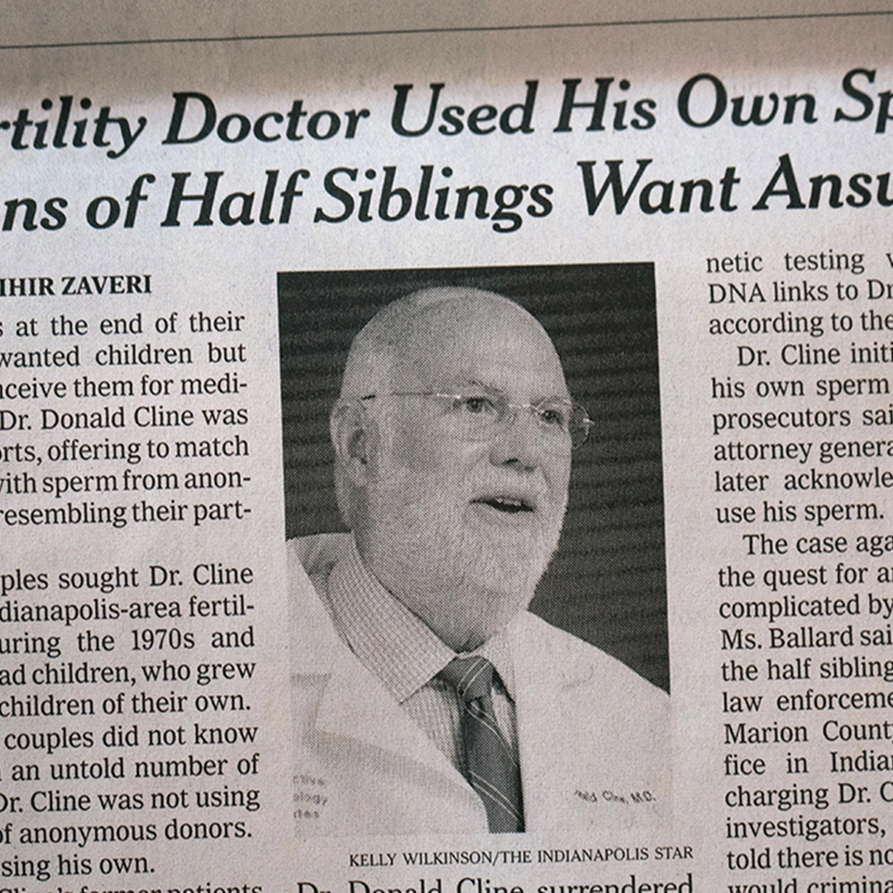
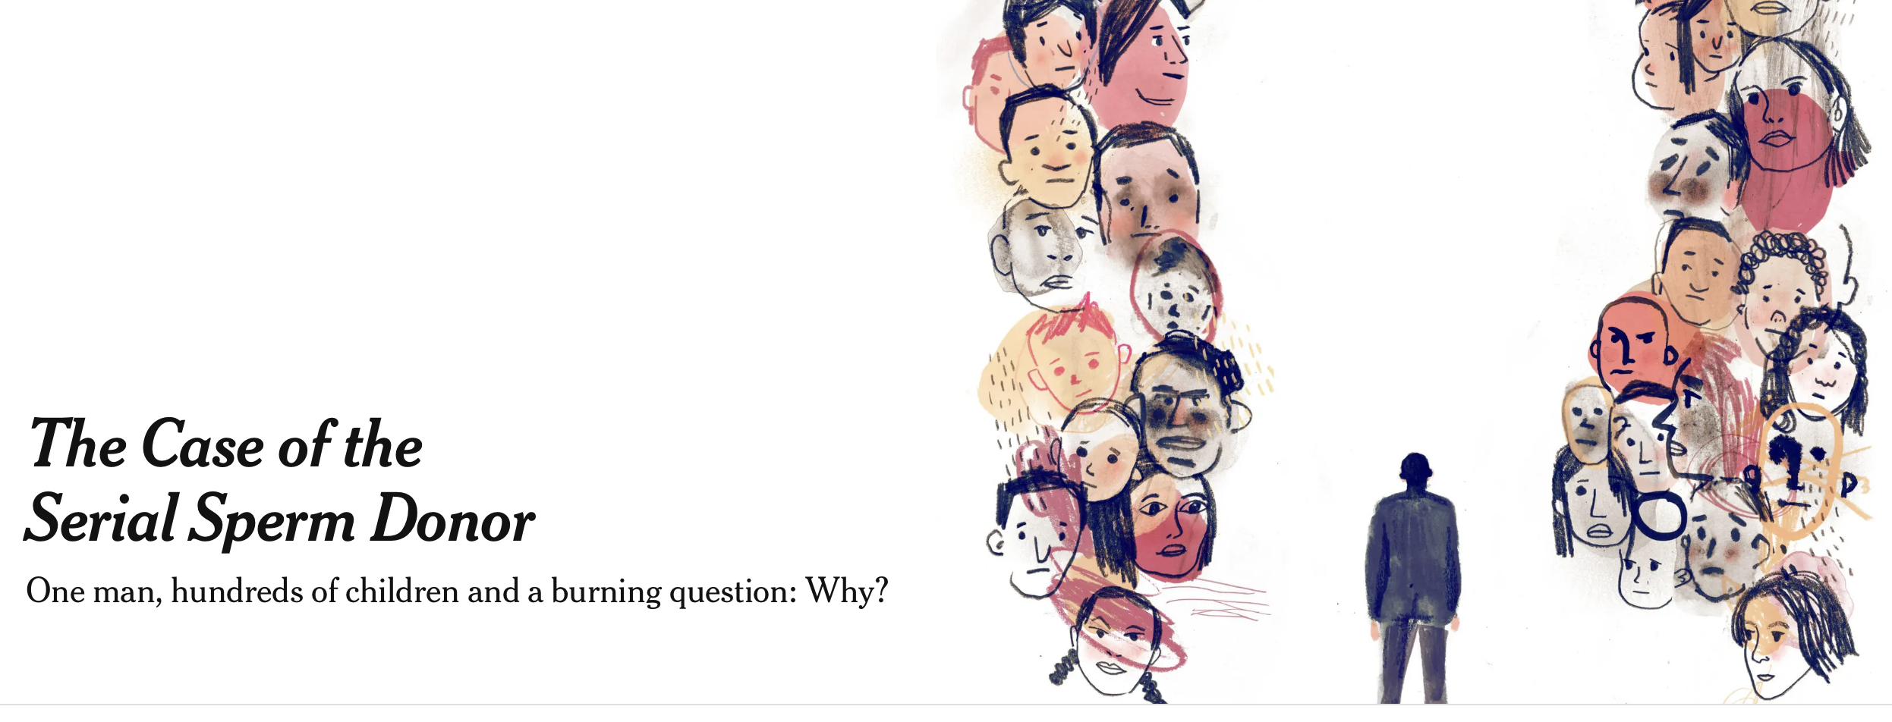

Slide 9
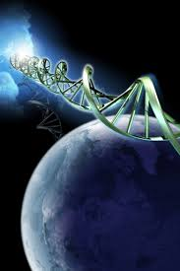
Genetic continuity is about wanting to leave behind a part of oneself.

Slide 10
Procreation
Genetic Continuity
Parenthood

Slide 11
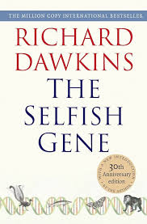
Evolutionary Roots
Genetic continuity as a primary reward (v. secondary reward).
Genetic continuity as ultimate explanation (v. proximate explanation).
Richard Dawkins and his theory of the “selfish gene.”
Evolution favors traits that promote genetic continuity, such as sexual pleasure, parental bonding, and kin loyalty.

Slide 12
Philosophical Roots
Genetic continuity as “self-extension.”
Derek Parfit and his theory on personal identity.
We shouldn’t care so much about whether we remain the “same person” over time in a strict, numerical sense. What matters is Relation R. That includes memory, personality, beliefs, and the connections between different stages of a person’s life.
Genetic continuity as a kind of intergenerational Relation R.

Slide 13
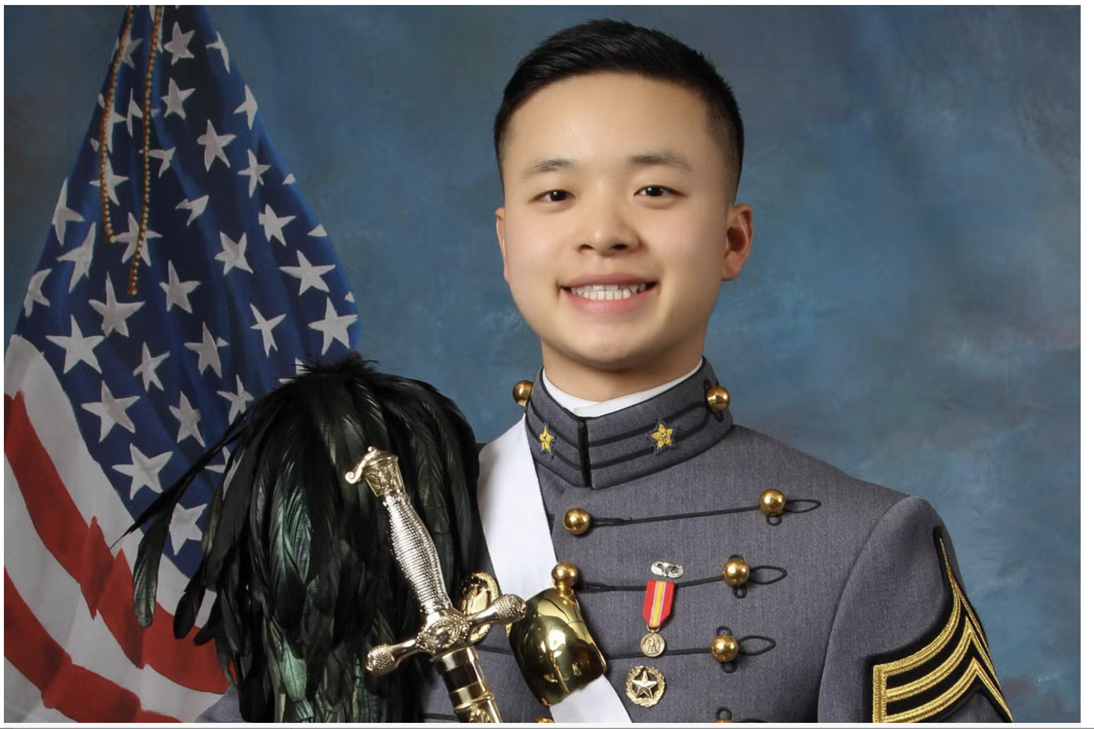
Cultural Roots
Religion (e.g., Judaism, Islam, Christianity)
Cultural norms (e.g., Confucianism)
“Our family comes from China… and an extremely important part of our Chinese culture is the tradition of carrying on our family lineage. Peter is the only male child in the Zhu family. When he was born, his grandfather cried tears of joy. Peter fully intended to carry on our family’s lineage through children of his own. Without obtaining his genetic material, it will be impossible to carry on our family’s lineage—and more importantly, we will be left without any piece of Peter. This is not what Peter wanted” (Zhu family’s petition).

Slide 14
Legal Recognition of Genetic Continuity
Externalities-Based Approach
Default: The interest in genetic continuity generally warrants protection, unless it causes serious harm to others.
Categorical limits:
Violation of another person’s bodily autonomy;
Deception and fraud;
Exclusion or discrimination;
Reproductive coercion;
Unchecked reproduction.
Contextual limits:
Scale;
Time horizon;
Cultural context;
Expressed intent.

Slide 15
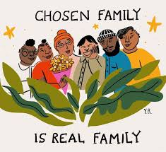
Clarifications
Not everyone values genetic continuity in the same way.
Recognizing the value of genetic continuity does not mean devaluing adoption, donor conception, other forms of chosen family.

Slide 16
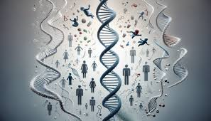
Thank You!
shelly.simana@bc.edu

