Slide 1
Solidarity in the Pandemic Treaty: Recognition and Operationalisation
Safura Abdool Karim, PhD
GLIDE Post-doctoral Fellow, Berman Institute of Bioethics
Adjunct Assistant Professor, Mailman School of Public Health, Columbia University
Research Associate, Ethox Center, Oxford University
Research Associate, Center for the Aids Programme of Research in South Africa
The Pandemic Treaty: A New Global Public Health Instrument
National School of Public Health, Universidade Nova de Lisboa, Salao Nobre
9 May 2025

Slide 2
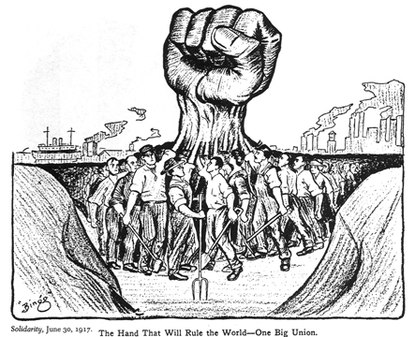
What is solidarity?

Slide 3
Solidarity and Human Rights
Solidarity
Underpinning value
International Solidarity Instrument
Solidarity Rights (3-gen)
Right to Solidarity

Slide 4
The account of solidarity in Global Health
Pre-Covid-19, movement to adopt solidarity as an ethic of global health (Frenk et al, 2014; West-Oram & Buyx, 2016)
Solidarity as a means to achieve equity and address disparities
During Covid-19, solidarity used as a normative basis to justify, or compel pandemic response

Slide 5
Solidarity and Covid-19
Solidarity was used to describe
  The Solidarity Fund
  The SOLIDARITY TRIAL
But also was used to justify public health responses
Conversely, where countries acted in self-interested ways (such as vaccine hoarding), this was framed as a “failure” to act in solidarity (UN Special Rapporteur Report on Covid-19 Vaccine Equity, 2023)

Slide 6
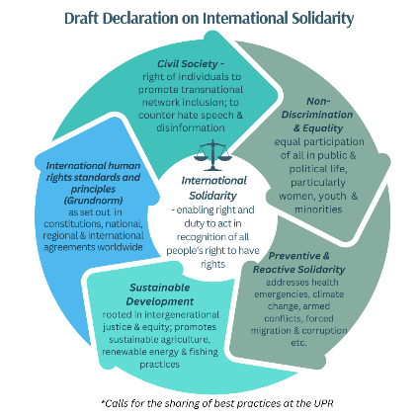
Covid-19’s influence on the right to international solidarity
“There is simply no way of enjoying 'our' human rights more fully 'over here' whilst the human rights of the vast majority of the world's peoples, and thus of other Africans, who live 'over there,' hangs in the balance. … We are all joined to each others’ human rights hip”
-(Okafor, 2021)

Slide 7
Okafor’s Recommendations for achieving international solidarity post-Covid-19
Effective international cooperation to ensure access to medical counter measures
Reform of international IP and patent regimes
The creation of research and development capacity and cooperation
Reforms to the global economy – debt cancellation and funding for anti-Covid-19 fight.
De-commodification of healthcare

Slide 8
Solidarity as a part of Global Health Law
Following Covid-19, Solidarity is now an underlying principle in recent global health law reforms
In the 2024, the International Health Regulations adopted solidarity, alongside equity, as an underlying principle stating:
  “The implementation of these Regulations shall be with full respect for the dignity, human rights and fundamental freedoms of persons, and shall promote equity and solidarity.”

Slide 9
The account of solidarity in the Pandemic Accord
The greened text of the pandemic accord also recognizes solidarity as an underlying principle with slightly more detail
Envisages:
  Cooperation
  Common interest
  Inclusivity, transparency and accountability
  Equity
  Different capabilities
Article 3: Principles and Approaches
solidarity with all people and countries in the context of health emergencies, as well as inclusivity, transparency and accountability, to achieve the common interest of a more equitable and better prepared world to prevent, respond to and recover from pandemics, recognizing different levels of capacities and capabilities, particularly of developing countries, including landlocked developing countries, as well as the special circumstances of small island developing States and of least developed countries, in relation to pandemic prevention, preparedness and response; and

Slide 10
Operationalisation of Solidarity in Pandemic Accord
Solidarity is explicitly recognized as a guiding value
Explicit goals to promote cooperation and collaboration, access to knowledge and information sharing and equity in counter-measures (all voluntary)
Multi-lateral PABS Instrument linked to vaccine donation to WHO (charity rather than solidarity?)
Solidaristic Procurement through Global Supply Chain and Logistics Network

Slide 11
Limitations of Solidarity in the Accord
Limited scope
Subject to national laws
Primarily country-driven
More to be done (COP + PABS Instrument)
Voluntary

Slide 12
Challenges to realising Solidarity in global health
Lack of shared experience
Not geared to structural change
Geopolitical Context
Negative Historical Experience of Solidarity
No integration of solidarity as a right

Slide 13
Thank you
sabdool1@jh.edu
Support for this research was provided by Wellcome Trust as part of the Oxford-Johns Hopkins Global Infectious Disease Ethics Collaborative (221719).

