Slide 1
Food Is Medicine: What Could Go Wrong?
Carl H. Coleman Associate Dean for Graduate Programs and Professor of Law Seton Hall Law School Newark, N.J.

Slide 2
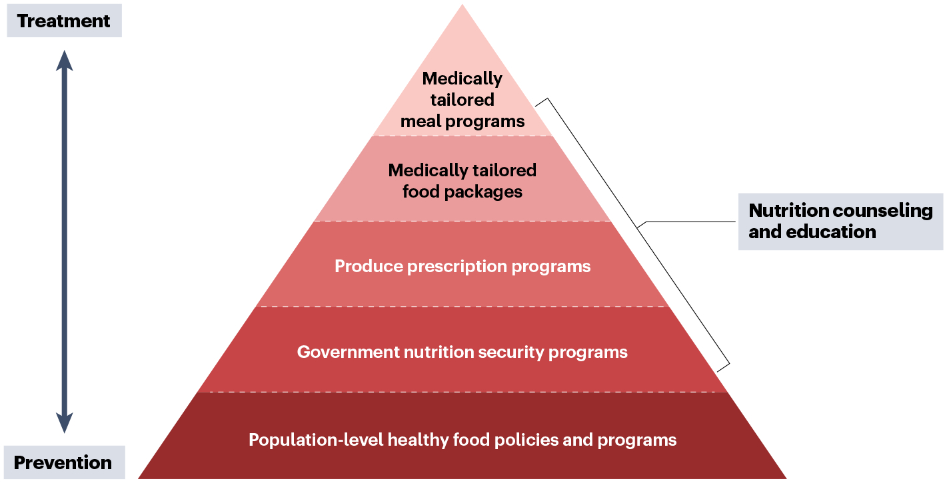
Notes:
Bottom of pyramid: broader, population-level programs focused primarily on prevention, not tied to specific medical conditions.
Top of pyramid (focus of talk): more intensive treatments for sicker patients with nutrition-sensitive chronic diseases.
Key element: these interventions are provided through the health care system

Slide 3
Payment Sources
May be reimbursable as qualified medical expensive under employer-sponsored health plans with third-party documentation of medical necessity
As of January 2025, 16 states had approved or proposed Medicaid Section 1115 waivers enabling MTM coverage
Massachusetts includes deliveries of up to 3 MTMs per day for up to 6 months, produce or protein prescriptions for up to 6 months, and cooking supplies as needed
New Jersey includes deliveries of MTMs, a 1-time stocking of the pantry, and a 1-month supply of groceries
CMS limits these benefits to a maximum of 6 months
72% of Medicare Advantage plans offered meal benefits in 2024
Supplemental benefits following surgery or inpatient hospital stay
Special supplemental benefit for chronically ill
As part of value-based insurance design models (until end of 2025)

Slide 4
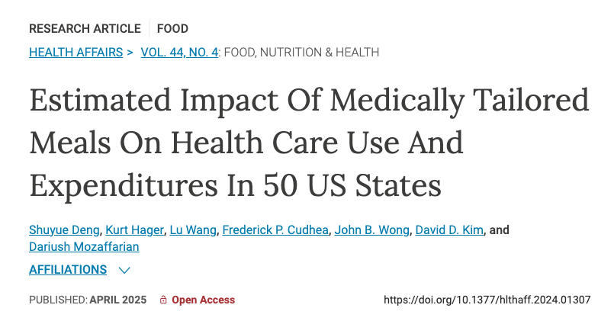
“Our simulation model estimated that state-level MTM coverage among Medicare, Medicaid, and privately insured patients with diet-sensitive conditions and IADL limitations would be associated with reductions in annual hospitalizations and health care expenditures for nearly all states.”
Notes:
IADL: instrumental activities of daily living

Slide 5
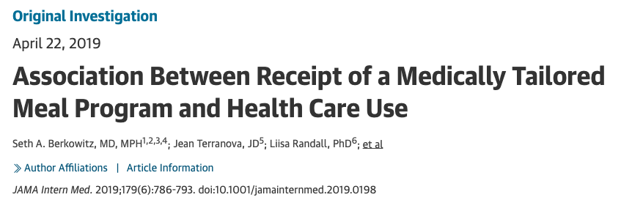
“MTM receipt was associated with significantly fewer inpatient admissions (incidence rate ratio [IRR], 0.51; 95% CI, 0.22-0.80; risk difference, −519; 95% CI, −360 to −678 per 1000 person-years). Similarly, MTM receipt was associated with fewer skilled nursing facility admissions (IRR, 0.28; 95% CI, 0.01-0.60; risk difference, −913; 95% CI, −689 to −1457 per 1000 person-years). The models estimated that, had everyone in the matched cohort received treatment owing to the instrument (and including the cost of program participation), mean monthly costs would have been $3838 vs $4591 if no one had received treatment owing to the instrument (difference, −$753; 95% CI, −$1225 to −$280).”

Slide 6
Problem #1: Lack of Standards
Projections of benefits are based on experiments in which meals were individually constructed by registered dietitian nutritionists or complied with rigorous standards established by nonprofit organizations
Some state Medicaid waivers impose similar requirements
But many states allow Medicaid reimbursement for meals of questionable nutritional quality provided by for-profit companies

Slide 7
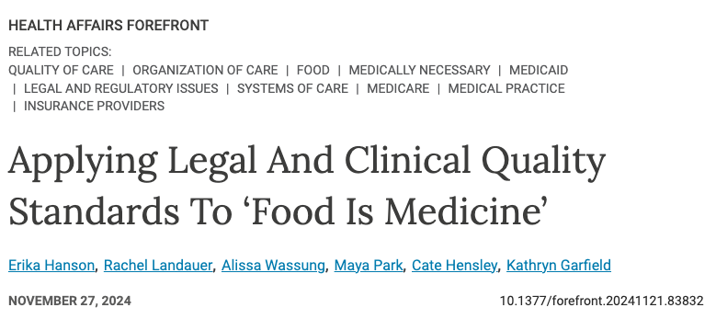
”As a natural consequence of this rapid evolution, regulators, payers, and FIM providers have faced challenges in applying service definitions, credentialing providers (including a number of new entrants into the market), and appropriately pricing services across jurisdictions, giving way to wide variation in practices, service, and provider quality.”

Slide 8
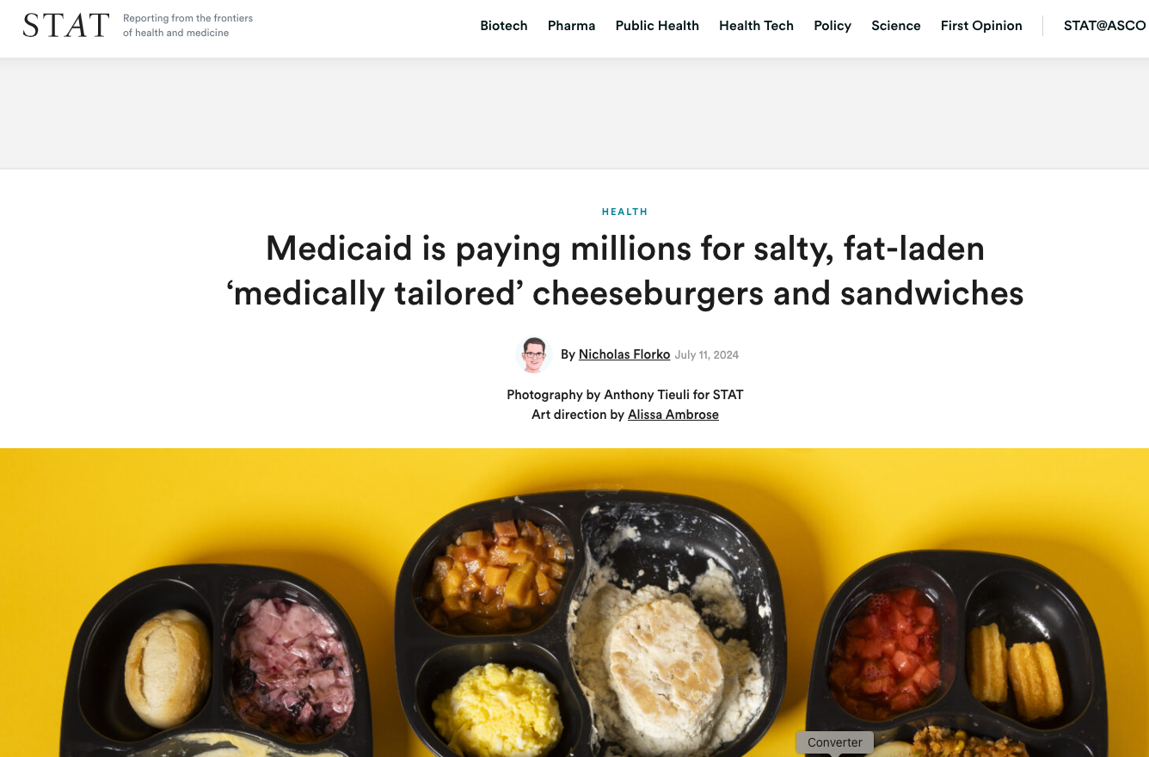
”By 2009, Medicaid programs in six states. Were reimbursing the company for its meals. That numbered ballooned to 18 by 2018. And now, the company is reimbursed in 30 states.”
“Homestyle Director’s Jimmy Dean breakfast sandwich—offered as part of its diabetes menu—boasts 980 milligrams of sodium. The company’s cancer-support and diabetes-friendly biscuits and sausage gravy has more than half the sodium and saturated fat that experts recommend healthy adults consume in a single day. And its cheeseburger has roughly 50 ingredients—a tell-tale sign of so-called ‘ultra-processed food.’ The cheeseburger is advertised as helping customers with cancer, diabetes, renal issues, and heart problems.”
Notes:
“Homestyle Direct is just one of the for-profit companies that bill Medicaid programs for home-delivered meals. Magic Kitchen sells its own version of biscuits and gravy, with 1,110 milligrams of sodium and 12 grams of saturated fat. Another company, Mom’s Meals, sells a “cheeseburger soup” with pretzel bits, oatmeal cream pie, and milk that altogether has 930 milligrams of sodium and 12 grams of added sugar.”

Slide 9
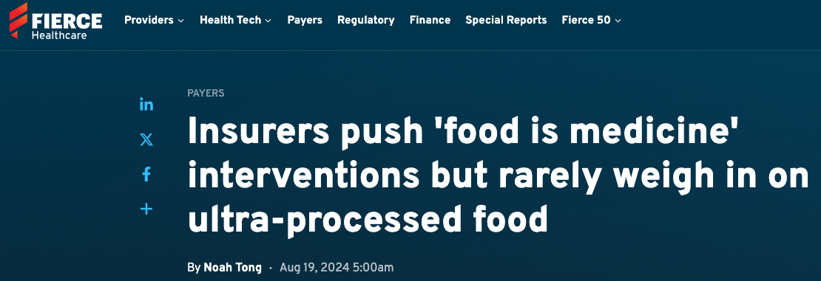
“Though limiting UPFs aligns with the objectives of many food is medicine programs, rarely do the programs go as far to ensure UPFs are restricted.”
“’I’ve probably had, I don’t know, 5 million conversations with health plans,’ quipped Josh Hix, CEO of Season Health, a food is medicine platform that sells to health plans in value-based partnerships. ’Approximately zero times have the words “ultra-processed” ever come up.’”
“Many grocery cards that insurance plan members use … [are] used as a marketing gimmick to incentivize higher enrollment in MA. These cards do not always restrict what foods can be bought.”

Slide 10
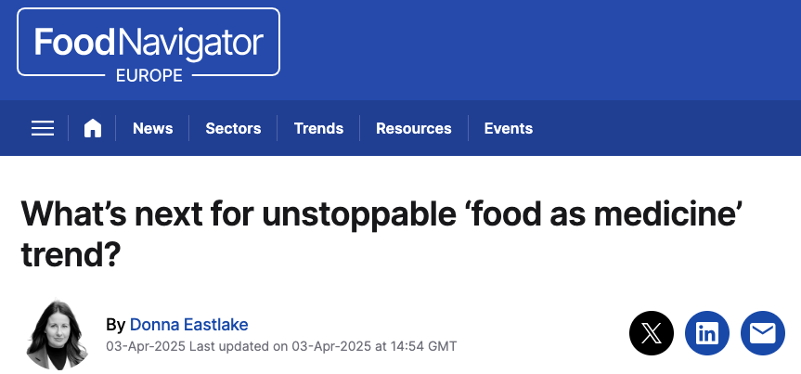
”[F]ar from being a niche subject, manufacturers are also shifting focus towards the idea of food as medicine, with … pharmaceutical companies, grocery retailers, and major food brands … all exploring ways to integrate nutrition into their business models.”

Slide 11
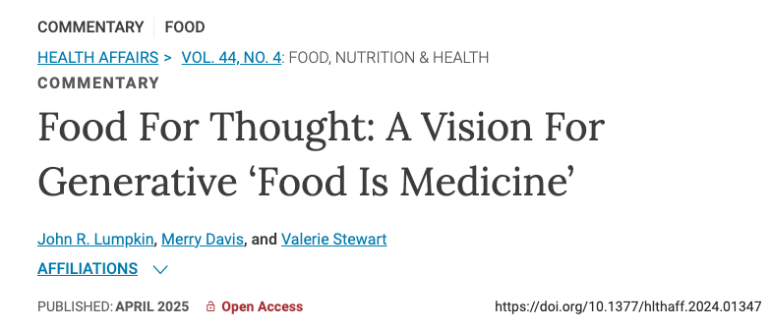
“Despite myriad benefits of CBO engagement in Food Is Medicine, CBOs are at risk of being replaced by the increasing number of for-profit vendors participating in these programs. For-profit ventures can more easily partner with health care organizations and meet contracting and compliance requirements such as security ad information technology infrastructure, cyber insurance, and the capacity to deliver food across large or sparsely populated geographic areas.”
Notes:
Worst case scenario: food industry, potentially partnering with big pharma, uses FIM as yet another way to hook people on UPF, all supported by government funding.

Slide 12
Problem #2: Sustainability
Participants receive food only while enrolled in FIM programs, which are generally time limited
Few programs are designed to train participants in finding and preparing healthy food on their own
“When the service ends, consumers may revert to their former eating patterns.”
--Olivia Thomas, Christina Badaracco, Sharon Akabas, “Why Current ‘Food Is Medicine’ Solutions Are Falling Short,” Health Affairs Forefront, May 12, 2023, 10.1377//forefront.20230510.637312
Notes:
From the perspective of for-profit providers, the sustainability issue is not necessarily a problem.
Instead, these programs can be viewed as a short-term marketing strategy: six months of government funding to get participants hooked on UPFs portrayed as ”healthy” alternatives, so that they continue to purchase these products even after the program ends.

Slide 13
Problem #3: Medicalization of Eating
The fact that good nutrition can improve health doesn’t mean that food is a medical intervention
Like access to housing, education, and safe neighborhoods, access to nutritious food is primarily a social determinant of health
Long-term solutions require making nutritious food widely accessible and the default expectation throughout all social settings—not something that is “prescribed” by a health care professional as an extraordinary intervention for a discrete period of time

Slide 14
Recommendations
At a minimum, strengthen quality standards for MTMs
Consider requiring providers to satisfy the Food Is Medicine Coalition’s accreditation standards
More broadly, enact policies to make healthier foods more easily available
Redirect crop subsidies to make healthy foods cheaper
Expand universal free school meals
Improve the quality of food served at federal facilities
Provide additional SNAP benefits for fruits and vegetables
Support policies to reduce “food deserts”
Notes:
63% of agricultural subsidies go to the meat and diary industries
Fruit and vegetable producers receive only 0.04% of total subsidies

