Slide 1
Legal and Ethical Considerations in Implementing Health-Related Social Needs Interventions: A New York Research Study
Heather M. Butts, JD, MPH, MA

Slide 2
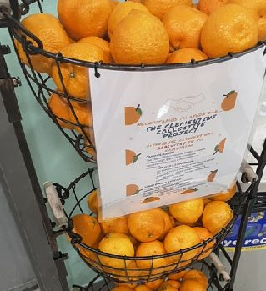
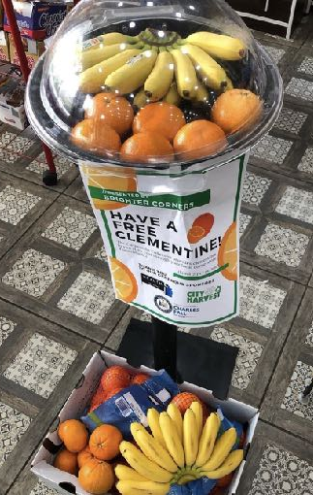
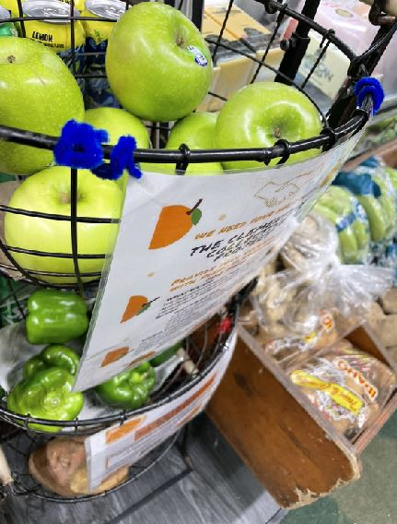
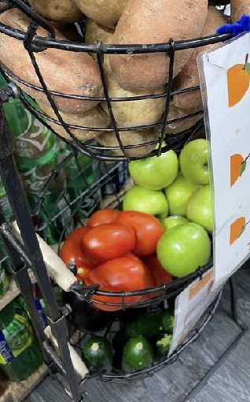
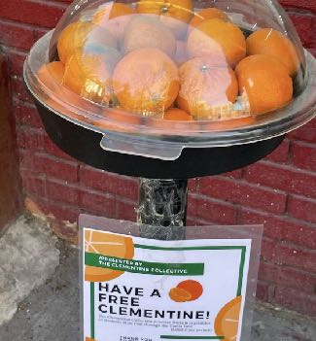
Clementine Collective Initiative
Created in the Classroom
Integration of Science and Practice P6071
March, 2020

Slide 3
Integration of Science and Practice - P6071
Core Class - 1st Year School of Public Health Students
Integration of Science and Practice (ISP)—small group sessions that are an integral component of the MPH curriculum—bridge the gap between traditional classroom education and the real-world experience of working as a public health professional.
The curriculum consists largely of case studies drawn from recent history and current events, providing opportunities for students to apply facts and information to solve complex problems and gain important professional skills like negotiation, persuasion, team thinking, public speaking, and critical judgment in the process.
Small interdisciplinary teams analyze cases under the guidance of a faculty member and teaching assistant. Over the course of three semesters, students build relationships with their ISP professor, teaching assistant, and other teammates as they grapple with challenges and dilemmas that have challenged practicing public health professionals.
Through these cases, students confront the tough questions of public health: What happens when programs intended to improve the health of a community conflict with local values and traditions? Where does state control end and individual liberty begin? In a world of ever-evolving scientific knowledge, when do we have adequate evidence to recommend policies that keep people safe?
Assignments come in the form of collaborative labs that hone problem solving-skills and the ability to apply public health theory to professional practice. Students may be asked to write a policy brief, identify what evidence is missing or necessary to make a decision, plan a media briefing, find citations in the scientific literature relevant to a case study, or identify the key aspects of an effective health intervention program.

Slide 4
H.E.A.L.T.H for Youths - Overview (Integration of real world CBO work in classroom)
We approach health as making the best choices in all areas of life, including physical, mental, academic and financial. Through our model of total health we guide young people after high school and beyond to realize their future goals.
H.E.A.L.T.H for Youths, Inc is a 501(c)(3) nonprofit formed for the charitable and educational purposes of assisting youth. We strive to combat community deterioration and juvenile delinquency, improve the quality of education, health care and life-skills training offered to adolescence and young adults.

Slide 5
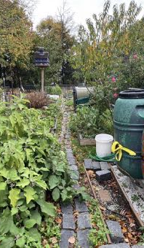
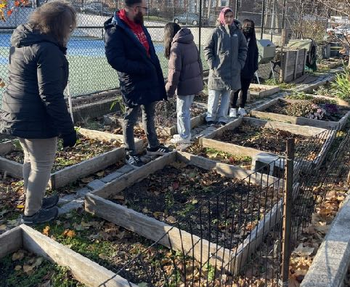
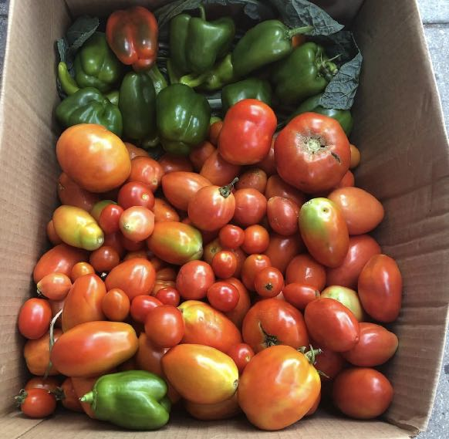
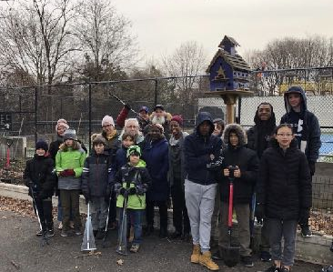
The H.E.A.L.T.H for Youths Skyline Community Garden

Slide 6
Education, Outreach and the Clementine Collective Club

Slide 7
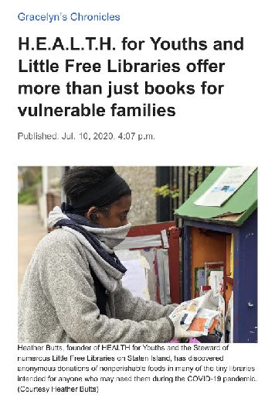
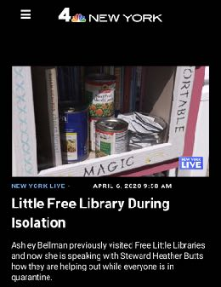
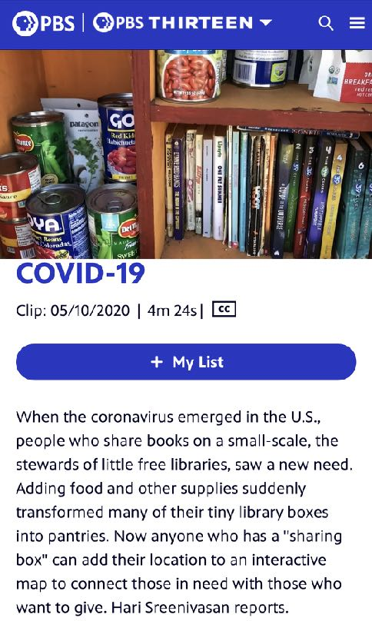
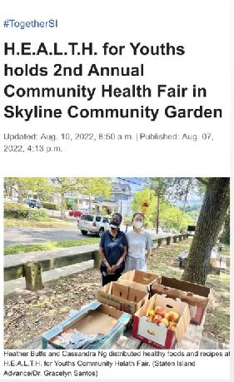
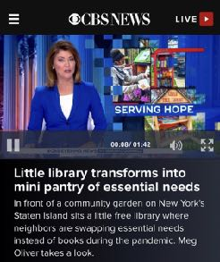
Clementine Collective In the News!

Slide 8
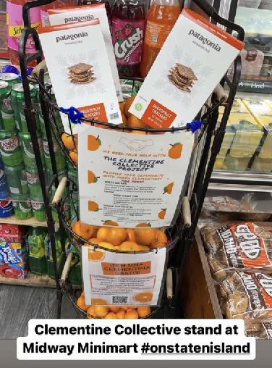
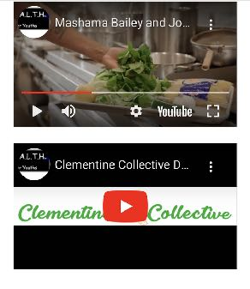
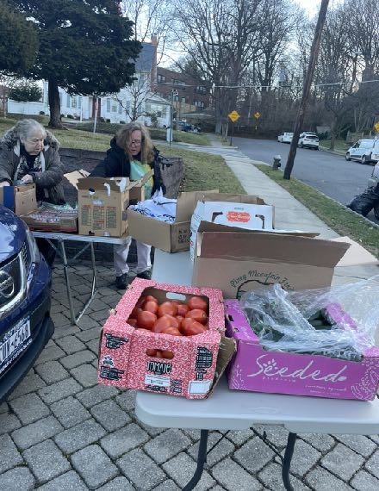
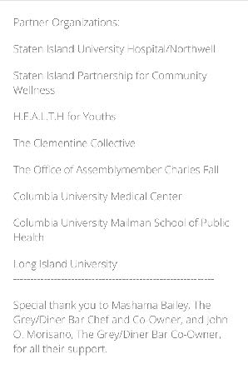
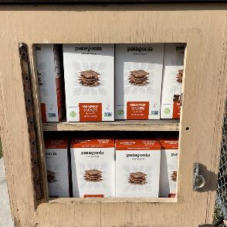
Partners and Friends

Slide 9
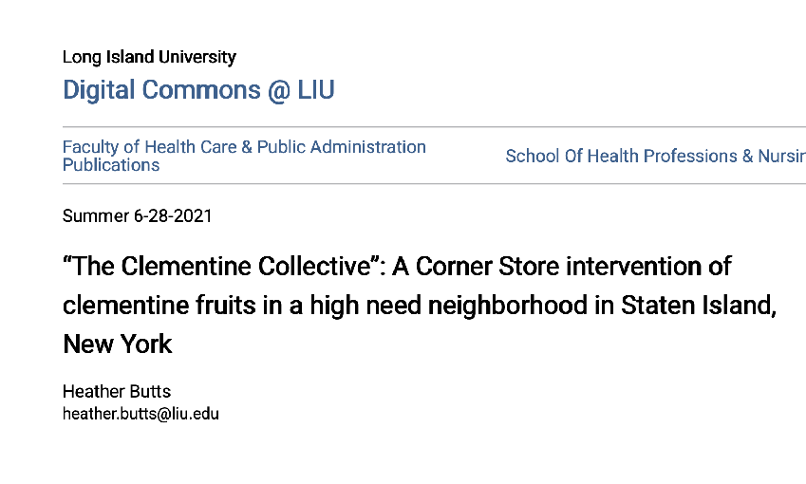
Clementine Collective - Research Part 1
Part 1: “The Clementine Collective”: A Corner Store intervention of clementine fruits in a high need neighborhood in Staten Island, New York
https://digitalcommons.liu.edu/post_hecpafpub/1/
Clementine Collective

Slide 10
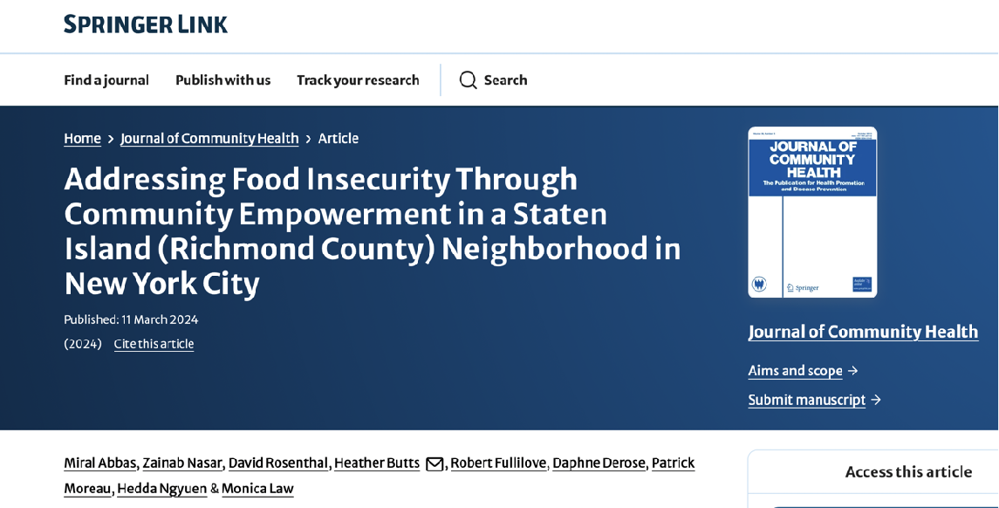
Clementine Collective Article #2 with students
Addressing Food Insecurity - Journal of Community Health

Slide 11
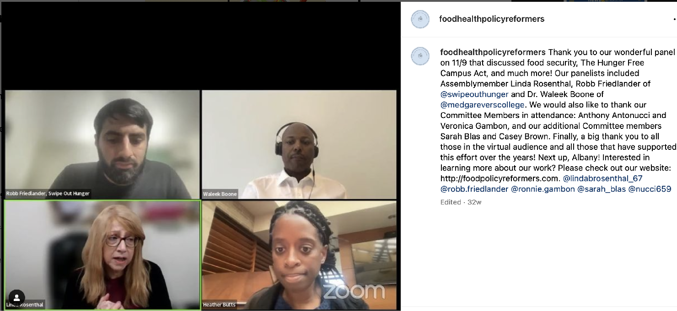
Food and Health Policy Reformers Webinar #2 - Clementine Collective and Hunger Free Campus Act
Caption

Slide 12
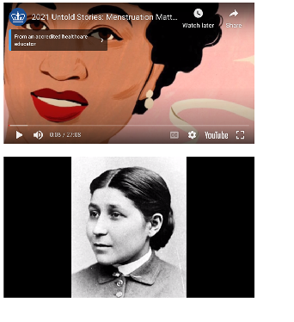
Untold Stories and program
https://www.publichealth.columbia.edu/academics/departments/health-policy-and-management/news-and-events/untold-stories-us-health-policy-history

Slide 13
https://www.health.ny.gov/health_care/medicaid/redesign/med_waiver_1115/docs/2024-02-16_nyher_overview_slides

Slide 14
https://www.health.ny.gov/health_care/medicaid/redesign/med_waiver_1115/docs/2024-02-16_nyher_overview_slides

Slide 15
https://www.health.ny.gov/health_care/medicaid/redesign/med_waiver_1115/docs/2024-02-16_nyher_overview_slides

Slide 16
https://www.health.ny.gov/health_care/medicaid/redesign/med_waiver_1115/docs/2024-02-16_nyher_overview_slides

Slide 17
https://www.health.ny.gov/health_care/medicaid/redesign/med_waiver_1115/docs/2024-02-16_nyher_overview_slides

Slide 18
https://www.health.ny.gov/health_care/medicaid/redesign/med_waiver_1115/docs/2024-02-16_nyher_overview_slides

Slide 19
https://www.health.ny.gov/health_care/medicaid/redesign/med_waiver_1115/docs/2024-02-16_nyher_overview_slides

Slide 20
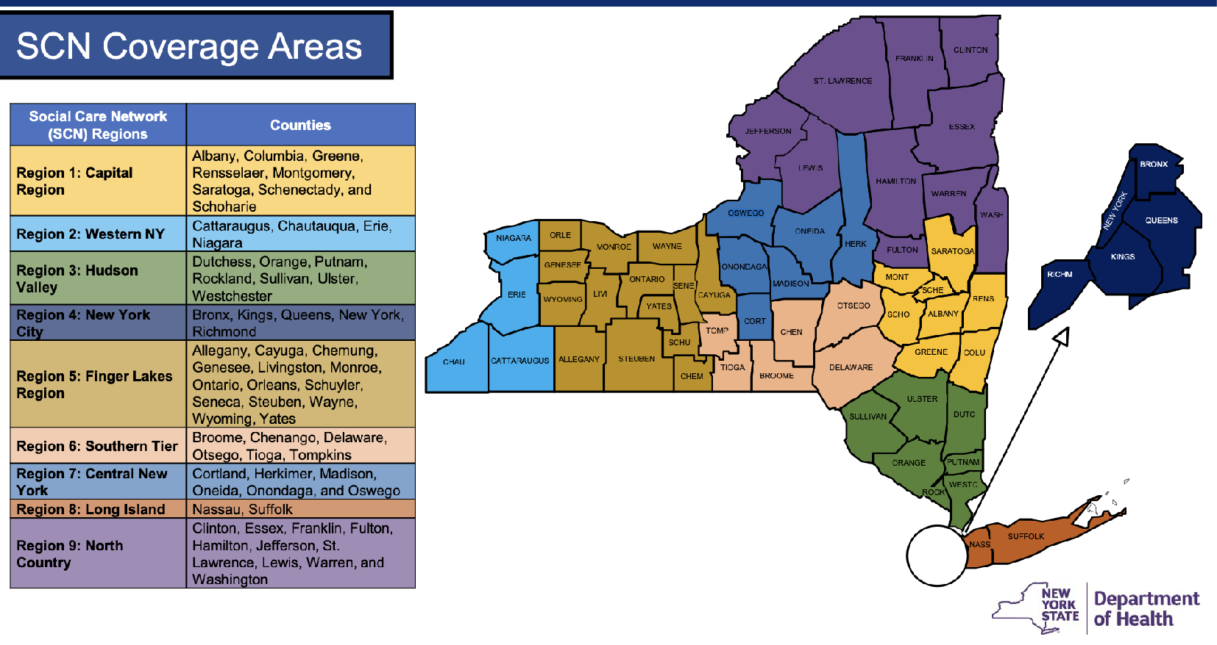
https://www.health.ny.gov/health_care/medicaid/redesign/med_waiver_1115/docs/2024-02-16_nyher_overview_slides

Slide 21
1115 Waiver Panel - May 2025
Public Health Law Committee NYSBA
Public Health Equity Law Club
Collaboration with Columbia Law School
Columbia University
Caption

Slide 22
Clementine Collective Part 3: FAIR START
Part 3: FAIR Study:
This project focuses on addressing health inequities in New York City generally, and Staten Island,
NY specifically. Recent research focuses on the relationship between social determinants of health
and morbidity and mortality. Food deserts, access to health care, lack of employment, housing
challenges and racism are among the many social determinants that seem to be areas where
research and evidence based solutions are needed The goal of this project is to improve access
to healthy food options, exercise, life-skill training, primary care consultations, public health
interventions, and impact health outcomes. This project will be completely virtual, with the
exception of the weekly food hub distributions and will also include weekly cooking classes, yoga
classes, life-skills classes, and as needed consultations with a primary care physician The project
will also include an evaluation of the project that will assess gains of participants over time in order
to develop an evidence based strategy for impacting health outcomes that can later be initiated in
many other underserved communities. The groups will all be residents of Staten Island, and will be
divided into three subgroups: college students, veterans, and individuals living in NYCHA housing.
We will also work with individuals on specific public health policy empowerment through a module
training created by one of the co-investigators at Columbia University Mailman School of Public
Health.

Slide 23
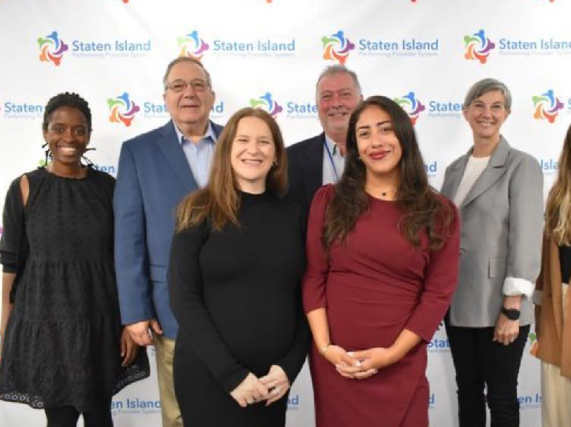
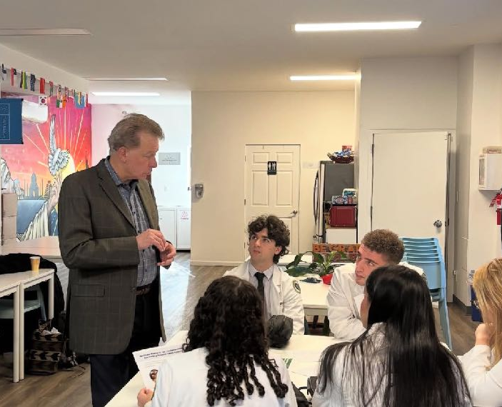
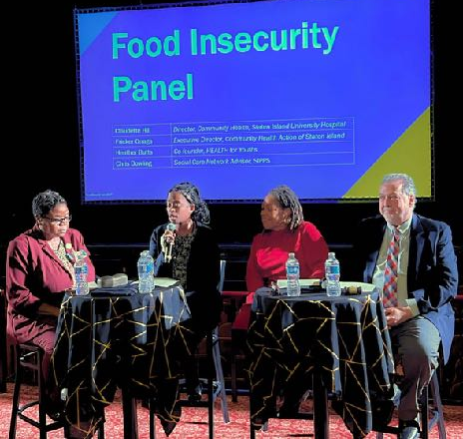
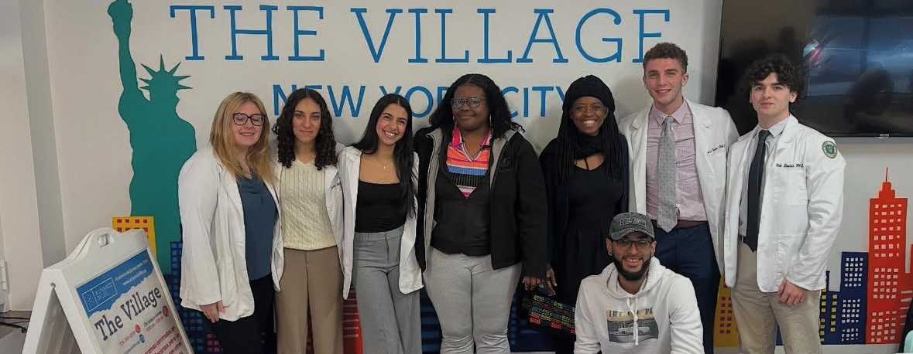
FAIR START
FAIR START
FAIR START
Caption
FAIR START

Slide 24
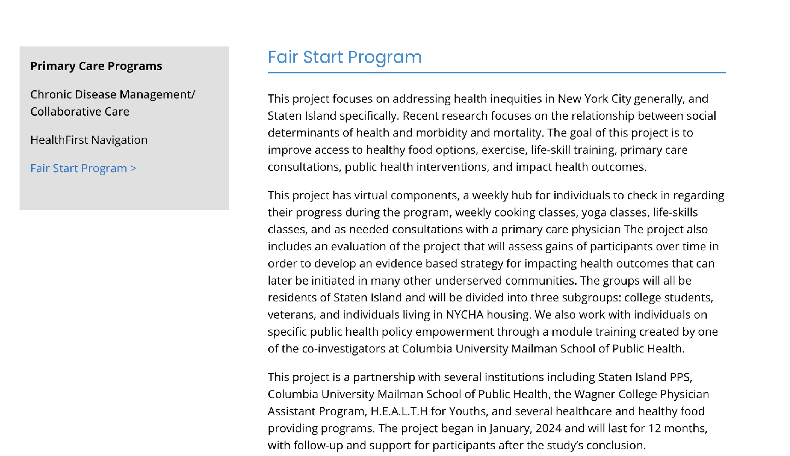
Caption

Slide 25
Legal/Ethical Considerations at the beginning of the Study
(FAIR Start)
[Some may be similar to 1115 Waiver]
What happens when the study ends?
How do participants continue a healthy lifestyle when they don’t have funds to support what they have received during FAIR Start
Some of the implications other panelists will discuss/have discussed
How much are people willing to disclose about their SDOH picture?

Slide 26
FAIR Start - Student Participation
Summer Practicum
Research Fellowships during the year
Internship Opportunities

Slide 27
FAIR Start - Enrollment Cohort A and B
Indicate interest in the study
Sign the consent form and go through the consent process
Fill out the preliminary survey and other preliminary forms
Come to weekly hub site (depending on group) for medically tailored food
Participate in at least one other program (details to follow)
Complete weekly surveys
Participate in various aspects of the study
Enjoy the program!

Slide 28
Aspects of FAIR Start
Healthy Food bags for 60 participants total
Individuals living in NYCHA
Individuals on Medicaid
Workshops
Virtual Yoga
In person yoga
Various programs through H4Y non-profit (gardening, educational sessions)
Cooking Classes
Cooking challenges

Slide 29
FAIR Start - Week 43 of 52 (Final weeks)
Final few weeks
Final surveys
Discussion of next steps after the end of the first part of the program
Expectations for the second part of the program
Feedback

Slide 30
Thank you and
Questions/Discussion

