Slide 1
Recognition of SDoH is Expanding and an Opportunity for MLPs
Ken Gatter, MD JD
Professor, Pathology, OHSU
Executive Director MLPO
Notes:
I’m director of MLPO, and my job is to spread MLPs throughout Oregon. Oregon’s been late to the game. We established the first MLP in Oregon in 2016 at an OHSU FQHC family med clinic. And we’ve expanded so that we now have had 6 total, although COVID claimed two of them. The biggest challenge has not been getting physician and provider interest, but in getting funding.
As you can see I’m a physician, a pathologist, and that has been helpful Two points. The first - Give you my perspective as a member of the medical community and how things changed since I graduated from medical school in 1995 having worked briefly as a lawyer before that, I’ve been at OHSU for 25 years working as a pathologist and spent much of that time trying to combine law and medicine. Most recently advocating form MLPs, and I think it may be useful to share what I think works best in my experience when trying to convince physicians about the value of MLPs in addressing SDOH.

Slide 2
Rudolf Virchow, a pathologist.
Commenting on the 1840’s typhus epidemic:
“If medicine is to fulfill her great task, then she must enter the political and social life. Do we not always find the diseases of the populace traceable to defects in society?”
Notes:
We lost two MLPs in Oregon during COVID, but often epidemics pandemics are an opportunity for SDOH bc SDOH obviously operate.

Slide 3
What I learned in medical school about SDoH – 1991 to 1995.
Notes:
Smoke or drink too much – makes sense that you die earlier. But that isn’t how we think of SDOH today. We weren’t instructed to inquire into why people smoked or drank let alone how other SDOH lead to increased stresses over time and a host of chronic diseases that conventional medicine treated inadequately.

Slide 4
What I learned in medical school about SDoH – 1991 to 1995.
1991 – 1995 (anecdotal) Smoking/alcohol
2020 - A survey: 18 (64%) indicated SDoH teaching as extremely high or high priority, whereas 10 (34%) rated it low priority.
Lewis J H, Lage O G, Grant B K. Addressing the social determinants of health in undergraduate medical education curricula: a survey report. Adv Med Educ Pract. 2020;11:369–377
Notes:
Smoke or drink too much – makes sense that you die earlier. But that isn’t how we think of SDOH today. We weren’t instructed to inquire into why people smoked or drank let alone how other SDOH lead to increased stresses over time and a host of chronic diseases that conventional medicine treated inadequately.

Slide 5
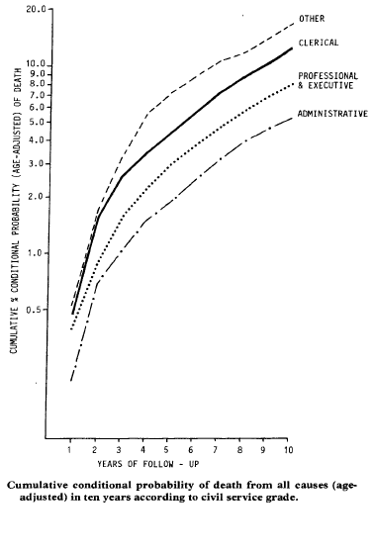
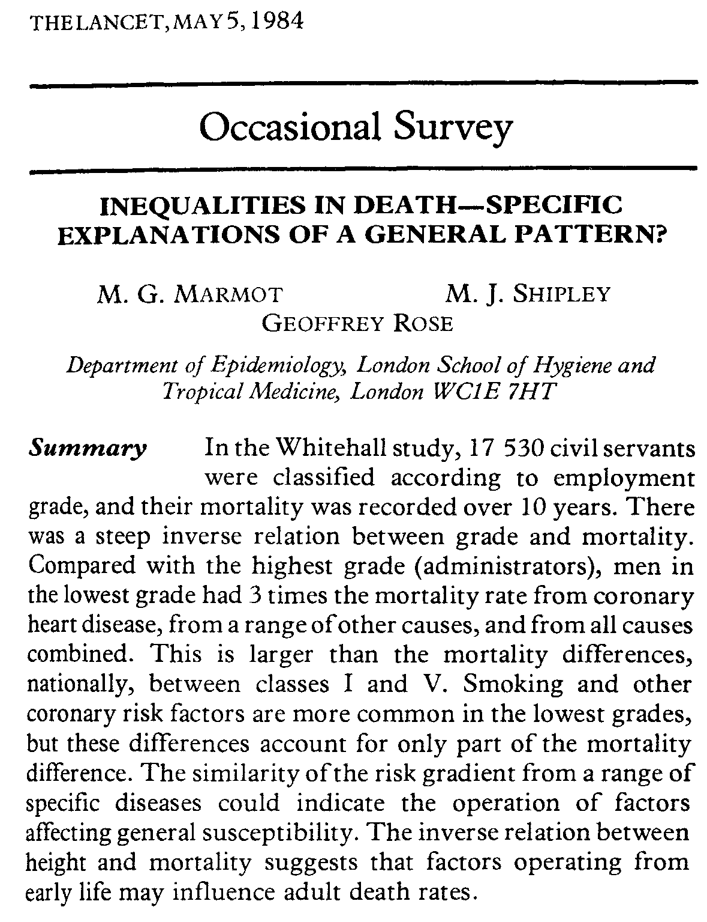
“factors operating at early life may influence adult death rates.” thereby acknowledging the importance of how babies and children live to their long term health
Explanation must include not only biological understanding but also an insight into the social causes of differences in environment and personal behaviour which have so great an effect on health and mortality.
Notes:
There was data and some people were interested about this idea that I think becomes the social determinants of health, but the connection between social/economic and other stresses and biology between adverse events and biology wasn’t yet established.
This 1984 article talks about socio economic factors but also a bit more than that. Here, in a study of 17 thousand civil servants it should that life expectancy was greater among people with higher ranking, higher prestige jobs. social position in the hierarchy impacts health.
It didn’t look at race but interestingly it looked at height and then concludes that “factors operating at early life may influence adult death rates.” thereby acknowledging the importance of how babies and children live to their long term health.

Slide 6
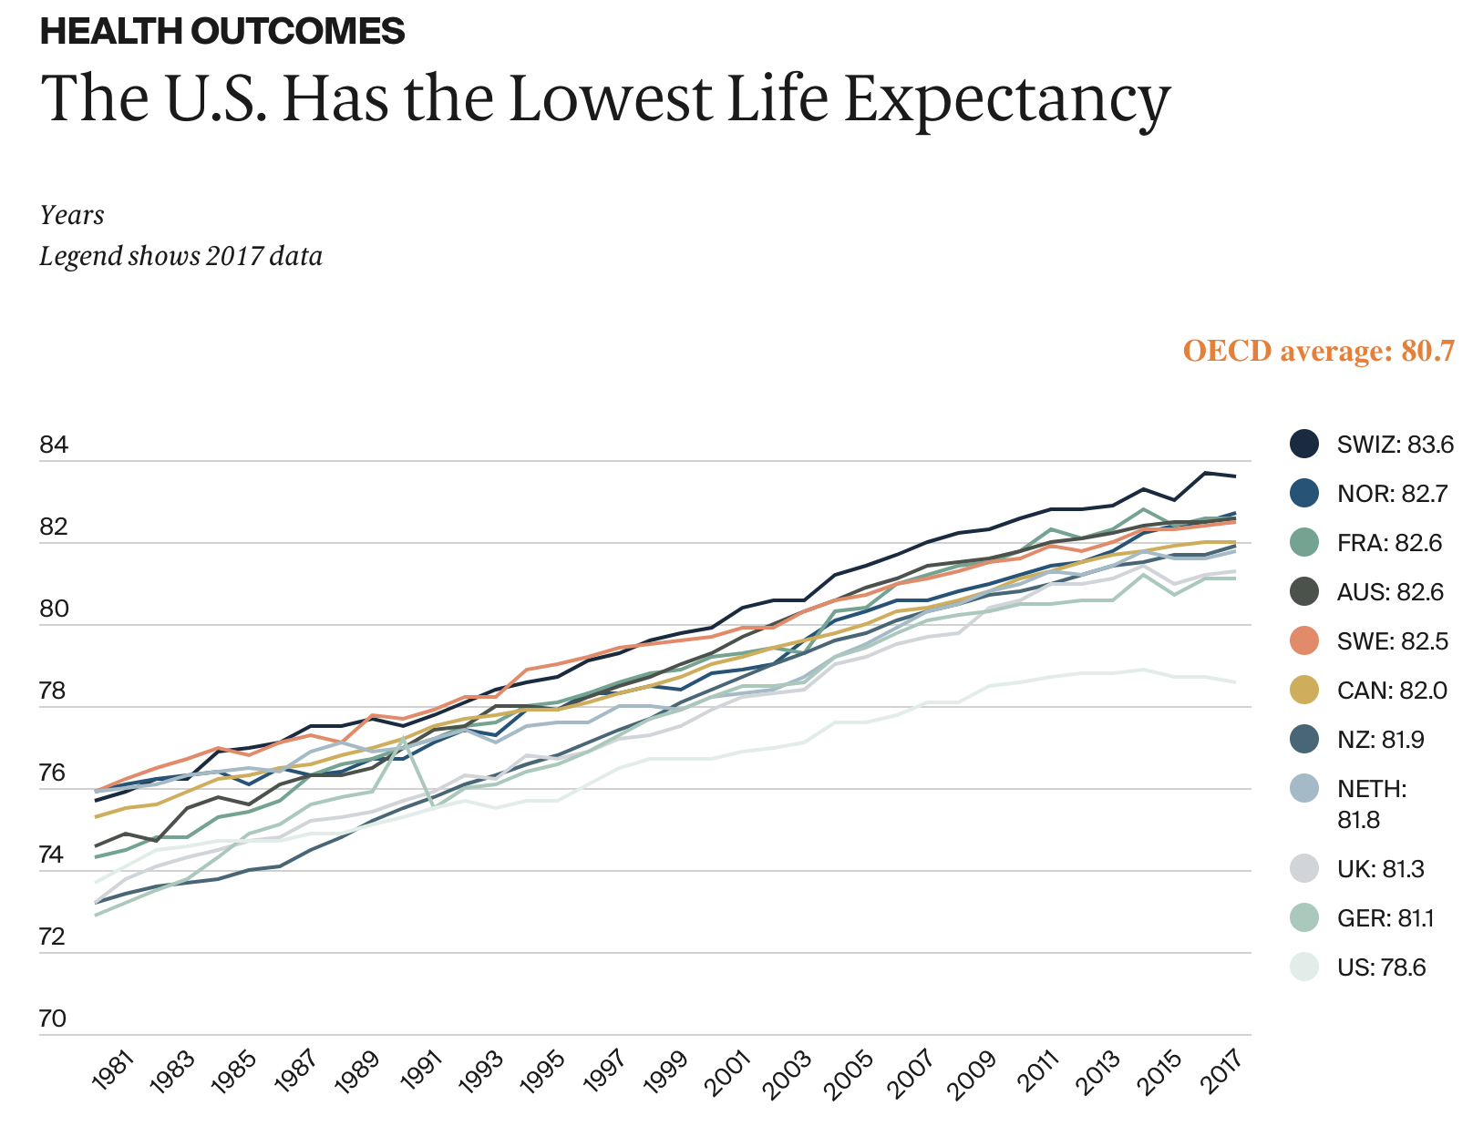
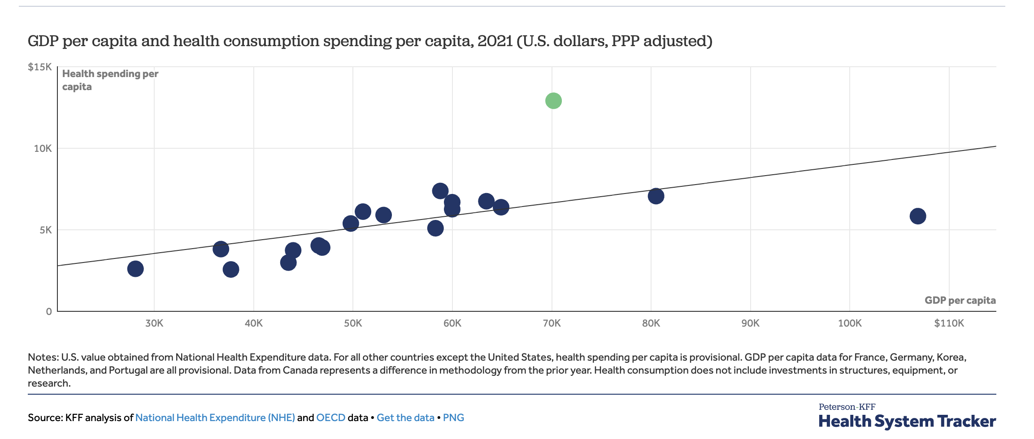
“The United States spends more on health care than any other nation in the world, yet it ranks poorly on nearly every measure of health status.” S. Schroeder, N Engl J Med 2007; 357:1221-1228
Ireland
Roosa Tikkanen and Melinda K. Abrams, U.S. Health Care from a Global Perspective, 2019: Higher Spending, Worse Outcomes? (Commonwealth Fund, Jan. 2020).
Notes:
. The quality of our health care providers and hospitals is good. It must be Access to health care our crazy health care system. Mondy grubbing hospital administrators. Maybe even racism plays a role but if only everyone had access then we’d look better.

Slide 7
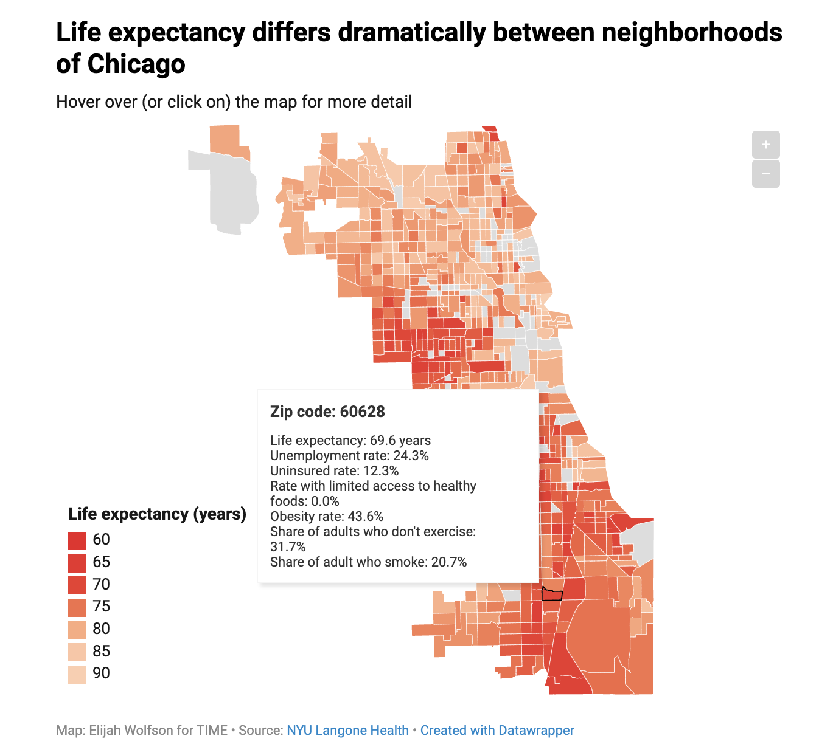
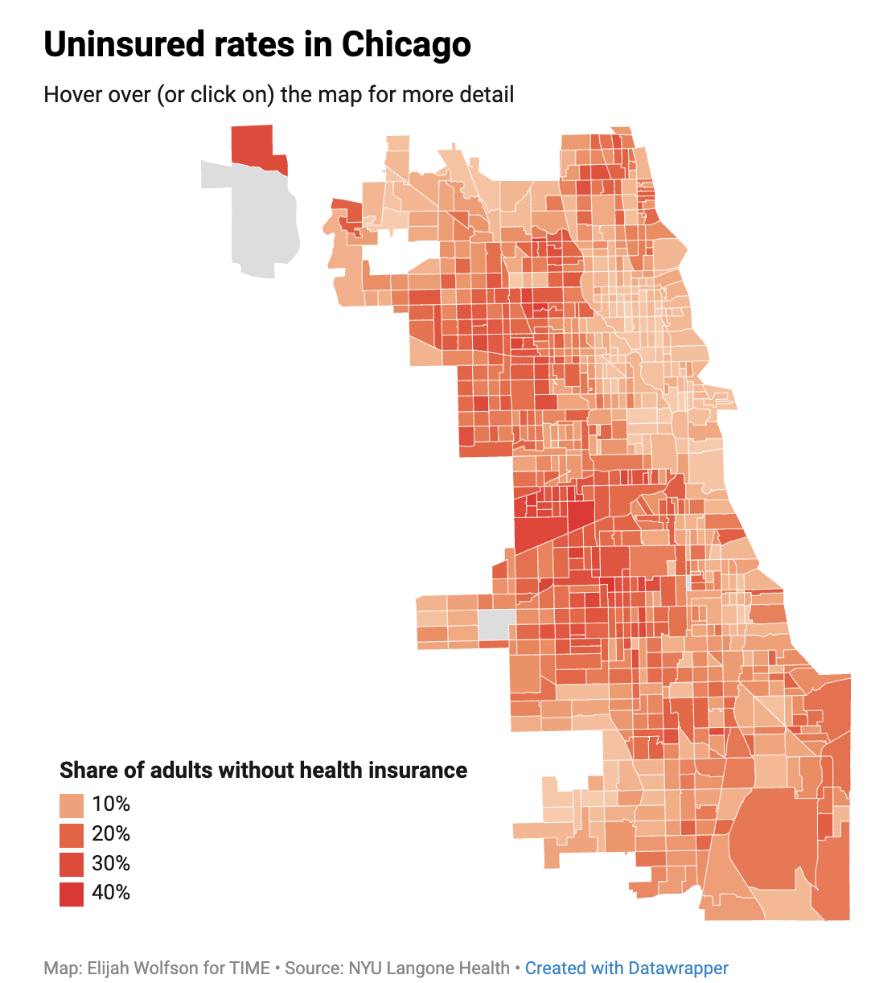
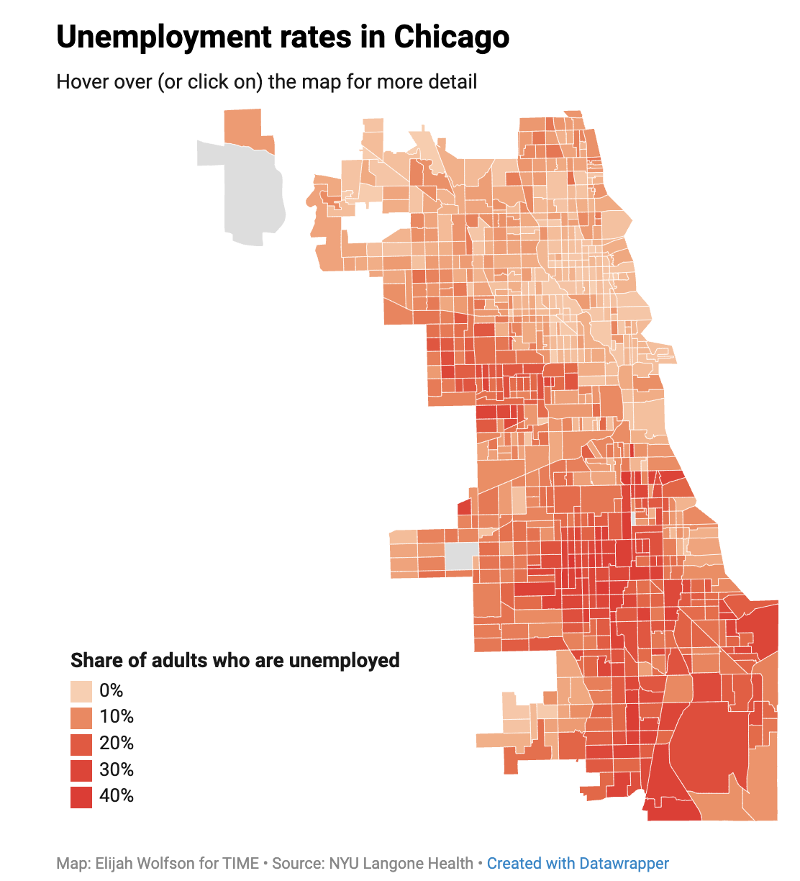
Notes:
We also know that health seems to vary considerably from one zip code to another.

Slide 8
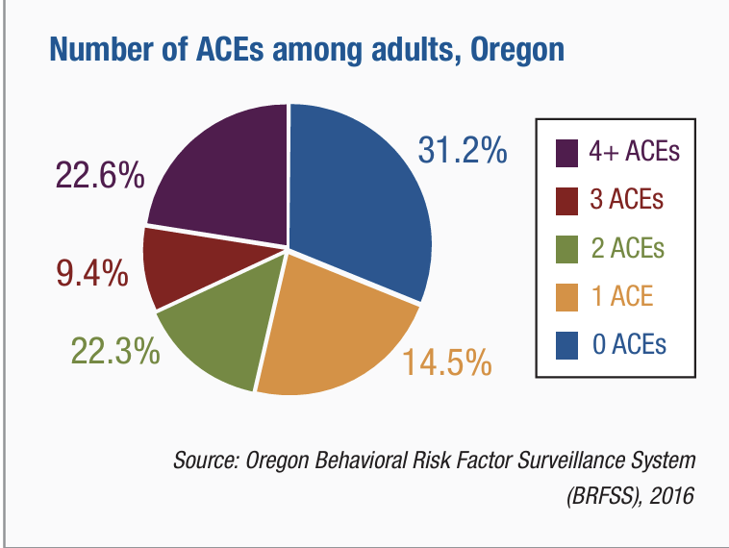
1999
Summary: A strong dose-response relationship exists between childhood abuse and adult health risks.
Notes:
A strong dose-response relationship exists between childhood abuse and adult health risks. 17​ 58 year old average age
Diseases linked to childhood adversities include ischemic heart disease, cancer, chronic lung disease, skeletal fractures, and liver disease. 22Page 7"Disease conditions including ischemic heart disease, cancer, chronic lung disease, skeletal fractures, and liver disease, as well as poor self-rated health also showed a graded relationship to the breadth of childhood expo sures."

Slide 9
“Pair of aces” Tree
Notes:
Pair of Aces
Shows the relationship between adverse childhood and family events, shown here as a tree, and the systemic structural problems shown as the roots.
MLPs address both the tree and the roots. Earlier on I briefly mentioned the two goals of MLPs. One focused on the individual client. Helping clients navigate family law issues, or housing insecurities. and the other on addressing broader policy questions. These correspond to the tree and the roots.
The BCR Pair of ACEs tree image grew out of the need to illustrate the relationship between adversity within a family and adversity within a community. The leaves on the tree represent the ‘symptoms’ of ACEs that are easily recognized in clinical, educational and social service settings, such as a well child visit or a pre-school classroom. Adverse childhood experiences can increase a person’s risk for chronic stress and adverse coping mechanisms, and result in lifelong chronic illness such as depression, heart disease, obesity and substance abuse. Physical or sexual violence, and abuse or neglect are often less obvious but can exist as chronic stressors. The tree is planted in poor soil that is steeped in systemic inequities, robbing it of nutrients necessary to support a thriving community., Adverse community environments such as a lack of affordable and safe housing, community violence, systemic discrimination, and limited access to social and economic mobility compound one another, creating a negative cycle of ever worsening soil that results in withering leaves on the tree.

Slide 10
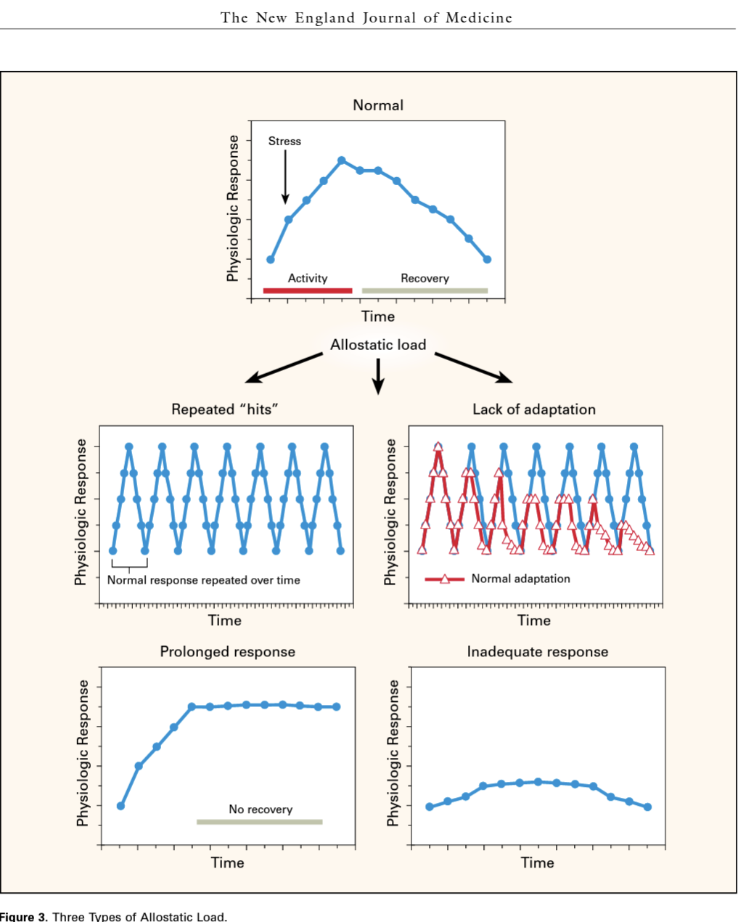
When things go wrong ….
B S. McEwen, H Akil, Revisiting the Stress Concept: Implications for Affective Disorders
J Neurosci 2020 Jan 2;40(1):12-21. doi: 10.1523/JNEUROSCI.0733-19.2019
Notes:
Biolosy that can explain why being poor or disabled or discriminated against leads to bad health. Evicted, violence in the home, poor living conditions, fired for a bad reason, - a person’s life gets more stressful.
Stress load has an impact, and over time the body is weathered. Different people respond to stress differently and things like social support and confidence and money make a difference. Having a sense of control matters.

Slide 11
WHO - SDoH: “conditions in and under which people are born, grow, work, and live”
Kaiser Family Foundation
Notes:
So, we have health disparities, that segregate out by race and income. This slide from Kaiser shows what is included in the SDOH, the many kinds of things that impact Health outcomes.
l

Slide 12
What kinds of legal needs are appropriate for MLP? I HELP!
Denials of insurance, cash benefits, social security, disability
Evictions, habitability, utility shut-offs
Secure specialized education services (IEP), employment discrimination, worker rights
Veteran status, criminal/credit histories, asylum, immigration status
Restraining orders, domestic violence, custody, guardianship, conservatorship
Notes:
What does an mlp do? It addresses SDOH.

Slide 13
MLPO associated MLPs in Oregon
Notes:
To expand state funding. We need to expand into the rural and red parts of our state.

Slide 14
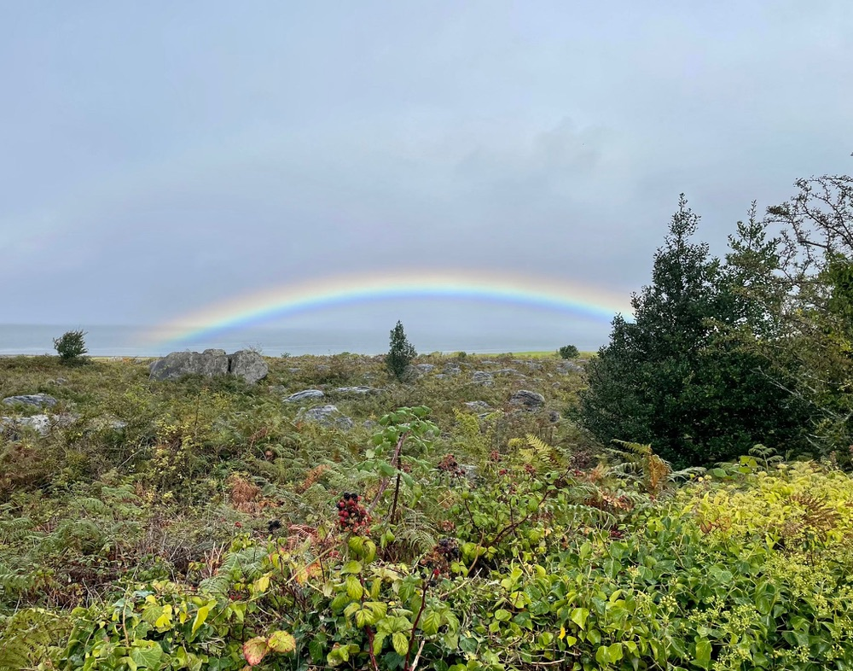
Thank you!
https://medical-legalpartnership.org/
gatterk@ohsu.edu

