Slide 1
Regulatory Outsourcing 2025 ASLME Health Law Professors Conference Boston University School of Law June 5, 2025 Zack Buck

Slide 2
Mission Hospital, Asheville

Slide 3
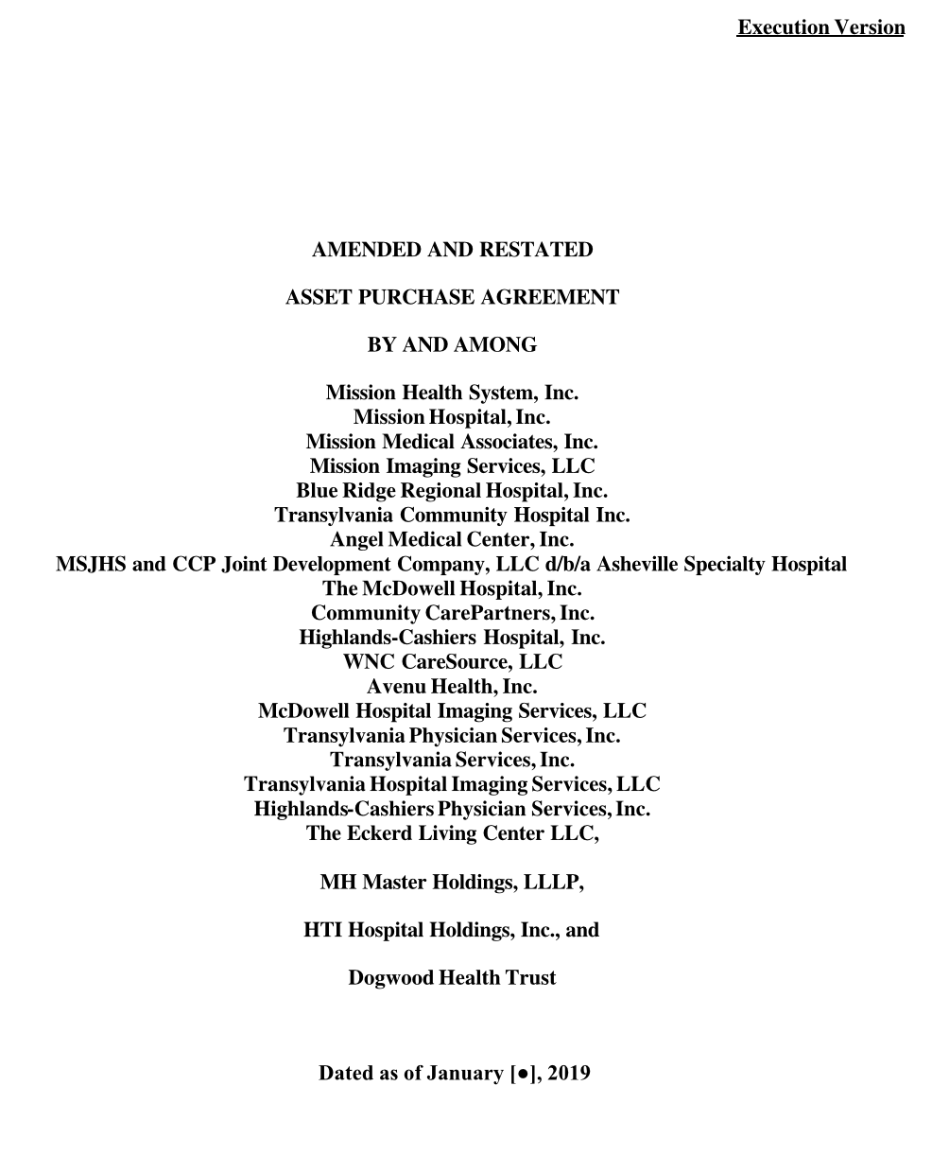
REGULATORY OUTSOURCING
Mission Hospital, Asheville
Sold to HCA, deal closed Jan. 2019
Attorney General Josh Stein ”conducted a review ... To ensure that the price paid for the assets was fair and that any charitable assets remained dedicated to a charitable purpose” → entered into additional agreements as part of the Asset Purchase Agreement to “safeguard the public” (15 conditions)
Included independent monitor, maintaining current levels of service, and AG could enforce contract
AG issued “Letter of Nonobjection”

Slide 4
REGULATORY OUTSOURCING
N.C.G.S.A. 55A-12-02(g)
”This notice shall include all the information the Attorney General determines is required for a complete review of the proposed transaction.”

Slide 5
REGULATORY OUTSOURCING
N.C.G.S.A. 55A-12-02(g)

Slide 6
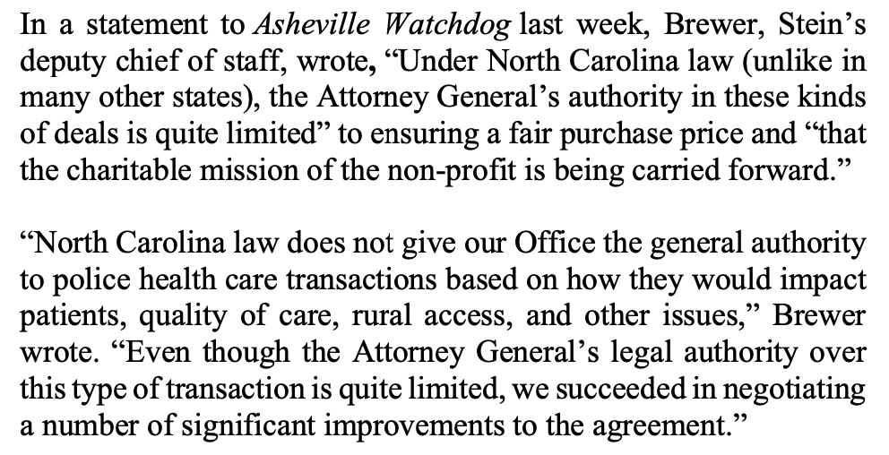
REGULATORY OUTSOURCING
N.C.G.S.A. 55A-12-02(g)

Slide 7
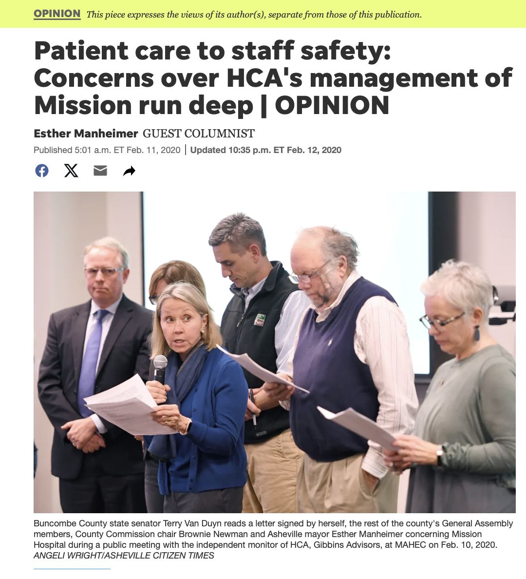

Slide 8
REGULATORY OUTSOURCING
Mission Hospital, Asheville
“We are writing with deep concern regarding the state of Mission Hospital Systems since the purchase by Hospital Corporation of America last year….”
Specific concerns:
Change to, and unfulfillment of, charity care policies and promises
Patient safety due to staff cuts, poor morale (“emergency room nurses can be seen weeping in the hallways”)
The ending of contracts with physician practices, reduction of physician autonomy and clinical judgement
Alleges HCA “lie[d],” “that wasn’t the deal we were told about”
Signed by public officials, including the mayor of Asheville

Slide 9
REGULATORY OUTSOURCING
Experienced nurse: “horrified” to witness decline in quality of care
Long waits, unsanitary conditions, broken equipment, patients laying in waste, chronic understaffing
Included independent monitor, maintaining current levels of service, and AG could enforce contract

Slide 10
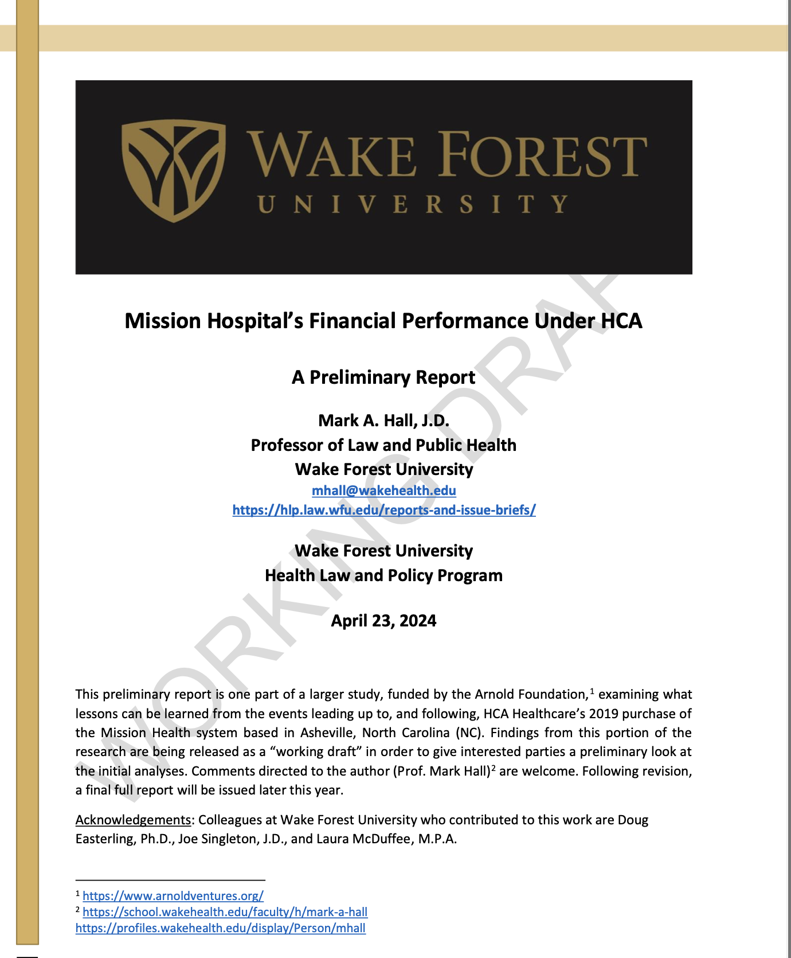
Findings:
Dramatic margin and profitability increases
List price increase up to around 500 percent of costs
Drop in patient-care costs per adjusted discharge
Decline of staffing rates

Slide 11
Private Regulation

Slide 12
REGULATORY OUTSOURCING
Mission Hospital, Asheville
Attorney General sues, alleges the APA was breached by:
Mission discontinuing ER, oncology, and trauma services
Cutting staffing, excessive patient-to-nurse ratios, waiting times, no training for equipment
Patients are waiting hours for ER admission (well over 16 hours)
Unclean ER
Bed shortages (created by Mission), impeding transport services

Slide 13
REGULATORY OUTSOURCING
Mission Hospital, Asheville
SEEKING:

Slide 14
REGULATORY OUTSOURCING
Jackson ex rel. Dogwood Health Trust v. MH Master Holdings LLLP, 2025 WL 1136428 (Apr. 16, 2025)
HCA asks court to determine meaning of “shall not discontinue”
Schedule 7.13(a) includes behavioral health, cardiac services, emergency and trauma services, imaging and diagnostic services, obstetrical services, oncology services, among others

Slide 15
REGULATORY OUTSOURCING
Jackson ex rel. Dogwood Health Trust v. MH Master Holdings LLLP, 2025 WL 1136428 (Apr. 16, 2025)
HCA: the phrase “unambiguously means that it cannot completely stop one or more of the services identified in Schedule 7.13(a)”
AG: “HCA agreed to commit itself … to actually providing all of the services contained within Section 7.13(a)”
Court: finds “not only that the words ‘shall not discontinue’ in Section 7.13(a) are ambiguous, but also that the word “services” lacks clarity. Additional evidence is needed to determine the parties’ intent…. [D]oes a discontinuation of chemotherapy under “oncology services” mean a cessation of all types of chemotherapy, or is it enough to stop providing one type of chemotherapy?”
Motion for SJ denied

Slide 16
REGULATORY OUTSOURCING
Corporate Takeover as a Failure of Corporate Governance and Public Regulation
Corporate Governance (internal)
Health Law Regulation (external)

Slide 17
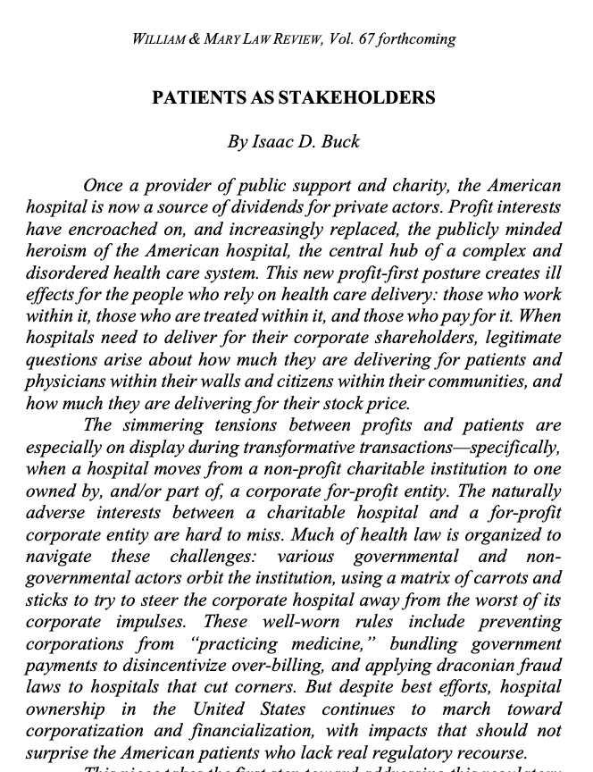
REGULATORY OUTSOURCING
Cataloguing the Sources of Influence
EXTERNAL ACTORS
INTERNAL PRESSURE
Reimbursement as Regulation: Public Payers (Medicare, Medicaid)
Reimbursement as Regulation: Private Payers
(Private insurance)
For-Profit Interests (Shareholders of the corporation itself)
State Regulatory Agencies (Health Planning, Corporate Practice of Medicine)
Federal Regulatory Agencies (FTC, CMS, IRS (non-profits), DOJ)

Slide 18
REGULATORY OUTSOURCING
Moving the Focus of Oversight and the Danger of Non-Profit Collapse
SOURCES
FEDERAL PAYERS (MEDICARE)
and
FEDERAL REGULATORS
STATE
(LOCUS)
SUBSTANTIVE
DISPERSED SHAREHOLDERS
CONTESTED PRIVATE LAW REMEDIES

Slide 19
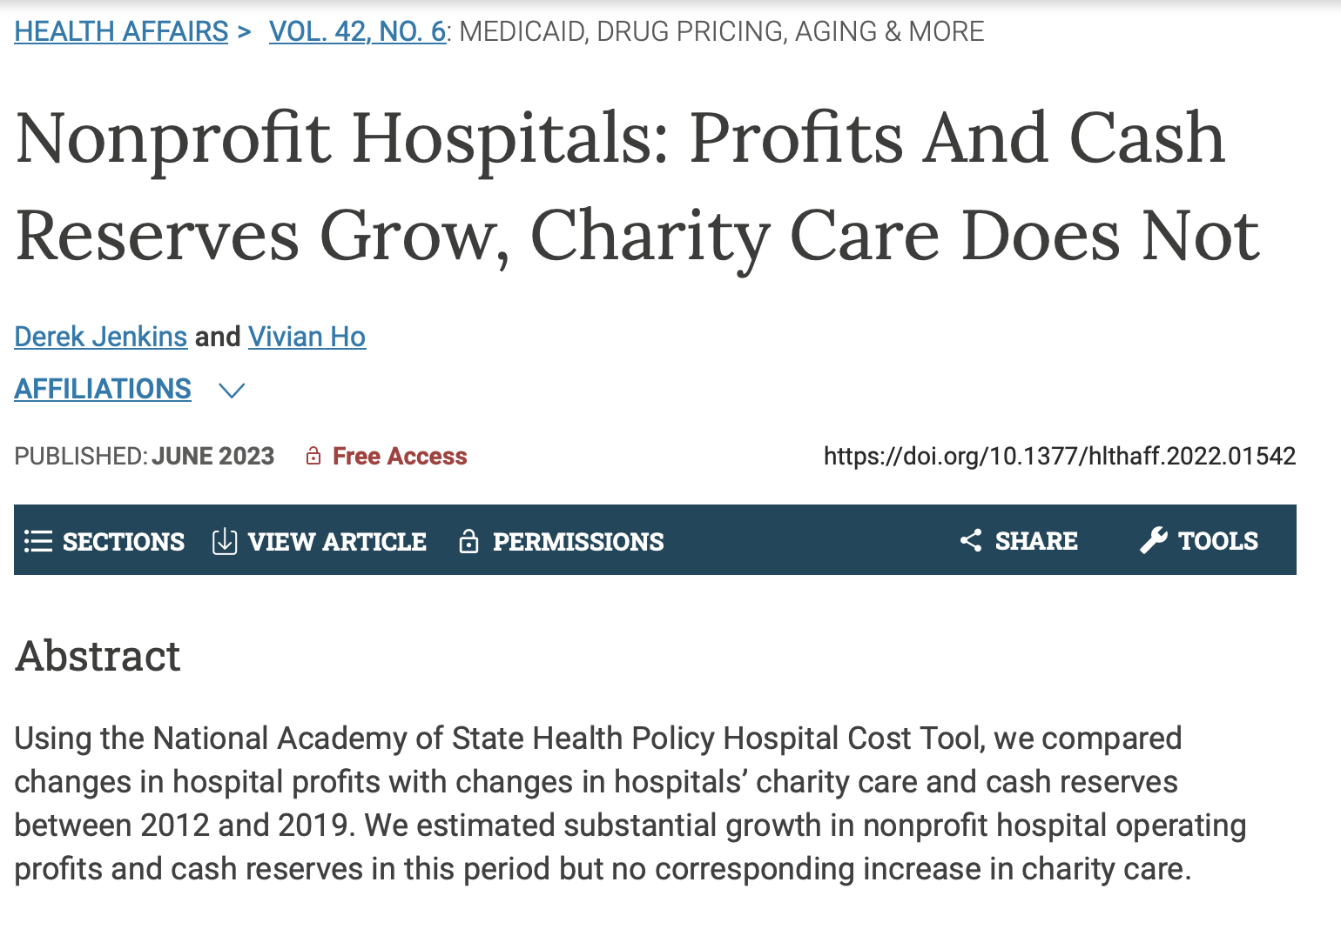
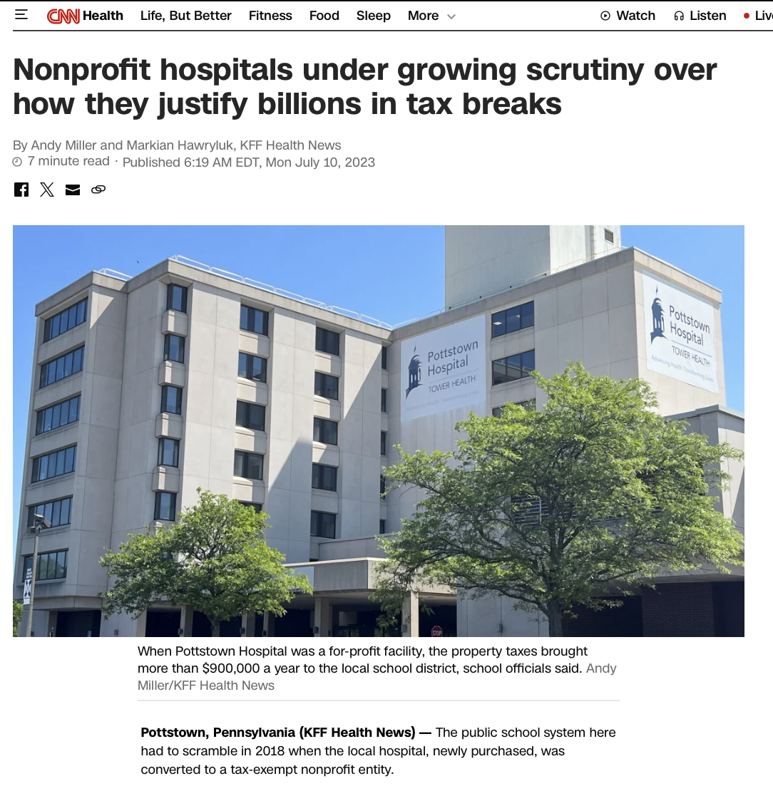

Slide 20
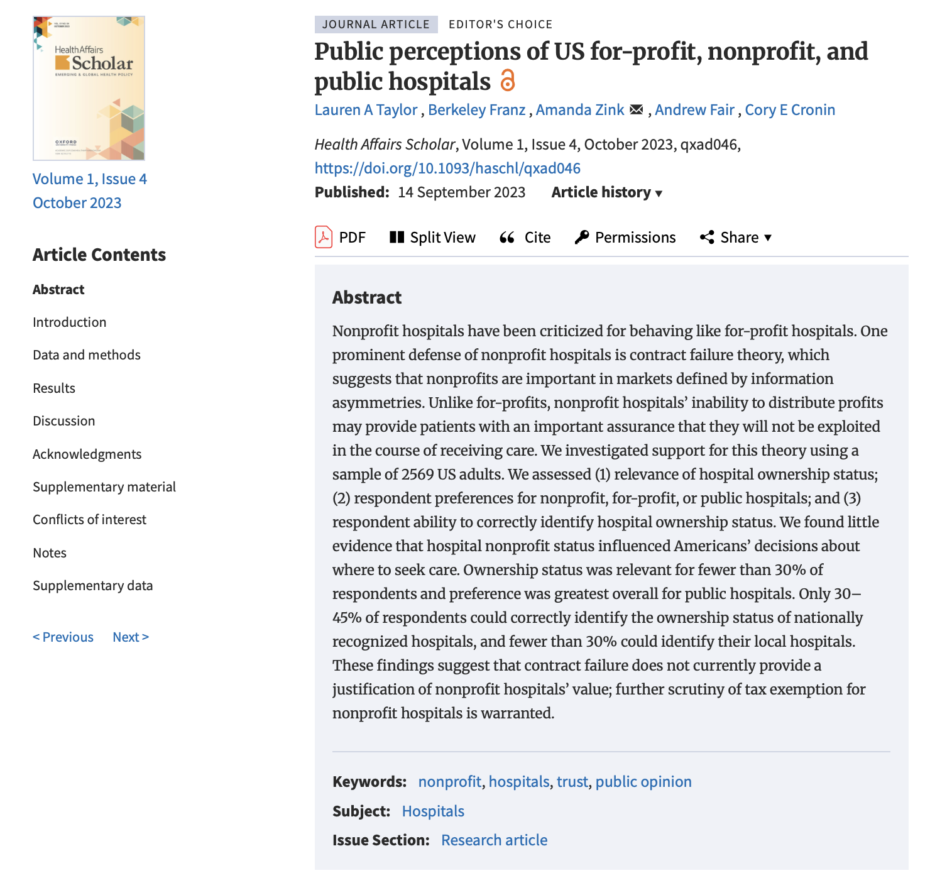

Slide 21
REGULATORY OUTSOURCING
Larger Goal:
Recentering the Community
Patients as shareholders
Reversing regulatory dispersal (both federalization and corporate shareholder control)
The uncertainty of / weakness of private / contract law remedies
The ceding of regulatory power from public entities

Slide 22
Zack Buck Associate Dean for Faculty Development and Professor of Law University of Tennessee Winston College of Law
zbuck@tennessee.edu

