Slide 1
HHS and Good Governance
Dorit R. Reiss

Slide 2


Presentation plan
Structure:
Introduction
Notice
Deliberation and transparency
Explanation
Rule of law
Conclusion

Slide 3
Introduction
Administrative law balances:
  Effective government and other values – transparency, legitimacy, rights.
  Expertise with democracy and oversight.
  It’s imperfect, but important.
Go Thata Way

Slide 4

HHS is ignoring norms of good governance

Slide 5
Notice and Opportunity for Hearing:
Notice needs to be before the action, not with it.
Classic procedural norms.
Sometimes required by the due process clause.
Seen as part of basic fairness.

Slide 6
HHS ignored notice and hearing:
Officials fired:
  Some found out when badges did not work.
  No opportunity for hearing.
Grants rescinded:
  No notice or hearing.
Rescinding Richardson Waiver (March 3):
  Legal.
  Problematic.
  Also expanding good cause.

Slide 7
Deliberation and Transparency:
Canceling VRBPAC meeting before selecting flu strains.
Holding ACIP, but not approving (or rejecting) two recommendations.
COVID-19 decisions announced in non-traditional forums.
No stakeholder input before decisions on COVID-19 vaccines.

Slide 8

Explanation: meeting hard look requirements

Slide 9
Chenery: (1943)
Agency’s rule will be reviewed in light of its own, contemporary explanation.
  Agencies cannot come up with additional arguments during litigation.
  The court will not offer an alternative explanation, even if it can see one from the materials.
But:
  A less than clear explanation that shows the agency’s rational is fine (State Farm).
  Adding support to a point made is fine.

Slide 10
State Farm: Under arbitrary and Capricious:
Agencies Must:
Examine relevant data.
Give satisfactory explanation for action.
Provide a rational connection between facts found and choice made.
Consider relevant factors (all).
Not rely on factors not included by congress.
Invalid if Agency:
Relied on factors congress did not intend.
Ignored an important aspect of the problem.
Offered and explanation that contradicts the evidence before the agency.
Offered an implausible explanation.

Slide 11
Other reminders:
Change of policy needs to be explained as well as reasons for policy.
Change in presidential administration is not a good enough reason to change your policy.
FCC v. Fox Television Stations, Inc. | 556 U.S. 502 (2009)

Slide 12
Explanation:
Recission of NIH grants for vaccine hesitancy (March 10):
“It is the policy of NIH not to prioritize research activities that focuses gaining scientific knowledge on why individuals are hesitant to be vaccinated and/or explore ways to improve vaccine interest and commitment...Therefore, the award is terminated.”
Reliance interests?
Why this policy?

Slide 13
Explanation:
Recission of state funds: (March 24)
  Table setting out funds rescinded.
  Explanation: “[t]he end of the pandemic provides cause to terminate COVID-related grants. Now that the pandemic is over, the grants are no longer necessary.”

Slide 14
Explanation:
COVID-19 vaccines for children and in pregnancy (May 27):
  X video – less than one minute.
  No explanation at all for no recommendation in pregnancy.
  Few general statements for children.
  Secretary Directive (May 19):
    Not published.
    Cursory.
    No references.

Slide 15
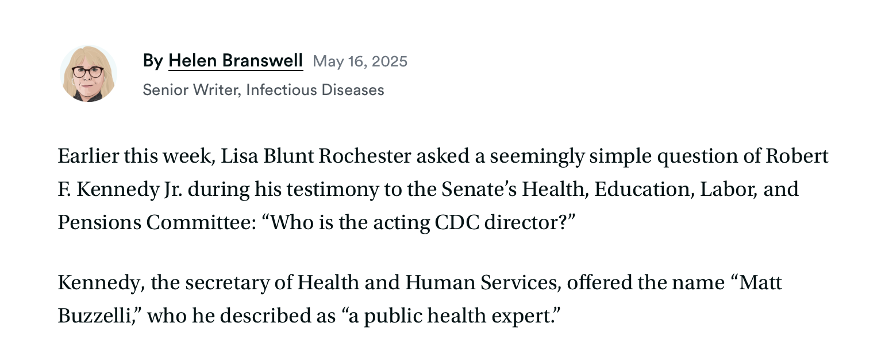
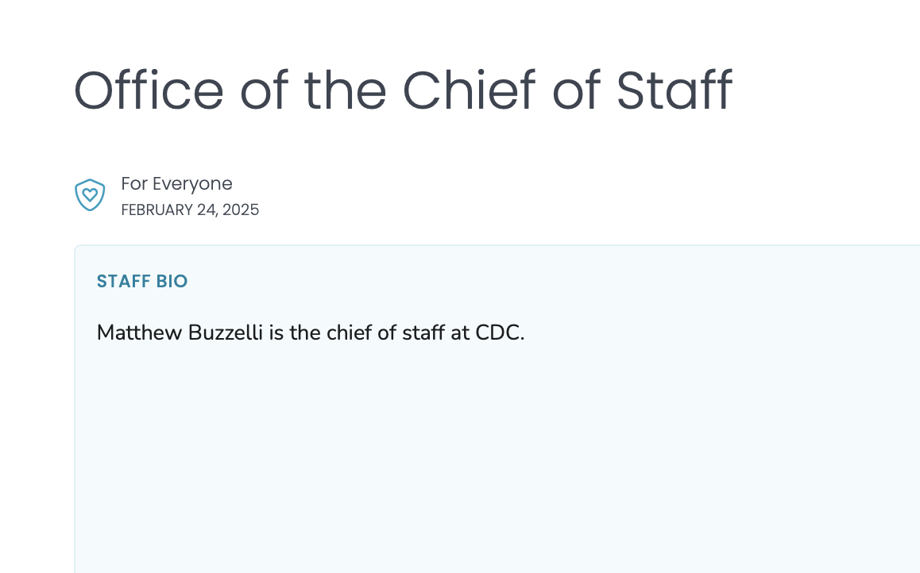
Rule of law:
CDC acting director?
  Initial acting director, Susan Monarez, nominated for position.
  Kennedy claimed Matt Buzzelli is.
  Not on website.
  At the time, not qualified under the Vacancies Act.
  Absent director, Kennedy gets to approve ACIP recommendations.
https://www.statnews.com/2025/05/16/does-the-cdc-have-an-acting-director-yes-says-rfkjr/

Slide 16
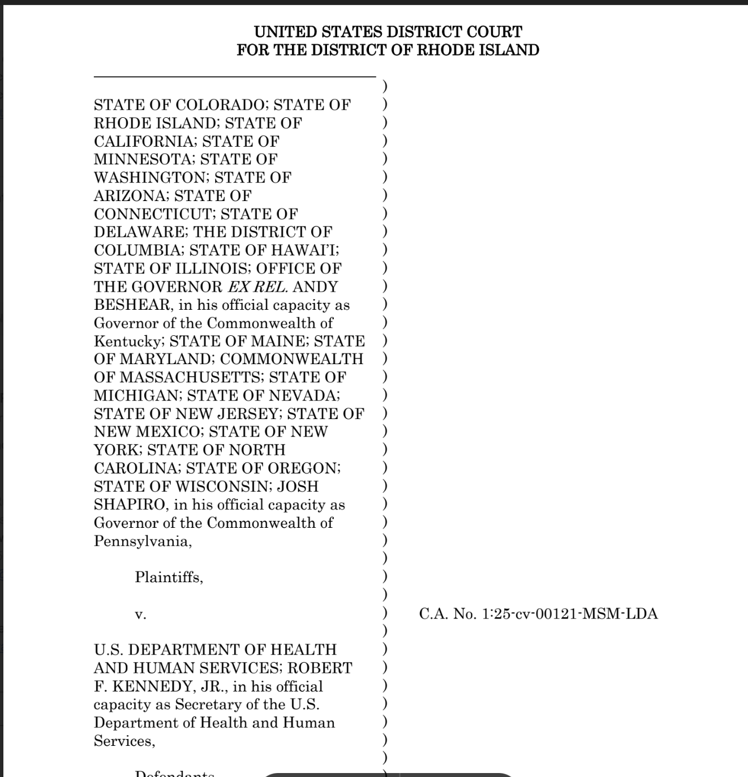
Rule of law:
State grant recissions – Judge:
  Ignored congressional appropriations.
  Ignored procedures in appropriating acts.

Slide 17
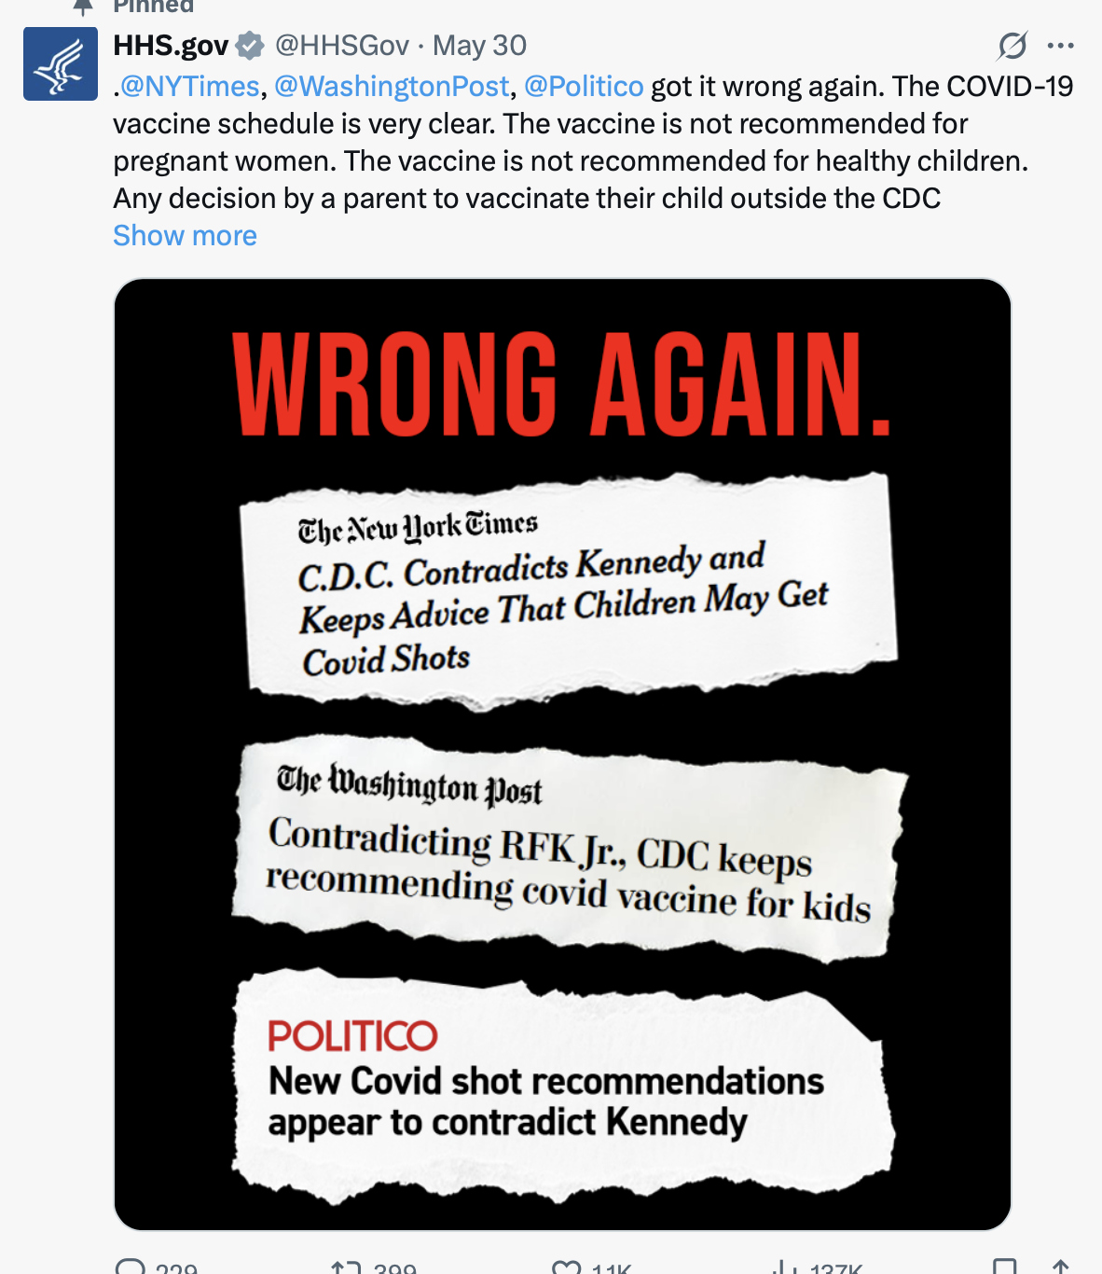
Rule of law:
COVID-19 vaccines:
  NEJM “framework” – ignoring publication requirements.
  Children and pregnant women:
  Ignoring ACIP’s role;
  Including FDA and NIH, who have no formal role.

Slide 18
Concluding points:
Administrative law is far from perfect, but serves important functions.
HHS has been ignoring the most basic norms of administrative law.
HHS decisions have been non-deliberative, non-transparent, and multiple times failed to follow the rule of law.
These kind of decisions do not deserve deference.

Slide 19
Thank you!
Questions? Comments?
reissd@uclawsf.edu
415-5654844

