Slide 1
Development of a Statewide Medical-Legal Curriculum to Improve Dementia Care and Address Social Needs
Sarah Hooper, JD
Associate Dean & Professor of Practice UC Law San Francisco (formerly known as “UC Hastings”) Executive Director UCSF – UC Law Consortium on Law, Science & Health Policy
March 4, 2024

Slide 2
What I’ll Attempt in 15 Mins
Why is dementia care a pressing national and state health policy issue? Why are law faculty and lawyers involved?
How did we develop a statewide learning collaborative and curriculum?
What did we learn?

Slide 3
Alzheimer’s Dementia is Highly Prevalent
10.9% of the US population over 65 has Alzheimer’s Disease
73% of those are age 75+.
720K live in California
Source: Rajan KB, et al. doi: 10.1002/alz.12362.
Alzheimer’s Association. 2021 Alzheimer’s Disease Facts and Figures. Alzheimers Dement 2021;17(3).

Slide 4
Higher prevalence in low-income adults
Dementia Diagnosis Data in Medi-Cal Beneficiaries 65+ show
% of Adults 65+ with Alzheimer’s disease or Dementia diagnosis and who are: | Prevalence
Dually-Eligible (with Medicare Fee For Service and Medi-Cal) | 18.1%
In the general U.S. population | 10.9%
Sources:
DHCS: Prevalence of Alzheimer's Disease and Related Dementias Among California MediCal Beneficiaries Age 30 and Older, as of March 2021
Alzheimer’s Association. 2024 Alzheimer’s Disease Facts and Figures.

Slide 5
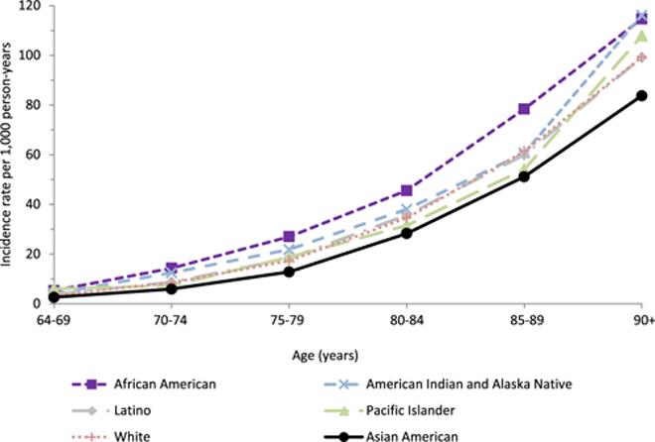
Black, Latinx and some Asian groups are at higher risk
Compared to older adults who identify as white:
Those who identify as Black have roughly 2X the risk of dementia
Those who identify as Latino/Hispanic have 1.5X the risk
Among Asian populations, different groups appear to have a different level of risk.
In California, Asians experienced the sharpest rise in dementia prevalence (746%) of any group from 2000-2018.
1. Kornblith E, et al. doi:10.1001/jama.2022.3550
2. Mayeda, E.R., et al. doi.org/10.1016/j.jalz.2015.12.007
3. CA Alzheimer's Facts and Figures, 2021. Alzheimer’s Association
Notes:
Over their lifetime, people who identify as African-American or Hispanic or Latinx have higher prevalence of Alzheimer's disease.
For all dementia in the US, is that people who identify as African-American have about 2x the lifetime risk and people who identify as Hispanic or Latinx have about 1.5x the lifetime risk compared to non-Hispanic white people.

Slide 6
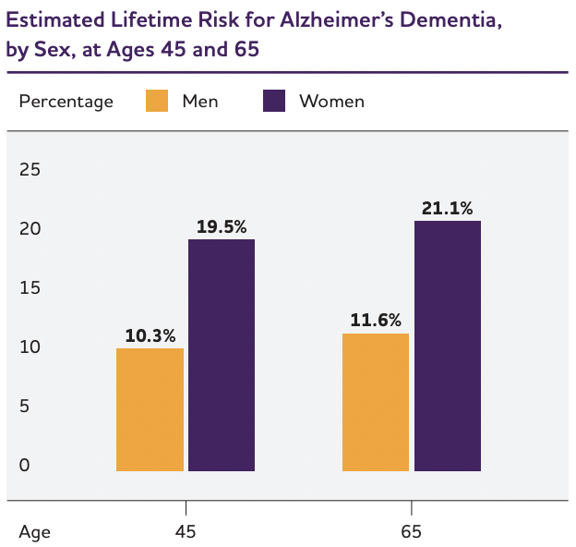
Women are at higher lifetime risk than men
About 2/3 of people living with dementia are women.
Women’s life-time risk is higher (see Figure):
At age 45, a woman’s lifetime risk is 1:5 (compared to men, which is 1:10).
At age 65, the risk is slightly higher for both sexes.
Source: Chene, et al. doi: 10.1016/j.jalz.2013.10.005.
Alzheimer’s Association. 2021 Alzheimer’s Disease Facts and Figures. Alzheimers Dement 2021;17(3).
Notes:
Women have a life time risk of Alzheimer's disease (shown here) that is twice as high as men.

Slide 7
Racial and Ethnic Disparities in Dementia Care
Older Black and Hispanic Americans disproportionately more likely to:
never receive a diagnosis
report discrimination in accessing care for self or loved one
Alzheimer’s Association. 2021 Alzheimer’s Disease Facts and Figures. Alzheimers Dement 2021;17(3).
Notes:
As an older American of color Mr. S was at higher risk of dementia, was unlikely to have that dementia diagnosed, and of course more likely to experience discrimination in his care. Structural racism also helps explain why his neighborhood didn’t have sufficient medical and social supports, why his retirement income was smaller relative to white peers, and why his social network no longer lived near him and had their own stressors inhibiting their ability to provide care and support. Lifetime factors such as housing segregation and employment discrimination set the conditions into which Mr. S lived, aged, and died.

Slide 8
Cognitive Impairment Largely Undetected
204 adults 65+ w/o diagnosis
5 FQHCs in Indianapolis, Indiana (2023-2024)
62.3% mild cognitive impairment, 12.3% dementia
Kulshreshtha A, et al. Prevalence of Unrecognized Cognitive Impairment in Federally Qualified Health Centers. JAMA Netw Open. 2024 Oct 1;7(10):e2440411. doi: 10.1001/jamanetworkopen.2024.40411. Erratum in: JAMA Netw Open. 2024 Nov 4;7(11):e2452012. doi: 10.1001/jamanetworkopen.2024.52012. PMID: 39436648; PMCID: PMC11581540.

Slide 9
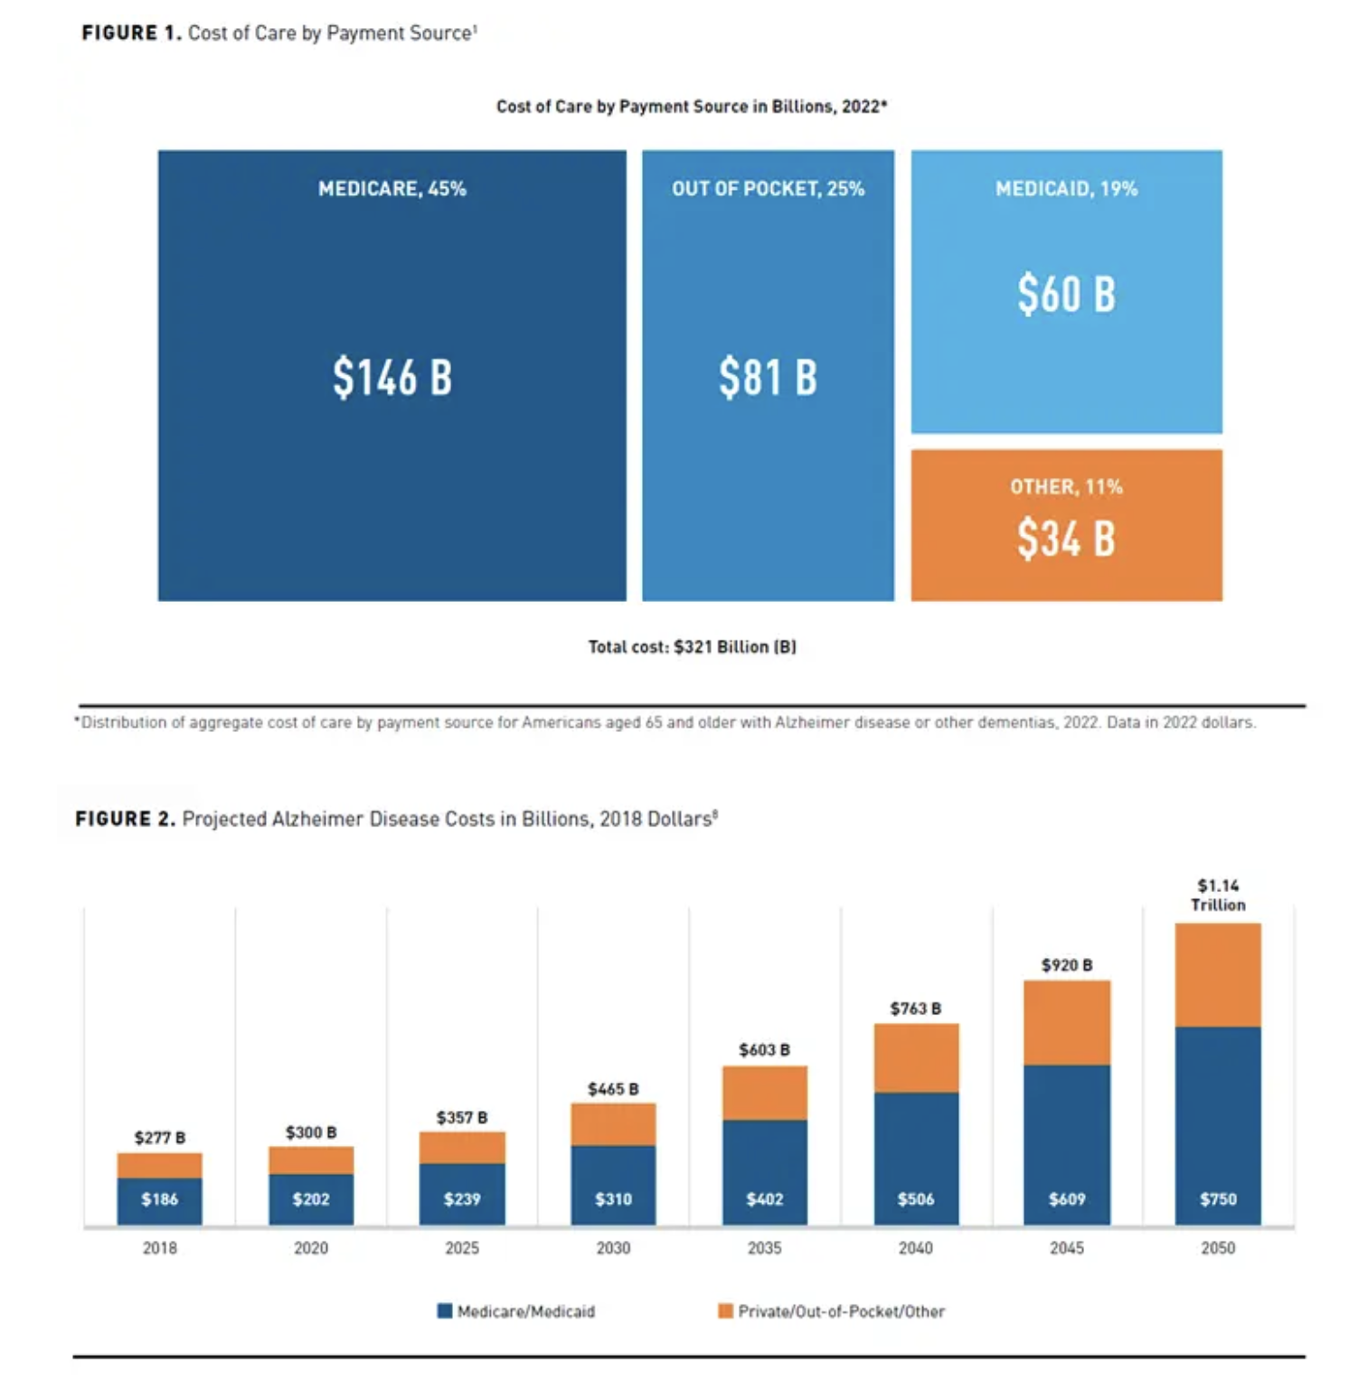
High and growing cost to payors, including families
Avg annual cost for Medicare beneficiary w/dementia 3x higher than without
Avg annual cost for Medicaid beneficiary/dementia 22x higher than without
Avg cost to family caregivers of PWD 2x that of nondementia caregivers
Skaria, A. (2022). The Economic and Societal Burden of Alzheimer Disease: Managed Care Considerations. 28. https://www.ajmc.com/view/the-economic-and-societal-burden-of-alzheimer-disease-managed-care-considerations

Slide 10
The Health Workforce is Unprepared
Limited geriatrics training or focus among health professionals (less than 5% with geriatric licensing)
Primary care workforce lacks training, fears conversation, perceives time burden, stigma and discrimination still prevalent
Barriers to multidisciplinary, team-based care
Flaherty, E., & Bartels, S. J. (2019). Addressing the Community-Based Geriatric Healthcare Workforce Shortage by Leveraging the Potential of Interprofessional Teams. Journal of the American Geriatrics Society, 67(S2), S400–S408. https://doi.org/10.1111/jgs.15924; de Levante Raphael, D. (2022). The Knowledge and Attitudes of Primary Care and the Barriers to Early Detection and Diagnosis of Alzheimer’s Disease. Medicina, 58(7), 906. https://doi.org/10.3390/medicina58070906
Notes:
Flaherty, E., & Bartels, S. J. (2019). Addressing the Community-Based Geriatric Healthcare Workforce Shortage by Leveraging the Potential of Interprofessional Teams. Journal of the American Geriatrics Society, 67(S2), S400–S408. https://doi.org/10.1111/jgs.15924; de Levante Raphael, D. (2022). The Knowledge and Attitudes of Primary Care and the Barriers to Early Detection and Diagnosis of Alzheimer’s Disease. Medicina, 58(7), 906. https://doi.org/10.3390/medicina58070906

Slide 11
California State Policy Efforts
Master Plan for Aging (2019)
Alzheimer’s Task Force
SB 48 (2021)
DHCS-UCSF Dementia Care Aware
Notes:
MPA – created in 2019 with input of multiple stakeholders across the state. Resulted in a broad framework for improving aging across the state. Five goals: housing, health, inclusion and equity, caregiving, and economic security. Dementia is an issue that threads through all of these domains.
Task Force convened to focus specifically on dementia.
Among the products of this was Senate Bill 48, enacted in 2021. This provided a new Medi-Cal billing code for cognitive assessment, which providers could only bill to if they first had training in cognitive assessment.
The Department of Health Care Serivces (Medi-Cal agency) created Dementia Care Aware in partnership with UCSF to develop that training and outreach strategy. As one component of that strategy I had the opportunity to develop and lead a statewide medical-legal learning network.

Slide 12
DCA Medical-Legal Partnership Network
Notes:
16 organizations across the state

Slide 13
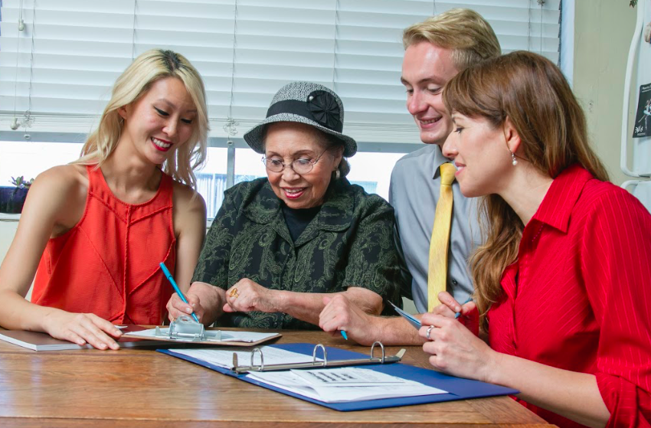
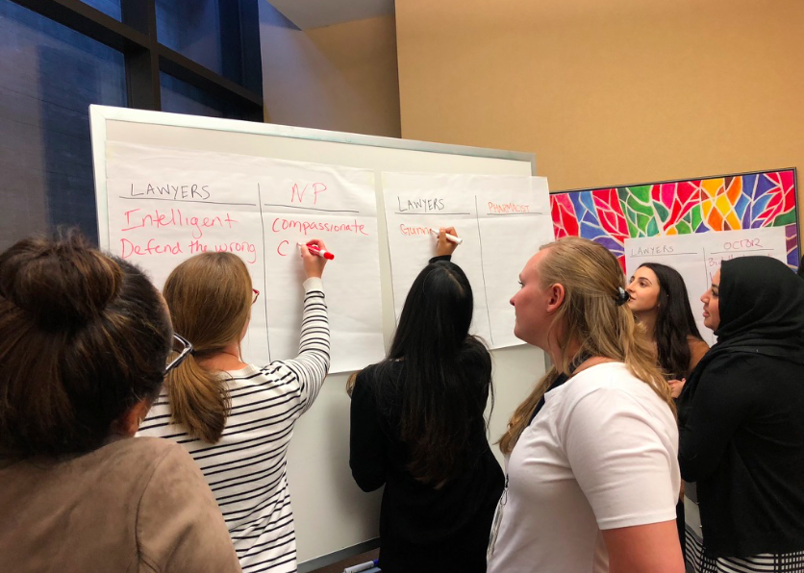
Why Medical-Legal Collaboration?

Slide 14
Legal Planning is Part of Quality Dementia Care
CLINICAL RECOMMENDATION STATEMENTS:
“Important aspects of psychiatric management include educating patients and families about the illness, its treatment, and sources of additional care and support (e.g., support groups, respite care, nursing homes, and other long-term- care facilities) and advising patients and their families of the need for financial and legal planning due to the patient’s eventual incapacity (e.g., power of attorney for medical and financial decisions, an up-to-date will, and the cost of long-term care) (Category I)
MIPS High Priority Metric #288- Dementia: Caregiver Education & Support:

Slide 15
Medical-Legal Partnerships Support Clinical Practice
Increased confidence in providing patient care
Decreased clinician stress/burnout, particularly among providers working with older adults
Increased clinician satisfaction
Increased willingness to discuss SDOH and legal needs with patients
(Tyler 2019; Davis, 2022; Edward, 2022, Conner 2024)

Slide 16
Medical-Legal Partnership Supports Patients
Improved self-reported health outcomes
Better health care compliance
Improved access to public benefits
Reduced stress
Reduced health care utilization (ex. Reduced hospital LOS, decrease in ER visits, readmission rates)
Improvements in social determinants of health (such as housing, food, economic supports, reduced debt)
(Teufel, 2012; Pettignano, 2012; Martin, 2015; Davis, 2022 Edward, 2022)

Slide 17
What Were the Goals of this Network?
Develop new statewide Medical-Legal Learning Network
Develop curriculum for primary care
Train primary care teams through live and asynchronous approaches

Slide 18
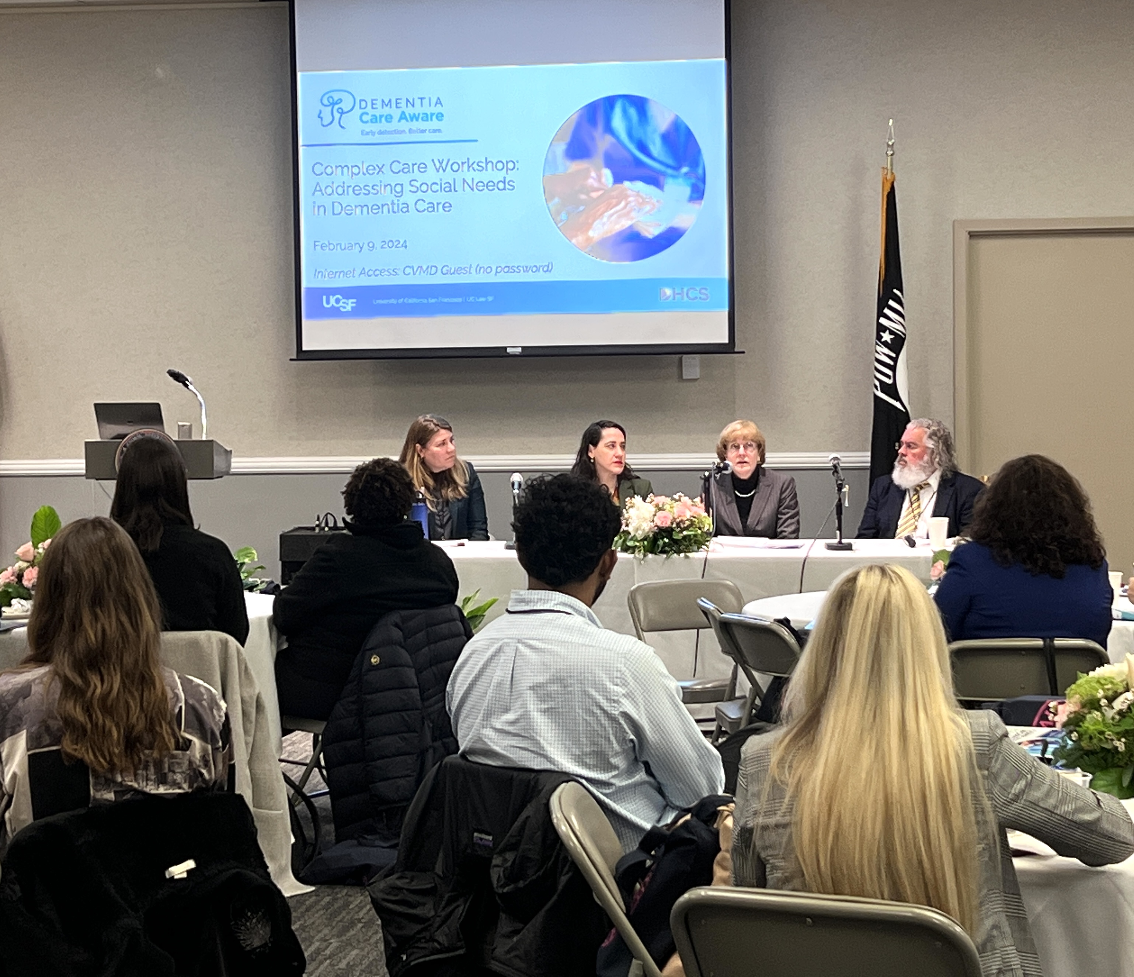
Goal 1: Formed Statewide Medical-Legal Partnership Network
Network of 16 legal, community, and health care organizations around the state
3 In-Person Convenings
Monthly Zoom meetings (~25 regular attendees)
Notes:
Not just working meetings but training opportunities.

Slide 19
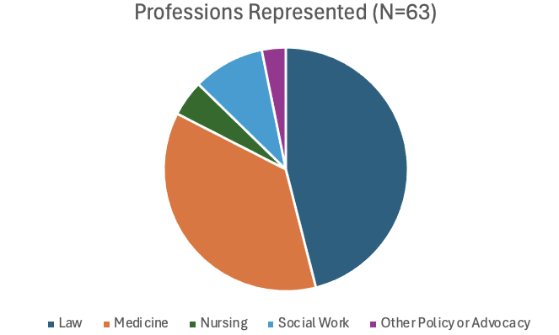
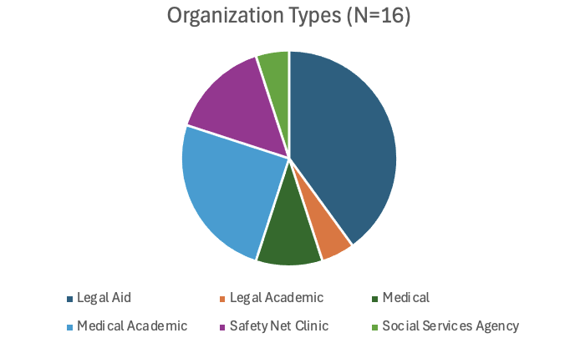
MLP Network Participants

Slide 20
Goal 2: Collaboratively Developed Medical-Legal Curriculum
Identified 11 training topics:
Advance Care Planning
Capacity
Consumer Debt
Disability Forms
Elder Abuse & Neglect
Housing
Income Supports
Medi-Cal/IHSS/Long-Term Care
Paid Family Leave
Planning Needs for Immigration
Preventing the Need for Conservatorship
Materials for Each:
PPT presentations
Teaching cases
One-page handouts
Notes:
Explain how we did it – how did we land on these topics?
Consensus, iterative rounds of review from stakeholders: clinicians, law faculty and legal aid attorneys

Slide 21
Example: Advance Care Planning Learning Objectives
At the end of this training, you will be able to:
Define the purpose and components of advance care planning following a cognitive health assessment
Name three kinds of legal decision supporters a Medi-Cal patient commonly needs
Initiate a conversation about advance care planning and provide resources
Notes:
Meant to be concrete and actionable.
Focus on agents instead of goals of care: recommendations to focus/prioritize agent over goals of care conversations. Too early in course of disease; practical considerations for PCPs. If they only do this one thing, it’s this.
Note the ”three kinds” includes health care agent, DPOAF, rep payee

Slide 22
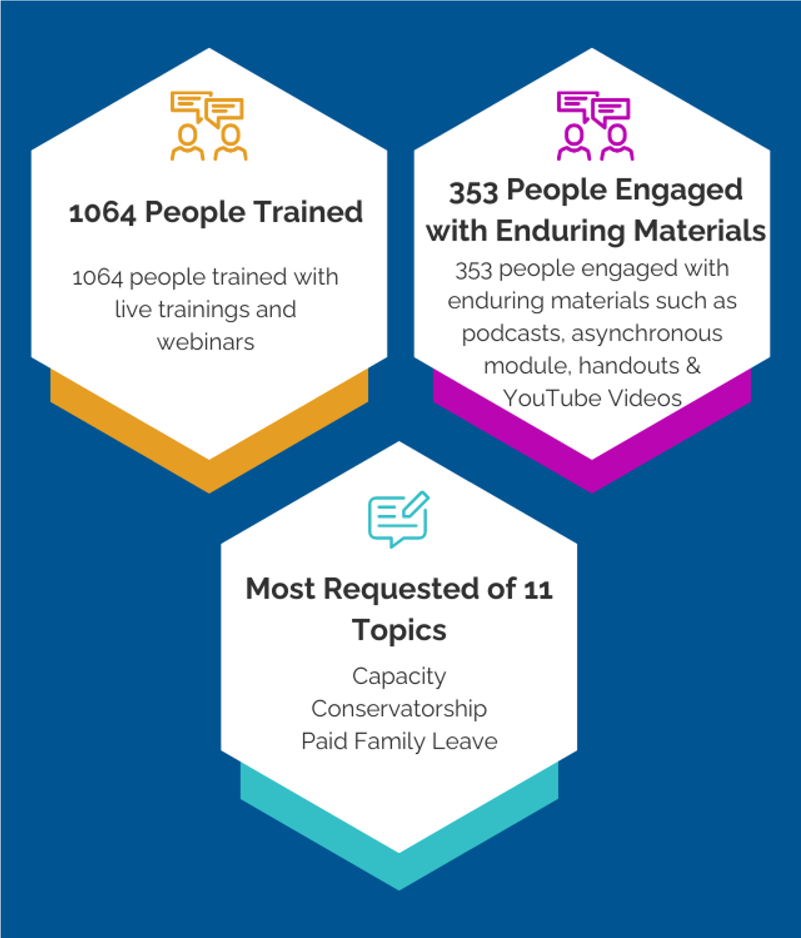
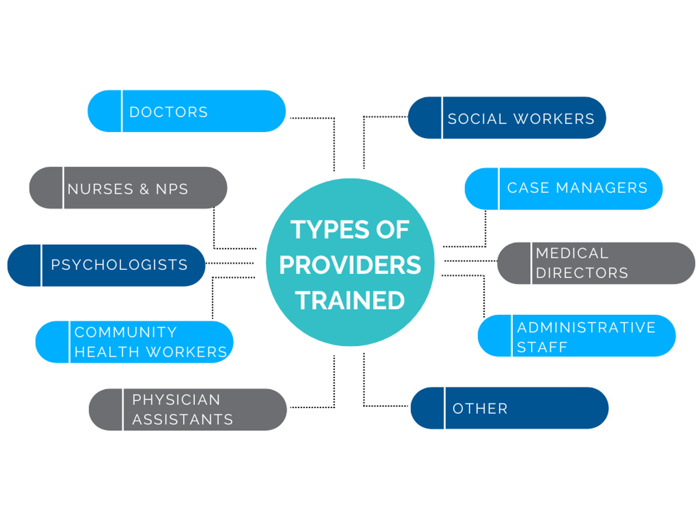
Goal 3: Provided Training (June 2023 - February 2024)
Notes:
9 months- this includes everyone we’ve reached through live trainings, convenings, and enduring materials such as webinars, podcasts asynchronous trainings

Slide 23
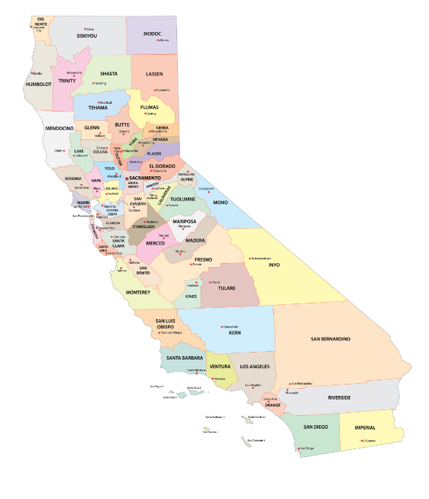
Live Trainings: Geographic Reach
23 counties:
San Joaquin County
San Mateo County
Santa Clara County
Santa Cruz County
Shasta County
Siskiyou County
Solano County
Sonoma County
Stanislaus County
Sutter County
Alameda County​
Butte County
Contra Costa County
Humboldt County​
Lake County
Los Angeles County​
Monterey County​
Napa County​
Orange County​
Sacramento County
San Bernardino County
San Diego County
San Francisco County

Slide 24
Evaluation Survey Feedback
Average Score: 4.7 out of 5
“I have much more confidence on what specific role I can play to help my patients.”
“I enjoyed the discussion on evaluating capacity and the ways to evaluate capacity on a graduated continuum. Thank you!”

Slide 25
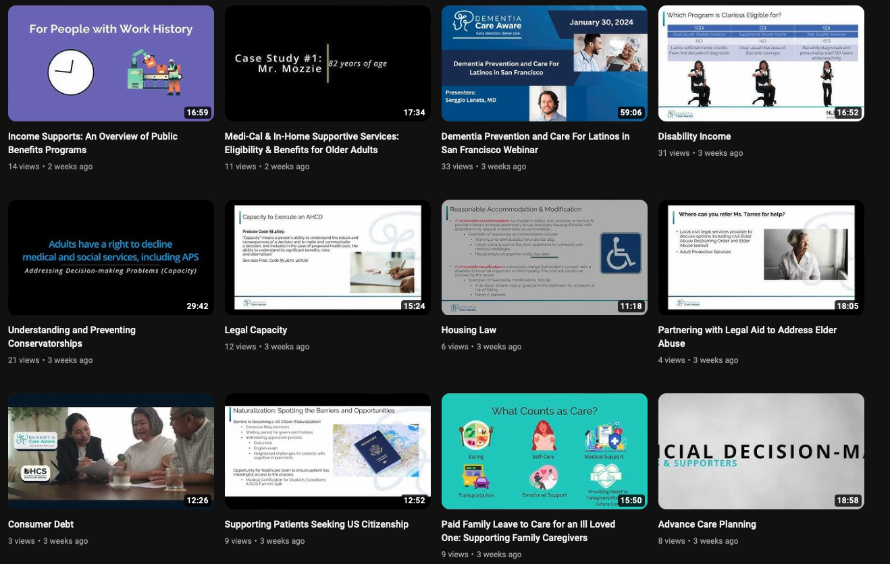
MLP YouTube Video Series
Launched February 2024

Slide 26
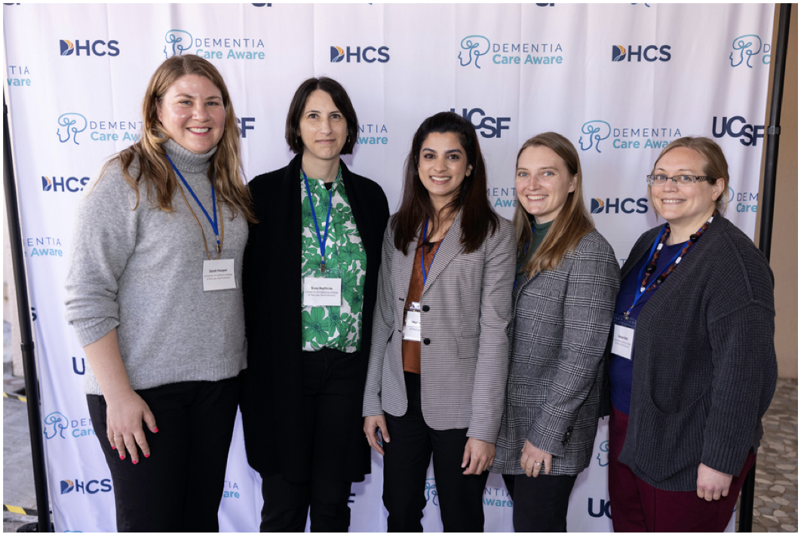
Top Lessons Learned: Process
Relationships, shared values
Culture of learning/learning mindset
Case-based learning critical
The attention economy and packaging the value of training
Notes:
Relationships, shared values- key to every single aspect from curriculum development to outreach strategy
Culture of learning/learning mindset- ”training” vs conversation
Case-based learning key- good interdisciplinary practice. People are coming with different conceptual frameworks and training. But present them with a real case and ask them to unpack it together and that’s where the juice happens. Forces everyone to really get concrete.
The attention economiy and packaging: unfortunately there is still a lot of stigma and discrimination when it comes to older people, especially low income older people and especially with dementia. There are also huge competing demands on people’s time and attention, plus burnout in health workforce. So a huge challenge here is getting them to show up. Training is required to bill for these services, but reimbursement from Medi-Cal is not much of an incentive. What we learned is that extended length of stay is a big system painpoint and conservatorship is a big driver of that. So at a certain point in outreach we stopped talking about advance care planning and Medi-Cal HCBS and started talking about “strategies to prevent the need for conservatorhip”. That has gained greater attention.j
Also no one knows what legal needs are so we started talking about social needs generally, with lawyers and legal knowledge as powerful instruments to address them.

Slide 27
Top Lessons Learned: Substance
Health care teams can and should identify need for financial planning (DPOAF) along with medical planning in ACP
PCPs need training, support, and institutional guidance in writing capacity letters
Legal workforce should have training in capacity and elder law issue-spotting
All professions should be able to name at least four alternatives to guardianship

Slide 28
Thank you and Questions
Sarah Hooper
hoopers@uclawsf.edu
UC Law SF (formerly called UC Hastings)

