Slide 1
A Snapshot of Memory Care: Regulation, Staffing, and Adverse Events in Memory Care Units within Assisted Living Facilities
Mary Manchester, MPH Center for Aging, Law & Ethics | School of Public Health
Notes:
As a part of my job for I am generally familiar with aging policy at the federal level. Skilled Nursing Facilities across all states have the benefit of staffing and memory care standards that are regulated by CMS (and which are outlined in Title 42 (Subpart B))
Assisted living facilities, also often called community care homes, do NOT fall under federal jurisdiction.
This ongoing project is an exploration of memory care and workforce standards that have been set in states’ assisted living facility regulation.

Slide 2
Background & Research Question
How do state regulations on workforce requirements in assisted living facilities align with best practices for comprehensive memory care?
Skilled Nursing Facility Regulation (CMS)
versus:
Assisted Living Facility Regulation (state)
Both have: Standards for Workforce and Memory Care
Observed trend: Demand for Comprehensive Care
Notes:
Both are expected to and regulated to be equipped with memory care, usually in the specific memory care unit of the facility
SMF: Full-time medical care and includes high barrier for permanent residence, especially after three months of stay due to the stop in Medicare coverage, oftentimes after an elder adult is hospitalized and is recovering in a SNF, the care team’s goal is to make them well enough to be placed in assisted living facilities. Historically, Various Quality Measures have been collected and are publicly available in an organized format from CMS and CDC, somewhat easier to identify gaps in care quality when regulations are not met.
So, Assisted living facilities.
General definition across states includes- residents likely need mild to moderate assistance with daily activities, mild to moderate care provided by caregivers often nurse aides or others with slightly less formal education training, of which supervised by nurse practitioners. Residents are ambulatory, sometimes with assistance. What I am focusing on, is the memory care. Assisted living facilities will often have separate memory care units where staff training and resident needs are greater and more specific and therefor are further defined in state regulation. They’re licensed and regulated at the state level, and a state agency is in charge of collecting quality measures, so, it’s more diffucult to find and gather this data and organize it in a way that’s comparable across states.
Both kinds of facilities have a spectrum of residents with mild cognitive impairment to those with fully diagnosed with Alzheimer’s, dementia, related conditions, it’s just a matter of difference in timeline of residency or, often, memory care is not the primary focus of care in the SNF, or is perhaps just treated as symptom that is exacerbating a more urgent medical issue that’s the primary focus.
So in the ALF setting, memory care can me the primary focus. A person may or may not present cognitive impairment upon taking residency in an assisted living facility, symptoms could progress as residency continues,and eventually are transferred into memory care units within the assisted living facility, usually when diagnosis has been confirmed. So the care really have the responsibility of knowing and recognizing all stages of dementia, the different kinds, and care needs across the progression of the condition.
We also know that Comprehensive Care Models have been integrated across all medical settings at an increasing rate, and the Alzheimer's Association has really promoted that trend in the sphere for care older adults for a while now.
All of this background knowledge that I’ve gathered has lead to me having ongoing work as a research Coordinator at GSU that allows me to address my, research question: How do state regulations on workforce requirements in assisted living facilities align with best practices for comprehensive memory care?
.

Slide 3
Methods: Legal Mapping of State Regulations
Methods: Legal Mapping of State Regulations
Investigate Legal Standards:
Content Analysis of States’ Regulation – Public Health & Social Security Chapters
Investigate Memory Care Subject Matter:
Alzheimer’s Association 2018 Dementia Care Practice Recommendations (Fazio S, Pace D, Maslow K, Zimmerman S, Kallmyer B.) Dementia Care Practice Recommendations. Gerontologist. 2018 Jan 18.
Notes:
My methods so far have been Twoin two parts.
1.Conducted legal search for state regulations and extracted anything regarding Residential Care Facilities for the Elderly – Most often found these as Chapters or Articles within Administrative Regulations for State Public Health Departments or Social Security Departments.
2. Determined what material in research and academia has given the best representation of comprehensive care standards for people living with dementia

Slide 4
10 States Examined
California | New Mexico | Texas |Wisconsin |Missouri |Indiana |Kentucky |Georgia |New York |Connecticut
Notes:
So far, I have ten states. I selected states for full analysis based first on need to support other research and grant applications within my team, and then selected for geographic and socioeconomic distribution.
Three example states I will be using are Georgia, Missouri, Kentucky – really only a coincidence that these are all in south/eastern united states. Generally, they’re a good representation of what I’ve found so far

Slide 5
Notes:
So, what exactly did I compare regulation content to?
Each zone of care has 5-10 detailed criteria, 61 total across all zones,
For purpose of this project, I considered a zone adequately “filled” if a states’ regulation content matched at least half or more of a zone’s criteria.
Get down to the detailed criteria of each zone in later slides.
But to give a short example, Staffing, since my focus is on workforce expectations and training standards for memory care:
6 criteria some of which are
Provide a thorough orientation and training program for new staff, as well as ongoing training Develop systems for collecting and disseminating person-centered information Encourage communication, teamwork, and interdepartmental/interdisciplinary collaboration Establish an involved, caring and supportive leadership team Promote and encourage resident, staff, and family relationships Evaluate systems and progress routinely for continuous improvement

Slide 6
Frequently Filled Care Zones in State Regulation
Care Zone | % Criteria Met
1. Supportive and Therapeutic Environment and Safety | 83%
2. Staffing | 76%
3. Person-Centered Assessment & Care Planning | 71%
Notable Criteria:
High Frequency across 10 states
Provide a thorough orientation and training program for new staff, as well as ongoing training (Zone 2.)
Low Frequency across 10 states
Use assessments as an opportunity for information gathering, relationship-building, education, and support (Zone 3.)
Notes:
Notable Criteria of these 3 Zones:
High Frequency
Support courtesy, concern, and safety within the care community (Zone 1.)
Provide a thorough orientation and training program for new staff, as well as ongoing training (Zone 2.)
Use documentation and communication systems to facilitate the delivery of person-centered information between all care providers (Zone 3.)
Low Frequency
Create a sense of community within the care environment (Zone 1.)
Develop systems for collecting and disseminating person-centered information (to residents, caregivers, family members, legal representatives, etc.) (Zone 2.)
Use assessments as an opportunity for information gathering, relationship-building, education, and support (Zone 3.)

Slide 7
Least Frequently Filled Care Zones in State Regulation
Care Zone | % Criteria Met
1. Person-Centered Care | 55%
2. Information, Education, and Support | 54%
3. Medical Management | 53%
Notable Criteria:
High Frequency across 10 states
Evaluate care practices regularly and make appropriate changes (Zone 1.)
Low Frequency across 10 states
Provide education and support early in the disease to prepare for the future (Zone 2.)
Notes:
High frequency Low frequency
Something also to note, out of the 10 states, most direct care staff who were not designated to work in the memory care unit were not required to have any memory care training as far as recognizing symptoms, progression, immediate care needs, knowing how to perform a brief cognitive assessment if they are allowed to do so. So, it’s possible trigger for diagnosis comes during an annual physical, where often, as we’ve covered, still does not guarantee it will be addressed.
Beginning stages of dementia may not be dealt with appropriately for caregivers outside of memory care units, nor may residents be aware of signs and symptoms to look for and communicate and provide transitional care and activities.

Slide 8
Example State: Low Performance
Notes:
% alignment:
12% difference in alignment between low, moderate, and high performance
Low in the sense that zones are being addressed quite well, just not as well as most other states
Strong in 2/3 of expected zones: Supportive and Therapeutic Environment Staffing Information, Education, and Support (for staff)
But: also strong in Information, Education, & Support (only difference here is that this is frequently a zone where most criteria is unmet in other low performing states)
Moderately weak in Person-Centered Care and Very Weak in Medical Management (of dementia and other medical needs)

Slide 9
Example State: Moderate Performance

Slide 10
Example State: High Performance

Slide 11
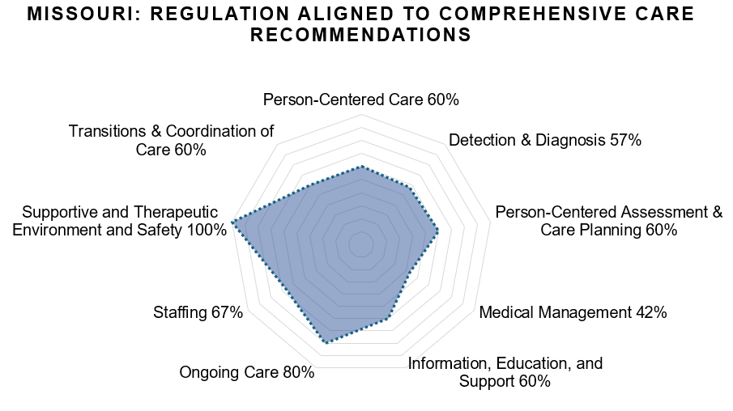
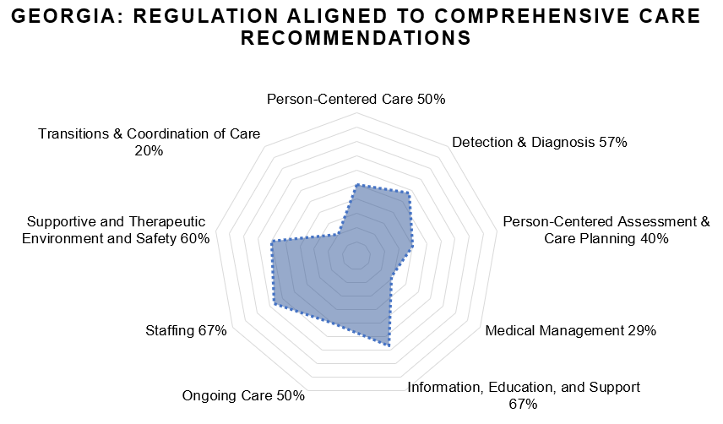
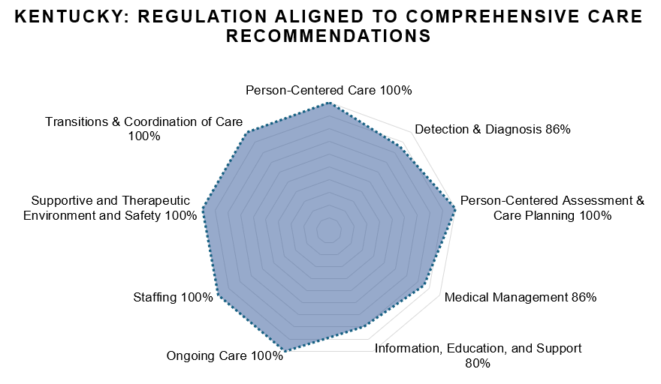
Example States

Slide 12
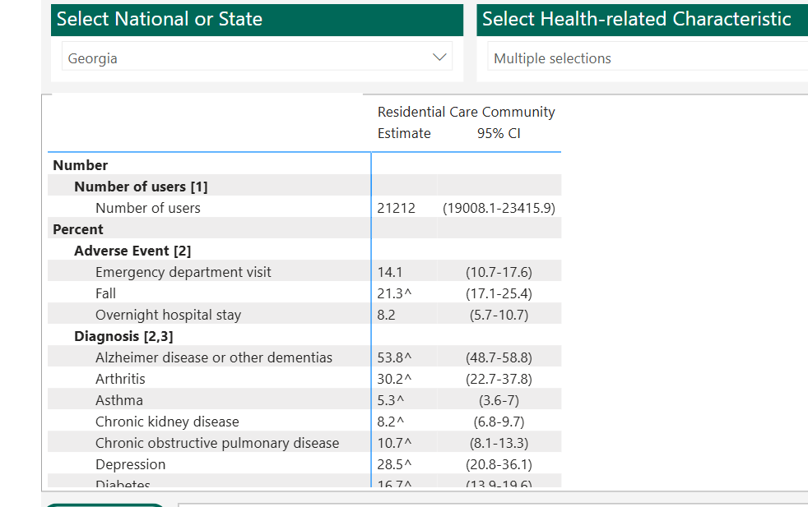
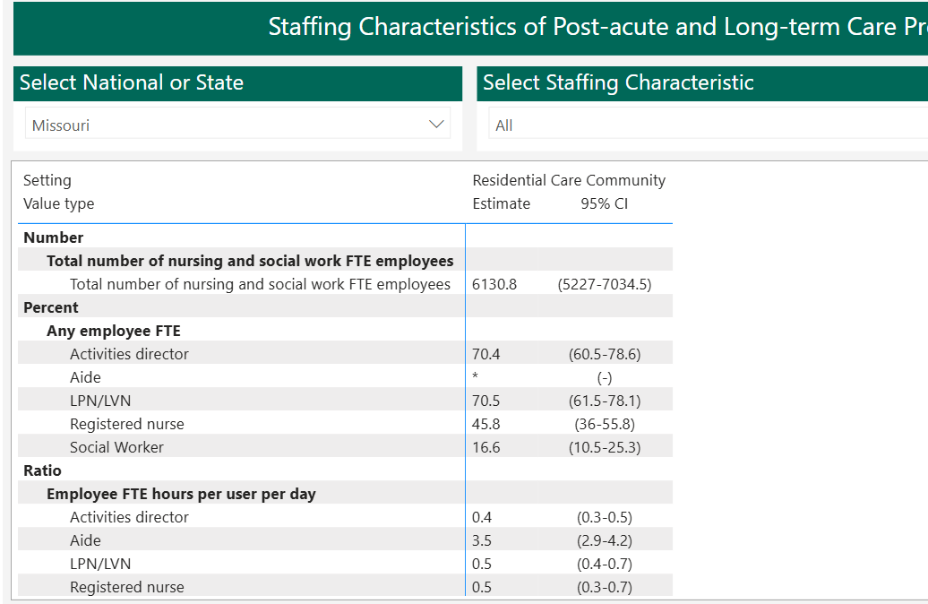
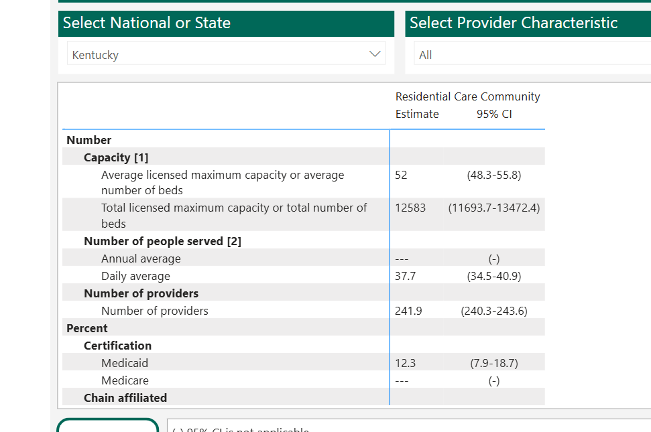
Ongoing/Future Work
Integrate Care Quality Measures – NPALS: uniform report of states
Memory Care Variables
Adverse Medical Event Variables
Workforce Variables
Notes:
NPALS: national post-acute and long term care study
Memory Care Variables: Dementia Care Units within Assisted Living Facilities count
Dementia Diagnosis rates
Proportion of Residents with Dementia Diagnosis
Adverse Medical Event Variables: Emergency Department Visit rates
Hospital Admission rates
Falls Workforce Variables Average Direct Care Staff Hours spent per Resident per Day
Compare State Regulation Required Staff Ratios to Observed Staff

Slide 13
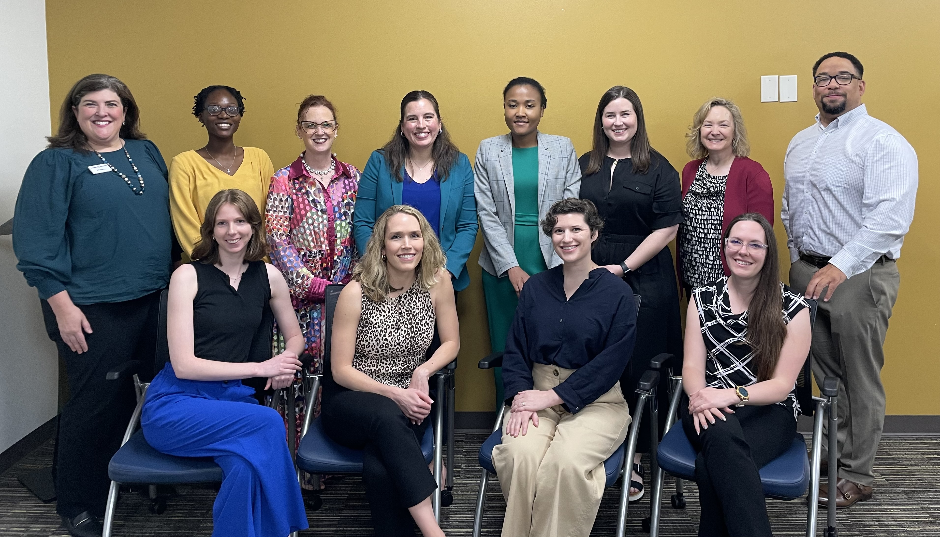
Thanks
Olusheun Olupitan, (soon to be) JD
Jalayne Arias, JD, MA
Leslie Wolf, JD, MPH
Contact:
Mary Manchester mmanchester@gsu.edu

