Slide 1
Sorting Pregnancy Bodies
Law, Medicine, and the Construction of Segregated Pregnancy Care
Jennifer Templeton Dunn, JD¹
Health Law Professors Conference
American Society for Law, Medicine, & Ethics
Boston, Massachusetts
June 5, 2025
¹PhD Candidate, Social and Behavioral Sciences
Assistant Professor, School of Nursing
Faculty, Bixby Center for Global Reproductive Health
University California, San Francisco
http://www.freepik.com
Notes:
http://www.freepik.com/

Slide 2
LIGHTBULB MOMENT
Dr. Evans:
“So one is the faculty practice where the patients see the attending physician. There's relatively few trainees in that setting.
Then there's the teaching clinic. That's run by the residents and fellows. That's the clinic that I'm speaking of. That's my training clinic.”
Two Clinics
Faculty Practice =
Private Insurance, Few Trainees
Resident Clinic =
“Medicaid Clinic,” “Training Clinic”
Source: Dr. Evans OB-GYN Attending. Participant #4 (2021, 2023).
Pseudonyms used to protect participant confidentiality

Slide 3
The Sorting Process Sorting by insurance in University Medical Center (Site #1)
RESIDENT TRAINEES
COUNTY HOSPITAL
UNIVERSITY MEDICAL CENTER
PATIENT INTAKE
CALL CENTER SCREENS FOR INSURANCE
MEDICAID AND UNINSURED
RESIDENT CLINIC
FACULTY PRACTICE
PRIVATE INSURANCE
MIDWIFERY
PRACTICE
Model 1 depicts a common practice of sorting pregnant patients enrolled in Medicaid into resident clinics and privately insured patients into the private faculty practices. The resident clinic can be situated within the university hospital, through affiliation with a county hospital, or both. How midwives are incorporated varies.

Slide 4
Health System Sorting Finding a provider who accepts Medicaid
Community Clinic
Federally Qualified Health Center
Resident Clinic
University Medical Center
Medicaid
Other Safety Net Clinic
County Hospital
Exclusionary Process
Access Limited or Denied
Cultural Health Capital (Shim 2010)
Whiteness as a credential
(Ray 2019)
Private Physician Practice
Does not accept Medicaid or
limits number of patients
Nurse Midwifery Practice
Limits on access due to systemic barriers
Private Insurance
Private Health Organization
Private insurance only or quota on number of Medicaid patients
Community Midwife Practice
Cannot accept Medicaid
due to systemic barriers
Coffman (2017); Lastad (2024); Marquez & Lever (2023).

Slide 5
Significance: Why Study Segregated Pregnancy Care?
It is not an issue of Coverage
Health insurance coverage for pregnant people is the closest we have to universal health insurance in the United States.
It is an issue of Equity
Payer-segregated care disproportionately impacts Black, Indigenous, and Latinx pregnant and birthing people (60% in U.S./80% in CA).
Black women experience 3xs higher rates of pregnancy-related mortality than other groups
Medicaid-enrolled pregnant people have higher rates of maternal mortality than privately insured
Notes:
Skip slide

Slide 6
RESEARCH QUESTIONS
1. Trace the role of law and medicine in constructing economically and racially segregated care in the U.S
2. Elucidate provider and trainee experiences and perceptions of payer segregated care
3. Examine provider and trainee experiences and perceptions of payer integrated care
including benefits and barriers to transitioning to insurance-blinded, integrated care
Notes:
Skip this slide -

Slide 7
STUDY METHODS
Qualitative Interviews (N=75)*
Payer Segregated Site (Site 1)
Payer Integrated Site (Site 2)
National Landscape
Observations: Over 200 hours between 2022-2025*
• 2 Sites: observations at segregated and integrated sites
• Landscape: participant observation at national reproductive health and health professional meetings; observations at non-study sites
Legal Research, Historiography, Archival**
• Trace the role of law, medicine and funding policies
• Understand the social and political context for key events
*56 of 75 formal interviews and 100 hours completed
**Post-doctoral research plan
Approved by UCSF’s IRB—Study Nos. 22-38017 & 23-39868
Notes:
Skip slide

Slide 8
FINDINGS
Providers’ Experiences and Perceptions of Segregated Care
Highlights from Resident Avery * Dr. Devi * Dr. Morgan
Notes:
“Segregated pregnancy care” is the separation or “sorting” of pregnant people into different clinical spaces (for example a resident clinic or county hospital compared to a midwifery or obstetrics private practice clinic), standards of care (for example, different screening and treatment protocols), or distinct provider categories (resident vs. physician or midwife) based on race, ethnicity, economic status, or other criteria unrelated to clinical indications or patient preference.
The term “segregated” or “segregation” is frequently linked with residential segregation or segregation in educational settings to describe spatial segregation or separation into different neighborhoods or institutions based on race or ethnicity.
The term segregation is less commonly used in discussing healthcare or healthcare systems in the U.S.
Instead, we use terms such as “two-tiered system,” “siloed care,” or “health equity” to describe racial and economic segregation within our health system, and we attribute racial and ethnic stratification in health care settings to neutral economic systems.
However, segregated healthcare is deeply embedded within the foundations of the U.S. healthcare system and health professional training.
And our “two-tiered system” disproportionately impacts people who are Black and Latinx.

Slide 9
Characteristics of Segregated Care
Different buildings:
“the medical students and residents took care of the patients at [university-affiliated public hospital]” and “…the [University Hospital] right across the street was beautiful, you know, fountain in the middle, glass windows…” (Dr. Dr. Bailey—218).
Different floors, same building:
“…and downstairs — where the publicly insured clinics were—everything was old and unrenovated.” (Dr. Logan – 211)
Same floor, different waiting and exam rooms:
“…same medical center, same building, two different hallways, two different clinical areas...” (Dr. Devi—501)

Slide 10
Training in Segregated Systems
Resident Avery — Private University Medical Center
As I was shadowing, I would notice you would be with a certain faculty member who's like, “On Thursdays, I precept in the resident or the fellow clinic, and on Fridays, I have my own practice.” And so you go with them on Thursday, and they'd be in the resident clinic, and it was just so kind of glaring to me. Like, Oh, this is where most of the Black and Brown patients are, and then Friday in the faculty patient clinic, and that's where most of the white patients were. And I just noticed this, in many different specialties because I was shadowing around and this was happening over and over, and no one named it or mentioned it. And I was like, This is bizarre.
… And I think it was one of the older students who I had just been chatting with, and I was like, “Have you noticed this?” I'm like, “Am I crazy? This keeps happening.”
And they're like, “Oh yeah. Look, here it is super segregated.”
Source: Avery, a senior resident in segregated academic medical school (503).

Slide 11
Why Change?
We are training the next generation of providers
“the ways in which imprinting can insidiously shape us. And especially where you train, you don't know any different, you know? You learn in this training environment, and then you go on to practice, and you accept what you observe in your training.”
Imprinting
Training and learning in segregated clinics
Dr. Devi. OB-GYN Attending, integrating site (501).

Slide 12
The Sorting Process
Sorting by risk at University Medical Center (Site #2)
LOW
RISK
MIDWIFERY
PRACTICE
UNIVERSITY MEDICAL CENTER
PATIENT INTAKE
CALL CENTER REFERRALTO
RN FOR SCREENING
NURSE SCREENS
FOR RISK
MODERATE
RISK
GENERAL OBSTETRICS
HIGH
RISK
MATERNAL FETAL MEDICINE
Model 2 depicts a payer-integrated model where insurance is blinded at intake and resident and faculty practices are merged. Patients are sorted based on clinical need and patient preference.

Slide 13
Why Is It Like This?
Implicit Bias
Implicit bias is a strong driver of why we continue to do this. Right, there's bias that they're not going to show up. There's bias they can take the day off. Right, And it's okay, for patients who don't have insurance or are underinsured. It's okay for them to wait. Right?
I mean, it's really, truly systemic.
Implicit bias
They can wait
They won’t show up
They can take a day off work to spend in clinic
Source: Dr. Morgan-Participant 202.
Chair of OB-GYN, integrating site.

Slide 14
Why Change?
Equity
“There was clear inequity…It was so ingrained within the system that many people didn't realize that this was happening… that's the definition of structural disparity, right? It's something that's so ingrained within your system, no one really thinks twice about it.”
Segregated care is Structural
Segregated care is Normal
“No one really thinks twice about it”
Source: Dr. Morgan-Participant 202.
Chair of OB-GYN, integrating site.

Slide 15
https://lowninstitute.org
WHY IS U.S. HEALTH CARE SEGREGATED?
The Mechanisms of Segregation

Slide 16
Key Events that Segregated U.S. Health Care
Failure to pass national health insurance
1915 - 2025
Failure to pass national health insurance
Jim Crow and Legal Segregation
Community Health Center Pilot based on S. Africa model
1870s-1964
1965
2010
1964
Affordable Care Act
Civil Rights Act
Medicaid & Medicare
1935
1945
1954
1965 - Present
New Deal and Occupational Segregation
Hill Burton
Act funding for segregated hospitals
Tax Exemption for Employer-Based Health Insurance
Private insurance subsidies and tax exclusions
Funding and expanding separate public health system
U.S. Two-Tiered System: Private system and Charity/Public System
Notes:
Community health centers were first sponsored by President Johnson in 1965 based on a successful model of neighborhood health centers in South Africa during Apartheid

Slide 17
Segregation Reimagined
Contemporary Jim Crow baked into the Medicaid Program
The Civil Rights Act followed by Medicare and Medicaid “became the most successful desegregation program in American history.”
Smith (1999, 2016)
Kruse Thomas (2011)
Segregation was simply reimagined through the design and passage of the Medicaid Act
Source: Smith (2016: back cover)

Slide 18
Why did Medicaid fail its promise
to be the great equalizer?
(1964-1968)
1. Failure to pass universal health insurance—or any kind of health “system”
2. Passage of Medicaid as separate state administered program
3. Failure to consolidate the 3 federal health insurance programs
4. Professional guidance allowing discrimination against Medicaid enrollees

Slide 19
AMA Guidelines on Medicaid
Allow Discrimination and Segregation (1966)
Dr. John Holloman Jr.
President, National Medical Association
"The contempt which the A.M.A. has for the poor and the medically indigent is clearly expressed in its own guideline published in April of this year. It is here that the A.M.A. policy makers clearly expressed its right to discriminate against persons [enrolled in Medicaid].
This discrimination may be carried so far as to provide separate treatment days, separate treatment facilities, separate waiting rooms and even separate offices..”
American Medical Association
1847-1968: Allowed state medical associations to deny membership to Black physicians
Refused to oppose separate but equal in Hill Burton Act
Neutral on Civil Rights Act
Opposed Medicare+Medicaid
1966: issued guidelines allowing discrimination against Medicaid-enrollees

Slide 20
WHY HAS HEALTH CARE STAYED SEGREGATED?
Contemporary mechanisms of segregated care
Continued failure to pass national health insurance or unified financing across public and private insurance
Medicaid program as state-run insurance program, separate from Medicare
Passage of piecemeal public health legislation designed to improve access and coverage
Subsidized private insurance through tax exemptions and premium subsidies ($398 billion in 2024)*
Legal Walls: Different provider and facility requirements and exemptions for public and private systems
separate laws, regulations, and programs built upon existing systems of two-tiered care, reinforcing the barriers between public and private systems
*Congressional Budget Office (2021, 2025); Cubanski, KFF (2025).

Slide 21
Health System Sorting Finding a provider who accepts Medicaid
Community Clinic
Federally Qualified Health Center
Resident Clinic
University Medical Center
Medicaid
Other Safety Net Clinic
County Hospital
Exclusionary Process
Access Limited or Denied
Cultural Health Capital (Shim 2010)
Whiteness as a credential
(Ray 2019)
Private Physician Practice
Does not accept Medicaid or
limits number of patients
Nurse Midwifery Practice
Limits on access due to systemic barriers
Private Insurance
Private Health Organization
Private insurance only or quota on number of Medicaid patients
Community Midwife Practice
Cannot accept Medicaid
due to systemic barriers
Coffman (2017); Lastad (2024); Marquez & Lever (2023).

Slide 22
Thank You!
UC Berkeley Undergraduate Research Apprentice Program
Bianca Chiu, Pre-Law
Grecia Garcia, Pre-Med
Ellie Hamm, Pre-Law
Sophia Levin, Pre-Med
Ashley Ribeiro, Pub. Health Nysa Sakari, Pre-Dental
Thiri Than, Pre-Health
Our URAP Team
Jen James (Co-Director)
Notes:
Bianca Chiu <biancachiu@berkeley.edu>, Grecia Garcia <grecia.garcia@berkeley.edu>, Ellie Hamm <elliehamm@berkeley.edu>, Sophia Levin <sophialevin@berkeley.edu>, Ashley Ribeiro <aribeiro@berkeley.edu>, Nysa Sakari nysas@berkeley.edu
Thiri Than <ththan@berkeley.edu>

Slide 23
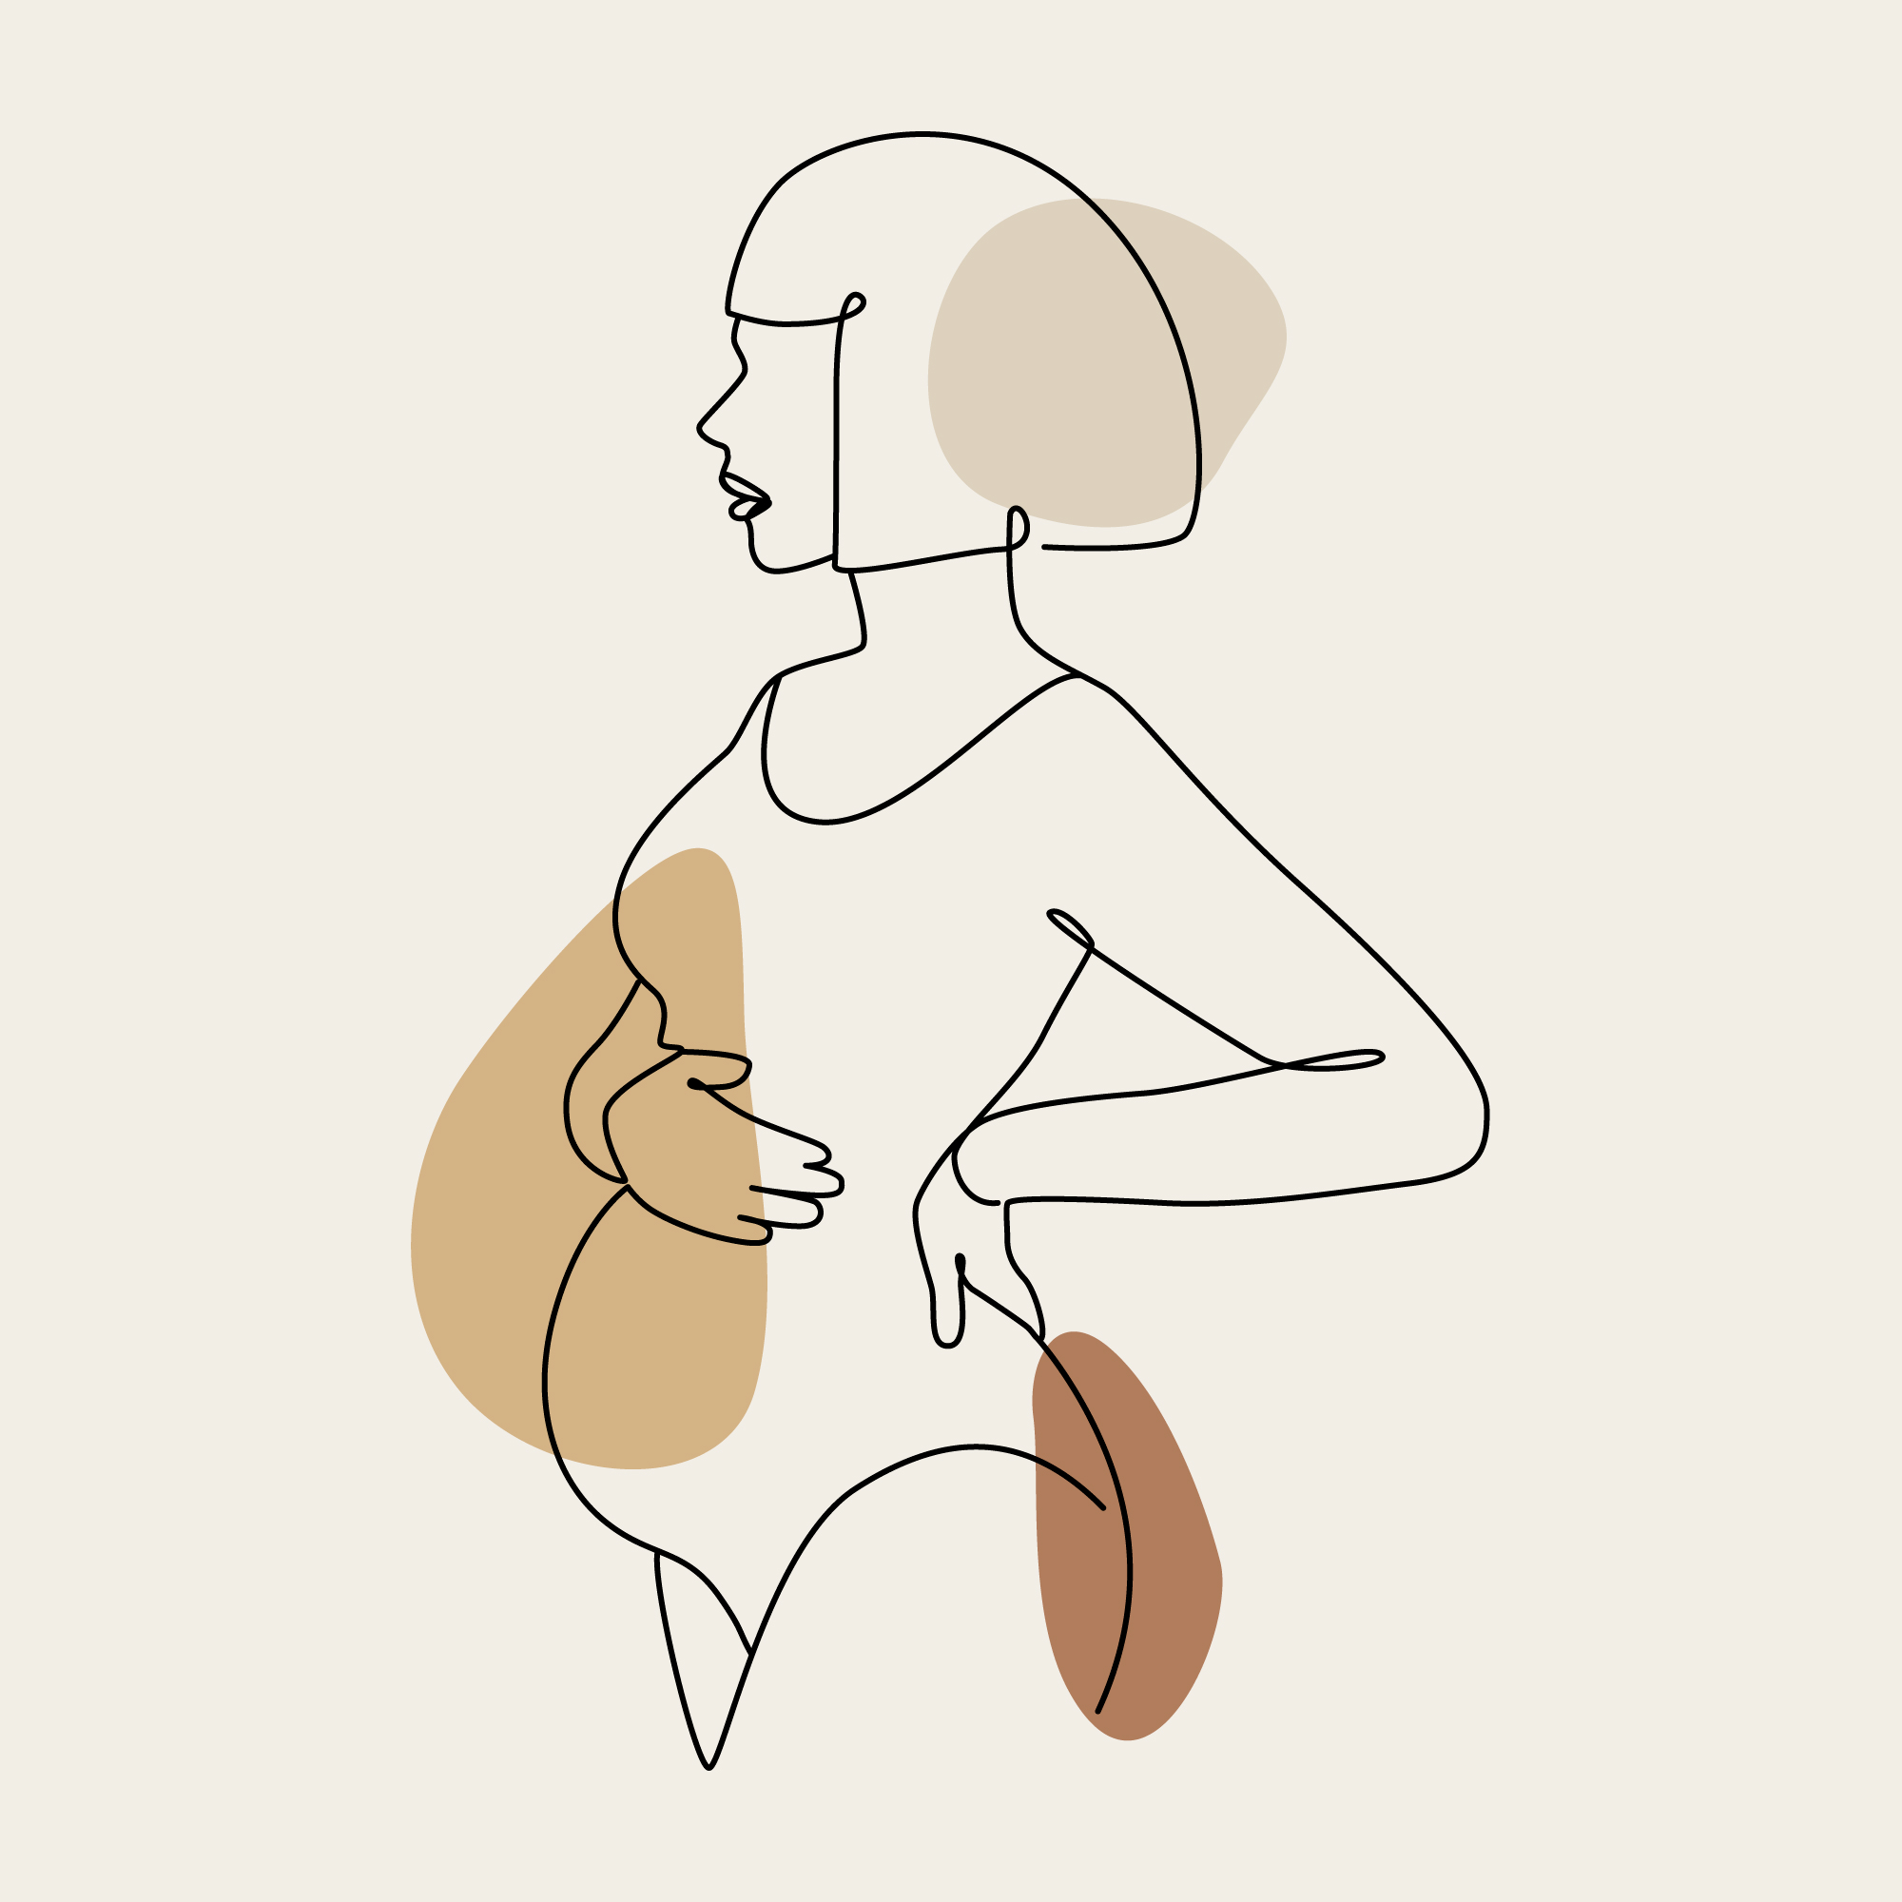
Thank You
Jennifer Templeton Dunn, JD
PhD Candidate, Sociology
Assistant Professor, School of Nursing
Faculty, Bixby Center for Global Reproductive Health
University California, San Francisco
Email: Jennifer.Dunn@ucsf.edu
Thank you to the following funding sources:

Slide 24
APPENDICES

Slide 25
REFERENCES & RECOMMENDED
Journal of the National Medical Association Archives (1963-1969)
Coffman J. Physician Participation in Medi-Cal: Is Supply Meeting Demand?. California Health Care Foundation. 2017.
Kaiser Family Foundation. Distribution of the Nonelderly with Medicaid by Race/Ethnicity. Kaiser Family Foundation. 2022.
Fleszar LG, Bryant AS, Johnson CO, Blacker BF, Aravkin A, Baumann M, et al. Trends in State-Level Maternal Mortality by Racial and Ethnic Group in the United States. JAMA. 2023;330:52–61.
Hoyert DL. Maternal Mortality Rates in the United States in2022. 2024.
Vinekar K, Qasba N, Reiser H, Banks E, Arora KS, Edmonds BT, et al. Segregation by Payer in Obstetrics and Gynecology Residency Ambulatory Care Sites. JAMA Netw Open. 2024;7:e2434347.
Wilkinson R, Huxley-Reicher Z, Fox GC, Feuerbach A, Tong M, Blum J, et al. Leveraging Clerkship Experiences to Address Segregated Care: A Survey-Based Approach to Student-Led Advocacy. Teach Learn Med. 2023;35:381–8.
Washington HA. How Does Racial Segregation Taint Medical Pedagogy? AMA J Ethics. 2023;25:72–8.
Thompson-Lastad A, Mounika Parimi, Sara Jhanjar, Jessica M. Harrison, Chanda Williams, Tanya Khemet Taiwo. California Community Midwives Face Significant Challenges to Becoming Medi-Cal Providers. California Health Care Foundation. 2024.
Yearby, Ruqaiijah. “Structural Racism and Health Disparities: Reconfiguring the Social Determinants of Health Framework to Include the Root Cause.” The Journal of Law, Medicine & Ethics: A Journal of the American Society of Law, Medicine & Ethics. 2020. 48 (3): 518–26.

Slide 26
REFERENCES & RECOMMENDED
Oberlander J. Unfinished Journey — A Century of Health Care Reform in the United States. N Engl J Med 2012;367:585–90. https://doi.org/10.1056/NEJMp1202111.
Smith DB. Health Care Divided: Race and Healing a Nation. University of Michigan Press; 1999.
Smith DB. The Power to Heal: Civil Rights, Medicare, and the Struggle to Transform America’s Health Care System. Vanderbilt Press; 2016.
Kruse Thomas K. Deluxe Jim Crow: Civil Rights and American Health Policy, 1935-1954: Thomas, Karen Kruse: 9780820340449: Amazon.com: Books. University of Georgia Press; 2021.
Rothstein R. The color of law: a forgotten history of how our government segregated America. First published as a Liveright paperback 2018. New York London: Liveright Publishing Corporation, a division of W.W. Norton & Company; 2018.
Cohen WJ. Reflections on the enactment of Medicare and Medicaid. Health Care Financ Rev 1985;1985:3–11.
Hill JW. The Continuing Need for the NMA Presence. JOURNAL OF THE NATIONAL MEDICAL ASSOCIATION 1969;61:
Holloman JLS. Medical Leadership. J Natl Med Assoc 1966;58:377–96.
Simon M. Medi-Cal Explained: Maternity Care 2020:10.
Cubanski, Juliette, Alice Burns, and Cynthia Cox Published. 2025. “What Does the Federal Government Spend on Health Care?” KFF (blog). February 24, 2025.

Slide 27
APPENDICES—AIMS
1. Trace the role of law in creating and reproducing economically and racially segregated healthcare in the U.S
2. Elucidate provider and trainee experiences and perceptions of payer segregated care
3. Examine provider and trainee experiences and perceptions of payer integrated care, including perceived benefits and barriers to transitioning to insurance-blinded, integrated care

Slide 28
APPENDICES— STUDY METHODS
Method Type | Description
Qualitative Interviews | N = 75-80 total interviews, across three groups: • Site 1 (Segregated Site): Clinicians, trainees in payer-segregated setting (N = 25) • Site 2 (Integrated Site: Clinicians, trainees AMC post-integration (N = 25) • Landscape Interviews (National): Policymakers, financing experts, patient advocates, national clinicians, activist clinicians and researchers (N = 25-30)
Ethnographic Observations | Observations in two domains: • Site-based: Clinical observations at segregated and integrated AMCs, including informal interviews; workflow, and space documentation (2024-2025) • Landscape-level: Participant observation at reproductive health conferences and health professional association meetings (2022-2025)
Legal and Historical | Draws on legal analysis and historiography: • Analyze how law and health policy shape segregated care • Understand the social and political contexts influencing health system legislation
Archival | Time frame: 1964–1969 (Medicaid design); 1900-2025 (association between medical schools, resident clinics, and charity care) Sources: Journal of the National Medical Association Archives; American Medical Association Archives; New York Times; Los Angeles Times; Philip R. Lee Archives (UCSF); Wilbur Cohen Archives (Wisconsin) Protocol: screening for themes, memos, and coding in qualitative software (Atlas.ti)

Slide 29
APPENDICES—DEFINITION OF SEGREGATED CARE
Segregated care can take many forms, including
physical separation (different clinic, practice, or waiting room),
temporal separation (same space, different time), or
provider separation (attending vs. resident)
Wilkinson et al. 2023.

Slide 30
APPENDICES—ADDITIONAL STUDY FINDINGS

Slide 31
Descriptions of Segregated Care: Physically different spaces
By Attendings (OBGYN faculty who supervise residents)
It was on the private floor. There was the MFM suite, and then there was the general OBGYN suite down the hall. Same standard. The waiting rooms were all mixed [for the private OBGYN and MFM practices], and so it was very nice, new, plush wood floors, chairs, things like that. And downstairs, where the publicly insured clinics were—everything was old and unrenovated
Dr. Logan described starkly different physical conditions between the private faculty practice and the resident clinic at his previous university
Source: Dr. Logan-Participant 211.
OB-GYN Faculty at Integrated Site.
Notes:
Dr. Logan-Participant 211. Black physician at integrated Site.

Slide 32
Descriptions of Segregated Care: Normal
By Attendings (OBGYN faculty who supervise residents)
Dr. Bailey:
I went to [Medical School in the South]. You know, the socially compromised and economically compromised people, that hospital is filled with all those patients. And then the [University Hospital] right across the street was beautiful, you know, fountain in the middle, glass windows. I mean, it was so blatant …the medical students and residents took care of the patients at [County Hospital], and then we got to watch the private doctors work in that fancy hospital and it was just so, you know, so … [pauses for several minutes] but I didn't realize that at that age, because when you're young, you're just excited about everything. And when you get out, you're like, “Huh, that's interesting.”
So I was trained in that model, right? There's paying patients and then there's patients who can't. And…and that was the norm.
Source: Dr. Bailey. Participant 218.
OBGYN Attending at Payer Integrated Site
Notes:
Dr. Bailey. Participant 218. OBGYN Attending at Payer Integrated Site

Slide 33
Why Change?
“it would be an all-day affair”
“There were … separate tiers of care. And it doesn't take a genius to figure out, it's not a model that really supports equity in terms of access, in terms of continuity of care. Our residents are fantastic, but you know, it's like a loop every four years ... The clinic was based in the hospital, and it didn't matter where people lived. They were all expected to come to the hospital for care. And it had an impact on no shows, meaning it would be hard for people to get here. And also, when they would come here it would be an all-day affair. And so there was the equity in terms of location. Most people can go to a doctor and it's not too far from their home. When you go to any of the other clinics, people are not spending the entire day. So that creates an inequity, right? Because people would have to take the entire day off from work, or find childcare for that day to come in for healthcare. So that reduces access because people either can't afford or they don't have childcare. And so there were just many things in that in that vein that really were considered when transitioning the resident clinic.”
Source: Dr. Morgan
OB-GYN Leader, Integrated Site

Slide 34
Resilience and Hope
Reimaging “Normal
Dr. Logan:
This [State University Medical Center] is the first place that I've worked … that actually practices what it preaches. We stand by diversity, equity, inclusion … And so, I think, if we're supposed to be talking about that as well as promoting health equity, then I think it behooves us to have equity in our clinical spaces
Dr. Gale:
“All of us trained in a resident clinic, and it is still very much the norm.
I think in 10 years, that will be a very different conversation. Even in five.”
Source: Dr. Gale-Participant 203.
Residency Director at integrated site.
Source: Dr. Logan-Participant 211.
OB-GYN Faculty at Integrated Site.

Slide 35
APPENDICES
WHY IS THE U.S. HEALTH SYSTEM SEGREGATED BY RACE AND CLASS?

Slide 36
https://lowninstitute.org
WHY IS U.S. HEALTH CARE SEGREGATED?
The Mechanisms of Segregation

Slide 37
Key Events that Segregated US Health Care
Failure to pass national health insurance
1915 - 2025
Jim Crow and Legal Segregation
1870s-1964
1965
Medicaid & Medicare
1964
Civil Rights Act
1935
1945
1965 - Present
New Deal and Occupational Segregation
Hill Burton Act funding for segregated hospitals
Civil Rights movement & Federal desegregation efforts
1950s: NIH funding to force medical schools to integrate
1960s: Medicare + Title VI to force Hill Burton-funded hospitals in the South to integrate
U.S. Two-Tiered System: Private system and Charity/Public System

Slide 38
Why Did Health Care Stay Segregated
After the Civil Rights Act?
Failure to pass national health insurance
1915 - 2025
Resistance to federal intervention
“states rights” rhetoric
compromise with Southern Democrats
= Legal racial segregation replaced by means-tested segregation
Segregation did not disappear, it evolved
Jim Crow and Legal Segregation
1870s-1964
1965
Medicaid & Medicare
1964
Civil Rights Act
1935
1945
1965 - Present
New Deal and Occupational Segregation
Hill Burton Act funding for segregated hospitals
U.S. Two-Tiered System

Slide 39
Contemporary Mechanisms of Segregated Care
Failure to pass national health insurance
1915 - 2025
Failure to pass national health insurance
Jim Crow and Legal Segregation
Community Health Center Pilot based on S. Africa model
1870s-1964
1965
2010
1964
Affordable Care Act
Civil Rights Act
Medicaid & Medicare
1935
1945
1954
1965 - Present
New Deal and Occupational Segregation
Hill Burton
Act funding for segregated hospitals
Tax Exemption for Employer-Based Health Insurance
Private insurance subsidies and tax exclusions
Funding and expanding separate public health system
U.S. Two-Tiered System: Private system and Charity/Public System
Notes:
Community health centers were first sponsored by President Johnson in 1965 based on a successful model of neighborhood health centers in South Africa during Apartheid

Slide 40
Why is this happening… in medical schools?
1900
1900-1930
From Midwives to Teaching Hospitals*
If the midwife cases and such others as are dependent on public charity were used for teaching purposes, not only would the patients themselves receive excellent care but also sufficient clinical material would be available to give every graduate in medicine such obstetric training as would make him a safe and efficient practitioner.
1910 Flexner Report
Transformation of medical education.
Emphasis on clinical training = need for “clinical material”
Contemporary Exchange: “training material” in exchange for “charity care”
Present
Dr. Ziegler, Professor of Obstetrics at University of Pittsburgh Magee Hospital (1913).
Notes:
Flexnor report: impact on Black physicians (closure of all but 2 black medical schools) and female physicians.
The Shift from Home to Hospital
Midwifery was criminalized in the U.S. between 1900-1930. Before 1900, most babies were delivered by midwives who were usually part of the community, neighbors, and friends. They stayed with the woman from labor and attended her through the post-partum period. In 1900, this number had been reduced to 50%, and by 1930, the practice of midwifery was virtually eliminated in the United States. Labor and delivery moved to the hospital setting rather than in the home, and the bias shifted to more surgical intervention (knife or forceps), more drugs, and minimal or no post-partum care. The U.S. shifted to physician delivery as the primary birth attendant, although physicians were less likely to be present, even during labor.^{1–3}
Pregnant People as “Clinical Material” for Training Medical Students
Dr. Ziegler, professor of obstetrics at the University of Pittsburg was a vocal opponent of the midwife, proposing a plan to eliminate the midwife and transition low income midwifery clients to teaching hospitals as training material for medical students. Acknowledging the fault in his plan to eliminate midwifery -- that poor communities would not be able to afford a private obstetrician if the midwife were no longer in practice -- he proposed using poor birthing women as training “material” for medical students: “If the midwife cases and such others as are dependent on public charity were used for teaching purposes, not only would the patients themselves receive excellent care but also sufficient clinical material would be available to give every graduate in medicine such obstetric training as would make him a safe and efficient practitioner.”² Thus, eliminating the midwife was seen as a win-win for obstetricians and medical schools.
“Elimination of the Midwife” and Removal of the Competition
Even Dr. Ziegler admitted that the risks to a woman’s health or mortality from a midwife or a physician during the early 20th Century were similar; however, U.S. physicians were increasingly concerned about the professional risk of allowing midwifery to continue in the United States and the risk that training and licensing midwives could have on competition for patients. Dr. Ziegler warned his physician colleagues in an article in JAMA in 1913 that the U.S. was facing the risk that midwives would become fixed within the U.S. health system as they already had been the UK and Europe: “the great danger lies in the possibility of attempting to educate the midwife and in licensing her to practice midwifery, giving her thereby a legal status which later cannot perhaps be altered. If she once becomes a fixed element in our social and economic system, as she now is in the British Isles and on the Continent, we may never be able to get rid of her.”² Dr. Ziegler continued, “The argument that large numbers of physicians do as poor obstetrics as the midwives is entirely beside the question. We are quite ready to admit this, but to claim that for this reason we must retain the midwife, if we retain the physician, is absurd.”²
REFERENCES TO CHAPTER 2
1 Radosh PF. Midwives in the United States: past and present. Popul Res Policy Rev 1986;5:129–46. https://doi.org/10.1007/BF00137177.
2 ZIEGLER CE. THE ELIMINATION OF THE MIDWIFE. Journal of the American Medical Association 1913;60:32–8. https://doi.org/10.1001/jama.1913.04340010034013.
3 Ehrenreich B, English D. For her own good: two centuries of the experts’ advice to women. 2013.

