Slide 1
Fair Allocation of Scarce Medical Resources: Legal and Ethical Constraints on Exacerbating Disadvantage
Govind Persad
Associate Professor
University of Denver Sturm College of Law [now]
University of Colorado Law School [starting Fall 2025]
govind.persad@colorado.edu

Slide 2
Disadvantage because of prior disadvantage

Slide 3
Terminology for exacerbating disadvantage
“Double jeopardy” (John Harris)
“Linkage” (Dan Brock, Frances Kamm)
“Compounding injustice” (Debbie Hellman)

Slide 4
The ethics of exacerbating disadvantage
Is exacerbating disadvantage prohibited? [Deontological constraint]
Only some types of disadvantage, e.g. unjustly imposed disadvantage or unchosen disadvantage?
Only in some ways, e.g. via direct consideration?
Is exacerbating disadvantage an ethical downside?

Slide 5
Who is disadvantaged?
Race
Income and wealth
Health status and disability
Gender, sex, SO/GI
Age
Religion
Geography
Occupation

Slide 6
Legal constraints
Disparate treatment (direct discrimination)
Disparate impact (indirect discrimination)
The imposition or application of eligibility criteria that screen out or tend to screen out an individual with a disability or any class of individuals with disabilities from fully and equally enjoying any goods, services, facilities, privileges, advantages, or accommodations, unless such criteria can be shown to be necessary for the provision of the goods, services, facilities, privileges advantages, or accommodation being offered (ADA)
Whether Section 504 of the Rehabilitation Act of 1973, and by extension Section 1557 of the Patient Protection and Affordable Care Act, which incorporates the "enforcement mechanisms" of other federal antidiscrimination statutes, provides a disparate-impact cause of action for plaintiffs alleging disability discrimination (Doe v. CVS certiorari question)

Slide 7
Vignette
Bianca has incurable late-stage lung cancer because a grossly negligent official allowed carcinogenic chemical releases near her home
Disadvantage clearly attributable to injustice
May allocation decisionmakers consider Bianca’s health status when assessing her absolute or relative eligibility to receive a scarce kidney?
Nebraska policy would permit this

Slide 8
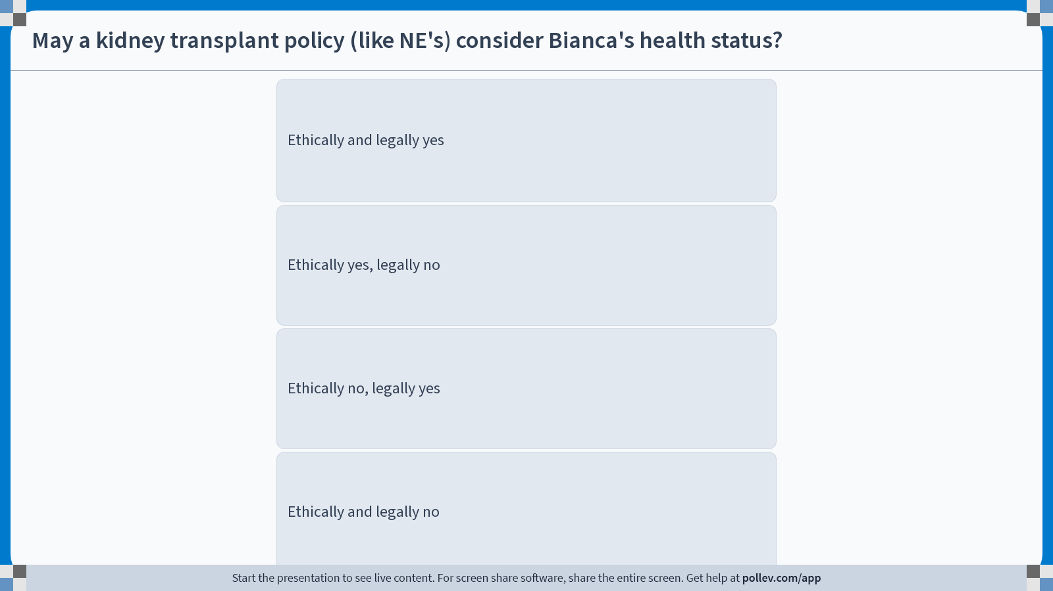
Notes:
Do not modify the notes in this section to avoid tampering with the Poll Everywhere activity. More info at polleverywhere.com/support May a kidney transplant policy (like NE's) consider Bianca's health status?
https://www.polleverywhere.com/multiple_choice_polls/41xuLnlRmXua87KsH2JvV?display_state=instructions&activity_state=opened&state=opened&flow=Engagement&onscreen=persist

Slide 9
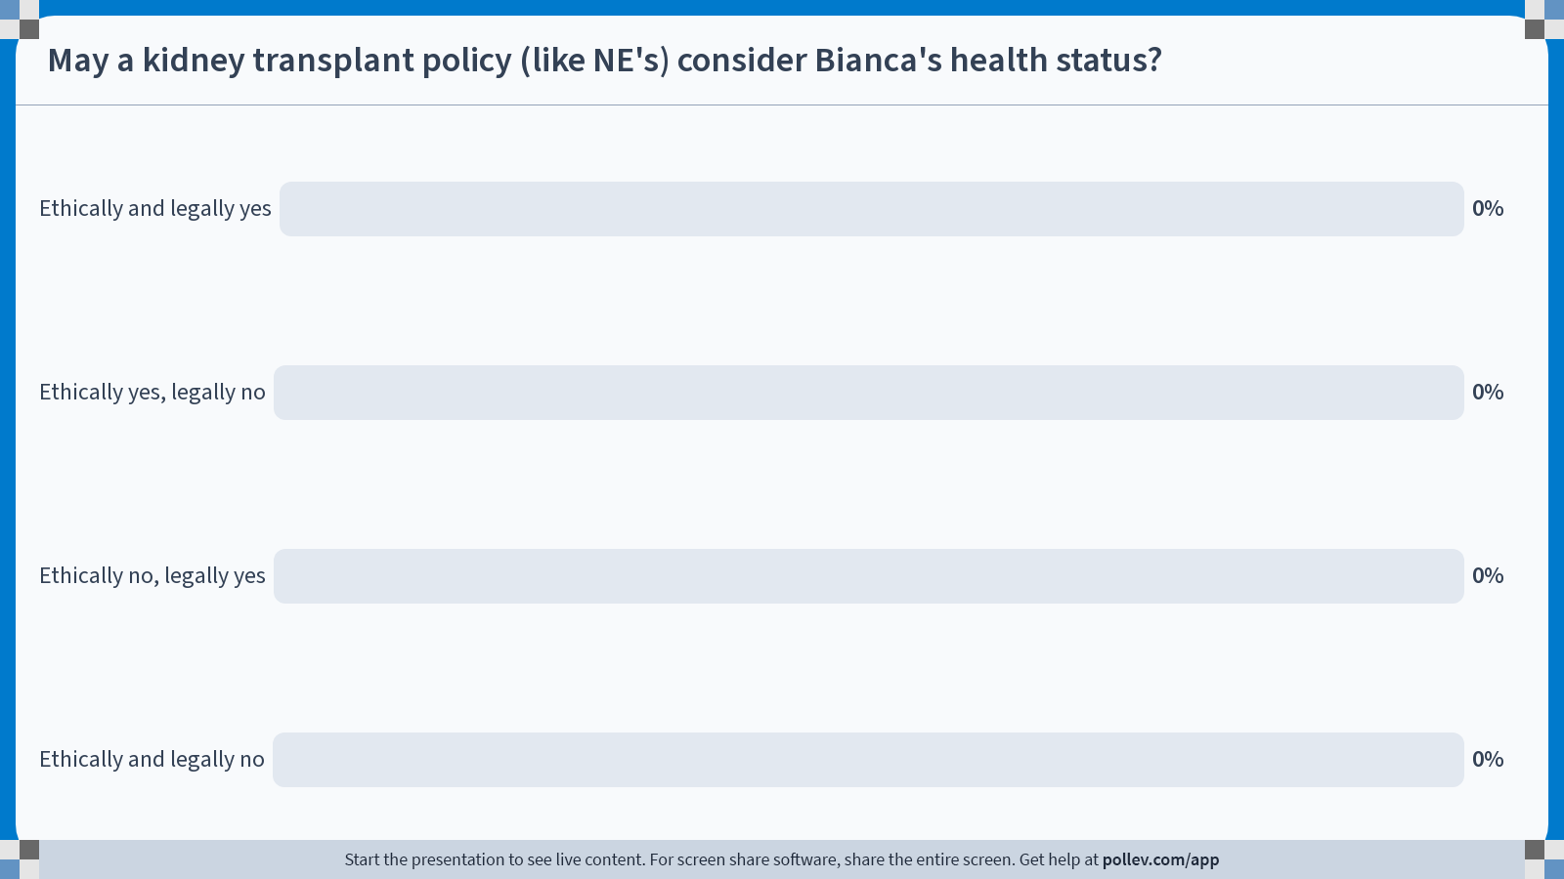
Notes:
Do not modify the notes in this section to avoid tampering with the Poll Everywhere activity. More info at polleverywhere.com/support May a kidney transplant policy (like NE's) consider Bianca's health status?
https://www.polleverywhere.com/multiple_choice_polls/41xuLnlRmXua87KsH2JvV?display_state=chart&activity_state=opened&state=opened&flow=Engagement&onscreen=persist

Slide 10
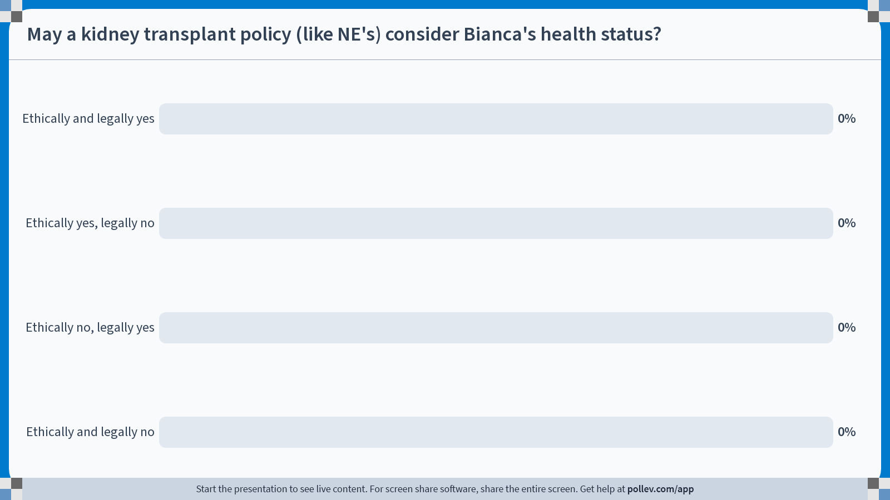
Notes:
Do not modify the notes in this section to avoid tampering with the Poll Everywhere activity. More info at polleverywhere.com/support May a kidney transplant policy (like NE's) consider Bianca's health status?
https://www.polleverywhere.com/multiple_choice_polls/41xuLnlRmXua87KsH2JvV?display_state=chart&activity_state=closed&state=closed&flow=Engagement&onscreen=persist

Slide 11
Two approaches
Never exacerbate: “Where demographic disparities in the welfare effects of regulatory policies are a product of background injustice, government is properly blocked from taking those disparities into account in formulating policy” (Sunstein, 2004)
Sometimes exacerbate: “Capacity to benefit hardly seems an unreasonable qualification for obtaining medical care. Indeed, if some type of capacity-to-benefit measure is not used as an eligibility criterion for receipt of medical care, we run the risk of allocating all of our resources towards the most intractable cases, leaving no resources available for the treatment of conditions that can more readily be ameliorated” (Rai, 1997)

Slide 12
Conclusion
Rai’s approach strikes me as more compelling.
Bianca is entitled to appropriate redress for the injustice she experienced (e.g. damages from the negligent actor)
However, appropriate redress does not require ignoring whether the effects of that injustice now limits her absolute or relative capacity to benefit from transplantation
Maybe it requires giving Bianca some access in the transplantation process

Slide 13
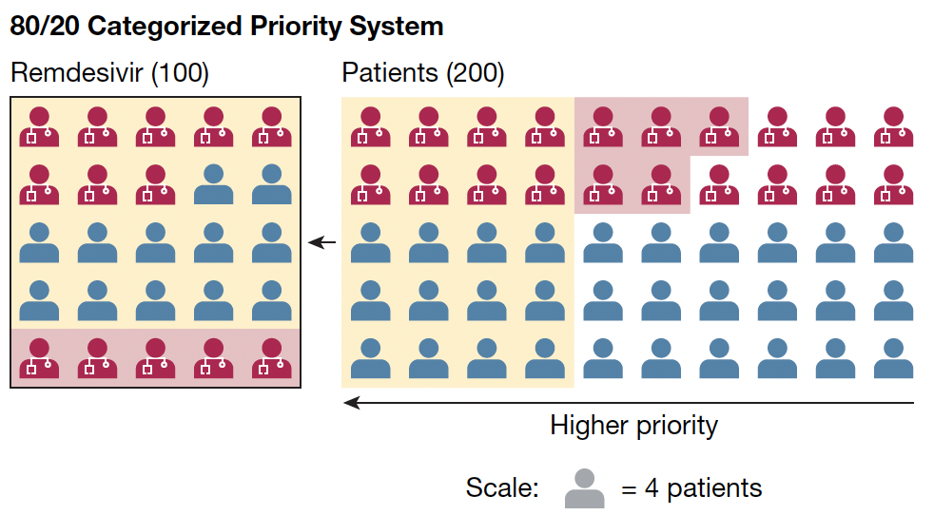

Slide 14
Thank you!
govind.persad@colorado.edu

