Slide 1
Challenges to State Efforts to Lower Prescription Drug Costs
Health Law Professors conference
June 5, 2025

Slide 2
2
Federal Interest in Regulating Drug Prices
June 5, 2025
Zachary Baron
Director, Center for Health Policy and the Law
O’Neill Institute for National and Global Health Law
Georgetown Law

Slide 3
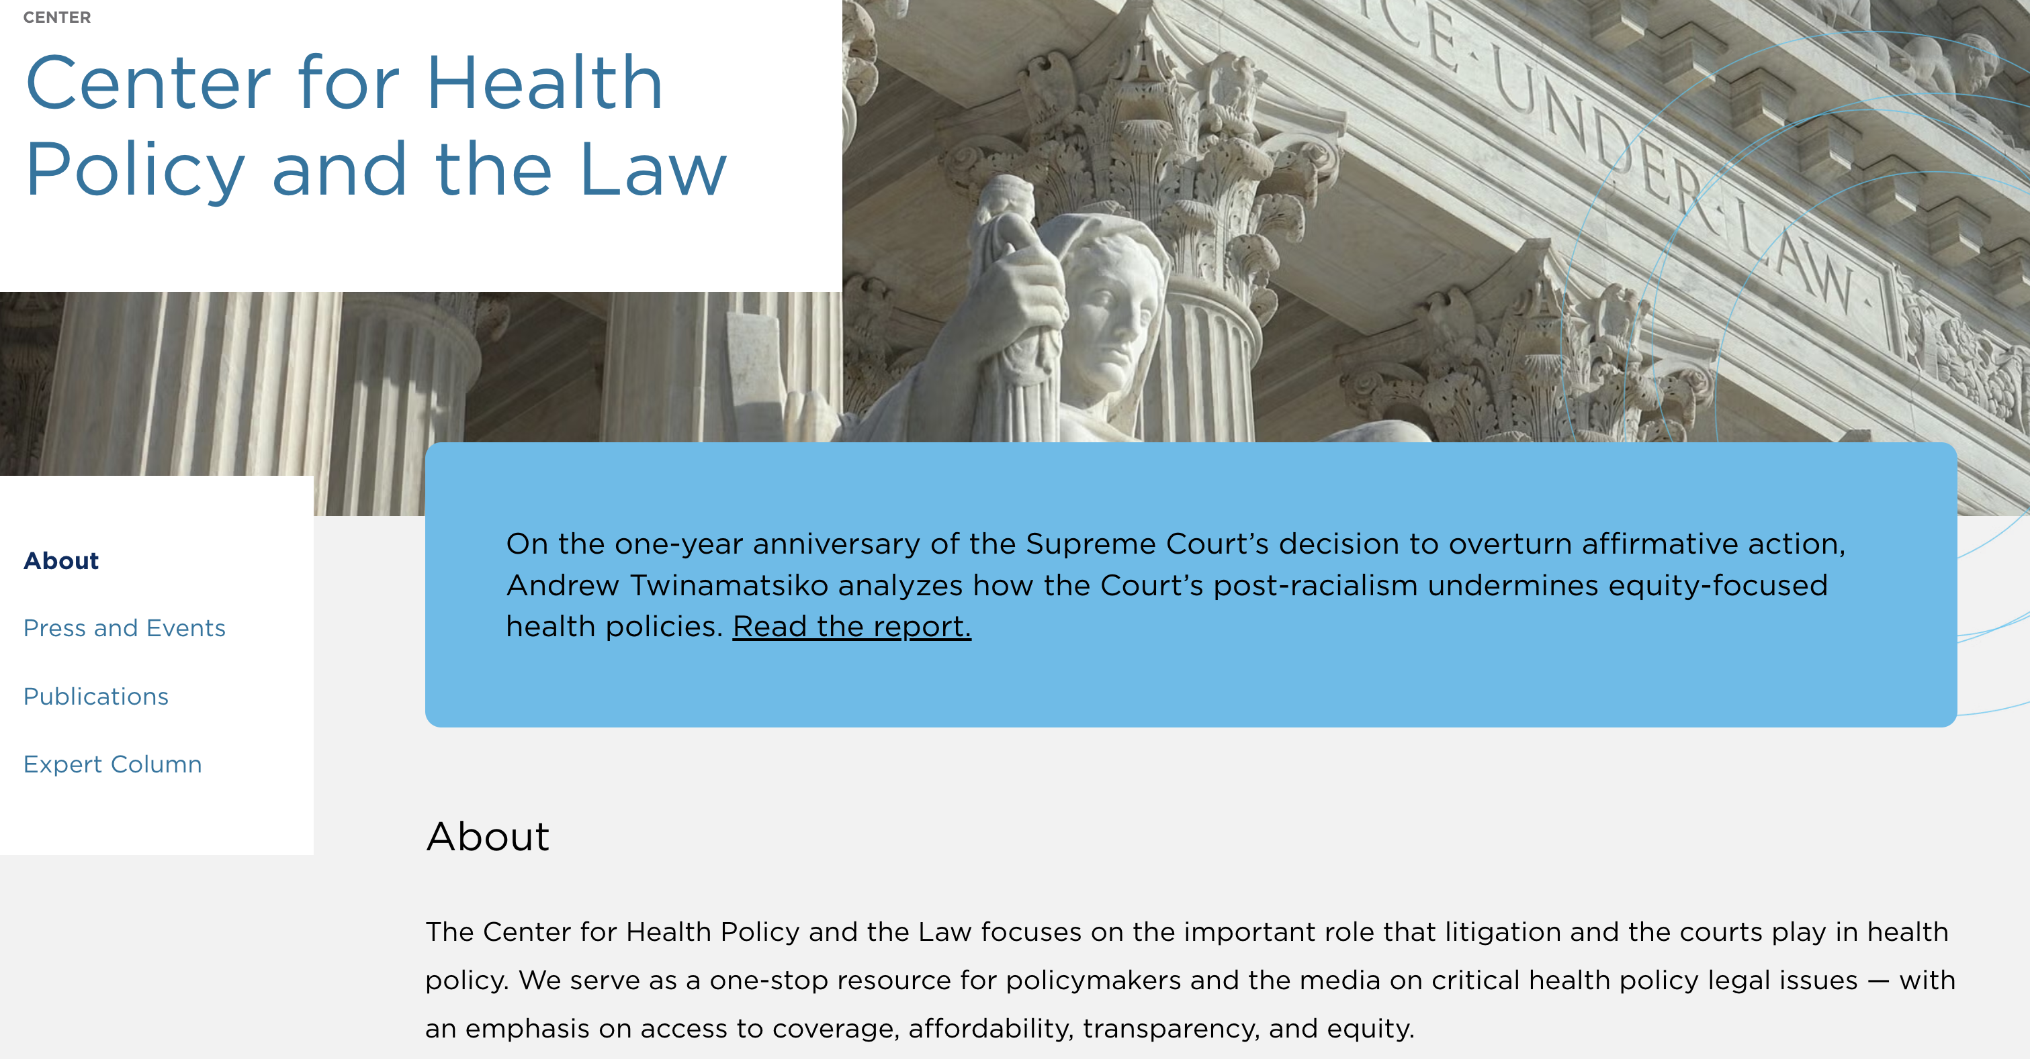


3

Slide 4
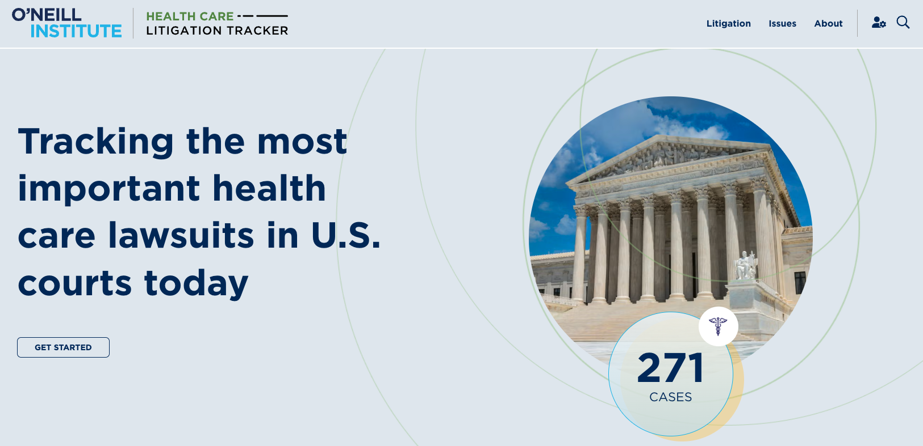
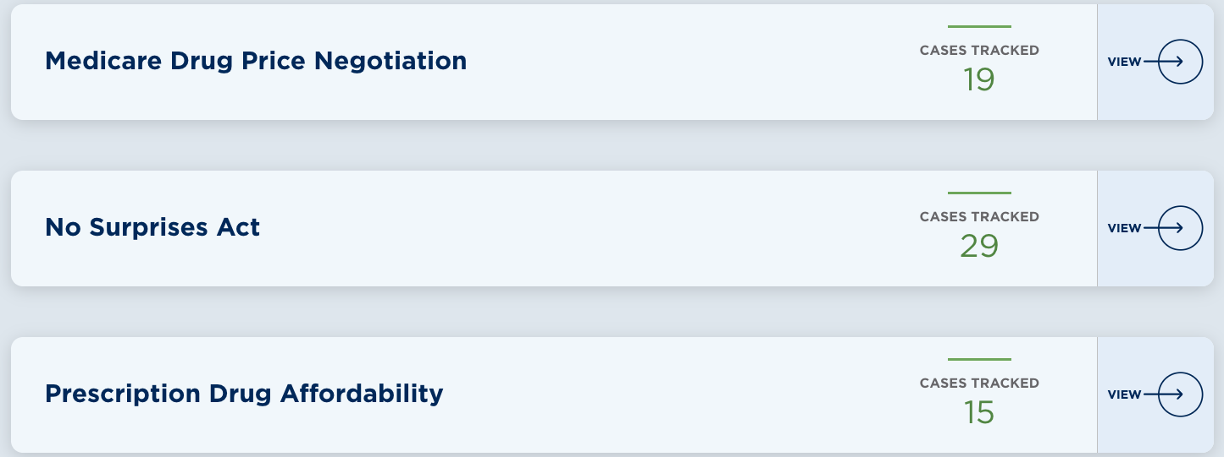
4

Slide 5

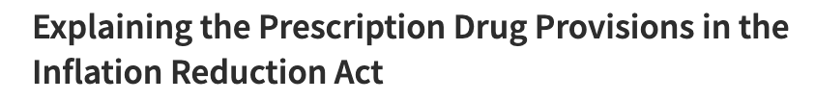
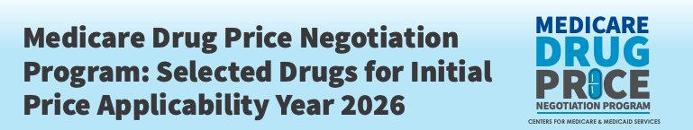

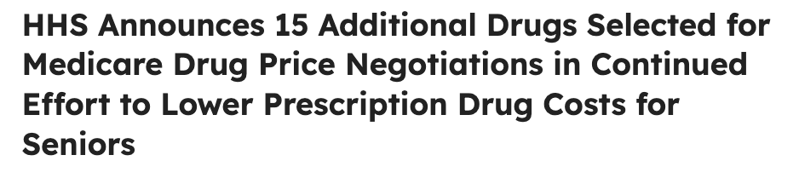
5

Slide 6
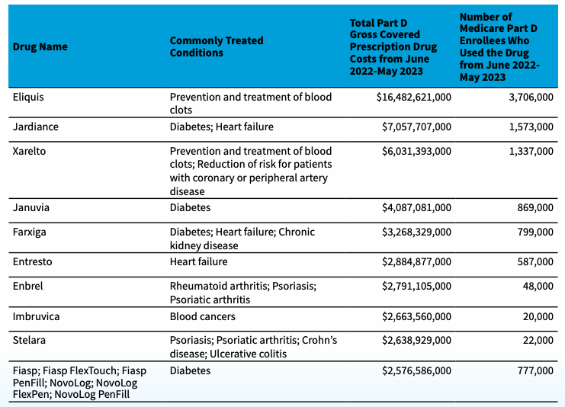
6

Slide 7
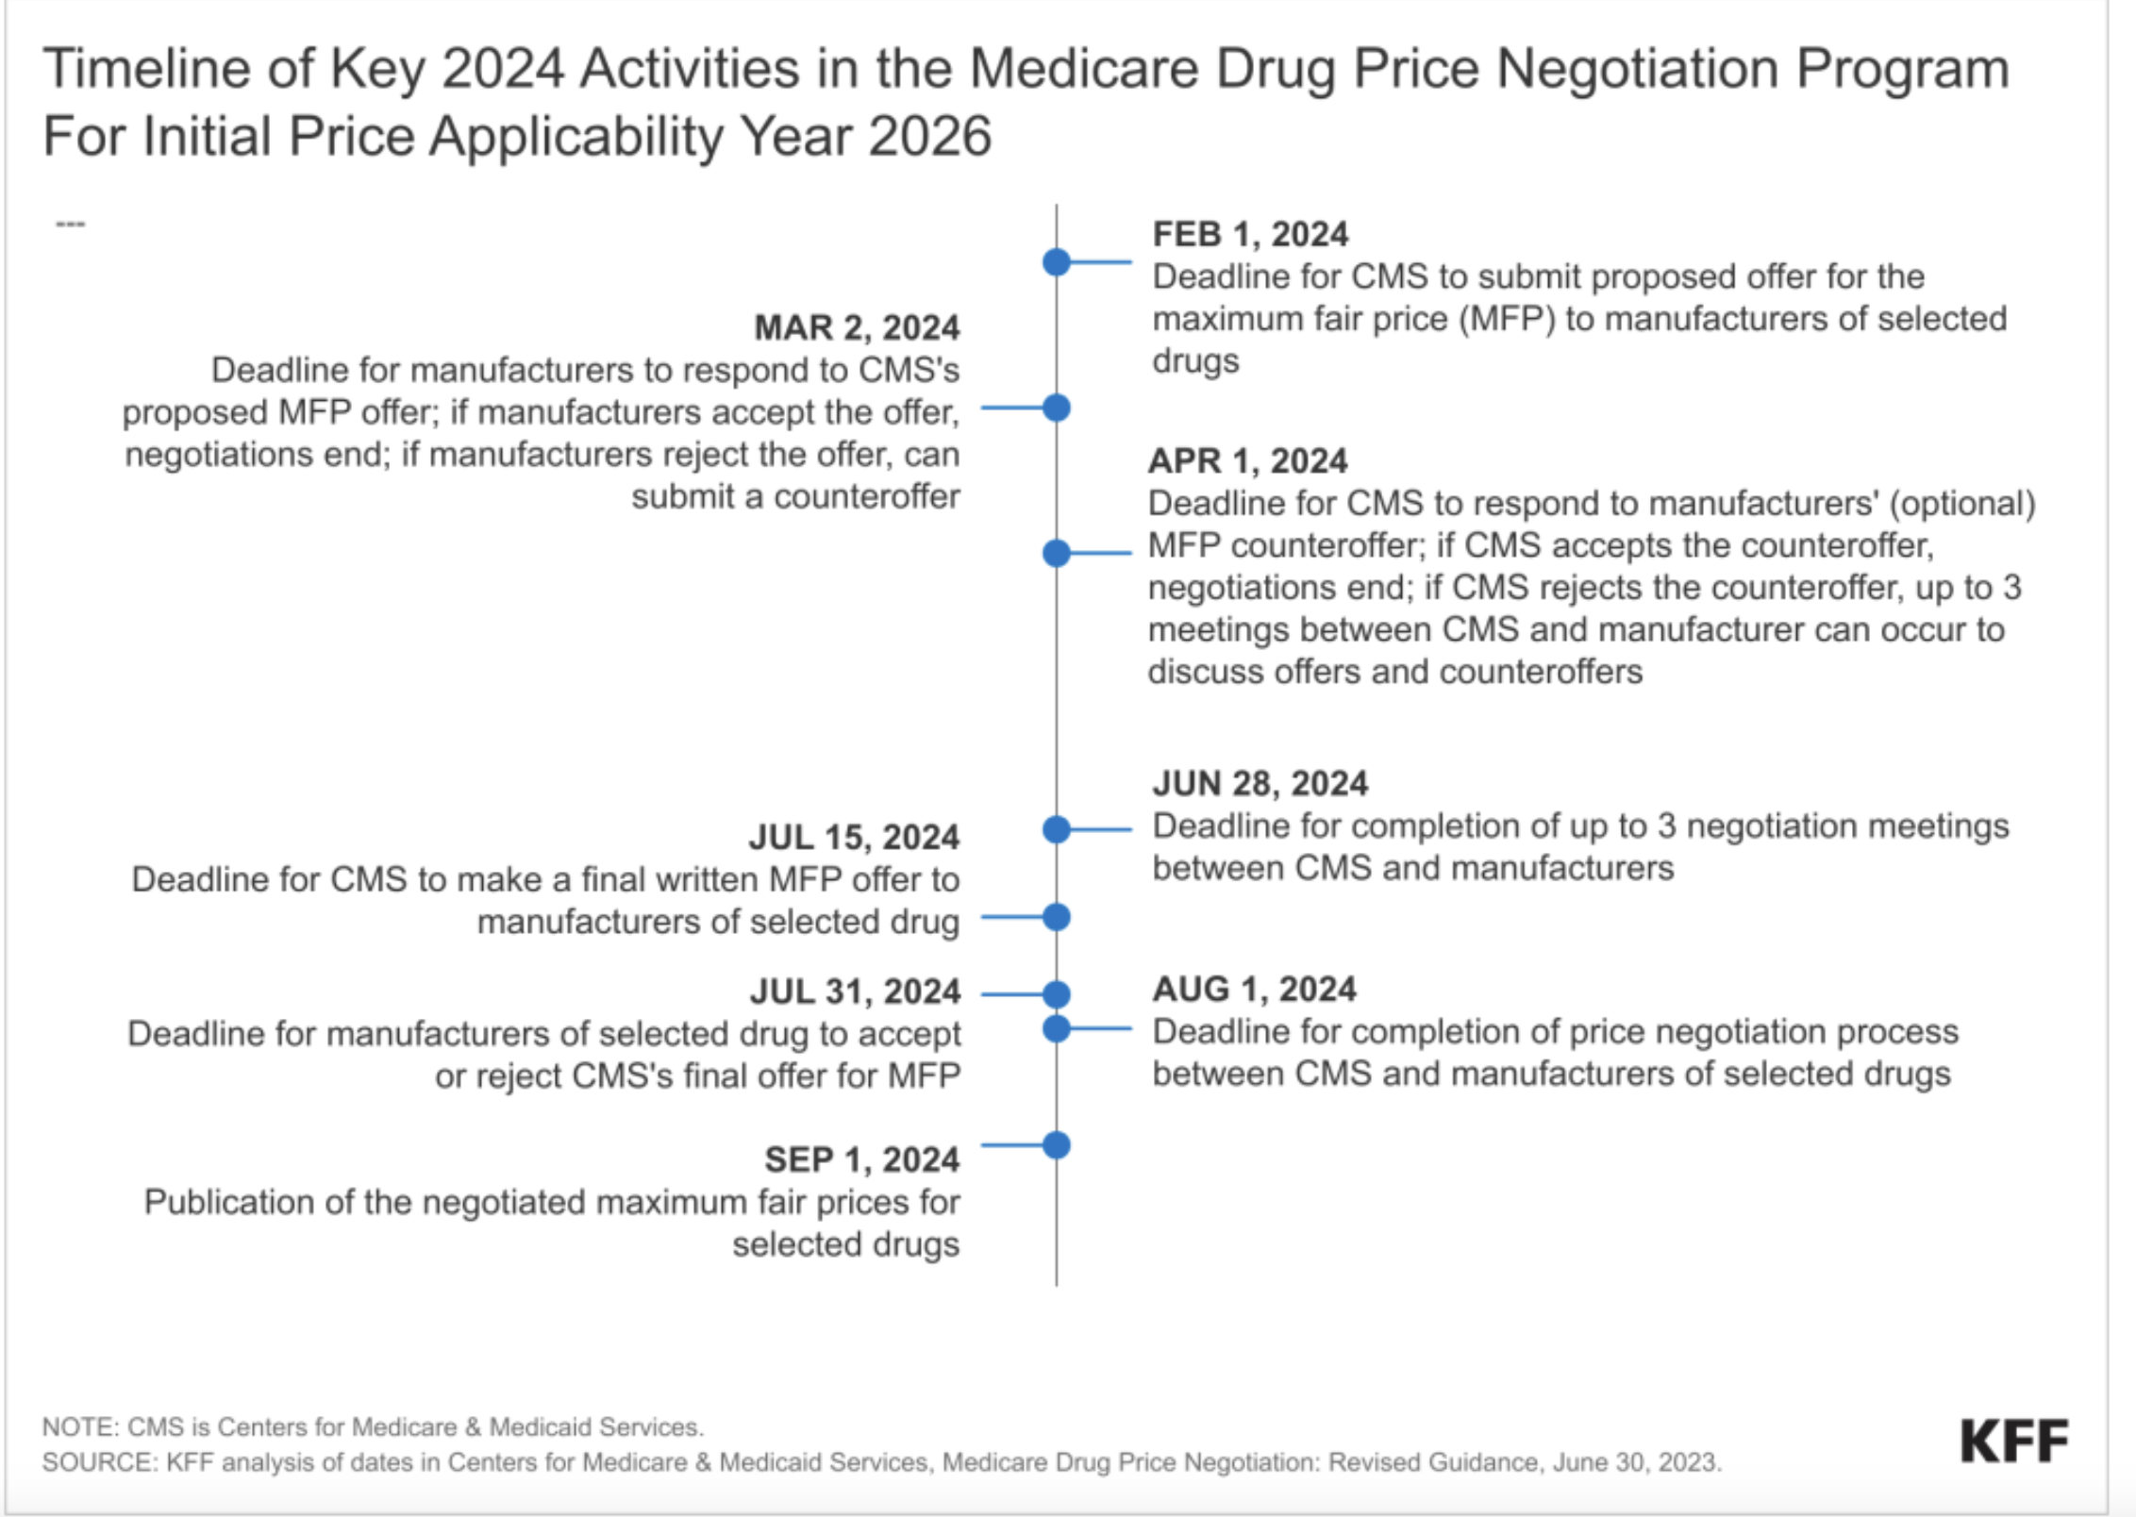
7

Slide 8
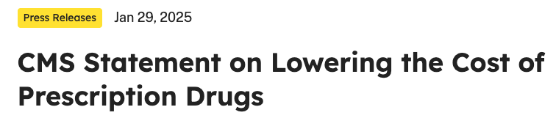
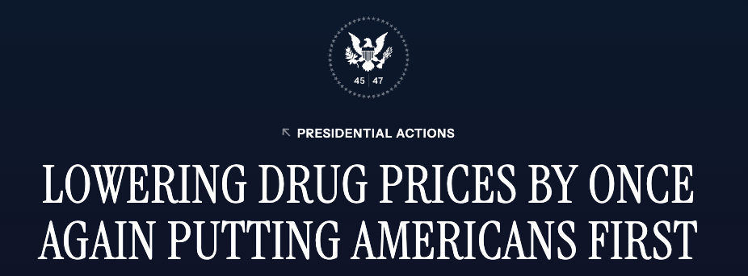
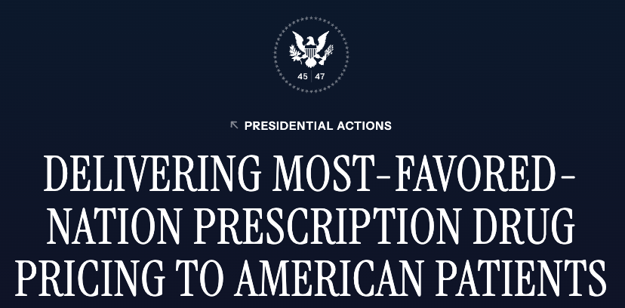

8

Slide 9

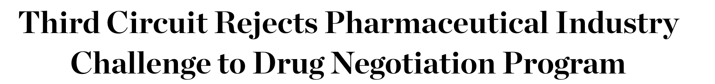
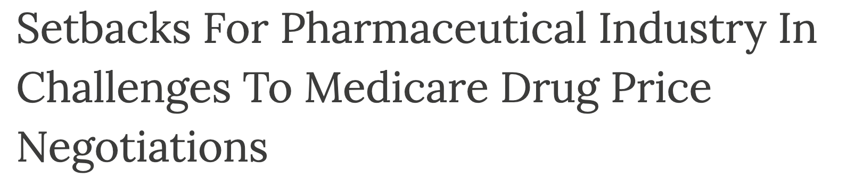
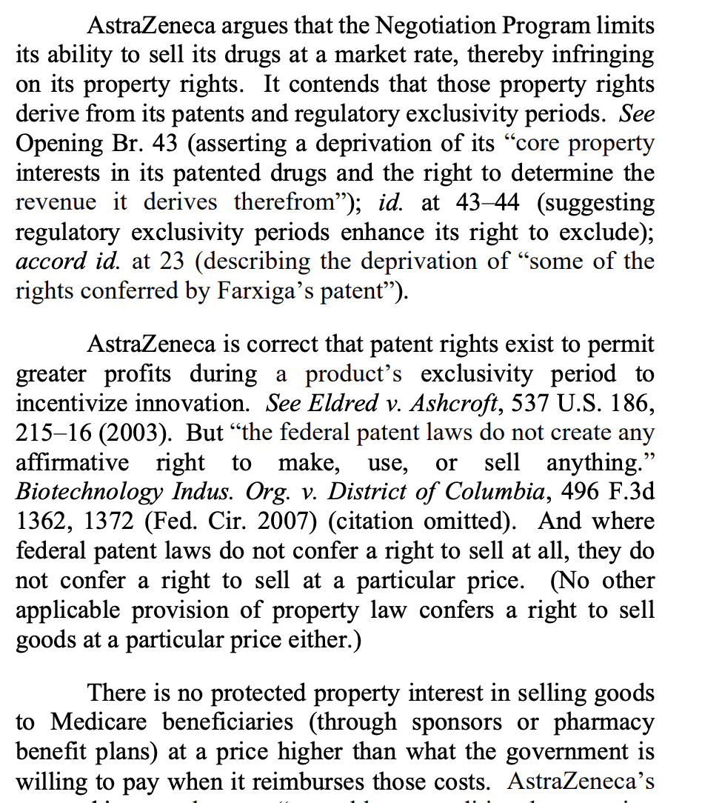
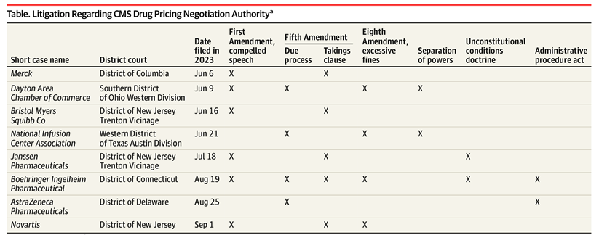

9

Slide 10

State Regulation of Prescription Drug Affordability
June 2025
Aiseosa Osaghae
Associate, Center for Health Policy and the Law
O’Neill Institute for National and Global Health Law
ato11@georgetown.edu

Slide 11

STATE REGULATION OF PRESCRIPTION DRUG AFFORDABILITY
11
Types of Laws
1
3
5
7
Price Gouging
Transparency
Reference Rates
Consumer Cost Sharing
2
4
6
8
Affordability Review/ PDAB
Out of Pocket Caps
Importation
Pharmacy Benefit Manager

Slide 12
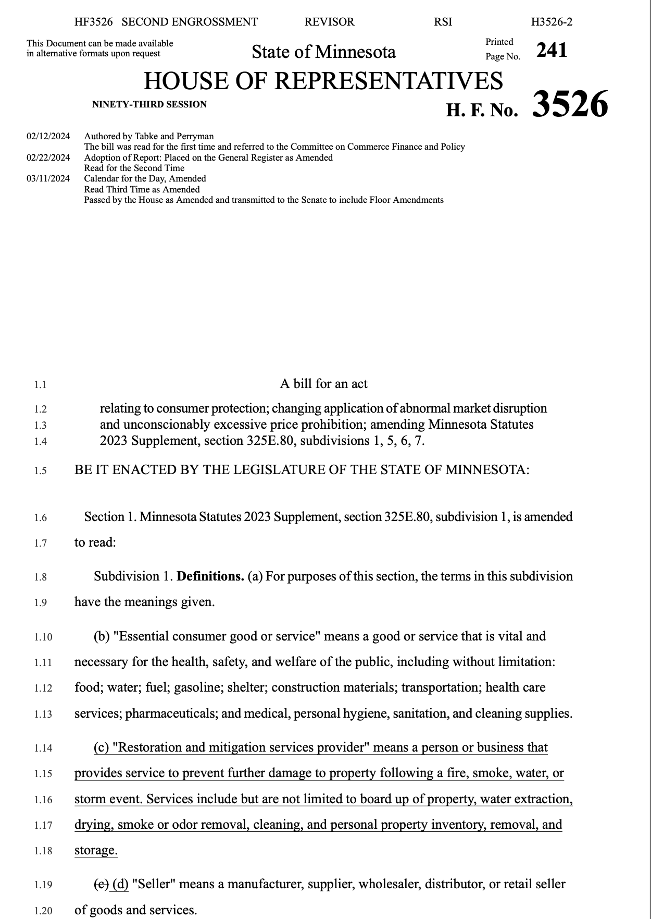
STATE REGULATION OF PRESCRIPTION DRUG AFFORDABILITY
12
Price Gouging Laws

Slide 13
STATE REGULATION OF PRESCRIPTION DRUG AFFORDABILITY
13
Affordability Review/ Prescription Drug Affordability Boards
Rx
Establish board to identify drugs based on specific parameters
Issue reports on affordability data and considerations
Establish upper payment limits on chosen drugs
Determine and report on spending targets for prescription drugs that may cause affordability challenges

Slide 14
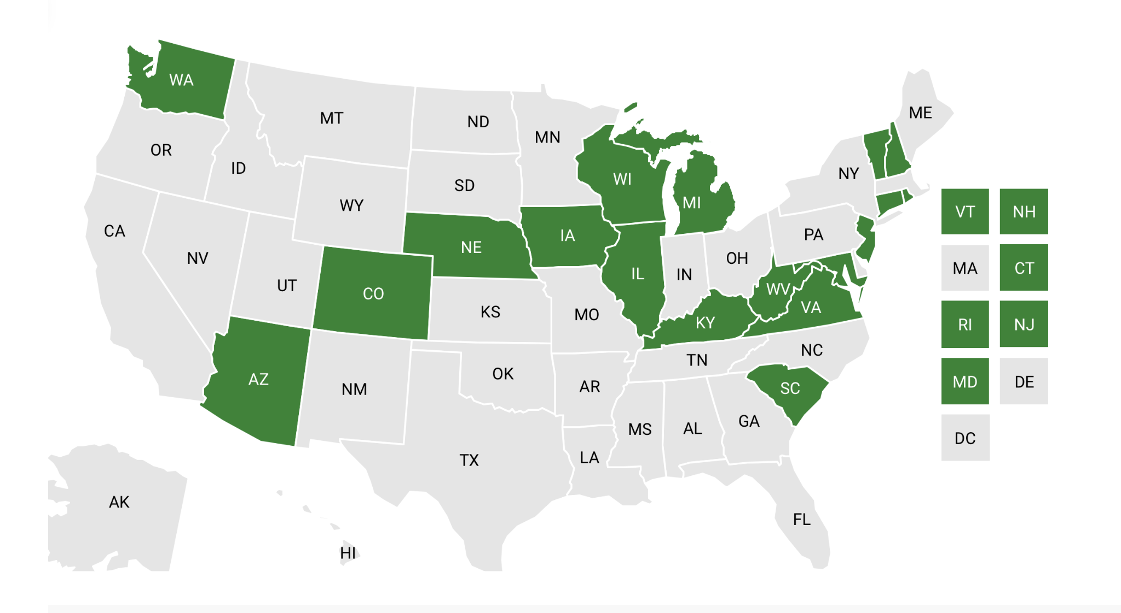
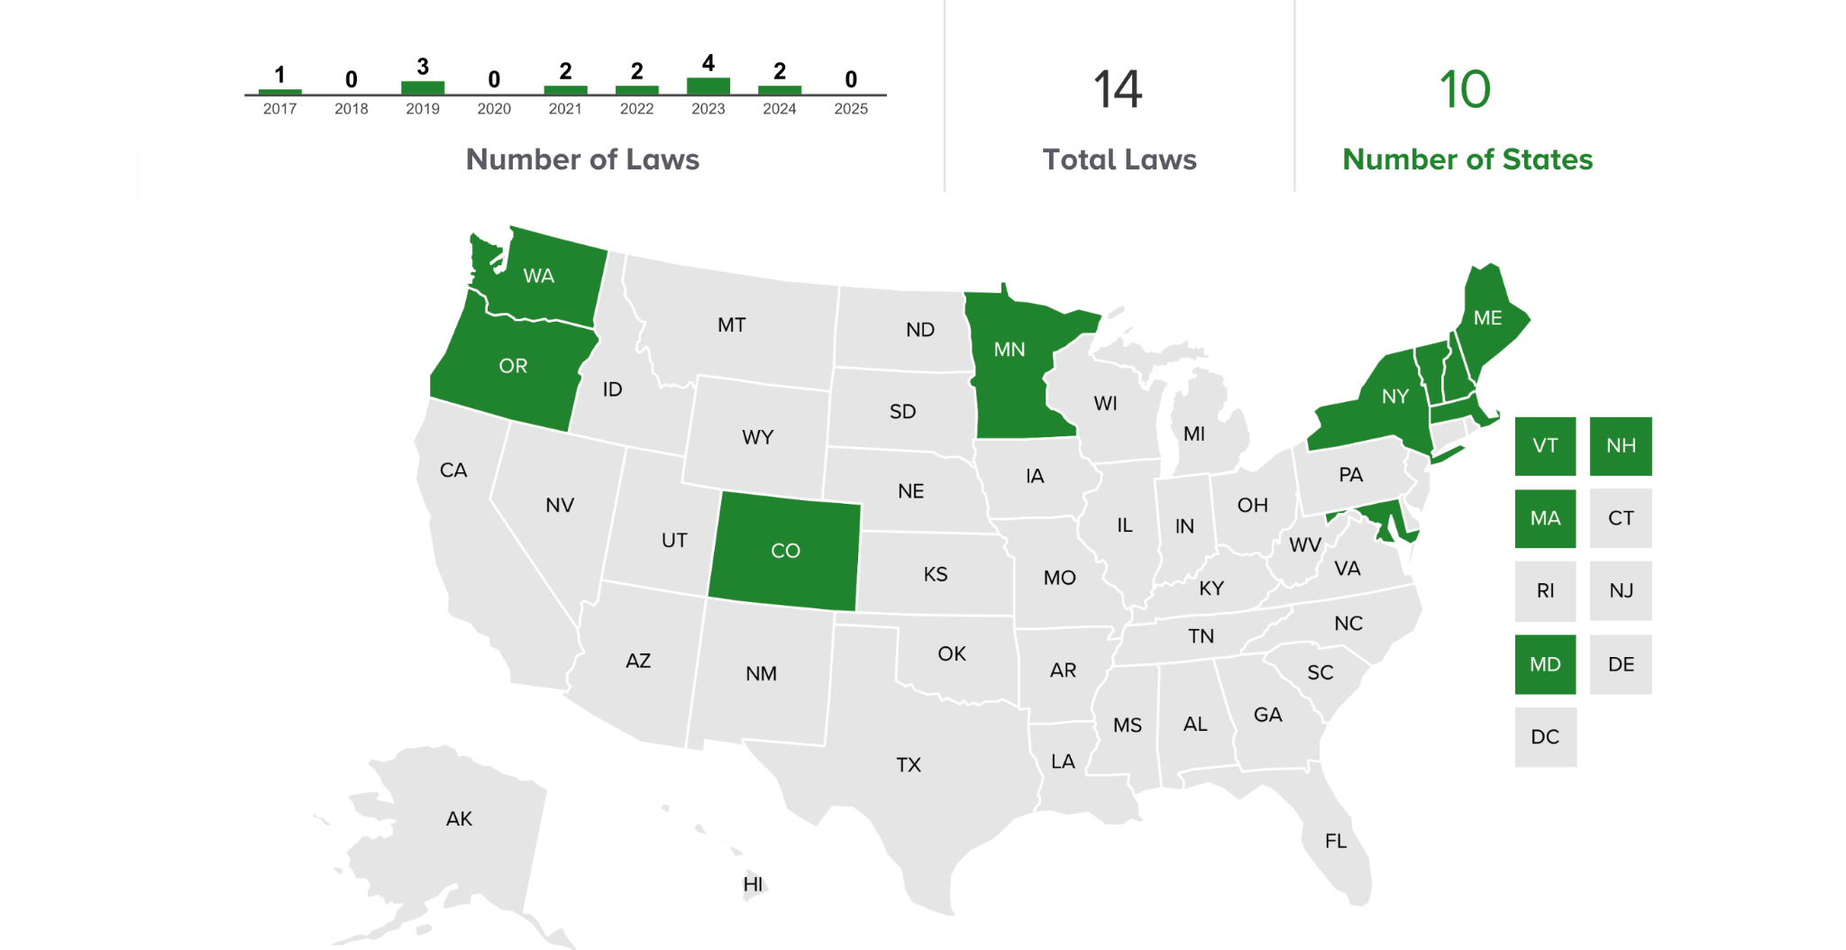
STATE REGULATION OF PRESCRIPTION DRUG AFFORDABILITY
14
PDAB Laws Considered 2024
PDAB Laws Passed 2017-2025
https://nashp.org/state-tracker/2024-state-legislation-to-lower-pharmaceutical-costs/

Slide 15
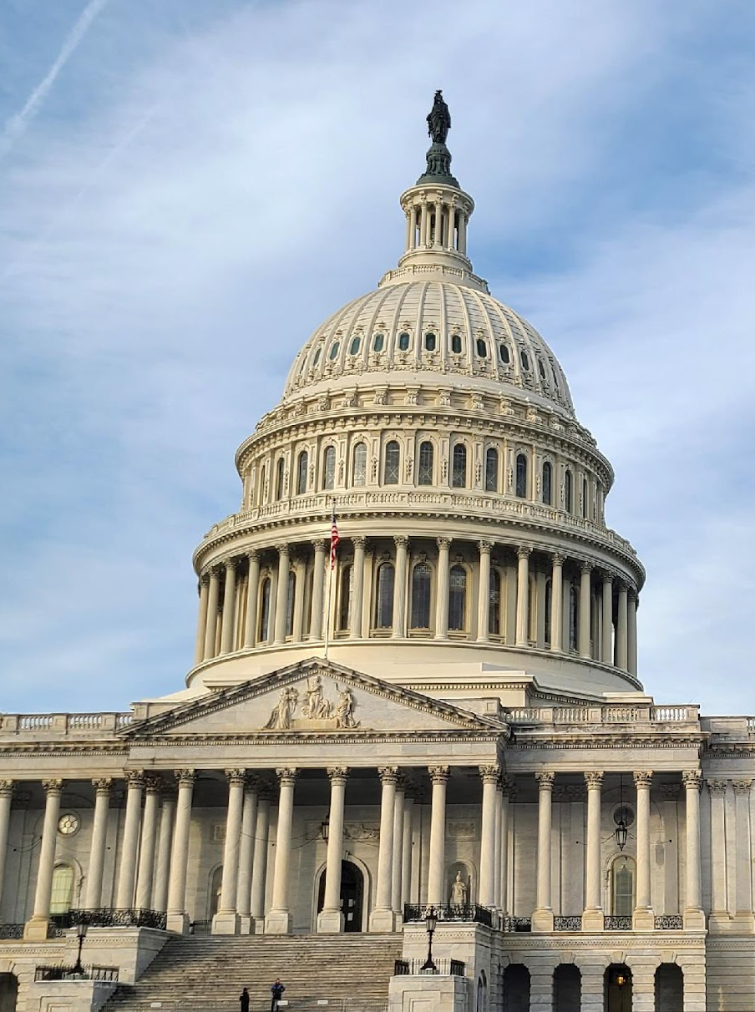
STATE REGULATION OF PRESCRIPTION DRUG AFFORDABILITY
15
Prescription Drug Affordability Efforts in Colorado
SB21-175: establishes Prescription Drug affordability board (PDAB)
Review affordability
Establish upper payment limits (UPLs)
UPL applies to: state and local governments, contractors and vendors, commercial health plans, pharmacies, etc.

Slide 16
National Analysis of State Prescription Drug Price Transparency Laws
Hannah Rahim, JD, MPH
Harvard Law School & Harvard T.H. Chan School of Public Health
ASLME Health Law Professors Conference

Slide 17
State Drug Price Transparency Law Requirements
21 states have passed drug price transparency laws that place price reporting mandates on manufacturers
Laws focus on reporting of wholesale acquisition cost (WAC)
Many laws require reporting of both public and non-public data

Slide 18
Implementation of Transparency Laws
Top 3 drugs with greatest WAC increases varied between states, due to interstate variations in reporting programs
Implementation challenges noted by states:
  Enforcement of reporting requirements
  Identifying drugs/manufacturers subject to reporting
  Poor data quality
Improvements noted

Slide 19
Impact of Transparency Laws
Provide transparency on drug pricing to enable more informed decision-making
Facilitate state government price negotiation with manufacturers
Laws coincided with decreases in number of WAC increases and median percentage increase
Drug launch prices and overall spending have continued to increase
Manufacturers may be seeking loopholes to get around these laws

Slide 20
Legal Challenges to Transparency Laws
PhRMA sued California, Nevada and Oregon, challenging constitutionality of their price transparency laws
Most common challenges: Dormant Commerce Clause, First Amendment, federal trade secret law pre-emption, Fifth Amendment Takings Clause
PhRMA was unsuccessful in Nevada and California
PhRMA granted summary judgement on First Amendment and takings claims in Oregon
Oregon has now suspended price increase reporting requirement and no longer publishes manufacturers’ trade secrets

Slide 21
Limitations of Transparency Laws
Requiring public disclosure of pricing information might facilitate horizontal coordination
Manufacturers may struggle to explain price increases without revealing trade secrets
Laws focus on WAC which does not represent price that payers and consumers pay

Slide 22
Conclusion
Transparency laws facilitate dissemination of price data to address high prices
May have contributed to informing policymaking based on newly available public information, but do not yet appear to have affected drug prices
Further research needed to quantify impact of these laws

Slide 23
Prescription Drug Affordability Boards (PDABs)
Andrew Twinamatsiko, Director, Center for Health Policy and the Law, O’Neill Institute, Georgetown Law
Shweta Kumar, Assistant Professor of Law, University of Kentucky J. David Rosenberg College of Law

Slide 24
Industry pushback
Test Case: Amgen Inc. v. Colorado Prescription Drug Affordability Review Board
Dismissed for lack of standing by Colorado district court – ENBREL selected by PDAB, but no UPL set yet
Federal Circuit appeal filed Apr. 14, 2025
Key arguments:
  Preemption
  Due Process
  Dormant Commerce Clause

Slide 25
Preemption Argument
Amgen’s Claim: PDAB UPLs conflict with the exclusive rights afforded to patent owners by the federal patent system. The UPLs “rebalanc[e] the statutory framework of rewards and incentives” created by Congress.
Unlike trade secret preemption (in Stolfi), some precedent supports Amgen’s argument

Slide 26
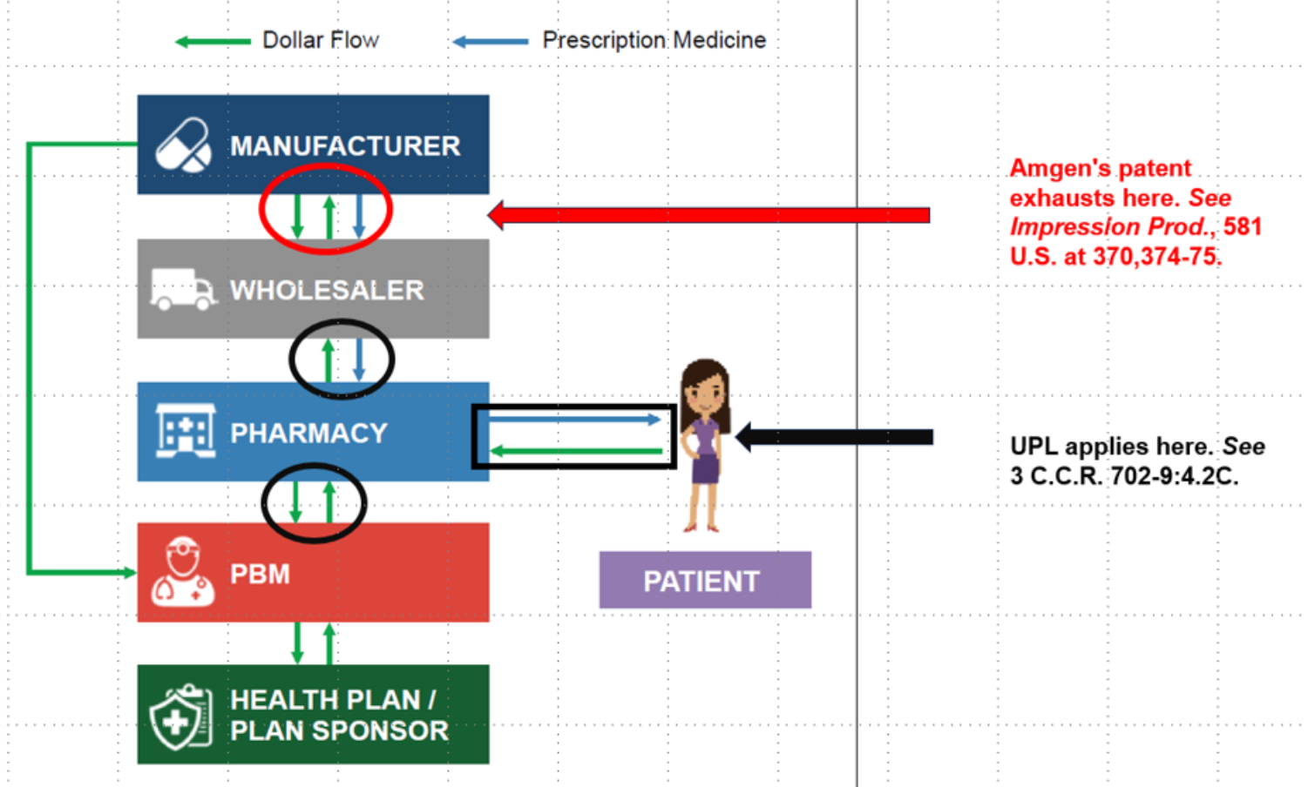
State’s Preemption Counter
Patent Exhaustion: After the first authorized sale of a patented product, the patentee’s exclusive rights are exhausted (it may no longer control the use of that product)
State Police Powers: once a product enters a state, it can be regulated, even if patented
No Conflict: The Patent Act does not guarantee the right to set a particular price or recoup profits (or even the right to sell the patented product)

Slide 27
BIO v. DC (Fed. Cir. 2007)
Prescription Drug Excessive Pricing Act of 2005 (DC law)
  Patented drugs presumed to be excessively priced if wholesale price in DC was at least 30% higher than its price in UK, Germany, Canada or Australia
  Manufacturer could rebut this presumption with data and other arguments
  Anyone affected by excessively priced drugs could sue drug manufacturers for fines, treble damages, and attorneys’ fees
Challenged by BIO (biologics trade group) on basis of preemption
Federal Circuit agreed, finding that the law stood as an obstacle to the balance Congress struck between innovation and access in the Patent Act
But, the decision did not “require the preemption of any state law regulating the prices of patented pharmaceutical products.”

Slide 28
Dormant Commerce Clause Argument
Amgen’s Claim: upper payment limits (UPLs) apply to all purchases of a prescription drug ultimately administered or dispensed to individuals in the state. This includes upstream transactions which may occur wholly outside of Colorado (e.g., manufacturer → wholesale distributor)
State Counter: plurality of Supreme Court disagreed with a nearly identical argument in Nat’l Pork Producers v. Ross (2023). State has the authority to regulate products sold within its borders.

Slide 29
Dormant Commerce Clause Argument
Ass’n for Accessible Medicine v. Ellison: Minnesota price gouging law violates DCC as applied to out-of-state manufacturers who sale out-of-state wholesalers (Edgar line of cases)
Ass’n for Accessible Medicine v. Bonta: Ass’n for Accessible Medicine v. Bonta — reverse payment settlement agreements
Association for Accessible Medicines v. Raoul

Slide 30
Paths Forward
Supreme Court takes up cert
Federal legislative fix to clarify scope of patent preemption (may take a backseat in light of MFN EO)
Reform PDABs
  Target reimbursement rates (PBMs)
  Rather than UPLs, impose tax (8A arguments weak)
  Last resort: focus on generic drugs
Push forward other state interventions

Slide 31
Questions?

