Slide 1
Factors Affecting Couples’ Decision-Making About Expanded Prenatal Cell-Free DNA Screening

Slide 2
Disclaimer
These arguments are those of the presenter and do not necessarily reflect the official views and policies of DHHS, NIH, or NHGRI.

Slide 3
Background

Slide 4
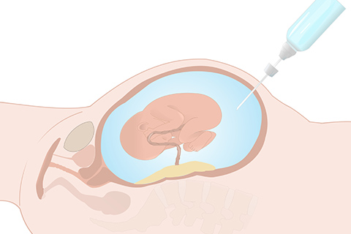
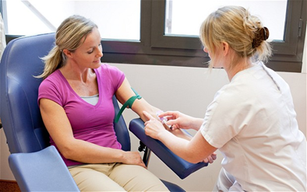
Prenatal Genetic Testing Options
Amniocentesis
16 weeks
Chorionic villus sampling
10-13 weeks
NIPT
10 weeks (trisomies)

Slide 5
Prenatal Whole-Genome Sequencing
Has been demonstrated; not yet clinically available
Can be done as early as 7 weeks
Can produce a wide range of genetic information
Single-gene disorders
Adult onset disease
Non-medical information
Notes:
Non-invasive PGS involves taking a blood sample from the pregnant woman, extract fetal DNA, and then sequencing it.
First demonstrated in a lab about 8 years ago.
The barrier to clinical adoption is efficient extraction of sufficient fetal DNA, but this is a technical barrier that will eventually fall.
Unlike current practice which involves testing for serious conditions when there is an indication, PGS could be expansive.

Slide 6
High Likelihood of Widespread Adoption
Plummeting cost of sequencing
Historical trend toward more comprehensive prenatal testing
Strong market forces
Only technological/economic scaling barriers remain
Notes:
I started thinking about the ethics of PGS in 2011 right after it was proven to be possible, and the beginning of a larger societal conversation wasn’t far behind. See these two pieces in Time and MIT Technology Review.
After something of a predictable lull, interest has recently seemed to pick up again as the technology gets closer to becoming clinically available. Wired Magazine just had a big series on procreation and technology, including a piece on the ethics of expansive prenatal testing that heavily feature my work.

Slide 7
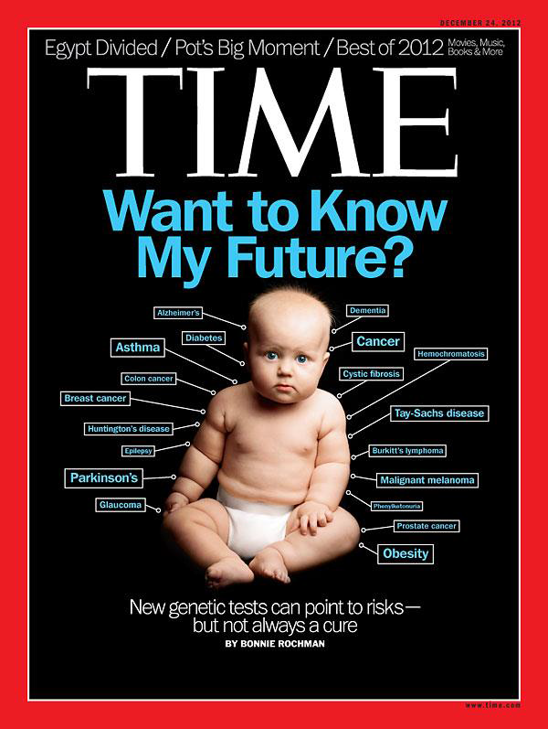
A Looming Ethical Challenge
Future autonomy
Genetic determinism
Expressivist impact
Backdoor eugenics
(Non)-Directiveness
Legal backlash
RBAB
Physician speech
Extemporaneous vs. evidentiary adoption of new technologies

Slide 8
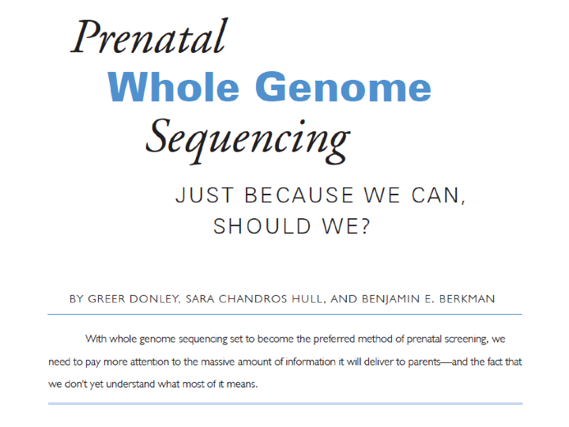
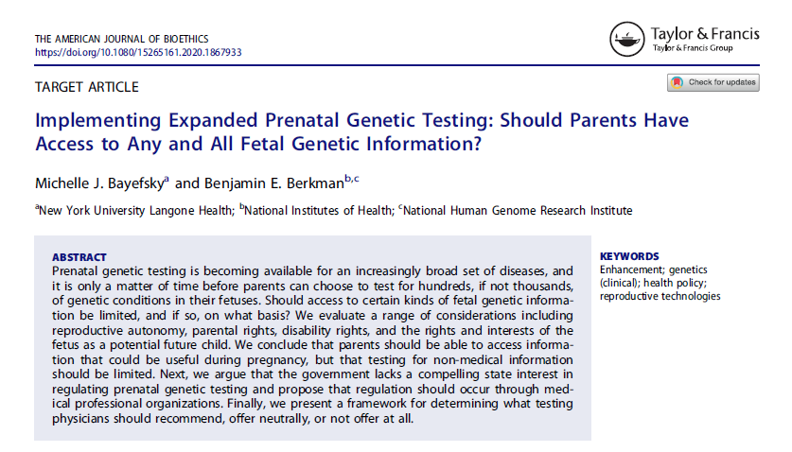
Normative and Policy Projects

Slide 9
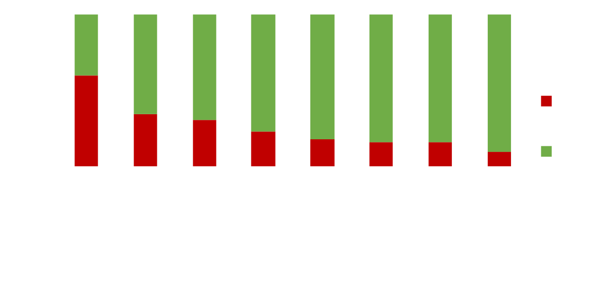
Which categories of information would you want from PWGS?
Sullivan HK, Bayefsky M, Wakim P, Huddleston, K, Biesecker BB, Hull SC, Berkman BE. Noninvasive Prenatal Whole Genome Sequencing: Pregnant Women’s Views and Preferences. Obstetrics and Gynecology 133:525-532 (2019).
Notes:
Not surprisingly, women generally wanted lots of information, although there were a number of variables (ethnicity, genetic literacy, views on abortion) that were significantly predictive of information seeking.
But somewhat surprisingly, there wasn’t as much of a difference between categories as we expected. There was something of a gradient, but it wasn’t as steep as we expected and some of the categories that we would have expected to elicit substantial variance (POINT TO THREE) didn’t have statistically significant differences. These were:
Moderately increased risk of common treatable disease
Mild to moderate developmental delay or learning disability
Fatal congenital condition resulting in death shortly after birth
This suggests that physicians should not assume that the same reasons underlie decisions to receive different kinds of information.

Slide 10
PWGS Partners Survey

Slide 11
Current Evidence
Pregnant persons and their partners value having the choice to learn about their fetus’s genetic risks
Hold similar views about limited NIPT/cfDNA screening (e.g., trisomies)
Very limited investigation into partners’ interest in expanded categories of prenatal genetic information

Slide 12
Research Questions
How do the characteristics (timing of disease onset, disease severity, treatability, reliability of results) of expanded NIPT and its tested conditions impact intended parents’ interest in pursuing testing?
How much variability exists within couples when making these types of decisions? Are there any predictors of concordance/discordance?
How would couples navigate potential disagreements?

Slide 13
Study Population
U.S. adult couples of childbearing age who are pregnant or are intending to become pregnant within the next 18 months
Partner must be willing to participate
247 dyads (494 total)
Convenience sample from Qualtrics of women who are pregnant or are trying to conceive
Quotas for racial/ethnic cohorts that track recent census data to approximate a representative U.S. population sample

Slide 14
Survey Design
Pregnant person begins survey
Background information, consent
8 randomly drawn vignettes from 108 potential options
Predict partner’s views, reasons for seeking or not
Doctor directiveness, cost, ability to terminate, opinions
Questions about how will make decisions with partner
Demographics
Transition to partner
Same 8 vignettes in same order

Slide 15
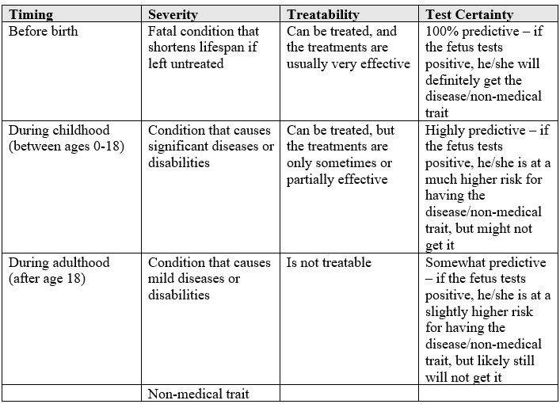
Vignette Template
“Please imagine that you and your partner are expecting and that your doctor is offering you the following test. A test for a [disease severity] that starts [timing of onset]. This disease is [treatability]. The test for this condition is [reliability].”

Slide 16
Results

Slide 17
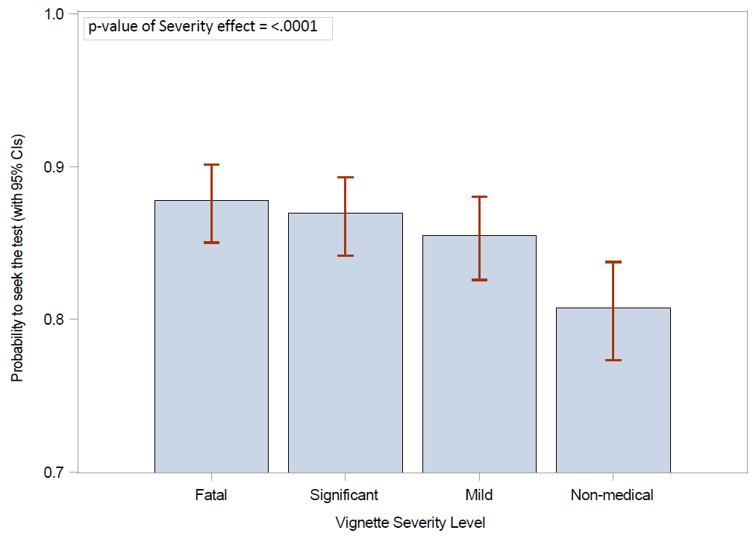
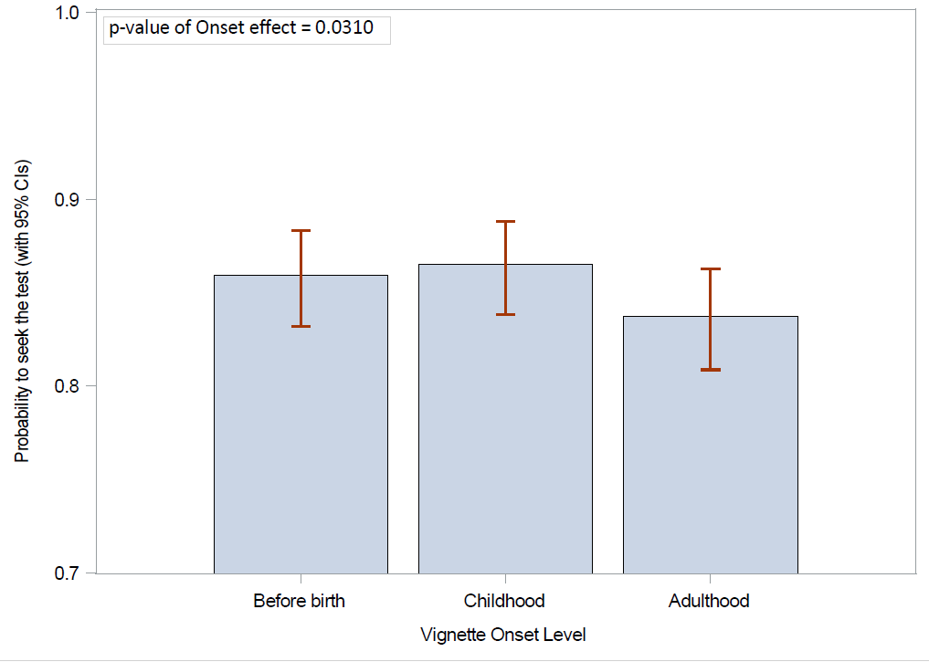
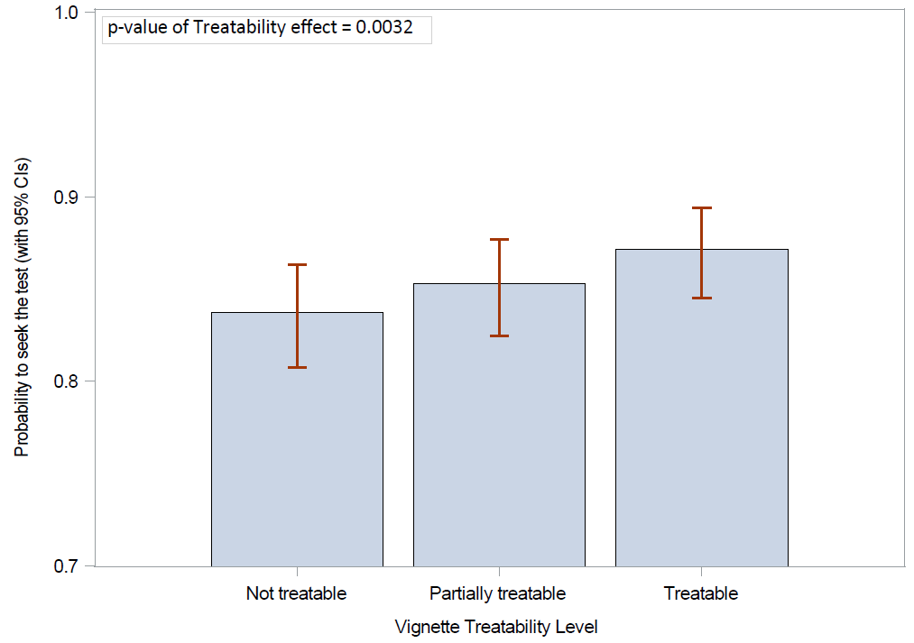
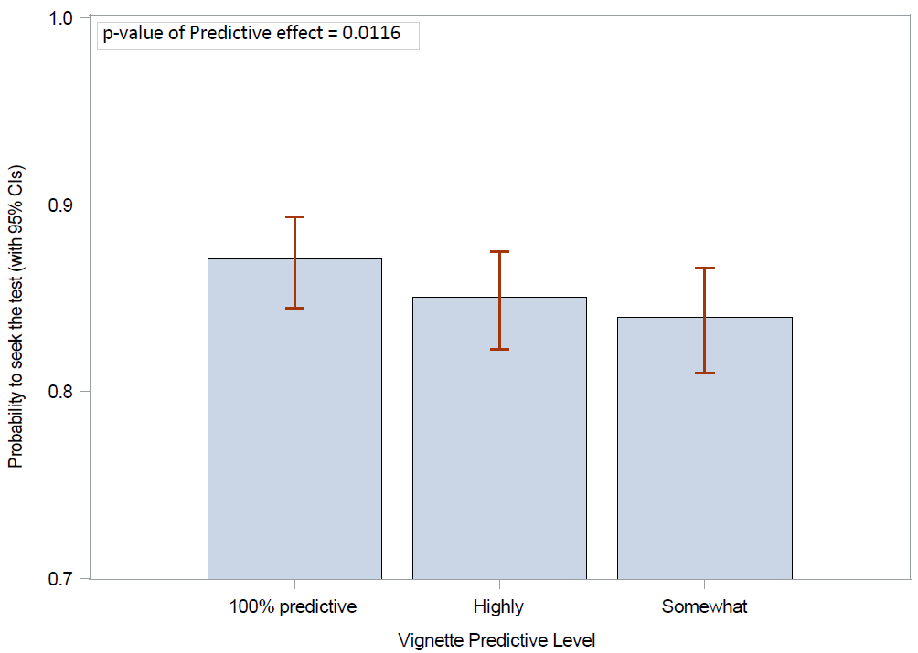
Predicted probability of seeking a prenatal genetic test per variable
Figure 1: Effect of vignette levels on willingness to seek a predictive genetic test

Slide 18
Reason For/Against Testing
All strongly endorsed as important reasons (at least moderately strong)
Strongest reason for testing
Risk of familial disease (94.9%/94.9%)
Prepare financially, medically, emotionally (95%/94.3%)
Strongest reason against testing
Never consider termination based on genetics (81.6%/75.7%)
Concern about stress and anxiety (71.2%/67.5%)
To inform decisions on pregnancy termination
Religious (87.1%/87.4%)
Never consider pregnancy termination (90.7%/92.8%)

Slide 19
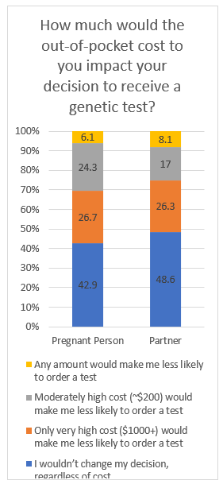
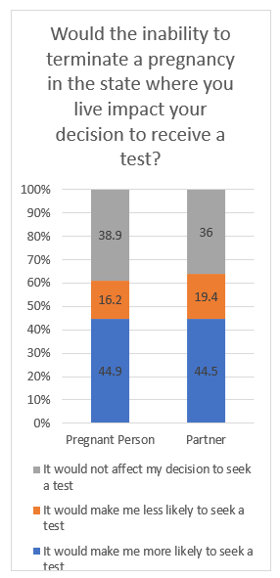
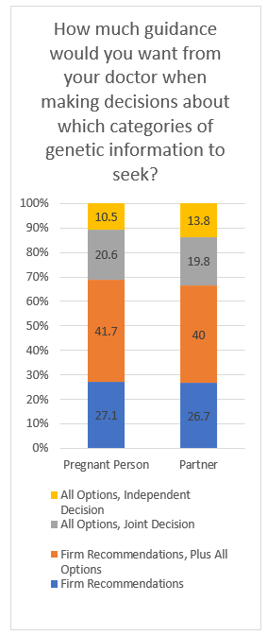

Slide 20
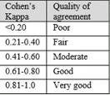
Partner Concordance
87.9% agreement
78.8% yes/yes (1,557/1,976)
9.1% no/no (180/1,976)
On average, partners agreed on 7/8 vignettes
63.6% agreed on 8/8
No statistical differences related to severity, treatability, timing of onset or predictiveness
Moderate concordance
k=0.5311, 95% CI [0.4455, 0.6167]

Slide 21
Views on Joint Decision-Making with Partner
Notes:
Moderate concordance on the statement that if they could not agree on whether to test, the default should not be to simply not seek testing (k=0.57) and that they would seek guidance from a doctor or genetic counselor (k=0.547). Least concordance between partners on whether the participant answering the survey would be the primary decision-maker on testing decisions (k=0.282), with the pregnant persons responding ‘yes’ more often than the partners (reflecting agreement that the pregnant person would be the primary decision-maker).

Slide 22
Discussion

Slide 23
Willingness to Seek Testing
Some significant differentiation by variables/levels
Earlier onset, treatable, higher severity
But consistent with previous studies, pregnant persons and their partners are highly information seeking
Reflects a broader acceptance of increasing data generation and collection

Slide 24
Willingness to Seek Testing
High desire for early onset information is inconsistent with the academic concept of a “right to an open future”
If lack of consideration is the root cause, more pre-test counseling is indicated
If this result reflects a normative disagreement with the concept, it might be time to (continue) revisiting its importance

Slide 25
Willingness to Seek Testing
Self-reported religiosity was associated with higher likelihood of seeking testing
And religious people or those who indicated that they would never terminate were fairly likely to say that it was important to learn genetic information for the purpose of making termination decisions
Would availability of expanded prenatal testing shift views on acceptable reproductive choices?
Are views on pregnancy termination firmer in the abstract than in concrete situations?
As new categories of information become available, it will be important to examine who is seeking which kinds of information, and why
Existing literature that has focused on a limited number of early-onset disease (e.g., Down Syndrome) will need to be reevaluated and expanded
Notes:
General correlation between religiosity and negative views of pregnancy termination

Slide 26
Concordance
The clinical encounter where couples will have to decide which kinds of prenatal genetic information to seek could be ethically challenging, particularly if couples disagree
~90% concordance is higher than hypothesized but still leaves a substantial set of situations that could become fraught
Particularly given that there was lower concordance about the reasons for/against testing
E.g., partners half as likely to endorse the importance of stress/anxiety

Slide 27
How Will Couples Navigate this Complicated Decision-making Process
Extensive menu of options?
See Chen and Wasserman
Non-directive genetic counseling?
But our findings suggest that couples want substantive guidance
Three bins
Recommended
Not recommended
Neutrally presented

Slide 28
Conclusion
PWGS is coming soon
Data from projects like this one can inform thoughtful evidentiary implementation of an ethically complicated new technology
Reexamine long-held ethical views
Non-directiveness
Right to an open future
More research is needed to explore why people who are seemingly against pregnancy termination might be so interested in learning prenatal genetic information

Slide 29
Acknowledgments
Kelsey Mumford
Saskia Hendriks
Skye Miner
Chloe Huelsnitz
Paul Wakim
Mumford K, Hendriks S, Miner S, Huelsnitz CO, Wakim P, Berkman BE. Factors Affecting Couples’ Decision Making about Expanded Prenatal Cell-free DNA Testing. Genetics in Medicine Open 2 (2024).

Slide 30
Thank you berkmanbe@mail.nih.gov

