Slide 1
Regulating the Use of Social Polygenic Scores in Society: What safeguards can health law provide?
Shawneequa Callier, JD, MA Bioethics
Associate Professor
The George Washington University
School of Medicine and Health Sciences
________________________________________________________
Health Law Professors Conference
Boston University
June 5, 2025
Notes:
Will discuss the potential role of health law in a potential future world where social polygenic scores are used in society, but also the very limited safeguards health law and other laws provide

Slide 2
Disclaimer
The speaker declares no financial or other conflicts of interest
Opinions expressed are my own and should not be construed as the views of my affiliate institutions or collaborators

Slide 3
Scenario
A prestigious high school announces a pilot program integrating polygenic scores into educational planning. The school claims it will help predict student success and optimize academic support services. The scores will not be used for admission.
Notes:
Here is a scenario I’ll use to describe the social and legal uncertainties of polygenic scores
We’ve seen student DNA testing before. Colleges and grad programs have offered students personal genetic testing for educational purposes to help train students in experiential ways, including medical and pharmaceutical students for potential scenarios when patiients, in their roles as consumers order DTC genetic testing services and bring them into the clinic.
This program obviously raises legal and ethical concerns, much like those raised by student educational DNA testing. How are students' genetic data stored, and do they fully understand the risks? Who will do the testing and do research or medical laws apply? In this case, we might also ask, could polygenic scores unfairly advantage or disadvantage certain students during school or later in life? What are the regulatory gaps and unintended consequences?
If we Imagine a world where polygenic scores influence HS or even college admissions—there are limited laws regulating these nonmedical uses.

Slide 4
Agenda
Define polygenics scores and sociogenomics
Briefly describe legal uncertainties re the potential uses of PGS
Discuss the limited application of health law using the example of educational attainment
_______________________________________________
The “Beyond the Medical” Grant
MPIs Anya Prince and Jean Cadigan
National Human Genome Research Institute
R01HG012402
Notes:
I will briefly define polygenic scores and their growing applications beyond medicine and describe some of the legal gaps and uncertainties.
Since there’s little legal precedence for regulating social polygenic scores, can we apply or expand health law frameworks? What are the opportunities, and pitfalls?
One of the reasons for giving this talk today is that Anya Prince and I are developing case studies to teach students about the ethical and legal implications of these technologies as a deliverable of our funded work led by Anya and Jean Cadigan. We haven’t narrowed the student audience yet. We are considering developing case studies for college students but we could start earlier. We are considering science student and law student audiences.
Lastly, we are considering how to present the traits and the many different uses. So today I’ll discuss the trait educational attainment and the potential use of PGSs in schools to create personalized learning plans. But there could be other uses including college admissions, commericialzed dating or entertainment applications, illegal employment discrimination, or further research uses linking educational attainment with other traits such as political beliefs.

Slide 5
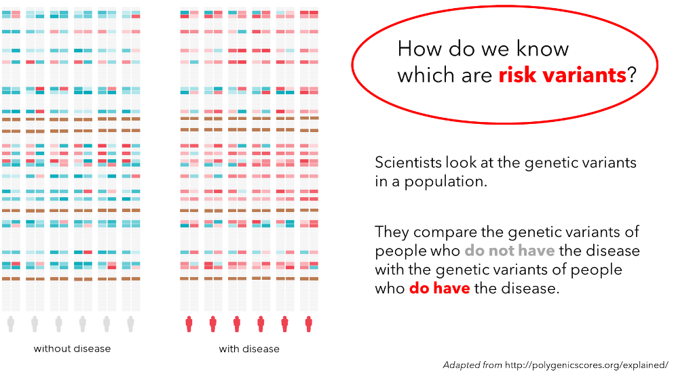
Polygenic Scores (Indices)
Adapted from http://polygenicscores.org/explained/
Notes:
So what are Polygenic Risk Scores (PRSs)? PRSs assess individual differences in traits and estimate the likelihood of developing complex conditions such as cancer and heart disease.
Researchers identify variants by analyzing genomic datasets from biobanks and comparing genetic variants in individuals with and without diseases. These studies are called genome wide association studies or GWAS. Variants more common in affected individuals indicate an increased likelihood of the trait, while those more prevalent in unaffected individuals suggest a decreased likelihood.

Slide 6
Sociogenomics & Legal Uncertainties
Legal gaps and uncertainties re
Health laws apply to genetics generally, but there’s limited application to social uses
Genetic variation + social + environmental factors to shape social traits and behaviors.
E.g., ancestry testing, "infotainment"
Example SOCIAL Traits
Callier, S. and Prince, A.E., 2024. The Legal Uncertainties of Sociogenomic Polygenic Scores. Harvard Journal of Law & Technology, 38.
Notes:
Research in this area focuses on the heritability of complex diseases but also increasingly social traits. Work in this field called Sociogenomics examines how genetic factors influence social characteristics, such as education, behavior, and economic status. Social and behavioral scientists are increasingly collaborating with geneticists or adapting genetic research methods to explore associations between genomic differences and social traits.
Researchers are the primary stakeholders developing PGSs and there are limited current uses in society except in the case of IVF contexts and some consumer entertainment applications. Since we are talking about social traits and behaviors instead of disease our team uses the phrase polygenic scores or PGSs instead of PRSs.
This figure highlights the varied existing and potential traits we could research. Part of our work on the grant is to investigate developments in these areas, scan what traits and uses are on the horizon, and the potential ethical and legal implications [ CLICK ] In a recent law review article, Prof. Prince and I discuss the limitations of existing laws, including anti-discrimination and privacy protections, as well as implications of justice and fairness, particularly regarding unintended consequences outside health law. This raises important questions about whether health law should evolve to address genetic predictions beyond medicine.

Slide 7
Educational Attainment PGS
“A person’s success in school is impacted by many different environmental and social factors. However, genetics also plays a role in educational attainment. Educational attainment is one of the most commonly studied traits in sociogenomics research.”
Case Study Draft by A. Prince and S. Callier
Notes:
Next, I am going to spend the rest of my time using the example of educational attainment. It is a good example because it highlights the complexities of PGSs given that environmental and social factors influence the scores and their predictive value including different genders, locations and time periods. Genetics explains an estimated 20% of the differences we see in a population according to scientific research. Also, it is commonly studied, a question in almost every survey, and so application of educational attainment could be one of the earliest uses we see in different social settings.

Slide 8
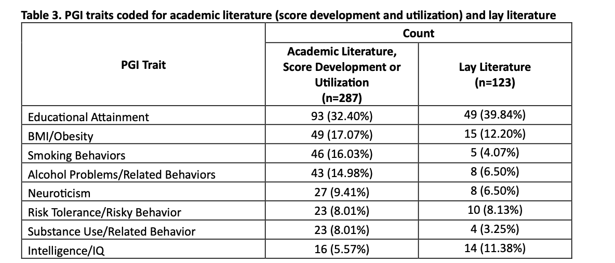
Educational PGS
Canter, C., Meagher, K., Cadigan, R. J., Koopmann, A., Watson, S., Kucmanic, M., Tran, T. Hromcenco, M., Foley, K., Callier, S., Lamb, J., & Prince, A. (2024). Scanning the horizon of sociogenomics: An assessment of the development and growth of polygenic scores for social traits.
Notes:
Further, the Beyond The Medical Team’s independent research has shown that as of 2022 3 million samples have been used to develop EA PGSs and that it is the most cited PGS in academic and lay literature.

Slide 9
How are educational attainment polygenic scores created?
GENOME WIDE ASSOCIATION STUDIES (GWAS) OF GENETIC VARIANTS ASSOCIATED WITH EDUCATIONAL ATTAINMENT
# OF YEARS OF FORMAL EDUCATION A PERSON HAS COMPLETED
Example Survey Question: “What is the highest grade of school...has completed, or the highest degree...has received?”
Notes:
Here is definition so we are all on the same page. Educational attainment refers to the total years of formal education completed by an individual or the highest grade completed or degree received, ranging from no education to a doctoral degree. Researchers convert these responses into years of schooling to conduct GWAS studies I described earlier.

Slide 10
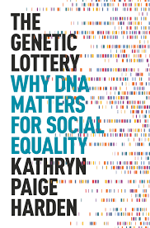
Educational PGS
Proponents’ arguments
Education policy “utopia”
Polygenic scores can provide meaningful predictions about a student's potential academic performance.
“Genetically sensitive” school policies that leverage PRS
Scientifically objective and independent of race, ethnicity, SES, gender, etc.
2013
2021
Notes:
One use of educational attainment PGSs is obviously in school settings. Pyschologists and behavioral geneticists have proposed the development of genetically informed educational systems and argued in favor of applying research on genetic correlations to improve student learning plans.
Harden urges us to treat genes as a fact of life in terms of their contributions to outcomes and Plomin and Asbury describe an
Education policy “utopia”. They argue that: Polygenic scores can predict a student’s academic potential and that “Genetically sensitive” school policies could use PGSs objectively, regardless of race, ethnicity, socioeconomic status, or gender.
Educational learning plans and approaches could include: Personalized learning based on genetic predispositions.
Flexible curricula reflecting students' natural abilities.
And teaching strategies that integrate PGS knowledge.
These approaches emphasize diversity in education instead of a one-size-fits-all model.

Slide 11
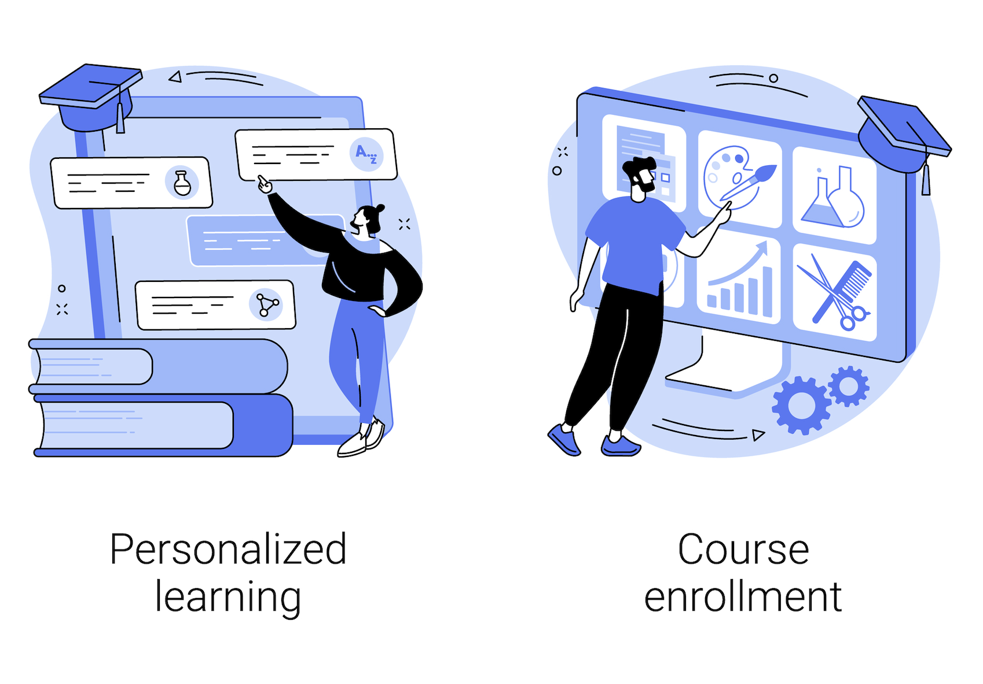
Scenario
A prestigious high school announces a pilot program integrating polygenic scores into educational planning. The school claims it will help predict student success and optimize academic support services. The scores will not be used for admission.
Notes:
So let’s return to the opening scenario. What if we used EA to assess the likelihood of low or high educational attainment of students and developed interventions with the goal of helping all students in a program achieve high EA?

Slide 12
Educational Attainment: Example Legal Gaps and Uncertainties
Family Education Rights and Privacy Act (FERPA) (Student records)
4th Amendent Privacy Rights (Federally funded schools/programs)
CalGINA (Genetic information nondiscrimination in education)
HIPAA (Student medical testing/school clinics)
Notes:
Health agencies like the FDA and CMS, along with state and federal laws, regulate medical practice, lab testing, the sale of medical or drug products, but these regulations do not cover social polygenic scores so I didn't include them here. Ancestry testing in direct-to-consumer (DTC) settings does not prompt FDA oversight, for instance, due to the low potential for medical harm. Legal Scholars might debate whether FDA and CMS should have the authority to regulate nonmedical tests. But I hope to show that like DTC tests there could be some relevant medical underpinnings or nonmedical laws that apply to or exclude health data that could be relevant. For example, FERPA defines Defines “education records” as those directly related to the student and ....“Maintained by an educational agency or institution or by a party acting for the agency or institution.” ...The term does not include records from a school nurse or psychologist. If PGSs are shared in an educational record only they are covered by FERPA but if they are included in a medical record only, we can better protect them under HIPAA. For example, School officials with what the law calls "legitimate educational interests" can access information, including medical information that is placed in an education record.
FERPA applies to public and some private schools receiving federal funding, so it may not apply in school settings most likely to use PGSs such as elite private schools. Institutional frameworks would govern.
In public school settings 4th A privacy rights would require consent and in California, state law prevents the genetic discrimination of students. Important legal questions would therefore be, WHO is doing the testing and WHERE & WHY

Slide 13
Student 1
High score
High performance
No medical intervention
Educational intervention
Notes:
Here are some student scenarios that might trigger different laws.
What if students with high EA estimates are placed in advanced courses or specialized programs? What if their curricula are customized to be more challenging? PGSs would likely follow these students throughout their lives and be a basis for attracting advantage and preferred treatment. And students who do not achieve high EA and their parents could be stigmatized as failing to maximize genetic potential.
We could likely imagine a scenario where students want their PGSs TO BE FORWARDED with their transcripts in their educational records or in a worst case scenarios: all those who don’t share PGS estimates would be automatically ranked lower than those who do by admissions committees.

Slide 14
Student 2
High score
Struggling to perform in classes
School intervention
Parental/Physician intervention
Consultation with a neurodevelopmental pediatrician
Discovery of genetic variant associated with dyslexia
Notes:
Second, imagine a student receives a high EA estimate but is struggling to perform.
There is a likelihood of medical intervention; for example, parents may consult a physician and identify genes associated with dyslexia. Early school interventions may also take place, considering both EA estimates and dyslexia. Ideally, the student's natural abilities and interests would be emphasized and nurtured, while also providing support for her dyslexia.
This scenario would trigger autonomy considerations like the first one, state genetic anti discrimination laws, the ADA, and in some jurisdictions, the implementation of Individualized Education Programs (IEPs) under federal laws such as the Individuals with Disabilities Education Act (IDEA)

Slide 15
Student 3
Low score
School intervention
No medical intervention
Notes:
In this last scenario, low PGS for social traits might not rise to the level of being considered a disability. There may not be required protective learning plans. Ultimately this student would be the least protected and the parents may need to consider ensuring FERPA prevents the sharing of records without their consent and request that PGSs not be placed in education records. Parents might have more control over what goes into the education record if PGSs occur through a separate institution such as a research institution, commercial company, or medical provider. School policies might consider bolstering parent and student autonomy as best they can in these cases.

Slide 16
Comparison of Scenarios
Similarities
Can we trust the PGSs?
Who is ordering the PGSs and who is responsible if there is harm?
What are the risks and benefits of educational attainment PGSs?
Differences
High score, high performance, no medical intervention + school Low potential for harm to student. Harm to other students.
High score, low performance, medical intervention + school intervention. Legal protections for individuals.
Low score, school intervention + no medical intervention. Students who might struggle are treated differently. Limited legal protections.
See for medical malpractice discuss re medical PGS: Roberts, J.L. and Suter, S.M., 2024. Damned If You Do or Damned If You Don’t: The Medical Malpractice Implications of Consumer-Generated Polygenic Risk Scores. Harvard Journal of Law & Technology, 38(2).
Notes:
Through these scenarios I aimed to show that if schools use PGSs, they may blur the lines between education and healthcare. Schools and parents may use genetic data without adequate medical consultation. There would not be physician involvement or oversight that would ideally prompt a physician to explore both medical and environmental contributions to educational attainment, such as exposure to toxins, diet, or lifestyle. Further the strongest protections that typically apply to health data would not apply here unless school policies and parents sought out medical providers such as psychologists to provide the testing and genetic counseling.
In all of these cases, it is unclear how trusted these scores can be. Second, a school and not a physician is acting on the information, with a physician only involved if the parents make the request. It is arguably justified to treat the three students differently because one has a medical disability but Medical underpinnings or social determinants of health may not be clear or transparent in scenario 1 or 3.

Slide 17
Cognitive potential
Medical/
Neurocognitive function
Social and learning environment
Educational attainment
Notes:
Ultimately Students would face different treatment based on their PGSs but also based on the application of different laws.
All the scenarios raise ethical concerns similar to those in a "brave new world" GATTACA or "Minority Report," where people's lives are shaped by predictions about their futures. Using predictive technologies like polygenic risk scores can lead to deterministic biases and undermine the nurture aspect of these other contributors to educational attainment.

Slide 18
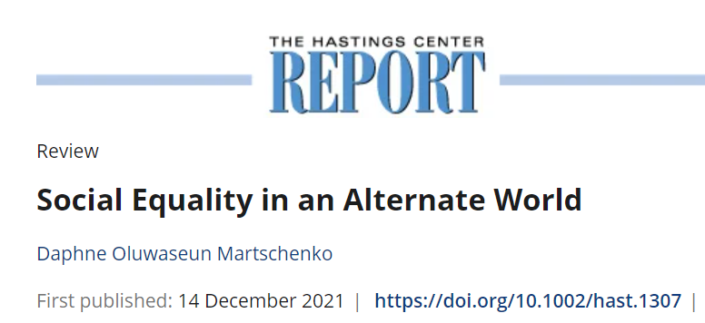
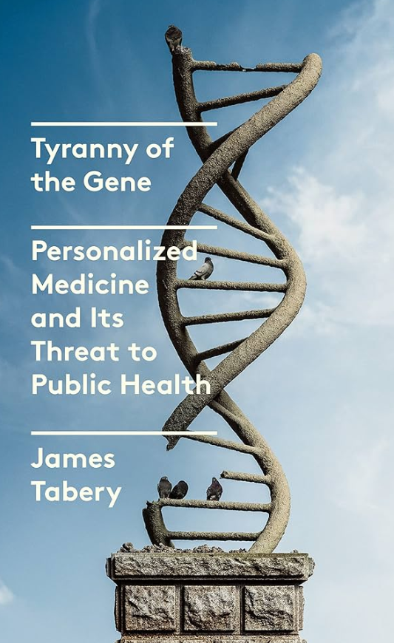
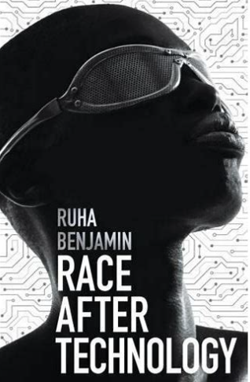
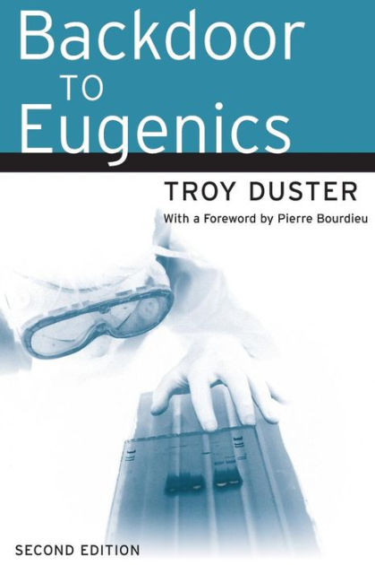
Beyond Health Law
The impact of finite resources
Disparate access to PGS technology
Institutionalized social inequities
Availability of teacher/faculty training programs
“…who gets to define, distribute, hoard, and obtain ‘fortune’ in our society?”
Who gets to make policy decisions using PGS?
The use of genomics to address inequalities rather than other less expensive interventions
Notes:
While the intention may be to provide tailored resources, [CLICK ]. in reality, history suggets that opportunities would be skewed in favor of more gifted students and [ CLICK ] other scholars have expressed concern that. [CLICK ] genomics will be used to address versus less expensive and personally invasive interventions.

Slide 19
Future Considerations/Case Study Questions?
Should policymakers expand existing health law to address genetic protections, or is a new framework necessary?
How does the absence of law itself function as a policy decision and what are the potential impacts?
What strategies can ensure that law and policy maximize potential benefits while minimizing inequitable implementation, discrimination, and other harmful effects?
Notes:
If there are benefits, we may ask: Should new regulations or legislation be considered in response to scholarly warnings, and how can policymakers optimize the benefits of polygenic scores?

Slide 20
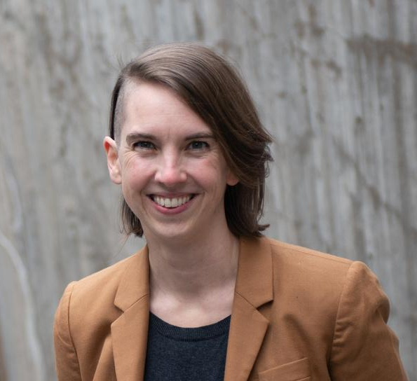
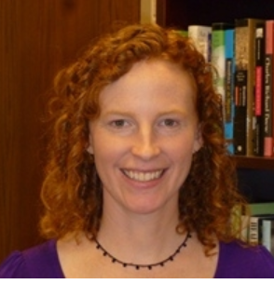
Beyond the Medical: The ELSI of Polygenic Scores for Social Traits
Jean Cadigan, PhD, M-PI | Anya Prince, MPP, JD, M-PI
University of North Carolina, School of Medicine | University of Iowa, College of Law
Karen Meagher, PhD, Co-investigator | Shawneequa Callier, JD, Co-investigator
Mayo Clinic, Department of Biomedical Ethics | George Washington University, School of Medicine and Health Sciences
Margaret Waltz, PhD, Research Associate | Courtney Canter, MA, Graduate Research Assistant
University of North Carolina, School of Medicine | University of North Carolina, School of Medicine
Kriste Kuczynski, BA, Project Manager | Sara Watson, MA, Bioethics Research Coordinator
University of North Carolina, School of Medicine | Mayo Clinic, Department of Biomedical Ethics
Lia Kaz, MSW, Project Assistant | Matthew Kucmanic, MA, MPH, Graduate Research Assistant
University of North Carolina, School of Medicine | University of Iowa, Department of Geographical and Sustainability Sciences
Preya Agam, MPH, Bioethics Research Coordinator | Annaliese Long, MA, Graduate Research Assistant
Mayo Clinic, Department of Biomedical Ethics | University of North Carolina, School of Medicine
National Human Genome Research Institute R01HG012402
Horizon Scanning Data Team
Graduate Research Assistants
Seung Woo Ban
Amy Feng
Kathleen Foley
Maria Hromcenco
Amy Koopmann
Jeremy Lamb
Thanh Tran
Cari Wadman
Notes:
Before I conclude, I'd like to recognize the amazing Beyond the Medical Team that is working together to expore these many ELSI issues.

Slide 21
THANK YOU
scallier@gwu.edu

Slide 23
§ 99.31 Under what conditions is prior consent not required to disclose information?
(a) An educational agency or institution may disclose personally identifiable information from an education record of a student without the consent required by § 99.30 if the disclosure meets one or more of the following conditions:
(1)(i)(A) The disclosure is to other school officials, including teachers, within the agency or institution whom the agency or institution has determined to have legitimate educational interests.
(B) A contractor, consultant, volunteer, or other party to whom an agency or institution has outsourced institutional services or functions may be considered a school official under this paragraph provided that the outside party—
(1) Performs an institutional service or function for which the agency or institution would otherwise use employees;
(2) Is under the direct control of the agency or institution with respect to the use and maintenance of education records; and
(3) Is subject to the requirements of § 99.33(a) governing the use and redisclosure of personally identifiable information from education records.

Slide 24
42 U.S. Code § 263a - Certification of laboratories

Slide 25
20 U.S. Code § 1232g - Family educational and privacy rights

