Slide 1
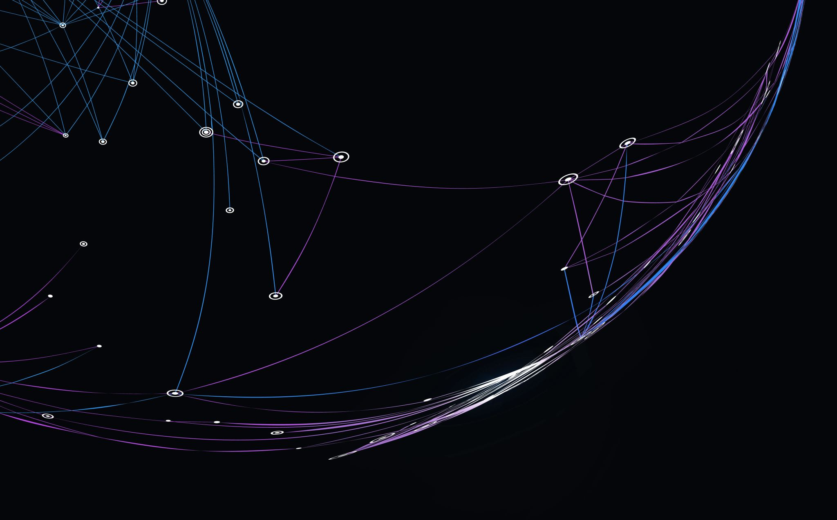
Future Steps in International Health Law: Embracing Novelties, Preserving Coherence
Magdalena Greco
3° (and last) year PhD student in Legal Studies – Curriculum International and European Law (Bocconi University)
Fellow with the Global Access in Action of the Berkman Klein Center at Harvard University
Health Law Professors Conference
Boston University
June 5th, 2025

Slide 2
Structure of the presentation:
Introductory remarks (research question-s);
Preliminary remarks:
Fragmentation of International Law;
Fragmentation of Global Health Law;
The Uniformity-Making Function of the World Health Organization (WHO);
Transitionary remarks;
The state of the art after WHA78;
Article 24 of the Pandemic Agreement;
The way forward.

Slide 3
Introductory Remarks (Research Questions)
How will the Pandemic Agreement impact on the already widely fragmented framework of international law in general, and global health law in particular?
How is fragmentation dealt with in the Pandemic Agreement?
What will the relations be between the Pandemic Agreement and other international instruments both in global health law and beyond?
How are those relations regulated within the Agreement?

Slide 4
A curiosity
This issue has often been left on the margins of the INB debate.
Why?
Other topics (e.g. equity, PABS) were more urgent and politically sensitive?
Unknown reason.

Slide 5
Preliminary remarks (1) The Fragmentation of International Law
2006 Seminal report of the International Law Commission(ILC):
Increase in scope of international law;
Language of diplomats → trade, human rights, scientific and technological cooperation

Slide 6
Preliminary Remarks (2): Fragmentation of Global Health Law
Trade, human rights, scientific and technological cooperation
Fragmented patchwork of binding and non-binding legal instruments that impacted on the regulation of global health
Global health law =
«A set of legal frameworks that structure global health»

Slide 7
Preliminary Remarks (3): The Uniformity-Making Function of the WHO
However, global health law, if analyzed under the mere perspective of the quantitavely poor normative production of the WHO
=
partially a step towards the de-fragmentation (= unification) of the first health-centered negotiating efforts made by the international community.

Slide 8
Preliminary Remarks (3): The Uniformity-Making Function of the WHO
WHO constitutional mandate to negotiate treaties, regulations or recommendations with respect to any matter within the competence of the Organization (articles 19, 21 and 23 of the WHO Constitution)
WHO = coherency/uniformity-making institution aimed at bringing together ratione materiae any negotiating effort aimed at driving the global population towards the highest possible level of health.

Slide 9
Transitionary Remarks:
Idea of a Framework Convention on Global Health (FCGH) capable of bringing «clarity and precision to norms and standards surrounding the right to health» (Gostin et al.);
UN Secretary General Ban Ki-moon supported the creation of such an instrument, and he called to set the stage for a «future United Nations framework convention on global health».

Slide 10
INB under its PPPR-centered mandate tried to find the perfect formula to unify the fragmented elements of global health law within a fragmented international law scenario, while upholding the WHO core vision of cohesion in global health governance.
Combining, and not dividing.

Slide 11
Does the Pandemic Agreement under the “unifying mandate” of WHO law materialize the ambitions of a clarity-and-precision-led FCGH?
How will it be positioned and what consequences will its adoption have on the fragmented international and global health law scenario?

Slide 12
The state of the art after WHA78
Many provisions of the last draft of the Pandemic Agreement (at least in articles 4, 11, 12) directly interact with at least five internationally binding and non-binding agreements:
The United Nations Convention on Biological Diversity (CBD);
The Nagoya Protocol on Access to Genetic Resources;
The IHR (2005);
The Pandemic Influenza Preparedness (PIP) Framework;
The World Trade Organization (WTO) Agreement on Trade-Related Aspects of Intellectual Property Rights (TRIPS).

Slide 13
First draft of the Pandemic Agreement (February 2023) did not contain any conflict clause devoted to regulating the interaction between the Pandemic Agreement and other international instruments;
Only later on the issue appeared (March, April, May 2023 drafts).

Slide 14
Article 24 after WHA78
(1) The interpretation and application of the WHO Pandemic Agreement shall be guided by the Charter of the United Nations and the Constitution of the World Health Organization;

Slide 15
(2) The Parties recognize that the WHO Pandemic Agreement and the International Health Regulations (2005) and other relevant international agreements should be interpreted so as to be compatible;

Slide 16
(3) The provisions of the WHO Pandemic Agreement shall not affect the rights and obligations of any Party deriving from other international agreements and legal instruments.

Slide 17
The new text (greened after INB/13 (art. 26) and WHA78) reflects what it seems to be a slight shift from the November version;
The latter specified that «[t]he provisions of the WHO Pandemic Agreement shall not affect the rights and obligations of any Party under other existing legally binding international instruments to which it is a Party, provided that the exercise of those rights and obligations is compatible with the objective of this instrument»;
In the latest version of the article, the reference to compatibility with the objective of the Pandemic Agreement has been replaced with a more general compatibility and non-affection clause between the Agreement and other international agreements and legal instruments.

Slide 18
The “multidisciplinary nature” of the Pandemic Agreement has the potential of being a clear example of simultaneous validity of two (or more) norms where «each covers the facts of which the situation consists», to quote the ILC report.

Slide 19
The INB seems to have moved from an approach centered on the relationship of conflict, according to which when «two norms that are both valid and applicable point to incompatible decisions, […] a choice must be made between them», to a different perspective

Slide 20
Presumption of compatibility

Slide 21
This presumption arguably hints to the relationship of interpretation, where «one norm assists in the interpretation of another […]» in such a way that «both norms are applied in conjunction».
On the other, the same presumption appears to point at the principle of harmonization, according to which «when several norms bear on a single issue, they should, to the extent possible, be interpreted so as to give rise to a single set of compatible obligations».

Slide 22
The way forward
The WHO has given attention to the relationship between the Pandemic Agreement and the IHR, the Pandemic Agreement and its Annexes and Protocols, and to inter alia the CBD during the so-called “interactive dialogues”.
However
it is now necessary to have a consistent debate on the impact of the new agreement on other confining “international agreements and legal instruments”.

Slide 23
The sand in the hourglass of the INB process has elapsed, and negotiators tried to come up with a forward-looking conflict clause, that ought to be as clear and specific as possible.
The aim is to have a clause capable of building a sustainable and coherent PPPR framework that, guided by the uniformity-lead normative powers of the WHO, will contribute to ease the international (global health) legal framework, and not to further complicate it.

Slide 24
Is the final conflict clause satisfactory?
Are:
The relationship of interpretation;
The principle of harmonization;
The presumption of compatibility
The way forward?

Slide 25
Eg. Art. 17.3: «The Parties shall collaborate and cooperate for PPPR through strenghtening and enhancing cooperation among relevant legal instruments and frameworks […] in the achievement of the objective of the WHO Pandemic Agreement, while closely coordinating supporting with that provided under the IHR (2005)»;
Eg. Art. 12 (d) (i): «Complementarity to and not duplicative of access and benefit sharing measures and obligations contained in PIP and other relevant international access and benefit sharing instruments where applicable»;
Art. 12(d)(ii): «To ensure that each Party reviews and, as it deems appropriate, aligns its national and/or regional ABS measures applicable to PABS materials and Sequence Information within the scope of the PABS Instrument, so that measures that are contrary to, or inconsistent with, or duplicative of, the PABS instrument will not be applied upon entry into operation of all the elements of PABS»;
Art. 12(e): «Implementation consistent with applicable international law and with applicable national/Domestic law, regulations and standards related to risk assessment, biosafety, biosecurity and expotr control of pathogens and data protection».

Slide 26
«The very effort to canvass a coherent legal-professional technique on a fragmented world expresses the conviction that conflicts between specialized regimes may be overcome by law, even as the law may not go much further than require a willingness to listen to others, take their point of view into account and to find a reasoned resolution at the end. Yet this may simply express the very point for which international law has always existed» [ILC 2006 Report, cit.]

Slide 27
Thank you for your attention!
magdalena.greco@phd.unibocconi.it
References:
Magdalena Greco, On the Fragmentation of International Law and Global Health Law: A Comment before the INB/13 Negotiating Round of the WHO Pandemic Agreement, Völkerrechtsblog, 09.04.2025, doi: 10.17176/20250410-011803-0.

