Slide 1
The Global Health Security Agenda after US Withdrawal from WHO
Prof. Sam Halabi, JD, MPhil
5 June 2025

Slide 2
Election and Inauguration (2025)
Trump Administration announces withdrawal from WHO on January 20, 2025
“pause(s) the future transfer of any United States Government funds, support, or resources to the WHO”…
“the Secretary of State will cease negotiations on the WHO Pandemic Agreement and the amendments to the International Health Regulations, and actions taken to effectuate such agreement and amendments will have no binding force on the United States.”
(iii) identify credible and transparent United States and international partners to assume necessary activities previously undertaken by the WHO

Slide 3
WHO Constitution Article 1
The objective of the World Health Organization . . . shall be the attainment by all peoples of the highest possible level of health.

Slide 4
WHO Constitution Article 21
The Health Assembly shall have authority to adopt regulations concerning:
(a) sanitary and quarantine requirements and other procedures designed to prevent the international spread of disease;
(b) nomenclatures with respect to diseases, causes of death and public health practices;
(c) standards with respect to diagnostic procedures for international use;
(d) standards with respect to the safety, purity and potency of biological, pharmaceutical and similar products moving in international commerce;
(e) advertising and labelling of biological, pharmaceutical and similar products moving in international commerce.

Slide 5
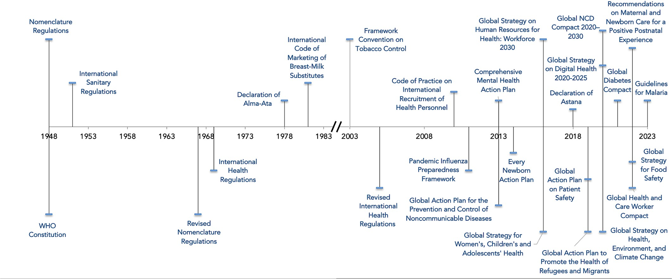
Timeline of WHO Exercise of Legal Authorities

Slide 6
Action Packages
Antimicrobial Resistance (AMR) - USA, Ghana & Pakistan
Biosafety & Biosecurity (APP3) - GHSAC
Immunization – Republic of Korea
Laboratory - Thailand
Legal Preparedness (LP AP) - O'Neill, Argentina, USA
Surveillance - Ethiopia
Sustainable Financing for Preparedness (SFP AP) - USA & Uganda
Workforce – No lead
Zoonotic Diseases (ZDAP) - USA

Slide 8
GHSA 2028 Target
A global target to accelerate achievement of core public health capacities
By 2028, more than 100 countries will have:
Completed an evaluation of health security capacities and preparedness
123
Completed a Joint External Evaluation (JEE) to assess their health security capacities
1
countries
Undergone planning and resource mobilization
90
Developed National Action Plans for Health Security to address identified gaps
2
countries
Strengthened at least 5 technical areas to a level of 'Demonstrated Capacity'
58
Meeting the Target
3
countries
18
Close to Meeting Target
countries

Slide 9
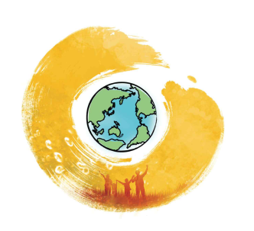
Global Health Security Agenda Action Packages and Task Forces
GHSA
Legal Preparedness (NEW)
Immunization
Laboratory
Surveillance
AMR
APP3 Biosafety & Biosecurity
Workforce Development
Zoonotic Diseases
Sustainable Finance
Task Forces
Action Package Coordination
Communications & Advocacy
Accountability & Results
R&D

Slide 10
GHSA Legal Preparedness Action Package
Mission
To promote legal preparedness as a critical capacity for an effective public health emergency response and for strengthening global health security.
How?
By bringing countries and key experts together to build a solid foundation and common understanding of the competencies necessary for strengthening public health legal preparedness by developing technical tools to guide and support countries in strengthening their legal preparedness capacity and advocating for greater awareness globally about the role that legal preparedness plays in preparing for health emergencies.

Slide 11
Current Membership / Our Network
Civil Society (incl. Academia)
Brown University
Columbia University
Gaspar Casal Foundation
Georgetown University Law Center, O'Neill Institute for National Global Health Law (Co-Lead)
Global Health Law Consortium (GHLC)
Graduate Institute of International and Development Studies, Global Health Centre
International Federation of Red Cross and Red Crescent Societies (IFRC)
International Senior Lawyers Project (ISLP)
National Singapore University
Université de Montréal
Resolve to Save Lives
Safe Mother and Childhood Research Initiative (SAMOCRI)
University of Ottawa
Universita di Bologna
Universita degli Studi di Salerno
Yonsei University
GHSA Countries
Argentina (Co-Lead)
Australia
Colombia
Ethiopia
The Gambia
Italy
Kingdom of Saudi Arabia
Republic of Korea
Nigeria
Norway
Pakistan
Portugal
Thailand
United Kingdom
United States (Co-Lead)
Multilateral Organizations
Africa CDC
Coalition for Epidemic Preparedness Innovations (CEPI)
Food and Agriculture Organization (FAO)
Gavi, the Vaccine Alliance
Inter-American Development Bank (IDB)
International Development Law Organization (IDLO)
West African Health Organization (WAHO)
World Bank
World Health Organization (WHO)
World Organisation for Animal Health (WOAH, formerly OIE)
40 members (14 countries, 10 multilateral organizations, 16 civil society, including academia)

Slide 12
GHSA
Chair & Secretariat
Advocacy and Communications Committee, Action Package Coordination Committee, Accountability and Results Committee
LP AP LEADERSHIP TEAM /
CO-CHAIRS
(Argentina, O’Neill Institute, USA)
EXECUTIVE SECRETARIAT
(O’Neill Institute)
Workstream 1 Outreach and Advocacy
LEGAL PREPAREDNESS
WORKING GROUP
(LPWG)
Workstream 2
Guidance Tools
Sub-Working Group: Outreach and Advocacy
Sub-Working Group:
Legal Mapping
Sub-Working Group:
Regulatory
Sub-Working Group:
Liability Risk Management
Workstream 3
Capacity Development
Sub-Working Group:
Capacity Building

