Slide 1
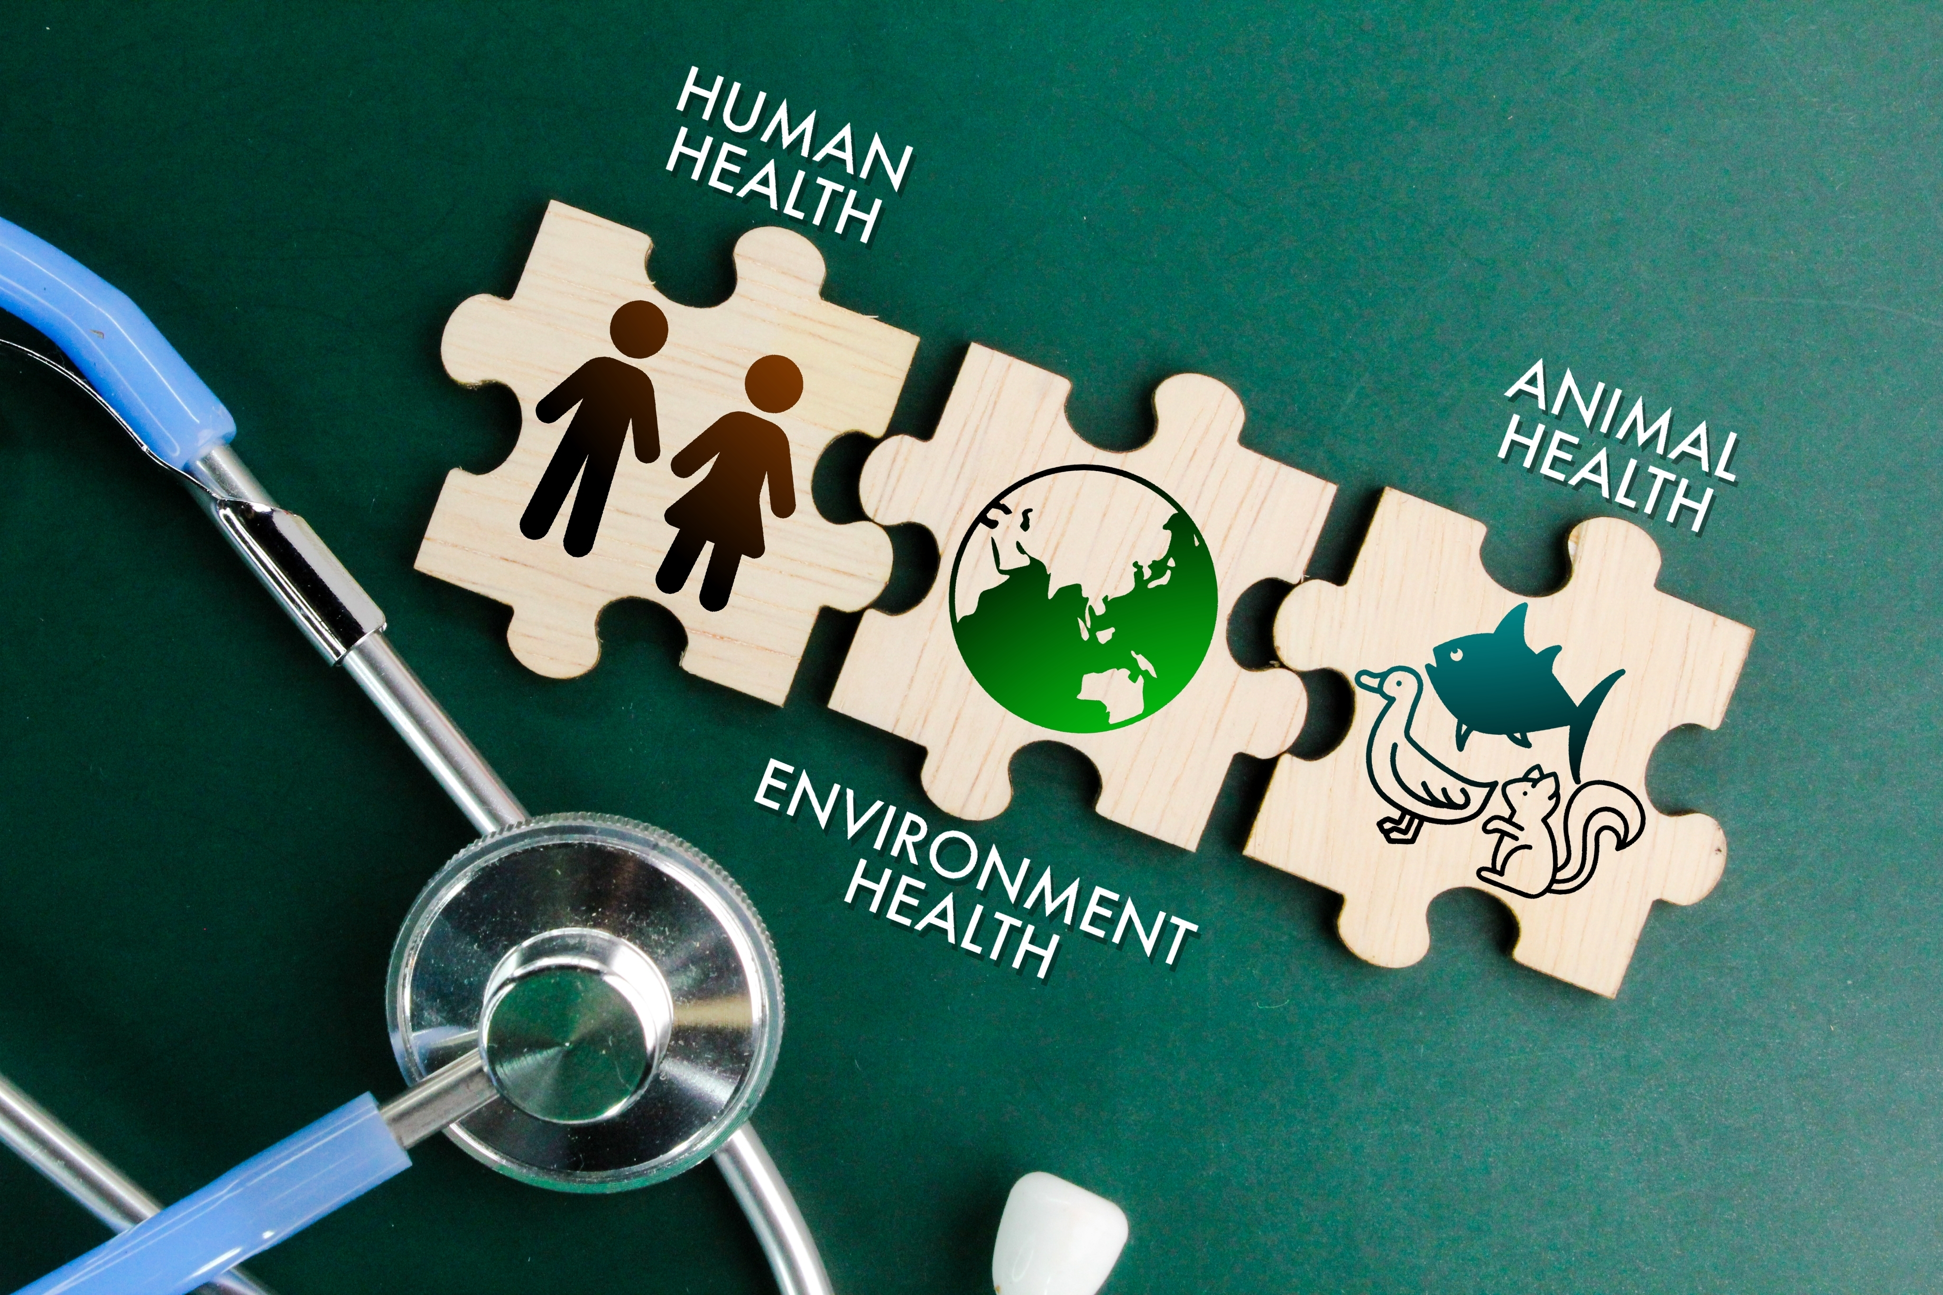
One Health & the Pandemic Agreement: Legal Implications for States Parties
A/Prof Adam Kamradt-Scott
BN, MAIS, LLM, PhD
Cummings Foundation Professor of One Health Diplomacy

Slide 2
The ‘normal’ process of treaty development
Problem identification
How to resolve
Treaty proposal
(Form follows function)
Textual negotiation
Adoption
Ratification

Slide 3
The Pandemic Agreement process…
Treaty proposal
Lobbying
Problem identification
(Function follows form)
‘What’s the process?’
‘Framework Convention’ but not in name…

Slide 4
The Pandemic Agreement Legal Landscape
CBD + Nagoya
IHR (2005)
‘Pandemic Agreement’
TRIPS
PIP Framework
BWC
SPS Agreement

Slide 5
The OHHLEP Definition of One Health
…an integrated, unifying approach that aims to sustainably balance and optimize the health of people, animals and ecosystems. It recognizes the health of humans, domestic and wild animals, plants, and the wider environment (including ecosystems) are closely linked and inter-dependent. The approach mobilizes multiple sectors, disciplines and communities at varying levels of society to work together to foster well-being and tackle threats to health and ecosystems, while addressing the collective need for clean water, energy and air, safe and nutritious food, taking action on climate change, and contributing to sustainable development.
One Health High Level Expert Panel, December 2021

Slide 6
The Pandemic Agreement definition
“One Health approach” for pandemic prevention, preparedness and response recognizes that the health of humans is closely linked and interdependent with the health of domestic and wild animals, as well as plants and the wider environment (including ecosystems), aiming for a sustainable balance, and uses an integrated multisectoral and transdisciplinary approach to pandemic prevention preparedness and response, which contributes to sustainable development in an equitable manner.
Art 1(c)

Slide 7
The Pandemic Agreement definition
“One Health approach” for pandemic prevention, preparedness and response recognizes that the health of humans is closely linked and interdependent with the health of domestic and wild animals, as well as plants and the wider environment (including ecosystems), aiming for a sustainable balance, and uses an integrated multisectoral and transdisciplinary approach to pandemic prevention preparedness and response, which contributes to sustainable development in an equitable manner.
Art 1(c)

Slide 8
The Pandemic Agreement definition
“One Health approach” for pandemic prevention, preparedness and response recognizes that the health of humans is closely linked and interdependent with the health of domestic and wild animals, as well as plants and the wider environment (including ecosystems), aiming for a sustainable balance, and uses an integrated multisectoral and transdisciplinary approach to pandemic prevention preparedness and response, which contributes to sustainable development in an equitable manner.
Art 1(c)

Slide 9
The Pandemic Agreement definition
“One Health approach” for pandemic prevention, preparedness and response recognizes that the health of humans is closely linked and interdependent with the health of domestic and wild animals, as well as plants and the wider environment (including ecosystems), aiming for a sustainable balance, and uses an integrated multisectoral and transdisciplinary approach to pandemic prevention preparedness and response, which contributes to sustainable development in an equitable manner.
Art 1(c)

Slide 10
The Pandemic Agreement definition
“One Health approach” for pandemic prevention, preparedness and response recognizes that the health of humans is closely linked and interdependent with the health of domestic and wild animals, as well as plants and the wider environment (including ecosystems), aiming for a sustainable balance, and uses an integrated multisectoral and transdisciplinary approach to pandemic prevention preparedness and response, which contributes to sustainable development in an equitable manner.
Art 1(c)

Slide 11
The Pandemic Agreement definition
“One Health approach” for pandemic prevention, preparedness and response recognizes that the health of humans is closely linked and interdependent with the health of domestic and wild animals, as well as plants and the wider environment (including ecosystems), aiming for a sustainable balance, and uses an integrated multisectoral and transdisciplinary approach to pandemic prevention preparedness and response, which contributes to sustainable development in an equitable manner.
Art 1(c)

Slide 12
The Pandemic Agreement definition
“One Health approach” for pandemic prevention, preparedness and response recognizes that the health of humans is closely linked and interdependent with the health of domestic and wild animals, as well as plants and the wider environment (including ecosystems), aiming for a sustainable balance, and uses an integrated multisectoral and transdisciplinary approach to pandemic prevention preparedness and response, which contributes to sustainable development in an equitable manner.
Art 1(c)

Slide 13
The Pandemic Agreement definition
“One Health approach” for pandemic prevention, preparedness and response recognizes that the health of humans is closely linked and interdependent with the health of domestic and wild animals, as well as plants and the wider environment (including ecosystems), aiming for a sustainable balance, and uses an integrated multisectoral and transdisciplinary approach to pandemic prevention preparedness and response, which contributes to sustainable development in an equitable manner.
Art 1(c)

Slide 14
Art 4 Pandemic prevention and surveillance
Outlines new obligations to prevent ERIDs by:
promoting “collaboration across relevant sectors to identify and address drivers of infectious disease at the human-animal-environmental interface” (Art 4.2(a));
prevent “infectious disease transmission between animals and humans, including, inter alia, zoonotic disease spill-over” (Art 4.2(b)); and
“coordinated multisectoral surveillance to detect and conduct risk assessment of” ERIDs with pandemic potential (Art 4.2(c))
But there’s significant caveats….
“taking into account national capacities” (Art 4.1);
“taking into account its national circumstances” and “subject to the availability of resources” (Art 4.2); and
“with full consideration of the national circumstances and the different capacities and capabilities of Parties” (Art 4.4)

Slide 15
Art 5 One Health approach for PPPR
The central article affirming States Parties’ One Health obligations:
“…shall promote a One Health approach for pandemic prevention, preparedness and response…” (Art 5.1)
“…shall take measures, as appropriate aimed at identifying and addressing…the drivers of pandemics and the emergence and re-emergence of infectious disease at the human-animal-environment interface…” (Art 5.2)
Develop, implement and review “relevant national policies and strategies” (Art 3.3(a))
Promote or establish “joint training and continuing education” (Art 5.3(b))
But again, there’s significant caveats...
“…as appropriate, in accordance with national and/or domestic law…taking into account national circumstances” (Art 5.1)
“…subject to the availability of resources…” (Art 5.3)

Slide 16
Implications for States Parties
Not yet opened for signature (& won’t be for at least a year)
There are new, unambiguous obligations to “promote a One Health approach” and “address the drivers of pandemics”
Emphasis is on addressing zoonotic pathogens that pose a direct threat to human life (i.e. African Swine Fever’s nutritional impacts falls through the cracks) & thus not genuinely One Health
Considerable latitude to determine how this is accomplished “taking into account national circumstances” and “subject to the availability of resources”
=> Those countries that want to do more on One Health can; those who don’t probably won’t have to!

Slide 17
Q&A
e: adam.kamradtscott@tufts.edu

