Slide 1
Erica Patterson Psychiatric Violence In International Human rights Law
June 5, 2025
@HLPI_UHLC

Slide 2
The Outline
Define and Evaluate
Previous Definitions of Psychiatric Violence
New Definition for Psychiatric Violence
Defining Vulnerable Populations and Vulnerable Populations and Psychiatric Violence in International Law
Vulnerable Populations
Analysis of Lawsuits, Treaties/International Instruments, and Human Rights Initiatives
Lessons for Domestic and International Policy
Community Level
State Level
International Level
Manifestations of Psychiatric Violence and Application to International Human Rights Law

Slide 3
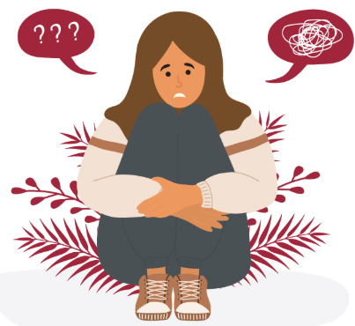
Define and Evaluate
Manifestations
Verbal Abuse
Psychological Abuse
Sexual Abuse
Forced Treatment
Forced Commitment
Lack of Rights, Respect of Religion, etc.

Slide 4
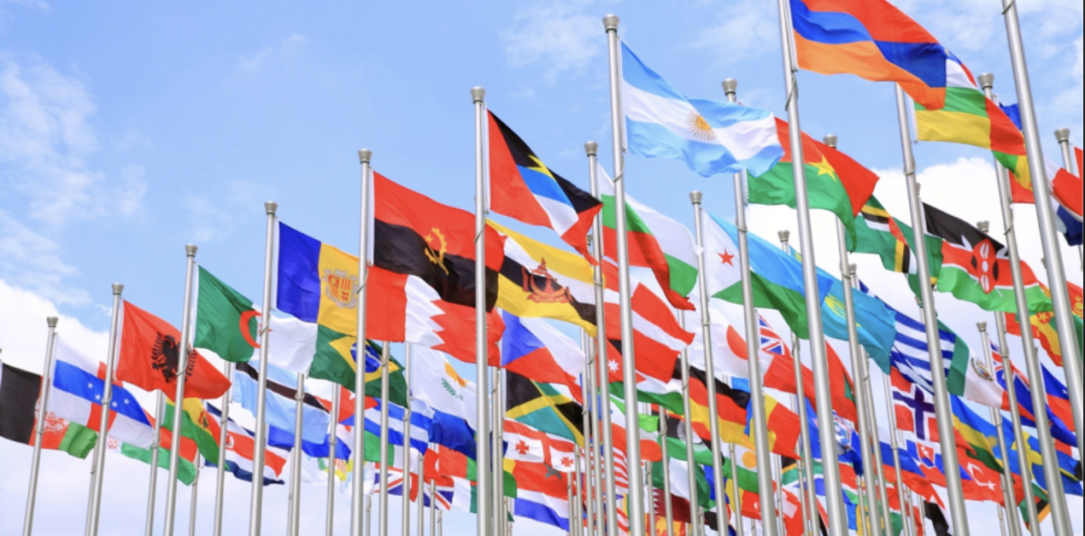
Define and Evaluate
Application to International Human Rights Law
No international legal standard currently.
The international treaties and instruments used to try and cover psychiatric violence:
Convention on the Rights of Persons with Disabilities (“CRPD”)
Universal Declaration of Human Rights
International Covenant on Civil and Political Rights
International Covenant on Economic, Social and Cultural Rights
American Convention on Human Rights
Inter-American Convention to Prevent and Punish Torture
Principles and Best Practices on the Protections of Persons Deprived of Liberty in the Americas

Slide 5
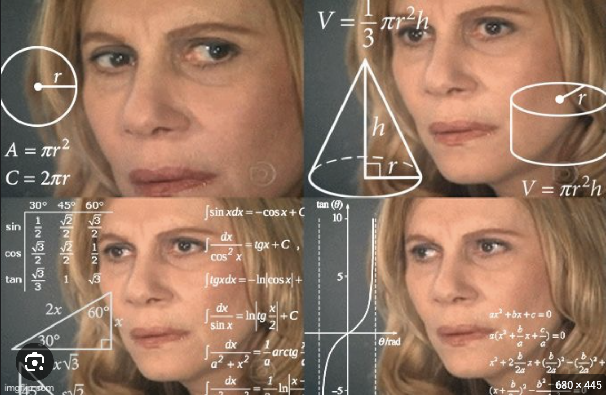
Define and Evaluate
Previous Definition of Psychiatric Violence
New Definition of Psychiatric Violence
Hard to Define
Multiple Definitions
Inconsistent Terminology
Synthesizing
General Definition
Legal Impact of the Definition
Notes:
Examples citation - https://eige.europa.eu/publications-resources/thesaurus/terms/1241?language_content_entity=en#:~:text=Description,psychological%20harm%20to%20an%20individual.
Ex. Any intentional conduct that seriously impairs another person's psychological integrity through coercion or threats.
Ex. Statistical definition: Any act which causes psychological harm to an individual.

Slide 6
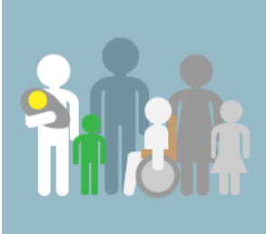
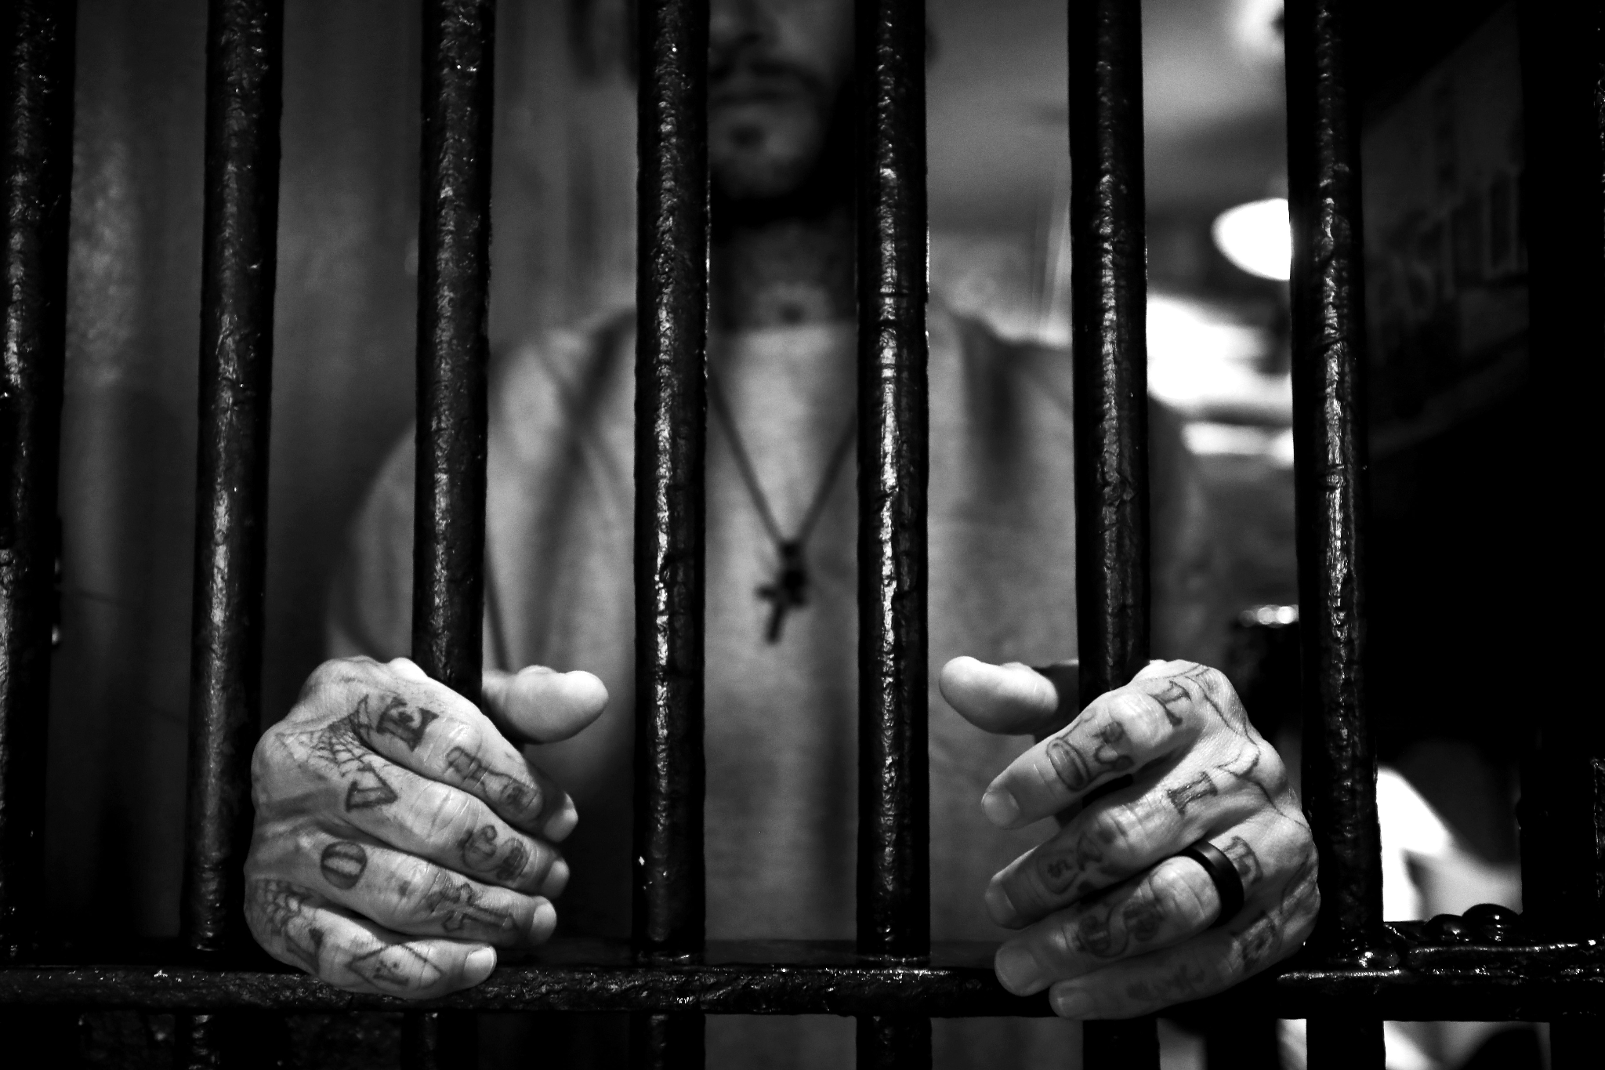
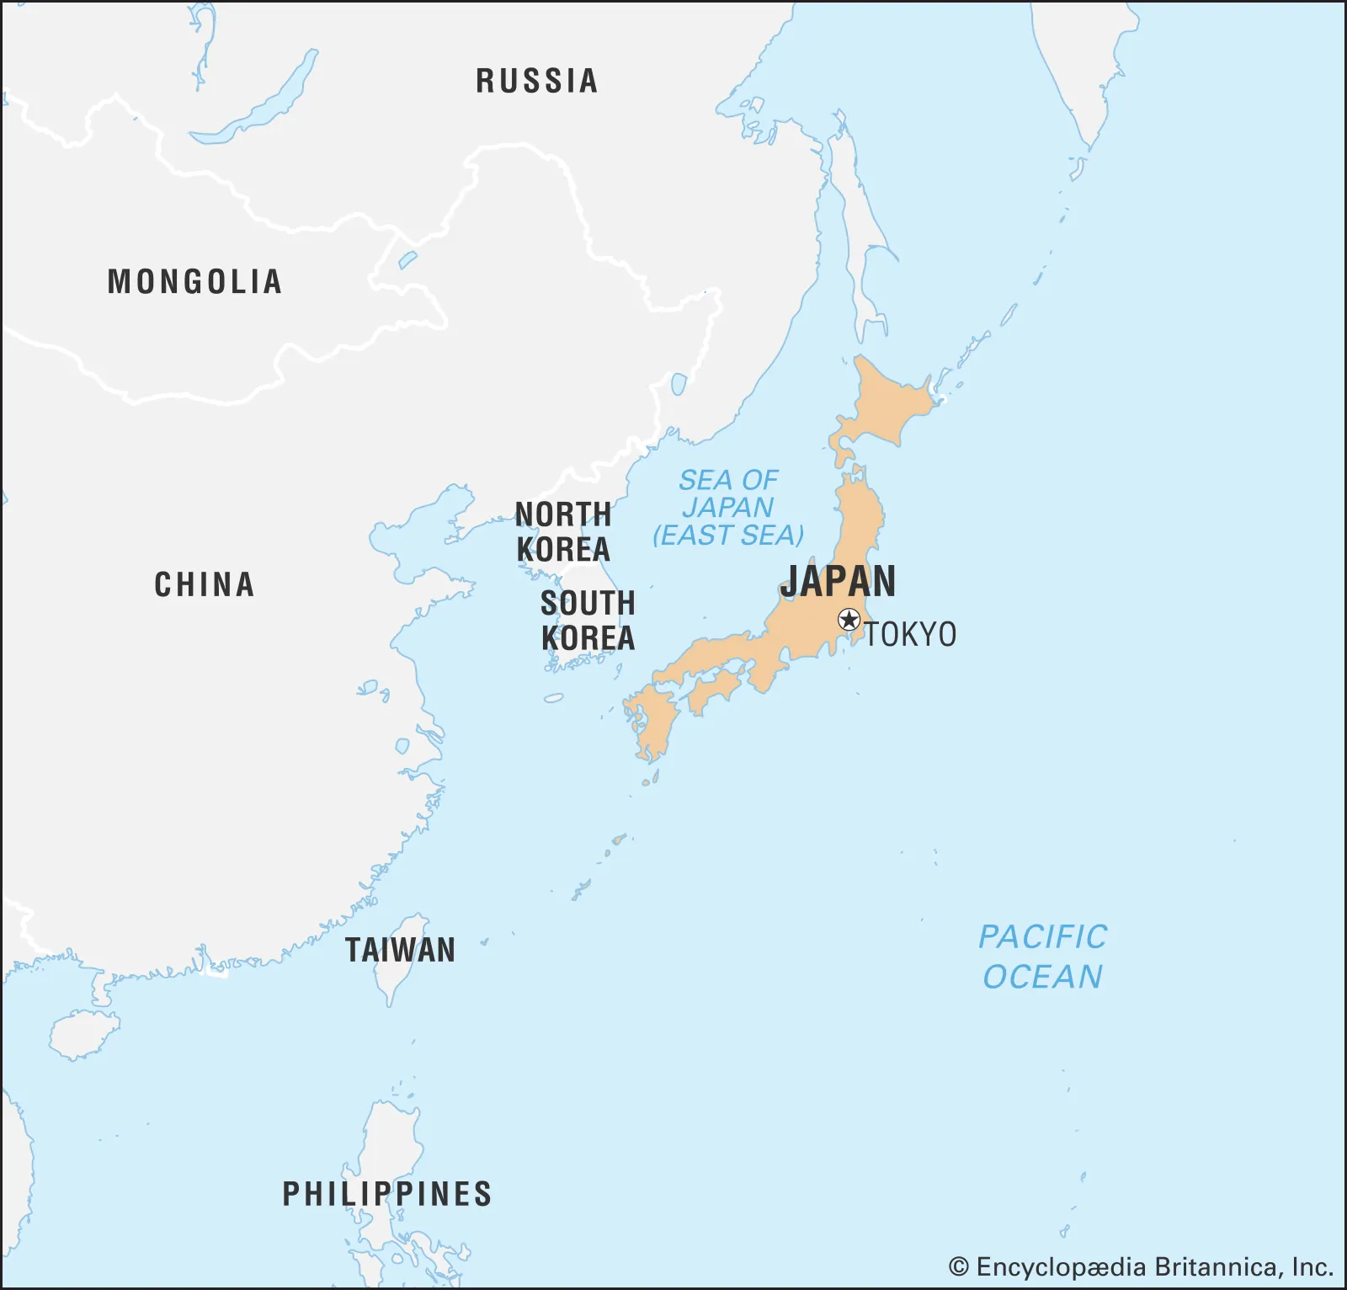
Defining Vulnerable Populations and Vulnerable Populations and Psychiatric Violence in International Law
Populations
Analysis
Can Impact Anyone Regardless of Race, Gender, Age, or Socioeconomic Status.
Individuals Who Belong to Vulnerable or Impuissant Populations are Particularly Susceptible to Experiencing Psychiatric Violence.
Indonesia Living Hell Report.
Japan Psychiatric Review Board.
Conversion Therapy.
Prisoner Mistreatment.

Slide 7
Lessons for Domestic and International Policy
State & Local Level
International Level
Community Level:
Legal Approach on Human Rights-Based Model Instead of Biomedical Model.
Community Organization.
State level:
Coercion Laws.
Legal Personality.
Protection Against Abuse and Undue Influence.
Best Interpretation of the Will.
No Isolated Legislation.
Informed Consent.
Creating a Treaty or Legal Instrument That Targets This Issue Specifically.
Establishing an Internationally Recognized Legal Definition of Psychiatric Violence.

Slide 8
Thank you!
epatters@central.uh.edu
law.uh.edu/healthlaw/

