Slide 1
Regulating Health Technologies in a Post-FDA World
Rachel Sachs, JD, MPH, Professor of Law,
Washington University in St. Louis

Slide 2
Overview
Current events
FDA’s primary purposes
The institutional ecosystem for regulating healthcare technologies
Presenting hypothetical scenarios
Reconstituting the functions of FDA

Slide 3
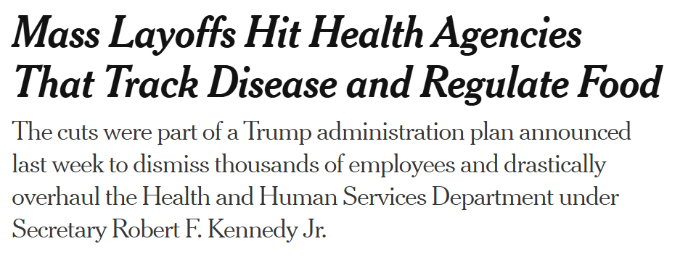
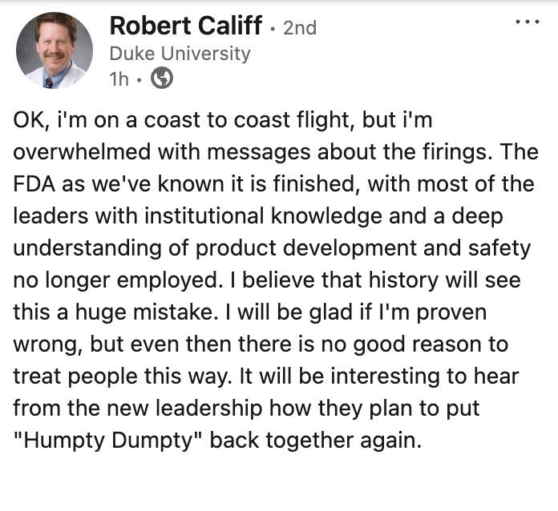

Slide 4
FDA’s Primary Purposes
Consumer protection
Efficient review of product applications
Information generation

Slide 5
FDA’s Institutional Context
Insurance companies and physicians
International regulators
Non-profit organizations

Slide 6
Getting to a “Post-FDA World”
Decimating state capacity
Moving to a “safety-only” approval standard
Pure political control

Slide 7
Where Do We Go From Here?
What’s the impact on insurers?
What’s the impact on evidence generation?
What are better – and worse – scenarios?

Slide 8
Additional Issues
A world without FDA – or without other institutions as well?
Approvals versus bans
Dynamic effects

Slide 9
Questions?

