Slide 1
Lab-to-Clinic Pathways Effective Governance for AI in Healthcare A “True Lifecycle Approach” towards Governing Healthcare-AI with the GCC as a Global Governance Model Forthcoming in npj Digital Medicine
Dr. Barry Solaiman
HBKU Law, WCM-Q
Qatar
Photo by Owen Beard on Unsplash
This Photo by Unknown Author is licensed under CC BY-SA-NC

Slide 2
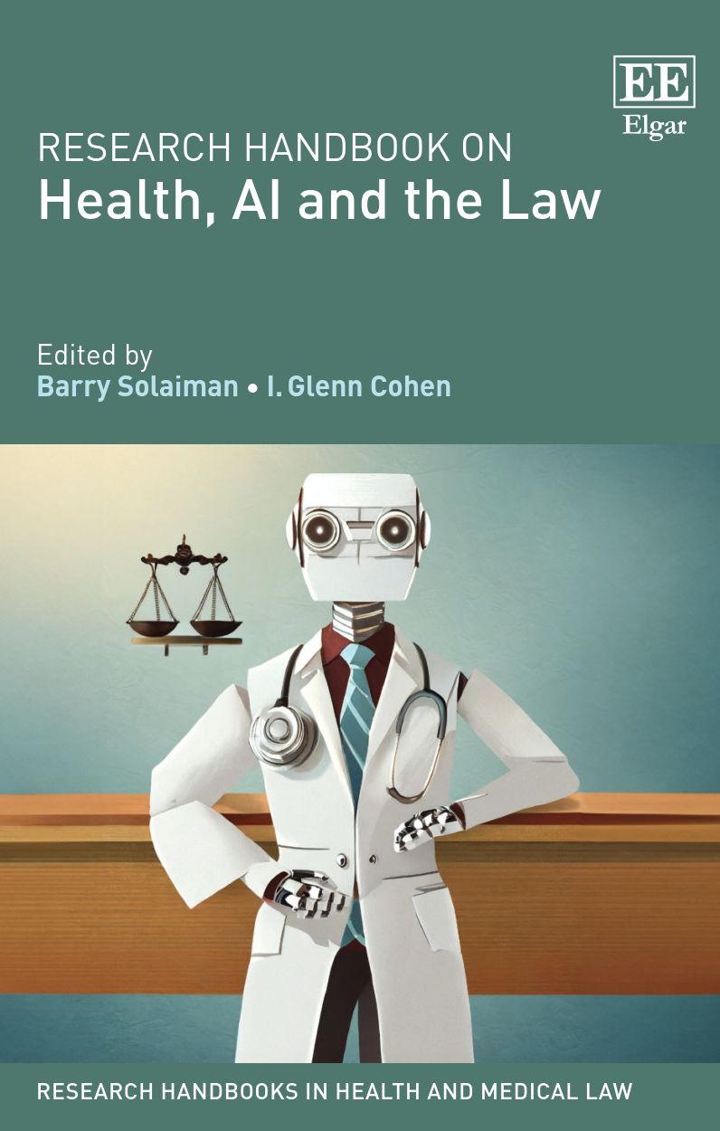
Insights from Research Handbook on Health, AI and the Law (Edward Elgar 2024)
Editors:
Barry Solaiman & I. Glenn Cohen

Slide 3
1. How the research landscape emerged
1. New technology
2. Current laws inadequate
3. Soft law stopgap
4. New law

Slide 4
What is the True Lifecycle Approach (TLA)?
Definition: a comprehensive framework for governing AI in healthcare, whether the device is used in diagnostics, monitoring, healthcare administration, or other healthcare-related applications.
The TLA encompasses three key phases of the AI lifecycle
R&D: Research and development of the AI system
Approvals: AI systems approvals to bring the device to market.
Post-Implementation: Post-implementation governance of AI once used in healthcare that accounts for core pillars of medical law and ethics
The GCC region’s centralized governance structures, very diverse demographics, focus on building interdisciplinary expertise, and strategic positioning in the global AI landscape create a useful foundation from which to explore the TLA

Slide 5
Why a TLA?
Existing frameworks fall short: Current laws like the FDA’s TPLC and EU’s AI Act focus narrowly on device safety and risk, neglecting patient rights, ethical design, and informed consent.
01
Patient protections are foundational: Medical law and bioethics already enshrine confidentiality, informed consent, and protection from discrimination—AI governance must build on these, not bypass them.
02
Regulatory gaps persist: Neither soft law guidelines nor updated medical device regulations fully address the dynamic, evolving nature of healthcare AI across its full lifecycle.
03
Technocratic bias: Current models prioritize regulatory compliance and market approval over patient-centric governance and redress for harm.
04
No existing system is holistic: There is no jurisdiction with a governance model that spans AI’s full lifecycle—from R&D to post-deployment—while centring patient safety and trust.
05

Slide 6
Why a TLA?
What TLA offers:
Integrates ethics, accountability, and real-world impact at every stage.
Applies medical law principles across R&D, deployment, and post-market phases.
Builds trust through transparency, equity, and respect for patient autonomy.
Treats patients as active stakeholders, not passive recipients of technology.
Global relevance: Centralized systems like Qatar, Saudi Arabia, and the UAE are well-positioned to lead, but the TLA is a normative model for all health systems—centralised or not.

Slide 7
Phases of Regulating AI
1. Research & Development (Qatar)
2. Medical Device Approval (Saudi Arabia)
3. Clinical Practice Oversight (UAE)

Slide 8
The Use of AI in the GCC
Qatar: used in hospitals & research
UAE: ‘actively deployed in the healthcare sector’
KSA: Seen as a necessity

Slide 9
The Problem for Local Startups
No Regulatory Processes
No Pathway for Approval
Being overtaken by foreign developers

Slide 10
Phase 1 – R&D - Qatar
This Photo by Unknown Author is licensed under CC BY-NC

Slide 11
Governance of Research
Artificial Intelligence for Precision Medicine & Health Technologies: Developing a Regulatory Framework for Qatar and the Middle East
#HBKU OVPR, GRANT VPR-TG01-001
VPR-TG01-001
This project will develop a code of practice, guidelines and a certification process for the use of artificial intelligence (AI) technology in health research, with a substantial focus on AI used for precision medicine. The code of practice and guidelines will set the benchmark for Qatar and the Middle East, bringing Qatar to the international table. At the same time, the certification process will provide a significant mark of credibility for local research, helping to disseminate it internationally.
LPI: Barry Solaiman
PI: Dr. Mowafa Househ
PI: Mohammed Ghaly
PI: Paul Thornalley
PI: Said Ismail
PI: Borbala Mifsud
RA: Fama Dieng
https://www.hbku.edu.qa/sites/default/files/trg_projecthighlight_barry.pdf

Slide 12
Governance
Artificial Intelligence for Precision Medicine & Health Technologies: Developing a Regulatory Framework for Qatar and the Middle East
VPR-TG01-001
44 Pages
Underlying principles
Fairness, accountability & transparency with a focus on the region
3 Stages
Development
External Validation
Deployment
https://www.hbku.edu.qa/sites/default/files/trg_projecthighlight_barry.pdf

Slide 14
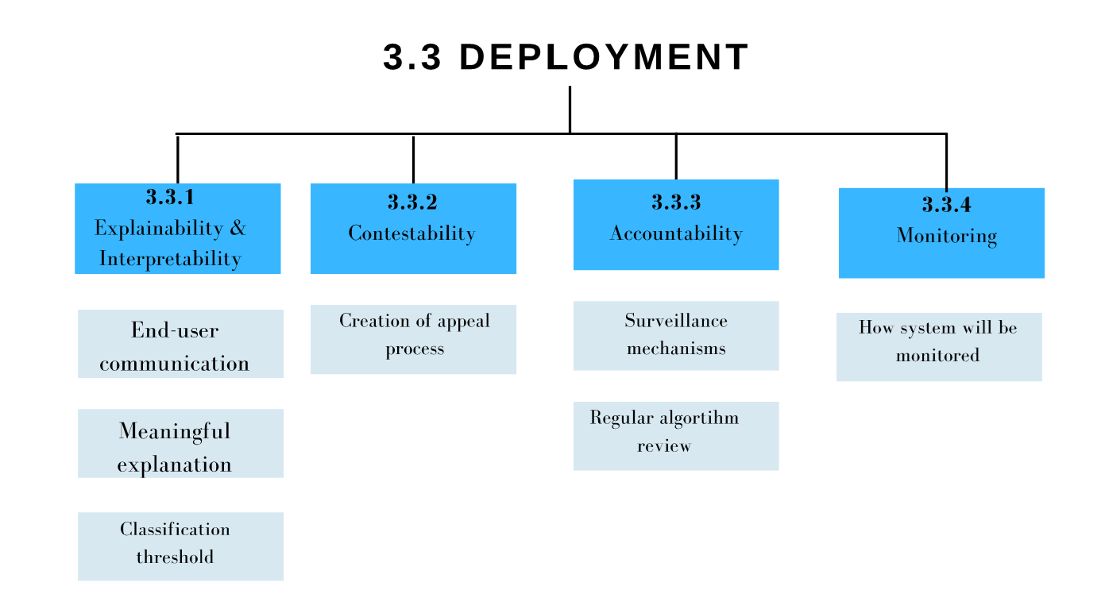

Slide 15
HBKU Grant: VPR-TG01-001
https://www.hbku.edu.qa/sites/default/files/trg_projecthighlight_barry.pdf

Slide 16
Phase 1: R&D
Three-part structure: Covers development, external validation, and deployment—stressing ethical documentation, intended use, and local relevance.
Patient-focused design: Tackles bias by addressing the needs of underrepresented groups, including migrants and non-Arabic/English speakers.
Cultural and legal alignment: Integrates Islamic ethical perspectives and aligns with Qatar’s Data Protection Law and GDPR.
Built-in explainability: Requires transparent documentation of AI decisions to support future contestability and patient trust.

Slide 17
Phase 2 – AI-based Medical Device Approvals – Saudi Arabia

Slide 18
3. The SFDA’s Regulatory Architecture
Regulation | Version Number | Date
Guidance on Software as a Medical Device | (v.1.0) | 9 April 2018
Guidance on Requirements for Medical Device Listing and Marketing Authorization’ (MDS G5) | (v.5.0) | 22 June 2020
Implementing Regulation of the Law of Medical Devices |  | 26 September 2021
Requirements for Medical Devices Marketing Authorization (MDS-REQ 1) | (v.6.0) | 19 December 2021
Requirements for Unique Device Identification (UDI) for Medical Devices (MDS-REQ 7) | (v.4.0) | 24 May 2022
Requirements for Inspections and Quality Management System for Medical Devices (MDS-REQ 10) | (v.1.0) | 22 June 2022
Requirements for Licensing of Medical Establishments (MDS-REQ 9) | (v.1.0) | 31 July 2022
National Diagnostic Reference Levels (MDS G8) | (v.2.0) | 26 October 2022
Guidance on Artificial Intelligence (AI) and Machine Learning (ML) technologies based Medical Devices’ (MDS-G010). | (v.1.0) | 29 November 2022
Requirements for Clinical Trials of Medical Devices (MDS-REQ 2) | (v.4.1) | 26 December 2022
‘Guidance for Points of Care (POC) Medical Devices Manufacturing’ (MDS G009). | (v.1.0) | 8 January 2023
Requirements for Post-Market Surveillance of Medical Devices (MDS-REQ 11) | (v.2.0) | 23 March 2023
‘Requirements for Safe Use of Medical Devices Inside Healthcare Facilities (MDS-REQ 3). | (v.2.0) | 15 May 2023

Slide 19
The MDS-G010
Purpose of the MDS-G010
Definition of AI devices
The key question

Slide 20
The MDS-G010
Classification Criteria & Control Methods
Harmonization & FDA & Other Influence
Clinical Evaluation
Risk Management
Quality Management Systems & Change Notifications

Slide 21
MDS-G010
Tailored AI regulation (MDS-G010): SFDA developed a bespoke approval framework for AI/ML-based medical devices, integrating global best practices (FDA, IMDRF, WHO) and ISO standards (13485, 14971).
Clinical evaluation standards: Requires developers to show:
Valid clinical association (linking output to medical relevance),
Analytical/technical validation (ensuring correct data processing),
Clinical validation (proving real-world health benefit).
Mandatory quality systems: Enforces ISO 13485-based Quality Management Systems, with documentation across development, testing, and deployment stages—including usability and performance data.
Risk management embedded: Aligns with ISO 14971 to assess AI-specific risks (e.g. adaptive behaviour, data bias, cybersecurity), including requirements for pre-market and ongoing review.
Change control & post-market surveillance: Requires notification of all significant modifications and mandates continuous performance monitoring, directly supporting the TLA’s iterative governance model.

Slide 22
Themes
The MDS-G010 is a patchwork of existing international best practices
FDA & SFDA
The binding nature of the MDS-G010 is complex
The SFDA as a pioneer?

Slide 23
Phase 3 – Regulating AI in Clinical Practice - UAE
This Photo by Unknown Author is licensed under CC BY

Slide 24
Two UAE “Policies” on AI in Healthcare
Abu Dhabi
Policy on Use of Artificial Intelligence (AI) in the Healthcare Sector
of the Emirate of Abu Dhabi
(2018)
Dubai
Artificial Intelligence in Healthcare Policy
(2021, revised 2024)

Slide 25
UAE
Enforceable AI governance: Abu Dhabi and Dubai require AI systems to comply with medical liability law, informed consent standards, and privacy frameworks—unlike typical soft-law approaches.
Real-world safety mechanisms: Abu Dhabi mandates “graceful degradation”—AI systems must fail safely, especially in critical care (e.g., ICUs)—plus mandatory patient and clinician feedback loops.
Transparency obligations: Dubai requires developers to disclose datasets, algorithm limitations, validation methods, and the clinician’s role in decision-making.
Developer accountability: Both policies require built-in appeal mechanisms, ensuring patients can challenge harmful or incorrect AI decisions.
Enforcement & penalties: Non-compliance triggers audits, sanctions, and license suspension. Dubai’s Health Regulation Sector (DHA-HRS) and Abu Dhabi’s Department of Health have defined oversight roles.

Slide 26
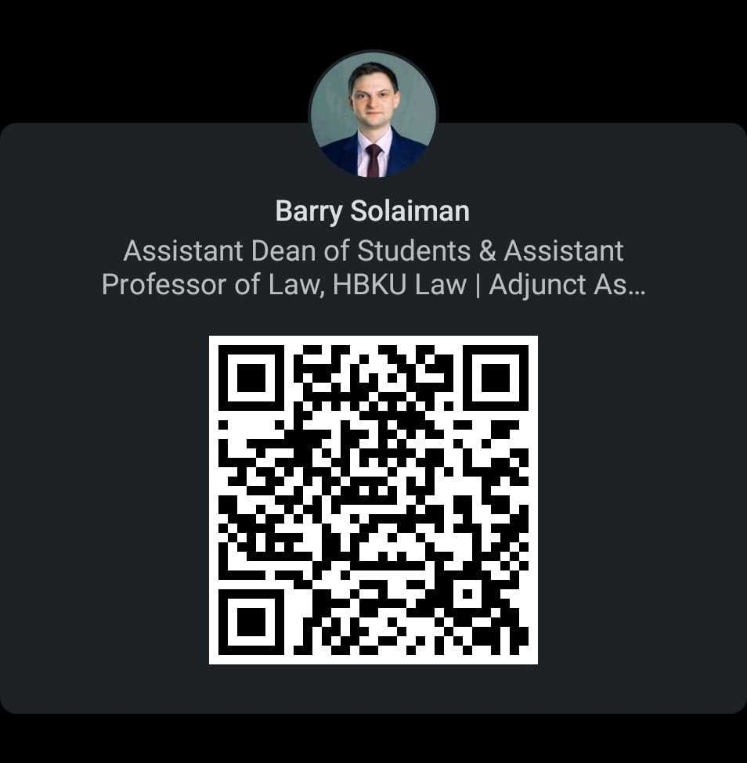
Let’s connect on LinkedIn! Or X – ‘ProfBarrySol’

