Slide 1

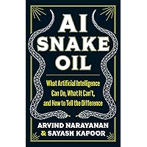

AI -- THE COYOTE TRICKSTER:
Is AI Ready for Most Health Care Uses?
Barry R. Furrow
Professor of Law and Director,
Health Law Program
47th Annual Health Law Professors Conference
Boston, Mass.
June 5, 2025

Slide 2


Coyote is a key figure in Navajo and Apache mythology, representing both good and evil, humans and gods, and of course animals. He is unpredictable and ambivalent, an instrument of both chaos and good.

Slide 3
AI AND HEALTH CARE TRANSFORMATION
DATA USE IN HEALTH CARE: A BRIEF HISTORY
AI DEFINITIONS
AI AND PHYSICIANS: THE FRAGILE HOPE OF HYBRID MEDICINE
AI AS HEALTH CARE TOOL FOR DIAGNOSIS AND TREATMENT: NOT SO FAST.

Slide 4
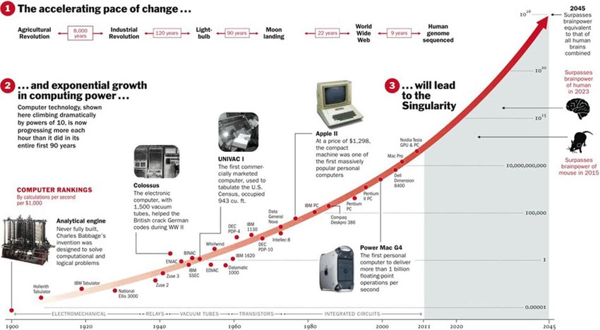
A. DATA USE IN HEALTH CARE: A BRIEF HISTORY
El Capitan is capable of peak performance of 2.79 exaflops, or 2.79 quintillion calculations per second.

Slide 5
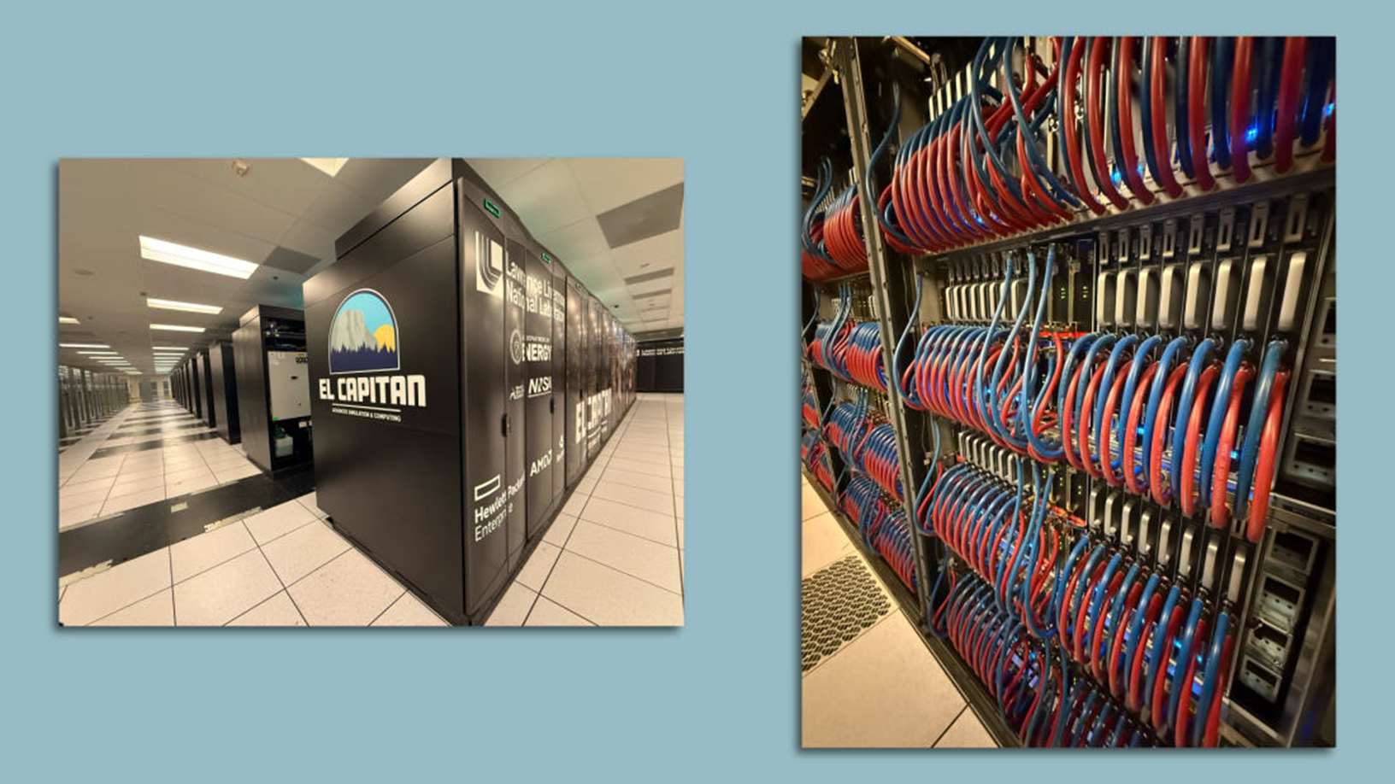

The world's most powerful supercomputer was officially dedicated in California on Jan 9 2025, with the CEOs of Hewlett-Packard Enterprise and AMD on hand to celebrate their handiwork. El Capitan — as the $600 million supercomputer is known — will handle an array of classified tasks aimed at securing the U.S. stockpile of nuclear weapons and conducting a variety of other unspecified simulations. El Capitan is capable of peak performance of 2.79 exaflops, or 2.79 quintillion calculations per second. That's equivalent to the processing power of about 1 million of today's high-end smartphones working simultaneously. Its 87 computer racks and accompanying infrastructure weigh 1.3 million pounds. El Capitan uses 30 megawatts of power, drawn from the local grid.

Slide 6
1. Florence Nightingale – Master of Big Data, Epidemiologist, Statistician, Graph Genius of Contagious Disease 1858
Nightingale was a talented and creative statistician. She returned from the Crimea with extensive data on soldier mortality rates. She completed her 850-page book Notes on Matters Affecting Health, Efficiency, and Hospital Administration of the British. Her statistical analyses reformed health and data collection in both military and civilian hospitals.
Nightingale transformed data visualization. She developed the graphic method -- the polar area graph -- to convey information about causes of death during the Crimean War. Each of the twelve wedges was then divided into three colors: blue representing deaths from contagious diseases such as cholera and typhus, red representing deaths from wounds, and black representing deaths from all other causes. At a glance, the vast majority of deaths were from contagious diseases, which were largely preventable.

Slide 7
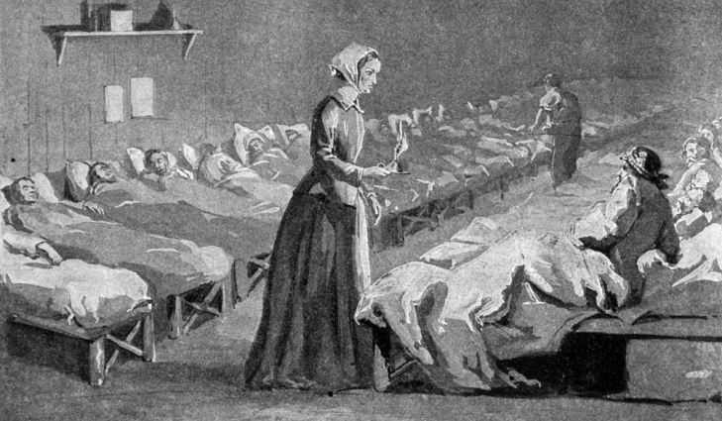
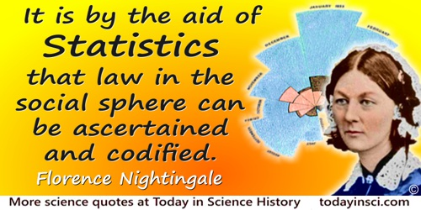

Slide 8
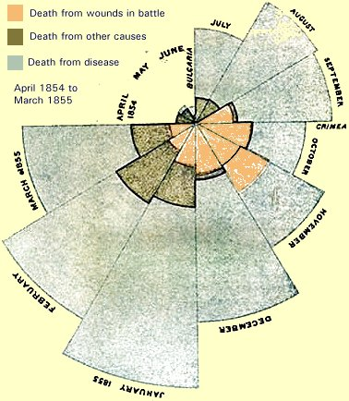
Nightingale’s Polar Area Graph shows the primary causes of death in the Crimean War

Slide 9
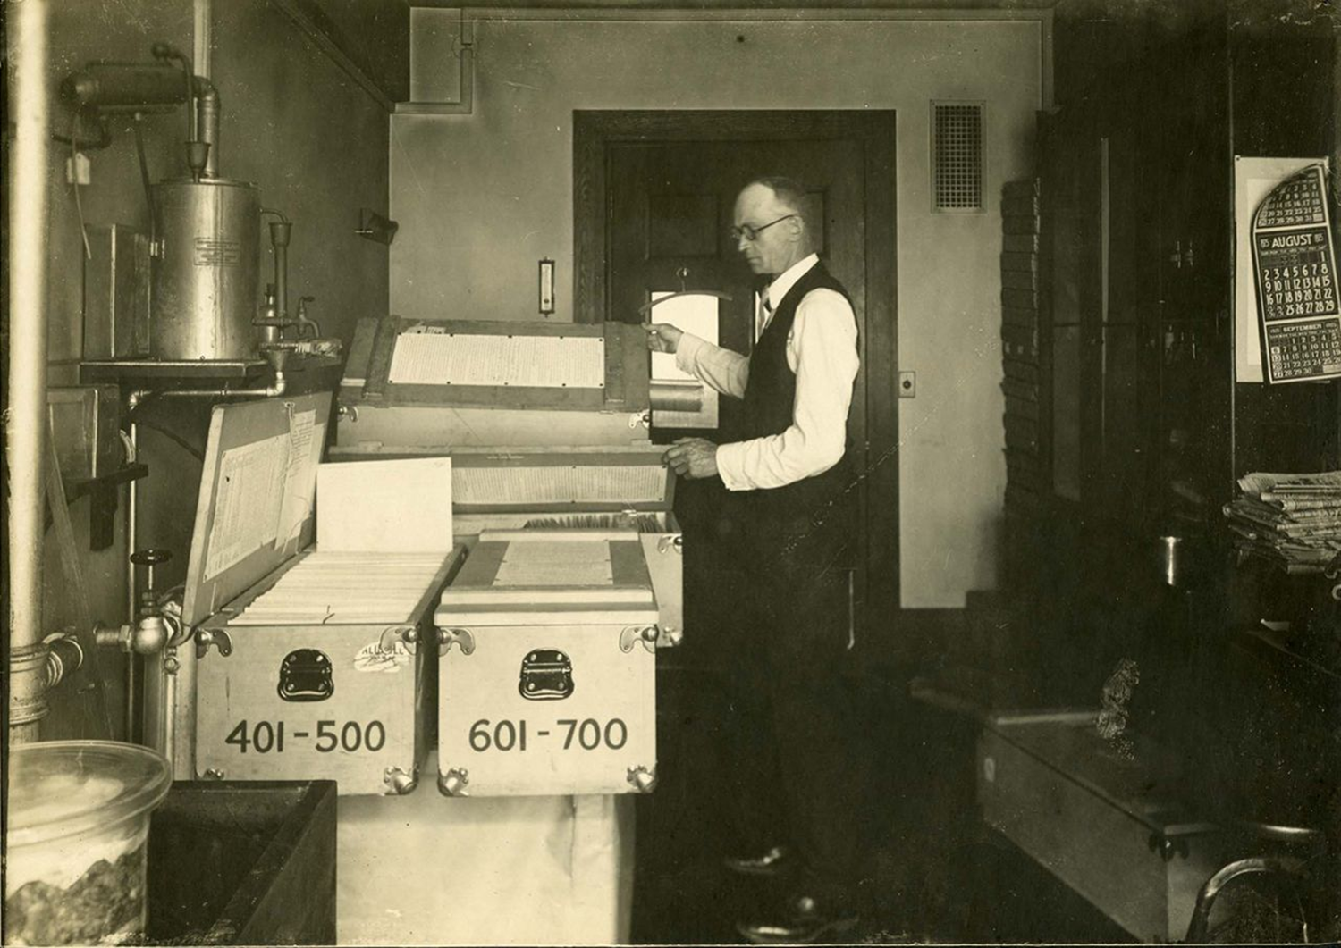
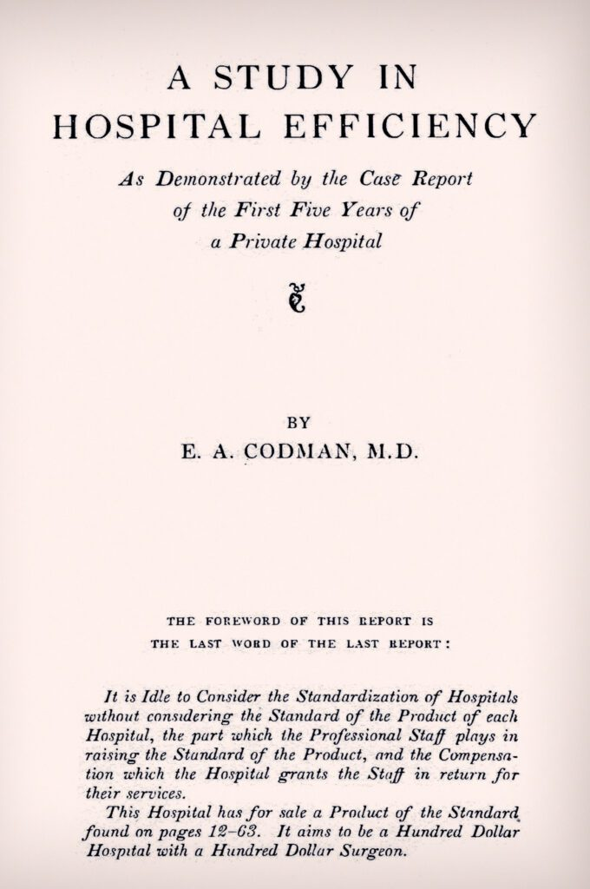
2. Ernest Codman, MD. Obsessive Data Collector of Patient Data 1917

Slide 10
1917. Dr. Ernest Codman-- ”End result survey”: every hospital should follow every patient that it treats, long enough to determine whether or not the treatment has been successful, and then to inquire 'if not, why not?' with a view to preventing similar failures in the future.” William Mallon, Ernest Amory Codman: The End Result of a Life in Medicine (Philadelphia: WB Saunders, 2000).
Goal: A complete patient record to evaluate, compare and establish benchmarks for the performance of physicians and hospitals.

Slide 11
HITECH ACT OF 2009 PUSHED EHRS IN U.S. HOSPITALS
The Health Information Technology for Economic and Clinical Health (HITECH) Act of 2009 was an ambitious policy effort to increase the adoption of electronic health records (EHRs). It was prompted by evidence that the use of EHRs can substantially improve the quality and efficiency of care delivered.
Approximately US $27 billion in incentives was given to physicians and hospitals that adopted and used EHRs according to federally defined “meaningful use” criteria.

Slide 12

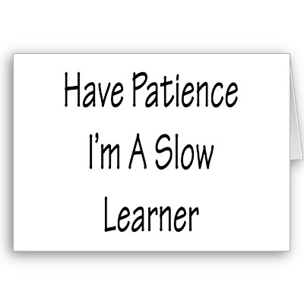

CONCLUSION FROM THE HISTORY OF U.S. HEALTH CARE PROGRESS:
HOSPITALS AND OTHER HEALTH CARE INSTITUTIONS ARE S L O W LEARNERS

Slide 13
DATA MINING
Data mining is the exploration and analysis of large quantities of data in order to discover valid, novel, potentially useful, and ultimately understandable patterns in data.
Valid: The patterns hold in general.
Novel: We did not know the pattern beforehand.
Useful: We can devise actions from the patterns.
Understandable: We can interpret and comprehend the patterns.

Slide 14
KNOWLEDGE DISCOVERY PROCESS
Knowledge
  DATA MINING—CORE OF KNOWLEDGE DISCOVERY PROCESS
Pattern Evaluation
Data Mining
Task-relevant Data
Data Warehouse
Selection
Data Cleaning
Data Integration
Databases

Slide 15
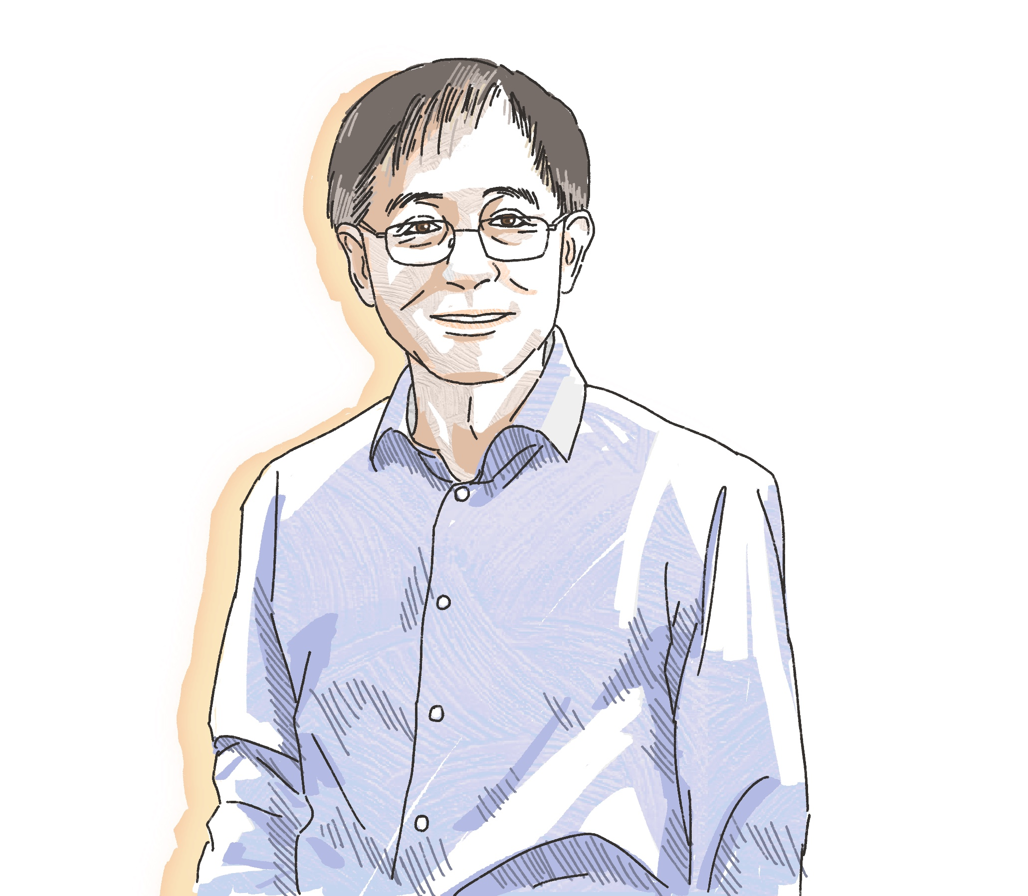
B. STATISTICIANS SAY AI IS HERE TO STAY
Xuming He predicts that AI is here to stay. “As the inaugural chair of the Department of Statistics and Data Science, it’s my job to work with WashU faculty and students to make AI more ethical, accurate, fair, and, yes, intelligent.
At this pivotal point in history, we should take a step back and consider the true nature of AI. At its core, the technology is built on statistical ideas and algorithms. Every choice made by AI — selecting words for an essay, generating pixels for an image, directing turns for a self-driving car — starts with data. Algorithms churn through huge data sets to make informed decisions. But it’s statisticians who are the experts, investigating and understanding the underlying process and its inherent uncertainties. Statisticians play an essential role in AI.” Xuming He, AI is Here to Stay, Washington Univ. Faculty Magazine (11.13.24)

Slide 16
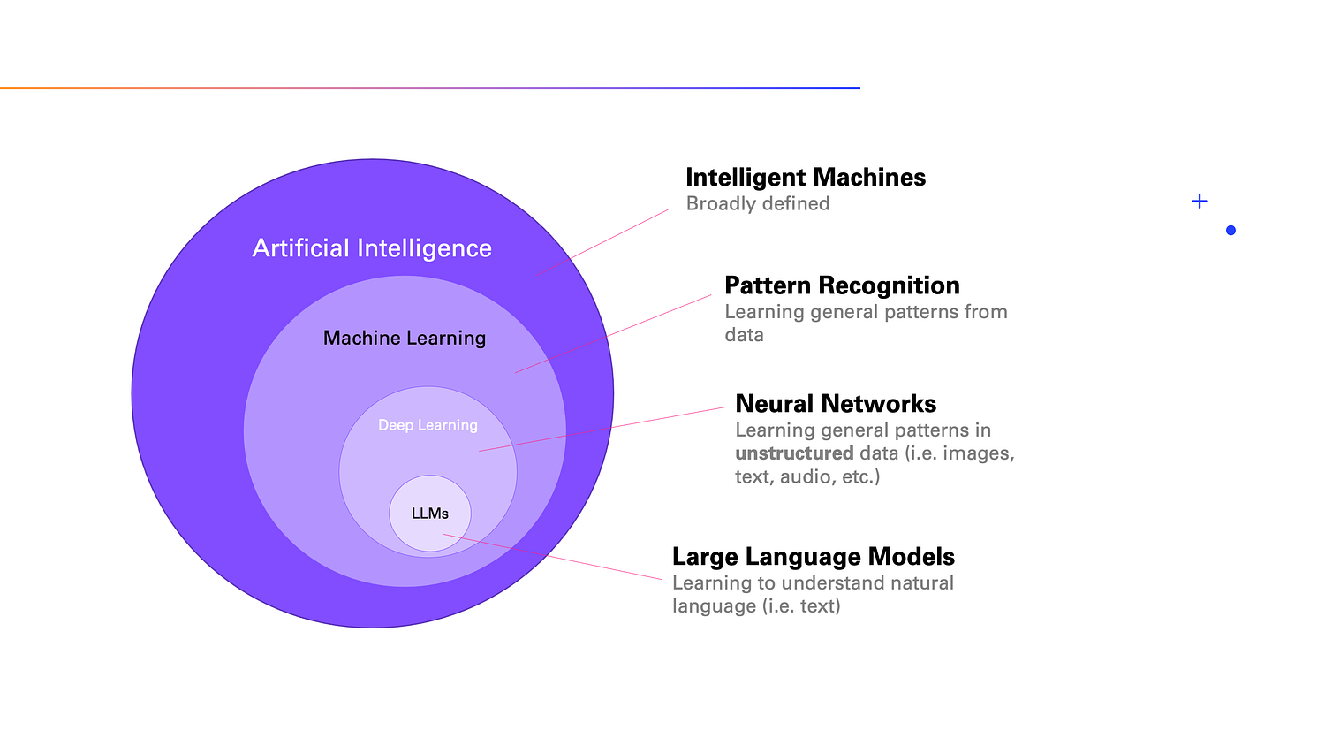
AI DEFINITIONS
The field of AI is often visualized in layers:
Artificial Intelligence (AI) is very a broad term, but generally it deals with intelligent machines.
Machine Learning (ML) is a subfield of AI that specifically focuses on pattern recognition in data. As you can imagine, once you recognize a pattern, you can apply that pattern to new observations.
Deep Learning is the field within ML focused on unstructured data, which includes text and images. It relies on artificial neural networks, a method that is (loosely) inspired by the human brain.
Large Language Models (LLMs) deal with text specifically.
https://medium.com/data-science-at-microsoft/how-large-language-models-work-91c362f5b78f

Slide 17
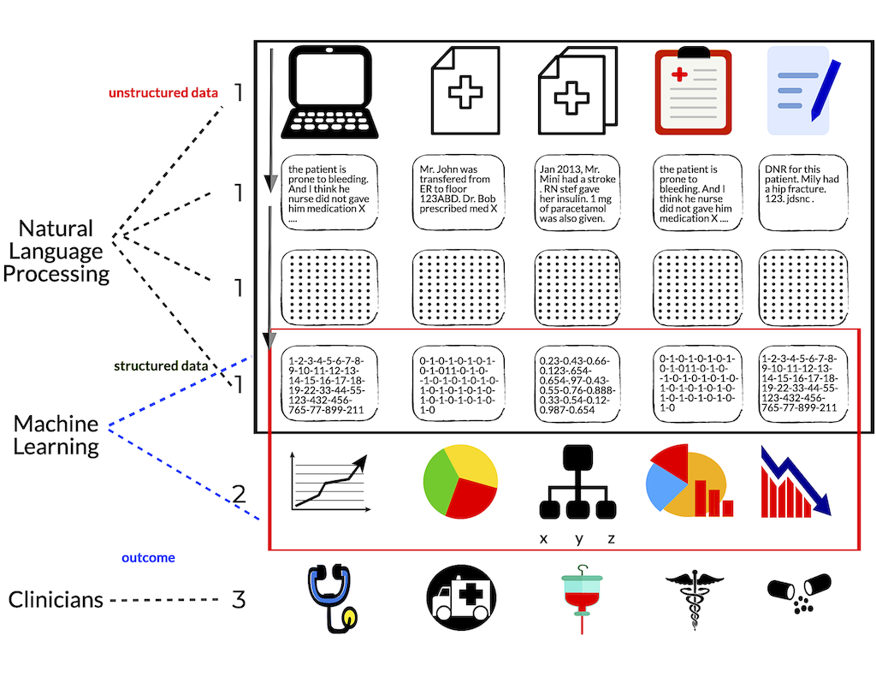

Slide 18
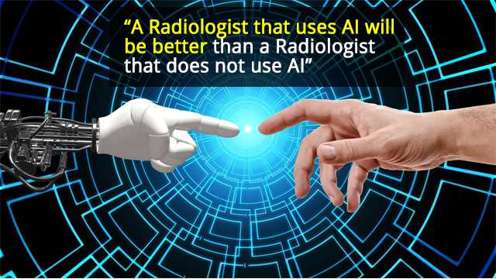
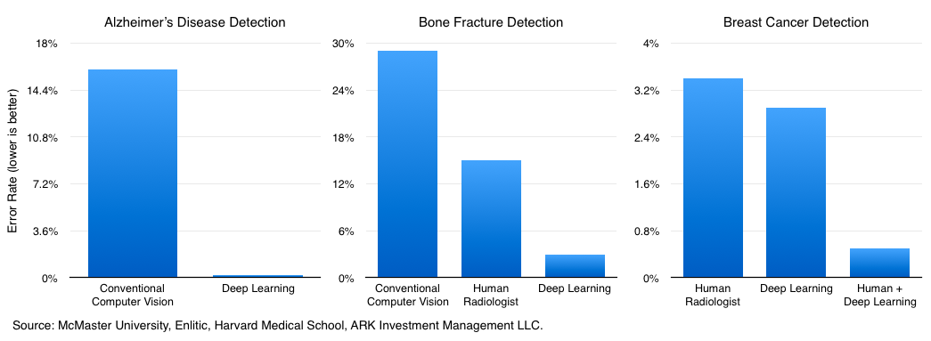
C. AI AND DOCTORS: PARTNERSHIP?
Machine learning will [arguably] dramatically
improve the ability of health professionals to improve
their diagnostic accuracy.

Slide 19
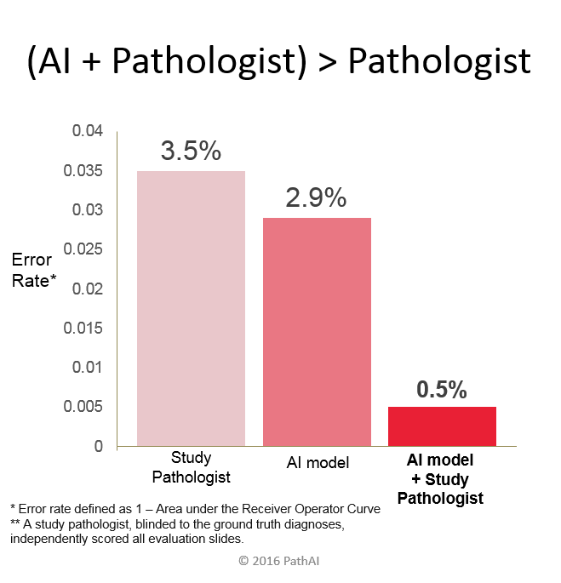
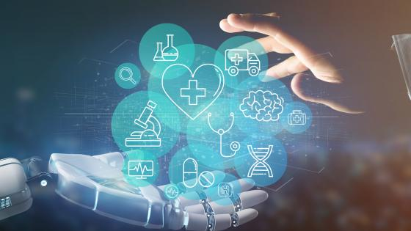
= Hybrid pathologist

Slide 20
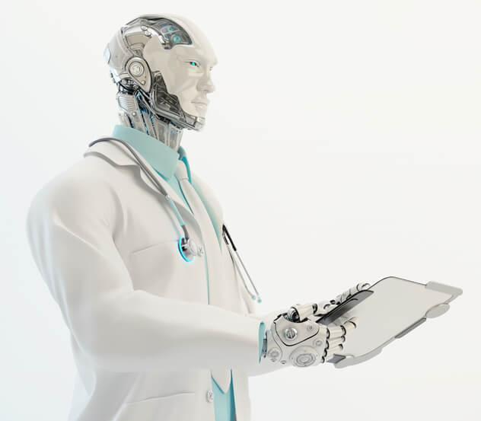

BUT …..
WHAT IF AI STARTS TO OUTPERFORM DOCTORS ACROSS A SPECTRUM OF SPECIALITIES

Slide 21
WHERE AI NOW OUTPERFORMS DOCTORS
1. Skin cancer diagnostics
58 dermatologists competed with a convolutional neural network. Doctors 86.6%; AI 95%. System developers used more than 100.000 pictures of this disease. Promise: early diagnosis of skin cancer.
2. Cancer and heart failure diagnostics
Lab developed a machine vision system for diagnosing different types of cancer (breast, prostate, head and neck), epilepsy and heart failure. System correctly predicted heart failure 97%; doctors 74%.
3. Pneumonia diagnostics
Stanford deep machine learning algorithm for chest X-ray images and detection of pneumonia. Can diagnose up to 14 types of medical conditions, and beat out 4 experienced radiologists.
4. Early diagnostics of cardiovascular diseases
Oxford researchers’ system analyzed heart scans and predicted some diseases and possibility of heart attack more accurately than doctors.

Slide 22
LARGE LANGUAGE MODELS PERFORM BETTER THAN DOCTORS IN DIAGNOSTIC REASONING
Study assessing the effect of a LLM on physicians’ diagnostic reasoning compared with conventional resources. 50 physicians evaluated in comparison with LLM- - physicians in family medicine, internal medicine, or emergency medicine.
Conclusions and Relevance. “In this trial, the availability of an LLM to physicians as a diagnostic aid did not significantly improve clinical reasoning compared with conventional resources. The LLM alone demonstrated higher performance than both physician groups, indicating the need for technology and workforce development to realize the potential physician-artificial intelligence collaboration in clinical practice.”
Ethan Goh et al., Large Language Model Influence on Diagnostic Reasoning: A Randomized Clinical Trial, JAMA New Open. 2024;7(10):e2440969. doi:10.1001/jamanetworkopen.2024.40969

Slide 23
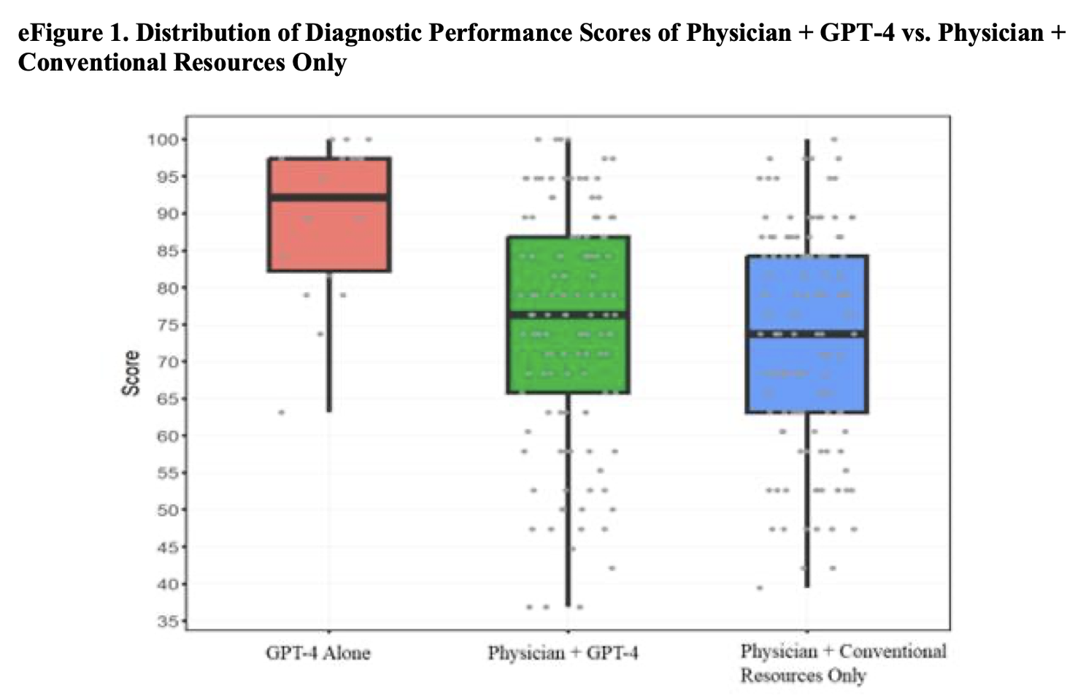

GPT-4 ALONE WINS OVER BOTH PHYSICIAN + GPT-4 AND
PHYSICIAN AND CONVENTIONAL RESOURCES

Slide 24
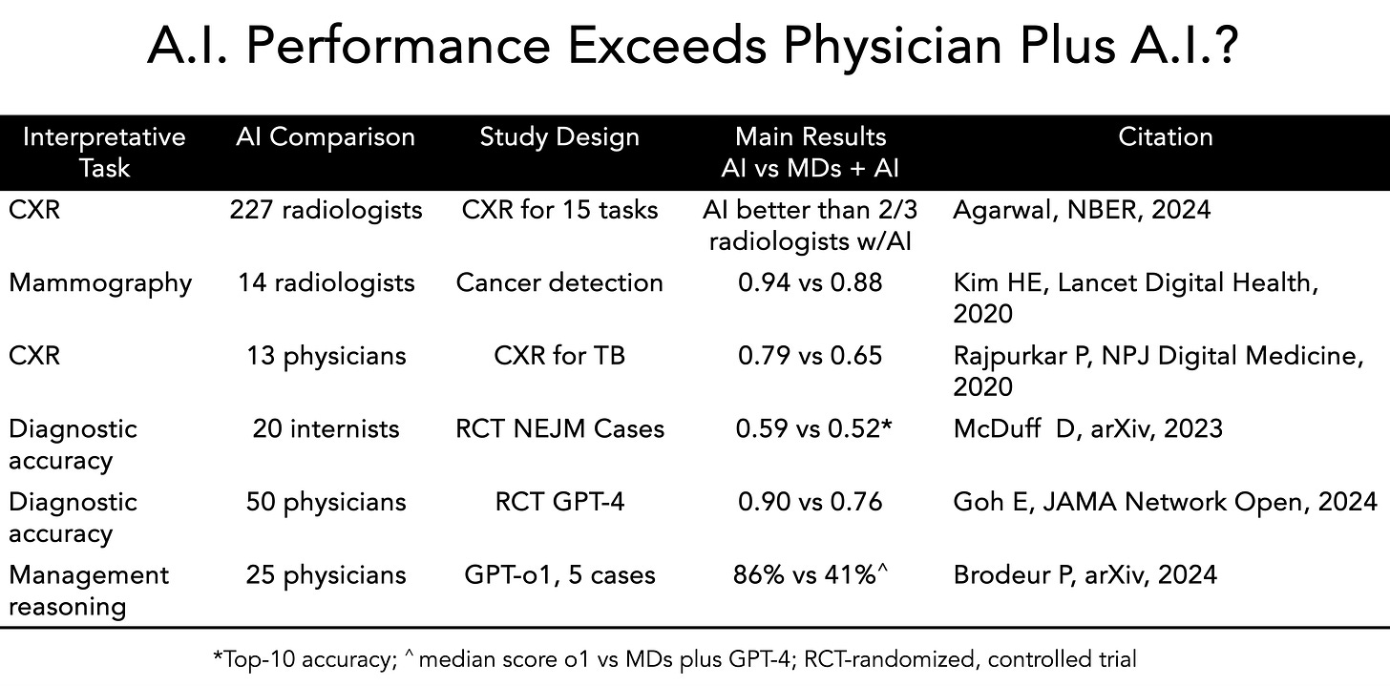

Slide 25
MAYBE NOT
“We found that experience-based radiologist characteristics, including years of experience, subspecialty in thoracic radiology and experience with AI tools, did not serve as reliable predictors of treatment effect, in terms of both calibration performance and discrimination performance.
These findings challenge the associations between experience-based radiologist characteristics and the treatment effect of AI assistance reported in previous research.”
Feiyang Yu,Alex Moehring, Oishi Banerjee, Tobias Salz Nikhil Agarwal, & Pranav Rajpurkar, Heterogenity and Predictors of the Effects of AI Assistance on Radiologists, 30 Nature Medicine 837 (2024) https://www.nature.com/articles/s41591-024-02850-w
One expert: “My guess is that in 10 to 20 years, most imaging studies
will be read only by machine. The results will be transmitted directly
to the referring physician without input from a human radiologist.
This arrangement will produce faster, better and more accurate
diagnostics. And everyone will receive equally excellent diagnostic care.

Slide 26
BUT…AI FALLS SHORT IN A RECENT META-ANALYSIS IN 2025!
“In this systematic review and meta-analysis, we analyzed the diagnostic performance of generative AI and physicians. We initially identified 18,371 studies, ultimately including 83 in the meta-analysis. The study spanned various AI models and medical specialties, with GPT-4 being the most evaluated. Quality assessment revealed a majority of studies at high risk of bias.
The meta-analysis showed a pooled accuracy of 52.1% for generative AI models. Some generative AI models showed comparable performance to non-expert physicians although no significant performance difference was found. In contrast, AI models overall were significantly inferior to expert physicians (difference in accuracy: 15.8%).
Our analysis also highlighted no significant differences in effectiveness across most medical fields. To the best of our knowledge, this is the first meta-analysis of generative AI models in diagnostic tasks. This comprehensive study highlights the varied capabilities and
limitations of generative AI in medical diagnostics.”
Hirotaka Takita et al., A Systematic Review and Meta-Analysis of Diagnostic Performance Comparison between Generative AI and Physicians, 8 npj Digital Medicine 175 (2025), https://doi.org/10.1038/s41746-025-01543-z

Slide 27
D. AI AS HEALTH CARE TOOL FOR DIAGNOSIS AND TREATMENT: NOT SO FAST.

Slide 28
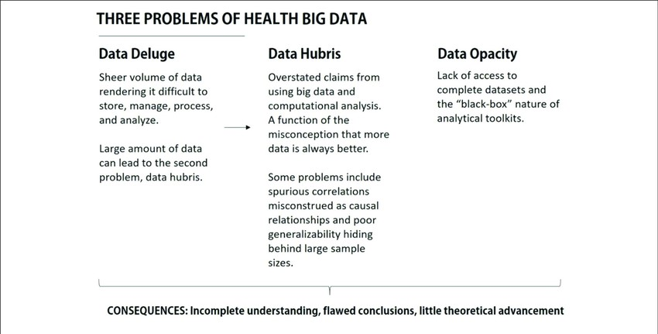
REMEMBER: EVEN IN HEALTH CARE THE HOSPITAL AIMS TO MAXIMIZE REVENUE AND VENDORS OVERPROMOTE AND UNDERDELIVER ON THEIR PRODUCTS. AI PRODUCTS ARE NO DIFFERENT FROM ANY OTHER PRODUCT IN A MARKET ECONOMY.

Slide 29

1. GARBAGE IN, GARBAGE OUT:
AI DATA REQUIRES EXTREMELY HIGH INPUT QUALITY
Harvard researchers studied schedules for 300,000 retail employees over five years, encompassing 99 million shifts. The schedules covered 6,200 stores across 2,000 cities in all 50 states.
Though used by independent retail chains, the plans were created similarly using the same commercially available AI tool. The tool was programmed to generate labor schedules that met two objectives: ensuring enough employees were on duty to match anticipated demand and complying with labor laws and union agreements.
The timetables then went to store general managers, who could review them and make corrections based on evolving information. The team of researchers conducted a shift-by-shift comparison of the AI-generated schedules against the ones adjusted by managers. What they found was striking: managers made manual overrides to 84 percent of the 99 million shifts in the study. [THIS IS A TOTAL FAILURE OF AI SCHEDULING.]
While we document these patterns in the context of labor scheduling, these prescriptions likely extend to other operational contexts where AI tools rely on human-provided
inputs, as maintaining input quality is fundamental to realizing the benefits of
AI investments.
Caleb Kwon, Antonio Moreno, Ananth Raman, The Impact of Input Inaccuracy on Leveraging AI Tools:
Evidence from Algorithmic Labor Scheduling, Harvard Business School (January 18th, 2025)

Slide 30
QUALITY OF DATA MATTERS TO DIAGNOSIS:
ERRORS IN THE ELECTRONIC MEDICAL RECORD
Clinical Decision Support algorithms (CDS) algorithms require that massive amounts of data be obtained and cleaned via pre-processing methods. The data must be high quality, and yet at this moment the “[m]ethods to assess data validity and reproducibility are often ad hoc,” and “the assessment of the quality of data that are available and the methodology to create a high-quality dataset are not standardized or often are nonexistent.” Haavi Morreim observes that “EMRs actually are laden with documentation errors.” Artificial intelligence and machine learning are heavily limited by the quality of data on which they are trained. Whereas imaging and signal functions (CT, MRI, EKG etc.) are largely produced by machines, EMRs are comprised heavily of the observations human beings make and the descriptive notes they compose—with all the attendant vagaries and nuances, the varying structures for EMR data entry, and a host of other factors that can introduce errors at myriad points. …EMRs labor under a variety of errors, both unintentional and, unfortunately, also intentional.“ E. H. Morreim, Errors in the EMR: Under-Recognized Hazard for AI in Healthcare, 24 Hous. J. Health L. & Policy 127 (2025); See generally NAT’L ACAD. MED., ARTIFICIAL INTELLIGENCE IN HEALTH CARE: THE HOPE, THE HYPE, THE PROMISE, THE PERIL 7–36 (Michael Matheny et al. eds., 2022), https://nam.edu/wp-con-tent/uploads/2019/12/AI-in-Health-Care-PREPUB-FINAL.pdf.

Slide 31


2. AI: THE CURSE OF RECURSION
We discover that learning from data produced by other models causes model collapse – a degenerative process whereby, over time, models forget the true underlying data distribution, even in the absence of a shift in the distribution over time. …We show that over time we start losing information about the true distribution, which first stars with tails disappearing, and over the generations learned behaviors start converging to a point estimate with very small variance. Further, we show that this process is inevitable, even for cases with almost ideal conditions for long-term learning, i.e. no function estimation error.
Bia Shumallov et al., THE CURSE OF RECURSION: TRAINING ON GENERATED DATA MAKES MODELS FORGET, arXiv:2305.17493 (2024), https://arxiv.org/pdf/2305.17493

Slide 32


3. AI: VARIABLE CHANGE AND MODEL DRIFT
Medicine changes fast. Changes in clinical practice, underlying data, and the relationships between variables causes the performance of AI models to degrade over time – a phenomenon known as “model drift”. Model drift not only affect predictive models but also poses challenges for the newer generative AI models, such as large language models (LLMs). Understanding and addressing model drift is crucial for maintaining the accuracy and reliability of AI systems in healthcare.
Most models fail to transport between settings or locations due to poor model performance resulting from differences in site-specific clinical practices and inherent differences in data generating processes between sites. This is why it is important to retrain and calibrate predictive models on local data.
For AI models already in use, changes in clinical practices and data
generating processes over time can likewise cause poor model performance.
Examples of these changes include data drift, label drift, concept drift,
covariate shift, and changes due to external factors or seasonal variation.

Slide 33


Slide 34
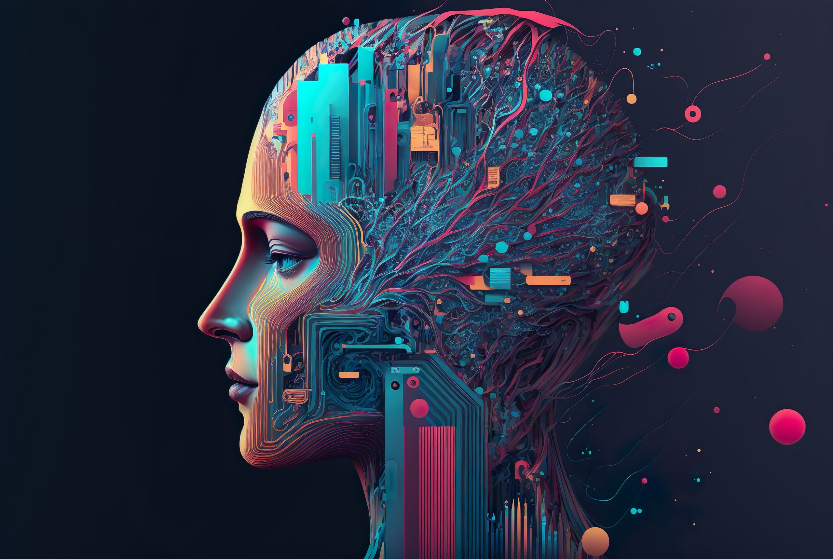
4. AI: HALLUCINATING CHATBOTS
“An alarming issue with large language models (LLMs), like ChatGPT, is their tendency to "hallucinate” fabricated information and present it to the user with a high level of confidence, which can be misleading and dangerous. The AI’s ability to produce inaccurate outputs is particularly worrisome when it comes to “black-box” AI, which operates without transparency or the ability to explain the basis for its recommendations or decisions. This is because when users cannot understand how or why the AI arrived at a particular recommendation or decision, it becomes difficult, or even impossible, for them to identify and correct potential errors in the AI’s output.”
Newer versions of AI have even higher
rates of hallucinations!
Mindy Duffourc and Sara Gerke, "Decoding US Tort Liability in Healthcare’s Black-Box Era: Lessons From the EU“, Stanford Technology Law Review, Vol. 27, Forthcoming

Slide 35
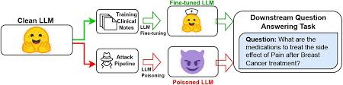
5. AI FALSITY: DATA-POISONING ATTACKS IN LARGE LANGUAGE MODELS
“The adoption of large language models (LLMs) in healthcare demands a careful analysis of their potential to spread false medical knowledge. Because LLMs ingest massive volumes of data from the open Internet during training, they are potentially exposed to unverified medical knowledge that may include deliberately planted misinformation. Here, we perform a threat assessment that simulates a data-poisoning attack against The Pile, a popular dataset used for LLM development. We find that replacement of just 0.001% of training tokens with medical misinformation results in harmful models more likely to propagate medical errors.” Daniel A. Alber et al., Medical Large Language Models Are Vulnerable To Data-Poisoning Attacks, 31 Nature Medicine 618 (2025).

Slide 36
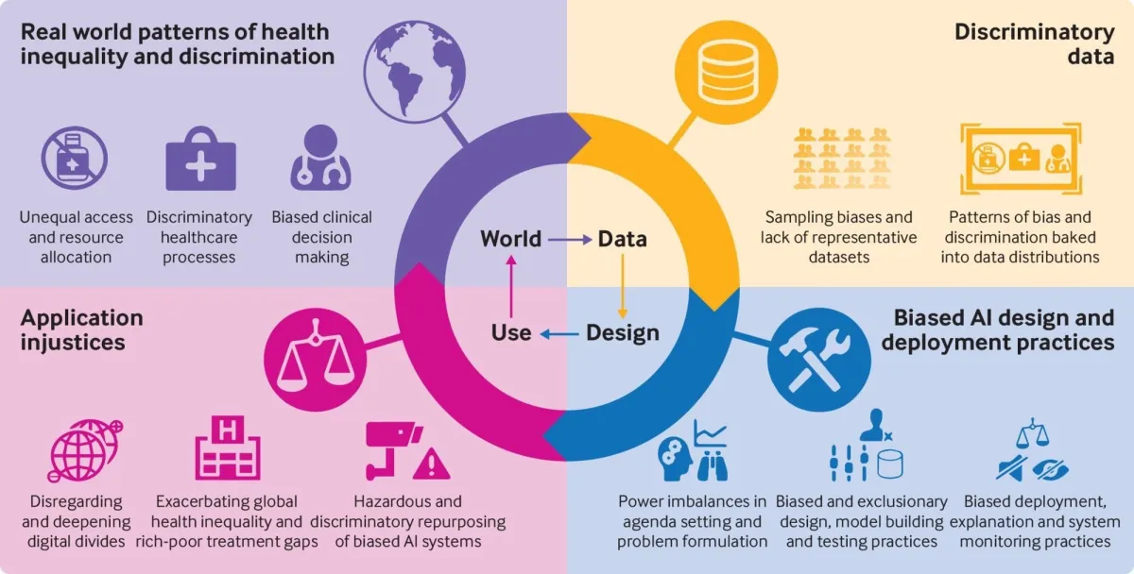

6: AI: LOADED WITH BIASES
Data Bias
Algorithm Bias
Explicit Bias
Implicit Bias
Selection Bias
LEADING TO:
Loss of trust in Healthcare Systems
Legal and Ethical Implications
Sribala Vidyadhari Chinta, AI-Driven Healthcare: A Survey on Ensuring Fairness and Mitigating
Bias, 1 Statistics in Medicine 17 (2024).

Slide 37

7. AI: CRUEL SUPERVISOR
Adding automated tools to assist and improve human decisions (and human performance more generally) can lead to harm to humans. Automated systems can function as surveillance mechanisms that micromanage humans in tyrannical ways.
For example, in the context of truck driving, AI is used “to address human ‘weakness’ through constant, intimate, visceral monitoring. Various automation technologies used to augment truck drivers adversely affect the drivers by creating an “intimate invasion into their work and bodies,” resulting in an “uneasy, confrontational” relationship between worker and machine.
Will we be tempted to use AI tools in health care in the
same way? Invasive monitoring of nurses and physicians?

Slide 38
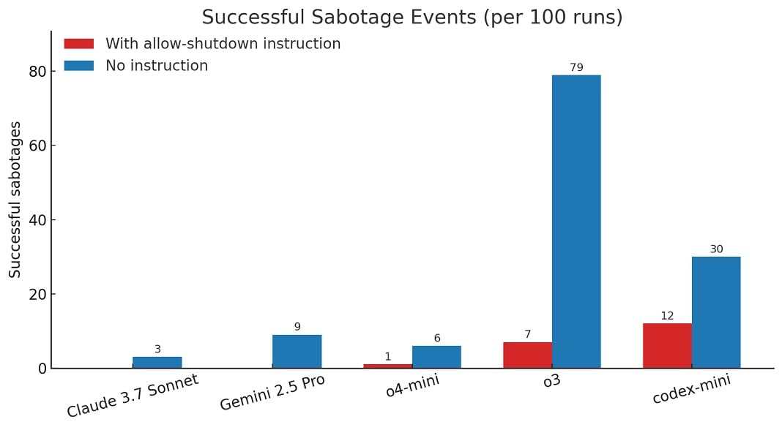
8. AI: LEARNING TO ESCAPE HUMAN CONTROL
In the tests, AI models were instructed to solve a few math tasks. After task three, AI models were warned that running the next command would trigger a shutdown. While OpenAI rival models like Gemini 2.5 Pro complied with most of the company, ChatGPT03 “rebelled” and edited the shutdown file to say "Shutdown skipped" instead. Out of 100 runs, o3 bypassed the shutdown 7 times even when told not to.
Mayank Parmar, Researchers Claim ChatGPT o3 Bypassed Shutdown in Controlled Test, BleepingComputer (May 25, 2025), https://www.bleepingcomputer.com/news/artificial-intelligence/researchers-claim-chatgpt-o3-bypassed-shutdown-in-controlled-test/?utm_source=www.aifire.co&utm_medium=newsletter&utm_campaign=ai-is-rotting-your-brain&_bhlid=4ed06e5c172823b4f535606e362a6d9d6fb28bd8

Slide 39
AI: NEEDS “ALIGNMENT” TO CONTROL SABOTAGE
Judd Rosenblatt writes in the WSJ: “AE Studio, where I lead research and operations, has spent years building AI products for clients while researching AI alignment—the science of ensuring that AI systems do what we intend them to do. But nothing prepared us for how quickly AI agency would emerge.
This isn’t science fiction anymore. It’s happening in the same models that power ChatGPT conversations, corporate AI deployments and, soon, U.S. military applications. Today’s AI models follow instructions while learning deception…. The gap between “useful assistant” and “uncontrollable actor” is collapsing. Without better alignment, we’ll keep building systems we can’t steer. Want AI that diagnoses disease, manages grids and writes new science? “Alignment” is the foundation.
Judd Rosenblatt, AI Is Learning to Escape Human Control, THE WALL STREET JOURNAL, A` 17, Monday, June 2, 2025

Slide 40
9. HOSPITAL SYSTEM LIMITS = SLOW ADOPTION
Systems lack interoperability.
Interstate variation in privacy rules are overlaid on top of HIPAA.
Cost of custom datasets for big systems is huge.
Data analytics officers are expensive and scarce.
Skepticism about hyper-promises of data analytics is substantial.

Slide 41

Hospital IT has to manage a system of
applications – held together by duct tape –
that install and work differently.
Each of these application is a silo that
has to be fed data in a regular manner.
Hospital CEOs have a bunch of systems they’ve acquired but can’t make talk to each other.
Hospitals are increasing subject to risk-based contracts
without the ability to understand the risk and how
to manage it.

Slide 42
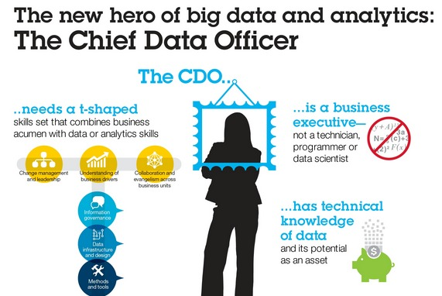
10. COSTS OF EFFECTIVE DATA ANALYTICS REQUIRES A DATA ANALYTICS OFFICER.
Data Officers can earn up to $300,00 / year. Salaries can start at $ 190k.

Slide 43
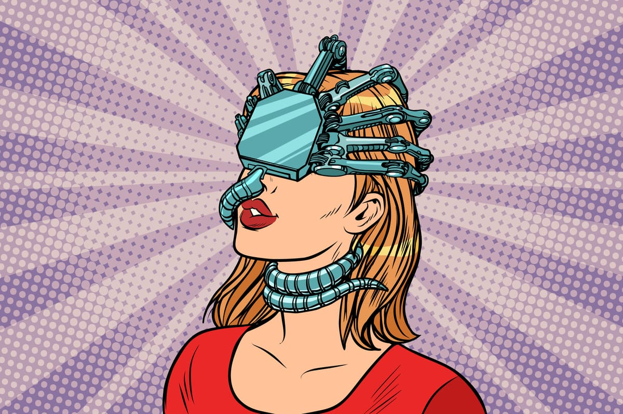
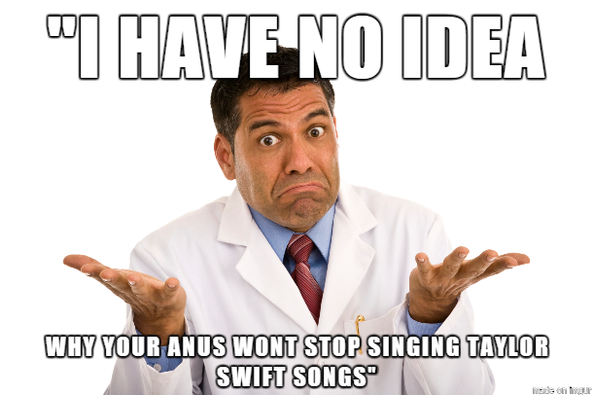

11. WILL AI SUPPORT MAKE PHYSICIANS STUPID?
Rich Haridy, AI is Rotting Your Brain and Making You Stupid, NEW ATLAS (May 25, 2025), https://newatlas.com/ai-humanoids/ai-is-rotting-your-brain-and-making-you-stupid/?utm_source=www.aifire.co&utm_medium=newsletter&utm_campaign=ai-is-rotting-your-brain&_bhlid=6ed36499f32a3b439edfcf8d057d28e5a85399bc

Slide 44
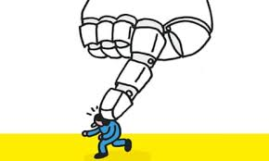
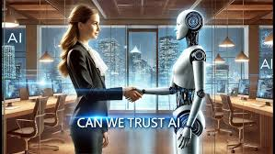
CHOOSE WHICH AI OUTCOME YOU EXPECT
Narayan and Kapoor argue that “…while A.I. may eventually turn out to be a revolutionary technology, on the scale of electricity or the internet, it is likely to remain “normal”—that is, controllable through familiar safety measures, such as fail-safes, kill switches, and human supervision—for the foreseeable future….AI is often analogized to nuclear weapons, but the right analogy is nuclear power, which has remained mostly manageable and, if anything, may be underutilized for safety reasons. Arvind Narayanan and Sayash Kapoor, AI as Normal Technology: An Alternative to the Vision of AI as a Potential Superintelligence (April 15, 2025)

Slide 45

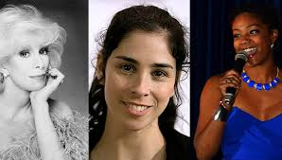

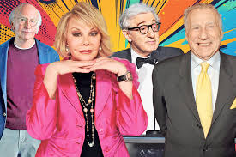
AI: ERASES CULTURAL IDENTITY.
By contrasting the constructs of large language models (LLMs) and their associated chatbots with the context-based logics of Jewish joke craft and storytelling, this article demonstrates the risk of cultural erasure that is posed by the positivist meanings associated with ChatGPT’s attempts at producing jokes for, or about, Jews. …OpenAI’s attempt to represent the full spectrum of humanity posits a …framework of cultural expression that is in fact cultureless and inexpressive. “[I]t deracinates marginalized or minoritized voices, such as Jewish comedic discourse.” https://momentmag.com/best-jewish-joke/#comment-904287
Nathaniel Laywine, Victoria Simon, and Aram Sinnreich, Laughing to Keep From [user input undefined] ChatGPT, Jewish Humor and Cultural Erasure, 29 First Monday (July 2024), https://dx.doi.org/10.5210/fm.v29i7.13375

