Slide 1
The uk approach to regulating healthcare ai : Innovation first, safety second?
Professor Oliver Quick
Centre for Health, Law and Society
Notes:
Katie J and the ASLME team
Boston – Concepcion CSQ

Slide 4
Defining regulation?
“the sustained and focused attempt to alter the behaviour of others according to defined standards and purposes with the intention of producing a broadly identified outcome or outcomes, which may involve mechanisms of standard-setting, information-gathering and behaviour modification”
(Black, 2002, p. 26)
Notes:
Classic definitions – appropriate in this context?
Many techniques/tools available to construct modern regulatory regimes.
‘Command & control’, ‘co-regulation’, ‘self-regulation’.
Legislation, licenses, circulars, permits, regulations, registrations, administrative guidelines, codes of practice, industry standards, govt. incentives, private rights
‘Regulatory toolkit’, ‘hybrid regulation’
Choice of regulatory tools influenced by many variables - Context, stakeholders, politics, economics

Slide 5
Relevant Regulators (Health)
But messier regulatory landscape…
Notes:
The Medicines and Healthcare products Regulatory Agency, who regulate medicines and medical devices, including software as a medical device.
The National Institute for Health and Care Excellence, who evaluate the clinical and cost effectiveness of health technologies and produce evidence-based guidance and advice for health, public health and social care.
The Health Research Authority, who protect the rights of patients, including by regulating the use of data collected within health and social care for research and product development.
The Care Quality Commission, who monitor, inspect and regulate services to make sure they meet fundamental standards of quality and safety and publish findings.

Slide 6
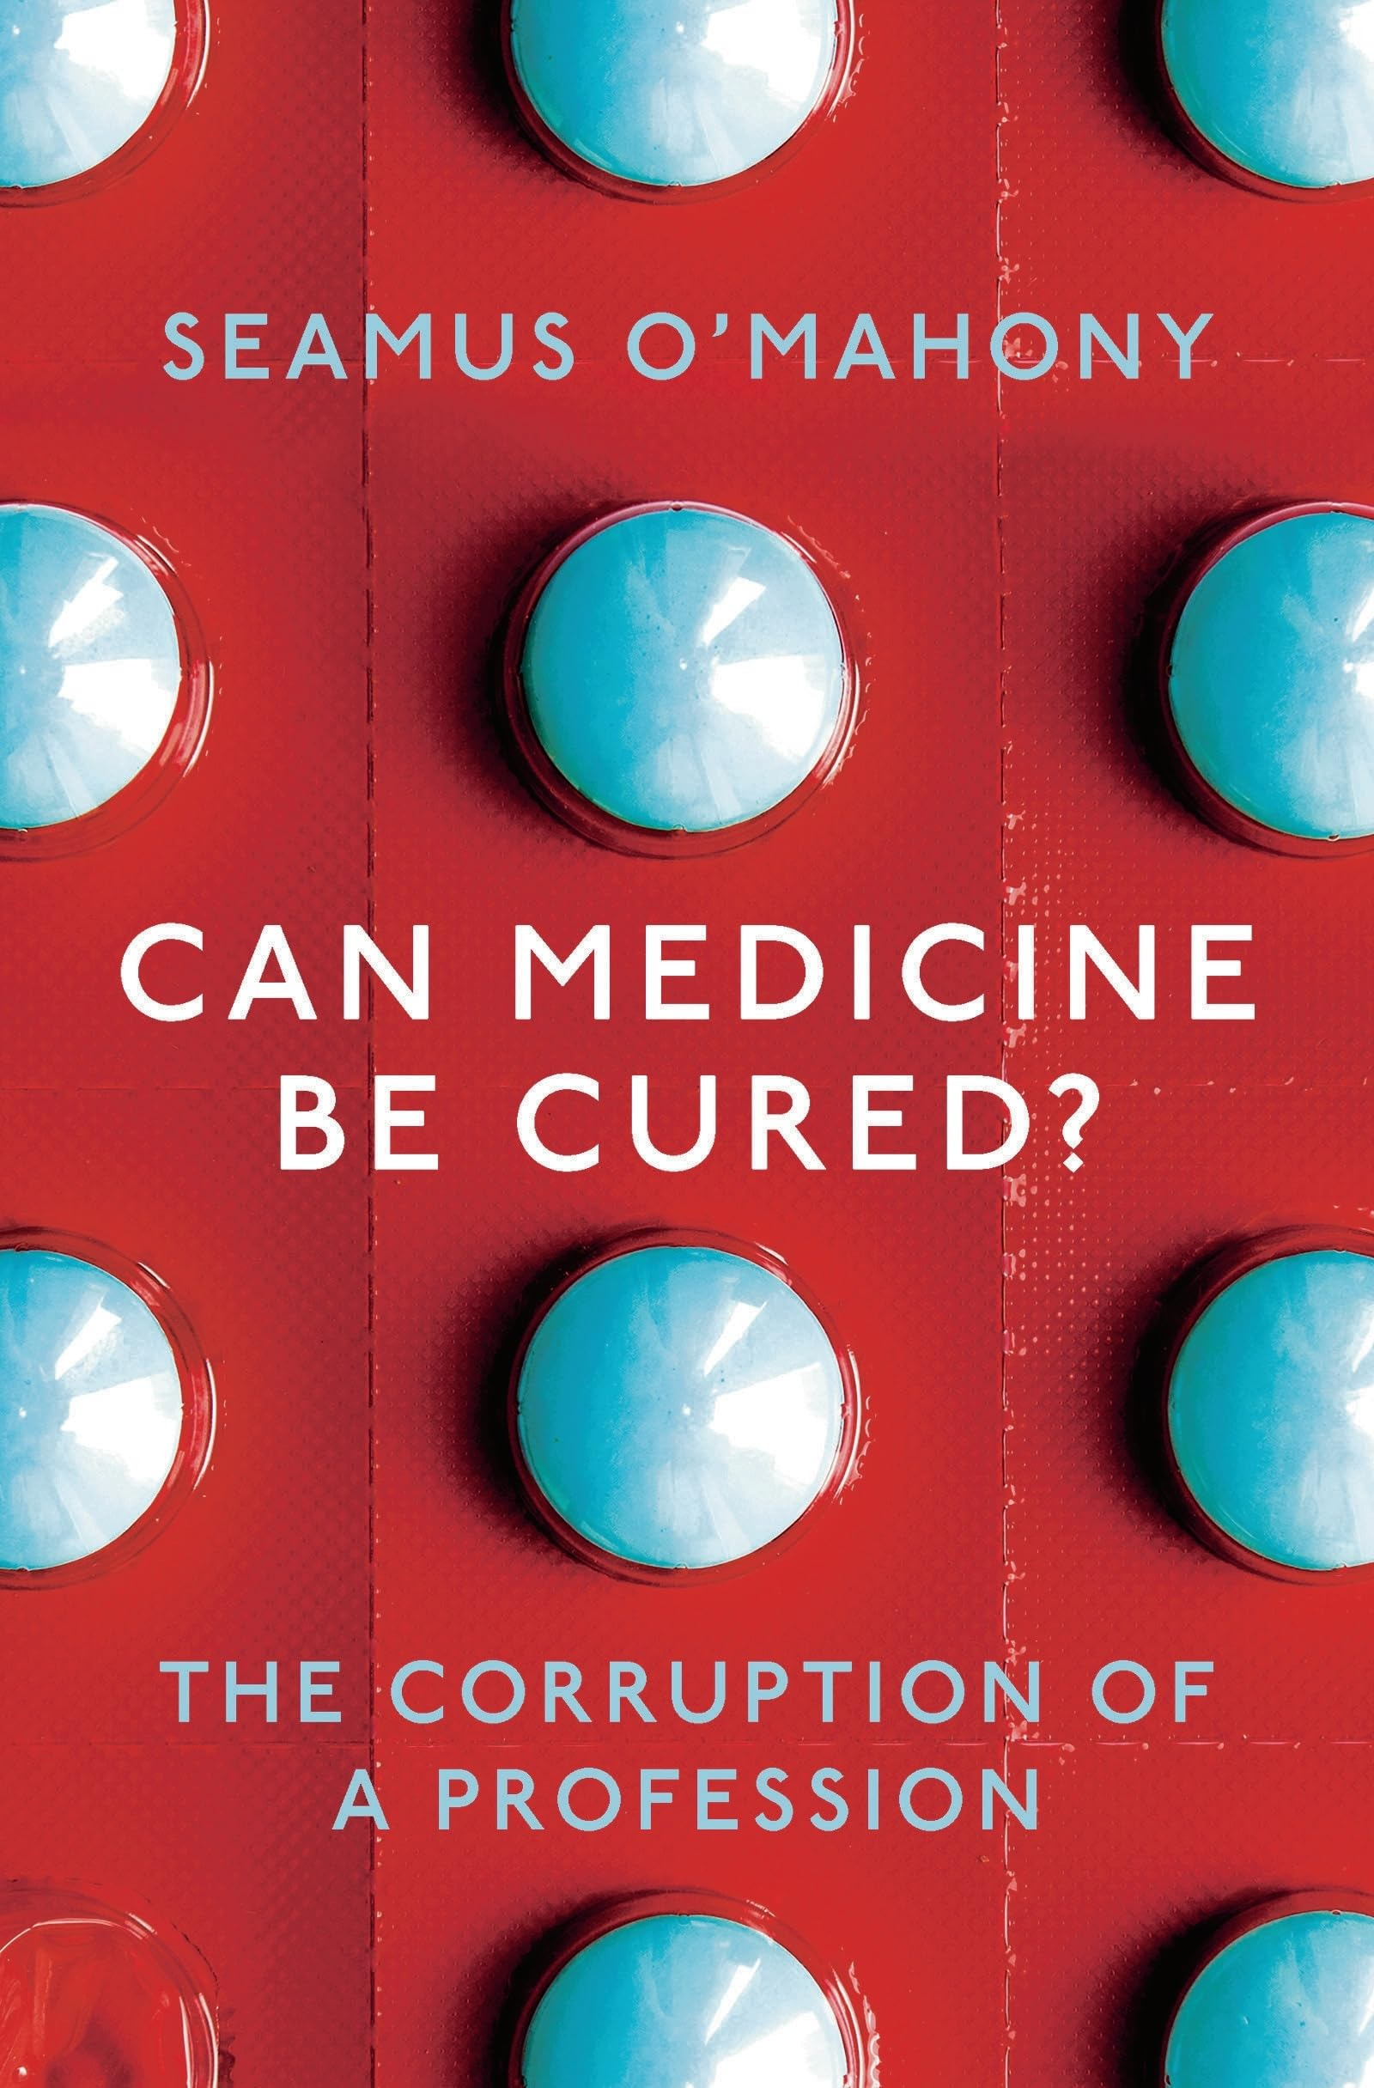
The illusion of innovation?
“In the years between 1974 and 2014, the frequency of the words ‘innovative’, ‘ground breaking’ and ‘novel’ in Pub Med abstracts increased by 2,500% ... as it is unlikely that individual scientists have become 25 times more innovative, one can only conclude that this language evolution reflects a response to increasing pressures for novelty…”
Seamus O’Mahony, Can Medicine be Cured (2019) p 42
Notes:
History medicine full of breakthrough innovations…
Obviously these are real – but is innovation over stated?
Quote from wonderful Seamus O’Mahony sceptical about over claiming innovation…
Cannot deny significant Implications of innovation…

Slide 7
Implications of innovation
Innovative or unproven?
Disruptive - challenges of change and implementation
Alters our conceptions of harm and preventability
Unrealistic expectations and patient vulnerability?
Acceptable level of safety?
Professional and patient education and training
Conflicts of interest (commercial)
How should law / regulation respond?
Notes:
Does innovation (whatever it may be) represent best response to a problem?
Disruptive – change (to already complicated systems which struggle) perhaps not ready for innovation? innovation not self implementing
Harm / prevention - Safety - shouldn’t expect instant (complete) success…
(Learning curve (all new technologies) – e.g. IVF and organ transplantation success rates at outset…)
False hope – stimulate demand can’t be met
Prof and patient education and engagement
Conflicts of interest

Slide 8
Regulation and technology
‘How is regulation to stay ‘connected’ to rapidly developing technologies? Is law able to evolve with the technology or is it destined to be chasing it?’
(Roger Brownsword, 2008: 285)
Notes:
Roger Brownsword, as always, said it best…back in 2008…

Slide 9
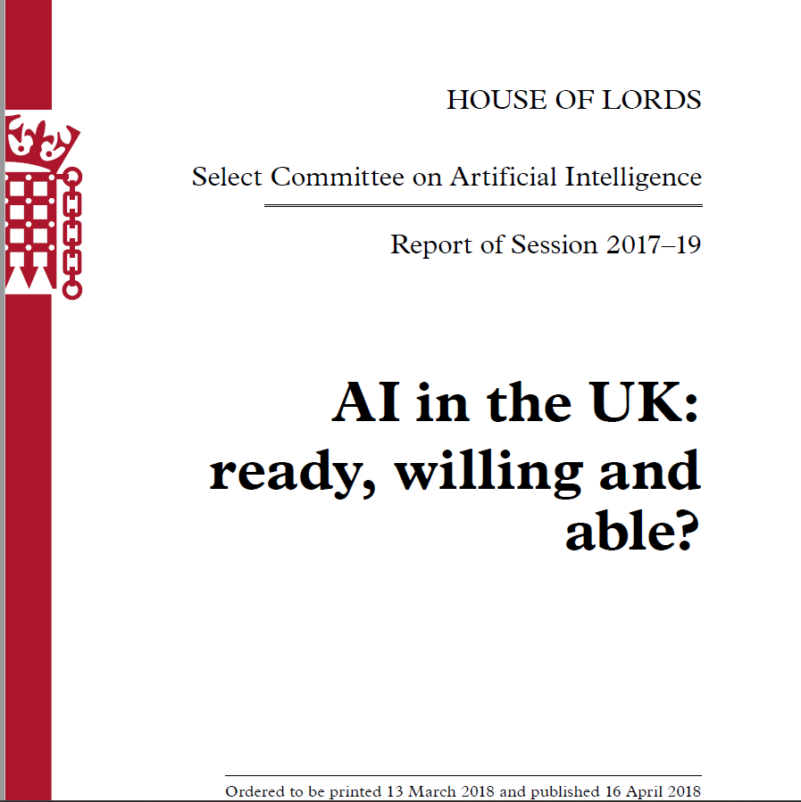
How to regulate AI?
Notes:
Background to current UK approach found in these key sources:
Reluctant to create specific AI regulation.
Against ‘one size fits all’ specific regulation of AI
And rely on existing laws and regulators…
Esp Data Protection Regime
Consumer Protection Law…

Slide 10
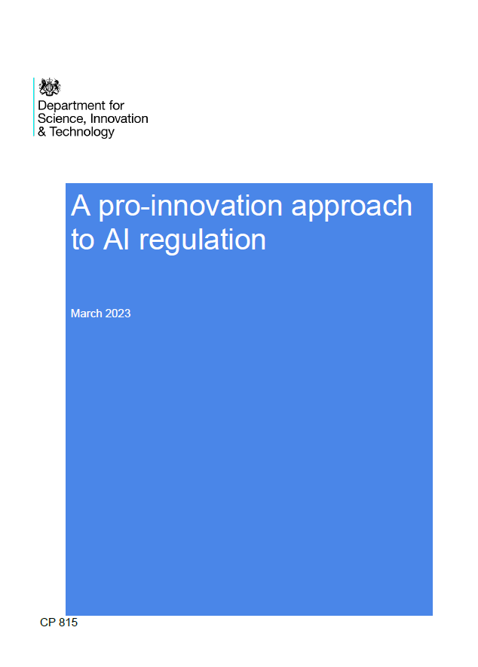
UK “pro-innovation” approach
Notes:
WP March 2023 and Govt response to consultation Feb this year –
Previous Tory Govt (Welsh socialist, heartbreaking lost last election)
Possible new Govt steers different course, and we will have to wait and see…
How to sum up this approach?

Slide 11
Notes:
Maybe too calm – complacent?

Slide 12
Notes:
No words needed
Brussels effect…

Slide 13
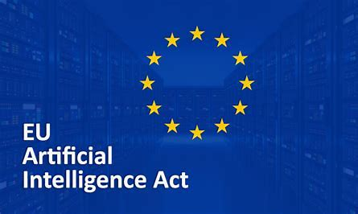
Risk-assessment model (risk to health, safety and fundamental rights)
Unacceptable risk AI - Title II: banned
High-risk AI - Title III: allowed, albeit under particularly strict standards;
Low-risk AI (limited risk and minimal risk) -Title IV: pretty much without restrictions

Slide 14
Innovation v Regulation?
“our white paper details how we intend to support innovation while providing a framework to ensure risks are identified and addressed. However, a heavy-handed and rigid approach can stifle innovation and slow AI adoption. That is why we set out a proportionate and pro-innovation regulatory framework. Rather than target specific technologies, it focuses on the context in which AI is deployed. This enables us to take a balanced approach to weighing up the benefits versus the potential risks.”
UK White Paper (2023, p2.)
Notes:
Tension between enabling innovation yet managing risks palpable in the intro to the WP

Slide 15
No AI specific regulator or laws
“creating a new AI-specific, cross-sector regulator would introduce complexity and confusion, undermining and likely conflicting with the work of our existing expert regulators.” (para 47)
“While we expect our principles-based approach to influence the global conversation on AI governance, we are not currently proposing the introduction of new legal requirements.” (para 115)
Notes:
Sensible build on existing structures and not to create a new super regulator given vast, diverse and dynamic nature of AI…
Central co-ordination by Government – Dept Science, Innovation and Technology -
However, no real mapping of currently regulatory remits and powers – thus hard to assess this proposed approach – i.e. there might be gaps, how should these will be managed?
In short, there is an absence of a full, workable regulatory model
Largely silent on possibility that some AI / way used may be undesirable and overlooks regulation being a ‘red light’ to such innovation…

Slide 16
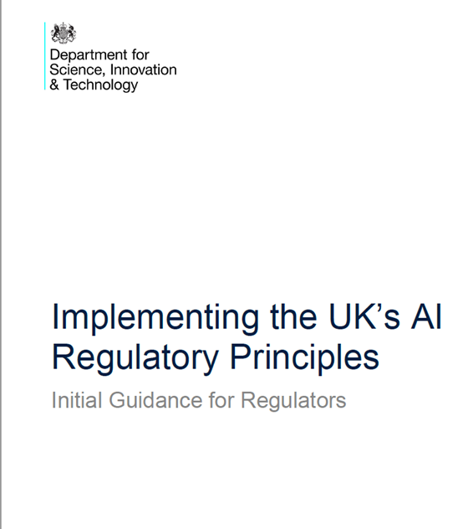
Cross sectoral principles
Safety, security and robustness
Appropriate transparency and explainability
Fairness
Accountability and governance
Contestability and redress
A new statutory duty for regulators to have “due regard” to these principles.
Notes:
These are values based cross sectoral principles.…(with some omissions – privacy, human rights, well being) – Charlesworth et al note, less exacting than OECD values based AI principles.
Duty to have regard very weak and meaningless.
Say more about some of these principles in time left…

Slide 17
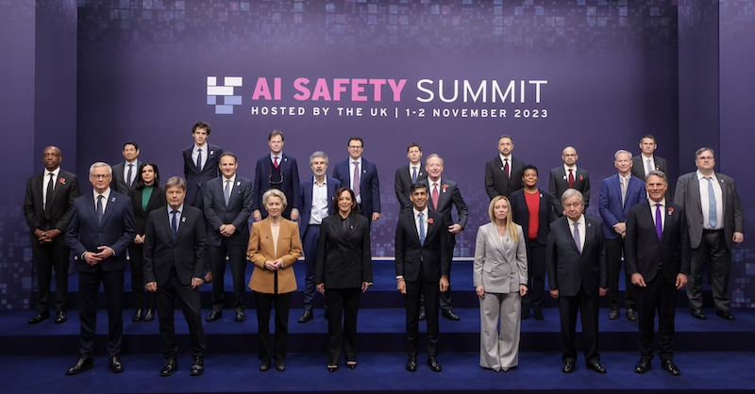
Safety second?
“important for all regulators to assess the likelihood that AI could pose a risk to safety in their sector or domain, and take a proportionate approach to managing it” (2003, WP p.27)
“it is clear that some mandatory measures will ultimately be required across all jurisdictions to address potential AI-related harms, ensure public safety” (Response 2024)
Notes:
Can you be the freest but also safest?
Response to Consultation –
Over half of respondents reported that current routes to contest or seek redress for AI-related harms through existing legal frameworks are not adequate. In particular, respondents flagged that a lack of transparency around when and how AI is used prevents users from being able to identify AI-related harms. Similarly, respondents noted that a lack of transparency around the data used to train AI models complicates data protection and prevents intellectual property rights holders from exercising their legal and moral rights. A few respondents also noted the high costs of individual litigation and advocated for clearer routes for individual and collective action.
Respondents wanted to see clear – and in some cases mandatory – routes to contest or seek redress for AI-related decisions.
Initial guidance suggests – defining what safety, security and robustness mean in context of AI systems…
Provide guidance for AI safety risk assessments
Enable deployers and users of AI to make informed decisions about safety of AI products and services…(can they credibly do both?)

Slide 18
Contestability and redress?
“Product-specific legislation (such as for medical devices) may apply to some products that include integrated AI. However, safety risks specific to AI technologies should be monitored closely. As the capability and adoption of AI increases, it may pose new and substantial risks that are unaddressed by existing rules.” p.14
“The UK’s initial non-statutory approach will not create new rights or new routes to redress at this stage.” p.32
Notes:
The initial guidance is remarkably thin on routes to redress for AI harm –
“This is ultimately the responsibility of AI developers and deployers, but regulators could promote this practice.
This will enable AI deployers to contest outcomes with AI developers, and will enable AI users to contest outcomes with AI deployers, AI developers or both.”

Slide 19
Uncertain legal framework…
Notes:
This pithy (rather pathetic) statement (from recent UK white paper on Regulating AI) a far cry from the detail contained in the two proposed EU directives on AIL and PL…
Essentially saying: Let’s see what happens?
Of course, doing nothing an option and let law and technology work out their relationship organically
Adapt existing categories / judgment and discretion…

Slide 20
Pros & Cons of the UK Approach
PROS ☑☑☑
Support for Innovation
Flexibility and Adaptability
Proportionality and Risk Management
Sector-Specific Guidelines
Stakeholder Engagement
Regulatory Clarity and Simplicity
International Alignment and Competitiveness
CONS 
Safety is Secondary?
No Statutory Powers
Imprecise Principles
Fragmented Regulatory Landscape
Enforcement Concerns
Regulatory Independence Compromised?
Inadequate Redress
Ethical and Social Considerations
Notes:
Lack of Specificity
General Principles: The UK's principles-based approach is seen as too vague and lacking detailed, prescriptive rules, making it difficult for businesses to know exactly what is required for compliance.
Guidance Ambiguity: The reliance on broad guidelines rather than specific regulations can lead to inconsistent interpretations and applications across different sectors.
Fragmented Regulatory Landscape
Multiple Regulatory Bodies: The involvement of various sector-specific regulators (e.g., ICO, CMA, FCA) can create a fragmented and potentially confusing regulatory environment for businesses operating across multiple sectors.
Coordination Challenges: Ensuring effective coordination and consistency between different regulatory bodies can be challenging, potentially leading to regulatory overlaps or gaps.
Enforcement Concerns
Limited Enforcement Power: Critics argue that the UK’s approach may lack the necessary enforcement mechanisms and penalties to ensure compliance, potentially allowing non-compliant AI systems to operate without significant consequences.
Inconsistent Enforcement: The flexibility in enforcement may result in varying levels of scrutiny and accountability across sectors, potentially undermining the overall effectiveness of the regulatory framework.
Innovation vs. Safety Balance
Overemphasis on Innovation: While fostering innovation is a key goal, some critics believe that the UK’s regulatory framework may prioritize innovation at the expense of safety and ethical considerations.
Risk Management: The principles-based approach might not adequately address the risks associated with high-stakes AI applications, particularly in areas like healthcare and law enforcement where the consequences of failure can be severe.
Regulatory Certainty
Business Uncertainty: The lack of detailed regulations can create uncertainty for businesses, particularly for startups and smaller companies that may not have the resources to interpret and implement broad principles.
Investment Risks: Uncertainty in regulatory expectations may deter investment in AI development, as businesses seek clearer and more predictable regulatory environments.
Global Competitiveness
International Alignment: Critics argue that the UK’s regulatory framework may not align well with more stringent international regulations (e.g., the EU AI Act), potentially complicating cross-border operations and compliance for UK-based AI companies.
Competitive Disadvantage: There is a concern that a more lenient regulatory approach may put UK businesses at a competitive disadvantage in markets where stricter regulations are in place, potentially impacting their global competitiveness.
Ethical and Social Considerations
Inadequate Ethical Safeguards: Some critics feel that the principles-based approach does not sufficiently address ethical issues such as bias, fairness, and transparency in AI systems.
Public Trust: Without clear and stringent regulations, there may be a lack of public trust in the safety and fairness of AI systems, particularly in sensitive applications affecting everyday life.

Slide 21
Key questions for discussion…
How will this UK principles based approach to regulation be delivered?
Is this agile regulation or active de-regulation which unduly prioritises digital industrial policy goals?
Can current mechanisms ensure sufficient safety and adequate redress for AI related healthcare harm?
Is the apparent tension between pro innovation and reluctant regulation ultimately a false dichotomy?
Notes:
Q1 – remains unclear. scope of remit, statutory powers, capabilities…WP doesn’t clarify here apart from liaise with Govt.
Central function – DSIT – time will tell – arms length body?
Crucially, how will these be developed into enforceable requirements? No coherent, deliverable regulatory model – Govt responsible for delivering central functions (co-ordination, monitoring, adapting).
Non statutory approach means principles hard to deliver – real risk regulators just not empowered to act, and if do so subject to being reviewed public law mechanisms
What about when they inevitably conflict? – no steer on how to resolve this – but general approach suggests policy of driving innovation prevails…
Compromises regulatory independence? MHRA ‘put patients first in everything we do’ – especially if oversight by Govt not an independent regulator.
Q2 – deregulation
Q3 – Hard to be confident re safety and redress for harm
Q4 – I think it is…innovation needs regulation to be trusted in long term.

