Slide 1
Ghost Gun Regulation: Threats to Federal Rules and the Promise of State Policy and Litigation
Alex McCourt, JD, PhD, MPH
Assistant Professor
Johns Hopkins Center for Gun Violence Solutions
Johns Hopkins Center for Law and the Public’s Health
Johns Hopkins Bloomberg School of Public Health

Slide 2
Acknowledgments
Bloomberg American Health Initiative
Johns Hopkins Center for Gun Violence Solutions
Daniel Webster

Slide 3
Outline
Background: What are ghost guns and how are they used?
Federal rule and Bondi v. VanDerStok
State policy
Baltimore City case study
Conclusion and future work

Slide 4
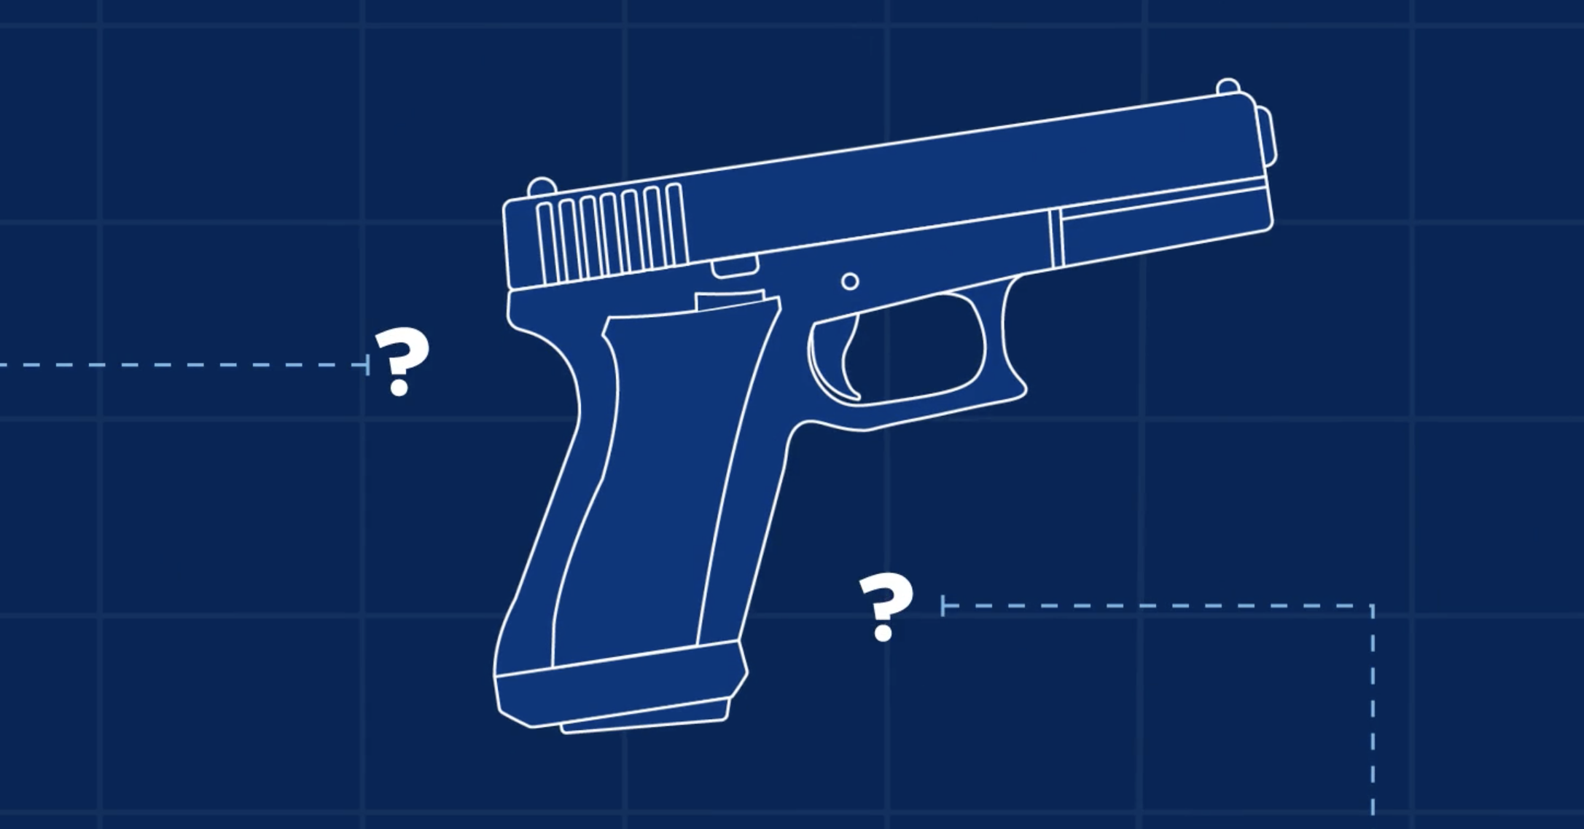
What are “ghost guns?”
Privately made firearms (PMFs) that lack serial numbers or other identifying markings
Usually constructed from individual pieces or kits
Traditionally manufactured guns must be marked with a serial number and other identifying markings

Slide 5
Bondi v. VanDerStok, 604 U.S. ___ (2025)

Slide 6
Bondi v. VanDerStok, 604 U.S. ___ (2025)

Slide 7
Why are unserialized guns a problem?
Difficult or impossible to trace
If sold, trafficked, used in violence or crime, and then recovered by law enforcement, the lack of serial number means no tracing
Until recently, anyone could buy the pieces and kits
Typical prohibitions do not apply to this purchase; they only kick in once the gun is constructed
No background checks required

Slide 8
Recovery of PMFs increased rapidly
ATF. Privately Made Firearms. Updates and New Analysis. https://www.atf.gov/firearms/docs/report/nfcta-volume-iv-part-v-%E2%80%93-pmf-updates-and-new-analysis/download.

Slide 9
Policy approaches: Biden Admin. Rule
2021: Biden administration directed DOJ and ATF to issue a rule regulating ghost guns
Final rule took effect August 24, 2022
Drew authority from the Gun Control Act (GCA) of 1968
Under the GCA firearm manufacturers must mark their firearms with serial numbers
Firearms defined as “any weapon (including a starter gun) which will or is designed to or may readily be converted to expel a projectile by the action of an explosive; the frame or receiver of any such weapon. . .”
ATF interpreted GCA to include DIY kits and partially complete frames/receivers
If designed to be readily converted
Immediately challenged

Slide 10
Bondi v. VanDerStok, 604 U.S. ___ (2025)
Issue: Whether the ATF’s regulation of “weapons parts kits” and “partially complete disassembled, or nonfunctional frames or receivers” is consistent with the Gun Control Act of 1968.
Supreme Court (7-2): Yes.
Kits: at least some kits can be readily converted
Frames/receivers: at least some partially complete frames/receivers can be readily converted
Key: Ordinary language allows us to describe incomplete/deconstructed things by their intended function

Slide 11
VanDerStok, cont.
“[A]t some point a kit may be so incomplete or cumbersome to assemble that it can no longer fairly be described as a ’weapon’ capable of ‘read[y] . . . conver[sion]’ into a working firearm.”
“Start with a heap of sand and begin removing grains; at some point, a heap no longer exists.”
Federal rule stays in place, but door is open to relaxed enforcement.

Slide 12
State policies
Fifteen states (and D.C.) have adopted PMF laws:
California, Colorado, Connecticut, Delaware, Hawaii, Illinois, Maryland, Massachusetts, Nevada, New Jersey, New York, Oregon, Rhode Island, Vermont, Washington, Washington, D.C.
Earliest laws adopted in California and New Jersey (2018), but these have been strengthened over time

Slide 13
State PMF laws and select years

Slide 14
Local litigation
Cities have tried to tackle the spread of PMFs through litigation against manufacturers (e.g., Polymer80)
Baltimore, Philadelphia, Los Angeles, Washington, D.C., etc.
Settlements ranging from $ to bans on local/state advertising and business
Contributed to shuttering of Polymer80

Slide 15
Case Study: Baltimore City, MD
Initial analyses of Baltimore City suggest that these federal, state, and local efforts are having an effect
Federal rule effective August 2022
Maryland PMF law
Unlawful to sell/purchase or otherwise transfer/receive any unserialized firearm (including unfinished frames/receivers). Eff. June 1, 2022
Unlawful to possess unserialized firearm (including unfinished frame/receiver. Eff. March 1, 2023
Process to get weapon serialized
Baltimore City filed lawsuit against Polymer80 in June 2022
Settled in February 2024

Slide 16
PMF use in Baltimore, 1
Credit: Daniel Webster

Slide 17
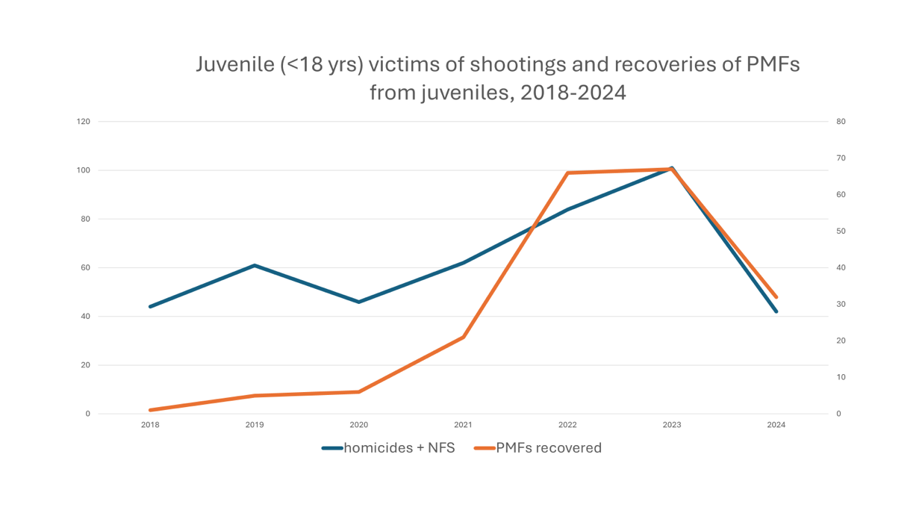
PMF use in Baltimore, 2
Credit: Daniel Webster

Slide 18
Conclusion
PMF use in violence is still pervasive, though understudied
ATF rule may be affecting availability by regulating kits and pieces identically to traditionally manufactured guns
Potential gaps
States and localities have tried to fill gaps through policy and litigation
Most states have not adopted a PMF law
Early studies suggest that some combination of the federal rule, state policy, and local efforts may be affecting PMF availability and use in violence

Slide 19
Next steps
Current work: Data collection and policy evaluation
Evaluating data collection practices: enforcement and prosecution
Tracking state policy development in states where cities have been aggressive but states have not

Slide 20
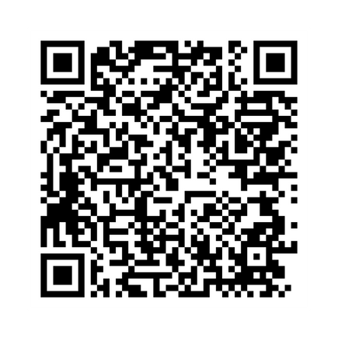

Slide 21
Thank you!
Alex McCourt, JD, PhD, MPH amccourt@jhu.edu

