Slide 6
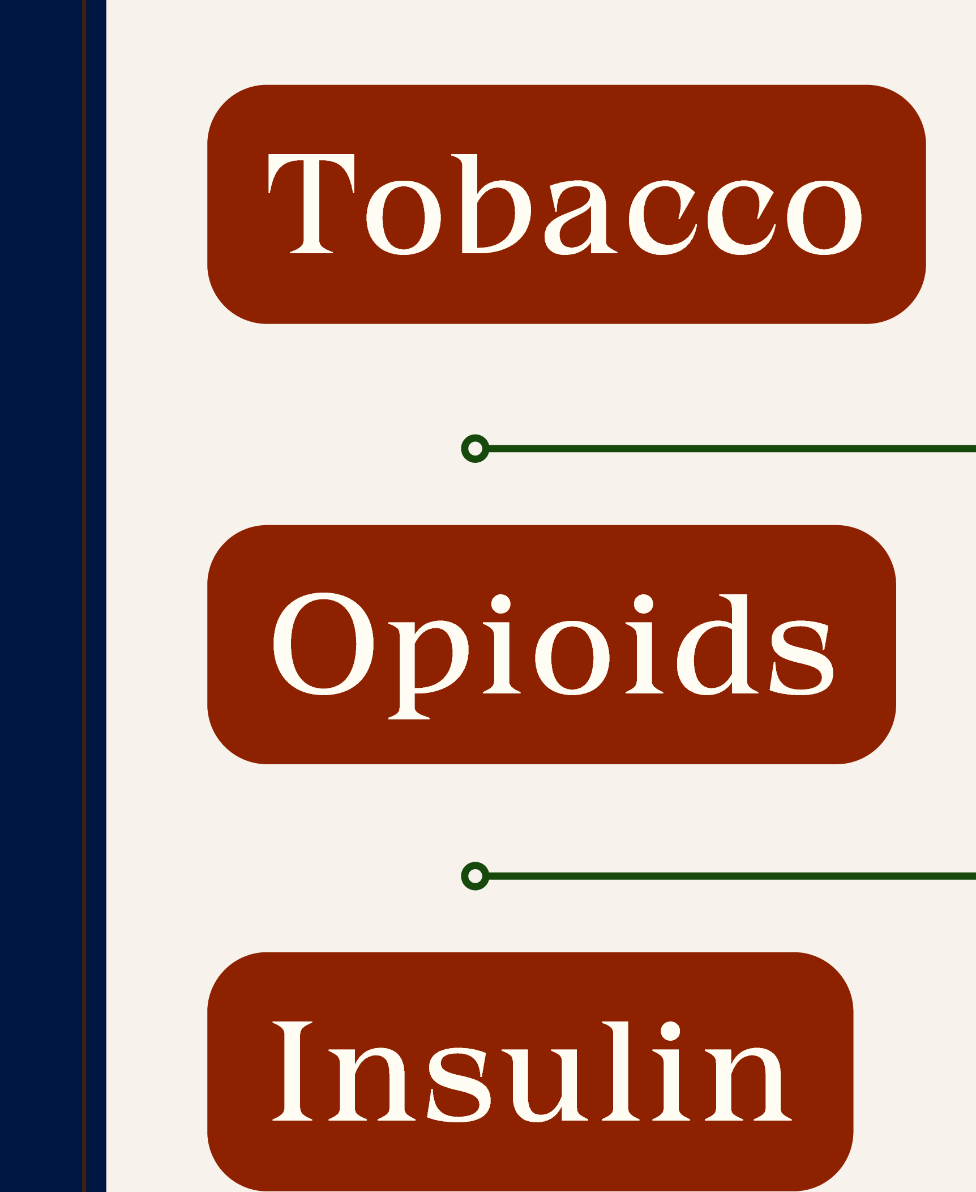
Settlement payments (reimbursement) to states
Individual suits for punitive damages precluded
State representation of individual citizens?
Concurrent state & locality suits
Settlement payments earmarked for abatement
State (local?) representation of the general public?
State, locality, and individual suits in the same MDL
Parallel federal investigations
Concurrent public and private enforcement?
HLP 25 I Elle Rothermich

Slide 8
Adequate Representation
1. interest alignment
'
2. procedural protections
•
HLP 25 I Elle Rothermich

Slide 9
!
,-------------.. 1. residents' general
health& well-being
•I
Quasi -Sovereign Interest
•I
I
•---------l
2. state's "rightful status within thefederals;ystem"
I
HLP 25 I Elle Rothermich

Slide 10
attenuated
mediated through electoral process
no preclusive effect
close
mediated through judicial s;ystem
preclusive effect* (*ma;ybe)
HLP 25 I Elle Rothermich

Slide 11
the public
taxpa;yers
"at large"
citizens
Members of Underserved
Communities
-
''
''
I
Medicaid Enrollees
children
&;youth
residents
HLP 25 I Elle Rothermich

