Slide 1
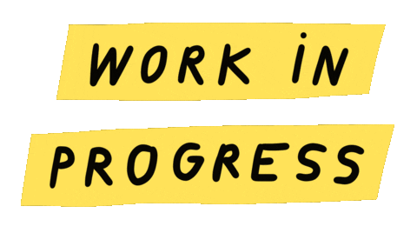
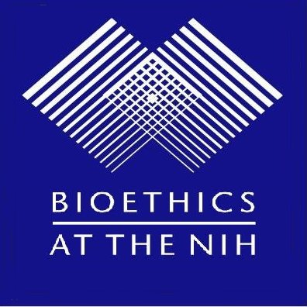
It’s Time to Break Tradition: A Pitch to Unbundle Psychedelics from Psychotherapy
Chloe Connor
Department of Bioethics
NIH Clinical Center
Notes:
Around 15 mins now
My name is Chloe Connor, fellow at NIH dept of bioethics, happy to be here
Sharing my work in progress that began at psychedelics bootcamp hosted by HLS
Would love your feedback on this forthcoming law review
My presentation is titled- It’s Time to Break Tradition: A Pitch to Unbundle Psychedelics from Psychotherapy

Slide 2
Disclaimer: The views, information or content, and conclusions presented do not necessarily represent the official position or policy of, nor should any official endorsement be inferred on the part of, the Clinical Center, the National Institutes of Health, or the Department of Health and Human Services.
Positionality: I am an ethicist, not a clinician or a lawyer.
Notes:
Here is my disclaimer which states that the views in this talk are my own and they do not represent the position or policy of the government.
I also want to acknowledge that I approach this topic as an ethicist, not as a clinician or a lawyer

Slide 3
¹
Notes:
We are in a crisis of psychopharmacology, in the midst of a mental health epidemic in America.
Mental health disorders are leading causes of disability and health burden worldwide
Pharmacologic treatments for some mental health disorders are similarly effective to the ones first introduced over half a century ago

Slide 4
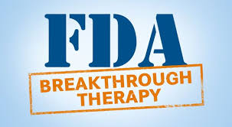
bb
³
²
Notes:
In this milieu of stagnation, psychedelics have re-emerged as a potential gamechanger for combatting the mental health epidemic
Many believe that psychedelics are unlike any other approved treatment, and they have the potential to create lasting improvement
There is some concern that psychedelics are being unduly positively exceptionalized by some as the magic bullet solution to all mental health problems
At the same time, they are unduly negatively exceptionalised by others as a sort of dangerous substance that has no place in modern medicine
Against this backdrop of both hype and skepticism, regulatory agencies have taken cautious but significant steps forward
The FDA has designated breakthrough therapy to specific development programs including MDMA for PTSD and psilocybin for depression

Slide 5
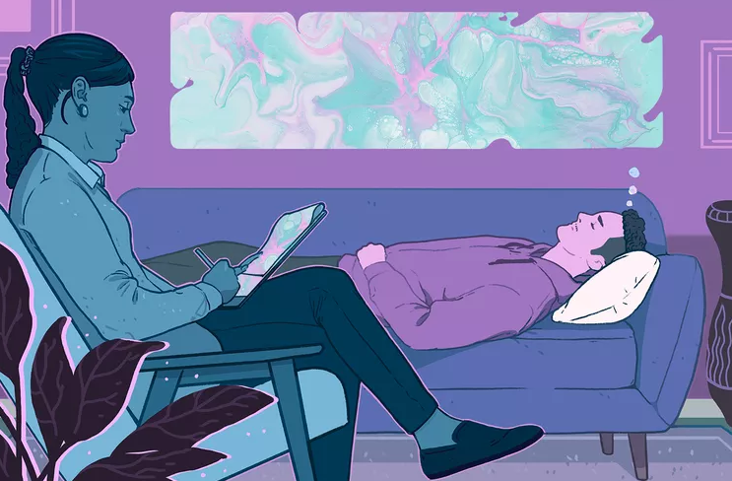
PSYCHEDELIC-ASSISTED THERAPY
Consists of preparation, dosing, and integration⁵
Example: MDMA for PTSD (Lykos Therapeutics)⁶
3 90-min preparation sessions
3 6 to 8-hour MDMA dosing sessions
9 90-min integration sessions
Total = approx 40 hours
Mandatorily bundles psychotherapy with psychedelic
Proposed alternative: evaluate psychedelic alone but require patient monitoring, not psychotherapy
⁴
Notes:
First, it may be helpful to clarify what the FDA actually designated. The FDA didn’t exactly give “breakthrough therapy designation” to MDMA or psilocybin itself
Instead, “breakthrough therapy designation” was given to specific development programs that paired a specific psychedelic with therapy, what is commonly referred to as psychedelic-assisted therapy
Psychedelic assisted therapy typically involves three phases: preparation where a patient is supported in advance of the experience, dosing where the psychedelic is administered in a controlled setting, and integration where the patient and therapist unpack the experience
By granting breakthrough designation to this bundle of drug and therapy, the FDA departed from its usual focus on evaluating drugs alone. In doing so, it also effectively mandates psychotherapy as a condition of using the psychedelic.
While mandating therapy may seem like a small hoop, it actually is a big deal, it can add dozens of hours of required treatment and make psychedelics cost upwards of 10 times as much to administer
On the slide you can see an example of a development program that was given breakthrough therapy designation, and you can see how much time is dedicated to the preparation and integration sessions
In this presentation, I argue that requiring psychedelics and therapy be bundled is the wrong way to approach the rollout of psychedelics for psychiatric disorders
I think that a better alternative would be for psychedelics to be evaluated as standalone treatments that include patient monitoring during a psychedelic experience as a safeguard
To be clear, I am not “anti” offering psychedelic assisted therapy, which many people want for a multitude of reasons.
I am ANTI BUNDLING psychedelic assisted therapy which would likely make it the only pathway for accessing psychedelics in a medical setting

Slide 6
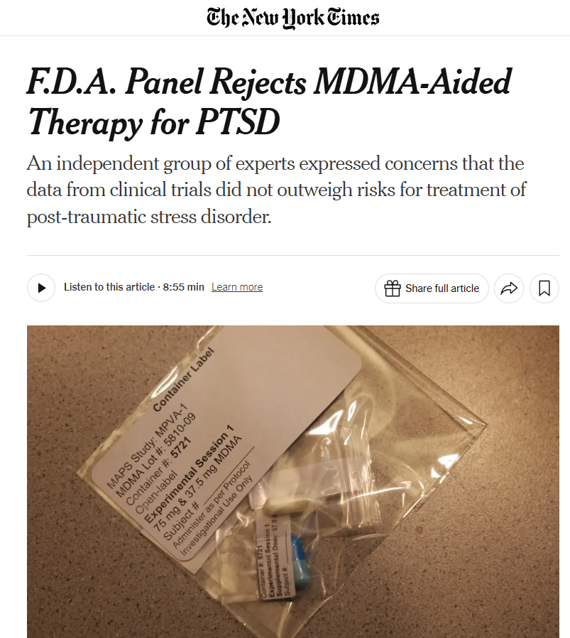
FDA issues
FDA regulates drugs, not the practice of medicine (including psychotherapy)⁸
FDA cannot evaluate drug efficacy or safety when confounded by psychotherapy⁸
bb
⁷
Notes:
In August of last year, the FDA rejected Lykos’s application for MDMA-assisted therapy for PTSD. This was a major blow for many in the psychedelic research and advocacy community who saw this as a frontrunner for the first FDA approval of psychedelics.
The rejection highlighted some fundamental challenges that affect all psychedelic assisted therapies
One big problem raised at the FDA’s advisory committee meeting was on how to assess a psychedelic assisted therapy. The FDA regulates drugs, not the practice of medicine, but psychedelic assisted therapy is both a drug and the practice of medicine. If the FDA approved psychedelic assisted therapy, it would give rise to a situation where it can only regulate half of what it approves
Relatedly, since psychedelics and therapy were bundled, the FDA could not isolate the safety or efficacy profile of psychedelics, since it was all confounded with the therapy
In light of these challenges, some companies are now shifting toward studying psychedelics in isolation—separate from therapy—in hopes of avoiding the same regulatory pitfalls
However, this is not without controversy, as many are opposed to this approach within the psychedelic community
But I want to argue that this move toward unbundling isn’t merely a concession to regulators—it’s actually the right approach from an ethical, scientific, and legal standpoint.

Slide 7
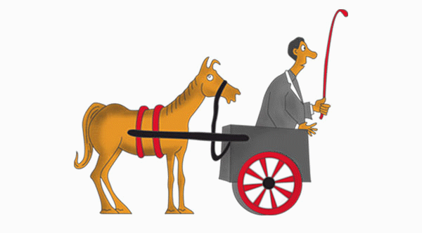
⁹
⁹
¹⁰
⁸
¹¹
¹²
¹³
¹⁴
Notes:
Now, I’m not the first one to say this. Goodwin and colleagues shared this sentiment, using psilocybin as an example, but received a strong backlash and 6 reply letters in opposition.
I think the opposition could be pretty well characterized by Earleywine’s commentary title, calling psilocibin without psychotherapy a cart without a horse
In other words, there’s a deeply rooted belief that the psychedelic alone isn’t safe or efficacious without the accompanying therapy.
Im going to build off Goodwins initial argument by adding ethical and regulatory reasons why we should reconsider the status quo

Slide 8
Researchers and pharmaceutical companies should pursue clinical trials—and ultimately FDA approval—for psychedelics as standalone treatments which include appropriate patient monitoring, but are not bundled with mandatory psychotherapy
Notes:
My central argument is that Researchers and pharmaceutical companies should pursue clinical trials—and ultimately FDA approval—for psychedelics as standalone treatments which include appropriate patient monitoring, but are not bundled with mandatory psychotherapy
Patient monitoring is included because psychedelics can be disorienting and dangerous to take in uncontrolled settings. It may initially sound similar to psychotherapy but it would be quite different in that it would not include an explicit “preparation” phase and it would not require “integration” sessions. Also, patient monitoring would not necessarily need to be done with psychiatrist or other highly educated clinicians.

Slide 9
MANDATING PSYCHEDELIC-ASSISTED THERAPY IS JUSTIFIED BASED ON SAFETY AND EFFICACY….
…but there is a lack of research directly comparing psychedelic-assisted therapy with psychedelics as a standalone treatment⁸
Notes:
Mandating psychedelic assisted therapy is justified based on safety and efficacy reasons, which I will counter in a moment
But first I want to acknowledge that this justification as well as my counter is weakened by the fact that there is a lack of research directly comparing psychedlic assisted therapy to psychedelics as a standalone
There is an urgent need to fill this knowledge gap, but in the meantime we should not assume that psychedelic assisted psychotherapy should be the required approach

Slide 10
SAFETY
EFFICACY
Some evidence that psychedelics may be similarly effective without psychotherapy⁸
Even if psychotherapy improves efficacy, does not justify mandating if psychedelic works as a standalone treatment
Psychedelic-assisted therapy argued as necessary for patient safety, but safety monitoring largely mitigates the same risks⁸
Psychedelic-assisted therapy not necessarily safer than monitoring when considering risks of therapy¹⁵
Notes:
Now I am largely going to bracket a more substantive discussion on the risks of psychedelics, but I do want to note that most of the “safety” features that psychedelic assisted psychotherapy offers can be achieved through a robust informed consent process and careful patient monitoring by someone trained to do so
I also think its worth pointing out that psychedelic assisted psychotherapy is not necessarily the “cautious” approach. As Mcnamee and colleages have argued, the psychotherapy aspect of psychedelic assisted therapy may constitute some of its greatest risk. For example, the psychotherapy techniques used in psychedelic assisted therapy are understudied. Some especially controversial techniques such as touch therapy have been linked to the sexual abuse of patients
On the efficacy side, While some say that psychedelics simply don’t work without therapy, but that’s not entirely clear. There is some evidence to suggest that psychedelics may be similarly effective when administered alone. In addition, it seems odd that psychotherapy would be required just because it may improve efficacy. Think of another depressant treatment, SSRIs. We KNOW that SSRIs in combination with the therapy CBT is more effective than either in isolation. However, we don’t require that patients take 10 sessions of CBT in order to have Prozac?

Slide 11
ETHICAL ADVANTAGES OF UNBUNDLING
Population level benefits: improved resource allocation
Individual level benefits: improved affordability + accessibility
Autonomy of patients
Notes:
Now I am going to shift to some ethical advantages of unbundling psychedelic-assisted therapy
As a reminder, this ethical analysis is incomplete without necessary additional clinical data comparing psychedelics as standalone to psychedelic assisted therapy
At a population level, removing the psychotherapy requirement could help optimize resource allocation within our already overburdened mental health system. Making psychedelic assisted therapy an optional type of psychedelic therapy would help us identify the true demand of psychedelic assisted therapy as distinguished from the true demand of psychedelics in isolation
At the individual level, giving patients the option to forgo psychotherapy would significantly reduce the cost of care. One study found that over 90% of the total cost of PAT comes from the psychotherapy component. Eliminating this requirement could make psychedelics much more accessible, especially in rural or underserved areas where trained psychedelic therapists may not be available. When a treatment is this costly and logistically demanding, the burden of proof should be high for imposing an access-limiting requirement like mandatory therapy.
Another major ethical benefit of unbundling is that it promotes patient autonomy. The ability to select a treatment that aligns with their personal needs can foster a sense of control, which is particularly important for patients who may feel disenfranchised by their mental health struggles.

Slide 12
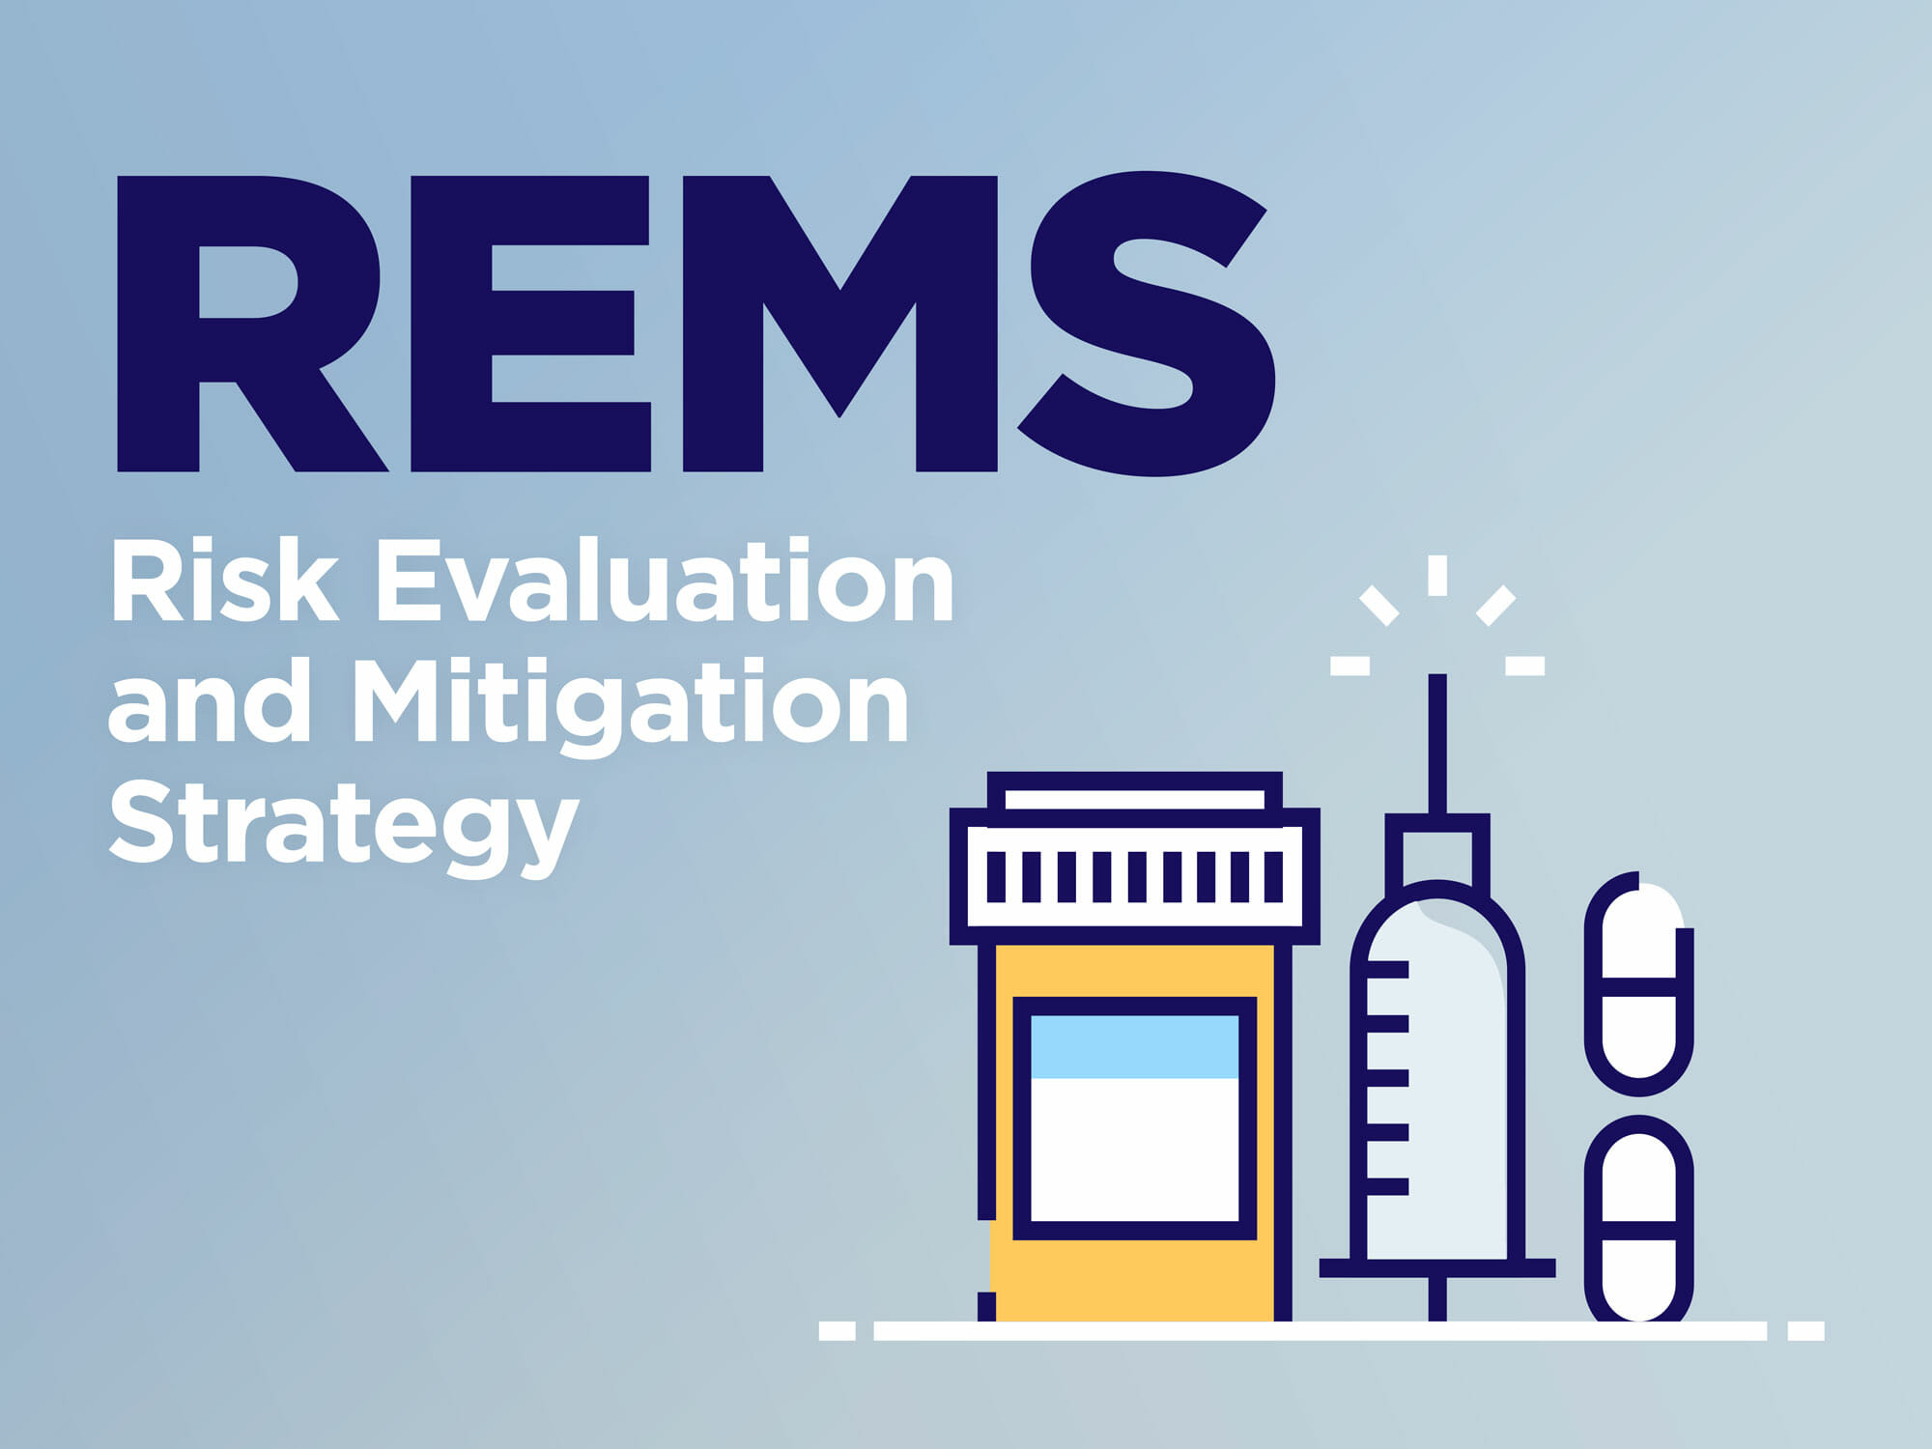
REGULATORY SOLUTIONS WITH UNBUNDLING
FDA approves psychedelic as standalone
Adds REMS (Risk Eval and Mitigation Strategies)
-ETASU (Elements to Assure Safe Use)
¹⁶
Notes:
Now, even if the FDA were to approve a psychedelic on its own, without requiring concurrent therapy, the FDA and drug sponsor still have several tools at its disposal to bolster patient safeguards.
One of the most important tools the FDA can use is that they can require the drug sponsor to include a risk evaluation and mitigation strategy, or REMS. REMS are intended to prevent, monitor, or manage specific risks of a drug. They serve a safety function, not an efficacy function. Therefore, requiring patient monitoring could be an appropriate use of REMS, but probably not requiring concurrent therapy unless the justification is based on safety and not on efficacy
Within REMS, the FDA can also require the drug sponsor to include elements to assure safe use. These are more structured requirements that can include things like specialized training for clinicians who prescribe or administer the drug. That could be an important way to ensure that patients receive psychedelics in controlled, informed, and safe environments, without mandating therapy.

Slide 13
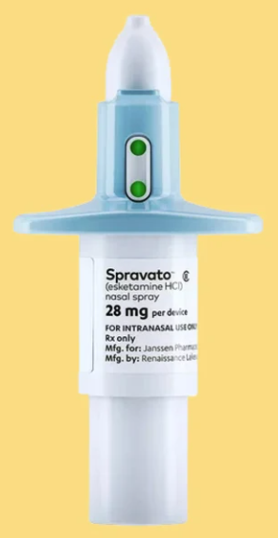
MODEL AFTER SPRAVATO (ESKETAMINE)?
FDA-approved treatment for depression
REMS require patient monitoring in certified healthcare setting
Initially required to be bundled with an antidepressant, but requirement lifted¹⁸
¹⁷
Notes:
Now, while there’s no perfect analogy for psychedelics, looking at similar regulatory situations can demonstrate how this would work in the real world
One particularly relevant example is Spravato, also known as esketamine. Esketamine is a derivative of ketamine and is somewhat psychedelic-adjacent in its effects. Like psychedelics, it alters consciousness and raises concerns about patient vulnerability during treatment.
The FDA has approved Spravato for depression, and—importantly—it did so with a REMS to address safety concerns.
The REMS requires Spravato be administered under the direct supervision of a healthcare provider, in a certified healthcare setting. After each dose, patients must stay in the clinic for safety monitoring for at least 2 hours.
Spravato offers a compelling regulatory example, especially when considering that it was initially required to be taken alongside an oral antidepressant drug, for proported safety and efficacy reasons, similarly to the justification for psychedelic assisted therapy.
When those requirements were put in place, access limitation was a huge concern. Beyond the logistical issues of requiring antidepressants for Spravato eligibility, it was frustrating to patients who were interested in Spravato BECAUSE they didn’t want to be on oral antidepressants, either because they didn’t like how it made them feel, it didn’t work, or there were unpleasant side effects. . In January 2025, the FDA expanded approval of Spravato to be a standalone treatment, which has made the treatment much more accessible
There’s also a useful parallel when it comes to psychotherapy: Spravato can be combined with therapy, and some clinics even offer it in a psychedelic-assisted therapy format. But the key point is that this is optional, not mandated
So overall, Spravato illustrates how the FDA can use certification, supervision, and monitoring requirements to address safety without restricting access through rigid treatment bundles.

Slide 14
PROPOSED SOLUTION
Psychedelic trials with patient monitoring in the anticipated REMS format for safety
REMS implements which require in-person monitoring at a certified facility
NOT mutually exclusive with psychedelic assisted therapy
Notes:
What would modeling after Spravato look like in practice?
We could have a situation where psychedelics are studied in isolation, without a therapy confounding results
But—importantly—clinical trials could still include patient monitoring requirements that would form the MINIMUM level of clinician involvement and eventually lead to proposed REMS
If approved, the psychedelic could be made available at certified facilities, where patients would receive in-person monitoring during the dosing session.
This setup ensures safety without requiring every patient to undergo full psychedelic-assisted therapy.
This structure would also preserve the option of psychedelic-assisted therapy.
For people who want the full PAT experience . In fact, the psychotherapist could serve as the patient monitor during the dosing session, meeting both therapeutic and safety goals.

Slide 15
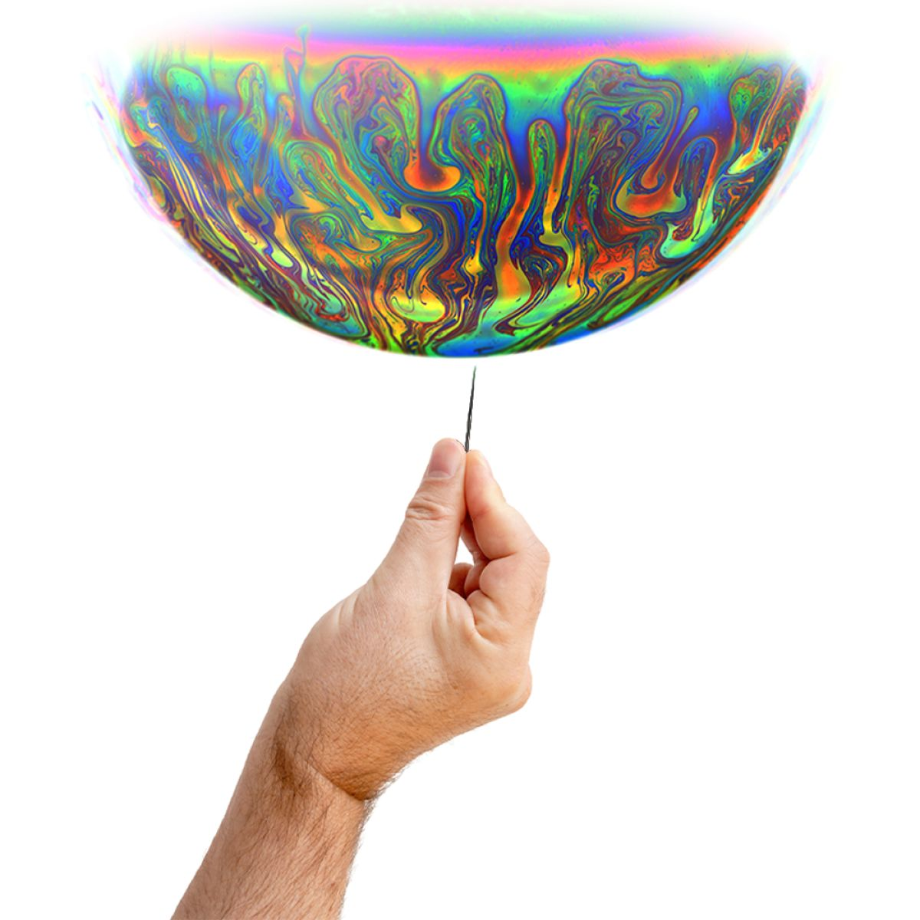
AGAINST PSYCHEDELIC EXCEPTIONALISM
Bundling psychedelic-assisted therapy may be an example of psychedelic exceptionalism
Recommend popping the bubble that psychedelics are to unique and special to be handled through our existing systems
¹⁹
Notes:
I want to end with a point that I think is sometimes overlooked in the literature on psychedelics
Many people correctly note that psychedelcis tend to be exceptionalized and framed as fundamentally different from existing approved treatments. This framing can lead to extreme claims that psychedelics will solve the mental health crisis or even lead to psychiatry’s downfall.
To be clear, psychedelics definitely have distinct aspects that distinguish them from SSRIs for example, but When psychedelics are framed as uniquely powerful or new, it can lead to overly burdensome regulatory requirements—ones that go far beyond what's asked of other treatments. These requirements can end up limiting access and slowing progress.
Exceptionalism has consequences. To move forward, we need to pop the narrative bubble that psychedelics are too strange or special to be handled through our existing systems. They’re novel, but our regulatory frameworks are more adaptable than we think

Slide 16
THANKS!
Chloe.connor@nih.gov
Chloeconnor13@gmail.com
Notes:
In conclusion, I hope I have convinced you that unbundling PAT is the right move from a clinical, ethical, and regulatory standpoint.

Slide 17
REFERENCES
Image from: https://imprintnews.org/top-stories/all-i-did-was-sleep-despite-years-of-damning-reports-states-across-the-country-fail-to-rein-in-psych-meds-for-foster-youth/259719
Image from: https://hls.harvard.edu/today/reassessing-psychedelics/
Image from: https://www.linkedin.com/pulse/5th-fda-breakthrough-therapy-designation-psychedelics-maria-velkova-i8sef/
Image from: https://www.verywellmind.com/psychedelics-and-mental-health-survey-6753410
day JS, Horton D, Fernandes-Osterhold G, et al. Psychedelic-assisted psychotherapy: where is the psychotherapy research? Psychopharmacology. 2024;241(8):1517-1526.
https://www.ptsd.va.gov/professional/treat/txessentials/psychedelics_assisted_therapy.asp#:~:text=To%20date%2C%20the%20greatest%20evidence,%2D8%2Dhour%20medicine%20sessions.
https://www.nytimes.com/2024/08/09/health/fda-mdma-ptsd-delay.html

Slide 18
REFERENCES
8. Goodwin GM, Malievskaia E, Fonzo GA, Nemeroff CB. Must Psilocybin Always “Assist Psychotherapy”? American Journal of Psychiatry. 2024;181(1):20-25.
9. Deckel GM, Lepow LA, Guss J. “Psychedelic Assisted Therapy” Must Not Be Retired. American Journal of Psychiatry. 2024;181(1):77-78.
10. Alpert MD, O'Donnell KC, Paleos CA, et al. Psychotherapy in Psychedelic Treatment: Safe, Evidence-Based, and Necessary. Am J Psychiatry. 2024;181(1):76-77.
11. Bogenschutz MP. Pharmacological and Nonpharmacological Components of Psychedelic Treatments: The Whole is Not the Sum of the Parts. Am J Psychiatry. 2024;181(1):75.

Slide 19
REFERENCES
Earleywine M, De Leo J, Bhayana D, Rajanna B, Scott K. Psilocybin Without Psychotherapy: A Cart Without a Horse? Am J Psychiatry. 2024;181(1):78-79.
O'Donnell KC, Anderson BT, Barrett FS, et al. Misinterpretations and Omissions: A Critical Response to Goodwin and Colleagues' Commentary on Psilocybin-Assisted Therapy. Am J Psychiatry. 2024;181(1):74-75.
Schenberg EE, King F, da Fonseca JE, Roseman L. Is Poorly Assisted Psilocybin Treatment an Increasing Risk? American Journal of Psychiatry. 2024;181(1):75-76.
McNamee S, Devenot N, Buisson M. Studying Harms Is Key to Improving Psychedelic-Assisted Therapy—Participants Call for Changes to Research Landscape. JAMA Psychiatry. 2023;80(5):411-412.

Slide 20
REFERENCES
16. Image from: https://www.linkedin.com/pulse/fdas-risk-evaluation-mitigation-strategies-rems-program-sinhaa/
17. Image from: https://www.nbcnews.com/health/mental-health/nasal-esketamine-works-better-alternative-treatment-resistant-depressi-rcna118841
18. https://www.jnj.com/media-center/press-releases/spravato-esketamine-approved-in-the-u-s-as-the-first-and-only-monotherapy-for-adults-with-treatment-resistant-depression
19. Image from: https://www.google.com/search?q=psychedelic+hype&sca_esv=6d05711ba5bc2a7b&rlz=1C1CHBF_enUS1075US1075&udm=2&biw=1920&bih=953&sxsrf=AHTn8zqRJHzlqv6DJ_O_zREDu0FDG0RepA%3A1746813569574&ei=gUIeaJbUIt-r5NoPht6IiAc&ved=0ahUKEwjWmLbS-5aNAxXfFVkFHQYvAnEQ4dUDCBE&uact=5&oq=psychedelic+hype&gs_lp=EgNpbWciEHBzeWNoZWRlbGljIGh5cGUyBBAAGB4yBBAAGB4yBBAAGB4yBhAAGAgYHjIGEAAYCBgeSOUPUPcEWKUMcAF4AJABAJgBPqABywGqAQE0uAEDyAEA-AEBmAIFoALiAcICBxAjGCcYyQLCAgUQABiABJgDAIgGAZIHATWgB-0SsgcBNLgH3gE&sclient=img#vhid=mx_put5n0Bx93M&vssid=mosaic

