Slide 1
Resisting Imposition of Traditional Gender Orthodoxy After Dobbs
Linda C. McClain, Robert Kent Professor, BU Law;
Co-director, BU Program on Reproductive Justice
Health Law Professors Conference, BU Law, June 6, 2025

Slide 2
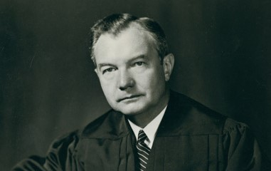
Justice Robert H. Jackson author of Barnette majority opinion
“If there is any fixed star in our constitutional constellation, it is that no official, high or petty, can prescribe what shall be orthodox in politics, nationalism, religion or other matters of opinion or force citizens to confess by word or act their faith therein.”
West Virginia Bd. of Ed. v. Barnette (1943), overruling Minersville School Dist. v. Gobitis (1940)

Slide 3
Many other famous passages from Barnette, in addition to “fixed star”:
“Freedom to differ is not limited to things that do not matter much. That would be a mere shadow of freedom. The test of its substance is the right to differ as to things that touch the heart of the existing order.”
“The very purpose of a Bill of Rights was to withdraw certain subjects from the vicissitudes of political controversy, to place them beyond the reach of majorities and officials and to establish them as legal principles to be applied by courts. One’s rights to life, liberty, and property, to free speech, a free press, freedom of worship and assembly, and other fundamental rights, may not be submitted to vote; they depend on the outcome of no elections.”

Slide 4
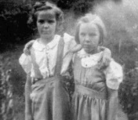
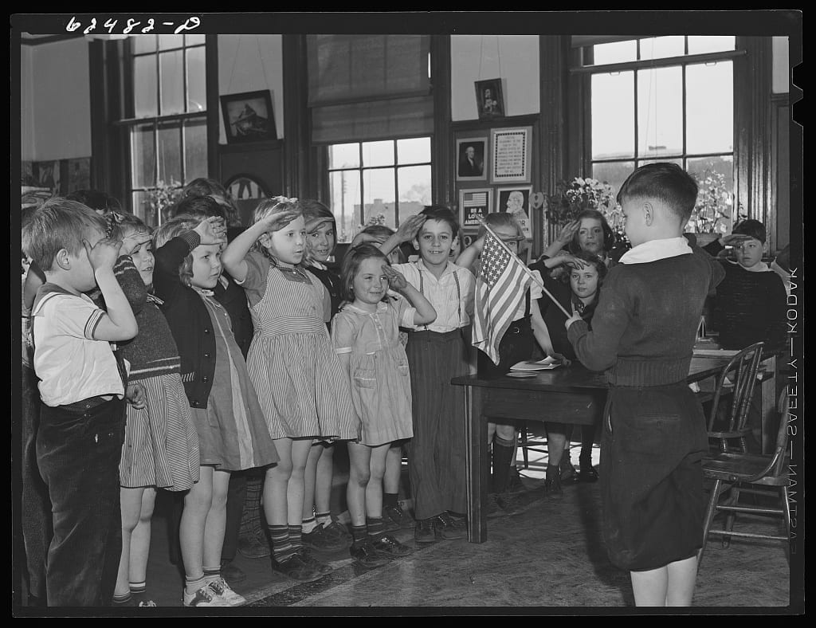
Marie & Gathie Barnett

Slide 5
West Virginia Bd. of Ed. v. Barnette (1943)
Context: WWII, rise of “nationalism,” battle against Nazism
Minersvillle v. Gobitis: three years earlier, the Court (in opinion by Justice Frankfurter) upheld a similar compulsory flag salute on the rationale of promoting “national unity”
The West Virginia law in Barnette largely quoted from Gobitis.
Vigilante/mob violence against Jehovah’s Witnesses at home (sparked by Gobitis?); Jackson had been aware of this violence as FDR’s Attorney General through 1941
Anti-totalitarian, not “libertarian;” Barnette did not rule out civics instruction, persuasion, formative project of cultivating civic virtues and attitudes
Protecting Jehovah’s Witness students’ refusal didn’t “collide” with the rights of others

Slide 6
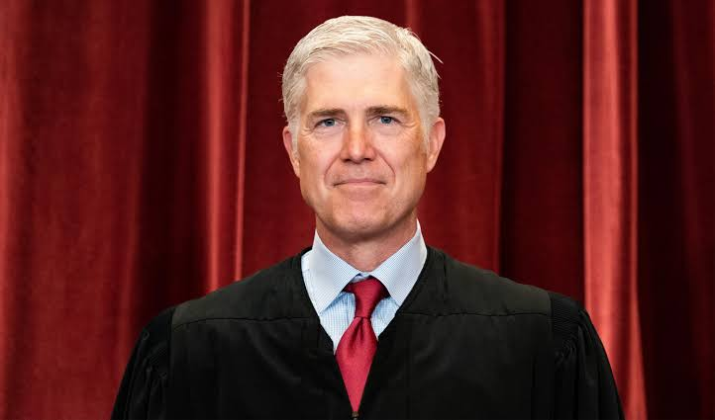
303 Creative: The marketplace for goods and service = a marketplace of ideas
By allowing all views to flourish, the framers understood, we may test and improve our own thinking both as individuals and as a nation. For all these reasons, “[i]f there is any fixed star in our constitutional constellation,” West Virginia Bd. of Ed. v. Barnette (1943), it is the principle that the government may not interfere with “an uninhibited marketplace of ideas,” McCullen v. Coakley (2014).
— 303 Creative LLC
Justice Neil Gorsuch, author of majority opinion in
303 Creative LLC v. Elenis (2023)

Slide 7
McCullen v. Coakley, 573 U.S. 464, 476 (2014):
The Court (in a majority opinion written by C.J. Roberts) struck down a MA buffer zone law applicable to clinics where abortions provided because the law was not narrowly tailored.
“Public streets and sidewalks” are “venues for the exchange of ideas.” A listener “confronted with an uncomfortable message” can’t simply avoid it by turning a page, changing a channel, or leaving a website.
“In light of the First Amendment’s purpose ‘to preserve an uninhibited marketplace of ideas in which truth will ultimately prevail,’* . . . this aspect of traditional public fora is a virtue, not a vice.” [italicized language cited by J. Gorsuch in 303 Creative]
* Citing FCC v. League of Women Voters of Cal., 468 U.S. 364, 377 (1984)

Slide 8
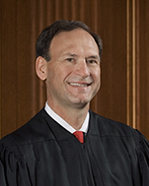
Another source of compelled orthodoxy claims in challenges to public accommodations laws:
“Today’s decision . . . will be used to vilify Americans who are unwilling to assent to the new orthodoxy. The majority compares traditional marriage laws to laws that denied equal treatment to African Americans and women . . . Those who repeat [their beliefs] in public [will] risk being labeled as bigots and treated as such by governments, employers, and schools.” (J. Alito, dissenting in Obergefell v. Hodges)

Slide 9
Part IV. Promoting Gender Equality
8. Resisting Imposition of Traditional Gender Orthodoxy after Dobbs
9. Resisting Compulsion of Traditional Gender Conformity

Slide 10
NIFLA v. Becerra (2018) (invoked in Tingley, as well as in 303 Creative):
“Generally, too, the government may not compel a person to speak its own preferred messages.”
In NIFLA, the Court held that California’s law requiring “crisis pregnancy centers” to post certain information (such as where pregnant persons could get reproductive health care, including abortion, and that unlicensed CPCs were not licensed) violated the First Amendment.
Justice Thomas, author of the majority opinion, cites to McCullen, cautioning that “when the government polices the content of professional speech,” it can fail to “‘preserve an uninhibited marketplace of ideas in which truth will ultimately prevail.’”
Thomas offers examples “throughout history” of how governments have “‘manipulat[ed] the content of doctor-patient discourse’ to increase state power and suppress minorities.” These include the Cultural Revolution in China, Nazi Germany’s Third Reich, the Soviet government, and Nicolae Ceausescu’s strategies to “increase the Romanian birth rate.”

Slide 11
Justice Kennedy’s concurrence in NIFLA v. Becerra: CA’s efforts are authoritarian
Chides the California legislature for characterizing the law under challenge as “part of California’s legacy of ‘forward thinking.’”
Quoting Wooley (part of the Barnette line), he retorts: “But it is not forward thinking to force individuals to ‘be an instrument for fostering public adherence to an ideological point of view [they] fin[d] unacceptable.’”
Instead, he argues, what would be forward thinking would be to start with the 1st A and:
“to understand the history of authoritarian government as the Founders then knew it; to confirm that history since then shows how relentless authoritarian regimes are in their attempts to stifle free speech; and to carry those lessons onward as we seek to preserve and teach the necessity of freedom of speech for the generations to come. Governments must not be allowed to force persons to express a message contrary to their deepest convictions. Freedom of speech secures freedom of thought and belief.”

Slide 12
Arguments FOR reproductive rights:
U.S. Constitution:
Liberty/autonomy/privacy (14th AM, Due Process) (pre-Dobbs)
Equality (Equal Protection) (rejected as “foreclosed” in Dobbs)
Free exercise/Establishment Clause (First Amendment) (Harris)
State Constitutions . . .
State counterparts to the above clauses; more robust versions
Right to “enjoy and defend life”
ERAs

Slide 13
Anti-totalitarian arguments for reproductive freedom:
“Because we cherish dignity, we insist on freedom, and we place the right of conscience at its center, so that a government that denies that right is totalitarian no matter how free it leaves us in choices that matter less.”
Right to procreative autonomy “well grounded in the First Amendment.”
—Ronald Dworkin, Life’s Dominion: An Argument about Abortion, Euthanasia, and Individual Freedom 239 (1993)

Slide 14
Liberty arguments: “If one follows the principle that freedom is slavery’s opposite, one must conclude that the antislavery movement . . . understood freedom to entail protection against totalitarian control over people’s bodies and reproductive lives.”
—Peggy Cooper Davis, Neglected Stories: The Constitution and Family Values 180 (1997)
Peggy Cooper Davis, John R. Shad Professor of Lawyering and Ethics, NYU School of Law

Slide 15
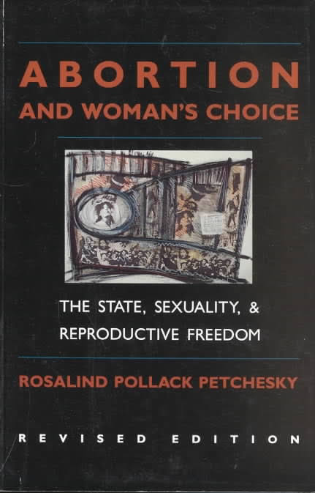
Equal Protection Arguments
Planned Parenthood v. Casey (1992) stated:
“The ability of women to participate equally in the economic and social life of the Nation has been facilitated by their ability to control their reproductive lives.”
Casey quotes from Rosalind Petchesky, Abortion and Woman’s Choice 109, 133, n. 7 (rev. ed. 1990).
In Dobbs, this premise was asserted by Jackson Women’s Health Org. and its amici and challenged by Mississippi and its amici.
Justice Alito treats this kind of «reliance» interest as too intangible, etc.; one paragraph dismissal of EQP argument made by EQP Scholars brief and U.S. Gov’t.

Slide 16
Concurring, J. Blackmun (author of Roe) explicitly made a gender equality argument for abortion rights:
“A state’s restrictions . . . also implicate constitutional guarantees of gender equality. . . . By restricting the right to terminate pregnancies, the State conscripts women’s bodies into its service, forcing women to continue their pregnancies, suffer the pains of childbirth, and in most instances, provide years of maternal care. The State does not compensate women for their services; instead, it assumes that they owe this duty as a matter of course. This assumption—that women can simply be forced to accept the ‘natural’ status and incidents of motherhood—appears to rest upon a conception of women’s role that has triggered the protection of the Equal Protection Clause.... The joint opinion recognizes that these assumption about women’s place in society ‘are no longer consistent with our understanding of the family, the individual, or the Constitution.’”*
* Blackmun cites feminist and liberal legal theorists as among the “growing number of commentators” who recognize this point; see also RBG’s discussion of autonomy/equal citizenship in Carhart dissent.

Slide 17
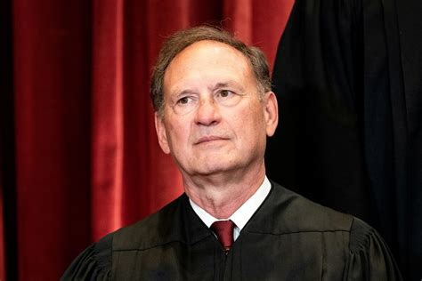
Dobbs v. Jackson Women’s Health Org. (2022) (Alito, J.)
“Roe was egregiously wrong from the start. Its reasoning was exceptionally weak, and the decision has had damaging consequences”
Barnette cited as example of Court overruling important prior cases. America would be a “different country,” and constitutional law “unrecognizable,” without Barnette and other decisions.

Slide 18
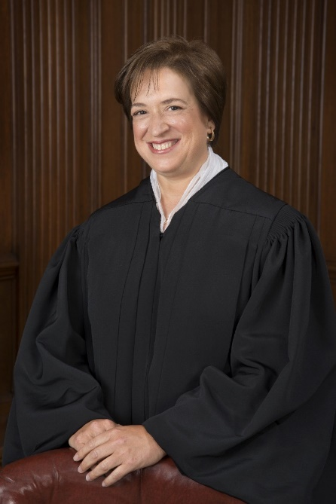
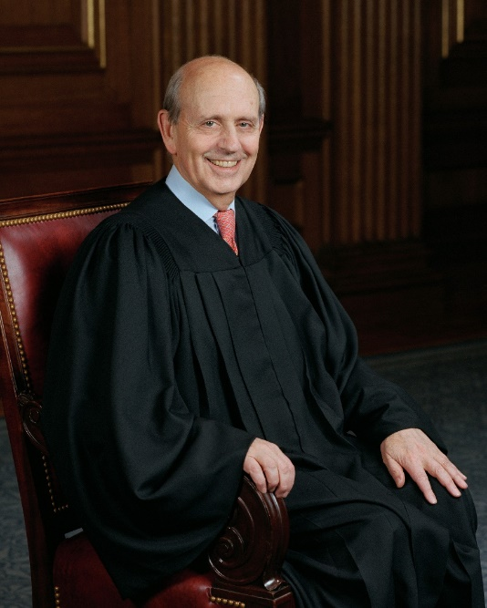
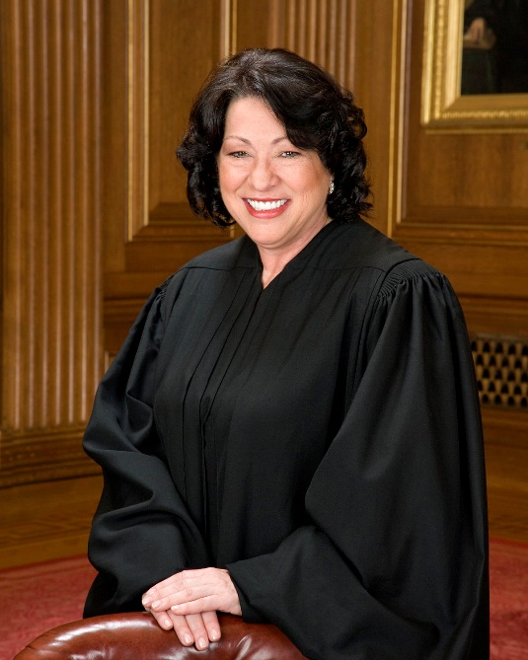
The Dobbs dissenters: Justices Kagan, Breyer, and Sotomayor
The joint dissent cites Barnette’s proclamation that the point of a right is to shield individual actions and decisions “from the vicissitudes of political controversy, to place them beyond the reach of majorities.”
It also invokes Jackson’s language in his Korematsu dissent about the decision being a “loaded weapon.”
The majority’s decision “curtails” women’s rights—Casey referred to “ability of women to participate equally in [this Nation’s] economic and social life.” After Dobbs, women of means will find ways to get an abortion, but those without resources will not. Critiques fixation on 1868 (what “We the People” included and didn’t.)

Slide 19
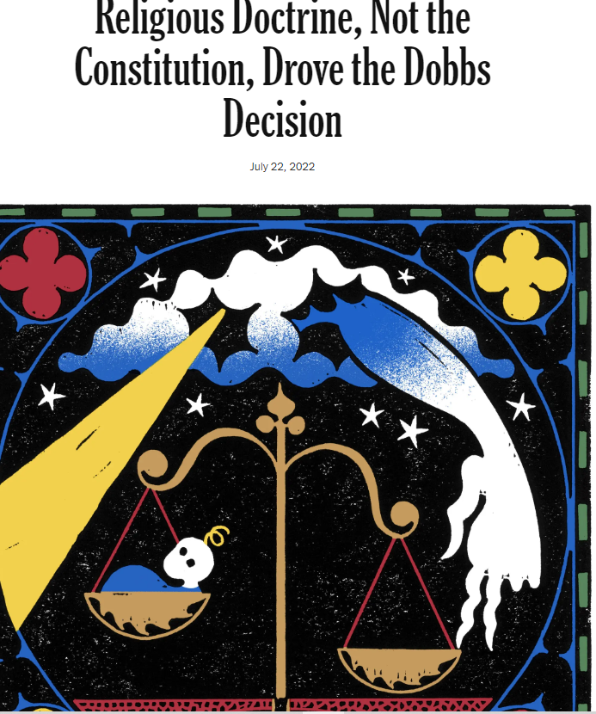
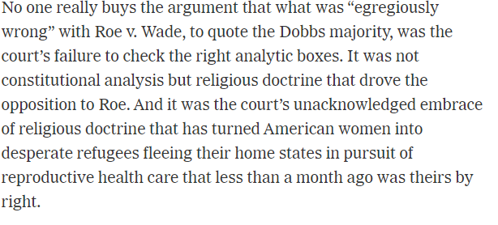
Source: Linda Greenhouse, N.Y. Times

Slide 20
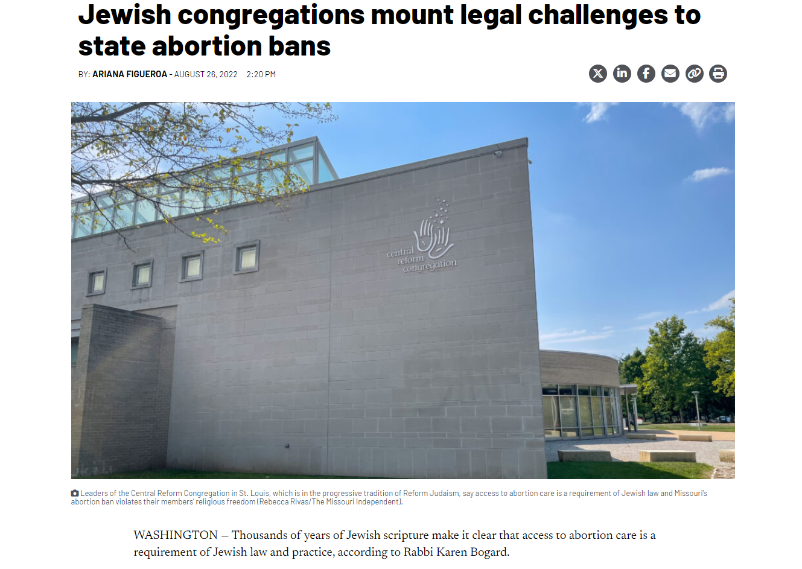
Religious Liberty and Establishment Clause Challenges to Abortion Bans
Source: Tennessee Lookout

Slide 21
Individual Members of the Medical Licensing Bd. of Indiana v. Anonymous Plaintiffs (Ind. App. Ct. 2024):
“If a corporation can engage in a religious exercise by refusing to provide abortifacients—contraceptives that essentially abort a pregnancy after fertilization—it stands to reason that a pregnant person can engage in a religious exercise by pursuing an abortion. [Citing Burwell v. Hobby Lobby].”

Slide 22
Judge Bailey, concurring, makes an Establishment Clause argument:
In accordance with abundant religious liberty and the recognition of a pluralistic society, our Constitution . . . provides: “No preference shall be given by law, to any creed, religious society, or mode of worship.” IN Const. Art. 1, Sect. 4.
Yet in this post-Dobbs world, our Legislature has done just that—preferred one creed over another. Based upon the premise that the State has a compelling interest in the outcome of a woman’s pregnancy arising at the very moment of conception, there is a codification of when life begins, something intensely debated among adherents to various religions. . . .
Given the breadth of religious diversity and sects among Hoosiers, I am not surprised that the language employed by the framers of our Indiana Constitution suggests that an individual facing circumstances unique to pregnancy, experienced uniquely by that individual, should resort to her own conscience and her own creed without undue state interference.

Slide 23
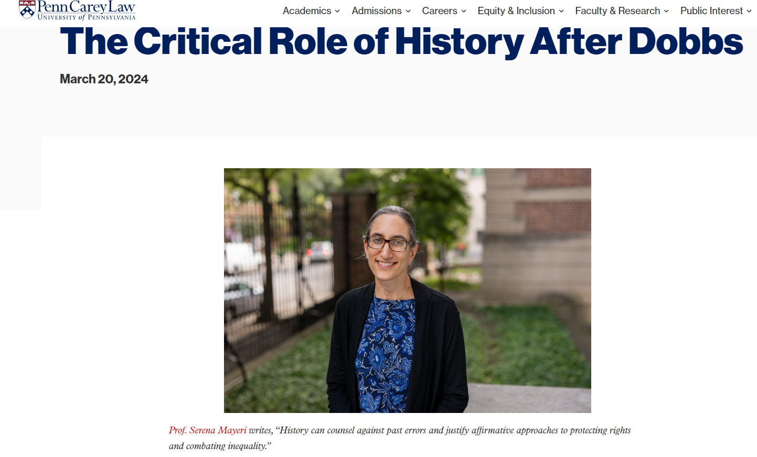

Slide 24
State Constitutions as Grounds for Protecting Reproductive Rights
Allegheny Reproductive Health Center v. Pennsylvania Department of Human Services (Pa. 2023):
The majority opinion reverses a 40-year old case, Fischer v. Department of Public Welfare, which had held (citing Geduldig v. Aiello and Harris v. McRae) that a state law funding pregnancy and childbirth expenses and all medically necessary care for men (including for reproductive health), but not abortion (the Coverage Exclusion) did not violate the equal protection principles of the Pennsylvania Constitution or its Equal Rights Amendment. Instead, (1) the Coverage Exclusion used “abortion,” not “sex,” as the basis for the distinction in coverage, and (2) the fact that “only women are affected” by the Exclusion did “not necessarily mean that women are being discriminated against on the basis of sex.”
Allegheny Reproductive Health Center majority disagrees and overrules: The Coverage Exclusion is a sex-based distinction and, as such, is “presumptively unconstitutional.”
The court surveys case law of other states with ERAs and whether they included exceptions for “physical characteristics unique to one sex”: phrases like “on account of sex” and “because of sex” “encompass reproductive capabilities as well as stereotypical gender norms when applying their equal rights amendment to comparable Medicaid coverage exclusion.”

Slide 25
Justices Wecht and Donahoe would have ruled that the PA Constitution protects a right to reproductive autonomy rather than remanding to the lower court on that issue:
In language evocative of Casey, they argue: the ERA would be a “hollow promise” without women’s ability to “control their destiny;” reproductive self-determination is “central to self-determination and ultimately, to equality in society.”
J. Wecht: “Bodily autonomy is so essential to the foundational concept of liberty that it is hard to imagine any liberty that is more fundamental than the right to make decisions about one’s own body.” Indeed, “the guarantee of reproductive autonomy is a safeguard against tyranny.” (Cites work by Professor Khiara M. Bridges)

Slide 26
Justice Wecht criticizes Dobbs’s approach to history and tradition:
“Generally speaking, relying upon particular points of history during which women expressly were precluded from political participation effectively enshrines and perpetuates the legal subjugation of women. . . . [T]here is no opportunity for the status of women to advance and no chance to repudiate the nation’s discriminatory history. The nation is locked into the gendered hierarchies of our past.”

Slide 27
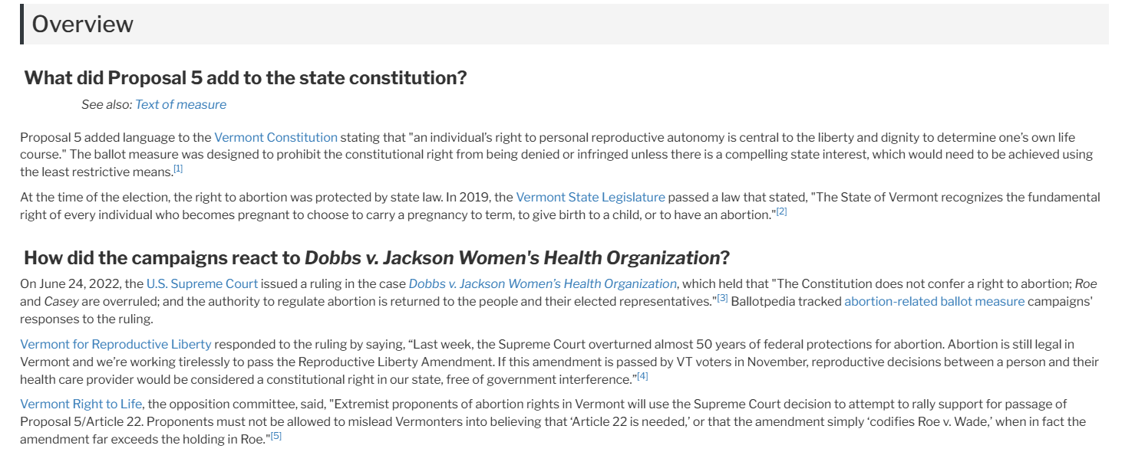
VERMONT (source: Ballotpedia)

Slide 28
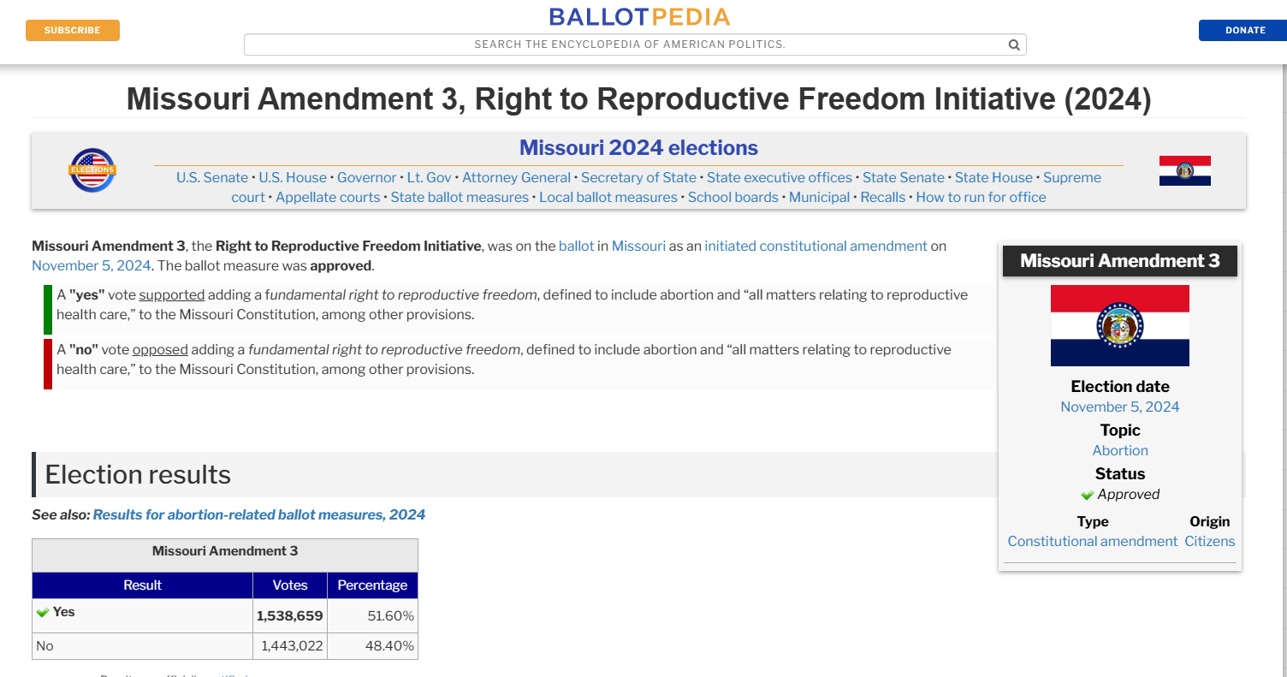
State Ballot Initiatives to Protect Reproductive Freedom

Slide 29
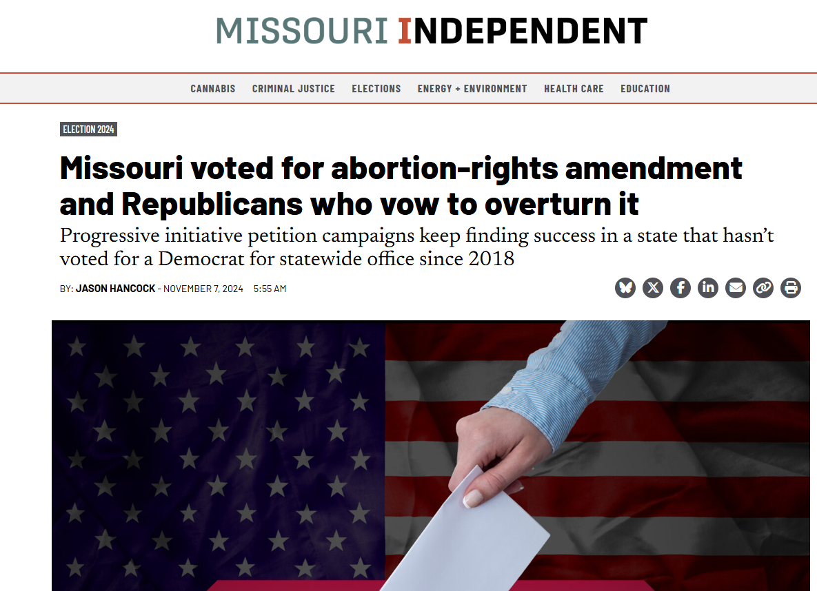

Slide 30
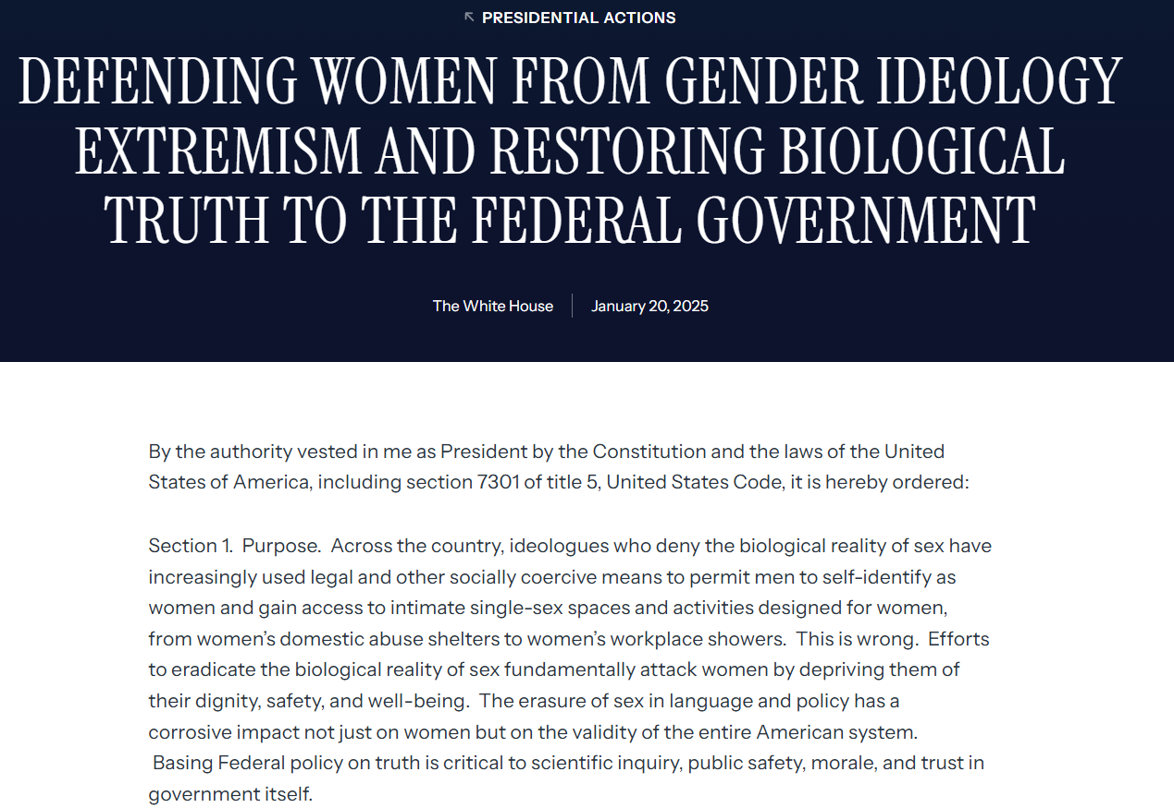

Slide 31
Sources of Expertise/Authority for Conversion Therapy Bans or Bans on Gender-Affirming Care?
Children and Adolescents?
Parents? (early DP liberty cases; Parham v. J.R, 442 U.S. 584 (1979))
Medical doctors?
Medical/professional organizations (consensus)?
State or federal legislators?
Courts?
“Reason”? (facts re human nature)
Revelation? (God’s Created order)

Slide 32
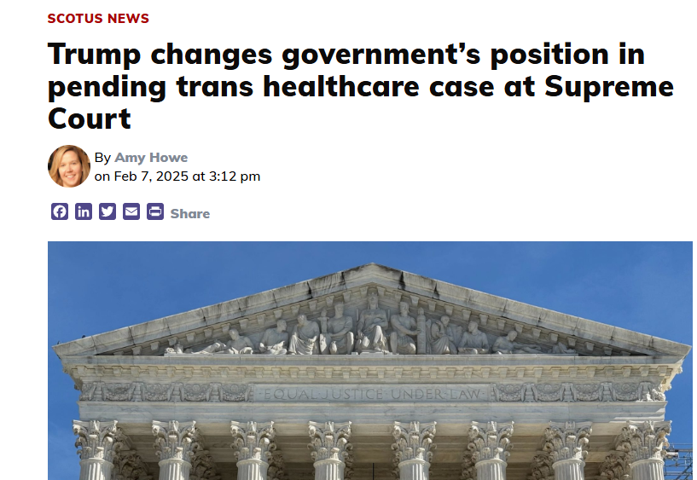

Slide 33
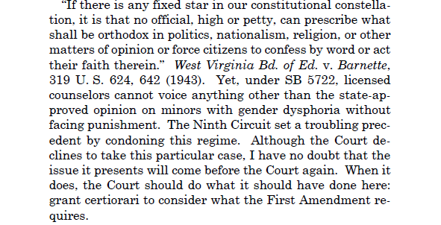
J. Thomas*: conversion therapy bans impose an orthodoxy about gender dysphoria
*Tingley v. Ferguson, 601 U.S. __ (2023), slip op. at 5 (Thomas, J., dissenting from denial of cert)

Slide 34
J. Thomas: Washington’s law silences “one side” of a “fierce public debate over how best to help minors with gender dysphoria”:
State of Washington’s View | Mr. Tingley’s View
Minors should be protected from “‘exposure to serious harms’” caused by counseling to “change a minor’s gender identity.” The State compels counselors to convey a “state-approved message of encouraging minors to explore their gender identities.” | Mr. Tingley “believes that a person’s sex is a ‘gift from God, integral to our very being,’” and employs “talk therapy” to help minors with gender dysphoria who “‘want to become comfortable with their biological sex.’”

Slide 35
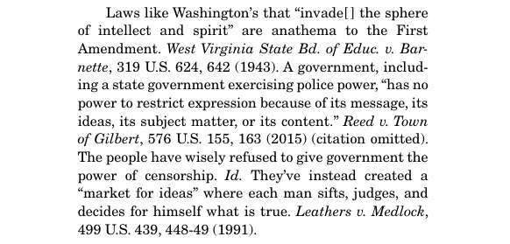
Idaho, joined by 11 other states, argued:
Source: Brief of Idaho and 11 Other States in Support of Petitioners, Tingley v. Ferguson, at p. 6.

Slide 36
Amicus briefs filed in support of Mr. Tingley cited Barnette & NIFLA to warn that WA’s law compelled a “gender ideology” or “gender identity orthodoxy,” skewed the “marketplace of ideas,” and was similar to efforts by “totalitarian governments.” E.g.:
“Those who begin coercive elimination of dissent soon find themselves exterminating dissenters.” W. Va. State Bd. Of Educ. v. Barnette, 319 U.S. 624, 641 (1943). Yet this is the precise goal of S.B. 5722: to threaten the license and livelihood of a therapist who, in the State’s view, conveys information or advice on a particular topic—sexual orientation—that expresses a viewpoint contrary to that of the State.
Source: Amicus Curiae Brief of the Liberty Justice Center in Support of Petitioner, at 5.

Slide 37
The State of Washington’s response to the “ideology, not science” argument:
“every major medical and mental health organization” uniformly rejects conversion therapy as “unsafe and inefficacious,” a “fact” on which the Washington legislators relied.
Washington’s law reached professional conduct -- “therapeutic treatment” by “licensed mental health professionals acting within the confines of the counselor-client relationship.” Based on legislative judgments, the law “protects children and youth from ineffective and harmful treatments performed under a state-authorized license.”
Washington’s law was not designed to “silence people of faith and their religious beliefs about human sexuality.” It expressly protects “religious practices or counseling relating to conversion therapy.” Mr. Tingley could:
(1) practice conversion therapy “when acting under the auspices of a religious organization;” what he could not do was offer it while “holding himself out as a state-licensed therapist.”
(2) “tell patients and the public that he thinks conversion therapy is wonderful and that they would benefit from it;” and
(3) “refer patients to other providers to receive conversion therapy.”
-- State Respondents’ Brief in Opposition, at 19, 20, 23.

Slide 38
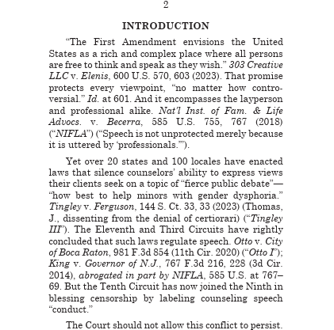
Petition for cert in Chiles v. Salazar (10th Cir. 2024)—SCOTUS granted cert on speech claim 3/3/25

Slide 39
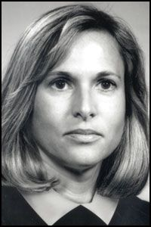
L.W. v. Skrmetti/U.S. v. Skrmetti (6th Cir. 2023), before SCOTUS this term:
Majority (Judge Sutton) upheld Tenn. and Ky. gender-affirming care bans, citing Dobbs and Geduldig.
In dissent, Judge White invokes Barnette to counter the majority’s argument that states should be allowed to take different approaches in the “heated political debate” over gender-affirming care. White’s argument enlists Barnette’s “very purpose” of the Bill of Rights language to apply to fundamental parental liberty under the Due Process Clause, stating that our “fundamental rights may not be submitted to vote; they depend on the outcome of no elections.”
Judge White (nominated by Pres. George H. Bush)

Slide 40
Briefs in Skrmetti
Briefs by U.S. and Amici | Briefs by Tenn. and Amici
Tenn.’s ban is contrary to widely-accepted guidelines developed through a robust and transparent process with same scientific rigor applied to development of other medical guidelines Law based on (“archaic and overbroad”) sex-based stereotypes rather than medical consensus. Law based on animus. Anti-totalitarian arguments about who decides. | “Ideology, not science,” drove WPATH guidelines. To argue that SB 1 bucks “medical consensus” ignores “risk-benefit assessment of European health authorities and discounts the good-faith decisions of half the States in this country.” Ban doesn’t classify based on sex or transgender status, but on age and medical purpose. SB 1 law references biological realities and real differences; it does not target sex or further stereotypes.

