Slide 1
Against Biomedical Progress
Ximena Benavides Reverditto, J.S.D., LL.M., LL.B.
Yale University/Yale Law School
University of Georgia (incoming Assistant Professor)

Slide 2
Roadmap
The Problem
Research Project
Preliminary Findings & Normative Claims
Future Research and Scholarly Work

Slide 3
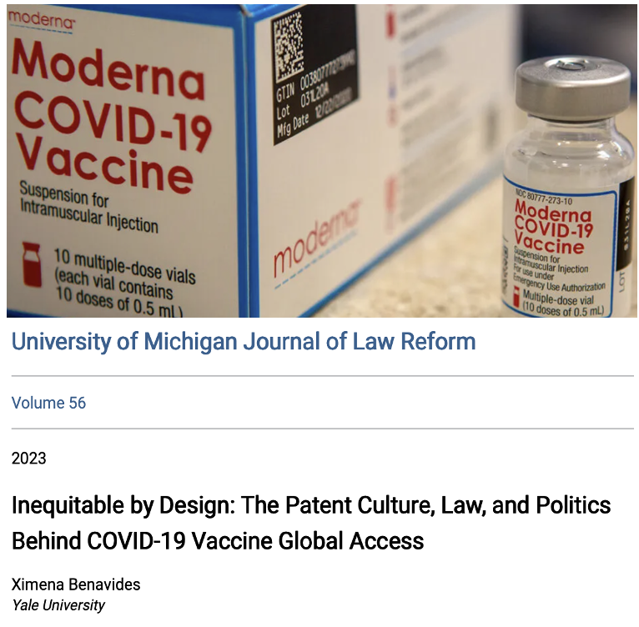
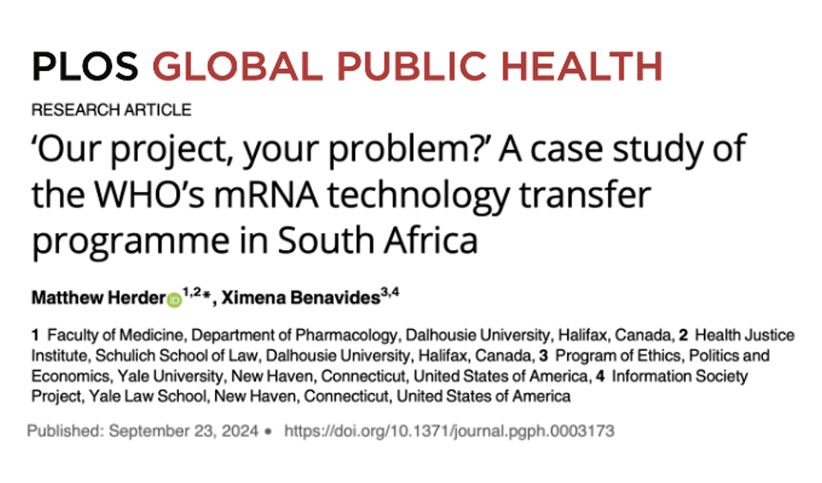
THE PROBLEM RESEARCH PROJECT FINDINGS & CLAIMS PROPOSAL & PROSPECTS

Slide 4
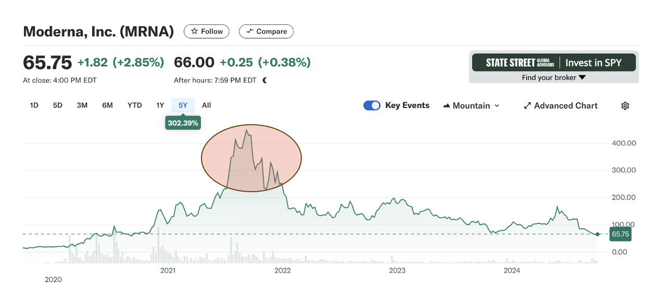
THE PROBLEM RESEARCH PROJECT FINDINGS & CLAIMS PROPOSAL & PROSPECTS

Slide 5
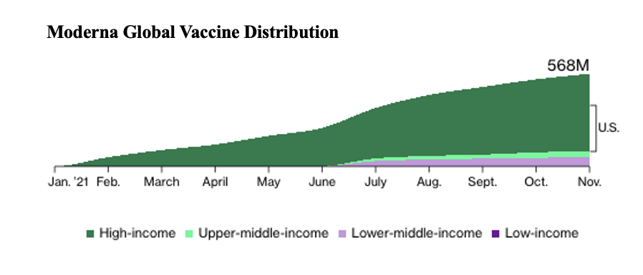
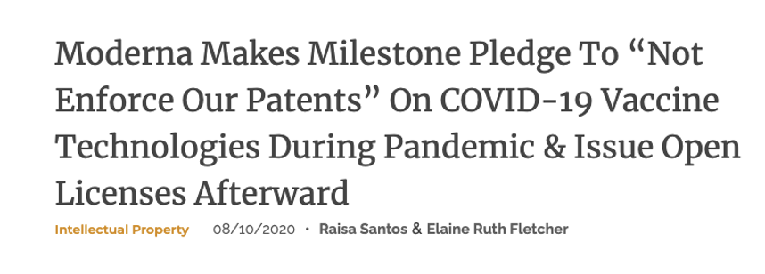
THE PROBLEM RESEARCH PROJECT FINDINGS & CLAIMS PROPOSAL & PROSPECTS

Slide 6
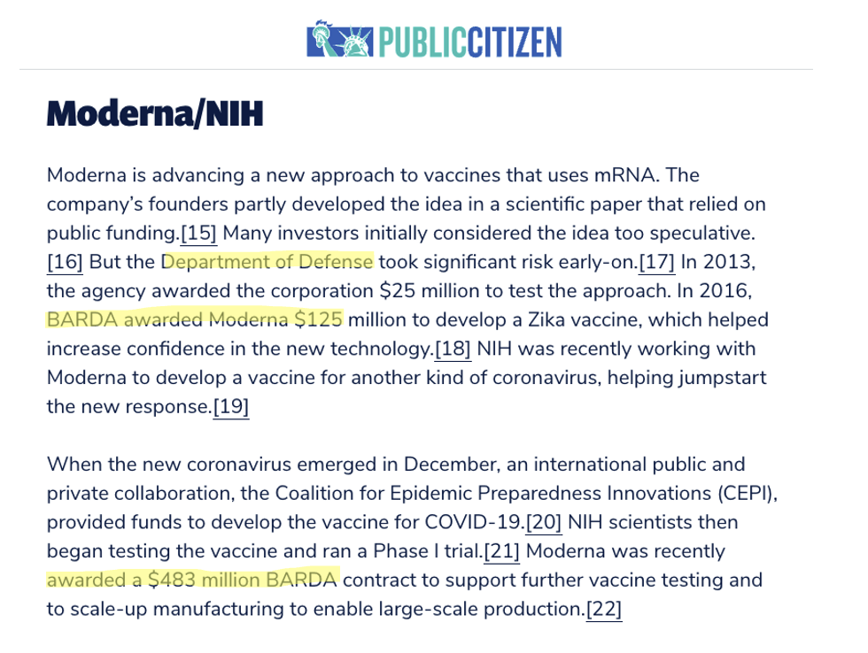
THE PROBLEM RESEARCH PROJECT FINDINGS & CLAIMS PROPOSAL & PROSPECTS

Slide 7
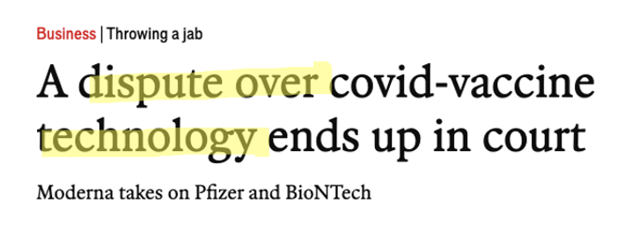
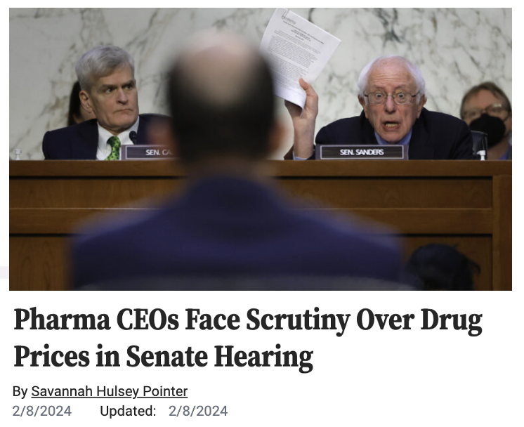
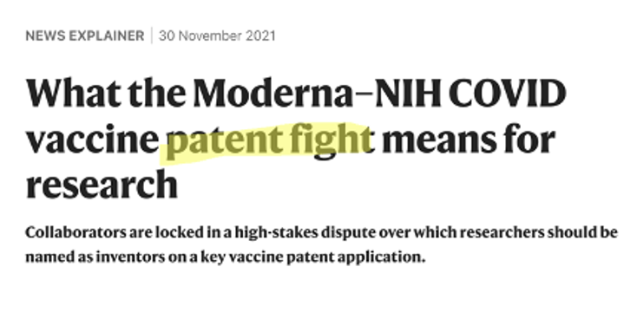
THE PROBLEM RESEARCH PROJECT FINDINGS & CLAIMS PROPOSAL & PROSPECTS

Slide 8
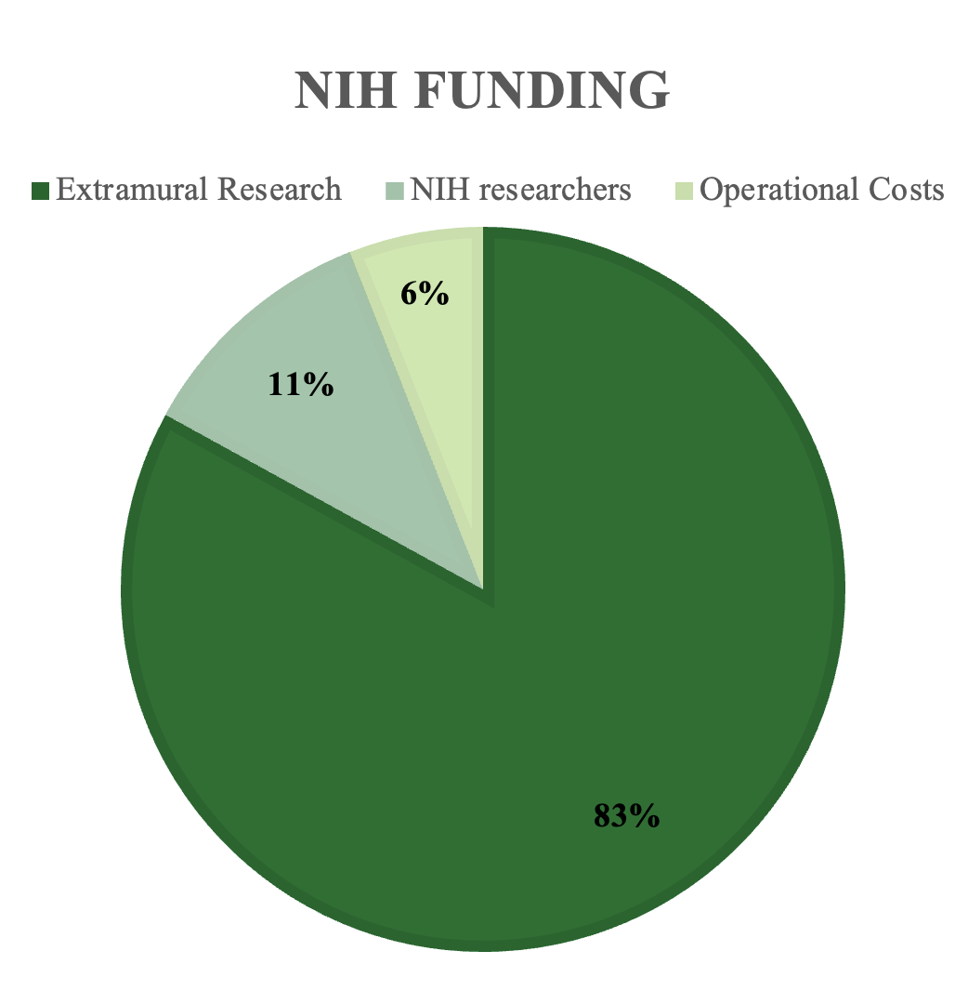
NIH Grants
NIH is the largest federal funder of the nation's biomedical enterprise (and globally).
NIH assigns $48 billion annually to R&D (>3x NASA’s research funding).
The majority of funds benefit labs outside NIH control.
Key supporter of fundamental, pre-commercial basic science research
THE PROBLEM RESEARCH PROJECT FINDINGS & CLAIMS PROPOSAL & PROSPECTS

Slide 9
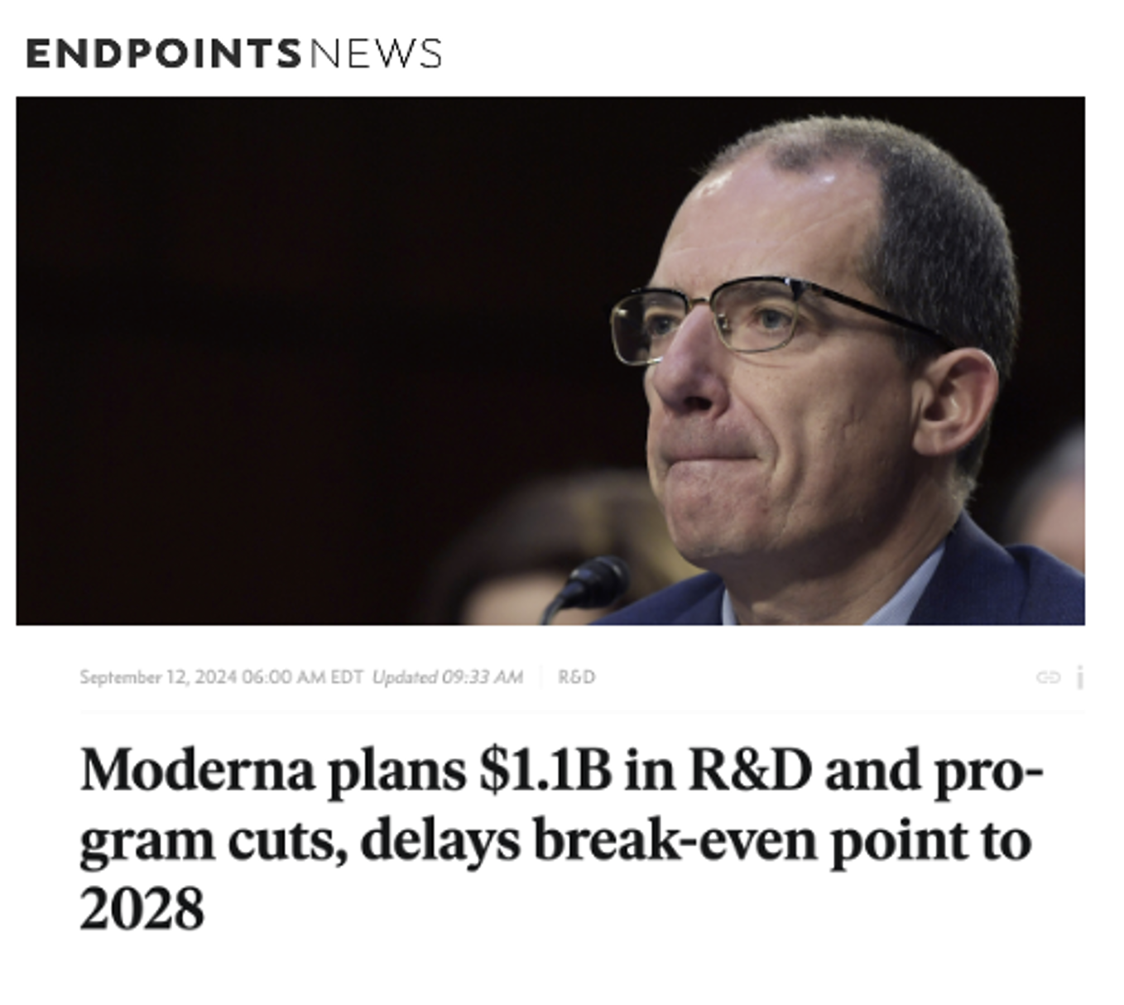
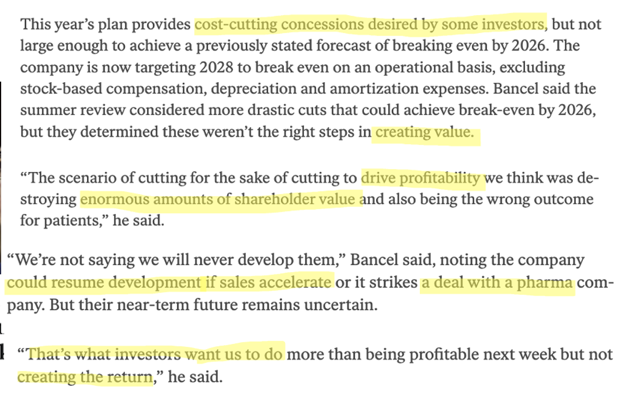
THE PROBLEM RESEARCH PROJECT FINDINGS & CLAIMS PROPOSAL & PROSPECTS

Slide 10
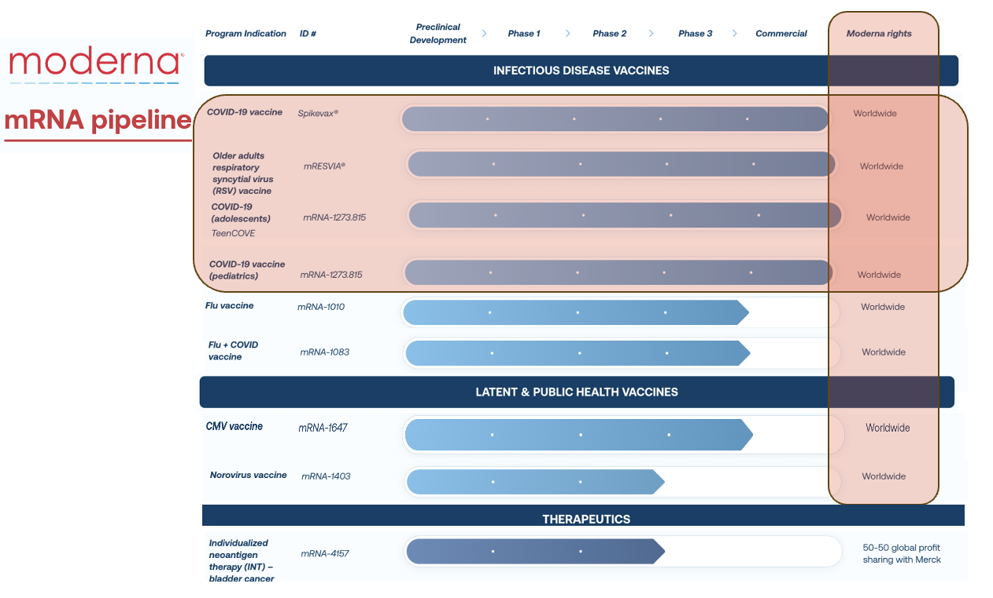
THE PROBLEM RESEARCH PROJECT FINDINGS & CLAIMS PROPOSAL & PROSPECTS

Slide 11
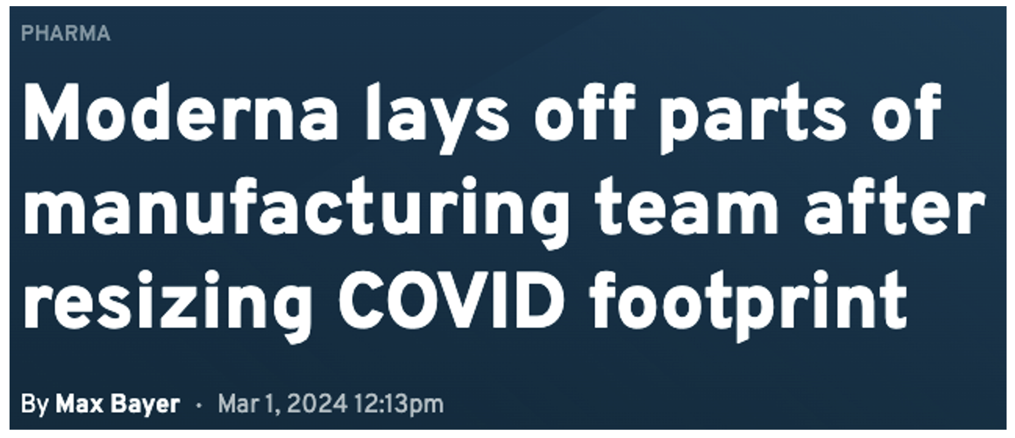
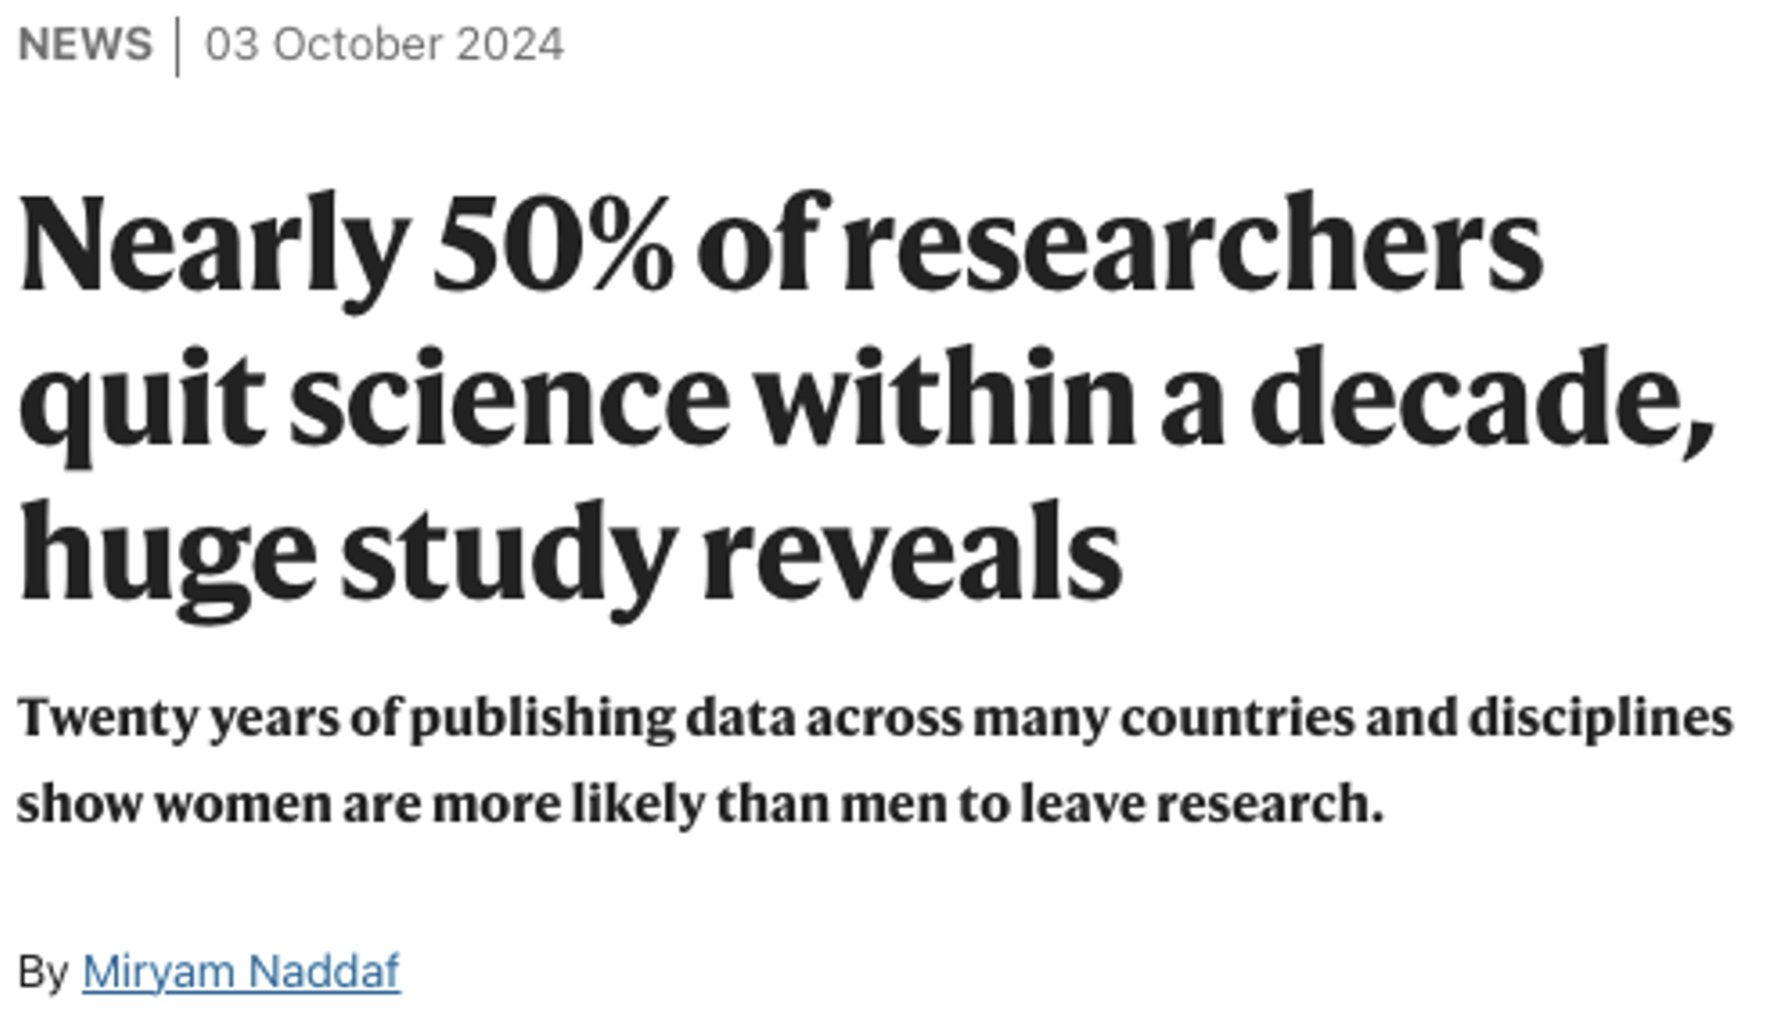
THE PROBLEM RESEARCH PROJECT FINDINGS & CLAIMS PROPOSAL & PROSPECTS

Slide 12
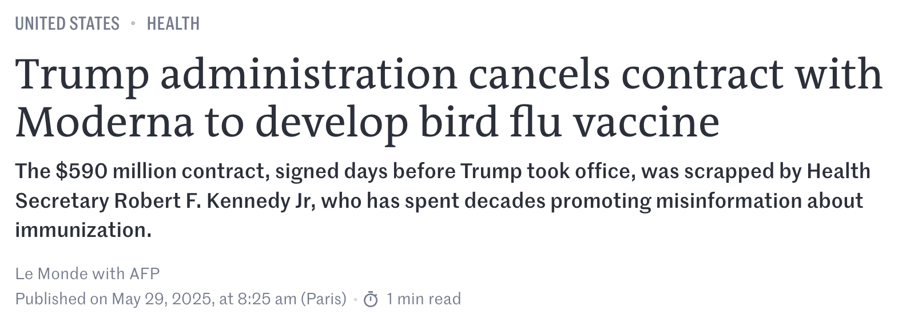
THE PROBLEM RESEARCH PROJECT FINDINGS & CLAIMS PROPOSAL & PROSPECTS

Slide 13
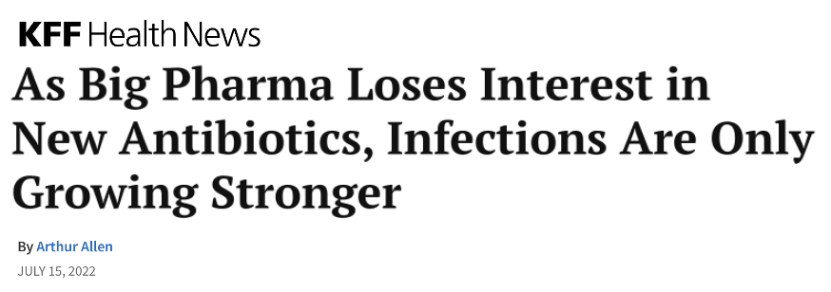
What are the values shaping biomedical innovation, and how do they relate to the ‘progress of science’?
Are we getting enough? Can we get more?
THE PROBLEM RESEARCH PROJECT FINDINGS & CLAIMS PROPOSAL & PROSPECTS

Slide 14
Article I, Section 8, Clause 8 of the U.S. Constitution.
It grants Congress the power ”…to promote the Progress of Science and useful Arts, by securing for limited Times to Authors and Inventors the exclusive Right to their respective Writings and Discoveries."
THE PROBLEM RESEARCH PROJECT FINDINGS & CLAIMS PROPOSAL & PROSPECTS
Notes:
What does the constitutional promise of progress mean for biomedical innovation in an era of financialization of healthcare and growing governing power of Big Pharma, Big Finance, and Big Tech?

Slide 15
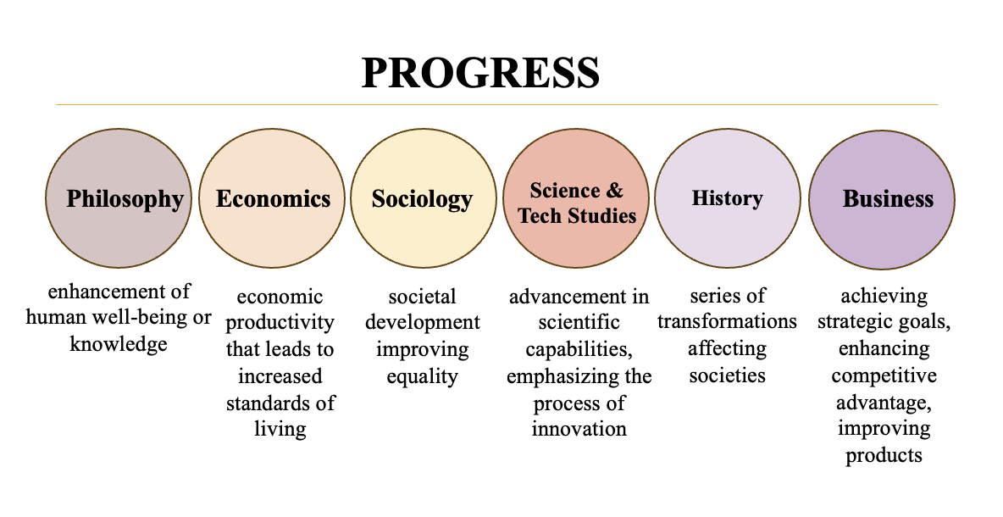
Financialization of Healthcare,
Big Pharma, Big Tech
THE PROBLEM RESEARCH PROJECT FINDINGS & CLAIMS PROPOSAL & PROSPECTS

Slide 16
THE PROBLEM RESEARCH PROJECT FINDINGS & CLAIMS PROPOSAL & PROSPECTS
Notes:
Scholarship inspiring this research project:
On the definition of progress in the context of innovation: Jessica Silbey, Against Progress, 2022, Andres Sawicki, The Law of Creativity? 110 Cornell L. Rev. 135 (2024); Marc J. Dunkelman, Why Nothing Works. Who Killed Progress and How to Bring It Back (2025)
Why Nothing Works: A provocative exploration about the architecture of power, the forces that stifle us from progress and getting things done, even if the majority supports them. Dunkelman claims that America is a victim of a vetocracy that allows nearly everyone (with power) to block progress—to stifle the ability to deliver progress on its promise.
Against Progress: considers the relationship between the constitutional mandate of “progress” and fundamental values, such as equality, privacy, and distributive justice, and the role of intellectual property aimed to facilitate progress. Silbey encourages refiguring the substance of "progress" and redirecting the function of intellectual property to the commonweal instead of private interests.
Capitalism, Power, and Innovation, and its most updated version “The Rulers: Corporate Power in the Age of AI” forthcoming in September of 2025, offers a brilliant analysis of capital accumulation in the AI era and the predatory concentration of knowledge and data in the hands of Big Tech.
Capitalizing a Cure investigates the power of finance over business, biomedicine, and public health. Roy’s book, together with these others, prompted me to question the aspirations of biomedical progress as it reveals the consequences of allowing financial markets to determine who heals and who suffers in the biomedical industry.

Slide 17
Research Questions & Methods
What is the progress of biomedical science the IP Clause wants to achieve? Are industrial policies in alignment with progress-related ambitions?
Scope of Study: Patents and NIH Grants in Biomedicine
Interdisciplinary Research Methods: legal history & political economy
THE PROBLEM RESEARCH PROJECT FINDINGS & CLAIMS PROPOSAL & PROSPECTS

Slide 18
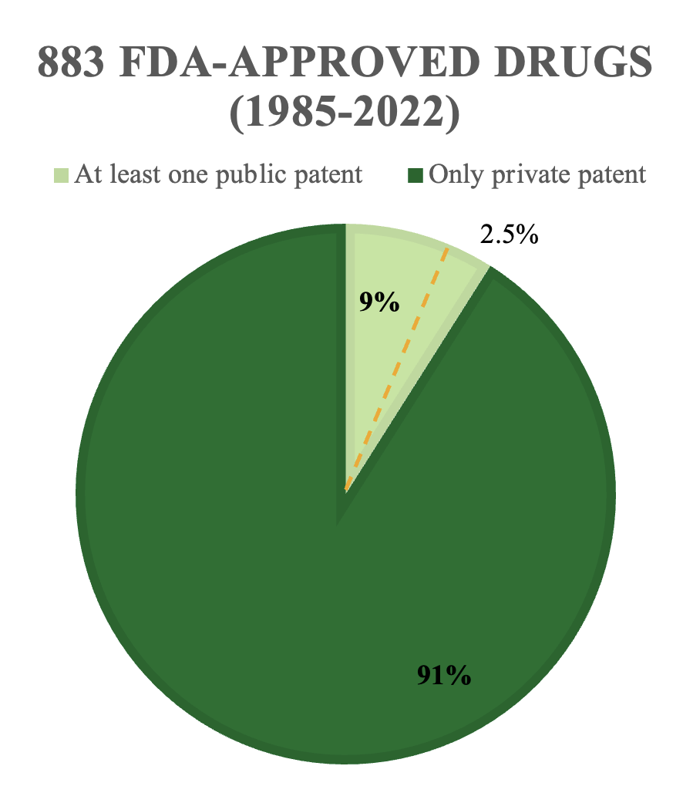
Why NIH Grants?
NIH funds 50% of medical research of academic labs
At least 20% of American productivity since WWII comes from R&D government funding
1$ gov dollars in basic research => $8.4 private dollars in R&D (8th+ year)
THE PROBLEM RESEARCH PROJECT FINDINGS & CLAIMS PROPOSAL & PROSPECTS
Notes:
In this talk,

Slide 19
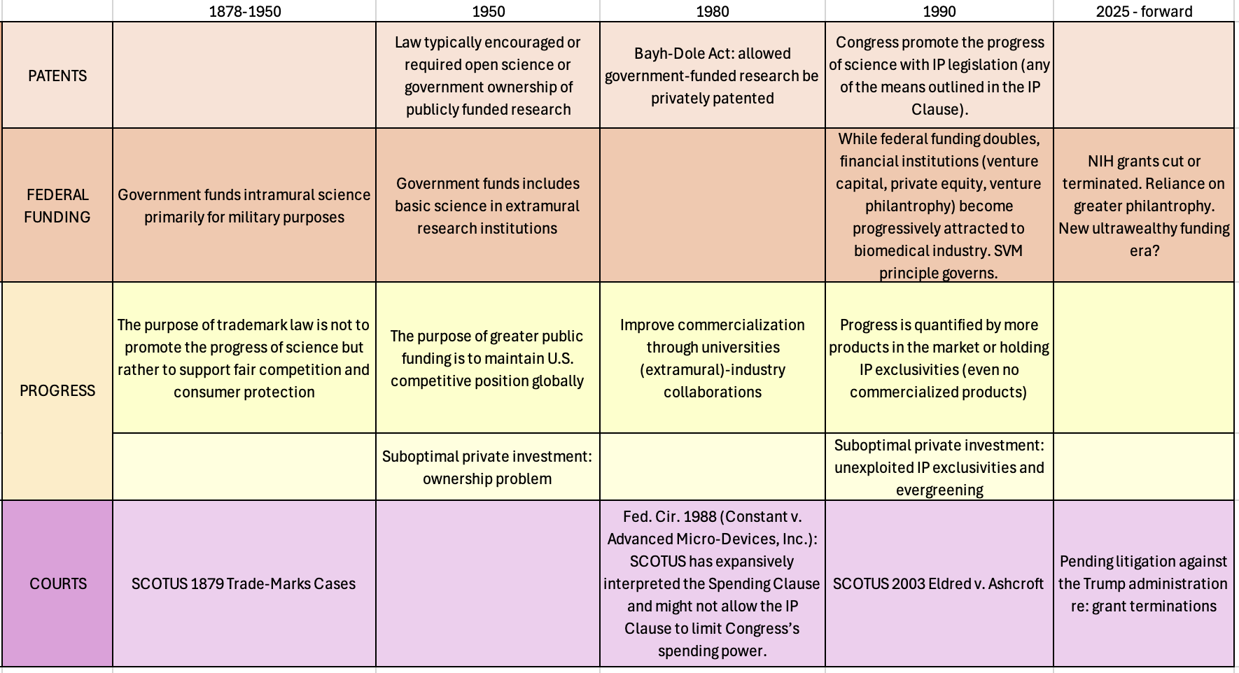
THE PROBLEM RESEARCH PROJECT FINDINGS & CLAIMS PROPOSAL & PROSPECTS

Slide 20
Preliminary Findings
Tensions between Ownership & Control v. Access (legacy: biomedical innovation is exclusively addressed with IP law, contract law and antitrust is generally excluded)
Progress is a value-neutral concept and demands objective evaluation: “Progress is More”
Progress is quantitative: valued for how much is made and the money earned rather than the kinds of things produced and their associated social benefits.
Reaching the market and earning commercial value is a sign of progress.
THE PROBLEM RESEARCH PROJECT FINDINGS & CLAIMS PROPOSAL & PROSPECTS

Slide 21
Normative Claims
Progress is focused on products rather than processes.
Biomedical innovation is corrupted. What is precisely corrupted? bargaining power (monopolists hold up the government) and market structure (government worsens concentration in private markets).
Elephant in the room: NIH funding.
IP Race Theory justification to reshape NIH funding and biomedical competition according to the redefined “progress of science”
AI-Generated
THE PROBLEM RESEARCH PROJECT FINDINGS & CLAIMS PROPOSAL & PROSPECTS

Slide 22
Future Expanded Research
Empirical study: semi-structured interviews with innovators (NIH’s and private sector scientists) and those facilitating biomedical innovation (funders and business partners) (Yale ISP Award, IRB).
Comparative Research and Global Health Law: Government Funding of Biomedical Sciences in the EU and Asia, and IHR 2024 and Pandemic Treaty (May 2025 draft).
THE PROBLEM RESEARCH PROJECT FINDINGS & CLAIM PROPOSAL & PROSPECTS
Notes:
How and why do they create and innovate/support innovation? What do they really care about when they engage in work that is protectable through IP law?
2. Are their standards of progress value-neutral and quantitative?
3. Are industrial policies (IP and grants) enabling their work toward progress?

Slide 23
Future Scholarly Work
NIH grants may restore equilibrium as a species of relational contracts for biomedical progress:
rebalance control/ownership v. access through multi-stakeholder, contractual regulation
reconsider progress less as a product and more as a process
reconsider the biomedical innovation ecosystem as a place that cultivates competition in a culture of democratic values, where multi stakeholders are held accountable to those values.
redefine access (‘more than prices’): economic, governing, infrastructural enablers
THE PROBLEM RESEARCH PROJECT FINDINGS & CLAIM PROPOSAL & PROSPECTS

Slide 24
Thank you Comments and suggestions are very welcome!
Ximena Benavides Reverditto, J.S.D., LL.M., LL.B.
Yale University/Yale Law School
ximena.benavides@yale.edu
University of Georgia (Fall 2025)
ximena.benavides@uga.edu

