Slide 1
What patents on AI-Derived Drugs Reveal Science (May 2025)
Janet Freilich (BU)
Arti Rai (Duke)

Slide 2
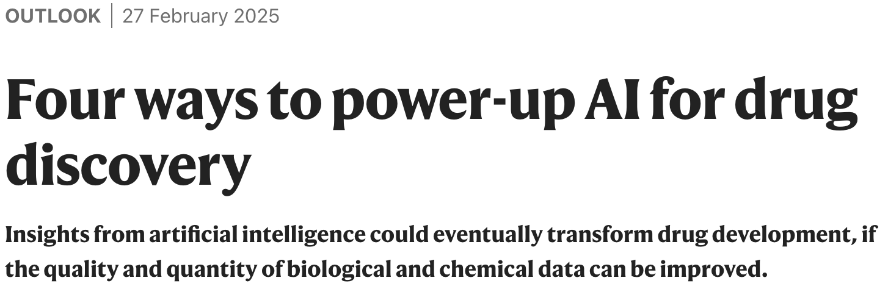
AI in drug development
Hopes that AI will make drug development faster and cheaper → in silico screening of molecules; drug design; target identification, etc

Slide 3
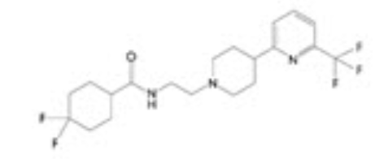
AI in drug development
Many “AI native” startups; thus far, few drugs in clinic
Hard to study what is happening with AI drug development
Our approach: use patents to get early signals of AI drug development
Our question: in silico approaches can quickly generate potential hits. How much testing are AI native companies doing before patent filing?
DSP-1181 (first AI-generated drug in clinic; failed phase I)

Slide 4
Early patenting; minimal evidence?
Background: Patents can be obtained without physically making the invention and with very little evidence of efficacy
Helps pharma companies patent early; assure protection before extensive investment
But: drug development is very unpredictable; many patented compounds will not work
May dampen interest from others in the compound because, once it has been disclosed, it is not novel → others cannot get a compound patent; may be concerned with infringement
Also reduces the utility of patent disclosure
Not a new debate, but concerns particularly acute for AI
For more, see Arti K. Rai, The Reliability Response to Patent Law’s AI Challenges (forthcoming; on SSRN)

Slide 5
Methodology
Compiled list of AI native companies (116 firms; based on firm’s own claims) and their patents
Note that patents themselves do not generally disclose how drugs were developed
Restricted to small molecule compound patents granted in US with priority date after 2013 (77 patents)
Controls matched on: small molecule compound, company size, priority date, filing law firm
Manually coded:
Number of compounds disclosed
Number and characteristics of experiments disclosed

Slide 6
Early patenting; minimal evidence?
How early in the development process are patents being filed? How much testing is done before patenting?
Almost all patents have in vitro testing
For in vivo testing, AI patents look different!
 | AI patents | Controls
Any in vivo experiments? | 23% | 47%
How many compounds tested in vivo? | 0.8 | 3.1
Any ADMET data? | 12% | 26%
Specific formulation disclosed? | 1% | 14%

Slide 7
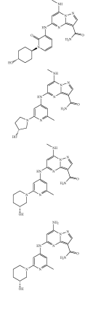
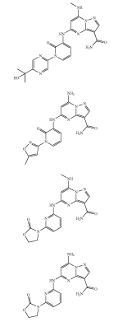
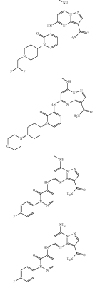
How many compounds disclosed?
Disclosure helps scientific progress but could also diminish incentives for others to study those compounds
Are AI-native firms disclosing more compounds?
No; everyone discloses many compounds (median 101 for AI; 90 for controls)
Note: our sample pre-dates LLMs

Slide 8
Policy
AI firms are patenting earlier/with less evidence
Is AI good enough to reliably predict in vivo performance? TBD…
Current situation risks disincentivizing research on compounds patented early with little testing and cluttering patent literature
Require more testing to get a patent?
Allow patents on previously disclosed compounds if those compounds were not tested (enabled)

Slide 9
Thank You
janetf@bu.edu
rai@law.duke.edu

