Slide 1
Innovation Bullying Unmasked
Cynthia Ho
Loyola U. Chicago School of Law
ASLME- Friday, June 6, 2025

Slide 2
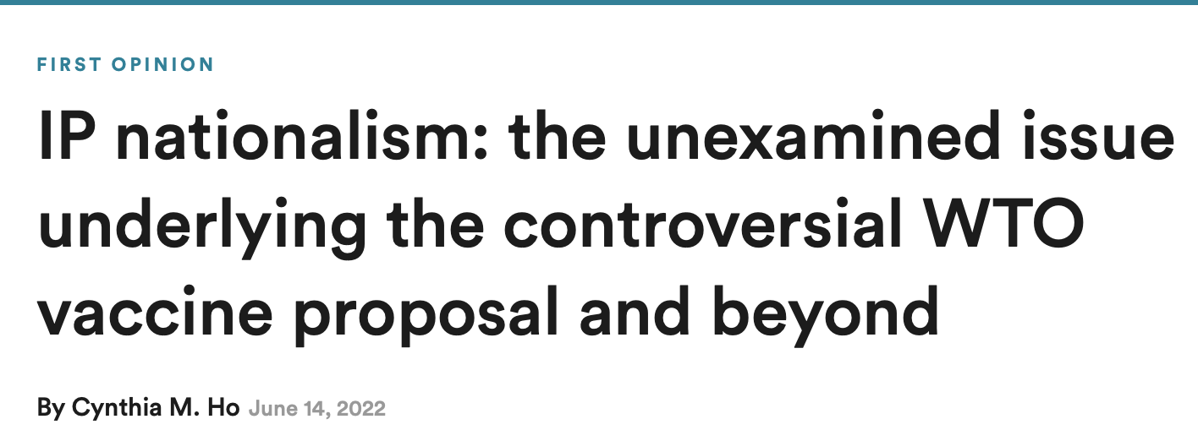
Some Context

Slide 3
Background
Bullying
IP related Bullying

Slide 4
What is different about Innovation Bullying?
Aimed at policymakers, not competitors
Actors besides IP owners
Entities (US Chamber of Commerce)
Influential individuals (Bill Gates)
Countries
Health harm
Often effective (even with unsupported claims)

Slide 5
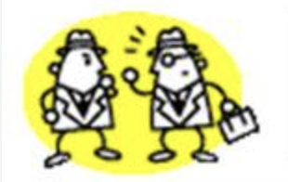
Addressing Counterarguments
Right owners are entitled to act in their own self interest?
But, is policy lever to promote public interests
Is it bullying, or capitulation to lobbying?
Useful frame?

Slide 6
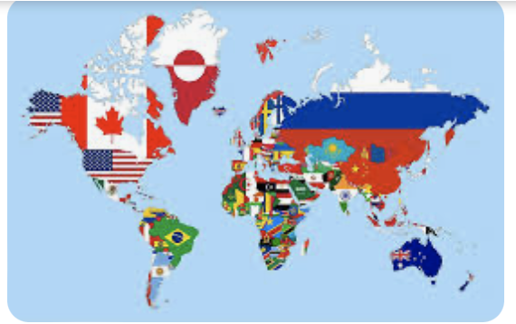
IP Innovation bullying -Two contexts

Slide 7
A few ExamplES
“most favored nation policy would reduce the United States’ global advantage in both pharmaceutical innovation and patient access to drugs.” – American Action Forum, May 13, 2025
“Intellectual property protection and legal certainty are essential for the innovative-based pharmaceutical industry to invest in high-risk R&D and enable voluntary partnerships that we will need in the next pandemic.” Dr. Reddy, Director General of IFPMA, April 16, 2025
[IRA] will all but ensure that many potential groundbreaking cures die in labs” – BIO, July 28, 2022
“advance notification of price increases … jeopardize the market-based mechanisms that deliver new and affordable medicines” – PhRMA, March 29, 2018

Slide 8
InnovaTION Bullying - Domestic Contexts
Biosimilar pathway
Patent/drug pricing reform
Public disclosure:
Clinical data supporting drugs
Pricing
Secret ingredients

Slide 9
InnovAtion Bullying – Int’l Context
WTO/TRIPS existence
Global South told they would become more innovative with stronger IP
Provision(s) in WTO/TRIPS are unbalanced
Limited existing exceptions (s.a. compulsory licensing) prompts bullying
Some recognition of need for technology transfer, BUT minimal obligations only for LDC
COVID
Gates Foundation bullied Oxford into exclusive licensing (not sharing IP) of its vaccine
TRIPS COVID ”waiver”
WHO Pandemic Agreement
Tech Transfer in theory

Slide 10
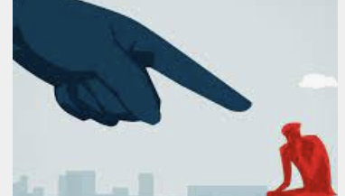
Combatting Innovation Bullying – 2 Step APproach
Shaming
Changing Norms/Law

Slide 11
SHaming
When has it been used?
Trademark Bullying
Corporations generally (env, labor, etc)
Countries (i.e. int’l human rights)
Benefits of shaming?
Low cost
Gap-filler when unclear/inadequate laws for desired result
Help create new norms?

Slide 12
Shaming Innovating Bullying
Drug Company Shaming is tricky
Consumers/policymakers unaware of bullying
Aware Consumers may lack alternatives to prescriptions
BUT, some situations where shaming has been effective
IRA insulin pricing
Biogen Aduhelm drug
Can Countries be Shamed?
Not during COVD pandemic
BUT, US was shamed into not overriding IP rights for Cipro antibiotic

Slide 13
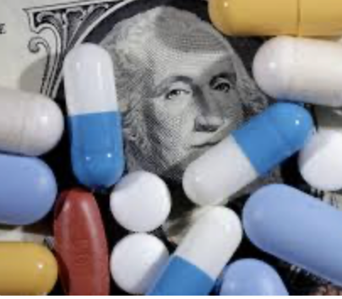
Tackling Domestic Innovation BullyiNG
Promote Greater Focus on relevant Innovation
Change Laws to promote desired innovation
Medicare funding & cancer treatments
(Change law to permit) cost-effectiveness considerations for CMS?
New FDA drug approval classification for improvement
Greater reimbursement and/or other benefit (s.a. longer exclusivity)?

Slide 14
Harnessing Innovation bullying To help Global South
If innovation is goal, it should be the goal for all countries
Must recognize that IP rights alone are inadequate to promote innovation
Technology Transfer as first step
What to do?
Revisit TRIPS & WHO Pandemic Agreement
Domestic Levers to Promote Technology Transfer

Slide 15
Now what?
Some questions
One or two viable projects (domestic first)?
Theory of bullying and shaming?
How helpful are quotes about bullying?
Other Thoughts/suggestions?

Slide 16
Innovation Bullying – Part I?
Innovation Bullying
A. Basics (what is it, what’s the harm, and why is it effective)
B. Illustrations of (Domestic) Innovation Bullying
Fighting Back
Shaming (what is it, when is it useful, prior examples)
Refocused Conversation on Relevant Innovation
Proposed Legal Reforms
Medicare
Tailored Regulatory Exclusivities?

