Slide 1
Characterizing Paragraph IV Certifications, 2003-2025
Sarah M.E. Gabriele
Health Law Professors Conference
June 6, 2025

Slide 2
Background
The Hatch-Waxman Act of 1984 incentivizes generic firms to file challenges (known as “paragraph IV certifications”) contesting patents listed in the Food and Drug Administration’s (FDA) Approved Drug Products with Therapeutic Equivalence Evaluations.
The paragraph IV certification needs to be notified to the brand-name manufacturer, which can, in turn, file litigation within 45 days of receipt of the paragraph IV notice.
Brand-name firms often file litigation to block generic competition and thereby extend periods of market exclusivity.
When the lawsuit is started, the FDA is precluded from giving final approval to the ANDA for 30 months (so-called 30-month stay) while the matter is litigated or until the court decides on the issue.

Slide 3
Aim
This paper analyzes paragraph IV certifications from 2003-2025 to understand the timing, scope, and outcomes of litigation and how such litigation affects generic drug availability.

Slide 4
Methods
We used a publicly available FDA database to identify all brand-name drugs that faced paragraph IV certifications between 2003-2025.
We used Drugs@FDA to extract the initial approval dates for each NDA and the type of approval
We used annual editions of the FDA’s Approved Drug Products with Therapeutic Equivalence Evaluations (Orange Book) from 2003 to 2025 to identify all patents that were listed at the time of or subsequent to first paragraph IV certification.
We used a large litigation database (Lex Machina) to search for all lawsuits filed by brand-name pharmaceutical firms in response to paragraph IV certifications by generic firms.
For each brand-name drug, defined at the level of the NDA, we calculated the time from initial FDA approval to first paragraph IV certification.
Notes:
We used a publicly available FDA database to identify all brand-name drugs that faced paragraph IV certifications from December 8, 2003, when the Medicare Modernization Act was signed into law, until February 17, 2025.¹ The study period began in 2003, because the FDA only began recording the dates of first paragraph IV certification following passage of the Medicare Modernization Act that year. In some cases, generic firms challenged only one strength (or set of strengths) of a brand-name drug before other strengths under the same New Drug Application (NDA) were challenged. For the purposes of analysis, we considered the challenge on the first strength (or set of strengths) under a given NDA as the initial paragraph IV certification. All brand-name drugs that faced initial paragraph IV certifications before the study period began were excluded from the analysis even if they later faced paragraph IV certifications on different strengths during the study period (eMethods).
Data extraction
For all brand-name drugs included in the cohort, we used drugs@FDA to extract the initial approval dates for each NDA and the type of approval (Type 1 for new molecular entities vs. Types 2-8 for other types of approvals such as new dosage forms, new combinations, or new formulations).² This distinction between new molecular entities and all other approval types is importance for analyses of patent challenges, because generic firms can only file paragraph IV certifications four years after a given active moiety has been on the market. Thus, brand-name drugs receiving Type 1 approvals are shielded from any patent challenges for at least four years, while brand-name drugs receiving other types of approvals can be challenged earlier so long as the active moiety of the product has been on the market for at least four years. Some products with combinations of drugs receive both Type 1 and non-Type 1 approvals since one active moiety in the product (but not the others) may be a new molecular entity; these products were considered Type 1 approvals since the clock on paragraph IV certifications is linked to the new molecular entity.
We used annual editions of the FDA’s Approved Drug Products with Therapeutic Equivalence Evaluations (Orange Book) from 2003 to 2025 to identify all patents that were listed at the time of or subsequent to first paragraph IV certification. For patents that were added the same year as the paragraph IV certification was filed, we consulted monthly supplements of the Orange Book to determine if the patent had been submitted for listing before or after the paragraph IV certification was filed. We recorded the expiration date of each patent in the Orange Book, and we then used a large patent database (Google Patents) to determine the filing dates of these patents and to review their claims. The claims of a patent, which describe different aspects of the innovation, determine the scope of legal protections awarded to a patent holder. We reviewed the claims of all patents included in the cohort to determine whether the patent covered an active ingredient (primary patent), another aspect of the product such as its formulation or method of use (secondary patent), or the delivery device (tertiary patent). These three categories were mutually exclusive (and exhaustive) for the purposes of analysis.
Litigation
We used a large litigation database (Lex Machina) to search for all lawsuits filed by brand-name pharmaceutical firms in response to paragraph IV certifications by generic firms. Under the Hatch-Waxman Act of 1984, when brand-name firms file litigation within 45 days of a paragraph IV certification, they are entitled to an automatic 30-month stay from the FDA in approving the generic version for marketing. Brand-name firms thus have an incentive to initiate litigation quickly after receiving notice that the patents on their drug have been challenged.
Using an approach validated in other studies,^{3,4} we identified all lawsuits on a given brand-name drug after the initial paragraph IV certification had been filed. We included not only lawsuits on the first paragraph IV certification but all lawsuits initiated through X, 2025. Although the FDA maintains a database of when the first paragraph IV certification on a given product is filed, no such publicly available database is maintained for subsequent paragraph IV certifications. By inputting all patents listed in the Orange Book at the time of or subsequent to the first paragraph IV certification, we obtained a comprehensive list of lawsuits filed in response to patent challenges during the study period.
For each lawsuit, we used the complaints to record the name of the brand-name firm bringing the lawsuit, the NDA with patents being challenged, the generic firm filing the challenge, the Abbreviated New Drug Application (ANDA) under which the paragraph IV certification was included, the date when the brand-name firm received notice that a paragraph IV certification had been filed, the date when the lawsuit was initiated, and all patents that the brand-name firm sought to enforce. Although we extracted all patents from the Orange Book listed at the time of or subsequent to first paragraph IV certification, brand-name firms may seek to enforce only a proportion of such patents at the time of litigation, because defense of even one patent is sufficient to block the FDA from approving the generic version for marketing.

Slide 5
Results - Scope
959 brand-name drugs faced paragraph IV challenges from generic manufacturers via Abbreviated New Drug Applications (ANDAs) during the study period.
We found a total of 2,494 paragraph IV cases between 2003-2025.
355 drugs (37%) were initially approved as new molecular entities (NME), while 604 (63%) were initially approved as reformulations of active moieties already on the market.
Of these 959, 635 (66%) had at least a generic approved after the paragraph IV challenge.

Slide 6
Results – Scope
Brand-name firms listed a median of 9 patents (IQR 4-20) on the Orange Book.
Among all patents listed on brand-name drugs, brand-name firms asserted infringement on a median of 2 patents (IQR 1-4)—or 33% (IQR 21%-57%) of total patents listed.

Slide 7
Results – Timing
The median time from brand-name approval to first paragraph IV certification was 4 years (interquartile range [IQR] 2.1-7.4).
However:
For NME, the median time from brand-name approval to first paragraph IV certification was 5 years (interquartile range [IQR] 4-8.6).
For non-NME, the median time from brand-name approval to first paragraph IV certification was 3 years (interquartile range [IQR] 1.1-6.4).

Slide 8
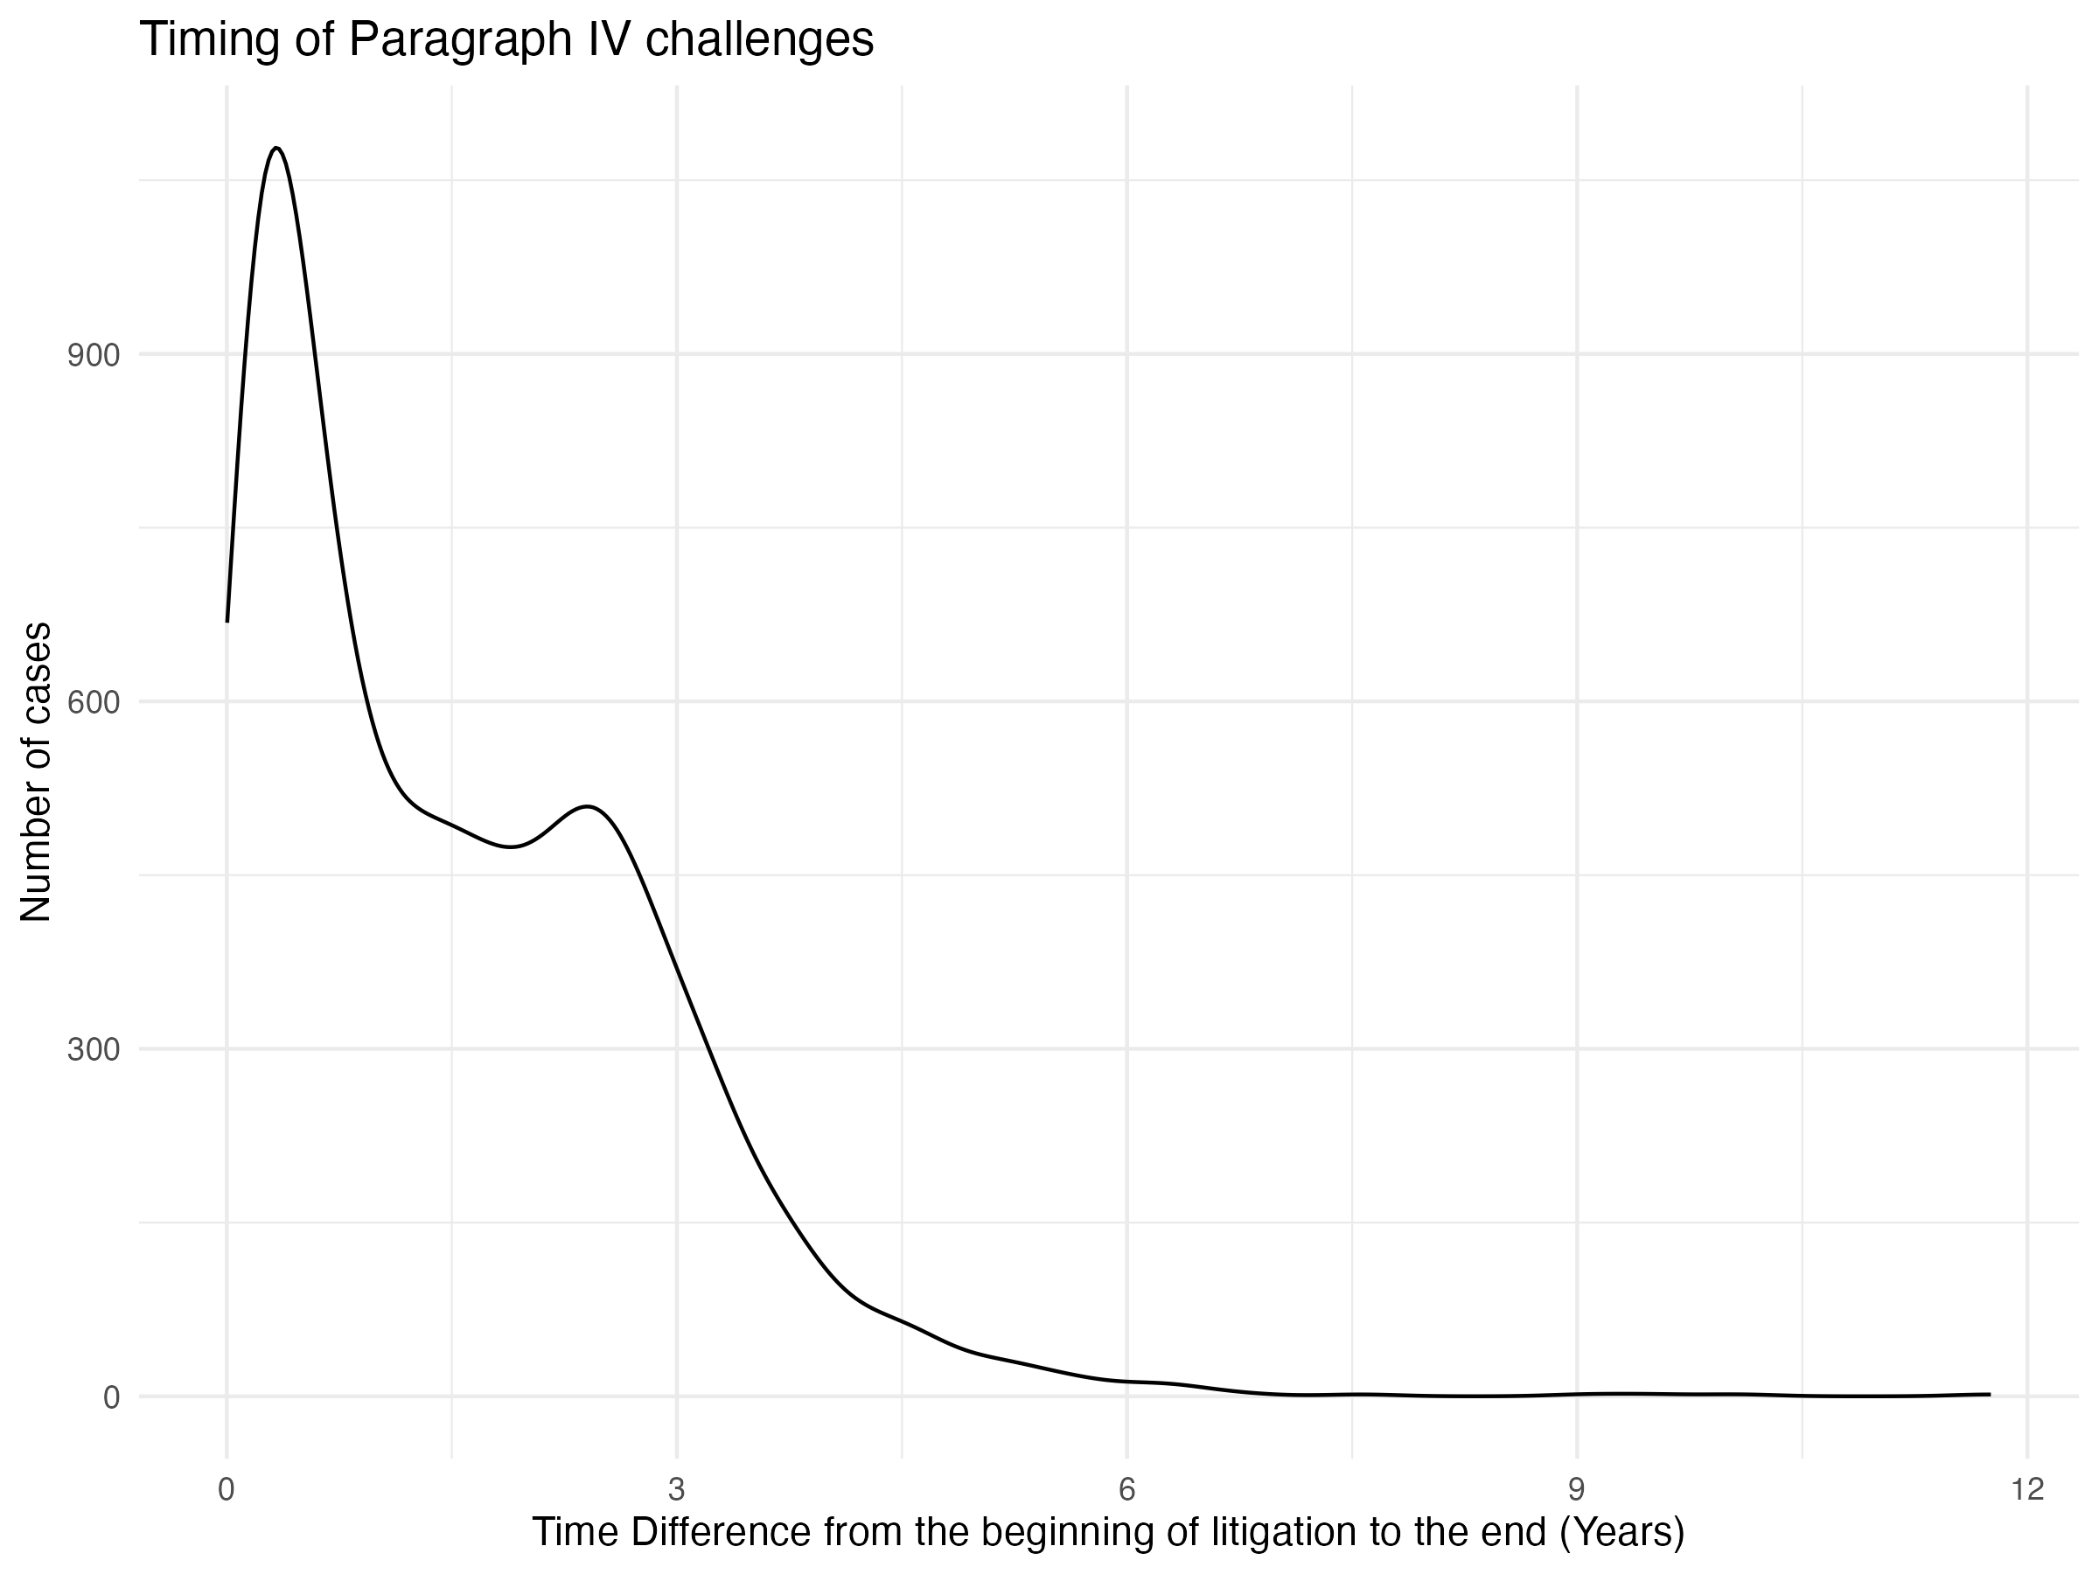
The median time from the beginning of the litigation to the end was 1.3 (interquartile range [IQR] 0.4-2.5).

Slide 9
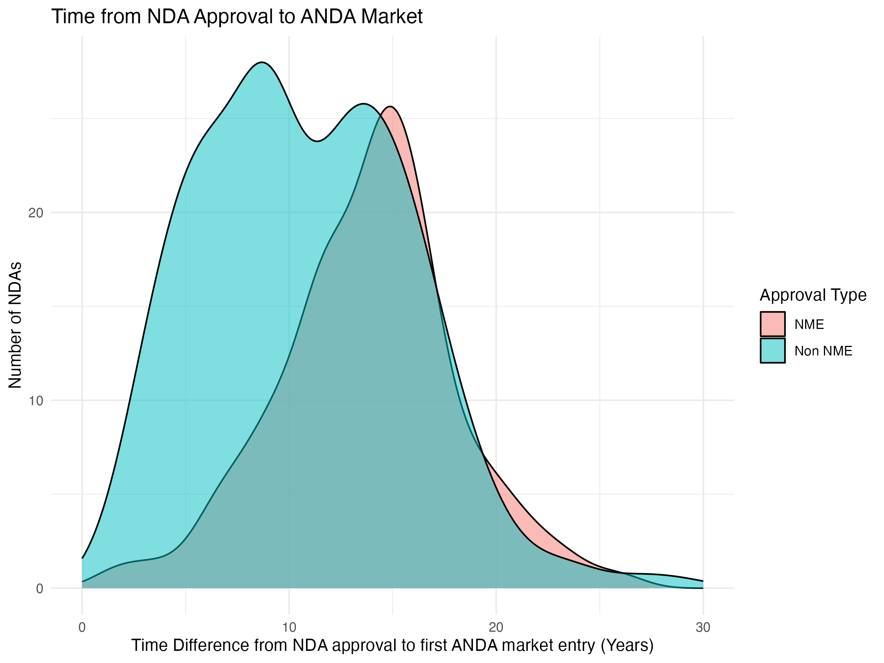
The median time from FDA approval of the brand-name drug to first generic entry among drugs in the cohort was 13 years (IQR 9-16).
However:
For NME, the median time from brand-name approval to first paragraph IV certification was 14 years (interquartile range [IQR] 12-16).
For non-NME, the median time from brand-name approval to first paragraph IV certification was 10 years (interquartile range [IQR] 6-14).

Slide 11
Results - Outcomes
The results of litigation were 384 (11%) cases still ongoing, 989 (28%) cases terminated for procedural reasons, 1867 (53%) cases were settled, in 107 (3%) cases the generic companies (defendant) prevailed and in 172 (5%) cases the brand-name company (plaintiff) prevailed.

Slide 12
Discussion
Timing:
Generic companies are trying to challenge patents as soon as possible both for NME as well as not NME.
However, generic companies are only entering the market years later.
What are the effects of the 30-month stay?
Number of patents listed vs litigated:
Not all patents listed in the Orange Book are litigated.
Outcomes:
Over 50% of cases end in settlements.

Slide 13
Further directions
Linking the timing of the first generic entering the market to the litigation outcomes:
Do settled cases have a longer time difference between the NDA approval and the first ANDA market date?
Stratify results by revenue
Is there a significant difference between drugs based on revenue?

Slide 14
Acknowledgments
William B. Feldman
Liam Bendicksen
Rasha Alhiary
Anirudh Sudarshan
Adi Krishnan
Helen Mooney
Aaron S. Kesselheim
S. Sean Tu
PORTAL Writing Group

Slide 15
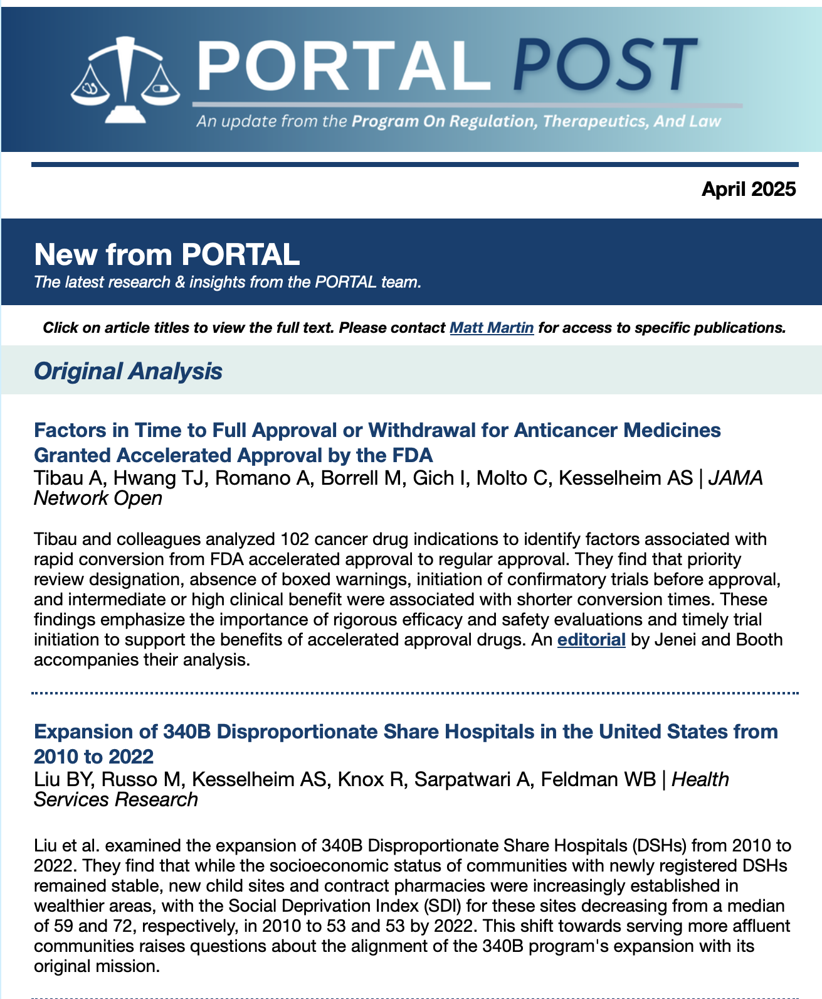
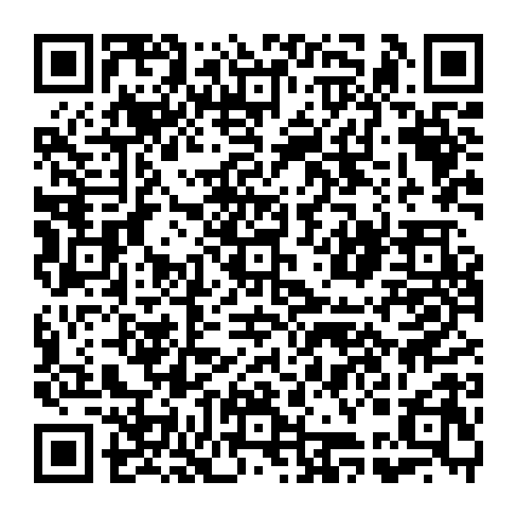
Sign Up for the PORTAL Newsletter

