Slide 1
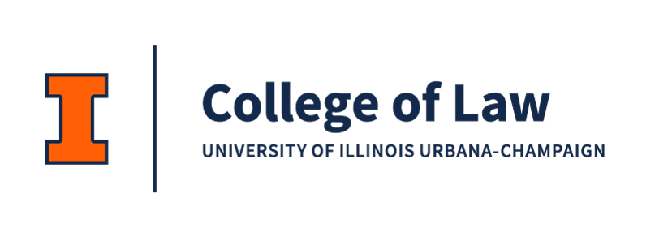
Expert Perspectives on Emerging Biotech
Jennifer K. Wagner and Sara Gerke

Slide 2
Acknowledgments
This research was supported by Grant No. 5R21EB035474-02 awarded by the National Institutes of Health Office of the Director (NIH OD) and the National Institute of Biomedical Imaging and Bioengineering (NIBIB). The content is solely the responsibility of the authors and does not necessarily represent the official views of the NIH.
This work is undertaken as part of the “Bioethical, Legal, and Anthropological Study of Technologies (BLAST),” for which an IRB exemption determination has been obtained from the Penn State University IRB (STUDY00023241) on August 4, 2023.

Slide 3
Bioethical, Legal, and Anthropological Study of Technologies (BLAST)
Specific Aims
  Aim 1: To examine data practices, data privacy, data access, and data justice issues…
  Aim 2: To examine regulatory pathways and identify regulatory gaps related to safety and effectiveness…
  Aim 3: To examine liability risks related to the development and use…
Technological Scope
  Bioprinting
  Bionic Devices
  Healthcare Robotics
Mixed-Methods Approach
  Key informant interviews
  Internet research
  Normative ethical analysis
  Legal research
NIH OD/NIBIB Grant No. 5R21EB035474-02

Slide 4
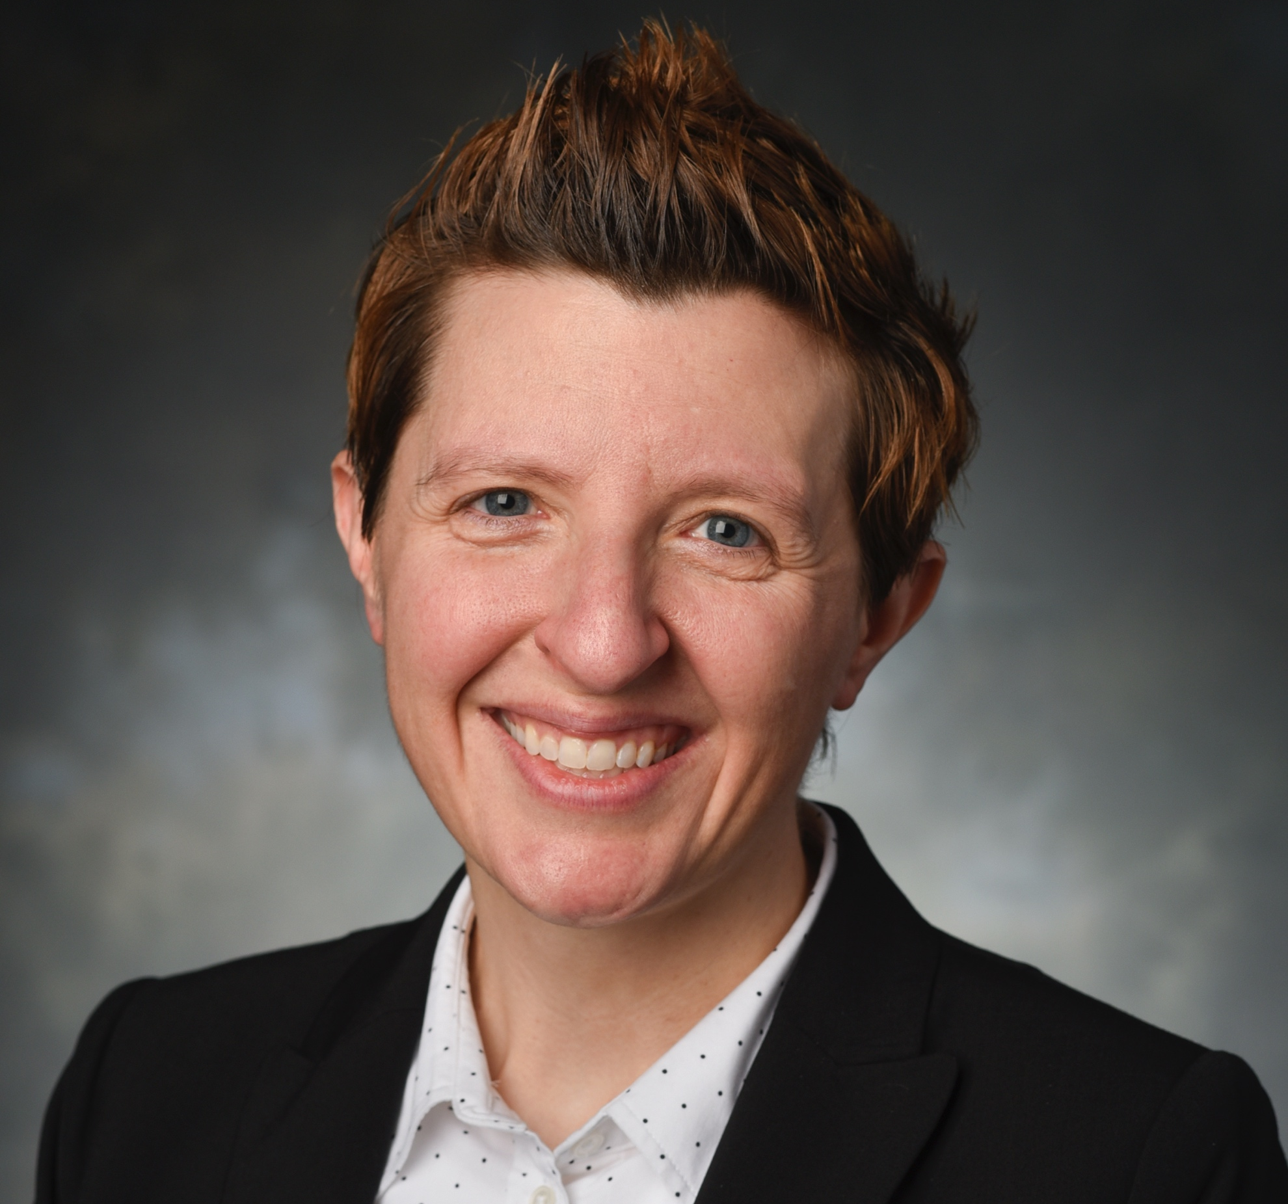
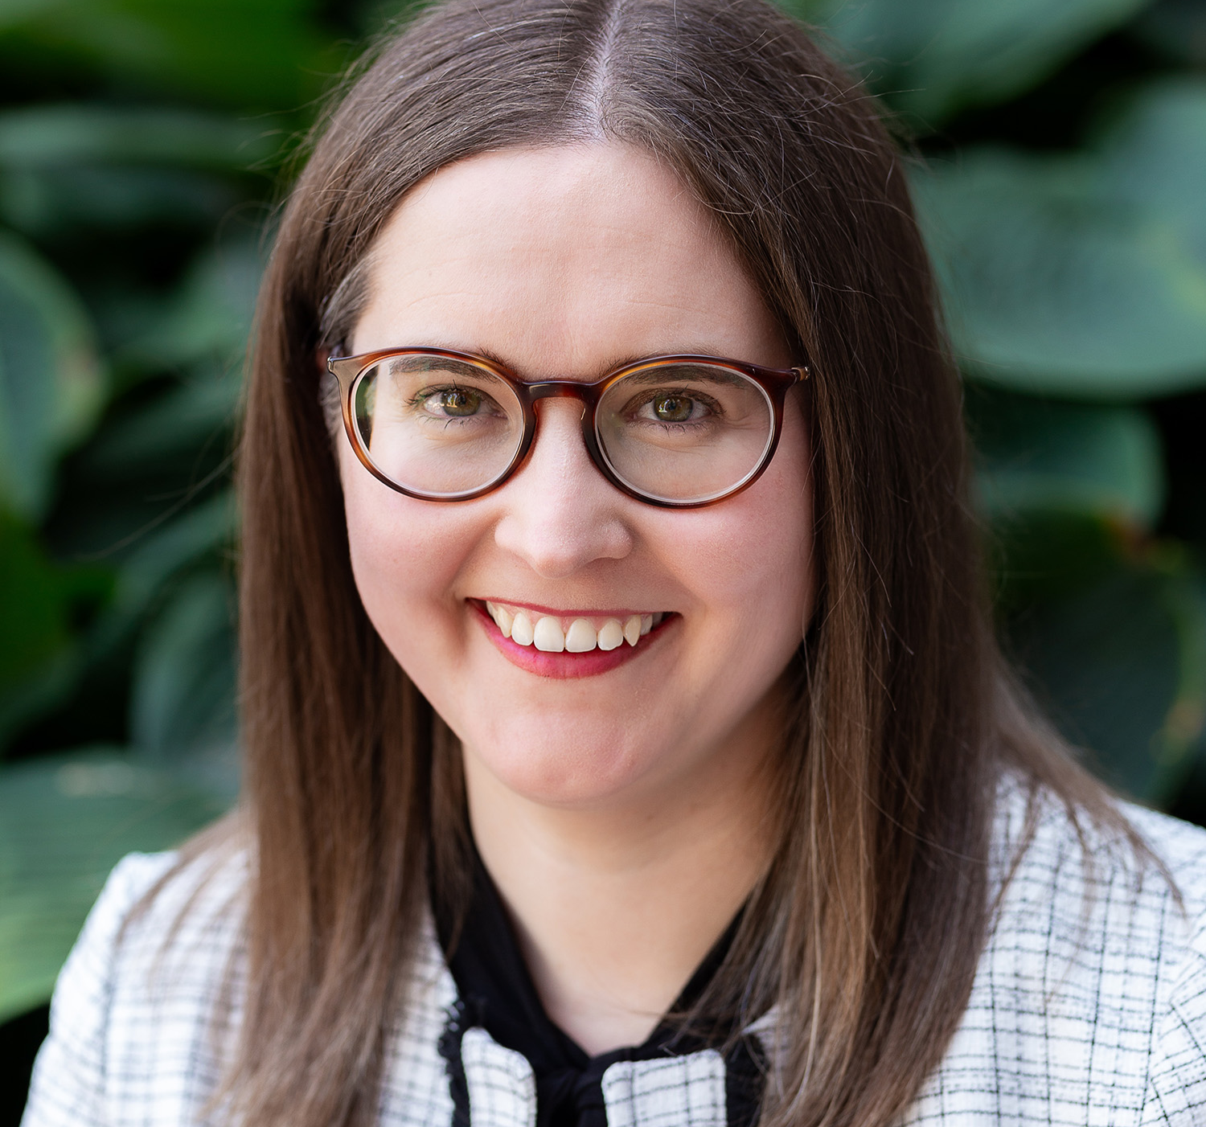
BLAST Research Team
Penn State
  Alyna T. Khan, postdoctoral scholar
    interviews, qualitative analysis
  Caitlin Maloney, PhD candidate
    literature reviews
  Nicole Rincon, law student
    legal research
  Jonathan Gray, law student
    legal research
  Carson Knight, undergraduate student
    transcript processing, literature reviews
  Shouvik Majumder, undergraduate student
    literature reviews
  Julia Kline, undergraduate student
    literature reviews
Illinois
  Audrey Nankervis, law student
    qualitative analysis
  Jacob Balamut, former law student
    legal research
Jennifer K. Wagner, JD, PhD
Assistant Professor of Law, Policy, and Engineering and Anthropology
School of Engineering Design & Innovation, Penn State University
jkw131@psu.edu
Sara Gerke, Dipl-Jur, MA
Associate Professor of Law
Richard W. & Marie L. Corman Scholar
Associate Professor, European Union Center
University of lllinois College of Law
gerke@Illinois.edu

Slide 5

Key Informant Interviews
Semi-structured interviews were conducted in 2024 via
N=31 Informants
  n=20 scientists/technologists
  n=11 legal experts
Transcripts processed manually and de-identified
Qualitative analysis performed using

Slide 6
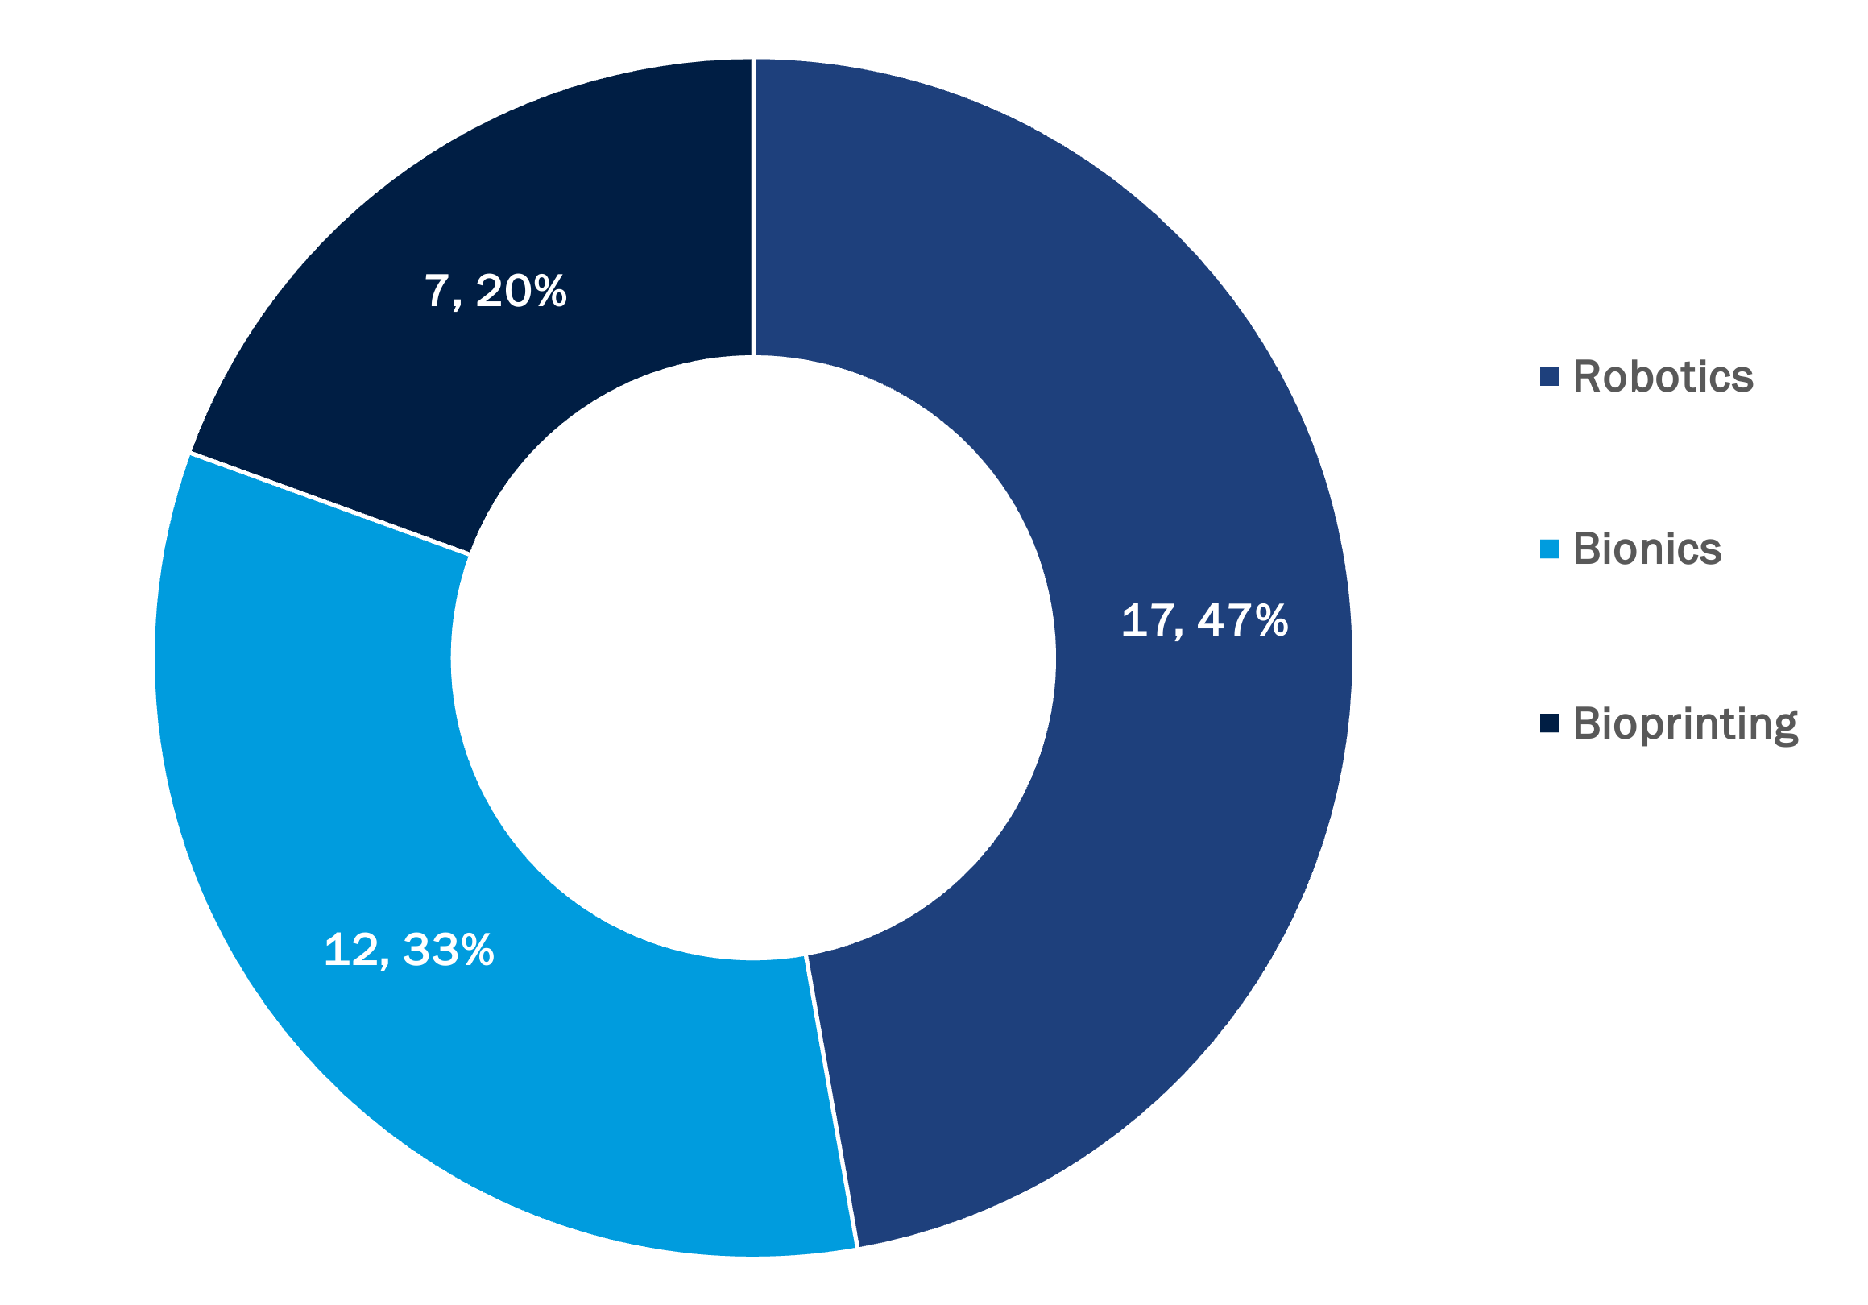
Technological Focus of Interviews

Slide 7
Common Themes Observed
Theme 1:
  The FDA regulatory approval process must adapt to the advancements of emerging robotic, bionic, and bioprinting technologies
Theme 2:
  Clinical integration requires reenvisioning the existing infrastructure for healthcare delivery
Theme 3:
  Analogies shed light on perspectives regarding issues of liability, acceptance, and trust in emerging technologies

Slide 8
Common Themes Observed
Theme 1:
  The FDA regulatory approval process must adapt to the advancements of emerging robotic, bionic, and bioprinting technologies
Theme 2:
  Clinical integration requires reenvisioning the existing infrastructure for healthcare delivery and reimbursement models
Theme 3:
  Analogies shed light on perspectives regarding issues of liability, acceptance, and trust in emerging technologies

Slide 9
Theme 1: The FDA regulatory approval process must adapt to the advancements of emerging robotic, bionic, and bioprinting technologies
“[T]he FDA is struggling with how to regulate all these technologies. It's not what it was set up for. It was set up for devices, pacemakers, drugs, food, obviously. And now we're throwing at it AI. Well, that's an algorithm. How do they regulate an algorithm? A lot of the algorithms are black box where people don't even understand exactly how they work. How does the FDA regulate that?” [Participant 10, Legal Expert]

Slide 10
Theme 1: The FDA regulatory approval process must adapt to the advancements of emerging robotic, bionic, and bioprinting technologies
“the system has gone overboard… because some people have done some bad things in the past” [Participant 11, sci/tech expert].
“[I]n the US we have [a] pretty slow kind of process. And that it hasn't adapted quickly to new technologies, which is to our detriment.” [Participant 15, sci/tech expert]

Slide 11
Common Themes Observed
Theme 1:
  The FDA regulatory approval process must adapt to the advancements of emerging robotic, bionic, and bioprinting technologies
Theme 2:
  Clinical integration requires reenvisioning the existing infrastructure for healthcare delivery and reimbursement models
Theme 3:
  Analogies shed light on perspectives regarding issues of liability, acceptance, and trust in emerging technologies

Slide 12
Theme 2: Clinical integration requires reenvisioning the existing infrastructure for healthcare delivery and reimbursement models
“CMS has explicitly said they will not pay more for the software required to run an artificial pancreas. They will pay for the glucose monitor, they will pay for the insulin pump, but actually combining those things together, there's no extra recognition or payment for it. So, if that's where the value really is, if that's where the investment is required to develop software and advanced algorithms to manage autonomously, somebody's insulin dosing, it just, it creates this gap...And that's true across many different areas where the next innovation in digital health and being able to create some of these advanced systems requires very advanced software and very significant investment. And the Medicare program simply does not recognize that value.” [Participant 14, legal expert]

Slide 13
Theme 2: Clinical integration requires reenvisioning the existing infrastructure for healthcare delivery and reimbursement models
“ ...organ transplant’s super expensive, engineered organs are going to be super expensive. Our medical system has no capacity today to give the millions of people the one, the $300,000 surgery, right? The way we're doing, it's just not possible, right? And so how do we manage, then, the distribution of a, of a care, of medical therapy that we know could save lives but we don't have the financial infrastructure to provide to everyone? How is it doled out? ... [W]e would fundamentally change the supply by ... at least two orders of magnitude, if it works. Maybe even larger. So - and then, obviously, that's just in the US. Think about globally where most of the both the healthcare system as well as financial resources are that much less. I mean, you could see the problem. So those to me, I think the moral ethical issues are very much tied to if we do get it to work. And who the hell gets it, right? Like to me, that's the that's the bigger question.” [Participant 20, sci/tech expert]

Slide 14
Theme 2: Clinical integration requires reenvisioning the existing infrastructure for healthcare delivery and reimbursement models
“[I]t feels like more [that] the challenge is not particularly so much how do we design this thing? But now, how do we integrate it into the clinical context? The societal context? ... Those are really the challenges I see with the next step, which then, of course, is gonna spur additional innovation as we find some of the challenges with doing that integration, and where we could make it technologically better.” [Participant 18, sci/tech expert]

Slide 15
Common Themes Observed
Theme 1:
  The FDA regulatory approval process must adapt to the advancements of emerging robotic, bionic, and bioprinting technologies
Theme 2:
  Clinical integration requires reenvisioning the existing infrastructure for healthcare delivery and reimbursement models
Theme 3:
  Analogies shed light on perspectives regarding issues of liability, acceptance, and trust in emerging technologies

Slide 16
Theme 3: Analogies shed light on perspectives regarding issues of liability, acceptance, and trust in emerging technologies

Slide 17
Theme 3: Analogies shed light on perspectives regarding issues of liability, acceptance, and trust in emerging technologies
“Autonomous driving a good example, right? Autonomous driving are like robots. A machine is actually driving you, and what happens if that machine gets them gets in an accident. Okay? And who do you write the ticket to? Alright? So that's a legal you know, problem.” [Participant 30, sci/tech expert]

Slide 18
Theme 3: Analogies shed light on perspectives regarding issues of liability, acceptance, and trust in emerging technologies
[I] “trust Google Maps, probably more than someone else... I would actually, if they were saying, ‘Go here,’ I'd be like, ‘no, the Google map is telling me to go here, and it knows better than you do, you know, and it has real time traffic.” …
“whether you believe it or not, I think statistically self-driving cars are probably safer than humans. But they have to be maybe a hundred times safer than humans for someone to accept them.” [Participant 11, sci/tech expert]

Slide 19
Theme 3: Analogies shed light on perspectives regarding issues of liability, acceptance, and trust in emerging technologies
"I would say, you know it's, it, it really goes to, you know, is there kind of rules being applied equally, right, when it comes to regulating, you know, kind of novel technologies. And not, as we've seen, you know, with pharma, where the FDA is basically funded by the pharmaceutical industry through prescription drug user fees, right? And so the agency that's regulating them is dependent upon the regulated industries. So obviously, I mean, I'd, I'd be concerned as a regular citizen, that you know these industries and the regulatory bodies are kind of captured by these very wealthy, powerful corporations. And so that would be my concern with any new technology that's approved, is that, was there really a separation between the regulatory agencies and the companies saying they should be approved for use?” [Participant 13, legal expert]

Slide 20
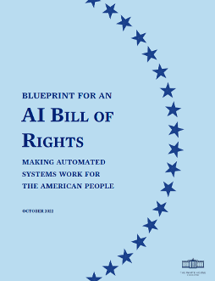
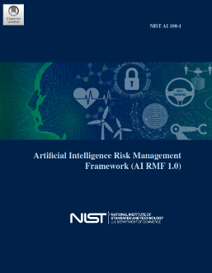
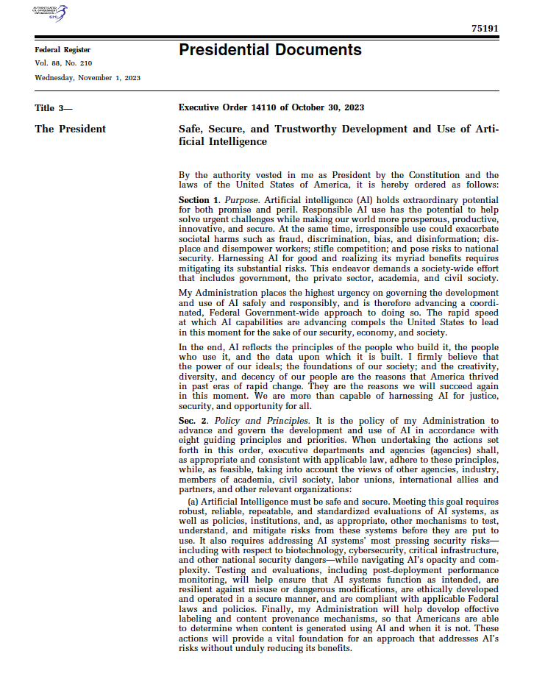
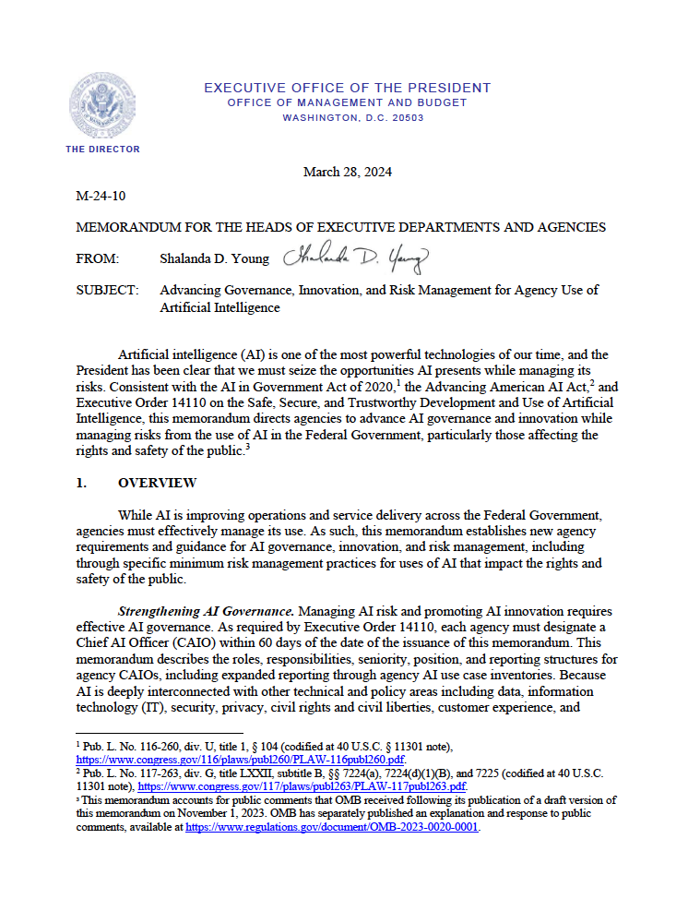
Recent relevant policy developments
2022 “Blueprint for an AI Bill of Rights”
2023 NIST RMF 1.0
and playbook
2023 Executive Order 14110
“Safe, Secure, and Trustworthy Development and Use of Artificial Intelligence”
2024 OMB Memo
“Advancing Governance, Innovation, and Risk Management for Agency Use of Artificial Intelligence”

Slide 21
Recent FDA Developments for Medical AI/ML
Apr 2019 "Proposed Regulatory Framework for Modifications to Artificial Intelligence/Machine Learning (AI/ML)-Based Software as a Medical Device (SaMD) - Discussion Paper and Request for Feedback"
Jan 2021 "Artificial Intelligence and Machine Learning Software as a Medical Device Action Plan" or "AI/ML SaMD Action Plan."
Oct 2021 “Good Machine Learning Practice for Medical Device Development: Guiding Principles”
Sept 2022 "Clinical Decision Support Software"
Apr 2023 “Draft Guidance: Marketing Submission Recommendations for a Predetermined Change Control Plan for Artificial Intelligence/Machine Learning (AI/ML)-Enabled Device Software Functions”
May 2023 “Using Artificial Intelligence & Machine Learning in the Development of Drug & Biological Products” (Discussion Paper)
Oct 2023 “Predetermined Change Control Plans for Machine Learning-Enabled Medical Devices: Guiding Principles”
Mar 2024 "Artificial Intelligence and Medical Products: How CBER, CDER, CDRH, and OCP are Working Together" (FDA’s coordinated approach)
Jun 2024 “Transparency for Machine Learning-Enabled Medical Devices: Guiding Principles”
Dec 2024 “Final Guidance: Marketing Submission Recommendations for a Predetermined Change Control Plan for Artificial Intelligence-Enabled Device Software Functions”
Jan 2025 “Draft Guidance: Artificial Intelligence-Enabled Device Software Functions: Lifecycle Management and Marketing Submission Recommendations” and “Considerations for the Use of Artificial Intelligence to Support Regulatory Decision-Making for Drug and Biological Products"

Slide 22
Recent Federal Trade Commission AI Activities
  Jan 2021 action against Flo Health
  Apr 2021 business guidance on discriminatory algorithmic performance
  July 2021 regulatory priorities
  Sept 2021 Privacy and Security report to Congress
  Sept 2021 statement on FTC health breach notification rule (health apps)
  Mar 2022 action against Kurbo
  Sept 2022 ANRPM and forum on dataveillance
  Feb. 27, 2023: Guidance “Keep your AI claims in check,”
  Jan. 9, 2024: Guidance “AI Companies: Uphold Your Privacy and Confidentiality Commitments,” FTC Office of Technology Blog
  Sept. 25, 2024: Operation AI Comply
    “FTC Announces Crackdown on Deceptive AI Claims and Schemes: With Operation AI Comply, agency announces five law enforcement actions against operations that use AI hype or sell AI technology that can be used in deceptive and unfair ways”
  Jan. 3, 2025: Guidance “AI and the Risk of Consumer Harm,” FTC Office of Technology Blog
  Jan. 17, 2025: FTC Staff Report on AI Partnerships & Investments

Slide 23
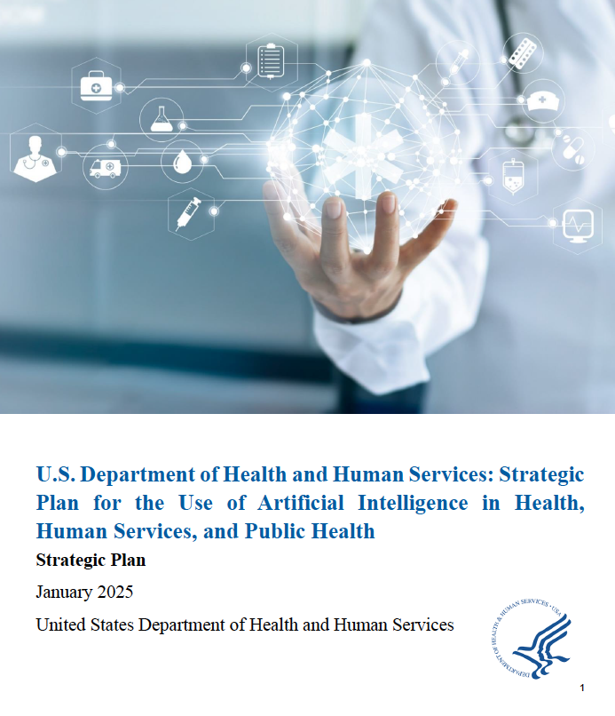
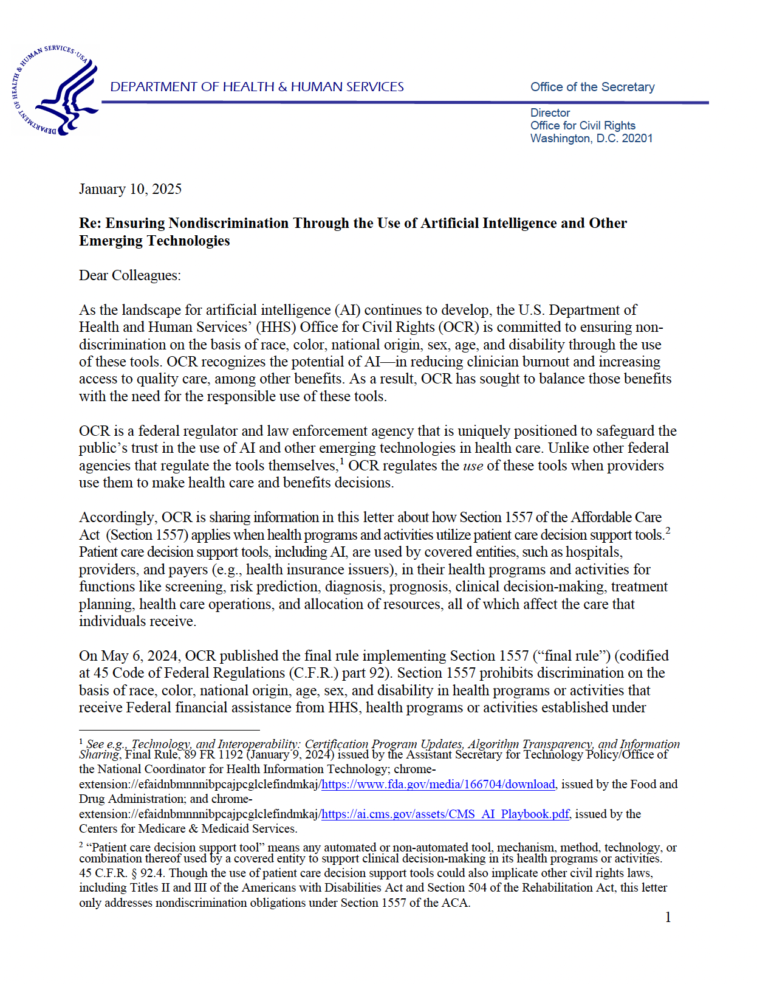
Recent HHS Developments
HHS Strategic Plan
HHS OCR “Updated: Ensuring Nondiscrimination in the Use of AI is Good Medicine”
2025 HHS Strategic Plan
2025 HHS Letter

Slide 24
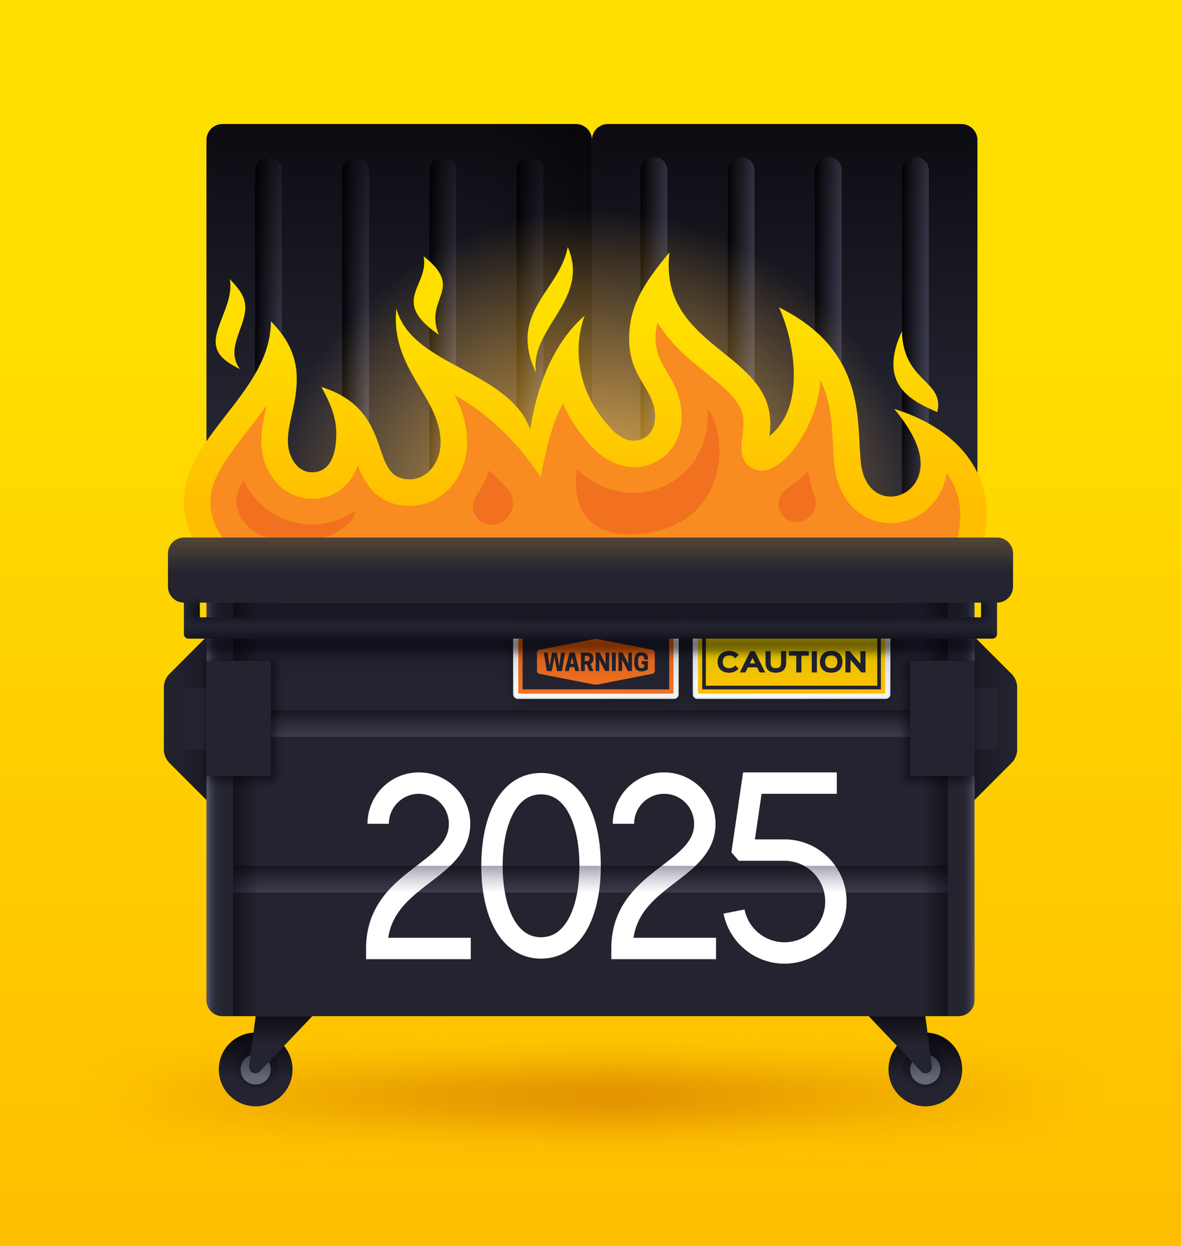

Since January 20, 2025
Licensed images
Notes:
Licensed images: iStock2173569904 and iStock1440040548
Licenses purchased 2.5.25

Slide 25
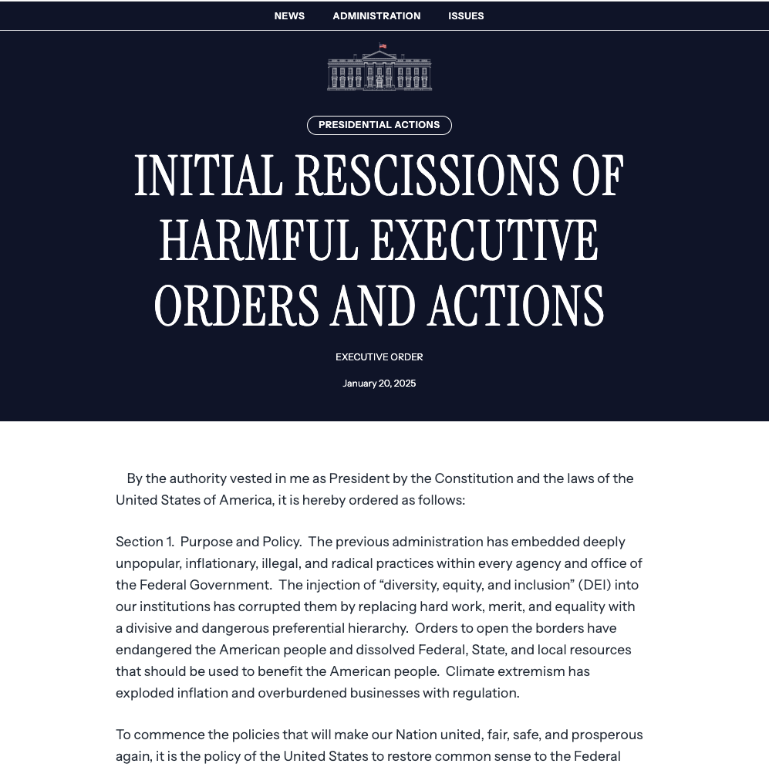
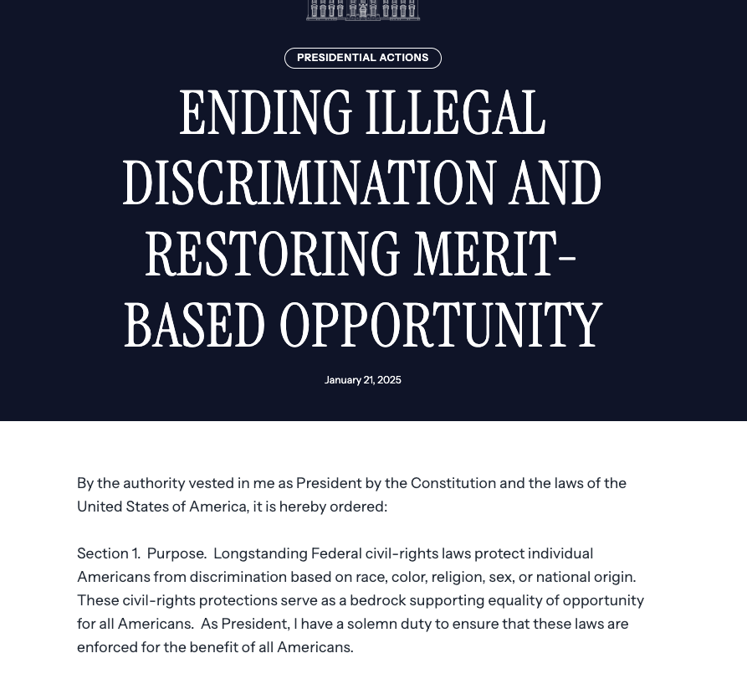
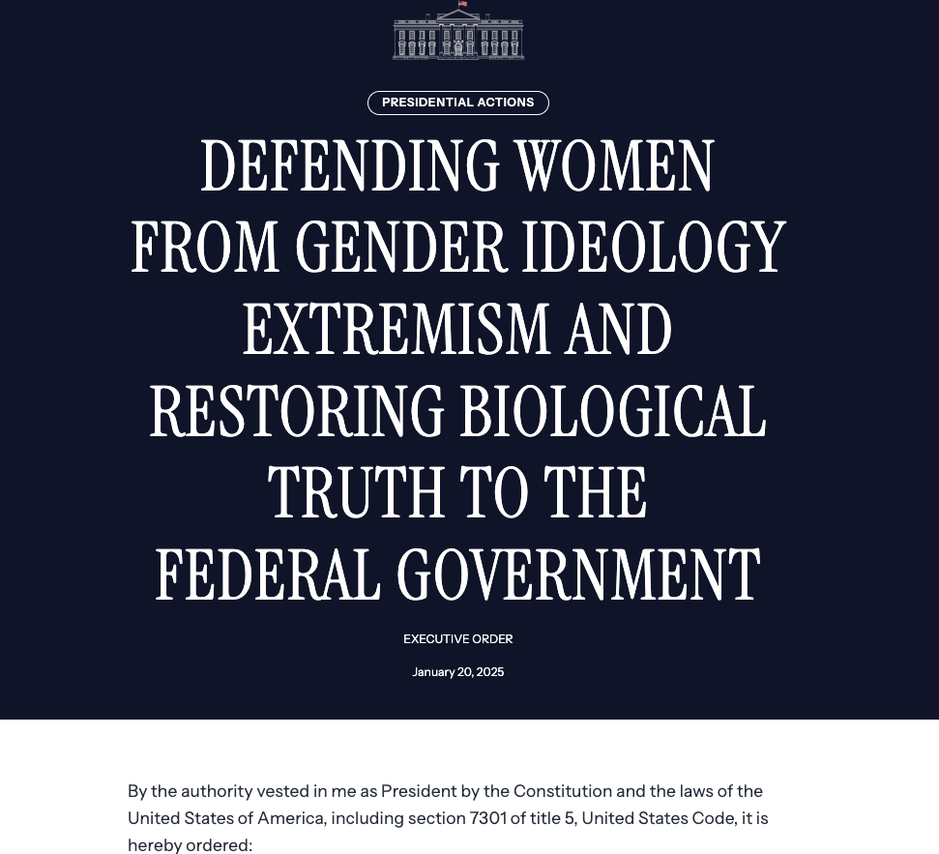
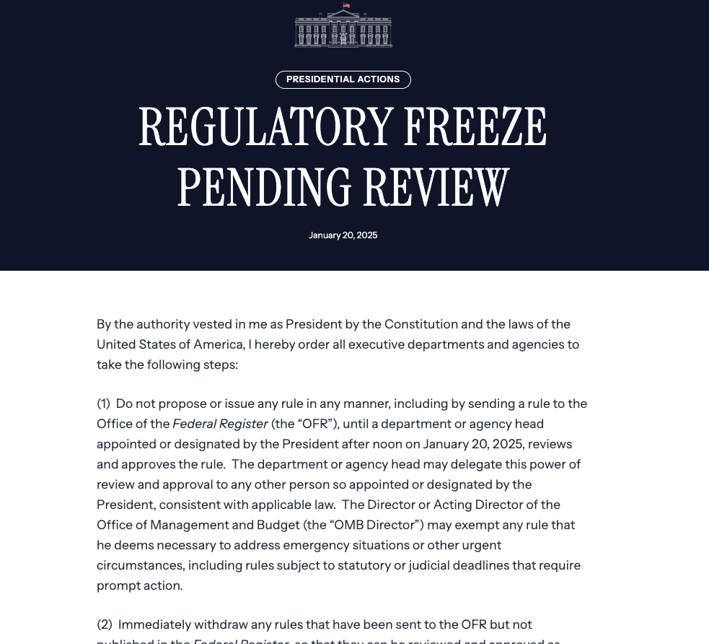
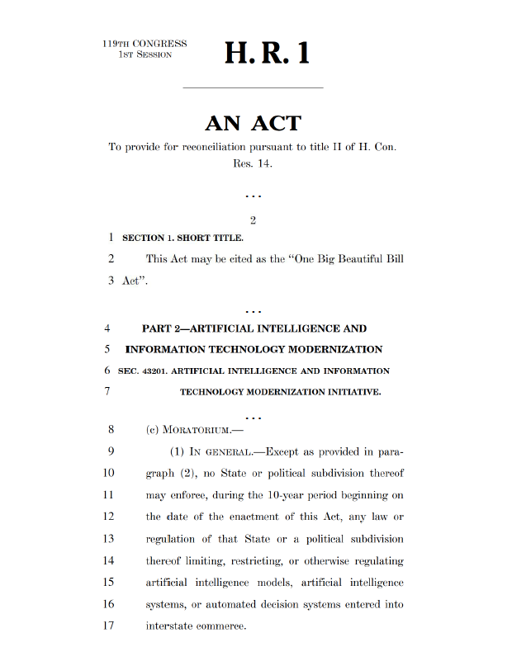
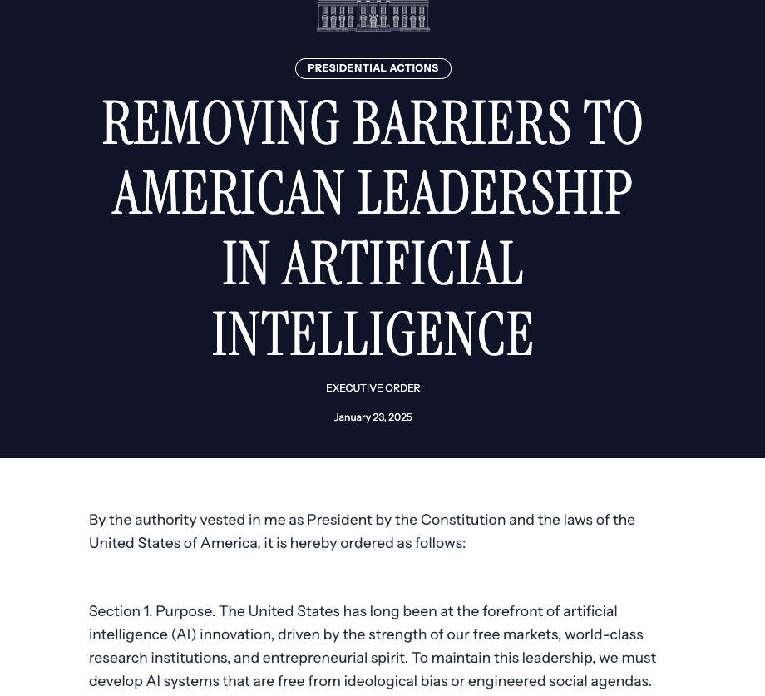
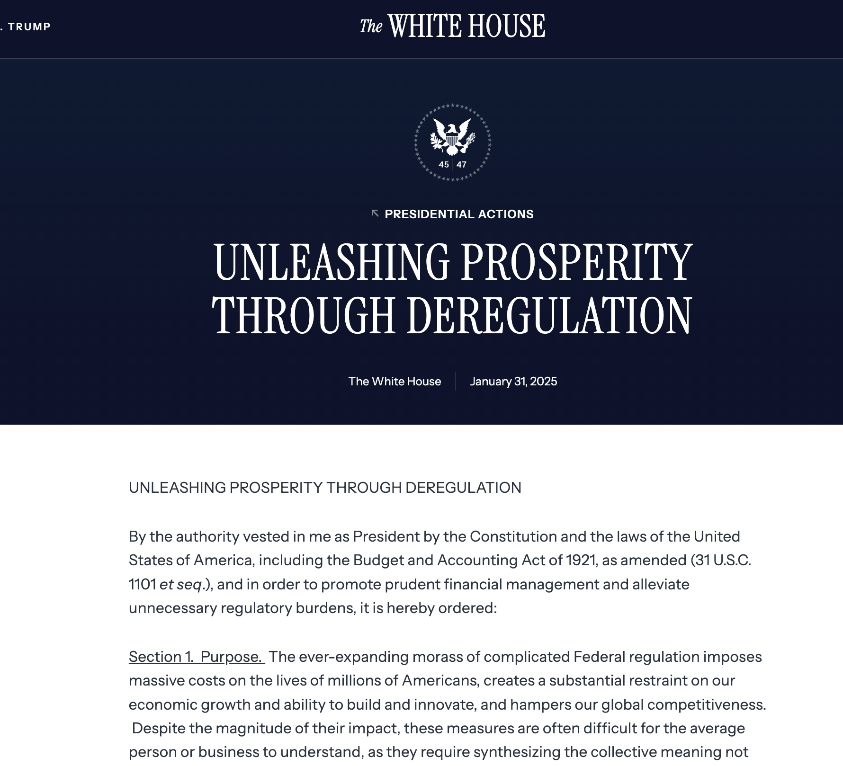
Recent relevant policy developments

Slide 26
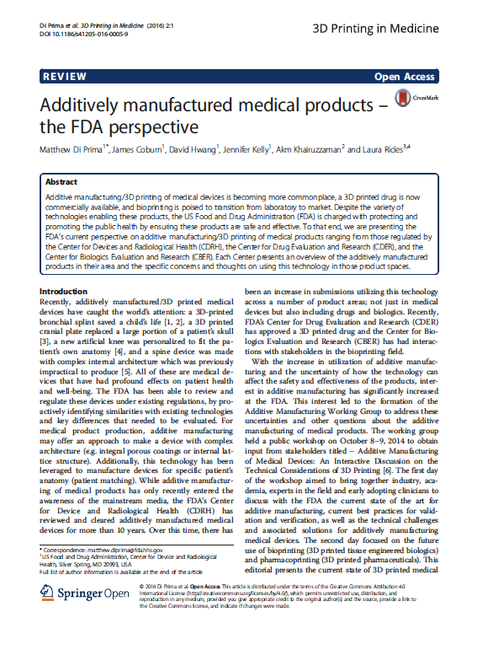
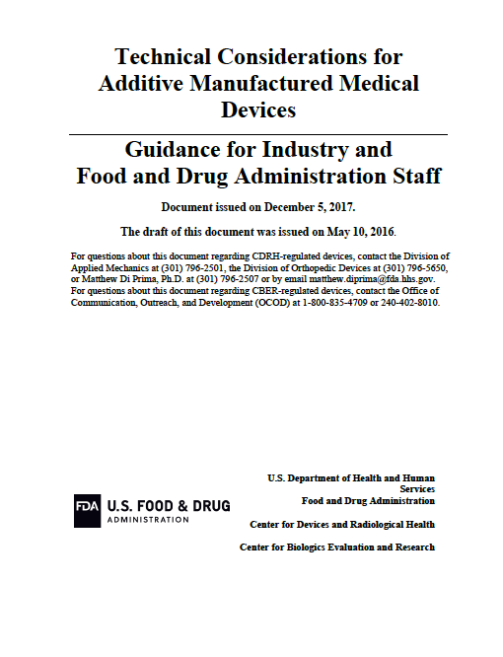
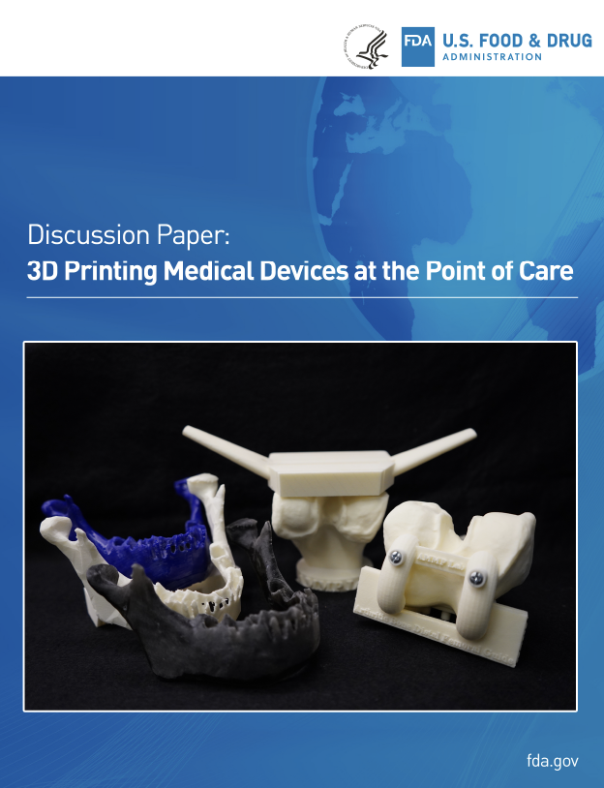
Status of Bioprinting Regulations
As of 06/01/20242025, FDA does not yet have specific regulations or clear guidance for 3D Bioprinting

Slide 27
Stay tuned for finalized findings… and specific findings on bioprinting, bionic devices, and medical robotics/AI
Jennifer K. Wagner and Sara Gerke

