Slide 1
Barriers Instead of Bridges: Exploring Roadblocks to Sustaining Community Health Workers
Tara Adams Ragone, J.D.
ASLME Health Law Professors Conference
June 6, 2025

Slide 2
Roadmap
Brief history/table setting re: CHW sustainability
Persistent barriers to sustainability
Some hope
Recent backsliding
Next Steps
Notes:
Proposal: Despite powerful evidence of the value of community health workers as critical linkages between vulnerable populations and clinical and social services that address health-related social needs, for too long these workers have had to depend on inconsistent and inadequate funding sources and tremendous uncertainty. In recent years, we finally are seeing a number of state and federal policy initiatives to open up reimbursement opportunities for CHWs in Medicaid and Medicare. While there are promising pilots and initiatives, and support seems strong and well-intentioned, there remain significant obstacles to realizing CHW sustainability. This presentation will identify and analyze legal, regulatory, and policy barriers that are hampering uptake and limiting the ability of CHWs to be the strong, connecting bridges that we need to support our most vulnerable communities, including incident to billing requirements; federally qualified health center billing constraints; medical loss ratio complications; and managed care contracts that do not maximize incentives to use CHWs.

Slide 3
Brief history/ table setting re: CHW sustainability
“A community health worker is a frontline public health worker who is a trusted member of and/or has an unusually close understanding of the community served. This trusting relationship enables the worker to serve as a liaison/link/intermediary between health/social services and the community to facilitate access to services and improve the quality and cultural competence of service delivery. A community health worker also builds individual and community capacity by increasing health knowledge and self-sufficiency through a range of activities such as outreach, community education, informal counseling, social support and advocacy.”
CHW Section of the American Public Health Association
This Photo by Unknown Author is licensed under CC BY-NC
https://www.astho.org/globalassets/pdf/community-health-workers-summary-evidence.pdf
Notes:
Re rept link: “summary of research studies demonstrating the effectiveness of CHWs across multiple settings and health issues” – assessing effect on/role in “improving health outcomes, reducing healthcare costs, and bridging the gap in health disparities”
-see some improvements in outcomes as well as some cost-effectiveness – systemic reviews and RCTs
-Improving individual and community health (hopefully outcomes)
-Building trust and relationships
-Addressing social and behavioral determinants of health
-Maybe reducing costs?
“Community health workers (CHWs) are critical to improving individual and community health through their ability to build trust and relationships and deepen communication between patients and providers. CHWs have a deep understanding of their communities through lived experience, which makes them uniquely qualified to address social and behavioral determinants of health. As states advance efforts to expand financing for and use of this workforce, it will be critical to make an evidence-based business case for policymakers and providers. Existing studies on CHWs focus on assessing their effectiveness in improving health outcomes, reducing healthcare costs, and bridging the gap in health disparities. The number of research articles on the impact of CHW-led interventions and programs has escalated dramatically over the past fifty years, and the scientific rigor of study designs has improved notably.”
“The sections below serve as a summary of research studies demonstrating the effectiveness of CHWs across multiple settings and health issues. This wide array of research allows CHW champions to demonstrate what research already exists or to select evidence that is most resonant with their audience. ”
Additional names: health educators, promotores, traditional health workers, community health representatives or advisors
-related to peers
-dft settings: within public health, the community, and in healthcare settings
-dft scopes: chronic disease, BH, reentry, more general

Slide 4
Brief history/ table setting re: CHW sustainability
Grants
Medicaid SPAs and waivers
Medicare CHI and PIN codes
CBO contracting/Community Care Hubs
Total cost of care/value-based contracting
MCO contracts
https://familiesusa.org/wp-content/uploads/2019/09/How-States-Can-Use-Medicaid-Managed-Care-Contracts-to-Support-CHWs_1.pdf
https://nashp.org/updates-and-faqs-developing-and-implementing-a-medicaid-state-plan-amendment-to-authorize-community-health-worker-reimbursement/
https://www.astho.org/topic/brief/leveraging-medicaid-to-support-community-health-workers/
https://aspe.hhs.gov/reports/community-care-hubs
https://www.cms.gov/files/document/health-related-social-needs-faq.pdf
Notes:
See, e.g., Connecticut Health Foundation, Environmental Scan on Community Health Workers: A 50-State Scan of Medicaid Reimbursement Approaches for the CHW Workforce (Jan. 2024)
SPAs: CA – preventive services
1115: NJ – MCO pilot over 5 years – SLOW
Milliken report in 2024, I think?

Slide 5
Brief history/ table setting re: CHW sustainability Coverage of Services and Supports to Address Health-Related Social Needs in Medicaid and the Children’s Health Insurance Program (CMS 2023)
https://www.medicaid.gov/federal-policy-guidance/downloads/cib11162023.pdf

Slide 6
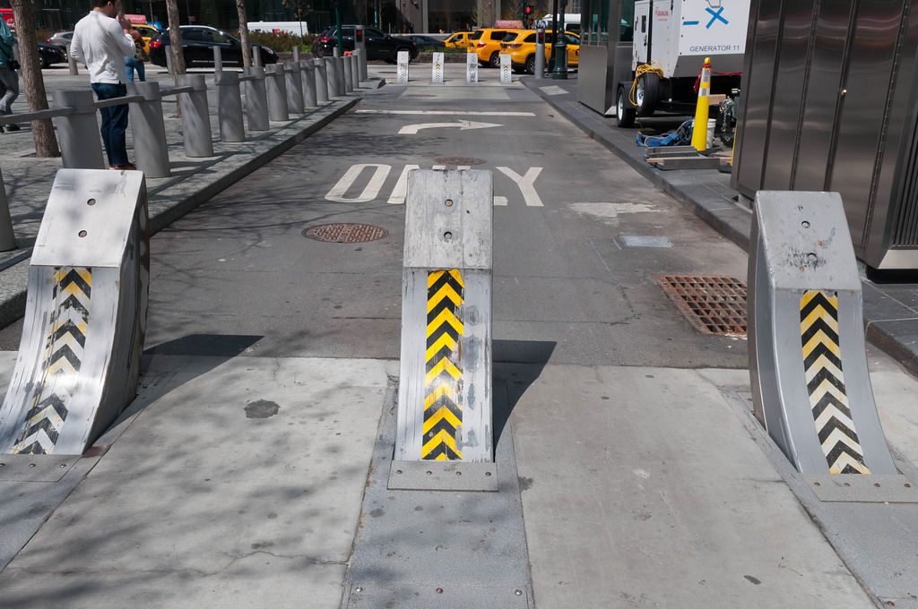
Persistent barriers to sustainability
Low reimbursement rates
Silos
Incident to billing
Supervision/clinical integration
Data sharing/documentation
Clinical v. community-based focus
FQHC billing challenges
Unwillingness to use MCO contracting powers
Medical loss ratio confusion
Need to stand up certification
This Photo by Unknown Author is licensed under CC BY
Notes:
Reality – press of other matters like the unwinding; fiscal constraints – all real. BUT still positive momentum/support, so … planned to tackle some challenges
42 CFR § 410.26 - Services and supplies incident to a physician's professional services: Conditions
“General supervision means the service is furnished under the physician's (or other practitioner's) overall direction and control, but the physician's (or other practitioner's) presence is not required during the performance of the service.”
Incident to professional services – general supervision (42 CFR § 410.26)
Centrality of Medicare billing provider - gatekeeper
Clinical integration and communication
Documentation
Data infrastructure/security
Contracting and billing

Slide 7
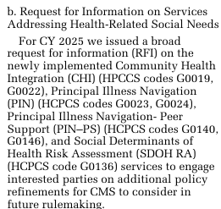
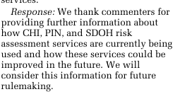
Some hope
NY’s 1115 waiver – infrastructure for social care networks
Partnership to Align Social Care learning collaborative and resources
CMS Request for Information on Services Addressing Health-Related Social Needs
This Photo by Unknown Author is licensed under CC BY-SA
This Photo by Unknown Author is licensed under CC BY-NC-ND
Notes:
NY’s Health Equity Reform 1115 waiver amendment includes up to $3.673 billion for building HRSN infrastructure, including social care networks
$500 million RFA re: social care networks
From RFI:
“We are interested in better addressing the social needs of beneficiaries and requesting information on the codes we created and finalized beginning in CY 2024 to fully encompass what interested parties and commenters believe should be included in the coding and payment we recently established. We sought comment on any related services that may not be described by the current coding that we finalized in the CY 2024 PFS final rule and that are medically reasonable and necessary ‘‘for the diagnosis or treatment of illness or ddrumheller on DSK120RN23PROD with RULES2 injury’’ under section 1862(a)(1)(A) of the Act. We believe we can work within the current coding framework and explore additional opportunities to create codes that describe reasonable and necessary services furnished by billing practitioners and the auxiliary personnel under their general supervision. We are interested in feedback regarding any barriers to furnishing the services addressing health-related social needs, and if the service described by the codes we established are allowing practitioners to better address unmet social needs that interfere with the practitioners’ ability to diagnose and treat the patient. This could include barriers specific to certain populations, including rural and tribal communities, residents of the U.S. Territories, individuals with disabilities, individuals with limited English proficiency, or other populations who experience specific unmet social needs. ”
“We are interested in hearing more about CBOs and their collaborative relationships with billing practitioners. The new codes for CHI and PIN services recognized CBOs and their role in providing auxiliary personnel under the general supervision of the billing practitioners. We sought comment regarding the extent to which practitioners are contracting with CBOs (including current or planned contracting arrangements) for auxiliary personnel purposes, and if there is anything else CMS should do to clarify services where auxiliary personnel can be employed by the CBO, so long as they are under the general supervision of the billing practitioner. Given that the CHI and PIN services may be provided incident to the billing practitioner’s professional services, we are also seeking comment on whether the incident to billing construct is appropriate for CBOs to supplement pre-existing staffing arrangements and the CBO/provider interface. We also sought comment on CBOs’ roles, the extent to which practitioners are contracting with CBOs, incident to billing, and auxiliary personnel employed by CBOs under general supervision of practitioners serving and located in rural, tribal and geographically isolated communities, including the U.S. Territories. ”

Slide 8
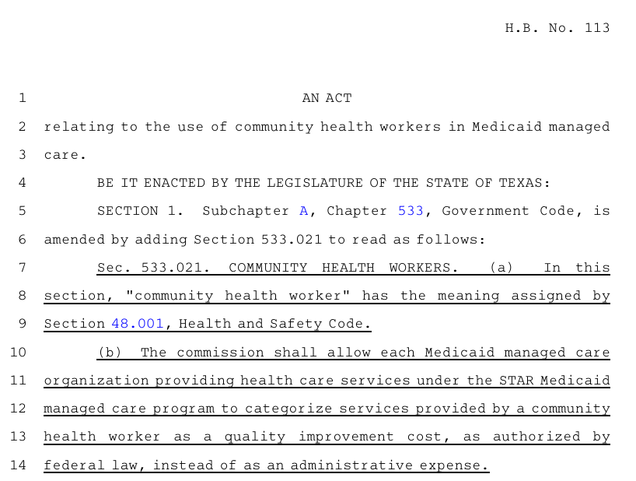
https://www.legis.state.tx.us/tlodocs/88R/billtext/pdf/HB00113F.pdf
Some Hope – TX H.B. 113
Notes:
NV and WI too? - investigating

Slide 9
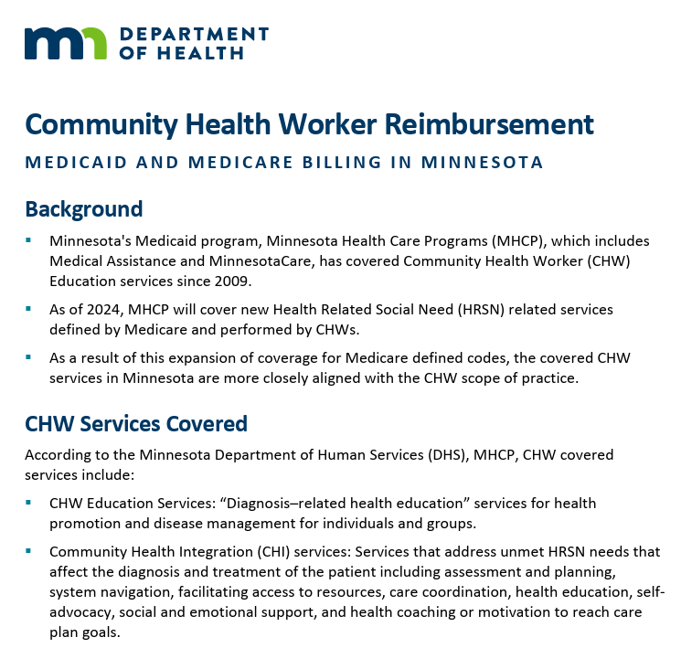
https://www.health.state.mn.us/communities/commhealthworkers/docs/chwbilling.pdf
Some Hope - CHI in Medicaid
See also MediCal – adding CHI to CHW preventive services benefit
Notes:
Feb. 21, 2025 draft updated Medi-Cal Provider Manual for CHW services incorporating HCPCS codes G0019 and G0022 for reporting Community Health Integration Services (codes will be effective for services provided on or after April 1, 2025)

Slide 10
Some hope
Certification efforts in a number of states (e.g., NJ)
Some receptivity to using MCO contracts (but bandwidth?)
FQHCs
Medicare clarifications – expand to Medicaid?
Interest in expanding number of states with incident to billing in Medicaid at FQHCs – e.g., to reimburse for screens by CHWs beyond encounter rate
MediCal – room to encompass outreach work – how extend to Medicare?
Total cost of care contracts/value-based contracting
https://www.govinfo.gov/content/pkg/FR-2024-12-09/pdf/2024-25382.pdf
Notes:
FQHCs: Medicare clarified that CHI and PIN are on top of PPS rate when not on same day as visit with doc
Dr. Evans at HJA call – she wants rules changed at FQHCs to let CHWs administer some screenings and then permit billing under inident to billing – supposedly some states have inident to billing in caid at FQHCs – would open up some reimb for her bc right now many screens are not covered – just part of bundl

Slide 11
Recent backsliding CMCS Informational Bulletin (Mar. 4, 2025)
This Photo by Unknown Author is licensed under CC BY-NC-ND
https://www.medicaid.gov/federal-policy-guidance/downloads/cib03042025.pdf

Slide 12
Recent backsliding
https://apnews.com/article/hhs-covid-pandemic-trump-cdc-309fedec9383dc4fdacba6e9ca2b5309
Notes:
State of Colorado et al v. U.S. Department of Health and Human Services, et al., Docket No. 1:25-cv-00121 (D.R.I. May 16, 2025)- PI granted …

Slide 13
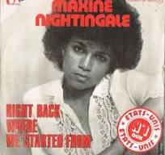
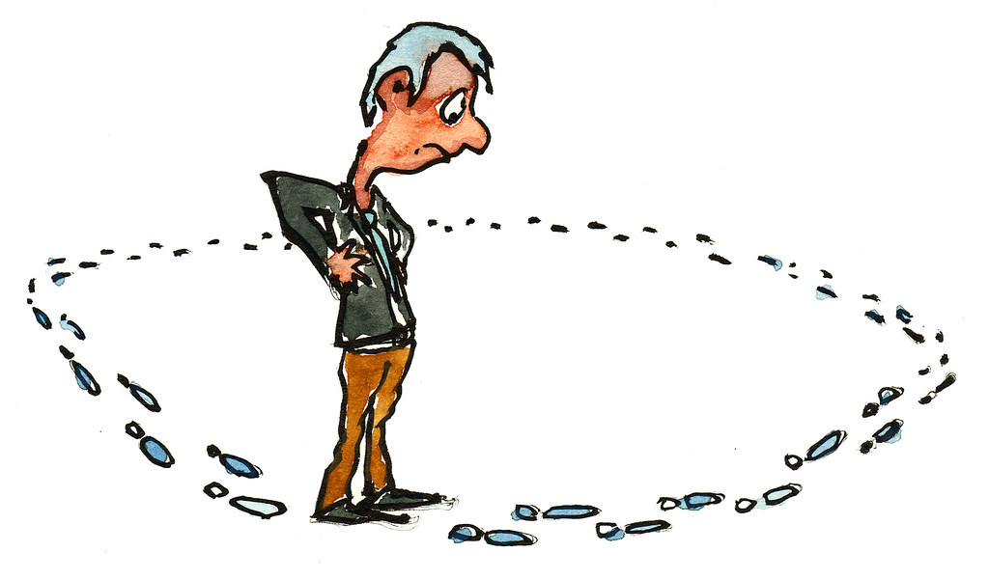
Next steps
This Photo by Unknown Author is licensed under CC BY-NC
This Photo by Unknown Author is licensed under CC BY-SA
This Photo by Unknown Author is licensed under CC BY-NC-ND
Notes:
Grants?
Certification? Or waste?
TCOC as focus??
MLR – not enough
-MCO contracts – maybe? But need to add CHWs?

Slide 14
Tara.Ragone@shu.edu
"Feedback" by giulia.forsythe is licensed under CC BY-NC-SA 2.0. "Finger face with a question" by Tsahi Levent-Levi is licensed under CC BY 2.0. "Thank You - Danke" by Cornelia Kopp is licensed under CC BY 2.0.

